Slide 1
Planning Your Career Path: NIH Experts Share Their Perspectives
Timothy A. Gondré-Lewis, Ph.D., NIAID
Alison Lin, Ph.D., NCI
Lauren Ullrich, Ph.D., NINDS

Slide 2
Poll
What career stage are you?
Graduate Student
Postdoctoral Scholar
Faculty
Other

Slide 3
Lauren Ullrich, Ph.D.
My Journey
B.A. Psychobiology
Swarthmore, PA
Ph.D. Neuroscience
Washington, DC
Program Director
Office of Programs to Enhance Neuroscience Workforce Diversity
NINDS
Lauren.Ullrich@nih.gov
Policy & Advocacy
Neuroscience Education & Training
Washington, DC
AAAS Science & Technology Policy Fellow at NINDS
Bethesda, MD
Office of Programs to Enhance Neuroscience Workforce Diversity
Bethesda, MD
Notes:
Seems linear and straightforward, but as I was living it, it seemed anything but

Slide 4
How to navigate your career path
Focus your exploration
Instead of: What do I want to do with my life?
Try: What do I enjoy doing?
Seek out resources and opportunities
Many skills are transferable (e.g., project management)
Develop your network
Networking can be useful and fun!
Notes:
the exchange of information and ideas among people with a common profession or special interest, usually in an informal social setting

Slide 5
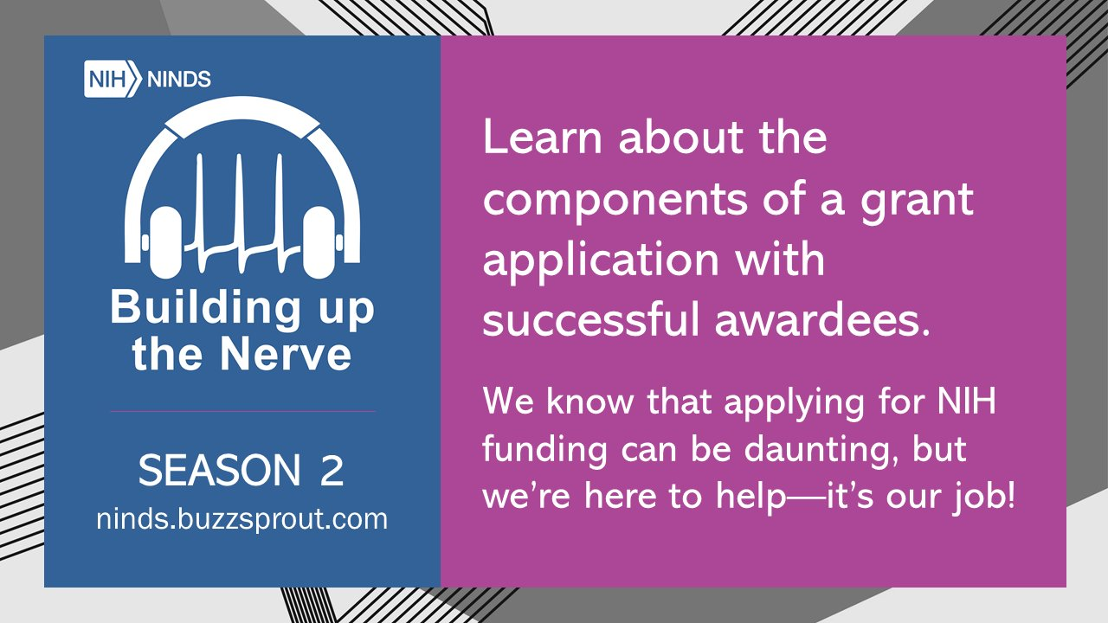
Resources
National Postdoctoral Association
https://www.nationalpostdoc.org/
Science Careers’ myIDP
https://myidp.sciencecareers.org/
Job Simulations
https://intersectjobsims.com/library/
Annual NIH Career Symposium
https://www.training.nih.gov/nih_career_symposium
And many more…
https://extramural-diversity.nih.gov/career-pathways/next-career-steps

Slide 6
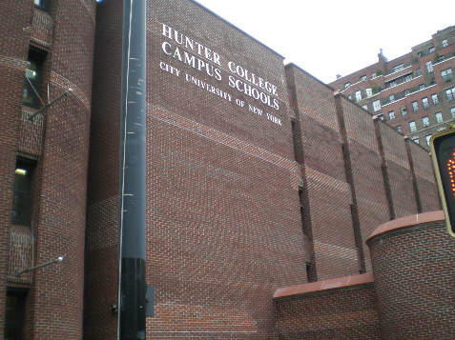
My Path to Becoming a Program Officer
Faculty Position
Postdoc in Immunology
PhD in Microbiology and Immunology
AB in Biology and African-American Studies
High School Diploma
Timothy A. Gondré-Lewis, Ph.D.
tglewis@niaid.nih.gov

Slide 7
Resources

Slide 8
Post-Docs’ Guide to Gaining Independence
https://www.niaid.nih.gov/grants-contracts/postdoc-guide

Slide 9
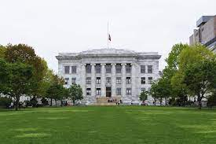
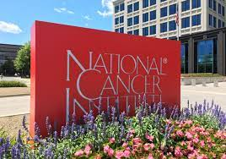
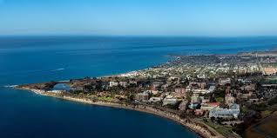
Alison Lin, PhD
Alison Lin, PhD |
Acting Chief, Diversity Training Branch, Center to Reduce Cancer Health Disparities
Supervisory
Health
Scientist
Administrator
2019 -
2001 -
1989 -
2012 -
“Through research each scientist grows as a human being and helps others to do likewise.”
- Pope John Paul II
High School & Undergraduate: Physics
Postdoc & Instructor:
Basic research in biomedical sciences
Graduate: Biophysics
“Interdisciplinary”

Slide 10
Building Blocks of a Career Path
Building Blocks of a Career Path
Things that keep us going
Motivation Inspiration
Inspiration needs follow-through
Skills and Knowledge
Things change .. Be open, finish tasks, develop transferrable skills
Flexibility
It’s OK to fail …as long as we don’t stop there
Persistence
Support Network
Recognize … Seize!
We can’t do it alone … and we are not alone
Opportunity

Slide 11
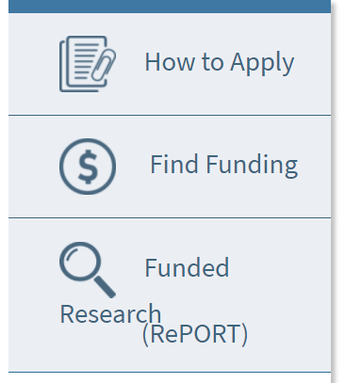
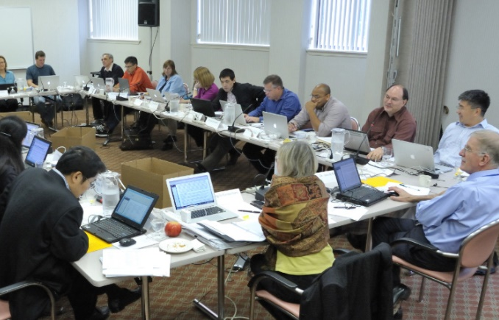
Tips for Grant Applications:
Opportunities and Resources
NCI Diversity-Focused Research Training Opportunities:
Extramural CURE Program:
https://www.cancer.gov/about-nci/organization/crchd/diversity-training/cure
Intramural iCURE Program:
https://www.cancer.gov/about-nci/organization/crchd/diversity-training/icure
Find NIH grants and funding information: https://grants.nih.gov/grants/oer.htm
Visit NIH extramural diversity website:
https://extramural-diversity.nih.gov
Learn about peer review at NIH Center
of Scientific Review: https://public.csr.nih.gov/ApplicantResources/Pages/default.aspx

