Slide 1

Enhancing Racial & Ethnic Equity – NIH UNITE
February 2, 2023

Slide 2

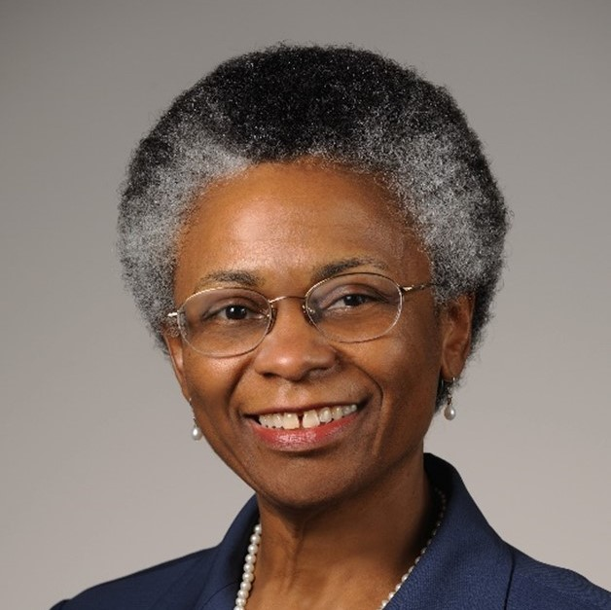
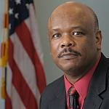

Today’s Presentation Team
MODERATOR
Ericka M. Boone, Ph.D.
Director,
Division of Biomedical Research Workforce
Office of Extramural Research (OER)
ericka.boone@nih.gov
PRESENTERS & PANELISTS
Marie Bernard, Ph.D.
Chief Officer for Scientific Workforce Diversity (COSWD)
Office of the Director (OD), NIH
Alfred C. Johnson, Ph.D.
Deputy Director for Management & Chief Financial Officer
Office of the Director (OD), NIH
Noni Byrnes, Ph.D.
Director,
Center for Scientific Review (CSR)
National Institutes of Health (NIH)

Slide 3
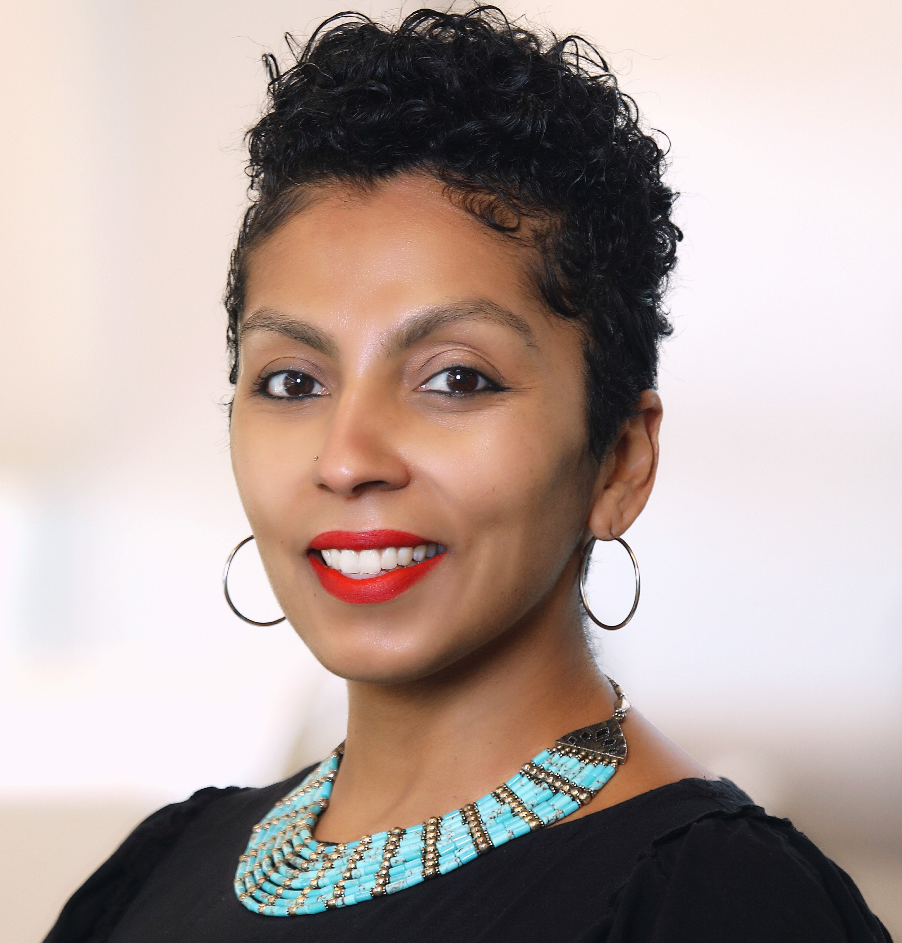
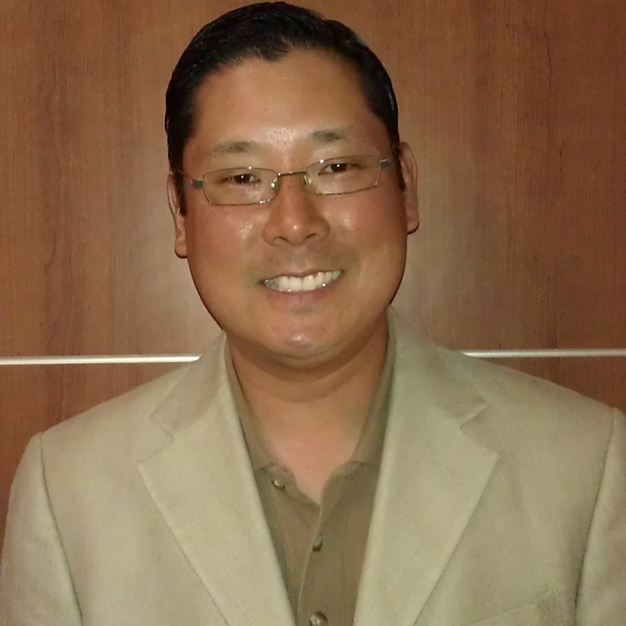
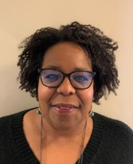
Presentation Team
Marguerite Matthews, Ph.D.
Program Director
Office of Programs to Enhance Neuroscience Workforce Diversity (OPEN)
National Institute of Neurological Disorders and Stroke (NINDS)
marguerite.matthews@nih.gov
Jean Shin, Ph.D.
Supervisory Social Science Analyst
Office of the Chief Officer for Scientific Workforce Diversity (COSWD)
jean.shin@nih.gov
Lauren Hill, Ph.D.
Deputy Director
Office for Disparities Research and Workforce Diversity
National Institute of Mental Health (NIMH)
hillla@mail.nih.gov
Ericka M. Boone, Ph.D.
Director
Division of Biomedical Research Workforce
Office of Extramural Research (OER)
ericka.boone@nih.gov

Slide 4

The NIH UNITE Initiative
Events of 2020 brought into sharp relief the ongoing reality of racial injustice in our country, and the responsibility of all of us to address this issue
A series of intense Institute and Center Director meeting discussions were held to identify initial issues
Two self-assembled affinity groups at NIH (8CRE, AA/B Scientists) and the Anti-Harassment SC met with NIH leadership for candid discussions that informed next steps
We have arrived at a shared commitment to address structural racism: we must not allow this pivotal moment to pass

Slide 5
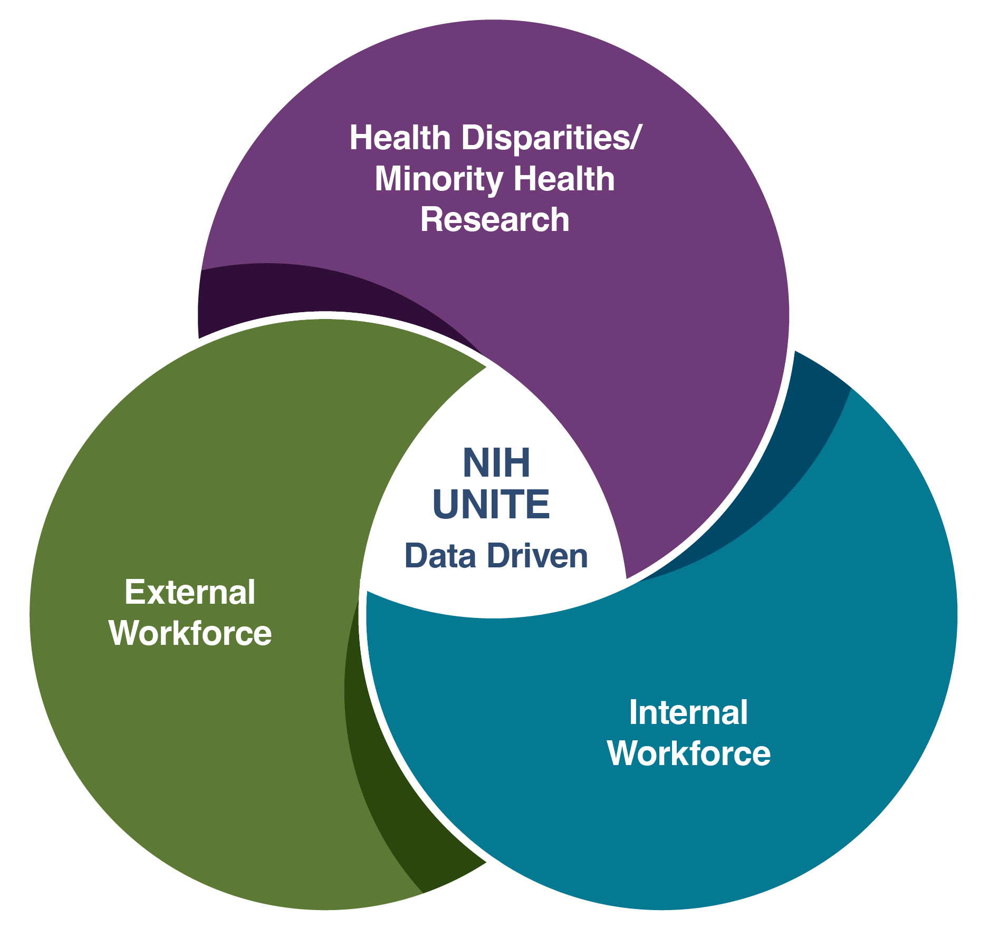
The NIH UNITE Initiative: Working Across Three Domains
Modified from: Bernard, MA; Johnson, AC; Hopkins-Laboy, T; Tabak, LA. Nature Med. DOI: 10.1038/s41591-021-01532-1 (2021)
Notes:
To address structural racism that may exist within the biomedical and behavioral enterprise, UNITE works across three domains—Health Disparities and Minority Health Research (HD/MH), internal NIH workforce, and external biomedical and behavioral research workforce. Data gathering and analysis are central to all activities, and therefore evidence drives the work of UNITE.

Slide 6





Four Focus Areas of UNITE As noted in the UNITE Progress Report released October 2022
Another way of visualizing UNITE’s work is to consider the 3 content foci and the data driving them as 4 focus areas. As of summer 2022, UNITE leadership and committees developed Challenge Statements and Goals for action for each focus area.
Notes:
Reminder of new Focus Areas for UNITE

Slide 7
UNITE Progress Report: Focus Area 1
FOCUS AREA 1: Elevating health disparities and minority health research across Institutes and Centers
$38 million over 5 years to support research on the role of structural racism and discrimination in health disparities
$58 million over 5 years for research to address health disparities and advance health equity
$400 million over 10 years to address health disparities via community-driven research priorities

Slide 8
UNITE Progress Report: Focus Area 2
FOCUS AREA 2: Promoting equity in the NIH-supported biomedical research ecosystem
Improving harassment reporting through multiple mechanisms
Increasing transparency of race and ethnicity data on funded researchers
Expanding existing grant programs to increase career opportunities for underrepresented groups and outreach to the K-12 STEM community
Developing a prize competition to reward institutions of higher education for innovative interventions that enhance faculty and student DEIA

Slide 9
Focus Area 2 – Approved Concepts
Concepts approved by NIGMS Council:
Institutional Climate Assessment and DEI Action Plan Development Grants
Excellence in DEIA Investigator’s Grants
Instrumentation Grant Program for Minority-Serving Institutions
Concept approved by NIMHD Council:
Institutional Research Capacity Building Needs Assessment and Action Plan Development Grants

Slide 10
UNITE Progress Report: Focus Area 3
FOCUS AREA 3: Promoting equity in the internal NIH workforce
Establishing an Anti-Racism Steering Committee to inform efforts to address any identified racial or ethnic inequities within NIH
Asking each NIH Institute and Center to create Racial & Ethnic Equity Plans
Publishing NIH workforce demographic data to enhance transparency and better understand barriers to equity
Diversifying the portraiture at NIH to recognize contributions of all NIH staff and create a culture of inclusion

Slide 11
UNITE Progress Report: Focus Area 4
FOCUS AREA 4: Improving the accuracy and transparency of racial and ethnic equity data
Request for information with 1100+ responses guiding UNITE actions
Listening session with 1300+ participants contributing to guidance
Developed data-dashboard to foster transparency and better understand barriers to equity

Slide 12
How to Keep Updated on UNITE?
Resources
Read the UNITE Progress Report and the RFI Report
Read the monthly Co-Chairs’ Corner
Sign up for UNITE Updates
Follow UNITE on LinkedIn

