Slide 1
How NIH Processes and Assigns Your Application
B. Duane Price, Ph.D.
Acting Director, Division of Receipt and Referral

Slide 2
Acronyms
Institutes and Centers (ICs)
Center for Scientific Review (CSR)
Division of Receipt and Referral (DRR)
Scientific Review Group (SRG)
Study Section (CSR SRG)
Integrated Review Group (IRG)
Scientific Review Officer (SRO)
Program Officer (PO)

Slide 3
Turning Ideas into Funding – An Overview
Applicant initiates
research idea
Prepares Application
Grantee
conducts research
IC allocates funds
Submits grant
application to NIH
IC staff prepare
funding plan for
IC Director
NIH CSR DRR assigns
to IC and IRG
Scientific Review
Group (SRG) evaluates
scientific merit
Advisory Council or
Board recommend Approval
Graphic by Rashid Shah

Slide 4
Submit Your Application Electronically
Institution ➔ Grants.gov ➔ NIH/eRA Commons ➔ DRR ➔ IRG ➔ SRG
Institution
System-to-System: Institution’s own system.
Workspace: A shared, online environment managed by Grants.gov.
ASSIST: NIH's web-based service.
Grants.gov
NIH/eRA Commons

Slide 5
Submit, Track, View Your Application
Submission Must be On Time:
5 PM Local Time (applicant institution), error-free
Weekend/holiday standard due dates roll to next business day
No error-correction window (after 5PM on due date is late)
EXCEPTION: Reported Federal systems issues verified by eRA Service Desk
https://grants.nih.gov/support/index.html

Slide 6
TIP: Two Day Viewing Window
ALWAYS track your application through to eRA Commons and view it.
You have the day you submit + next 2 business days to make changes.
All changes must be made before the application deadline.
THEREFORE, SUBMIT EARLY!
Submit 2 days early = 2 days to perfect/correct application
Submit 2 hours early = 2 hours to perfect/correct application

Slide 7
Late Applications - Rules
Approval is never given in advance
Cover letter is required
Reasons apply to PD/PI only (or at least one MPI)
Leniency for Federal systems issues
Document e-submission problem with eRA Service Desk (https://era.nih.gov/need-help)
Demonstrate diligence in resolving the problem
Acceptance on case-by-case basis
See NOT-OD-15-039

Slide 8
DRR is at the End of the Grants.gov Pipeline
Institution ➔ Grants.gov ➔ NIH/eRA Commons ➔ DRR ➔ IRG ➔ SRG
Some numbers:
~85,000 applications per year
~60,000 are reviewed in CSR SRGs
~20,000 are reviewed at other ICs
~5,000 go to other HHS Agencies

Slide 9
DRR staff
7 administrative staff
28 PhD-level scientists with broad scientific background
8 full-time staff
22 part-time referral officers (also CSR SROs)
Experts in:
IC scientific interests
SRG guidelines
NIH policy

Slide 10
Assignment of Your Application
DRR Scientific Staff make IC and SRG assignments based on:
IC Mission, Guidelines, and Programmatic Mandates
Funding Opportunity Announcement (FOA) Content
Locus of Review Agreements
SRG Guidelines

Slide 11
Institute/Center (IC) Assignment

Slide 12
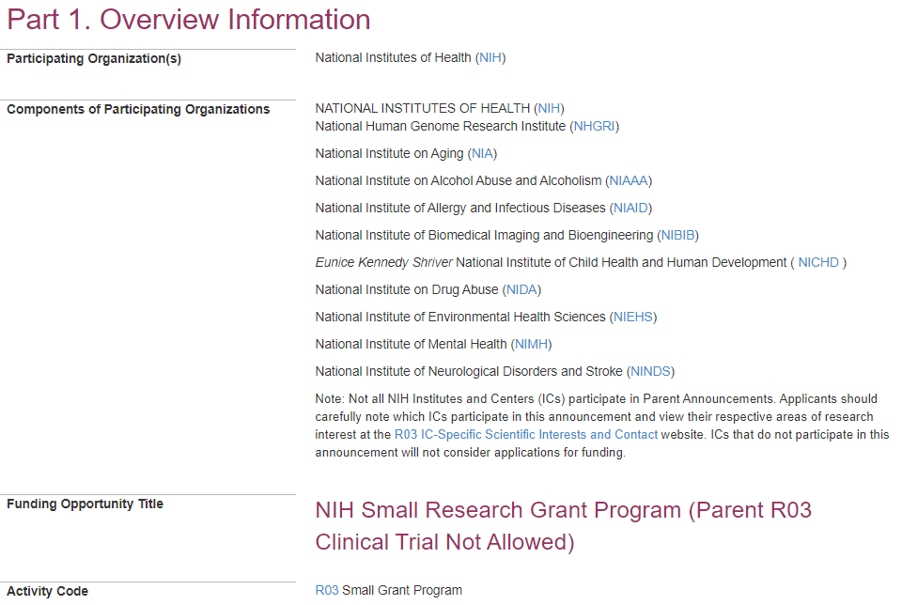
IC Must Be On FOA to Be Assigned
Only ten ICs can take applications through this FOA (PA-20-200).
Consequences? Your Application May Be Withdrawn.

Slide 13
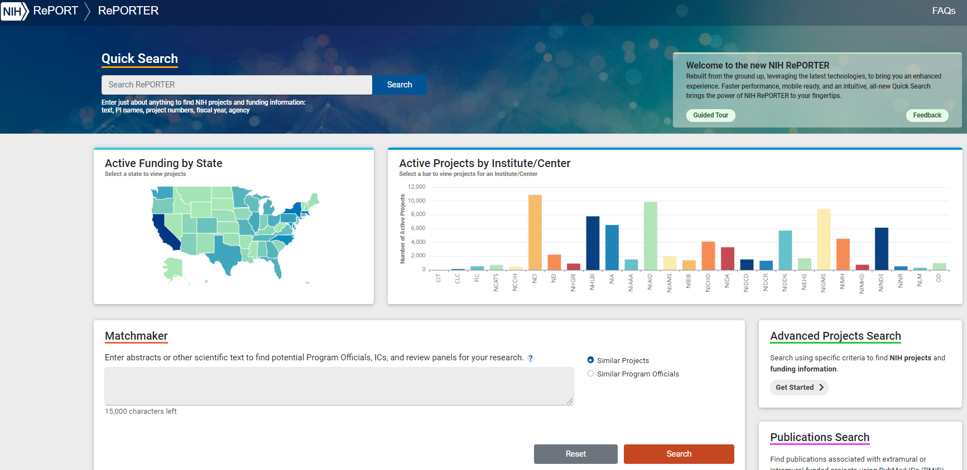
TIP: If You Are Not Sure Which IC, Try Matchmaker
https://reporter.nih.gov/matchmaker

Slide 14
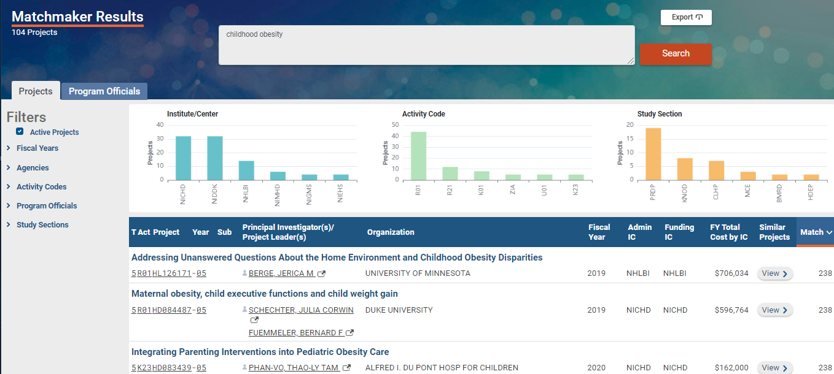
Matchmaker to Suggest IC and Similar Projects
Find a potential IC.
Find projects similar to yours that have been funded

Slide 15
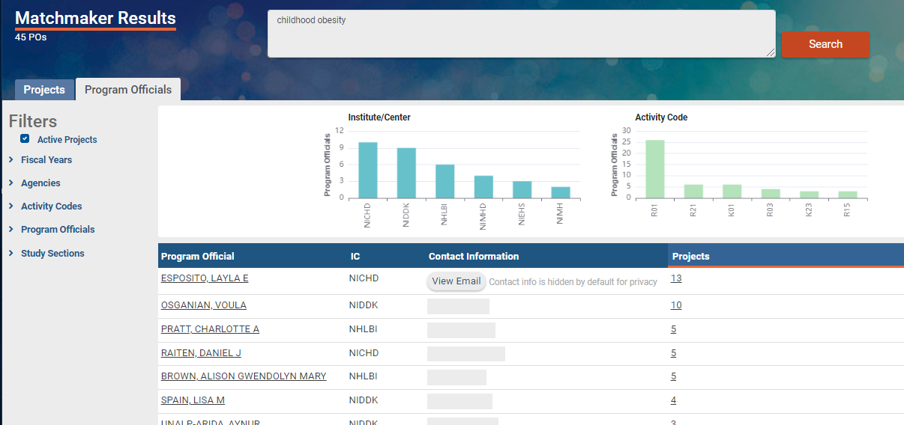
Matchmaker to Suggest POs
Find a potential PO. The PO is responsible for the programmatic, scientific, and/or technical aspects of grants.
Have a Conversation

Slide 16
Scientific Review Group (SRG) Assignment

Slide 17
75% of Applications are Reviewed at CSR
Institution ➔ Grants.gov ➔ NIH/eRA Commons ➔ DRR ➔ IRG ➔ SRG
Assignment Resources
CSR SRG Guidelines
RePORTER
Assisted Referral Tool (ART)
SRGs in the Genes, Genomes and Genetics IRG:

Slide 18
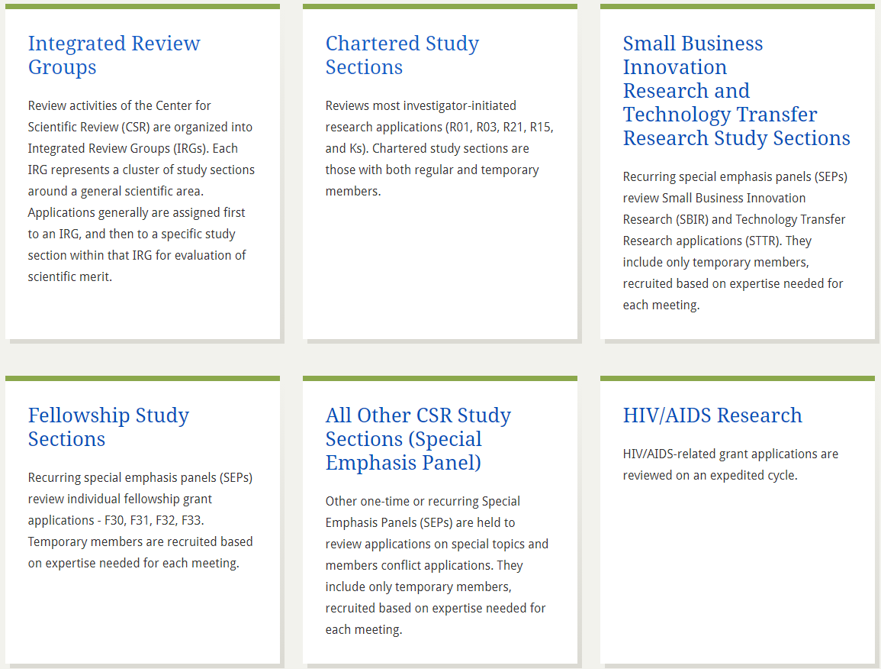
Browse CSR SRG Guidelines
https://public.csr.nih.gov/StudySections

Slide 19
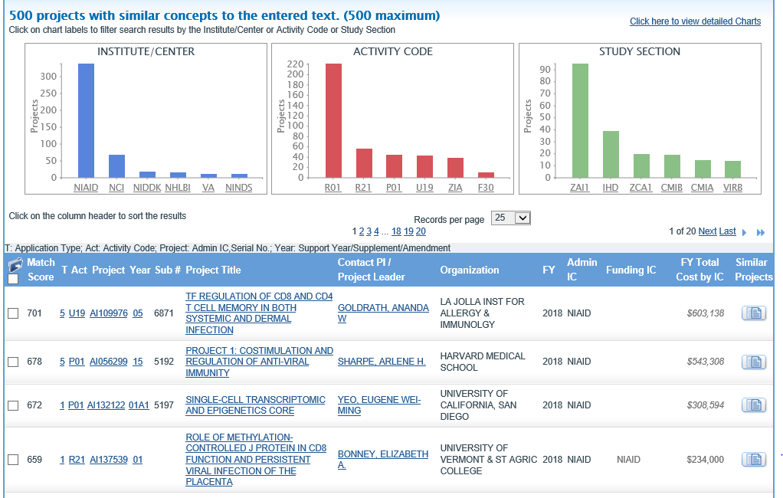
Matchmaker to Suggest SRG
Find a potential SRG (Study Section)
Caveat 1: Looks at funded applications only
Caveat 2: Returns active and retired SRGs

Slide 20
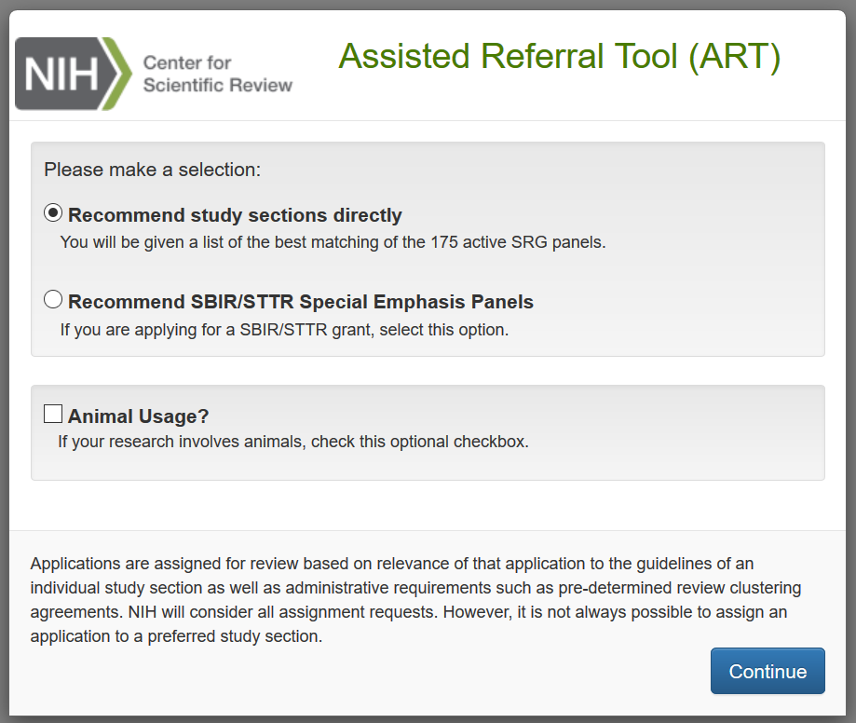
Use The Assisted Referral Tool!
https://public.csr.nih.gov/ForApplicants/ArtHome

Slide 21
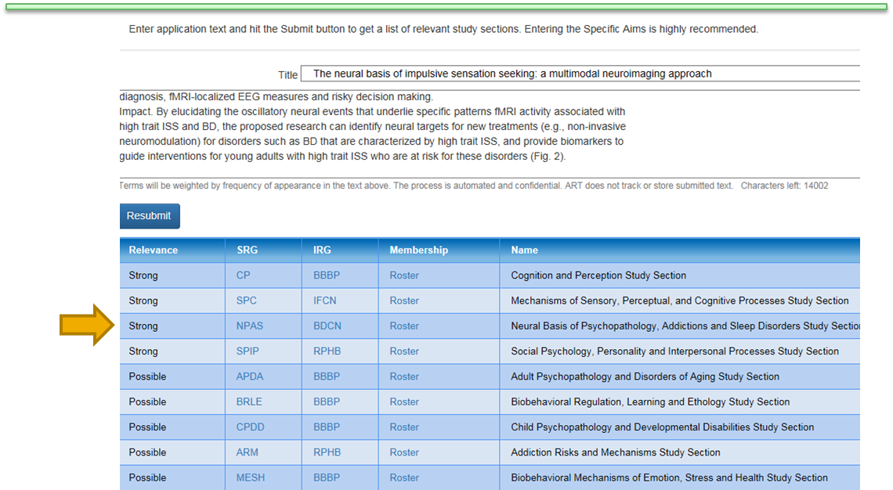
ART Suggests Active CSR SRGs

Slide 22
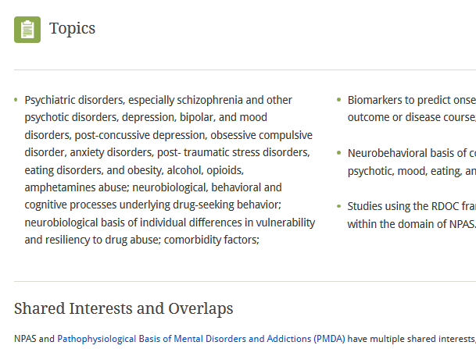
Browse SRG Guidelines and Rosters
https://public.csr.nih.gov/StudySections/DNDA/BDCN/NPAS

Slide 23
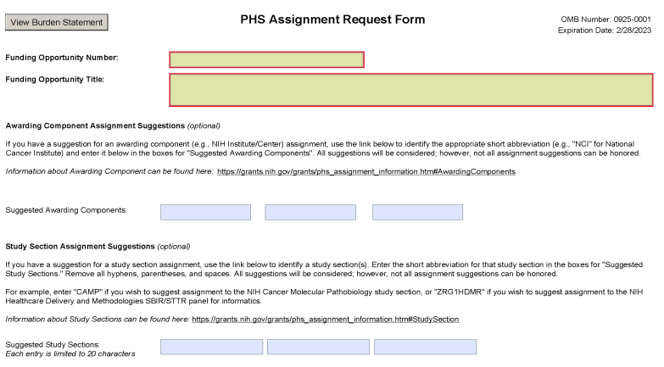
Assignment Request Form (ARF)
The ARF should be used to:
Make IC and SRG assignment requests
Identify potential conflicts of interest
List areas of expertise needed to evaluate the application
It is NOT appropriate to suggest specific reviewers.

Slide 24
Unsure? Let DRR Make the Best Assignment Choice for you.
We are good at this.

Slide 25
We Also Look At Policy Compliance
Late Applications
Font/Format
Excess Materials
Duplicate/Overlapping Applications
Unallowable (Re)Submissions
https://grants.nih.gov/grants/guide/notice-files/NOT-OD-15-039.html
https://grants.nih.gov/grants/guide/notice-files/NOT-OD-11-080.html
https://grants.nih.gov/grants/guide/notice-files/NOT-OD-18-197.html

Slide 26
Referral Outcome
In your eRA Commons Status View for the application, find:
IC Assignment
PO Name and Contact Information
SRG Assignment
SRO Name and Contact Information
SRG Meeting Date/Time and Council
Correspondence and notifications from DRR

Slide 27
Who to Contact When
Submission Problems
eRA Commons Service Desk https://era.nih.gov/need-help
During the Referral and Assignment Process
Division of Receipt and Referral
301-435-0715 or csrdrr@mail.nih.gov
During Review
SRO
After Review
PO

Slide 28
Contact DRR any time for information!
csrdrr@mail.nih.gov
301-435-0715 (8 AM to 5 PM, weekdays)

Slide 29
Get The Latest News and Information
Subscribe to the NIH Guide:
http://grants.nih.gov/grants/guide/listserv.htm
Get a weekly digest of
New Guide Notices with policies and updates
New Funding Opportunity Announcements
https://grants.nih.gov/grants/guide/YearlyIndex/AllYearsIndex.cfm

Slide 30
Decorative slide

