Slide 1



Turning Discovery Into Health: NIH’s Unified Funding Strategy​
August 14, 2026
Matthew J. Memoli, M.D., M.S.
Principal Deputy Director, National Institutes of Health

Slide 2
NIH’s mission is to seek fundamental knowledge about the nature and behavior of living systems
and the application of that knowledge
to enhance health, lengthen life, and reduce illness and disability

Slide 3



What Makes a Successful NIH Portfolio?
NIH’s success is not determined by projects or papers, but by improved health
Turning Discovery Into Health
Discovery
Health

Slide 4

How We Turn Discovery Into Health
Strong research ecosystem
Innovative
Fosters creativity, curiosity, and breakthrough ideas.
Mission-Driven
Aligned with NIH’s mission to improve health and advance science
Futureproof
Builds capacity, adapts to change
and prepares for tomorrow’s challenges
Discovery
Health
  What incentives are needed to drive discovery that produces a strong research ecosystem?

Slide 5






Unified Funding Strategy
Multifaceted and harmonized approach to funding that incentivizes a strong research ecosystem
Mission Alignment
ICO Priorities
Peer Review
Career Stage
Geographic Balance
$
Stewardship of Funds

Slide 6
How Are Core Tenets Applied?
Moving beyond a single number
Payline Strategy
Unified Funding Strategy
One number
In both funding approaches, Institute & Center Directors make final funding decisions
31
Average of peer review scores
$
Portfolio Level Consideration
Funding Decisions
Funding Decisions

Slide 7
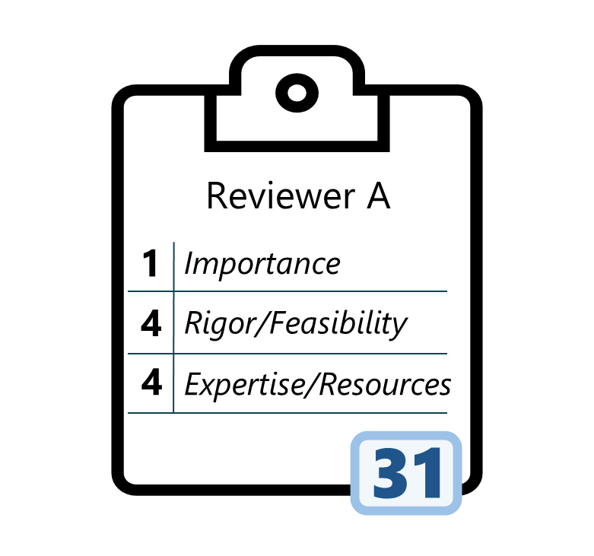
Scientific Review Remains Vital
Using reviewer feedback to its full potential
Payline Strategy
Unified Funding Strategy
Reviewer feedback as a multifaceted input
One number
Reviewer A Comments
31
Highly Innovative
Average of peer review scores
Emerging Methods
Early Career Scholar

Slide 8
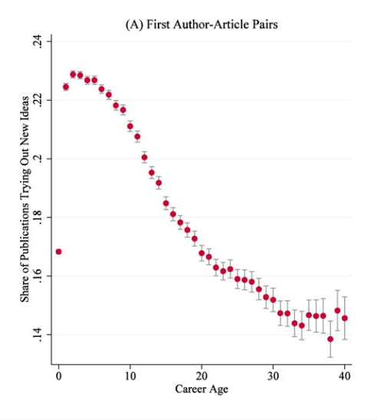
Scientific Review Remains Vital
Incentivizing innovation uplifts early career researchers
First Author-Article Pairs
Unified Funding Strategy
Reviewer feedback as a multifaceted input
Reviewer A Comments
Share of Publications Trying Out New Ideas
Highly Innovative
Emerging Methods
Early Career Scholar
Career Age
Bhattacharya & Packalen. (2019). Age and the Trying Out of New Ideas. Journal of Human Capital.

Slide 9
Incentives Matter
measures success
democratizes ideas
motivates innovation
takes risks
NIH incentives can rewire how the research ecosystem…
perceives replication
collaborates
discovers new ideas
supports junior scholars
challenges assumptions
assesses applications

Slide 10

End of Presentation

