Slide 1
Reviewer Orientation for NIH Peer Review Under the Simplified Review Framework
Applies to activity codes (effective, 2025/10 Council Round): R01, R03, R15, R16, R21, R33, R34, R36, R61, RC1, RC2, RC4, RF1, RL1, RL2, U01, U34, U3R, UA5, UC1, UC2, UC4, UF1, UG3, UH2, UH3, UH5, and phased awards (R21/R33, UH2/UH3, UG3/UH3, R61/R33)
SRO:
Study Section:
Meeting Dates:
Council Round:

Slide 2
NIH’s Two-Level Review System
1
2
First Level of Review:
Scientific Review Group (SRG)
Second Level of Review:
Institute/Center (IC) Advisory Council
Evaluation of Scientific Merit
Review of first-level peer review outcomes, recommendation for funding, advice on programmatic priorities
First-level peer review has a singular, important goal: provide expert advice to the NIH on the scientific and technical merit of grant applications.

Slide 3
Your Role as an NIH Reviewer
Evaluate the scientific merit of each application.
Do not make funding recommendations.
Do not provide advice to the applicant.
Apply the review criteria and scoring guidance consistently to reduce bias that can distort evaluation of scientific merit.
Evaluate the application as it is presented.
Do not attempt to improve or redesign the application.
Explain the basis for your review.

Slide 4
Review Integrity is the Foundation for a Fair, Independent Review, Free from Inappropriate Influences
Maintain absolute Confidentiality of all review materials and discussions.
Do not share with anyone.
Delete/discard all materials 30 days after the review meeting.
Report any Conflict of Interest (COI) that may directly affect or appear to affect the integrity of the peer review process.​
Report a COI as soon as you identify it -- at any point in the process.
Contact the SRO in private (to avoid tainting the review) if you suspect Research Misconduct: Data fabrication, data falsification, plagiarism
All comments must be independently generated by the reviewer.
Not copied from the application, prior summary statements, or other reviewers’ critiques
Not generated using generative AI technologies
4
Notes:
COI Resource: https://grants.nih.gov/grants/peer/Grant-Reviews-508.pdf

Slide 5
Review Criteria
3 Factors (Simplified Review Framework)
Factor 1: Importance of the Research (Significance & Innovation)
Factor 2: Rigor and Feasibility (Approach)
Factor 3: Expertise and Resources (Investigator & Environment)
OVERALL IMPACT
The likelihood for the project to exert a sustained, powerful influence on the research field(s) involved, considering
the 3 Factors and Additional Review Criteria (as applicable)
Additional Review Criteria
Protections for Human Subjects
Vertebrate Animals
Biohazards
Resubmissions, Renewals, Revisions
Additional Review Considerations
(no effect on Overall Impact score)
Authentication of Key Biological/Chemical Resources
Budget and Period of Support
Notes:
SROs should remind reviewers to look at the review criteria in Section V. of the NOFO for each application
(See NOT-OD-24-010 for standard SRF review criteria language)
https://grants.nih.gov/grants/guide/notice-files/NOT-OD-24-010.html

Slide 6
Reviewers Address 3 Key Questions about the Proposed Project
1. Should it be done?
Factor 1: Importance of the Research (Significance and Innovation)
2. Can it be done well?
Factor 2: Rigor and Feasibility (Approach)
3. Are the expertise and resources in place to do it?
Factor 3: Expertise and Resources (Investigator and Environment)

Slide 7
Should it be done? Factor 1 - Importance of the Research
Evaluate how the proposed project, if successfully completed, would advance the field (Significance).
Note that Importance of the Research refers to the importance of the proposed research, not the importance of the research field or disease.
Evaluate whether the scientific background justifies the proposed study.
NIH has a broad scope, including basic and mechanistic research, non-hypothesis driven work, method and technology development, different model systems, rare diseases etc.
Do not introduce scientific bias by under- or over-valuing certain types of research.

Slide 8
Should it be done? Factor 1 - Importance of the Research
Evaluate the novelty of the project (Innovation) and the extent to which that novelty influences the importance of the research.
For some projects, the development of new conceptual models, technologies or methods is precisely what makes the research important. Other projects use existing concepts, methods or technologies in novel ways that enhance the importance.
A project may be of critical importance for the field without applying novel concepts or approaches; in this case, comments on innovation are not needed.

Slide 9
Can it be done well? Factor 2 – Rigor and Feasibility
Rigor: Evaluate the potential to produce unbiased, reproducible, robust data.
Feasibility: Evaluate whether the proposed approach as presented is sound and achievable, including plans to address potential challenges.
Don’t expect detailed plans to address every possible obstacle.
Don’t be risk averse--evaluate experimental risk in the context of the potential for major advances.
For clinical trial applications, evaluate whether the study timeline and milestones are feasible.
Focus on important issues, not technical minutiae.
Evaluate the rigor and feasibility of the study design and methods as presented:
Don’t assess investigator qualifications/resources (Factor 3) or personnel effort (Budget) in Factor 2.
Don’t use the investigator’s track record to give them a pass on rigor or feasibility issues.
Notes:
Resource for evaluating Clinical Trials (study timeline/milestones): https://grants.nih.gov/sites/default/files/Reviewer-Guidance-Clinical-Trial-Applications.pdf

Slide 10
Factor 2 Considerations: Inclusion plans (human subjects)
As an integral part of your assessment of rigor and feasibility, evaluate inclusion plans and plans to recruit and retain participants.
Inclusions:
Sex
Race and ethnicity
Phase III clinical trials -- Plans for valid design and analysis of sex, race, and ethnicity.
Age across the lifespan
Inclusions must be scientifically justified, based on the scientific goals of the proposed research, not the geographical make-up of the study site.

Slide 11
Factor 2 Considerations: Sex as a Biological Variable (SABV; vertebrate animals and human subjects)
As an integral part of your assessment of rigor, evaluate whether the investigators presented adequate plans to address relevant biological variables, such as sex or age, in the design, analysis, and reporting.
Assess SABV in the context of the research question and current scientific knowledge.
If the study is intended to test for sex differences, is the design/analysis adequately rigorous to test for those differences?
If the study is not testing for sex differences and both sexes are included, does the project demonstrate plans to report data disaggregated by sex?
If only a single sex is included, is there a strong justification provided?
Additional SABV resources: Decision Tree, FAQ
11

Slide 12
Are the expertise and resources in place to do it? Factor 3 - Expertise and Resources
Evaluate whether the investigator(s), as presented, have demonstrated background, training, and expertise, as appropriate for their career stage, to conduct the proposed research project.
Evaluate whether the institutional resources, as presented, are appropriate to ensure the successful execution of the proposed research project.
Do not evaluate the team/institution outside the context of the proposed research (e.g., based on academic title, funding status, general reputation) as this introduces bias.
Do not evaluate personnel effort in Factor 3 (belongs in the Budget).

Slide 13
Scoring Factors 1 and 2
Scores in the high range should be based on strengths, not merely the absence of weaknesses.
Scores in the low range should be based on weaknesses.

Slide 14
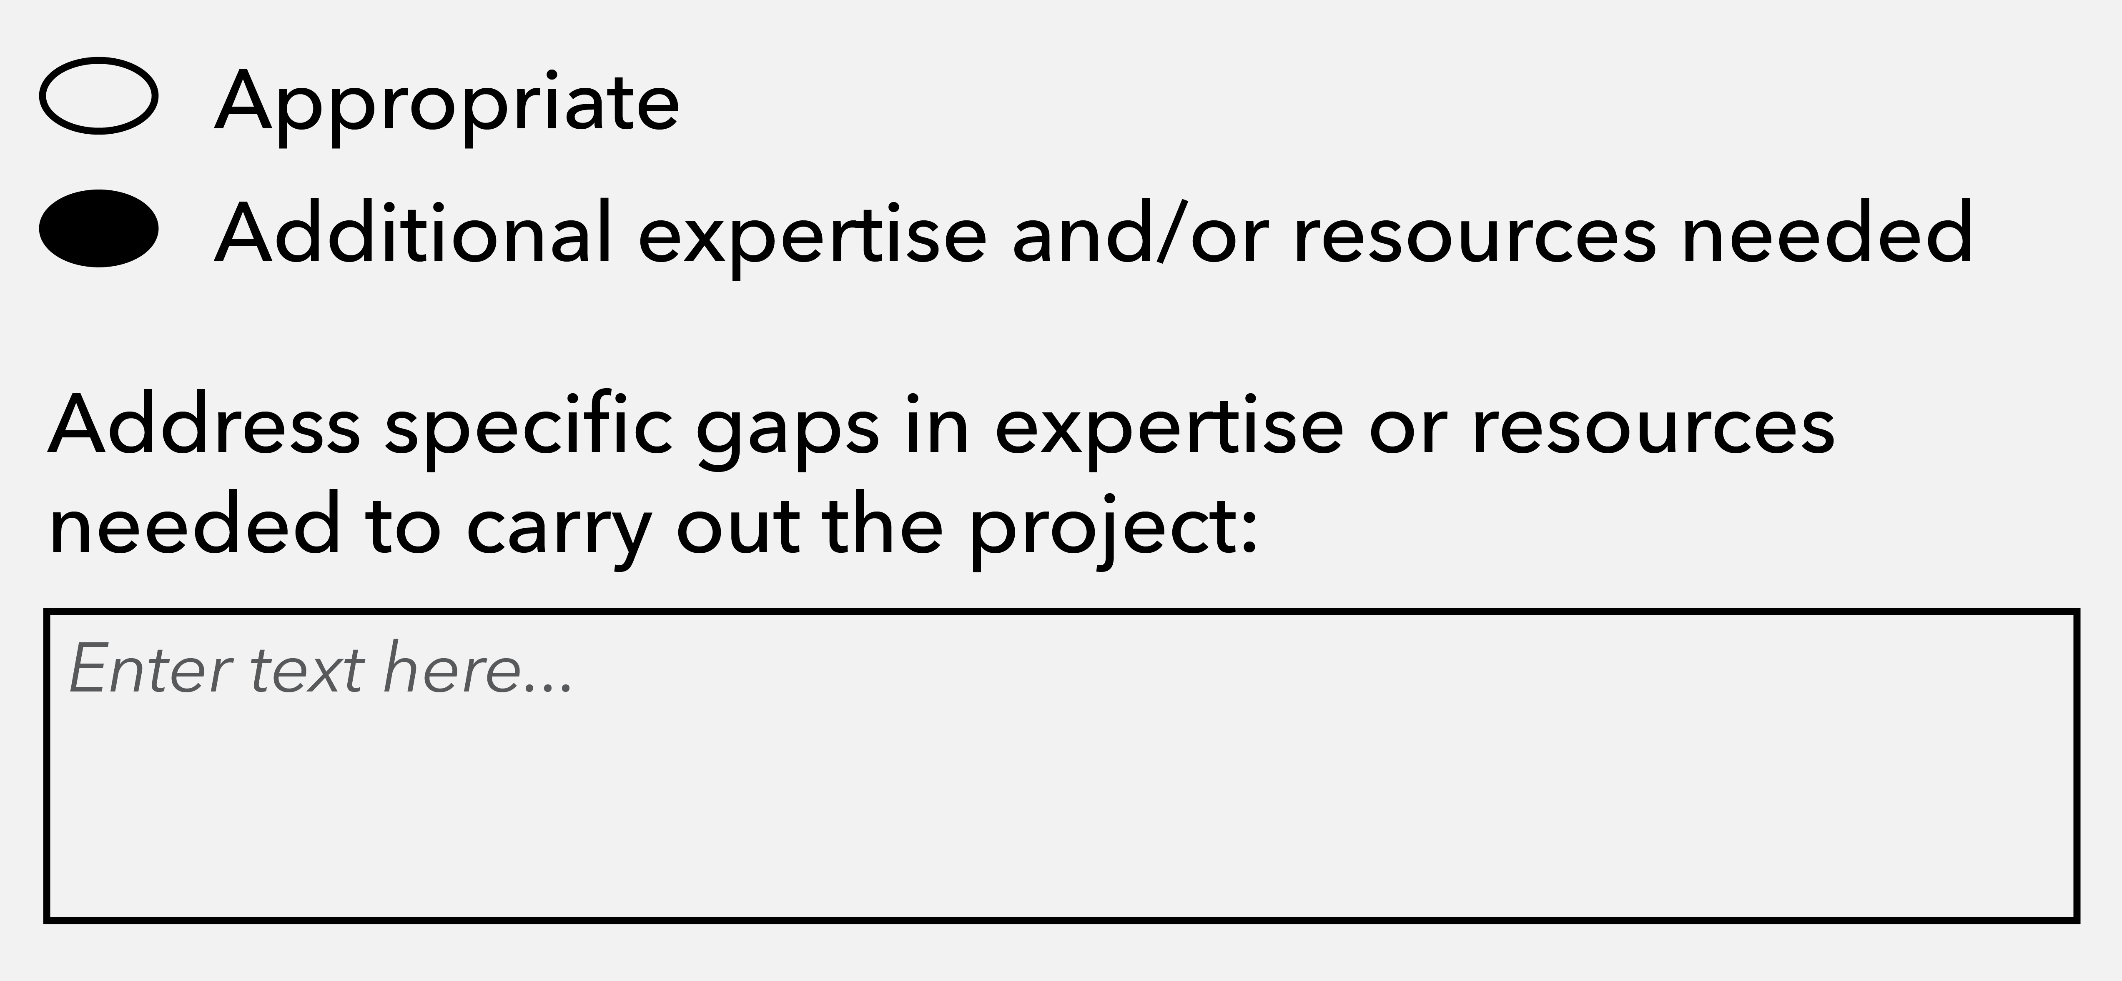
Rating Factor 3
If sufficient expertise and resources are in place, choose “appropriate”.
No comments are allowed.
If there are any gaps in the expertise and/or the resources needed for the project, choose “additional expertise and/or resources needed”.
Describe the gaps.
The binary rating provides the NIH with critical input about needed expertise and resources without leaving room for reputational bias.

Slide 15
Additional review criteria (can affect Overall Impact score)
Protections for Human Subjects
Vertebrate Animals
Biohazards
Resubmissions, Renewals, Revisions
Notes:
Note to SRO per the SRF NOFO NOT-OD-24-010:
Resubmissions: As applicable, evaluate the full application as now presented.
Renewals: As applicable, evaluate the progress made in the last funding period.
Revisions: As applicable, evaluate the appropriateness of the proposed expansion of the scope of the project.

Slide 16
Additional Review Criteria: Protections for Human Subjects
Evaluate the justification for involvement of human subjects and the proposed protections from research risk relating to their participation according to these criteria:
Risk to subjects
Adequacy of protections against risk
Potential benefits of the research to subjects and others
Importance of the knowledge to be gained
Data and safety monitoring for clinical trials
Notes:
Resource: https://grants.nih.gov/grants/peer/guidelines_general/Guidance-for-Review-of-Human-Subjects-Protections.pdf

Slide 17
Additional Review Criteria: Vertebrate Animals
Evaluate the involvement of live vertebrate animals according to these criteria:
Description of procedures, including species, strains, ages, sex, and total number of animals to be used
Justifications for the use of animals versus alternative models and for the choice of species
Minimization of pain and distress
Method of euthanasia
Notes:
Resource: https://olaw.nih.gov/sites/default/files/VASchecklist.pdf

Slide 18
Additional Review Criteria: Biohazards
Biohazards are research components known in the professional community to pose a risk to research personnel and/or the environment (biological organisms, toxins, radioactivity, dangerous chemicals, or recombinant DNA).
Determine whether proper handling procedures and adequate protections are addressed (personnel training, safety protocols, containment facilities, waste disposal).
Notes:
Resource: https://grants.nih.gov/sites/default/files/Biohazards-and-Select-Agents.pdf
Note: Under SRF, the Additional Review Consideration for Select Agents is no longer considered during review (shifted to NIH staff post-review)

Slide 19
Scoring Overall Impact
Logically, a project of moderate or limited importance (Factor 1) cannot be made more impactful by a strong approach (Factor 2) and/or appropriate expertise and resources (Factor 3)
Your Factor 1 score should set a limit for the best possible overall impact score.
Factors 2 & 3 can either reinforce the score set by the Factor 1 limit or worsen it.
Concerns with the Additional Review Criteria can worsen the score.

Slide 20
Writing the Overall Impact paragraph
Explain how you arrived at your overall impact score.
Always comment on Factors 1 and 2, noting only the major strengths and weaknesses that drove your overall impact score.
If there are gaps in expertise and/or resources (Factor 3), explain how they affected your overall impact score.
If Factor 3 is rated as appropriate, no comments are needed. Comments praising the investigators/environment are not appropriate and can introduce bias.

Slide 21
Additional Review Considerations (no effect on Overall Impact score)
Authentication of Key Biological and/or Chemical Resources: As applicable, evaluate the brief plans for identifying and ensuring the validity of these resources.
Budget and Period of Support: Evaluate whether the budget and requested period of support are fully justified and reasonable in relation to the proposed research.
Notes:
NOT-OD-17-068: Reminder: Authentication of Key Biological and/or Chemical Resources
Resource for Budget: https://grants.nih.gov/grants/peer/guidelines_general/budget_information.pdf

Slide 22
Progressing from independent review to full panel discussion
Individual reviewers submit preliminary scores and critiques.
Reviewers read and consider other critiques, recalibrating scores, if warranted.
At the meeting, all reviewers play an active role and cast an informed score.
Assigned reviewers: Explain your score, consider your colleagues’ views
Unassigned reviewers: Listen, ask questions, share different perspectives
If you hear a comment that doesn’t relate to the review criteria, mitigate potential bias by asking clarifying questions or contact the SRO.
The goal is to reach clarity, not consensus.

Slide 23
Thank you for serving as a reviewer.
Additional materials can be found in Meeting Materials—IAR
Contact the SRO with questions

