Slide 1
Focus on Fellowships
Part 3. Fellowship Application Peer Review
Ericka Boone, Ph.D.
Director, Division of Biomedical Research Workforce (DBRW)
Office of Extramural Research (OER), NIH​
Lystranne Maynard-Smith, Ph.D.
Scientific Review Officer, Reviewer Training Coordinator
Center for Scientific Review (CSR), NIH​
Mufeng Li, Ph.D.
Scientific Review Officer, Fellowship Point Person
Center for Scientific Review (CSR), NIH​

Slide 2
Video Agenda
1.
Introduction to NIH Peer Review
2.
First-stage Fellowship Peer Review
3.
Summary Statements
4.
Second-stage Fellowship Peer Review
5.
Tips and Advice

Slide 3
Introduction to NIH Peer Review

Slide 4

Which Ideas Should be Funded?
In fiscal year 2024, NIH:
Reviewed 87,632 applications
Held 2,525 meetings
Hosted 35,378 reviewers
Peer Review
Which are scientifically most meritorious
Tens of thousands of applications per year
Link: report.nih.gov/nihdatabook/category/12

Slide 5
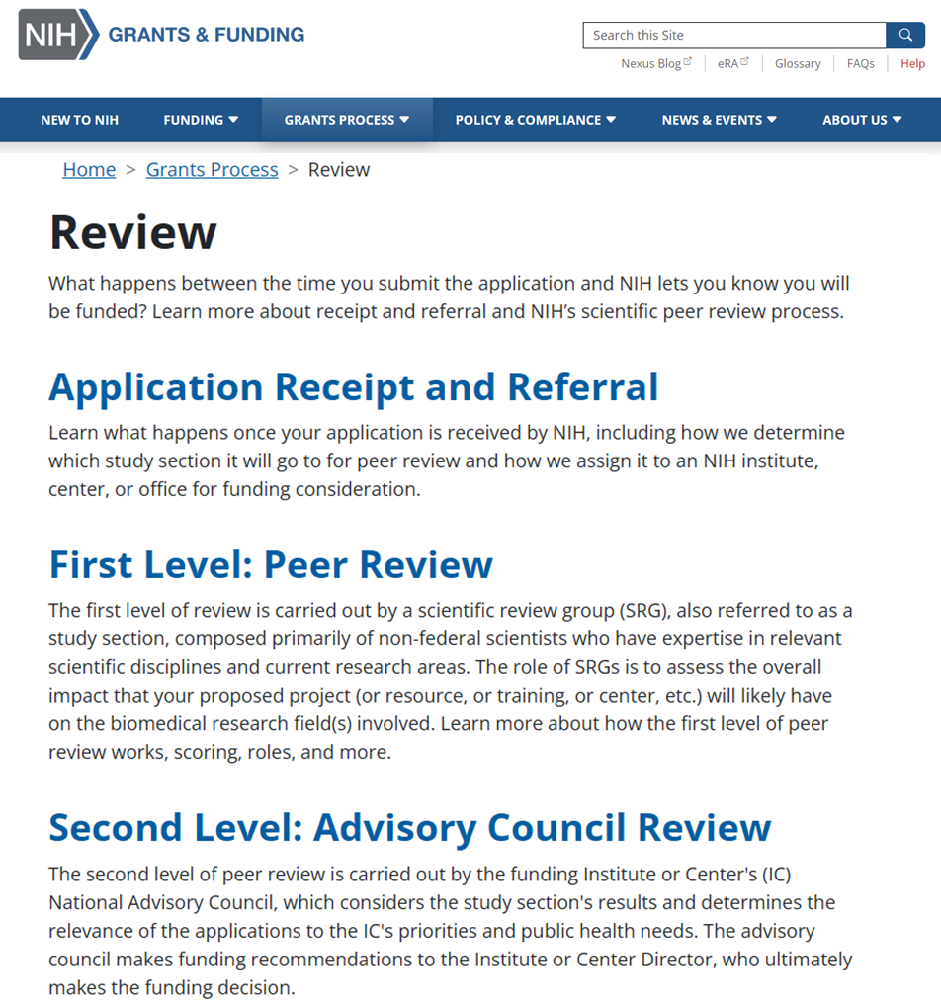
NIH Peer Review Process
Once your application is received by NIH, it is checked for completeness and assigned both to an NIH institute or center for funding consideration, and to a scientific review group where it will go to for peer review.
First level review: Review group members will assess the merit of the application using defined review criteria to produce a summary statement and assign an impact score
Second level review: Advisory Councils will consider application impact scores, summary statements, and other factors to recommend which applications to fund
Link - grants.nih.gov/grants-process/review

Slide 6
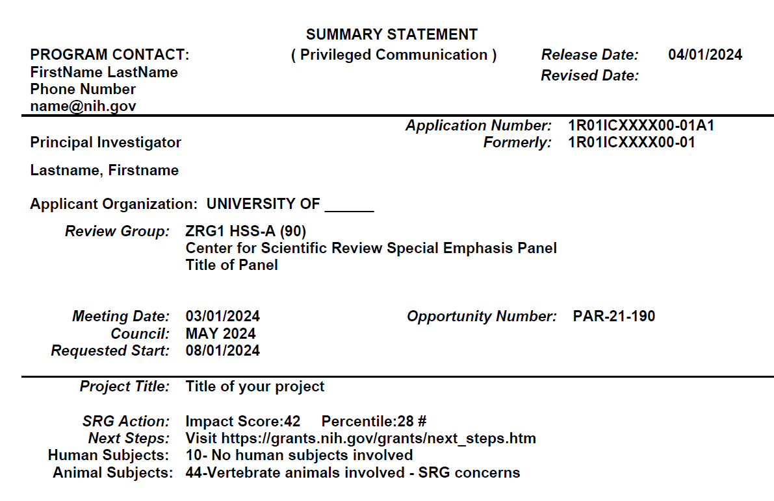
Summary Statement
Includes:
Overall impact score
Scores for each criteria
Reviewers’ comments
Is shared with:
IC advisory council
Applicant(s)
1F31ICXXXX00-01A1
1F31ICXXXX00-01
PAR-XX-XXX
⬇️ Reviewer feedback and scores ⬇️
6

Slide 7
First-stage Fellowship Peer Review

Slide 8
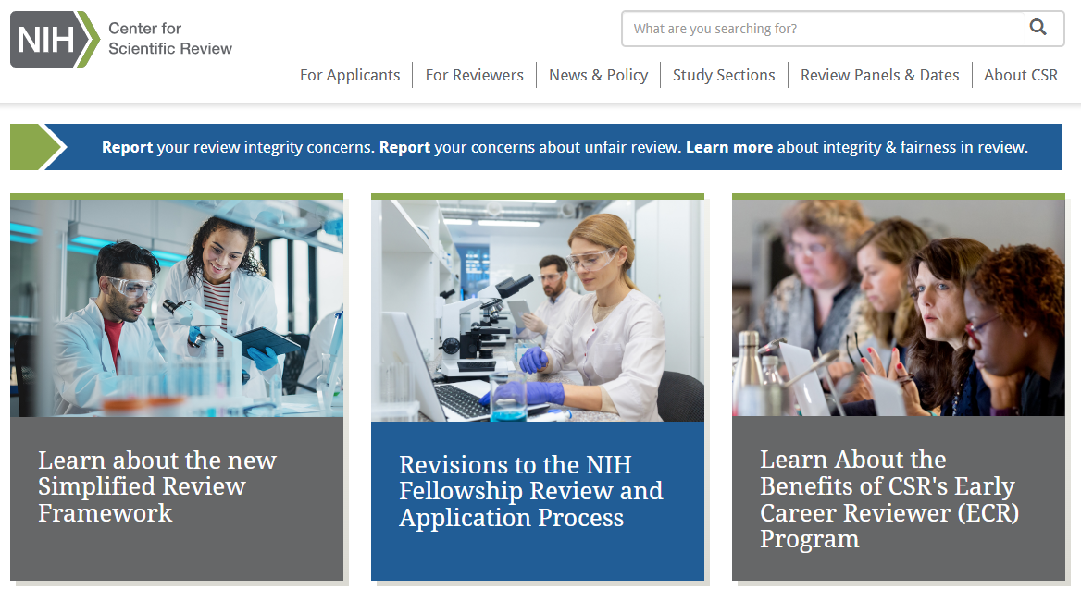
The First Stage of Review Takes Place at the NIH Center for Scientific Review
The NIH Center for Scientific Review (CSR) will manage first-stage review
Link: public.csr.nih.gov/

Slide 9

Review Groups Are Made Up of Scientific Experts
Federal Code requires that the composition of peer review groups be made up of experts in scientific or technical fields.
The scientific expertise of the review panel must be able to evaluate the potential impact, specific aims, and methodology of the proposed work.
The scientific review group will assess the application using the review criteria and considerations described in the Notice of Funding Opportunity applied to.
Tip – Read about CSR’s standing fellowship review groups.

Slide 10
Fellowship Review Criteria
1. Candidate’s Preparedness and Potential
Discuss the candidate’s preparedness for the proposed research training plan. Consider the context, for example, the candidate’s stage of training and the opportunities available.
Assess whether the candidate and sponsor statements as well as the referee letters provide convincing evidence that the candidate possesses qualities (such as scientific understanding, creativity, curiosity, resourcefulness, and drive) that will improve the likelihood of a successful research training outcome.
Consider the candidate’s potential to benefit from the fellowship research training plan and to transition to the next career stage in the biomedical research workforce.
Tip – General fellowship review criteria can be found on the NIH Grants and Funding site

Slide 11
Fellowship Review Criteria
2. Research Training Plan
Assess the rigor and feasibility of the research training project and how completion of the project will contribute to the development of the candidate as a research scientist.
Evaluate the goals of the overall research training plan and the extent to which the plan will facilitate the attainment of the goals.
Discuss whether the research training plan identifies areas of needed development and contains appropriate, realistic activities and milestones to address those needs.
Consider whether the sponsor(s), scientific environment, facilities, and resources are adequate and appropriate for the proposed research training plan
Tip – The full review criteria and considerations are included in the fellowship funding opportunity

Slide 12
Fellowship Review Criteria
3. Commitment to Candidate
Assess whether the sponsor(s) presents a strong mentoring plan appropriate to the needs and goals of the candidate.
Evaluate the extent to which the sponsor(s) and organizational commitment is appropriate, sufficient, and in alignment with the candidate’s research training plan.
Consider whether the level of commitment provided will contribute to the successful completion of the proposed plan and allow the candidate to advance to a productive career in the biomedical research workforce.
Tip – Learn more about the scoring process on the NIH Grants and Funding site

Slide 13
Second-stage Fellowship Peer Review

Slide 14

The Second Stage of Review Takes Place at the Awarding Institute or Center
Advisory Council/Board of the potential awarding Institute/Center (IC) performs the second level of review
  Composed of scientists and public representatives chosen by the respective IC and approved by the Department of Health and Human Services
Funding IC considers the review group outcomes and their IC ‘s mission and research priorities
IC Advisory Council makes funding recommendations
IC Director makes funding decisions
Tip – Track your application on eRA Commons

Slide 15
Tips and Advice

Slide 16
Who You Can Go to With Questions
Scientific Review Officer
  To request permission to send additional/corrective materials after reviewing the post-submission materials policy.
  To discuss review concerns (e.g., expertise needed on the review panel, conflicts, reviewers that may have bias).
Program Official
  To discuss the outcome of review after receiving and reviewing your summary statement.
Contact - Look in your eRA Commons account or Notice of Award for the name and contact information for the assigned scientific review officer or program official
Report concerns about unfair review outcomes to reportconcern@csr.nih.gov
Link: grants.nih.gov/help/ic-staff-roles

Slide 17
Preparing a Competitive Application
Applications are reviewed based on the review criteria included in the funding opportunity. A competitive application will clearly meet each of the criteria.

Slide 18
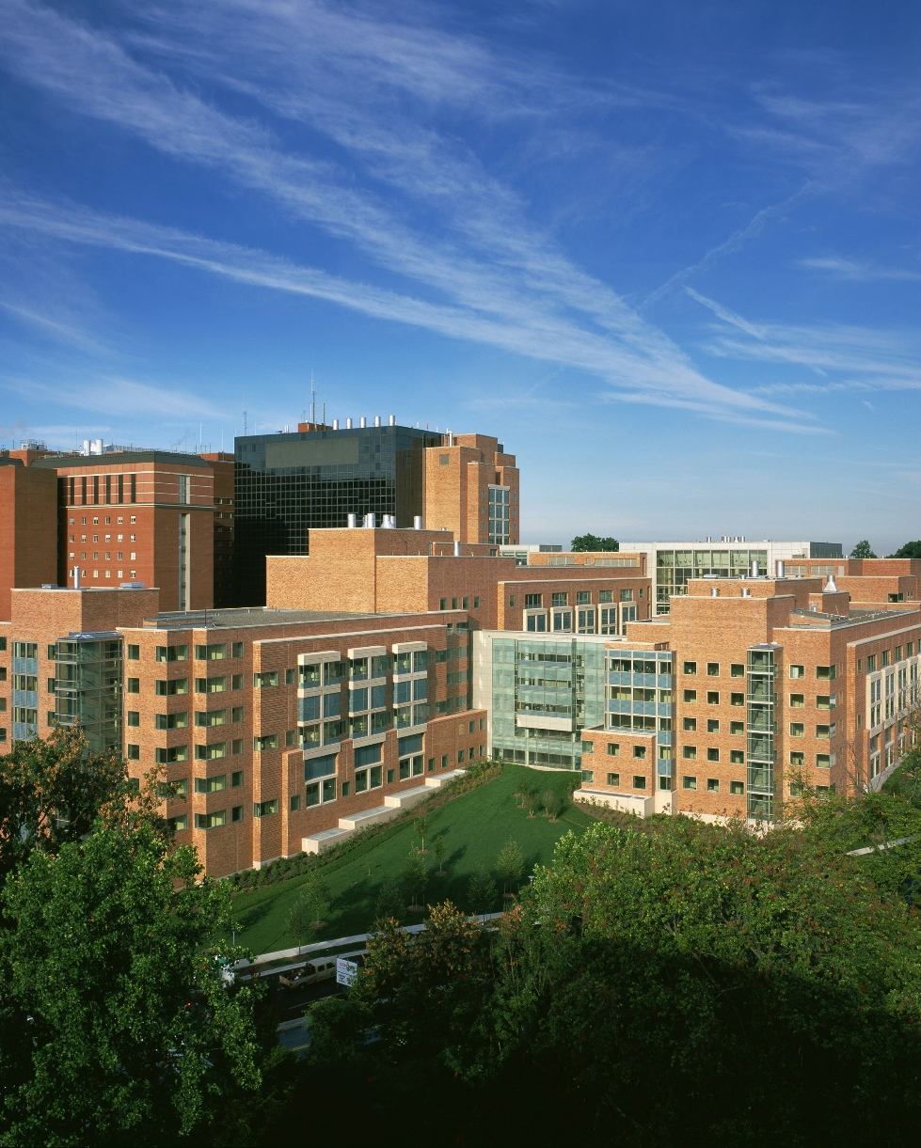
Thank You for Watching
Find Us:
https://linkedin.com/company/center-for-scientific-review-csr/
www.youtube.com/@NIHfunding​
CSR
https://public.csr.nih.gov
Additional Resources:
Find funding - grants.gov
Research Training and Career Development - grants.nih.gov/funding/funding-categories/research-training-and-career-development

