Slide 1
NIH Clinical Trials and Transparency Reforms Why the Changes?

Slide 2
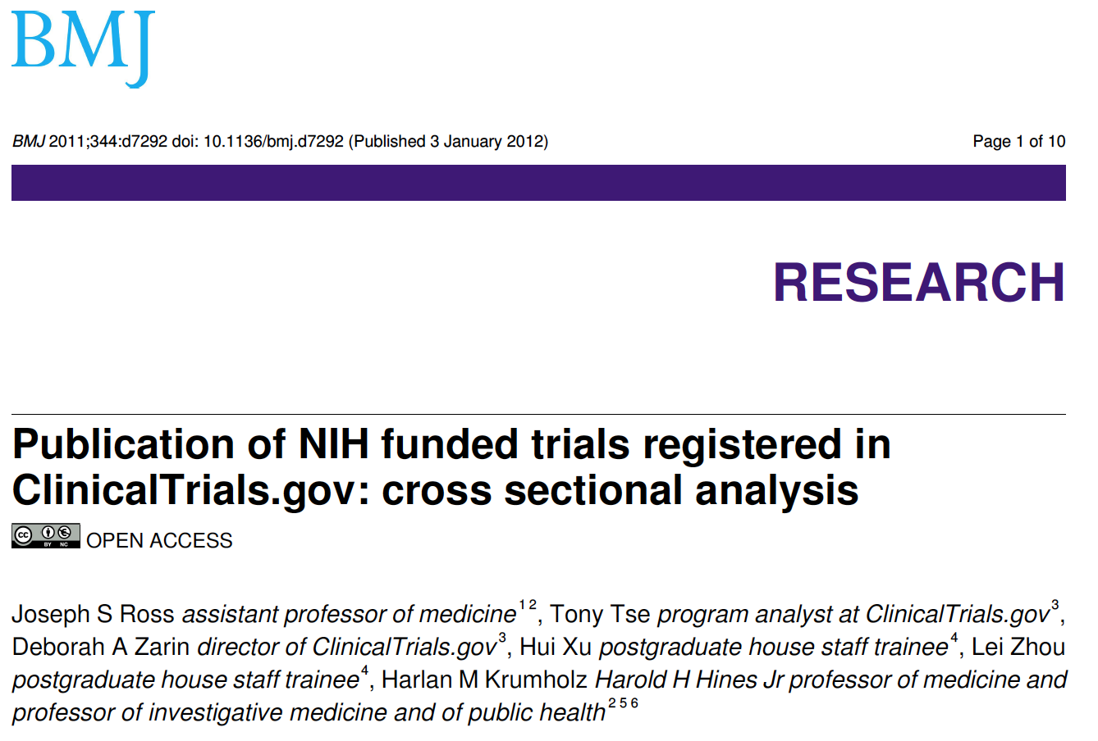
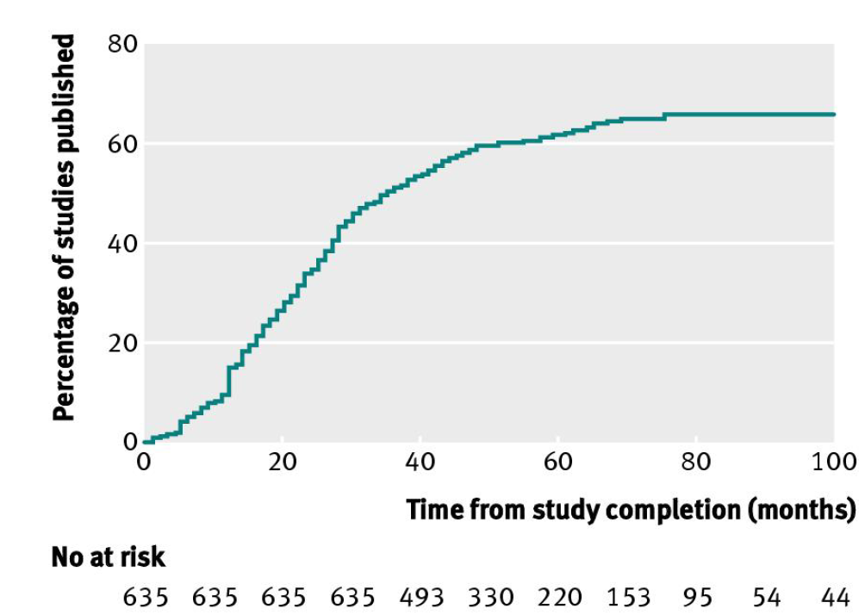
Problems!
“There are many [NIH-funded] trials not covered by [FDAAA], such as trials of behavioral interventions and surgical procedures. No policies exist to make sure that the public has access to results from NIH funded research that is not published”
BMJ 2011;344:d7292 doi: 10.1136/bmj.d7292 (Published 3 January 2012)

Slide 3
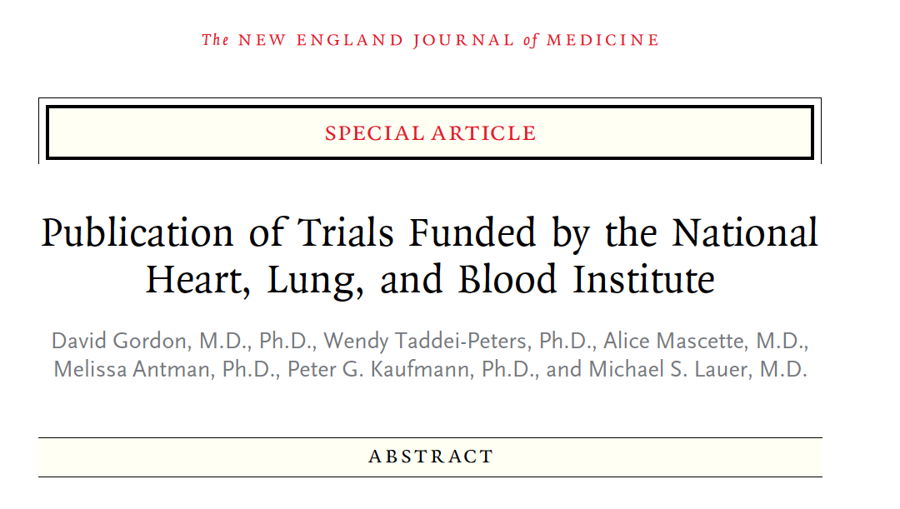
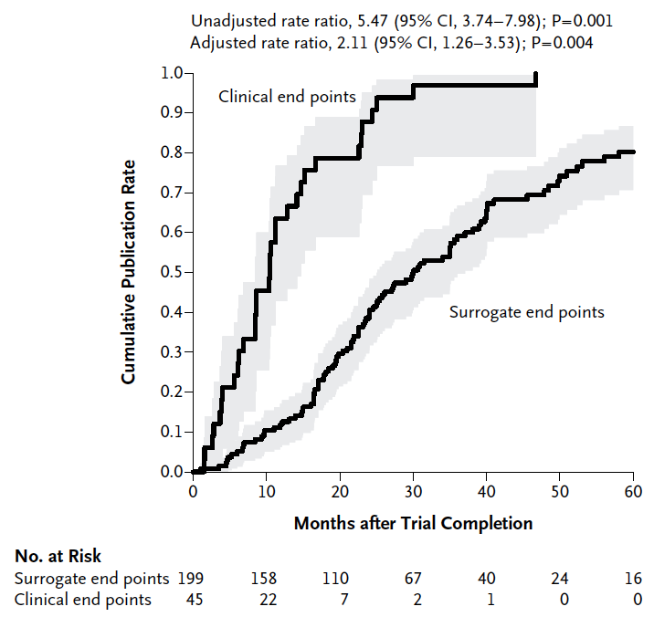
We Did Not Believe It
“A number of parties share responsibility, including funders, investigators, academic medical centers, [universities], clinical research organizations, and ... journals.”
N Engl J Med 2013;369:1926-34

Slide 4
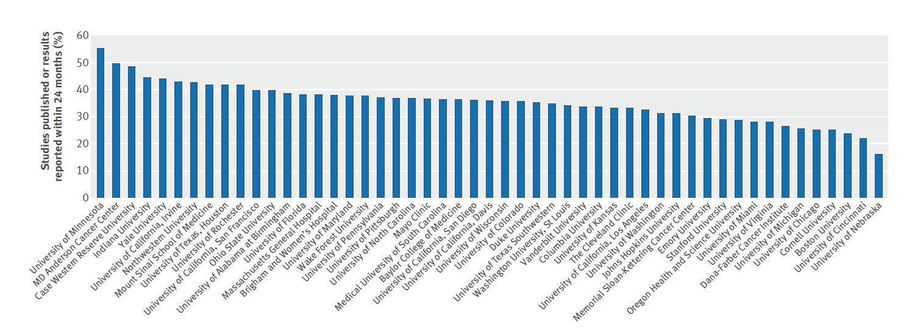
At Your Institution
“Despite the ethical mandate and expressed values of academic institutions, there is poor performance and noticeable variation in the dissemination of clinical trial results across leading academic medical centers.”
BMJ 2016;352:i637

Slide 5
Just How Serious This Is…
“We have a bottleneck at our nation's bastions of research excellence. Too many times, study results are neither reported on the government website, clinicaltrials.gov, nor published in a journal.
The failure to share results is so pervasive that it seems inappropriate to blame individuals. Instead, it is a systemic problem.”
http://www.npr.org/sections/health-shots/2016/02/23/467712481/academic-medical-centers-get-an-f-in-sharing-research-results

Slide 6
Continued… “Sharing Results Should Not Be Optional”
“Not reporting results violates the basic principle of the scientific method. It hurts patients, society and science. It dishonors the people who gave their consent and bore the risk of participating...
The holding back of the results impedes progress toward scientific breakthroughs, corrupts the medical literature and wastes research funding.”
http://www.npr.org/sections/health-shots/2016/02/23/467712481/academic-medical-centers-get-an-f-in-sharing-research-results

Slide 7
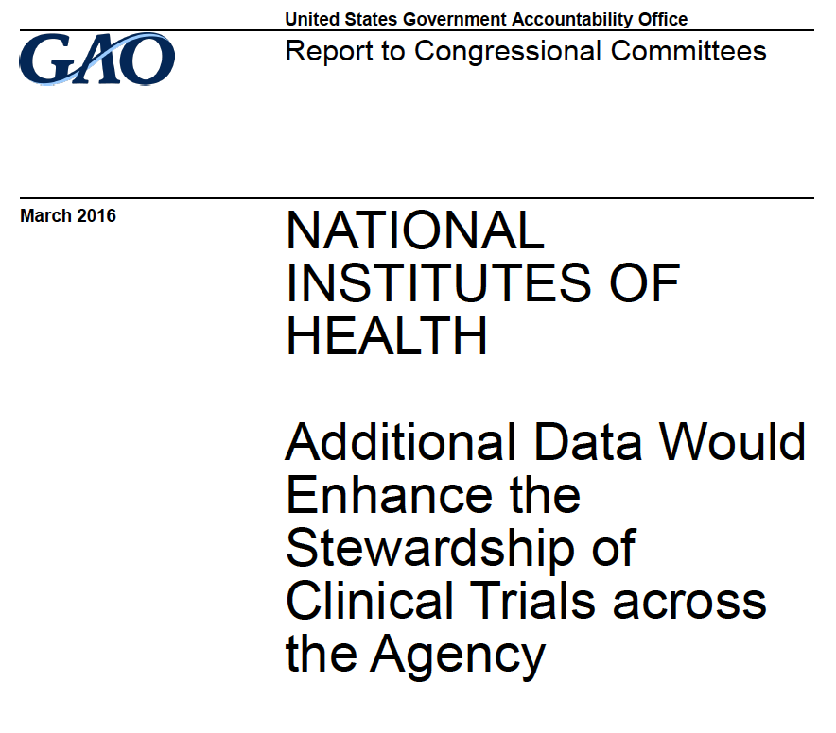
More Problems
“NIH’s OD reviews some data on clinical trial activity across NIH but has not finalized what additional data it needs or established a process for using these data to enhance its stewardship.
NIH is limited in its ability to make data-driven decisions regarding the use of its roughly $3 billion annual investment in clinical trials.”

Slide 8
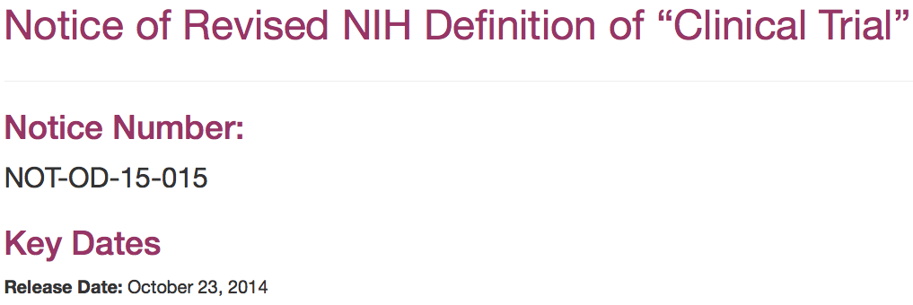
A Long Road

Slide 9
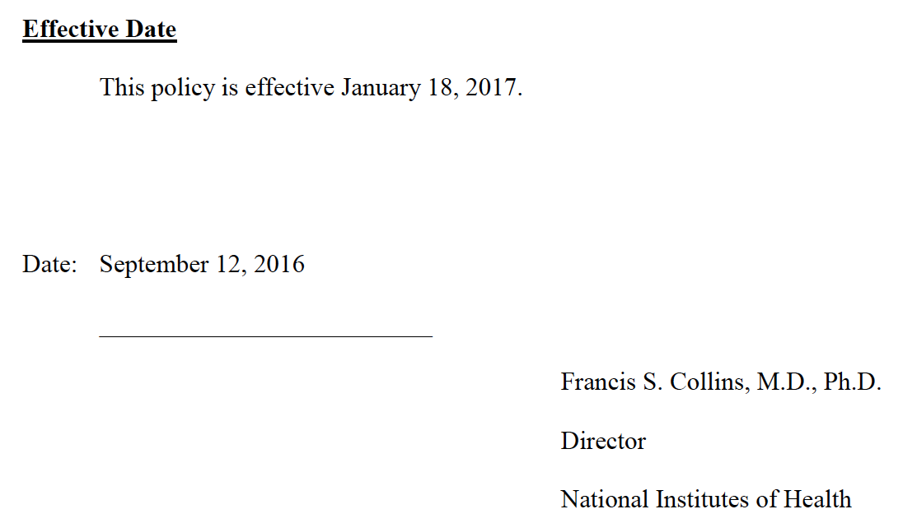
Now the Policy Exists…
“A fundamental premise of all NIH-funded research is that the results must be disseminated …
In research involving human beings, scientists have an ethical obligation to ensure that the burden and risk that volunteers assume comes to something, at the very least by ensuring that others are aware of the study and that its findings contribute…”
https://www.federalregister.gov/documents/2016/09/21/2016-22379/nih-policy-on-the-dissemination-of-nih-funded-clinical-trial-information

Slide 10
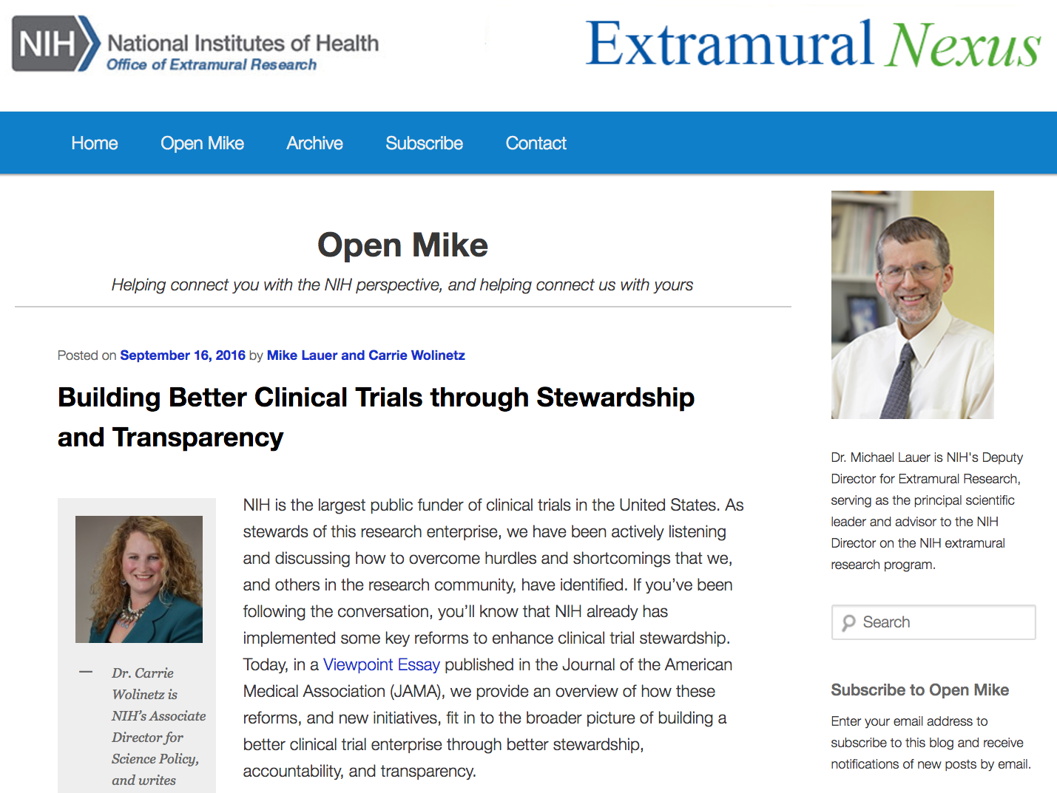
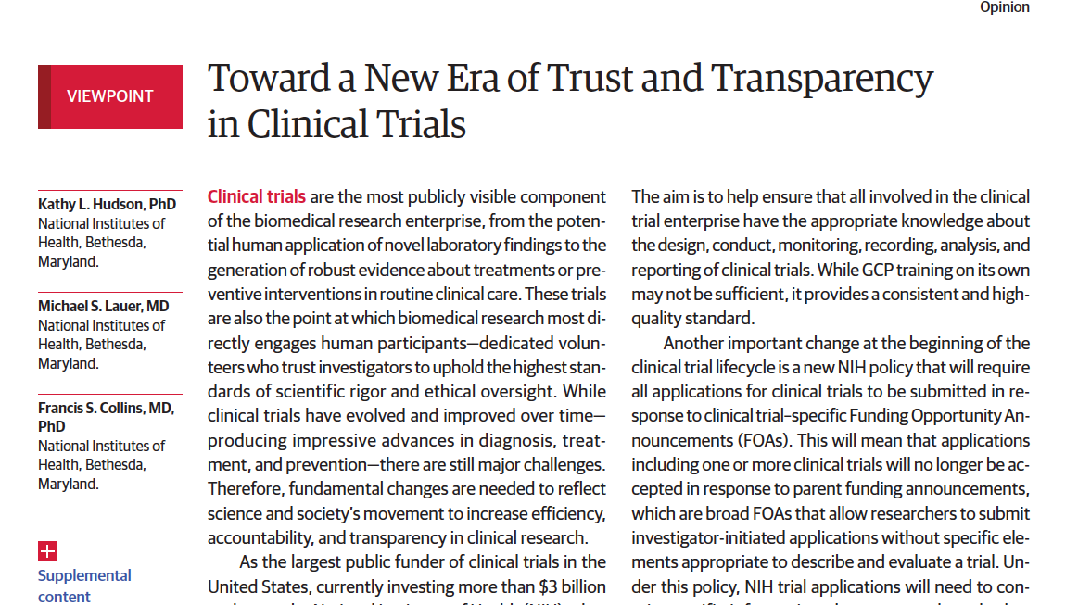
Publicity

Slide 11
Laudable Goal … As Long as It Doesn’t Affect Me ...
“We disagree with commenters who suggested that there is no need for coverage of certain types of trials. The benefits of transparency and the need to fulfill the ethical obligation to participants is as relevant to these types of trials as to any other type.
We believe that 12 months represents an appropriate balance between investigators’ interests and the interests of the public in having access to the results of a publicly funded trial.”
https://www.federalregister.gov/documents/2016/09/21/2016-22379/nih-policy-on-the-dissemination-of-nih-funded-clinical-trial-information

Slide 12
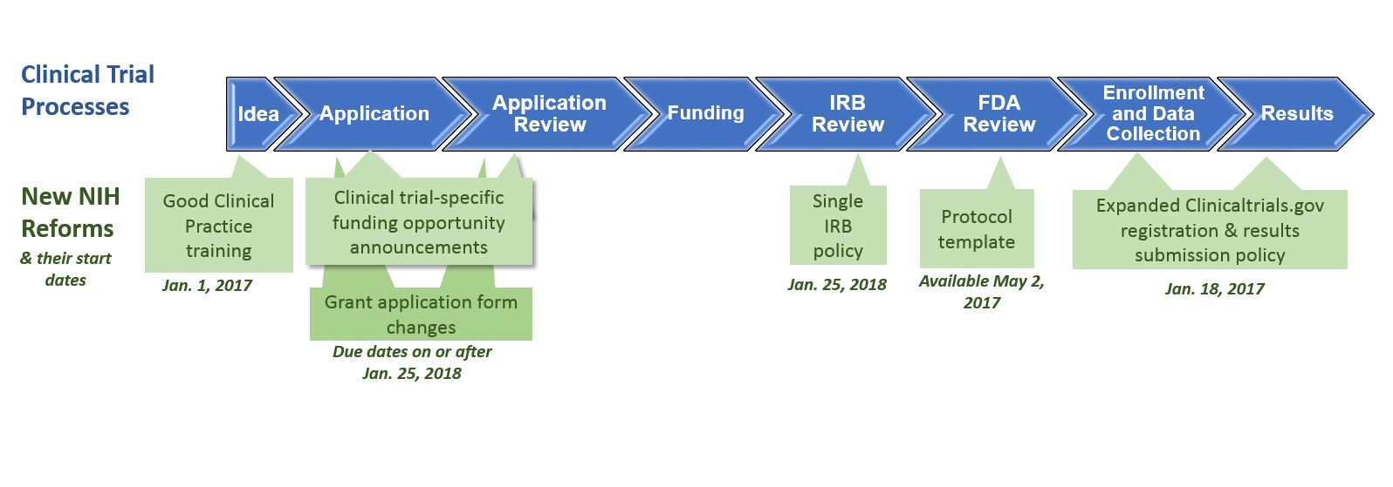
Enabling Systems (Culture) Change
Report
Results
Data for Stewardship
Register

Slide 13
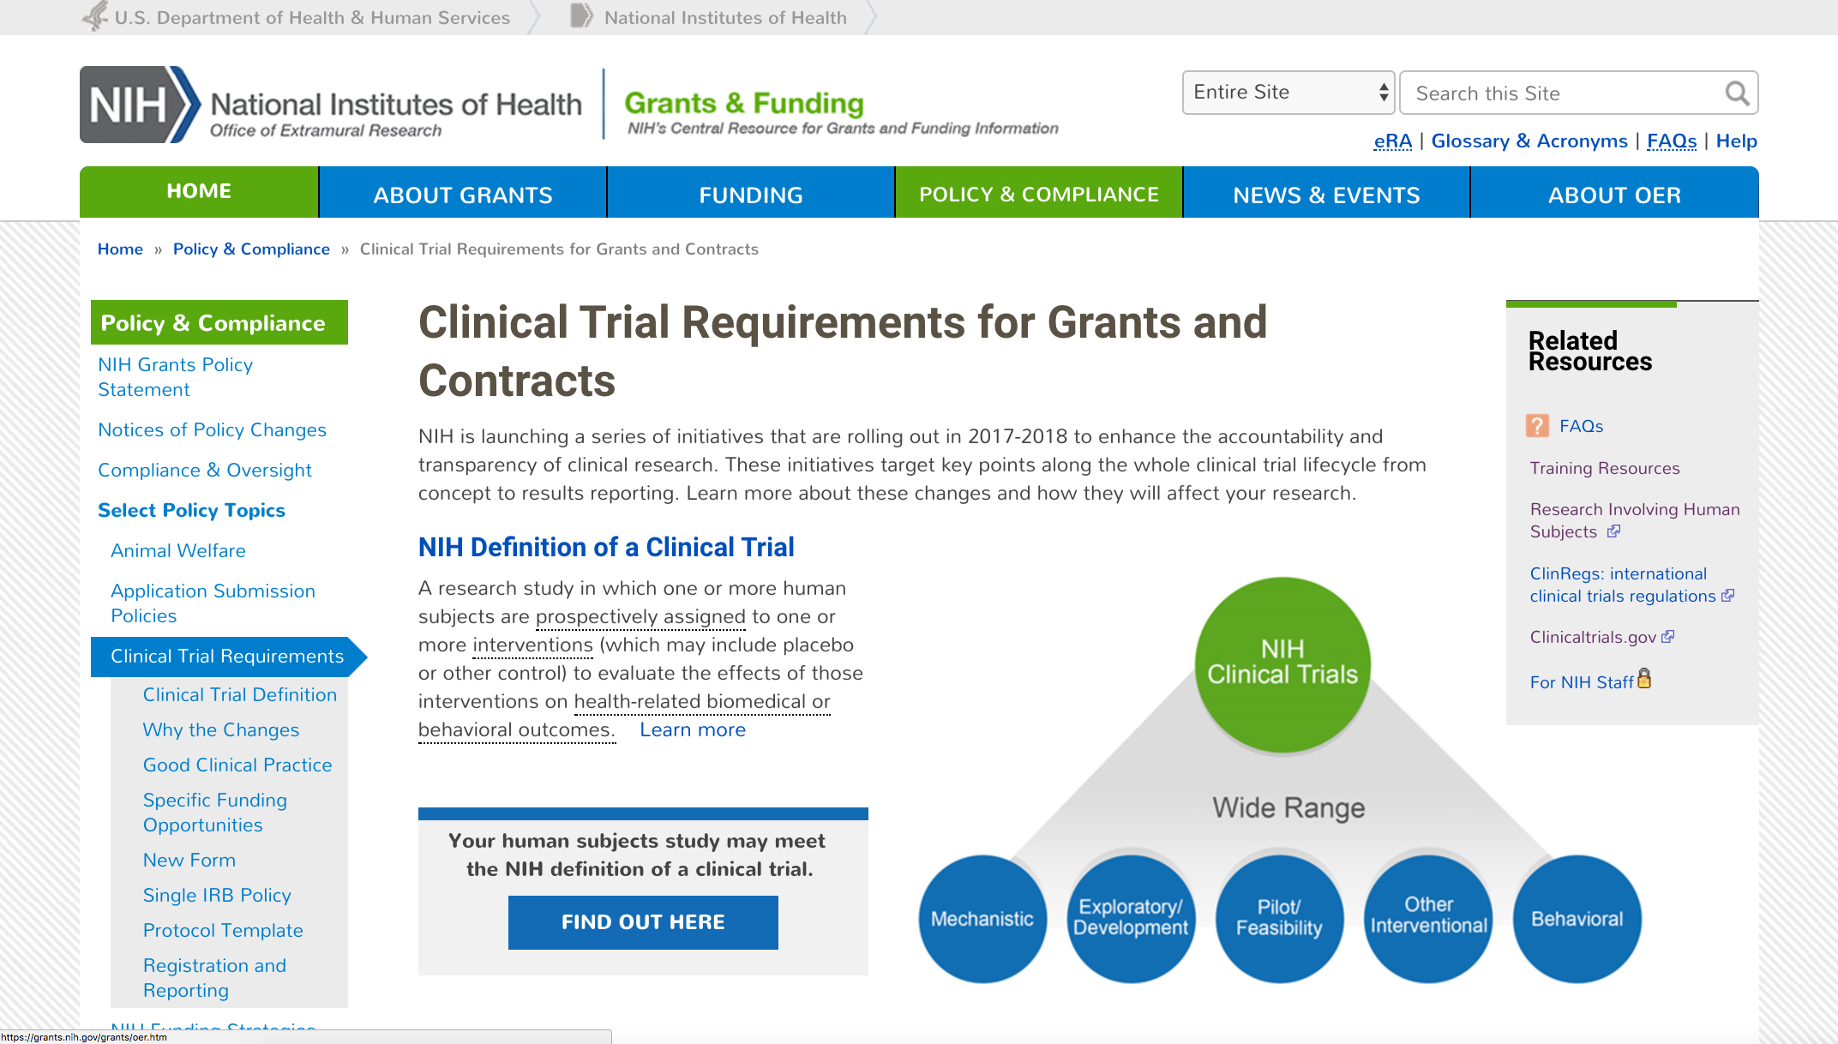
Public website
https://grants.nih.gov/policy/clinical-trials.htm

Slide 14
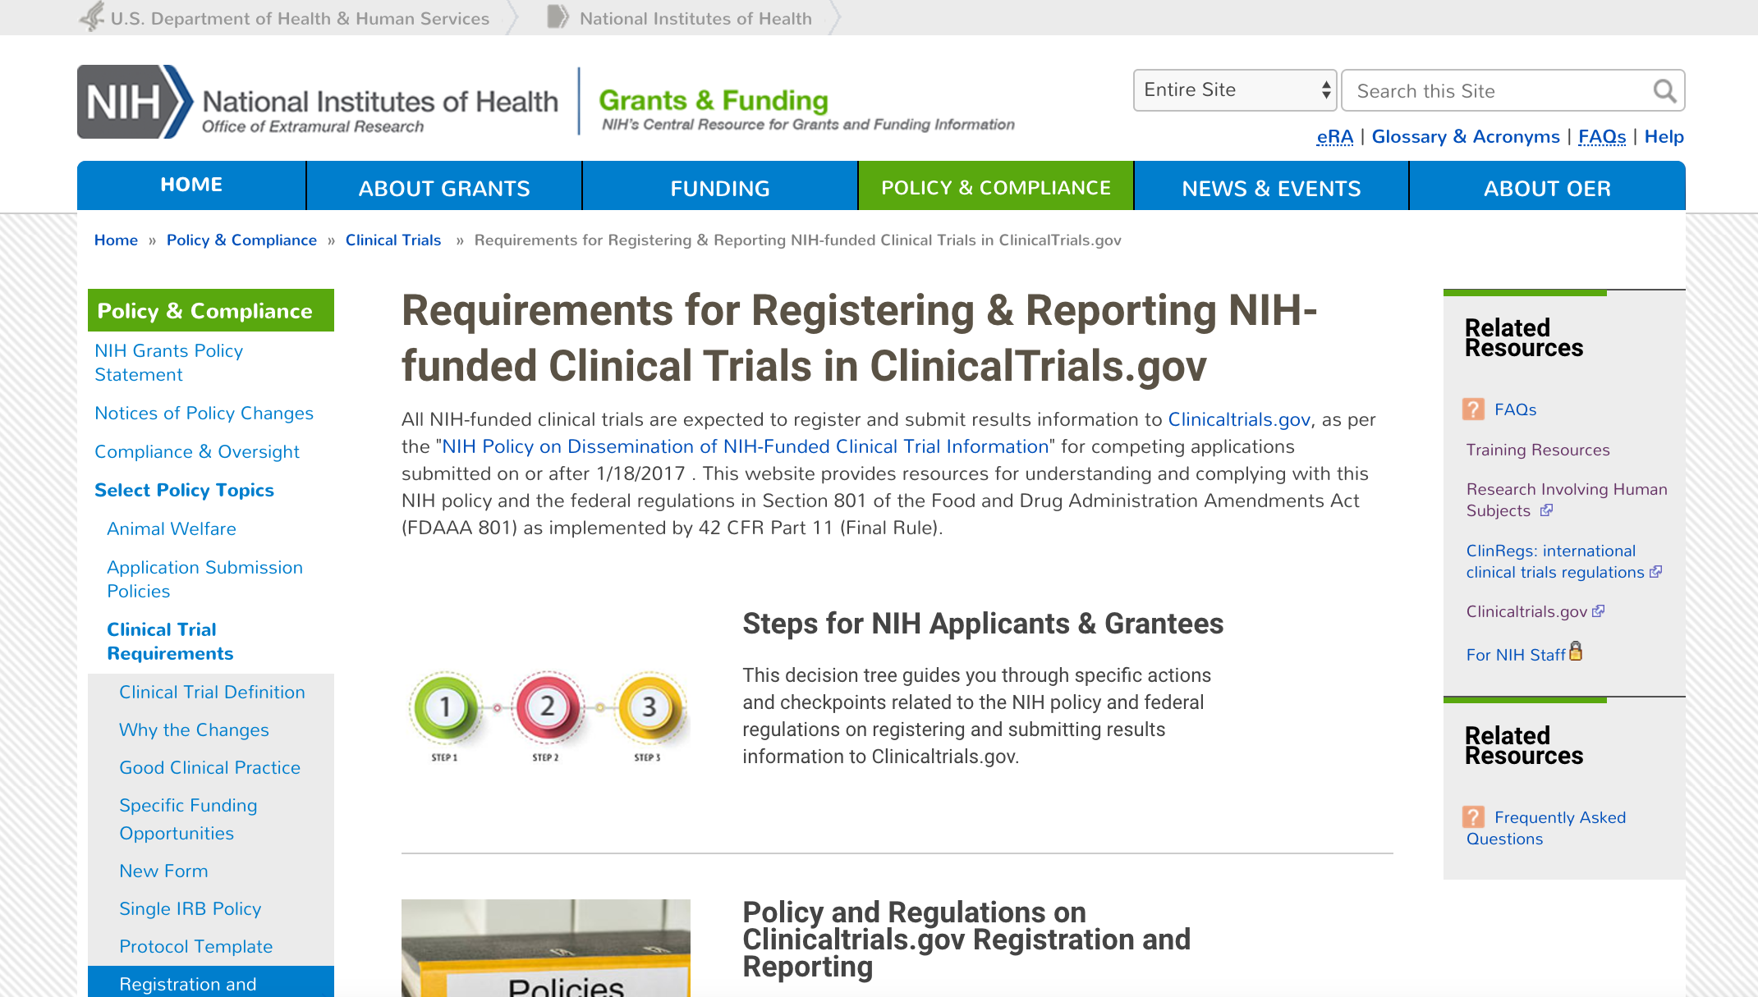
OER Site for Steps for Registering and Reporting in ClincalTrials.gov
https://grants.nih.gov/policy/clinical-trials/reporting/index.htm

Slide 15
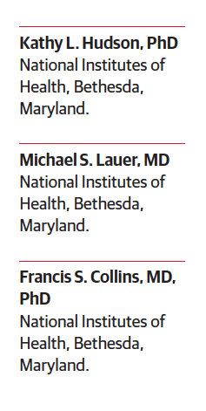
Accountability, Ethical Mandate, Transparency
“To realize the benefits of a clinical trial, the data must be broadly shared quickly. The DHHS has released a regulation for registration and summary results reporting. The NIH will withhold clinical trial funding if the agency is unable to verify adequate registration and results reporting…”
JAMA 2016 (online September 16, 2016)
Notes:
If you don’t register and report, consequences, Otherwise jeopardize CT funding at the institution

Slide 16
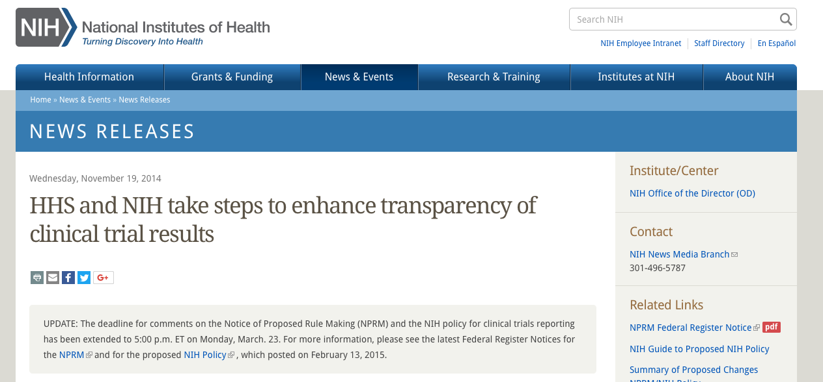
Accountability, Ethical Mandate, Transparency - Not a Suprise
https://www.vox.com/the-big-idea/2017/8/1/16012946/clinical-trial-research-public-transparency
https://www.nih.gov/news-events/news-releases/hhs-nih-take-steps-enhance-transparency-clinical-trial-results

