Slide 1
NIH Grants Policy Updates presented by the Office of policy for extramural research administration
JANUARY 31, 2024

Slide 2
AGENDA
UPDATES:
Budget
Policy
System Process
Compliance Updates
Policy Reminders
Resources
Q&A
Kasima Garst
Acting Director,
Division of Grant Systems Integration,
NIH
Brian Sass-Hurst
Assistant Grants Compliance Officer,
NIH

Slide 3
BUDGET updates

Slide 4
NIH Budget Updates
On November 16, 2023, President Biden signed the Further Continuing Appropriations and Other Extensions Act, 2024, and Other Extensions Act (Public Law 118-22), into law.
As a result, NIH issued NOT-OD-24-039:
Continues government operations through February 2, 2024.
Note: On January 19, 2024, the Further Additional Continuing Appropriations and Other Extensions Act (Public Law 118-35) further extended DHHS and NIH through March 8, 2024.
NIH Institutes and Centers may, at their discretion, issue non-competing research grant awards at a level below that indicated on the most recent Notice of Award.
New Executive Salary Levels have been issued. See NOT-OD-24-057.
Effective January 1, 2024, the salary limitation for Executive Level II is $221,900.
Learn more: NOT-OD-24-039; NOT-OD-24-057

Slide 5
Policy updates

Slide 6
NIH Updated Policy Guidance for Subaward/Consortium Written Agreements
On September 15, 2023, NIH issued NOT-OD-23-182, NIH Final Updated Policy Guidance for Subaward/Consortium Written Agreements, which announced the several updates to Section 15.2, Administrative and Other Requirements of the GPS.
Effective January 1, 2024:
NIH will not support any agreement that does not meet the minimum requirements outlined in section 15.2.1 of the GPS.
Foreign subrecipients must provide access to copies of all lab notebooks, all data, and all documentation that supports the research outcomes as described in the progress report to the primary recipient with a frequency of no less than once per year, in alignment with the timing requirements for Research Performance Progress Report submission. Such access may be entirely electronic.
NIH expects recipients to update existing subaward agreements to address this requirement within 60 days of the effective date of this notice. NIH recognizes that recipients may need additional time depending on the number of agreements an institution has in place for each project. Therefore, extensions may be requested, if needed.
Learn more: NOT-OD-23-182 and Open Mike Blog Post

Slide 7
Small Business Innovation Research (SBIR) and Small Business Technology Transfer Research (STTR) Extension Act of 2022
NIH has issued the following policy guidance:
NOT-OD-23-092, Notice of Change to Minimum Performance Standards for SBIR and STTR Applicants.
NOT-OD-23-139 covers the Implementation of the NIH SBIR and STTR Foreign Disclosure Pre-Award and Post-Award Requirements.
Effective for SBIR and STTR applications submitted for due dates on or after September 5, 2023.
Disclosure of all funded and unfunded relationships with foreign countries is required for all owners and “covered individuals”.
Submitted via the “Required Disclosures of Foreign Affiliations or Relationships to Foreign Countries” form during the Just-in-Time process.
Disclosure form is available on NIH’s Required Disclosures of Foreign Affiliations or Relationships to Foreign Countries web page.
Will not mitigate security risks identified as part of the due diligence program.
Notice includes further details on the new NIH Due Diligence Program and process.
Learn more: NOT-OD-23-092; NOT-OD-23-139; and Public Law No: 117-183

Slide 8
NIH Peer Review – Simplified Review Framework
NOT-OD-24-010, Simplified Review Framework for NIH Research Project Grant Applications
Effective for applications with due dates on or after January 25, 2025.
Summer 2025 peer review
October 2025 Advisory Council
Applies to most research project grant (RPG) applications (i.e., grants and cooperative agreements) with the following RPG activity codes:
DP1, DP2, DP3, DP4, DP5
R01, R03, R15, R16, R21, R33, R34, R36, R61, RC1, RC2, RC4, RF1, RL1, RL2
U01, U34, U3R, UA5, UC1, UC2, UC4, UF1, UG3, UH2, UH3, UH5
Also includes the following phased awards: R21/R33, UH2/UH3, UG3/UH3, R61/R33
Learn more: NOT-OD-24-010 and Simplifying Review of Research Project Grant Applications.

Slide 9
System process updates

Slide 10
Common Forms for Biographical Sketch and Current and Pending (Other) Support
NIH has been working closely with the National Science Foundation (NSF) and other federal agencies on the Common Forms for the Biosketch and Current and Pending (Other) Support, as part of the U.S. Office of Science and Technology Policy (OSTP) Research Security Subcommittee.
The Common Forms have been cleared by OSTP and OMB.
New forms are posted on the NSF website.
Estimated timeline:
Common Forms (Biosketch and Current and Pending (Other) Support) Implementation: January 2025
SciENcv templates available: May 2025
Reminder: Until the Common Forms are fully adopted by NIH, NIH requires applicants and recipients to use the current NIH Biosketch and Other Support formats for applications, Just-in-Time (JIT) Reports, and Research Performance Progress Reports (RPPRs).
Electronic signatures and supporting documentation are required.
Failure to follow the appropriate formats may cause NIH to withdraw applications from or delay consideration of funding.
Learn more: NIHGPS Section 2.3.7.12 and Guidance for Implementing National Security Presidential Memorandum 33.
Learn More: Biosketch FAQs & Other Support FAQs; Send inquiries to: nihosbiosketch@nih.gov

Slide 11
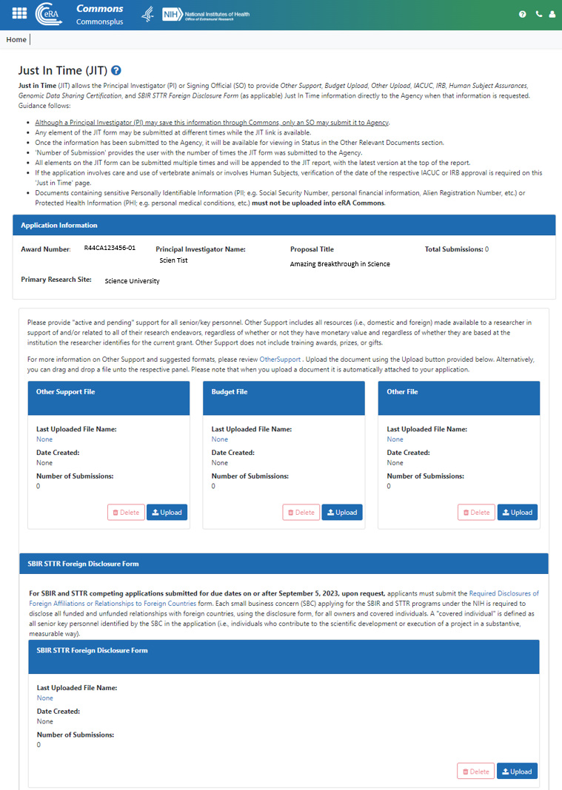
Just-in-Time (JIT) Update for SBIR/STTR
This section appears ONLY for SBIR/STTR awards (R41, R42, R43, R44, U43, U44, UT1, UT2, SB1, UB1).
Upon request, applicants must submit completed SBIR STTR Foreign Disclosure Form for each application when requested at JIT.
Form must be completed in its entirety, signed, and flattened.
Institutes/Centers cannot accept JIT materials by email (See NIH GPS Section 2.5.1).
Resources: eRA Online Help – Just-in-Time (JIT)

Slide 12
Reminder: eRA Commons ID Requirement
An eRA Commons ID must be entered in the “Credential, e.g. agency login” field for all Senior/Key Personnel, and Other Significant Contributors (OSCs) listed on the R&R Senior/Key Person Profile Form.
Previously, applicants will encounter an eRA system warning if the “Credential, e.g. agency login” field is blank or does not contain a valid eRA Commons ID.
The validation has been updated from a warning to an error in mid-January in advance of due dates on or after January 25, 2024.
Applicants are encouraged to check that their Commons account is active well before the due dates.
Learn more: NOT-OD-24-042
FAQs: Registration in Commons

Slide 13
Compliance updates

Slide 14
Retrospective Review of Single Audits
NIH is enhancing its pre-award risk assessment procedures to review each institution’s single audit results and may take actions based on findings reported.
Some awards may be released prior to the completion of this review; these recipients will have a term added to their awards identifying that, based on the outcome of the retrospective review, NIH may unilaterally take administrative action to safeguard NIH funds in accordance with the NIH Grants Policy Statement (GPS), Section 8.5.1, Specific Award Conditions – Modification of the Terms of Award.
Upon completion of the review, additional terms may be added based on the specific risks identified by NIH.
Single audit requirements are summarized in NIH GPS Section 8.4.3, Audit.
Learn more: NIH GPS 8.4.3

Slide 15
Unilateral Closeout Reporting
On January 23, 2024, NIH issued NOT-OD-24-055, NIH Enforcement of Unilateral Closeout Reporting in the System for Award Management Responsibility/Qualification
NIH is strengthening enforcement of longstanding closeout requirements, outlined in Section 8.6, Closeout, of the GPS.
NIH recipients must submit a Final Federal Financial Report (FFR), Final Research Performance Progress Report (F-RPPR), and Final Invention Statement and Certification (FIS) within 120 calendar days of the end of the period of performance (project period).
Without prior approval from the awarding Institute or Center for a delay in closeout, NIH will initiate unilateral closeout for all awards that fail to meet closeout requirements within 120 days.
NIH will report all unilateral closeout actions as a Responsibility/Qualification (formerly FAPIIS) record in the entity's information in the System for Award Management (SAM.gov) retroactively, beginning with all unilateral closeout actions taken since January 1, 2023.
Learn more: NOT-OD-24-055

Slide 16
New 90-Day Closeout Reminder Notification
NIH recipients must submit a Final Federal Financial Report (FFR), Final Research Performance Progress Report (F-RPPR), and Final Invention Statement and Certification (FIS) within 120 calendar days of the end of the period of performance (project period), as required in section 8.6 of the NIH Grants Policy Statement.
NIH previously sent reminder emails to recipients 10, 120, and 150 days after the project period end date.
Effective January 2024, NIH has begun sending an additional reminder closeout email notification 90 days after the project period end date.
Learn more: NOT-OD-24-047

Slide 17
Federal Audit Clearinghouse Transition from Census Bureau to General Services Administration
Management of the Federal Audit Clearinghouse (FAC) is being transitioned from the Census Bureau to the U.S. General Services Administration (GSA). The new www.FAC.gov by GSA was launched October 1, 2023.
Reminder: FAC is the Federal repository for all single audit reports required from a State government, local government, or non-profit organization (including hospitals and institutions of higher education)
Submission of all single audit reports to FAC is now via: www.FAC.gov
The old, Census FAC website hyperlink will now automatically redirect users to: www.FAC.gov
Search functionality for submitted/accepted audit reports is still under transition:
All single audit reports accepted after October 1, 2023: Search via GSA FAC: www.FAC.gov
All prior single audit reports: Search via Census FAC search page: https://facdissem.census.gov/Main.aspx
GSA anticipates transition completion by the end of the year, when submission of all audit reports and all historic single audit data will be available at www.FAC.gov
Reminder: For-Profit and Foreign organizations must still submit audit reports to the HHS Audit Resolution Division
Learn more: NIH GPS 8.4.3

Slide 18
Policy reminders

Slide 19
Reminder: Timely Progress Reports
Annual Research Performance Progress Report (RPPR) Format
Due Dates
Non-SNAP: Approximately 60 days before the start of next budget period
SNAP: Approximately 45 days before start of the next budget period
Multi-Year Funded: on or before award anniversary date
Searchable list to determine which progress reports are due: https://public.era.nih.gov/commons/public/quickqueries/progressReportByIpf.era

Slide 20
Reminder: Federal Financial Report and Financial Closeout Service Center Updated Guidance for Returning Grant Funds
NIH recipients who need to return funds in the PMS for NIH grant awards that have ended, but funds have not yet expired (e.g., funds obligated from an annual appropriation within 5 years of current fiscal year).
When recipients need to return funds on an NIH grant:
If the refund is $20,000 or greater, NIH recipients must
(1) submit a revised FFR, and
(2) post the refund to the PMS document if the funds have not expired and are reconciled and closed in PMS.
All refunds under $20,000 on closed PMS documents should be sent directly to PMS with instruction to post the funds to Miscellaneous Receipts.
PMS refund instructions may be found at https://pms.psc.gov/grant-recipients/returning-funds-interest.html.
A chart outlining the updated refund process for various scenarios may be found at https://grants.nih.gov/policy/compliance.htm under Compliance Resources.
Learn more: NOT-OD-23-102

Slide 21
Reminder: Invention Reporting
Reporting of inventions through iEdison is mandatory.
Reminder: Management of the iEdison system has transitioned from the NIH eRA to the NIST, U.S. Dept. of Commerce (DOC). The new iEdison by NIST was launched August 9, 2022.
Annually, in the progress report (RPPR Section C.4), identify any inventions, patent applications and/or licenses resulting from the award.
A Final Invention Statement and Certification (HHS 568) must be submitted within 120 calendar days of the project period end date of all awards that support research. The Statement shall include all inventions which were conceived or first actually reduced to practice during the course of work under the grant or award, from the original effective date of support through the date of completion or termination.
Failure to report all inventions may result in your organization’s loss of rights in the invention or other actions as appropriate.
Learn more: NIH GPS 8.2.4 and NIH GPS 8.6.3
About iEdison: NIST FAQ; NIST Training Opportunities; NOT-OD-22-100; NOT-OD-22-158

Slide 22
Reminder: Required Language for Government Support Clauses on Patented Intellectual Property
Per the Bayh-Dole Act, The Government Support Clause is a statement acknowledging federal support of a subject invention that MUST be included in the specification of a U.S. patent application or a U.S. issued patent (35 USC 202(c)(6))
See: NIH Grants Policy Statement, Section 8.2.4 “Inventions and Patents”
As a reminder, the Government Support Clauses must specifically identify “the National Institutes of Health” as the funding agency
Sample: This invention was made with government support under (grant number, including the two-letter institute code and six-digit serial number, e.g., CA012345) awarded by the National Institutes of Health. The government has certain rights in the invention.
Learn more: Section 8.2.4 of the GPS

Slide 23
Reminder: Grant Closeout Requirements
Closeout of an award is the process by which NIH determines that all applicable administrative actions and all required work of an award have been completed by the recipient and NIH.
NIH continues to require and enforce longstanding closeout requirements due within 120 days of the project period end date:
Final Progress Report (RPPR)
Final Federal Financial Report (FFR) (SF 425)
Final Invention Statement and Certification (HHS 568)
NIH will initiate unilateral closeout (including potential enforcement actions) if recipients fail to submit final reports on time.
Learn more: NIH Closeout and NIH GPS 8.6 Closeout

Slide 24
Reminder Notifications for Final Federal Financial Reports (FFRs) in Rejected Status
Beginning November 2023, NIH will send reminder email notifications to recipients with Final FFRs in rejected status.
Reminder: Revised Final FFRs must be resubmitted in a timely manner in accordance with NIH GPS GPS 8.6 and 8.6.1 to ensure all administrative and financial closeout requirements are conducted within the required time frames. (See 2 CFR Part 200.344 and NIH GPS 8.6).
Please direct all inquiries to OPERA FFR Reconciliation and Financial Closeout Support Center (ODOPERARejectedFFR@od.nih.gov)
Learn more: NOT-OD-24-017

Slide 25
Resources
Application Submission | Grant Application Basics: https://grants.nih.gov/grants/grant_basics.htm Find Grant Funding- NIH Guide for Grants and Contracts: https://grants.nih.gov/funding/searchguide/index.html#/ How to Apply - Application Guide: http://grants.nih.gov/grants/how-to-apply-application-guide.htm Annotated SF424 (R&R) Application Forms: https://grants.nih.gov/grants/how-to-apply-application-guide/resources/annotated-form-sets.htm eRA Training: Video Tutorials: https://www.era.nih.gov/era-training/era-videos.htm How we check for application completeness: https://grants.nih.gov/grants/how-to-apply-application-guide/submission-process/how-we-check-for-completeness.htm
eRA | eRA Commons: https://www.era.nih.gov/ eRA Commons Help & Tutorials: https://www.era.nih.gov/help-tutorials/era-commons/user-guide.htm Self Help Resources and eRA Service Desk: https://www.era.nih.gov/need-help
General | NIH Grants & Funding web page: https://grants.nih.gov/ NIH Grants Policy Statement: https://grants.nih.gov/policy/nihgps/index.htm NIH Extramural Nexus – newsletter for the extramural community: https://nexus.od.nih.gov/all/ NIH Frequently Asked Questions (FAQs): https://grants.nih.gov/faqs#/ Research Portfolio Online Reporting Tools (RePORT): https://report.nih.gov/ RePORT Expenditures & Results (RePORTER): https://reporter.nih.gov/
RPPR | RPPR Webpage, including links to the NIH RPPR Instruction Guide, RPPR Guide Notices, FAQs, Training, and Contacts: https://grants.nih.gov/grants/rppr/index.htm

Slide 26
NIH Listservs
NIH Guide for Grants and Contracts:
Official publication for NIH Grant Policies, Guidelines & Funding Opportunities
https://grants.nih.gov/grants/guide/listserv.htm
Office for Human Research Protections (OHRP):
https://www.hhs.gov/ohrp/index.html
Office of Laboratory Animal Welfare (OLAW):
https://olaw.nih.gov/
eRA News: https://www.era.nih.gov/about-era/get-connected.htm
Virtual NIH Grants Conference and Events:
https://grants.nih.gov/learning-center/conference

Slide 27
Questions
Division of Grants Policy: GrantsPolicy@mail.nih.gov
Division of Grants Compliance & Oversight: GrantsCompliance@mail.nih.gov
Systems Policy Branch: OPERAsystemspolicy@mail.nih.gov
Division of Extramural Inventions and Technology Resources: Inventions@nih.gov
OPERA FFR Center: OPERAFFRInquiries@od.nih.gov

Slide 28
Frequently asked questions

Slide 29
When will the new NIH Grants Policy Statement (GPS) be published?

Slide 30
Where can I learn the basics of application preparation and submission?

Slide 31
NIH Application Submission Resources
NIH Grants and Funding: https://grants.nih.gov/
Grant Application Basics: https://grants.nih.gov/grants/grant_basics.htm
How to Apply - Application Guide: http://grants.nih.gov/grants/how-to-apply-application-guide.htm
Application Preparation and Submission Presentations: https://grants.nih.gov/grants/how-to-apply-application-guide/resources/application-submission.htm
How to Apply Video Tutorials: https://grants.nih.gov/grants/how-to-apply-application-guide/video/index.htm#part2
Virtual NIH Grants Conference and Events: https://grants.nih.gov/learning-center/conference

Slide 32
How do recipients request changes to an approved Data Management and Sharing (DMS) Plan?

Slide 33
Prior Approval Requests to an Approved DMS Plan Require Prior Approval Module
Effective October 12, 2023, recipients are required to use the Prior Approval Module in eRA Commons to submit prior approval requests for changes to an approved Data Management and Sharing (DMS) Plan.
Recipients must select “Prior Approval – Other Request”
Reminder: Any changes to an approved DMS Plan (for funded awards subject to the Final NIH Policy for Data Management and Sharing (DMS) Policy) requires the recipient to submit a timely formal prior approval request to the funding NIH Institute, Center, or Office (ICO).
Learn more: NOT-OD-23-185

Slide 34
Prior Approval Requests to an Approved DMS Plan Require Prior Approval Module (Cont’d.)
If DMS Plan revisions are necessary (e.g., new scientific direction, a different data repository, or a timeline revision), Plans should be updated by recipients and reviewed and approved by the NIH ICO.
All requests for NIH ICO prior approval must be submitted by the Authorized Organization Representative (Signing Official (SO) role in eRA Commons) at least 30 days in advance of the requested change, and the currently approved DMS Plan remains in effect for the award until the request is approved by the funding NIH ICO.
Learn more: NOT-OD-23-185

Slide 35
Who should I contact if I have issues submitting my FFR in PMS?

Slide 36
Who should I contact if the dates on my final FFR in PMS do not reflect an approved No Cost Extension?

