Slide 1
Interacting Electronically with NIH The Search for Treasure (aka… Grant Funding)
June 25-27, 2014
NIH Regional Seminar
Sheri Cummins
Communications & Outreach
eRA
National Institutes of Health
Joe Schumaker
Communications Specialist
eRA
National Institutes of Health

Slide 2
Idea Tree with Creative Coconuts
“I have a great research idea. But where will the funding come from?”

Slide 3
Electronic submission via Grants.gov is now required for ALL competing grant applications to NIH
Electronic Interaction points
Learn about grants from NIH Grants Web Site
Find Opportunities from NIH Guide and Grants.gov
Download Application and Submit Application at Grants.gov
Check Submission Status at eRA Commons & Grants.gov
View Assembled Application Image at eRA Commons

Slide 4
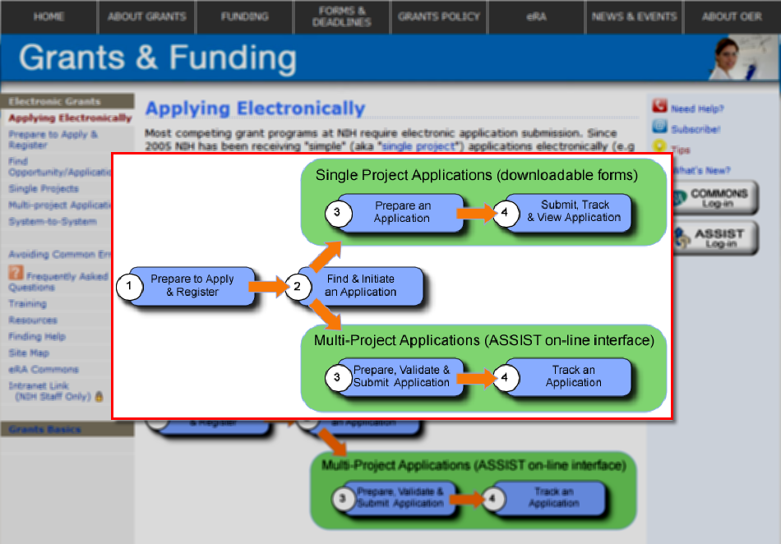
A Good Place to Start
http://grants.nih.gov/grants/ElectronicReceipt/

Slide 5
Two Systems Working Together
Grants.gov
The Federal government’s single online portal to find and apply for Federal grant funding.
Used by all 26 Federal grant-making agencies
eRA Commons
Allows applicants, grantees, and Federal staff to access, share and transmit information related to grant applications and awards.
Used by NIH and other HHS agencies
Important: Each system has its own registration and application requirements

Slide 6
Registrations - SAM
System for Award Management
Entity (i.e. organization) registration in SAM required prior to registering with Grants.gov
Replaced Central Contract Registry (CCR) registration
Must be renewed yearly
User guides, helpful hints and webinars available from the Help tab at www.sam.gov

Slide 7
Registrations – Grant.gov
Applicant organizations only
Authorized Organization Representatives (AORs) must be authorized to submit on behalf of organization
Registration user guides, tutorials, and checklists
http://www.grants.gov/web/grants/applicants/applicant-resources.html
No registration needed to find opportunities or download application forms

Slide 8
Registrations – eRA Commons
Applicant organization, Signing Official (SO) & Project Director/Principal Investigator (PD/PI)
Prepare to Apply and Register
http://grants.nih.gov/grants/ElectronicReceipt/preparing.htm#
Many organizations are already registered. Check with your Office of Sponsored Research.
New organizations should allow 6 weeks to complete registrations in all systems.

Slide 9
Obtain the needed software…
Version of Adobe Reader compatible with Grants.gov forms
http://www.grants.gov/web/grants/support/technical-support/recommended-software.html
PDF conversion software
NIH PDF guidelines and tips:
http://grants.nih.gov/grants/ElectronicReceipt/pdf_guidelines.htm
Web browser
eRA verifies service compatibility with IE and Firefox, however, many users also have success with other browsers

Slide 10
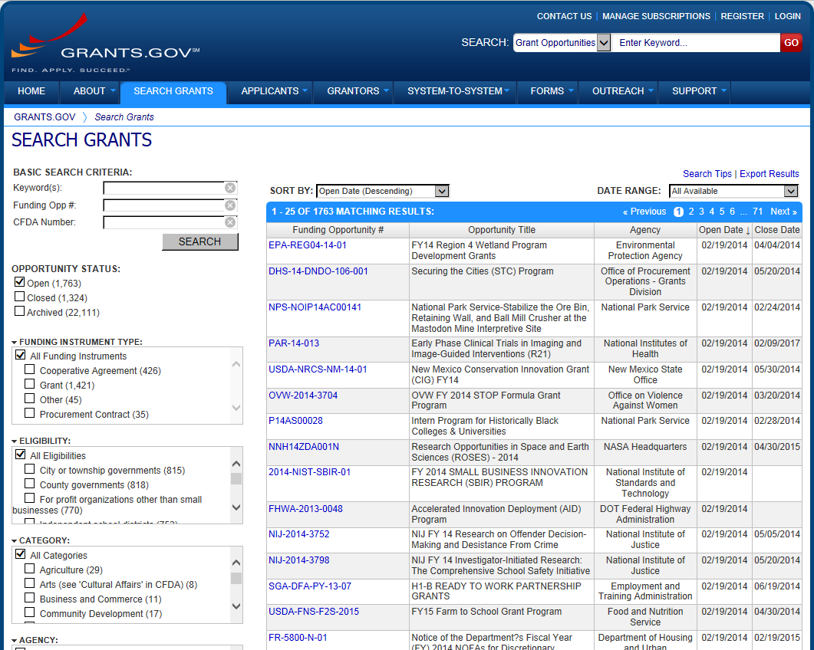
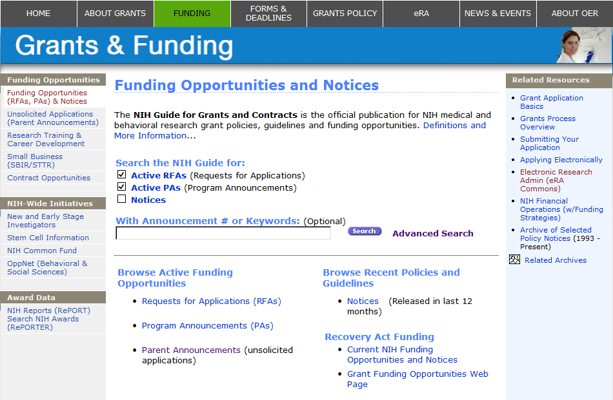
Find an Opportunity – 2 Places to Look
NIH posts Funding Opportunity Announcements (FOAs) on multiple sites:
NIH Guide for Grants and Contracts
Grants.gov

Slide 11
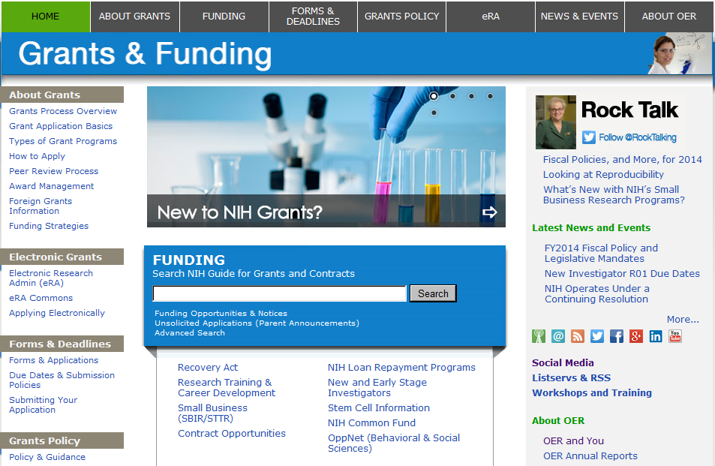
Find an Opportunity - NIH
Go to NIH Grants & Funding page
http://grants.nih.gov/grants
Search based on key word, activity code, or Institute or Center, or
Search for Unsolicited Applications by Parent Announcement

Slide 12
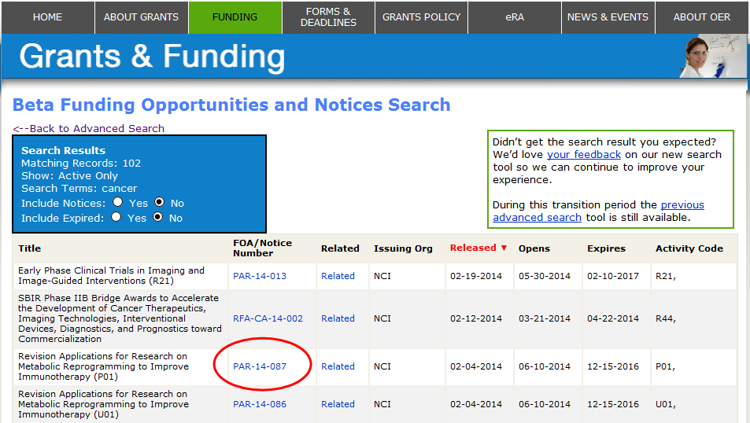
Finding FOAs in the NIH Guide
Review list of FOAs matching your criteria and find FOA of interest.
Click the FOA/Notice Number to access FOA Information

Slide 13
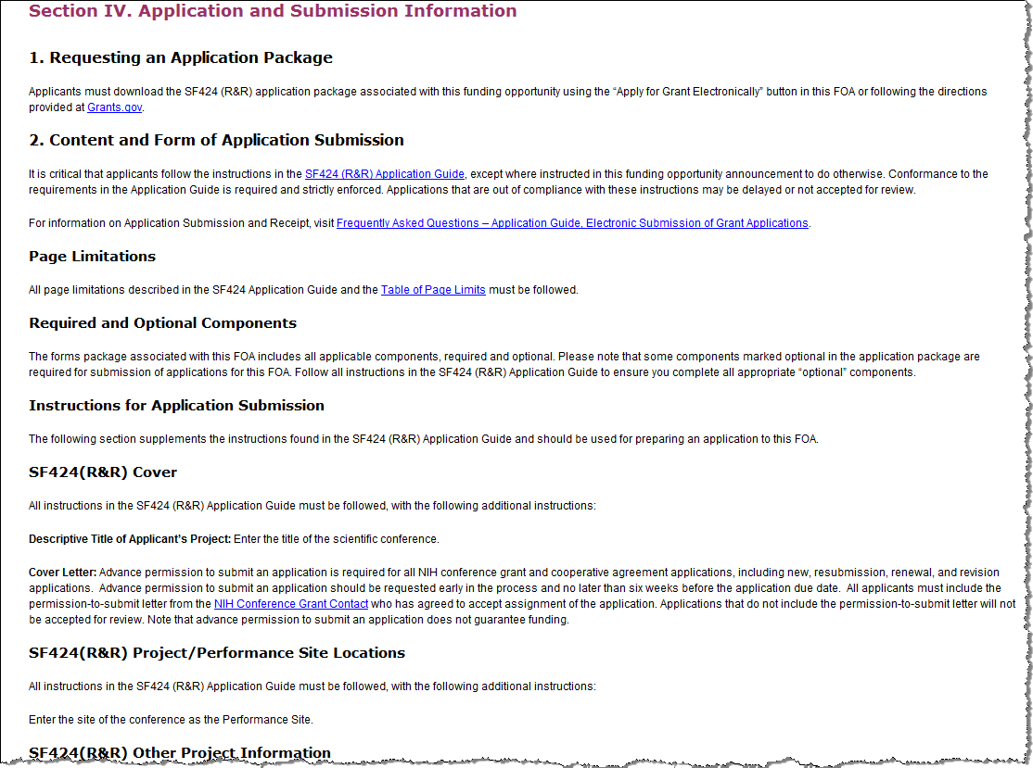
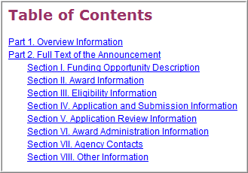
Read, Read, Read The Funding Opportunity Announcement
Pay special attention to Section IV. Application and Submission Information
Includes any FOA-specific submission instructions
Instructions in FOA win over instructions in the application guide

Slide 14
Download the FOA
Click Apply for Grant Electronically button found within the FOA in the NIH Guide
Use the Competition ID and Title to choose correct application forms, and
If given a choice, always select the more recent version of application forms

Slide 15
Download Application Instructions & Package

Slide 16
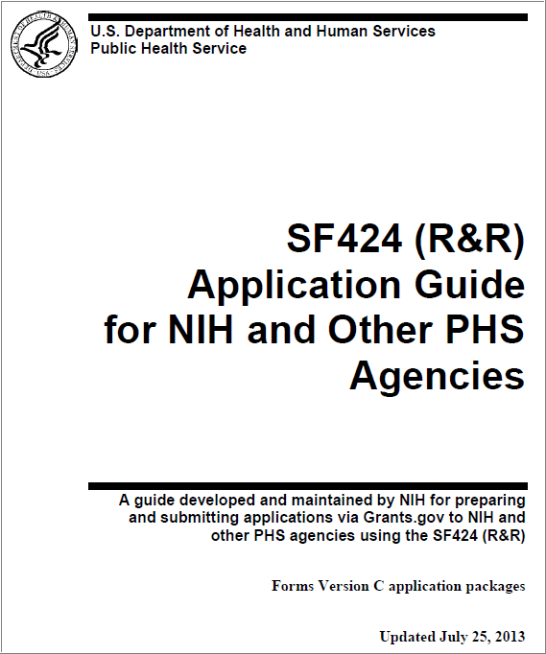
Application Guide
Read and follow application guide instructions
Agency-specific instructions are marked with the HHS logo
Remember to check for supplemental instructions

Slide 17
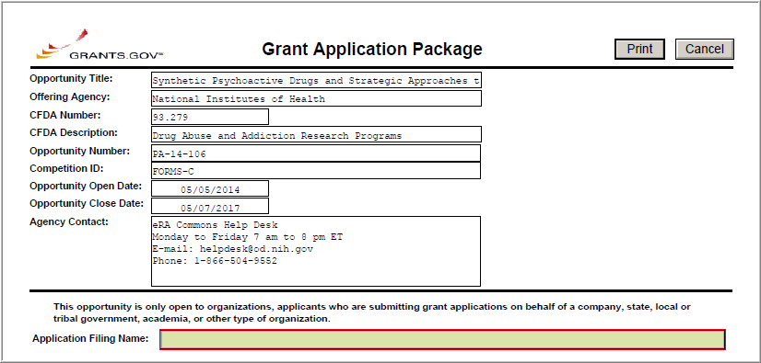
Grant Application Package – Required Fields
Mandatory Grants.gov fields highlighted with red box.

Slide 18
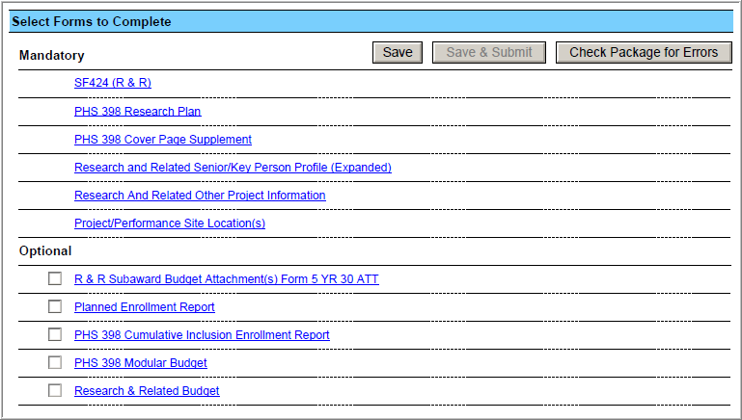
Grant Application Package – SF424
Complete the SF 424 (R&R) form first—info from this form pre-populates fields in other forms in the package
Save locally
See application guide to determine which Optional documents you need to complete

Slide 19
Completing The Application
Take advantage of available resources:
Annotated form sets, tip sheets, quick reference guides:
http://grants.nih.gov/grants/ElectronicReceipt/communication.htm
Avoiding Common Errors page
http://grants.nih.gov/grants/ElectronicReceipt/avoiding_errors.htm
FAQs
http://grants.nih.gov/grants/ElectronicReceipt/faq_full.htm
READ & FOLLOW APPLICATION GUIDE & FOA INSTRUCTIONS!

Slide 20
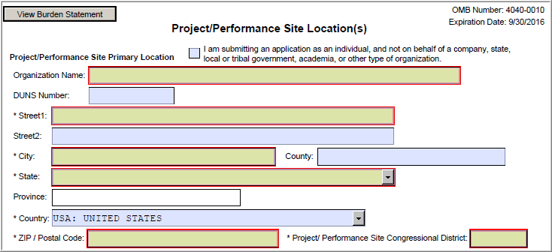
Avoiding Common Errors
Watch for fields that are required by NIH but not marked required on federal-wide forms.
Primary Project/Performance Site DUNS is not required by Grants.gov, but is required by NIH for federal reporting

Slide 21
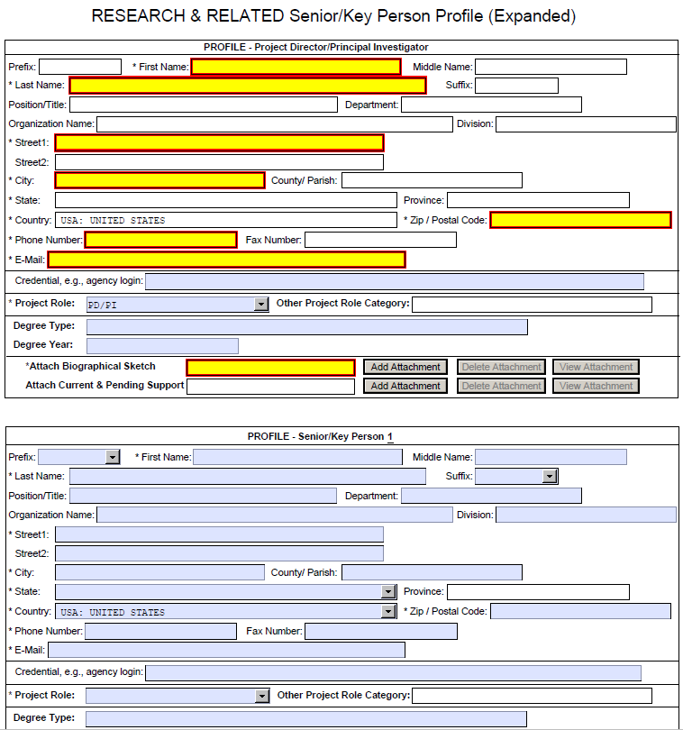
Avoiding Common Errors – Other NIH Required Fields
eRA Commons Username must be supplied in Credential field for all PD/PIs in the application
Organization name is used to determine reviewer conflicts and is required for all Sr/Key entries

Slide 22
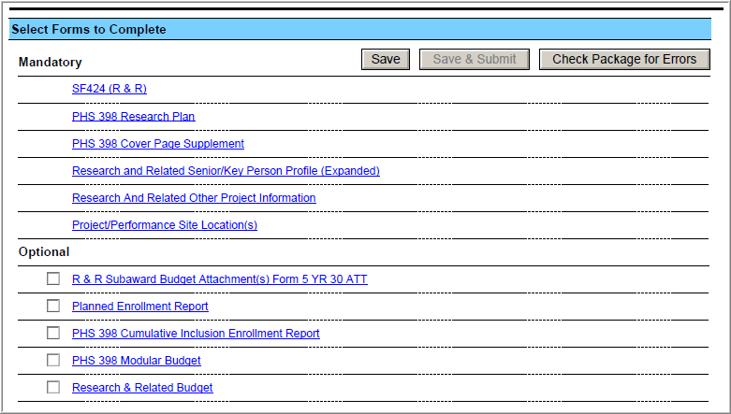
Get Ready to Submit
Save & Submit button will not become active until application is saved and information required by Grants.gov is completed
Check Package for Errors button only checks a subset of Grants.gov rules. Additional Grants.gov and agency business rules are checked after submission.

Slide 23
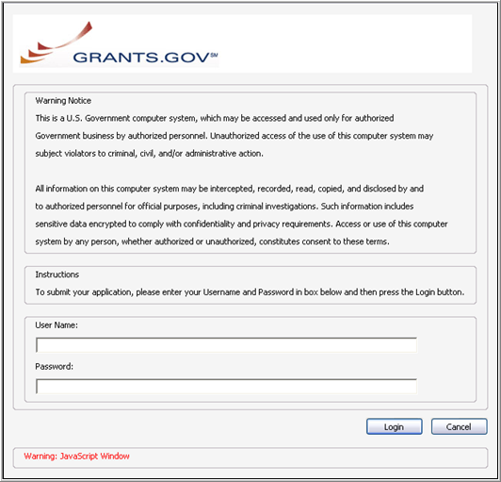
AOR - Submit Application
Only AORs can submit!
AOR credentials are used for the official electronic signature for the application.
AOR must have 'signature' authority.

Slide 24
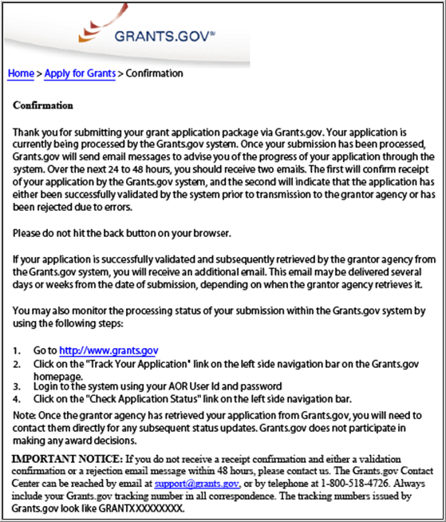
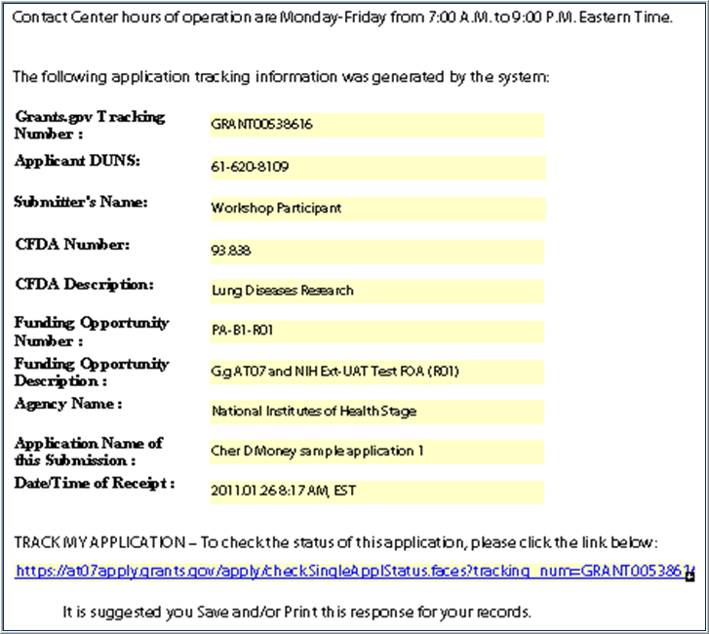
AOR – Confirmation of Submission
Print and save your confirmation screen information.
Note the Grants.gov Tracking Number
Note the Date/Time Stamp used to confirm 'on-time' submission

Slide 25
On-Time Submission
Error-free applications must be accepted by Grants.gov with a time stamp on or before 5:00 p.m. local time of the submitting organization on the due date.
A few important reminders:
NIH recommends submitting early (days, not minutes!) to allow time for correcting any errors found during the application viewing window prior to the due date
NIH’s late policy does not allow corrections after the due date

Slide 26
Trouble Submitting Due to System Issues?
When SAM, Grants.gov or eRA system issues threaten your on-time submission…Contact appropriate support team to try to get resolution.
If working with SAM and/or Grants.gov, contact eRA Commons Help Desk to document issue and steps taken toward resolution
If the eRA Commons Help Desk verifies that a system "bug" or service interruption has occurred, they will provide instructions to complete the submission
Document your issues and corrective actions including support ticket numbers in cover letter
Guidelines for Applicants Experiencing System Issues: http://grants.nih.gov/grants/ElectronicReceipt/support.htm#guidelines

Slide 27
Track the Application
Submitting your application to Grants.gov is NOT the last step!
Signing Officials (SOs), Principal Investigators (PD/PIs) and delegated Assistants (ASSTs) can track application status in the eRA Commons

Slide 28
Tracking Your Application in eRA Commons
Commons “Status” is an integral part of electronic application submission:
Applications are retrieved from Grants.gov by eRA Commons and checked against NIH application and funding opportunity instructions
Processing results are available to SOs, AOs, PIs and delegated ASSTs in eRA Commons Status
E-mail notifications concerning processing results are sent

Slide 29
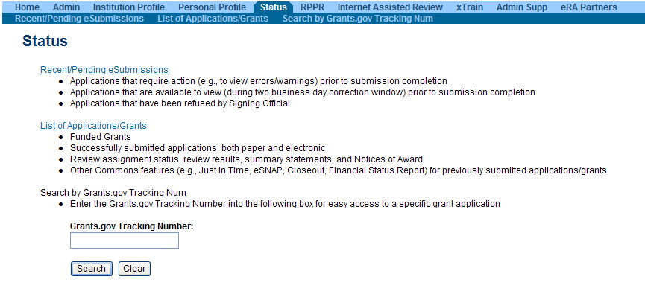
Tracking Your Application in eRA Commons Via Status
Log into Commons
Click on Status tab
Click either:
Recent/Pending eSubmissions
Or provide Grants.gov tracking number from email confirmation

Slide 30
Track Status in eRA Commons - PD/PI
Search table will display recently submitted applications
eSubmission Status column indicates if there were submission errors
Show Prior Errors and Warnings link opens a document with the list of errors and warning for each submission attempt.

Slide 31
Track Status in eRA Commons – Errors and Warnings
Errors stop application processing and must be corrected before submission deadline
Warnings do not stop application processing and are corrected at the discretion of the applicant
All corrective submissions must be made by the submission deadline in order for the submission to be considered on time!
Avoiding Common Errors page: http://grants.nih.gov/grants/ElectronicReceipt/avoiding_errors.htm
Annotated Forms:
http://grants.nih.gov/grants/ElectronicReceipt/communication.htm#forms
Full list of Commons Validations:
http://grants.nih.gov/grants/ElectronicReceipt/validations.htm

Slide 32
View Application Image in eRA Commons
Once an error-free application is received by NIH, the eRA system will:
Assemble the grant application image
Insert headers (PI name) and footers (page numbers) on all pages
Generate Table of Contents and bookmark important sections
Post the assembled application image in the PD/PI’s eRA Commons account

Slide 33
Application Viewing Window
Applicants have two (2) business days to view the assembled application image before the application automatically moves forward for further processing
SO can Reject application within viewing window and submit a Changed/Corrected application prior to the due date
If you can't VIEW it,
we can't REVIEW it!

Slide 34
Status - View Application Image
Log into Commons
Click on Status tab
Click either:
Recent/Pending eSubmissions
Or provide Grants.gov tracking number from email confirmation
Click on the Application ID link
On detailed Status Information page, click the e-Application link under Other Relevant Documents

Slide 35
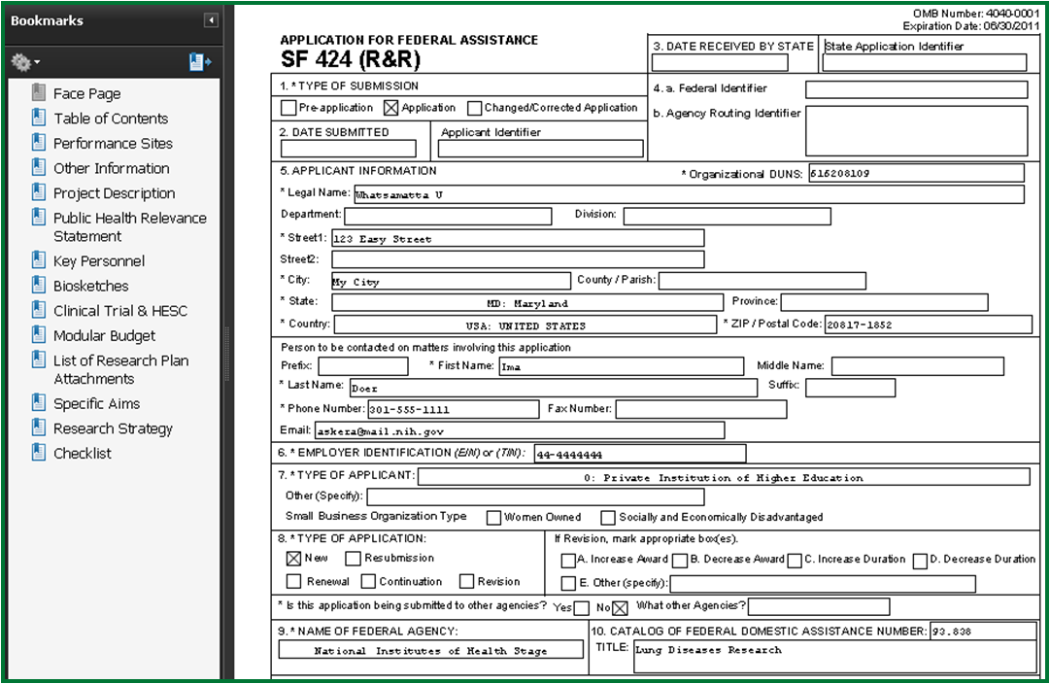
Status - e-Application
Carefully review the entire application. This is your chance to view and print the same application image that will be used by Reviewers!

Slide 36
Submission Complete!
If no action is taken during the two business day viewing window, the application automatically moves forward for further processing at NIH
Any subsequent application changes are subject to the NIH policy on late submission of grant applications and the NIH policy on post-submission application materials

Slide 37
Grant Administration in eRA Commons
My application is submitted......now what do I do?
eRA Commons Features
Profiles (Personal and Institutional)
Application and Award Tracking (Status)
Just-In-Time (JIT)
Internet Assisted Review (IAR)
Research Performance Progress Report (RPPR)
Administrative Supplements (Type 3)
Federal Financial Report (FFR)
No-cost Extension (NCE)
Closeout
xTrain
Financial Conflict of Interest (FCOI)

Slide 38
Institutional Profile (IPF)
The Institutional Profile:
Contains information necessary to facilitate processing and review of grant applications submitted by an institution
Is a central repository of information for Commons-registered organizations
Contains data established and maintained by Signing Officials at the organization. Only SOs can edit information in the IPF
It includes information such as:
Preferred institution name and contact information
Signing Official’s name, e-mail, and phone number
Institutional DUNS number
Institutional Assurances
E-mail addresses to receive Notice of Award and other notifications

Slide 39
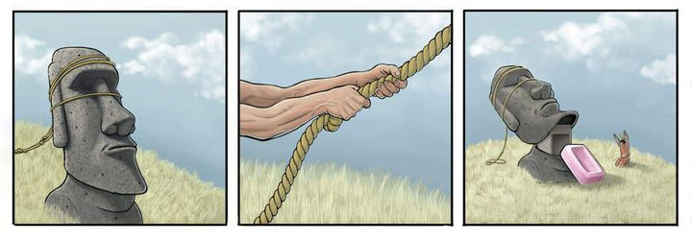
Personal Profile (PPF)
The Personal Profile includes information such as:
Name, race/ethnicity, date of birth, contact information
Employment history
Reviewer work address
Degrees earned
Personal Profile maintenance:
Individual Commons users are responsible for keeping their information accurate and up-to-date.
Commons will require a change of password every 90 days for security reasons.
Note: Always keep your e-mail address up to date. E-mail addresses are used to retrieve forgotten passwords and as the primary source of communicating grants-related information.

Slide 40
Establishing Institution Workflow
eRA Commons allows many functions to be delegated to other registered Commons users (e.g., Assistants with the ASST role).
Delegate Progress Report
Delegate PPF Edit
Delegate Status
Delegate xTrain Authority
Delegate Sponsor
Delegate FCOI
Delegate Submit

Slide 41
Status in eRA Commons
eRA Commons Status allows users to:
Track the status of grant applications through the submission process
View assembled application images
View Notices of Award and other key documents
Perform several additional post-submission and post-award transactions
User capabilities:
Remember: The functions available to a user are based on the role(s) associated with his or her Commons account!

Slide 42
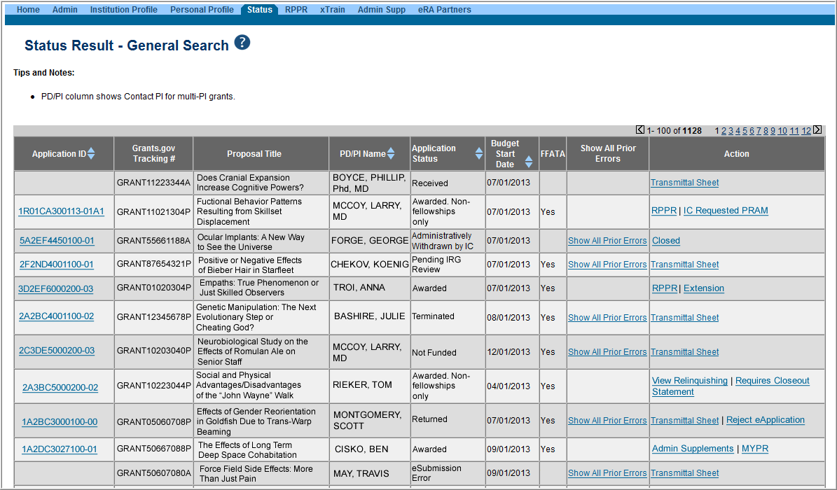
Status Result - General Search
Click App ID link for Detailed Status Information
Action links: RPPR, JIT, Extension, etc.
Status is your link to the Action!

Slide 43
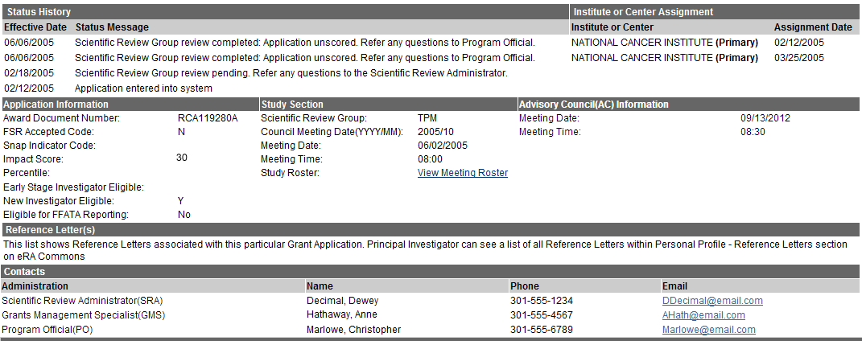
Track Assignment Information in Detailed Status
You can find information about:
Primary institute the application is assigned to
Study Section Assignment
Key NIH Contact Information

Slide 44
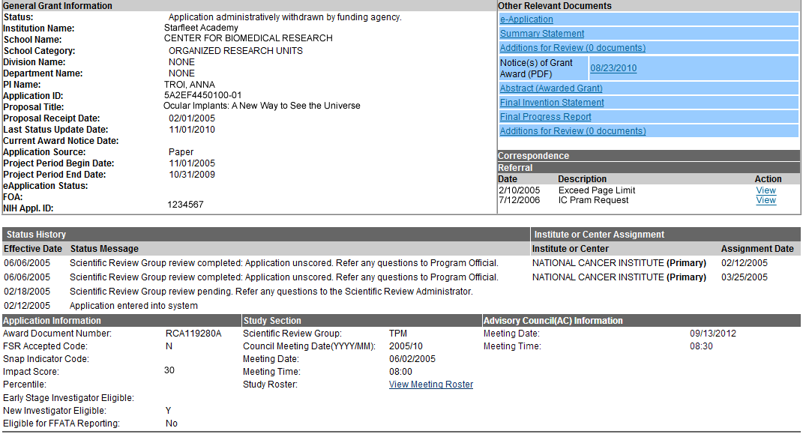
Track Review Outcome
Check Summary Statement, Priority Score and Percentile Information from detailed Status Screen

Slide 45
Just In Time Submission (JIT)
Allows PD/PIs, AOs, and SOs to prepare and SOs to submit additional grant application information requested by NIH prior to an award decision
Other Support, IRB and/or IACUC Approval Dates, Human Subjects Education info
Not an indication that application will be awarded
Wait for a request from NIH to submit the information
System-generated e-mail or contact from the Grants Management Specialist (GMS)
You may submit JIT info piece by piece!

Slide 46
Research Performance Progress Report (RPPR)
The RPPR is required for all awards issued under the Streamlined Non-competing Award Process (SNAP), and all F awards, with budget start dates on or after July 1, 2013.
Starting April 25, 2014, RPPR was made available for all Type 5 non-SNAP progress reports. See NOT-OD-14-079 for more information.
NIH anticipates piloting the RPPR for non-SNAP awards in calendar year 2013. Paper submissions of the PHS 2590 for non-SNAP awards and all Training awards will be accepted until further notice.
RPPR Resources
RPPR Page: http://grants.nih.gov/grants/rppr/
Background Information
RPPR Instruction
GuideScreen shots
Archive training webinars
Relevant Guide Notices

Slide 47
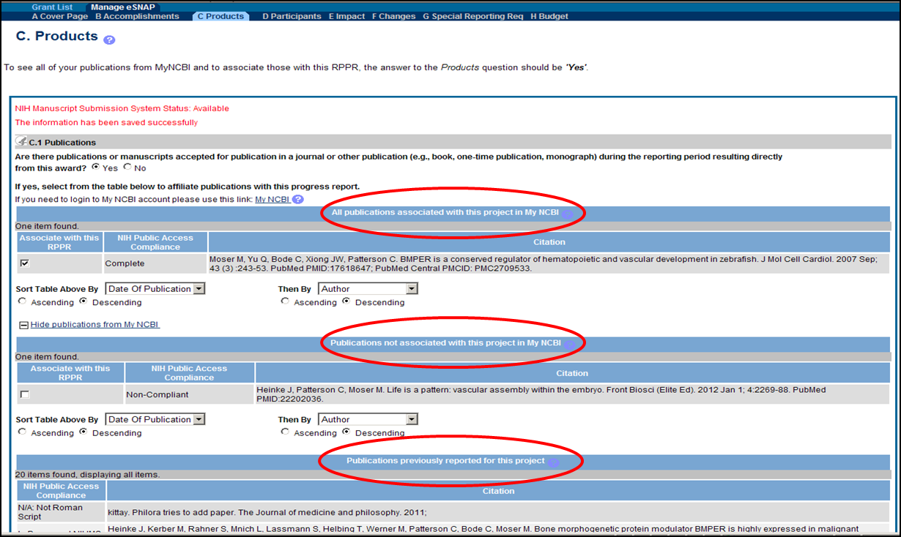
My Bib Publications in Progress Report
Products screen shows MyNCBI publications that can be associated with a RPPR report.
For more My NCBI & My Bib info: http://era.nih.gov/ncbi/ncbi_overview.cfm

Slide 48
Administrative Supplements - eRA Commons
Starting an Administrative Supplement in Commons you must find eligible grant and Initiate Request.

Slide 49
Federal Financial Report (FFR)
Replaces the Financial Status Report (FSR) for the reporting of expenditure data elements
Same data elements as the FSR, except only cumulative data is reported
Due date for annual FFRs is 90 days after the end of the calendar quarter in which the budget period ends
FFRs must be submitted in eRA Commons via the FFR/FSR module
For more about FFR/FSR, view the NIH Guide Notice
and the eRA Overview:
http://grants.nih.gov/grants/guide/notice-files/NOT-OD-11-017.html http://era.nih.gov/services_for_applicants/reports_and_closeout/financial_status_report.cfm

Slide 50
Financial Conflict of Interest (FCOI)
FCOI allows grantee institutions to:
Initiate and prepare a FCOI report
Submit the FCOI report and supporting documents electronically to Agency
Can provide comments to Agency
System accommodating new regulations
Changes accommodate annual requirements and inclusion of Significant Financial Interests and their values

Slide 51
Financial Conflict of Interest (FCOI) Part 2
Commons FCOI integration with internal (NIH) FCOI tracking system
Commons FCOI and Internal FCOI systems will share information once daily
Internal FCOI users can request additional information and rescind reports
Report to institution made from internal FCOI system and also is reflected in Commons FCOI history

Slide 52
xTrain
xTrain uses:
Required for NIH grantees to prepare and submit appointments and termination notices for research training and career development awards, fellowships, and research education awards
Grantee institution staff use xTrain to:
Create, route and submit appointments, re-appointments, amendments and termination notices
Track the status and timing of training actions

Slide 53
Types of Grants Supported in xTrain
Kirschstein-NRSA Undergraduate Institutional Training Grants (T34)
Kirschstein-NRSA Pre-doctoral and Post-doctoral Institutional Training Grants (T32, T35, T90, TL1, TU2)
Kirschstein-NRSA Fellowships (F30, F31, F32, F33)
NLM Institutional Training Grants (T15)
Research Education Awards (RL5, RL9, R25, R90)
Institutional Career Development Grants (K12, KL2, KM1)
CDC/OSHA Training Grants (T01, T02, T03, T42)
xTrain resources and training materials available at: http://era.nih.gov/training_career/index.cfm

Slide 54
No-cost Extension
No-cost Extension (NCE) allows SOs to:
Electronically submit a notification to exercise one-time authority to extend without funds the final budget period of a project period of a grant
NCE link appears 90 days before the end of the project period
SO (only) can extend project period up to 12 months
E-mail notification sent to NIH Grants Management staff when SO processes the extension

Slide 55
No-cost Extension Link
Status Result - General Search screen shows grants that may be extended one time via a No-cost Extension (see Extension hyperlink in Action column).

Slide 56
Closeout
Closeout allows grantees to:
Electronically submit required Closeout documents for grants in Closeout status
NIH GM Specialist must mark the grant “ready for close out” for link to appear in Commons
Contact assigned GMS if link is not appearing
Required Closeout items include:
Federal Financial Report (FFR)
Final Progress Report
Final Invention Statement

Slide 57
Closeout Link
Closeout Search screen shows grants that are Closed or Requires Closeout

Slide 58
The Real Treasure.... Having Help
Website Links
NIH About Grants website:
http://grants.nih.gov/
Electronic Research Administration:
http://era.nih.gov/
NIH Applying Electronically website:
http://grants.nih.gov/grants/ElectronicReceipt/index.htm
eRA Commons:
https://public.era.nih.gov/commons/

Slide 59
Subscription Lists
Subscribe for eSubmission/Commons News & Updates
http://grants.nih.gov/grants/ElectronicReceipt/listserv.htm
Subscribe for weekly e-mails of new postings in NIH Guide for Grants and Contracts:
http://grants.nih.gov/grants/guide/listserv.htm

Slide 60
System for Award Management (SAM):
For help with the registering your organization, entity management, e-Business Point of Contact, and renewals that must be done yearly.
Check Federal Service Desk Website:
www.fsd.gov
SAM Contact Information
Contact Center Phone: 866-606-8220
Business Hours: Monday – Friday 8:00 a.m. to 8:00 p.m. ET (closed on Federal Holidays)

Slide 61
Grants.gov:
For help with the Grants.gov registration process, downloading forms, form behavior or with technical aspects of submitting through the Grants.gov system:
Check the Grants.gov Website: www.grants.gov
Grants.gov Contact Center
Contact Center Phone: 1-800-518-4726
Business Hours: 24 hours/day; 7 days/week
(closed on Federal Holidays)
E-mail: support@grants.gov

Slide 62
eRA Commons:
For help with eRA Commons registration or system validations after submission through Grants.gov:
Check the eRA Commons Website:
https://public.era.nih.gov/commons/
eRA Commons Help Desk
Web support:
http://grants.nih.gov/support/
Phone: 301-402-7469
Toll Free: 866-504-9552
Business hours: Mon.–Fri. , 7 a.m.– 8 p.m. ET

Slide 63
Grants Info:
For help with grant policy, application content requirements and other general inquiries:
Review the Application Instruction Guide
Review the FOA
Phone: 301-435-0714
E-mail: GrantsInfo@nih.gov

