Slide 1

New PHS
Human Subjects and Clinical Trials Information Form
Preview of coming changes

Slide 2
Disclaimer
This resource is:
  A representation of the data items collected in the new PHS Human Subjects and Clinical Trials Information form
  Continuously evolving as we work through implementation details
This resource is NOT:
  A representation of the final look and feel of the form based on a pre-implementation form mock-up

Slide 3
Goals
Consolidation of human subjects, inclusion enrollment, and clinical trial information previously collected across multiple agency forms
Expansion and use of discrete form fields for clinical trial information to
  provide the level of information needed for peer review;
  lead applicants through clinical trial information collection requirements;
  present key information to reviewers and agency staff in a consistent format; and
  align with ClinicalTrials.gov (where possible) and position us for future data exchange with ClinicalTrials.gov

Slide 4
Getting Acclimated to New Form
New form included in all applications (whether or not human subjects or clinical trials are involved)
Collects study level information
Required form fields vary based on a number of factors, including:
  Whether study is delayed onset
  Announcement-specific instructions
  Human subject exemptions
  Whether study involves a clinical trial

Slide 5
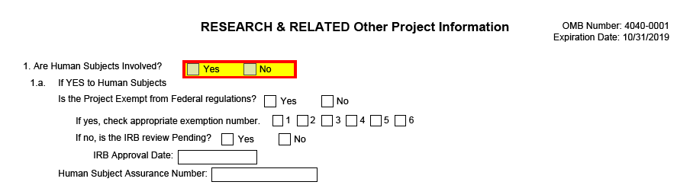
Research & Related Other Project Information Form
NIH will continue to collect some application level Human Subjects information on the Research & Related Other Project Information form
  Used federal-wide, not within NIH control to remove Human Subjects questions from this form to our new PHS Human Subjects and Clinical Trials Information form

Slide 6
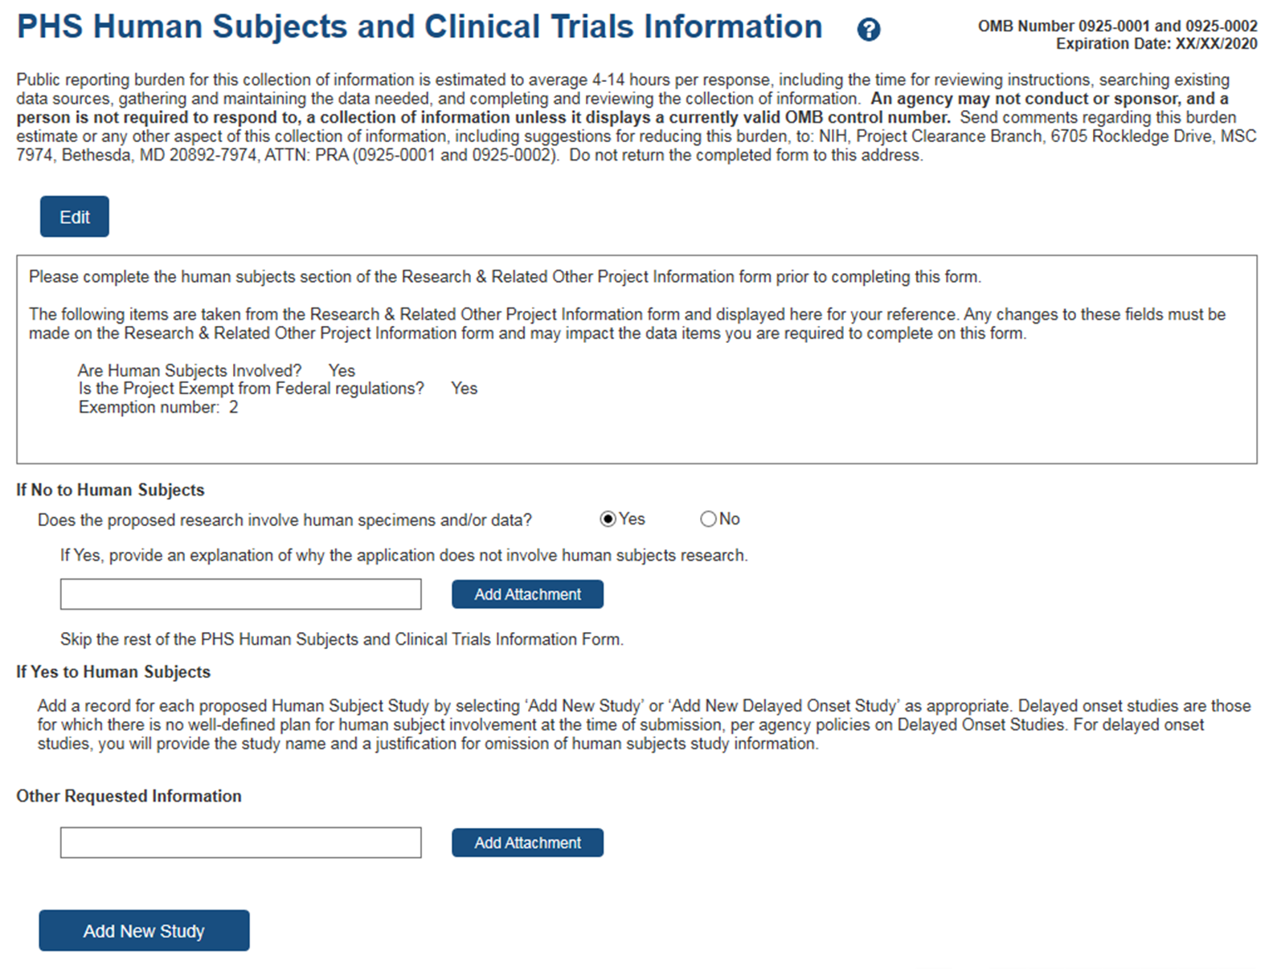
When Human Subjects = No
Form is included in each application even when Human Subjects (HS) = No on Research & Related Other Project Information form
No
No
Information populated from R&R Other Project Information form for reference.
When HS=No applicants answer a single question and associated attachment and are done with this form.
Attachment available regardless of whether Human Subjects = Yes or No.

Slide 7
When Human Subjects = Yes
When HS= Yes on Research & Related Other Project Information form applications must include one of the following:
  1 or more full study records, OR
  1 or more delayed onset study records, OR
  A combination of full and delayed onset study records

Slide 8
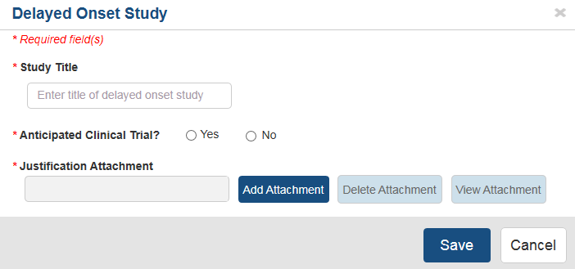
Delayed Onset Studies
Delayed onset - no well defined plan for human subject involvement at time of application
  Does NOT mean delayed start of study
  Minimal data collection
    Must justify why full study information can not be provided

Slide 9
When Human Subjects = Yes (not delayed onset)
Full study records require quite a bit of data
  New data collection leads applicants through clinical trial information collection requirements
  Data collection expanded for new policies
    Use of Single IRB for Multi-Site Research (NOT-OD-16-094)
    Dissemination of NIH-Funded Clinical Trial Information (NOT-OD-16-149)
Add up to 150 study records

Slide 10
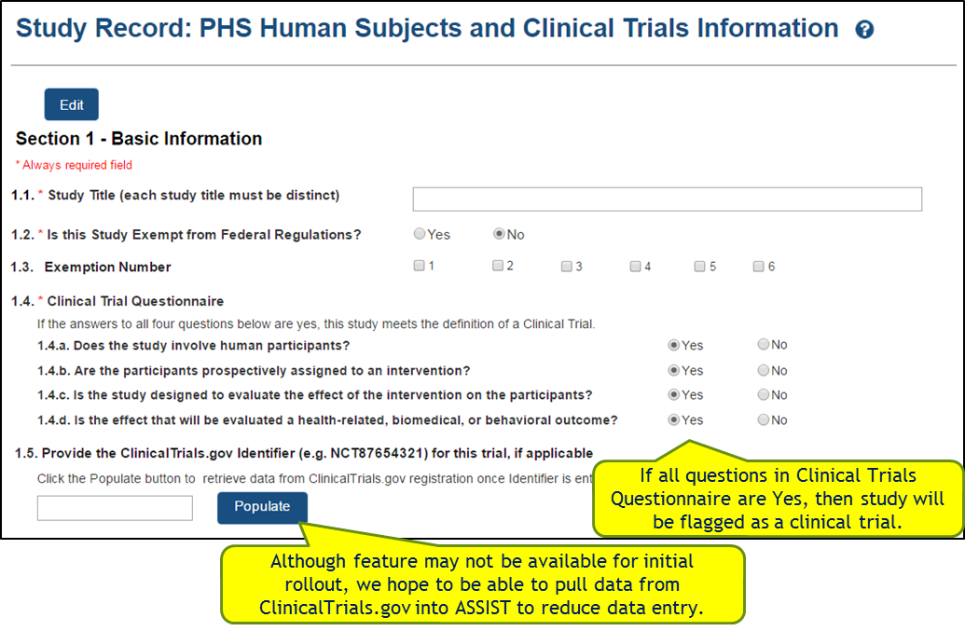
Study Record: Section 1 – Basic Information

Slide 11
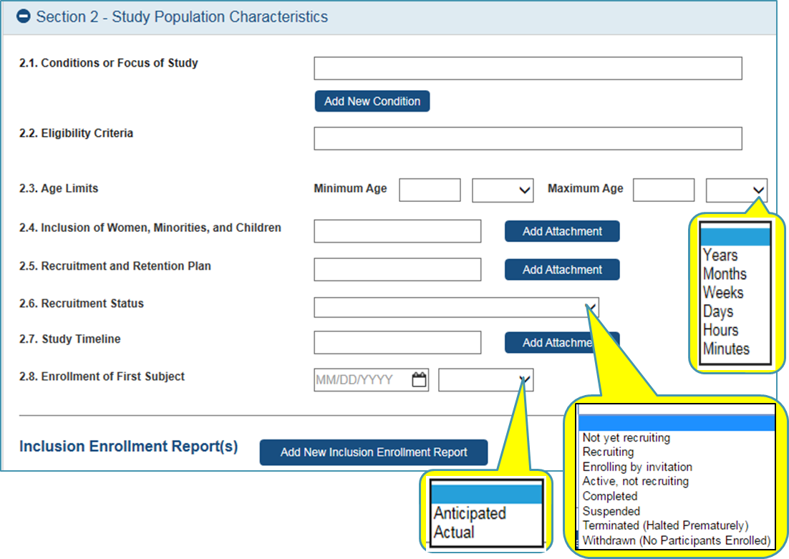
Study Record: Section 2 – Study Population Characteristics

Slide 12
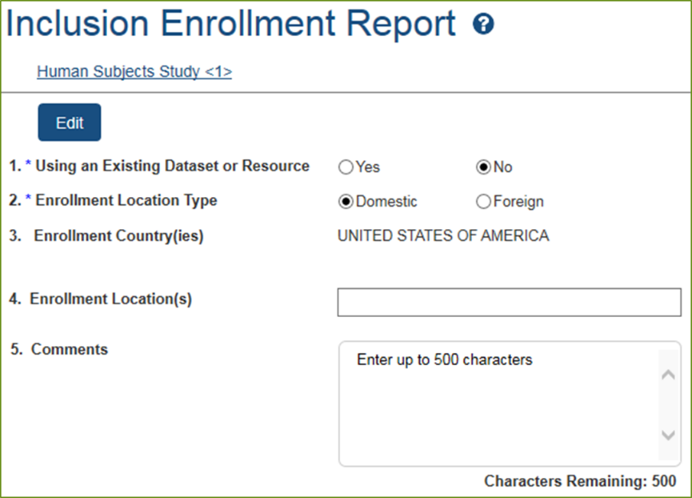
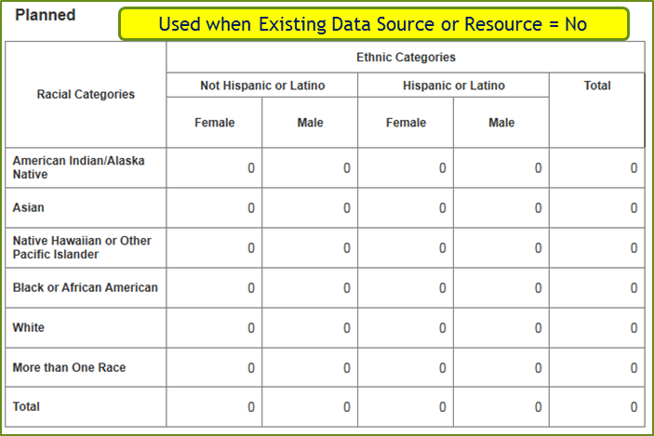
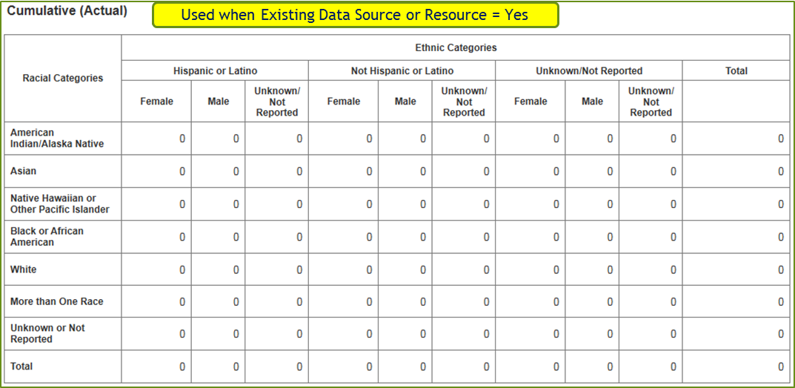
Inclusion Enrollment Report

Slide 13
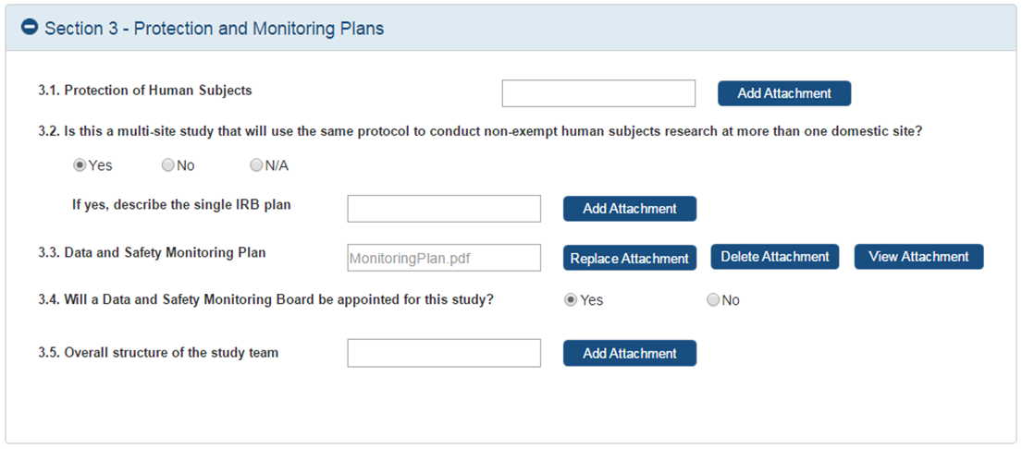
Study Record: Section 3 – Protection and Monitoring Plans

Slide 14
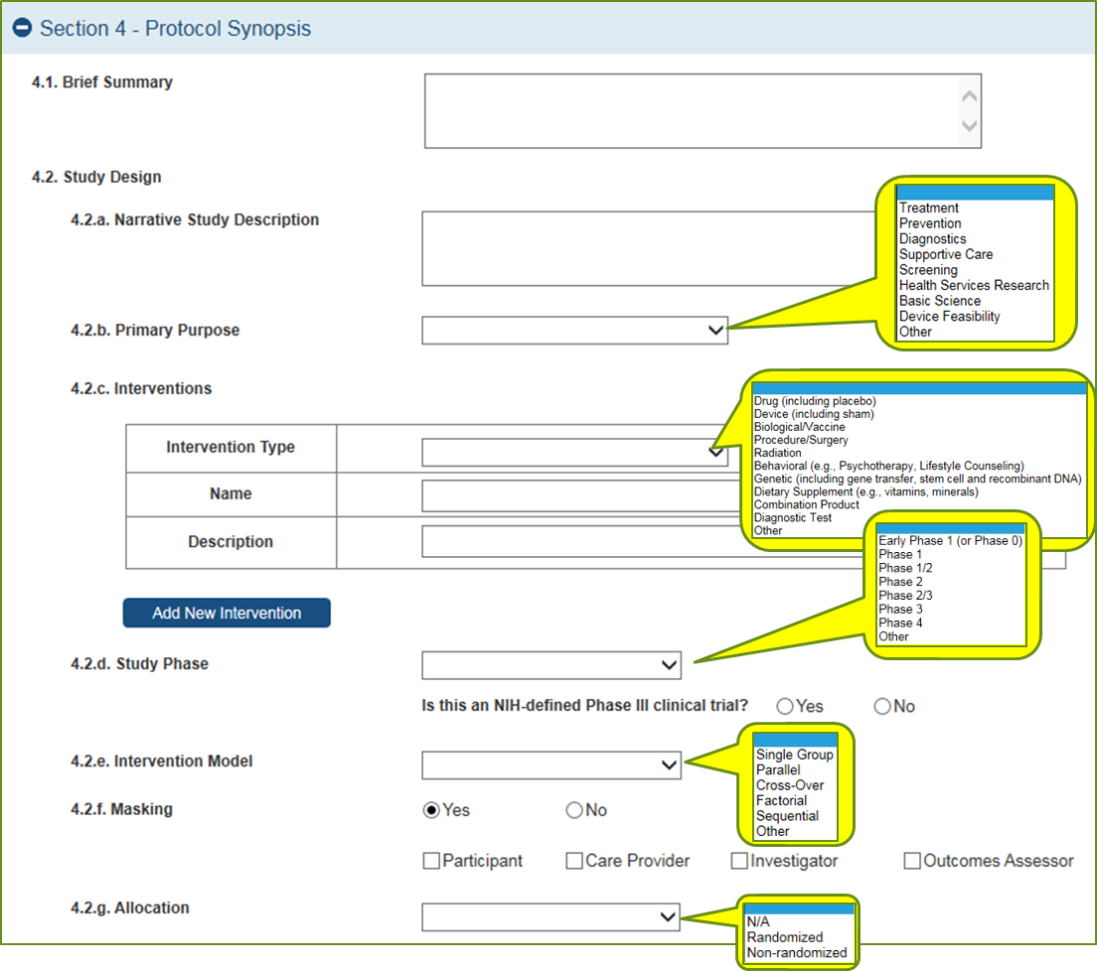
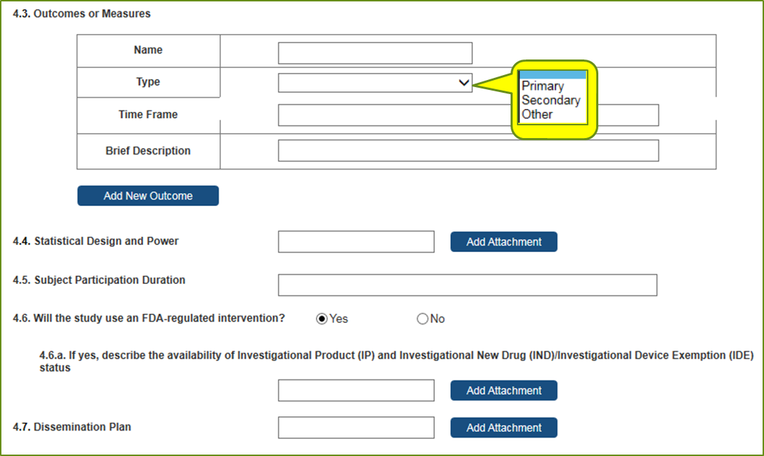
Study Record: Section 4 – Protocol Synopsis

Slide 15
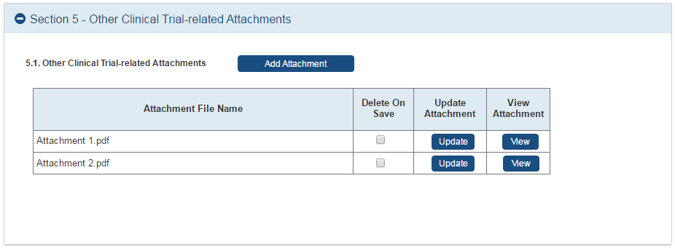
Study Record: Section 5 – Other Clinical Trial-related Attachments

Slide 16
Implementation Notes
All clinical trial applications must apply to announcements specifically designed for clinical trials
  NOT-OD-16-147
  Existing clinical trials announcements will expire on or before Jan. 24, 2018
New clinical trials FOAs will be posted starting in October 2017 for due dates on or after Jan. 25, 2018
Since all applications will use the new form, all active announcements will be updated with new form sets (FORMS-E) for due dates on or after Jan. 25, 2018

