Slide 1
Data & Resource Sharing:
Firming Foundations
For Future Frontiers
NIH Virtual Seminar
NIH Office of Extramural Research (OER)
November 4, 2021

Slide 2
Presenting Today
Julia Slutsman, PhD
Director, Genomic Data Sharing Implementation
julia.slutsman@nih.gov
J.P. Kim, JD, MBA, MSc, MPP, MA
NIH Extramural Data Sharing Policy Officer
jpkim@nih.gov
Nonye Harvey, DrPH, MPH
Health Science Policy Analyst
harveyn@mail.nih.gov
Office of Extramural Research (OER),
Office of the Director (OD),
National Institutes of Health (NIH), HHS
GDS@mail.nih.gov

Slide 3
Overview
Background for NIH data sharing initiatives and focus on selected policies
Refresher: NIH Research Tools Policy and 2003 Data Sharing Policy
Overview: NIH Genomic Data Sharing (GDS) Policy
Evolution of Agency-Wide Access for Federally Funded Research Results
Update: Final NIH Policy on Data Management and Sharing (DMS)

Slide 4
UPCOMING SESSION: Data Management and Sharing Policy
AFTER-HOURS CONVERSATIONS - Auditorium A
Update on Implementation of the New Data Management and Sharing (DMS) Policy
Thursday November 4, 2021
5:00 – 5:45 PM

Slide 5






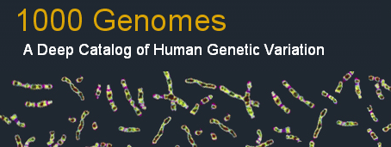




NIH Commitment to & Investment in Data Sharing
  “Consistent with both the NIH mission to improve public health through research and its longstanding legislative mandate to make available to the public the results of the research activities that it supports and conducts….”
  https://grants.nih.gov/grants/guide/notice-files/NOT-OD-07-013.html

Slide 6
NIH’s Data Sharing Initiatives & Milestones
NIH Intramural Human Data Sharing Policy
HHS Rule and NIH Policy on Clinical Trial Results Dissemination
White House Initiative
NIH Data Sharing Policy
Genome-wide Association (GWAS) Policy
Big Data to Knowledge (BD2K) Initiative
Genomic Data Sharing (GDS) Policy
All of Us Research Program
(RFI) on Proposed Provisions for a Draft Data Management and Sharing (DMS) Policy
Model Organism Policy
Research
Tools Policy
NIH Public Access Policy (Publications)
NCI Cancer Moonshot
NIH Data Commons Pilot
NIH Data Management and Sharing (DMS) Policy Effective
Modernization of NIH Clinical Trials
1999
2003
2004
2007
2008
2012
2014
2015
2016
2017
2019
*2020- 2022
2023
*DMS Final policy
Released Fall 2020
Implementation 2021-2022

Slide 7
Some Shared Challenges…
Time and effort
  Cost and burden
Requires infrastructure
Human Resources
Policy coordination among
key stakeholders
  Across agencies, funders, publishers
Ethical, Legal, and Social Implications and Privacy Issues
  DUAs, Data security even if de-identified data
Limited training
Lack of rewards and incentives
Proprietary interests / Culture shift
  Institutions/Investigators want to maintain competitive advantage
Compliance and Enforcement
  Especially after the award has ended
    What are the NIH data sharing policies?
    What are their requirements?
    How do they apply?

Slide 8


Goals of Data Sharing
Advance rigorous and reproducible research
Enable validation of research results
Make high-value datasets accessible
Accelerate future research directions
Increase opportunities for citation and collaboration
Promote public trust in research
Foster transparency and accountability
Demonstrate stewardship over taxpayer funds
Maximize research participants’ contributions
Support appropriate protections of research participants’ data

Slide 9
Research Tools Policy (1999) and 2003 Data Sharing Policy

Slide 10
NIH Research Tools Policy
NIH Research Tools Policy
“Sharing Biomedical Research Resources: Principles and Guidelines for Recipients of NIH Research Grants & Contracts” (1999)
Principles
Ensure Academic Freedom and Publication
Ensure Appropriate Implementation of the Bayh-Dole Act
Minimize Administrative Impediments to Academic Research
Ensure Dissemination of Research Resources Developed With NIH Funds
Guidelines
Appendix: Guidelines for Disseminating Research Resources Arising Out of NIH-Funded Research

Slide 11
2003 NIH Data Sharing Policy
NIH Data Sharing Policy of 2003
  Issued February 26, 2003
  For applications received on or after October 1, 2003 (until January 24, 2023)
  For funding applications (grants, contracts, cooperative agreements) requesting $500K or more in direct costs in any given year
  Expects a data sharing plan or state why data sharing is not possible
  NIH expects "the timely release and sharing" to be no later than the acceptance for publication of the main findings from the final data set

Slide 12
NIH Genomic Data Sharing Policy (2015)

Slide 13

NIH Genomic Data Sharing (GDS) Policy
Purpose
  Sets expectations and responsibilities for investigators and institutions to ensure broad, responsible, and timely sharing of genomic research data
Scope
  Applies to all NIH-funded research generating large-scale human or non-human genomic data and secondary research using these data
  Applies to all funding mechanisms (grants, contracts, intramural support) regardless of cost
Effective January 25, 2015
    NIH Intramural – August 31, 2015

Slide 14

Categories of Genomic Data
Two-tiered access for human data:
  Unrestricted-access: Data are publicly available to anyone (e.g., The 1000 Genomes Project)
  Controlled access: Investigators must obtain approval from NIH Data Access Committees (DACs) to use data from NIH-designated data repositories (e.g., dbGaP)

Slide 15
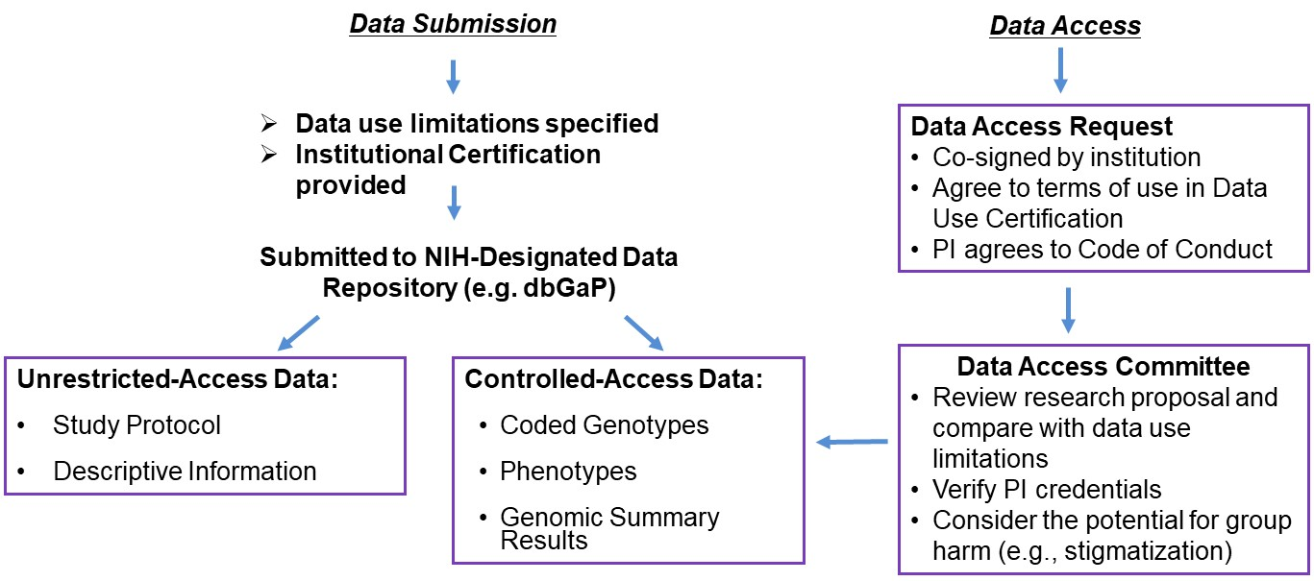
Process for Submitting or Accessing Data

Slide 16

PI and Institutional Responsibilities When Accessing/Using Data
To be approved for access, PIs submit a Data Access Request co-signed by their Institutional Signing Official agreeing to the Data Use Certification and Addendum
In the Data Use Certification & Addendum PIs agree to these terms and conditions:
  Use the data only for the approved research
  Protect data confidentiality
  Follow applicable laws, regulations, and policies for data use
  Not to attempt to re-identify individual participants
  Share the data only with individuals listed in the data
  access request
  Report immediately any GDS Policy violations
  to the appropriate NIH Data Access Committee
  Provide annual updates to NIH on research

Slide 17
Evolution of Agency-Wide Access for Federally Funded Research Results

Slide 18
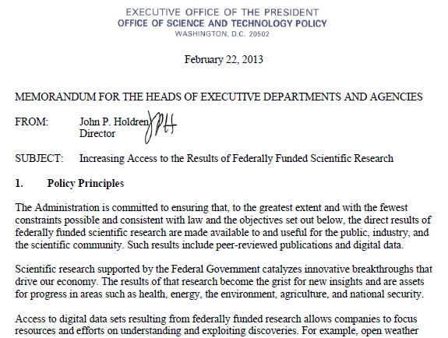
2013 “Holdren Memo”
Feb. 2013: White House Office of Science and Technology Policy (OSTP) released memorandum entitled “Increasing Access to the Results of Federally Funded Scientific Research”
Consistent with the America COMPETES Reauthorization Act of 2010
Directed all Federal Agencies with annual R&D expenditures of $100 million+ to work toward requiring data management plans be developed by all funded researchers
  Development of agency Plans
  Applies to peer-reviewed
  publications and digital
  scientific data

Slide 19
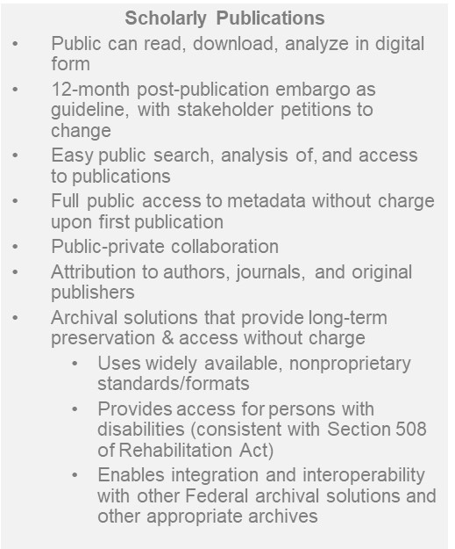

Objectives of the Holdren Memo
Digital Data
Maximize free access while
  Protecting privacy and confidentiality, national security
  Recognizing intellectual property rights
  Balancing costs & benefits of long-term preservation
Require data management plans (DMPs)
Allow inclusion of costs in applications for funding
Ensure appropriate evaluation of DMPs
Monitor compliance by investigators
Encourage deposit of data in public repositories, where possible
Cooperate with the private sector
Develop approaches for data citation & attribution
Support training, education and workforce development
Assess long-term needs for preservation and options for repositories

Slide 20
NIH Plan for Increasing Access to Publications and Digital Scientific Data
February 2015: “NIH Plan” released
Publications: NIH Public Access Policy
Digital Scientific Data: Plan for Public Access to Digital Scientific Data
  Consider how to require data sharing
  Consider how to require and evaluate data management and sharing plans
  Encourage the use of existing repositories and standards
  Promote FAIR (Findable, Accessible, Interoperable, Reusable) principles
  Plan ≠ Policy; NIH to establish priorities for data sharing

Slide 21
NIH Data Management and Sharing Policy (2020 Policy, Effective 2023)

Slide 22
NIH Data Management and Sharing (DMS) Policy
Key differences between the 2003 and 2020 Policies:
Policy Provision | 2003 Policy | 2020 Policy
Scope | Awards $500K or more a year in direct costs | All awards generating scientific data
Data to share | Final research data | Scientific data regardless of whether data underlie a publication
Mode of sharing data | To be described in Plan | Use of established repository named in Plan
Plan elements | Flexible level of detail | Detailed guidance provided in Supplemental Information
Questions – Email: SciencePolicy@od.nih.gov (NIH Office of Science Policy (OSP))

Slide 23
NIH Data Management and Sharing (DMS) Policy
Scope - replaces 2003 Data Sharing Policy for new and competing applications
Effective January 25, 2023
WHAT | All research, funded or conducted in whole or in part by NIH, that results in the generation of scientific data Extramural grants, contracts, Intramural Research Projects, or other funding agreements regardless of NIH funding level Submission of a Data Management and Sharing Plan outlining how scientific data and any accompanying metadata will be managed and shared, taking into account any potential restrictions or limitations Compliance with DMS Plan approved by NIH Institutes, Centers and Offices
WHERE | High-quality data repositories that exemplify desired characteristics in the Policy and are consistent with FAIR data principles
WHEN (Timeline) | Data should be available as soon as possible and at whichever point of time comes first: No later than the time of associated publication, OR Before the end of the performance period
HOW | Implementation underway. Additional FAQs and materials under development. See Policy for details on policy requirements and supplemental information.
WITH WHOM | Data should be available to the broad research community

Slide 24
NIH Data Management and Sharing (DMS) Policy
Supplemental Information to the NIH Policy for Data Management and Sharing:
Elements of an NIH Data Management and Sharing Plan
  NOT-OD-21-014
  https://grants.nih.gov/grants/guide/notice-files/NOT-OD-21-014.html
Recommended elements of a Plan:
  Data type
    Identifying data to be preserved and shared
  Related tools, software, code
    Tools and software needed to access and manipulate data
  Standards
    Standards to be applied to scientific data and metadata
  Data preservation, access, timelines
    Repository to be used, persistent unique identifier, and when/ how long data will be available
  Access, distribution, reuse considerations
    Description of factors for data access, distribution, or reuse
  Oversight of data management
    Plan compliance will be monitored/ managed and by whom

Slide 25
NIH Data Management and Sharing (DMS) Policy
Supplemental Information to the NIH Policy for Data Management and Sharing:
Allowable Costs for Data Management and Sharing
  NOT-OD-21-015
  https://grants.nih.gov/grants/guide/notice-files/NOT-OD-21-015.html
Reasonable costs allowed in budget requests
  Curating data/developing supporting documentation
  Preserving/sharing data through repositories
  Local data management considerations
NOT considered data sharing costs
  Infrastructure costs typically included in indirect costs
  Costs associated with the routine conduct of research (e.g., costs of gaining access to research data)

Slide 26
NIH Data Management and Sharing (DMS) Policy
Supplemental Information to the NIH Policy for Data Management and Sharing:
Selecting a Repository for Data Resulting from NIH-Supported Research
  NOT-OD-21-016
  https://grants.nih.gov/grants/guide/notice-files/NOT-OD-21-016.html
Encourages use of established repositories to improve FAIRness
  Includes broader data repository ecosystem supported by other organizations
  Provides considerations for storing human data
Helps investigators identify appropriate data repositories
  Provides desirable characteristics
  Refers to list of NIH-supported data repositories
NIH ICs may designate specific data repository(ies)

Slide 27
Implementation Activities
  Outreach activities: engaging the community to make aware of the policy, what it does and does not mean (no biospecimens!), and understand implementation challenges (e.g., April 2021 NASEM workshop on the culture of data management & sharing)
  Enhance compliance mechanisms: building tools to streamline compliance and facilitate tracking, public posting of Plans
  Develop resources: harmonize with NIH policies (e.g., GDS Policy), develop FAQs, guidance
  Strengthen incentives for data sharing, e.g., through data citation

Slide 28
Data Management and Sharing Policy- continued
AFTER-HOURS CONVERSATIONS - Auditorium A
Update on Implementation of the New Data Management and Sharing Policy
Thursday November 4, 2021
5:00 – 5:45 PM

Slide 29
Resources: Select NIH Grants Policy Excerpts
Grantees own the data they develop with federal funds.
  NIH Grants Policy Statement 8.2.1.
Public Access Policy Final peer reviewed manuscript, upon acceptance for publication must be published at: http://www.pubmedcentral.nih.gov.
  NIH Grants Policy Statement 8.2.2.
NIH Research Tools Policy requires sharing of unique research materials/biological materials (“research tools”).
  NIH Grants Policy Statement 8.2.3.

Slide 30
Resources: Links
NIH Genomic Data Sharing
  https://osp.od.nih.gov/scientific-sharing/genomic-data-sharing/
NIH Research Tools Policy
  https://grants.nih.gov/grants/intell-property_64FR72090.pdf
NIH Public Access Policy
  http://publicaccess.nih.gov/
NIH Data Sharing Policies
  https://grants.nih.gov/policy/sharing.htm
NIH Data Management and Sharing Policy
  https://grants.nih.gov/grants/guide/notice-files/NOT-OD-21-013.html

Slide 31
Acknowledgements
We would like to thank Cheryl Smith (NIH/OSP), Ellen Wann (NIH/OSP), Taunton Paine (NIH/OSP), and Cindy Danielson (NIH/OER) for their contributions to this presentation.

Slide 32

Questions?
Thank you!
GDS@mail.nih.gov

