Slide 1
The NIH Policy for Data Management and Sharing (DMS) in Effect: Planning for Success
NIH Grants Conference
February 1, 2023

Slide 2
Presentation Team
MODERATOR
Elyse Sullivan, Ph.D.
NIH Office of Research Integrity (ORI)
Office of Extramural Research (OER), NIH
Elyse.Sullivan@nih.gov
PRESENTERS
Cindy Danielson, Ph.D.
Associate Director, Systems Integration
Office of Extramural Research (OER), NIH
Cindy.Danielson@nih.gov
Julia Slutsman, Ph.D.
Director, Office of Scientific Review
Office of Extramural Research (OER), NIH
Julia.Slutsman@nih.gov

Slide 3
Polling question 1
Are you a:
Researcher
Research Administrator
Other?

Slide 4
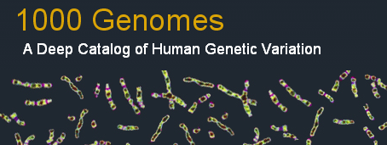
NIH Commitment to & Investment in Data Sharing
“Consistent with both the NIH mission to improve public health through research and its longstanding legislative mandate to make available to the public the results of the research activities that it supports and conducts….”
https://grants.nih.gov/grants/guide/notice-files/NOT-OD-07-013.html

Slide 5
Iterative Policy Development through Consistent Community Engagement
2020
Final Policy Released
2023
Policy Effective
2019
RFC: Draft Policy and
Guidance
2018
RFI: Proposed Provisions for a Draft Policy
2016
RFI: Strategies on Data Management, Sharing, and Citation
Tribal Consultation*
Input from Secretary’s Advisory Committee for Human Research Protections & other agencies
*See “NIH Tribal Consultation Report: NIH Draft Policy for Data Management and Sharing”
Notes:
OSP has led policy development

Slide 6
Goals of Data Sharing
Advance rigorous and reproducible research
Enable validation of research results
Make high-value datasets accessible
Accelerate future research directions
Increase opportunities for citation and collaboration
Promote public trust in research
Foster transparency and accountability
Demonstrate stewardship over taxpayer funds
Maximize research participants’ contributions
Support appropriate protections of research participants’ data

Slide 7
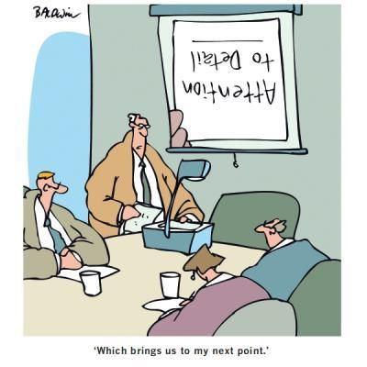
Policy Details
Requirements (effective January 25, 2023):
Submission of Data Management & Sharing Plan
Compliance with ICO-approved Plan (may affect future funding)
Scope: All NIH-supported research generating scientific data
What’s in: “Recorded factual material… of sufficient quality to validate and replicate research findings, regardless of whether the data are used to support scholarly publications”
What’s out: Lab notebooks, preliminary analyses, peer reviews, physical objects
Timelines:
When to share data: No later than publication or end of award (for unpublished data), whichever comes first
How long to share data: Consider other relevant requirements and expectations (e.g., journal policies, repository policies)
Notes:
relates to the proposed research questions and can include findings underlying unpublished null results

Slide 8
Activities Subject to the DMS Policy
Applies to all research that generates scientific data, including:
Research Projects
Some Career Development Awards (Ks)
Small Business SBIR/STTR
Research Centers
Does not apply to research and other activities that do not generate scientific data, including:
Training (Ts)
Fellowships (Fs)
Construction (C06)
Conference Grants (R13)
Resources (Gs)
Research-Related Infrastructure Programs (e.g., S06, S10)
See Research Covered Under the Data Management & Sharing Policy

Slide 9
Additional Expectations for Plans
Sharing should be…
The default practice
Maximize appropriate data sharing; Plans may justify limitations (e.g., ethical, legal, technical factors)
All scientific data should be managed; not all must be shared
Responsibly implemented
Plans should outline protection of privacy, rights, and confidentiality
Existing laws, regulations, and policies continue to apply
Prospectively planned for at all stages of the research process
During informed consent, including communicating how data will be used and shared
Data submission, including whether access to data, even if de-identified, should be controlled

Slide 10
Potential Limitations on Sharing
Justifiable ethical, legal, and technical factors for limiting sharing of data include:
Examples include:
Informed consent will not permit or limits scope of sharing or use
Explicit federal, state, local, or Tribal law, regulation, or policy prohibits disclosure
Reasons not generally justifiable to limit sharing include:
Examples include:
Dataset too small
Researchers anticipate data will not be widely used
Data are not thought to have a suitable repository
See FAQ for details
Notes:
Justifiable ethical, legal, and technical factors for limiting sharing of data include:
Informed consent will not permit or limits scope of sharing or use
Privacy or safety of research participants would be compromised and available protections insufficient
Explicit federal, state, local, or Tribal law, regulation, or policy prohibits disclosure
Restrictions imposed by existing or anticipated agreements with other parties
Datasets cannot practically be digitized with reasonable efforts
Reasons not generally justifiable to limit sharing include:
Data are considered too small
Researchers anticipate data will not be widely used
Data are not thought to have a suitable repository
Additional considerations:
NIH respects Tribal sovereignty and supports responsible management/sharing of AI/AN participant data
SBIR/STTR Program Policy Directive permits withholding data for 20 years, as stipulated in agreements and consistent with program goals

Slide 11
DMS Policy FAQs
Policy Scope
How does the DMS Policy fit in with other NIH data sharing policies and requirements?
How does the DMS Policy interact with the data sharing expectations of other research partners (e.g., other funding agencies, collaborators)?
Are projects establishing repositories or creating data infrastructure subject to the DMS Policy (i.e., establishing a data coordinating center with no research question proposed)?
Managing and Sharing Scientific Data
Does the timeline for sharing scientific data change in the event of a no cost extension?
What are justifiable reasons for limiting sharing of data?
Do SBIR/STTR projects have to share scientific data under the DMS Policy?
Considerations for Scientific Data Derived from Human Participants
What steps does the DMS Policy take to ensure institutions and researchers protect research participants?
Does the DMS Policy expect that when consent is obtained for research involving human participants, it must be for broad sharing and the future use of data?
Compliance and Enforcement
How will noncompliance with the NIH DMS Policy be handled?
See DMS Policy FAQs

Slide 12
Public Outreach and Training
August 11 and September 22, 2022: 2-part public webinar series, A Conversation with NIH: Implementing the new Data Management and Sharing Policy
4,900+ attendees at each event
300+ questions at each event
Recording and materials posted publicly https://sharing.nih.gov/about/learning
Upcoming events https://sharing.nih.gov/news-events

Slide 13
Elements of a Data Management and Sharing Plan
Data type
Identifying data to be preserved and shared
Related tools, software, code
Tools and software needed to access and manipulate data
Standards
Standards to be applied to scientific data and metadata
Data preservation, access, timelines
Repository to be used, persistent unique identifier, and when/ how long data will be available
Access, distribution, reuse considerations
Description of factors for data access, distribution, or reuse
Oversight of data management
Plan compliance will be monitored/ managed and by whom
See Writing a Data Management & Sharing Plan for details

Slide 14
Format of a Data Management and Sharing Plan
Recommended to be no more than 2 pages
Optional format page available and incorporated into FORMS-H application instructions
Federal Demonstration Partnership (FDP) pilot project to test structured templates and tools for DMS Plan submission
DMS Plan format page added to list of Format Pages and incorporated into FORMS-H application instructions

Slide 15
Sample NIH DMS Plans Available
Several sample NIH DMS Plans available for educational purposes, including:
Human clinical and/or MRI data (NIMH)
Human genomic data (NIMH & NHGRI)
Human & non-human genomic data (NIMH)
Secondary data analysis (NIMH)
Human clinical and genomics data (NICHD)
Human survey data (NICHD)
Model organism (Zebrafish) data (NICHD)
Technology development (NHGRI)
See Writing a Data Management & Sharing Plan for details

Slide 16
Harmonization of Genomic Data Sharing (GDS) and DMS Policies
NOT-OD-22-198: Implementation Changes for GDS Plans
Single Plan for applications subject to both DMS and GDS Policies
For more information about the GDS Policy and other NIH sharing Policies, please attend tomorrow’s 11:00 am presentation:
Overview of the NIH Genomic Data Sharing (GDS) Policy, Other Sharing Policies, and Open Q&A

Slide 17
Polling question 2
Have you explored the resources on sharing.nih.gov?

Slide 18
sharing.nih.gov: Resources for Writing a DMS Plan
Expectations for writing a Data Management & Sharing Plan
Includes instructions and optional format for submitting Plans
Addresses Genomic Data Sharing Policy expectations
Recent FAQs that address Plans

Slide 19
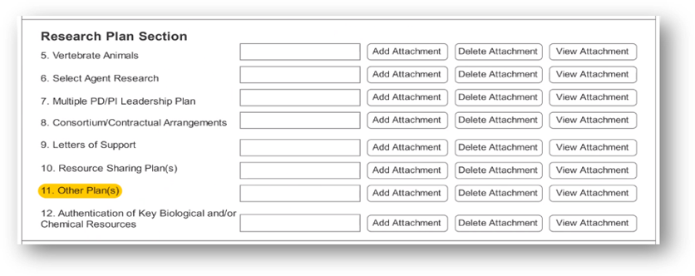
Changes to DMS Plan Submission
Updates made to FORMS-H version of grant application forms – updated instructions available now
New “Other Plan(s)” field added to PHS 398 forms to collect a single DMS Plan PDF attachment
Separate “Data Sharing Plan” and “Genomic Data Sharing Plan” attachments will no longer be collected as Resource Sharing Plan(s)
Plans for sharing genomic data will be included as part of the DMS Plan in Other Plan(s)
DMS Plan will NOT be visible to peer reviewers.
*except for certain FOAs with a data sharing focus
Notes:
Other Plans attachment was also added to F and T forms but NIH is not using at this time; refer to application instructions

Slide 20
What About the Resource Sharing Plan(s) Field?
Existing “Resource Sharing Plan(s)” field will remain to support Research Tools and Model Organism Sharing Policy
“Resource Sharing Plan(s)” attachment will continue to be visible to peer reviewers and included as an Additional Review Consideration
eRA validations to ensure DMS Plans are attached to appropriate form field

Slide 21
Data Management and Sharing Costs
ALLOWABLE COSTS:
Curating data/developing supporting documentation
Preserving/sharing data through repositories
Local data management considerations
IMPORTANT: Must be incurred during the performance period
UNALLOWABLE COSTS:
Infrastructure costs typically included in indirect costs
Costs associated with the routine conduct of research (e.g., costs of gaining access to research data)
See Budgeting for Data Management & Sharing for details

Slide 22
Supplemental Information: Repository Selection
Encourages use of established repositories
Generally improves FAIRness of data
Helps investigators identify appropriate data repositories
E.g., use of persistent unique identifiers, attached metadata, facilitates quality assurance
NIH ICs may designate specific data repository(ies)
See Selecting a Data Repository for details

Slide 23
Supplemental Information: Repository Selection Specialized Data Repositories
Prioritizes data-type and discipline-specific data repositories
Refers to NIH-supported data repository list outlining:
Repository description (e.g., data-types accepted, research community served, tools available),
Supportive NIH IC(s),
Whether and when new data are accepted, and
How to submit data
Examples include:
dbGaP BioData Catalyst
GenBank ImmPort
NIMH Data Archive BioLINCC

Slide 24
Submitting DMS Budgets
Direct costs to support activities proposed in DMS Plan must be indicated as “Data Management and Sharing Costs”
R&R Budget Form: line item in section F. Other Direct Costs
PHS 398 Modular Budget Form: within Additional Narrative Justification
Data Management and Sharing Costs
Notes:
If no cost will be incurred, enter "0" in the "Funds Requested" column

Slide 25
Justifying DMS Budgets
Brief summary of DMS Plan and description of DMS costs (recommended ≤ ½ page) must be included within the budget justification attachment; peer reviewers may comment on requested DMS costs based on this information
R&R Budget Form: section L. Budget Justification
PHS 398 Modular Budget Form: Additional Narrative Justification
See Instructions in FORMS-H Application Guide

Slide 26
DMS Plan Assessment
In preparation for an award, program staff ensure the Elements of a DMS Plan have been adequately addressed and assess the reasonableness of those responses
Applications will only be funded when DMS Plan is complete and acceptable
Any issues with a DMS Plan will need to be resolved through the Just-in-Time (JIT) process
DMS Plans may be updated throughout award lifecycle if revisions are necessary (e.g., new scientific direction, a different data repository, or a timeline revision)
Revised DMS Plans must be assessed and approved by the NIH ICO

Slide 27
Monitoring Compliance with DMS Plans
Approved DMS Plan becomes Term and Condition of Award
Recipient reports progress on implementing approved DMS Plan in Research Performance Progress Report (RPPR)
RPPR instructions will be updated
NIH reviews compliance annually
Failure to comply may result in an enforcement action, including additional special terms and conditions or termination of award, and may affect future funding decisions

Slide 28
How to Get Started on a DMS Plan
Steps for preparing for the DMS Policy:
Identify existing resources within your institution that may be able to assist you, such as data librarians
Review examples of relevant sample plans on sharing.nih.gov
Try drafting a Data Management and Sharing Plan for your work based on the recommended elements (NOT-OD-21-014)
Review your past data sharing practices to meet other funder or publisher expectations and consider what you may need to update for the new DMS Policy
Read FOA for any ICO or program-specific DMS requirements

Slide 29
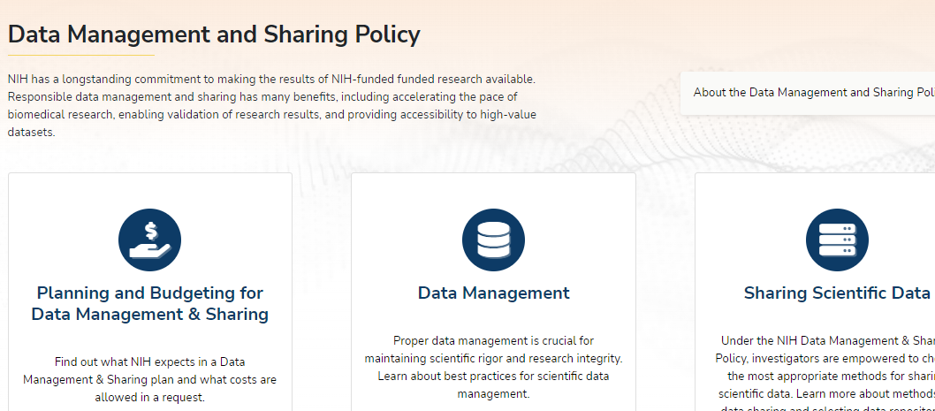
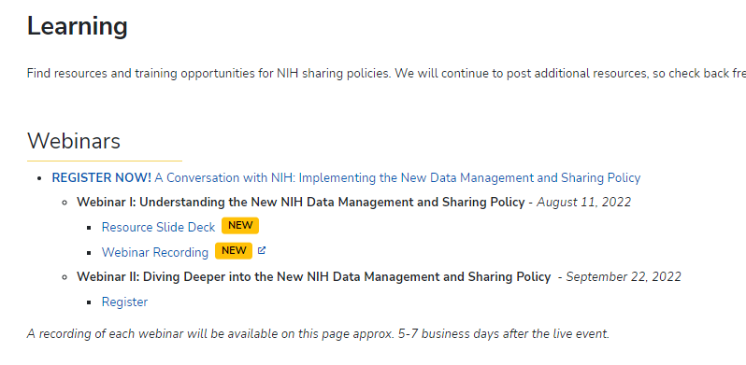
For More Information…
Website: NIH Scientific Data Sharing
FAQs: DMS Policy FAQs
Email Box: Sharing@nih.gov
Webinar Series: NIH DMS Policy Implementation
Notes:
NIH Data Management and Sharing Policy Webinar Series – Implementation of the NIH DMS Policy

Slide 30
Extra Slides

Slide 31
Policy and Supplemental Information
NOT-OD-21-013 – Final NIH Policy for Data Management and Sharing
NOT-OD-21-014 – Supplemental Information to the NIH Policy for Data Management and Sharing: Elements of an NIH Data Management and Sharing Plan
NOT-OD-21-015 – Supplemental Information to the NIH Policy for Data Management and Sharing: Allowable Costs for Data Management and Sharing
NOT-OD-21-016 – Supplemental Information to the NIH Policy for Data Management and Sharing: Selecting a Repository for Data Resulting from NIH-Supported Research

Slide 32
Relevant Notices
NOT-OD-22-189 – Implementation Details for the NIH Data Management and Sharing Policy (August 5)
NOT-OD-22-195 – New NIH "FORMS-H" Grant Application Forms and Instructions Coming for Due Dates on or after January 25, 2023 (August 8)
NOT-OD-22-198 – Implementation Changes for Genomic Data Sharing Plans Included with Applications Due on or after January 25, 2023 (August 31)
NOT-OD-22-213 – Supplemental Information to the NIH Policy for Data Management and Sharing: Protecting Privacy When Sharing Human Research Participant Data (September 21)
NOT-OD-22-214 – Supplemental Information to the NIH Policy for Data Management and Sharing: Responsible Management and Sharing of American Indian/Alaska Native Participant Data (September 21)

Slide 33
Informed Consent and DMS Policy
Policy encourages researchers and institutions to establish robust consent processes, but:
Does not establish additional consent expectations
Does not require consent be obtained any particular way (e.g., broad consent)
Policy recognizes limitations on data sharing based on the informed consent process
Informed Consent Resources:
Points to consider
Sample language for future use and/or data sharing
Informed Consent Resource

Slide 34
Supplemental Information for Protecting Privacy When Sharing Human Research Participant Data
Provides a basic framework for considering how to protect privacy when sharing data from human participants
Not intended as a guide for regulatory compliance
Broadly applicable to different research contexts
Establishes shared principles, provides best practices, and offers considerations for determining whether to control access to data
NOT-OD-22-213

Slide 35
Supplemental Information: Responsible Management and Sharing of American Indian/ Alaska Native Participant Data
Information to assist in developing appropriate DMS Plans
Best Practices for Responsible Management and Sharing of AI/AN Participant Data
Emphasizes:
Respect for Tribal Sovereignty
Partnerships and mutual agreements
Building trust
Developed through Tribal Consultation and stakeholder engagement beginning in 2019
NOT-OD-22-214

