Slide 1
National Institutes of Health Loan Repayment Programs
Matthew Lockhart Acting Director Division of Loan Repayment

Slide 2
The Basics

Slide 3
Role of LRPs as an Important Career Path and Funding Option
Graduate/ClinicalTraining
Postdoctoral Training/ Clinical Residency
Early Research Career
Established Investigator
T32, T35
T32
K01, K07, K25, K12, KL2
K08,K23, K12, KL2
R03, R21, R01, R35
R01, R35, P01, P50
F30, F31
F32
R38, (K38)
R25, K12
K22,K99
K22, R00
K02, K24
Loan Repayment Programs
Diversity Supplements
Re-Entry Supplements
https://researchtraining.nih.gov

Slide 4
Purpose of the NIH LRPs
NIH LRPs are a vital component in our nation's effort to keep health professionals in research careers
Here’s how it works:
YOU: Commit to perform research for 2 years
NIH: Repays up to $100,000 of your qualified educational debt and covers resulting Federal tax (39%)
Outcome: Increase in nation’s stock of biomedical research scientists

Slide 5
Extramural LRP Subcategories For individuals conducting research at non-profit institutions
Clinical Research
Patient-oriented research conducted with human subjects or materials of human origin (including cognitive phenomenon) on the causes and consequences of disease in humans
Pediatric Research
Research related to diseases or disorders in children
Health Disparities Research
Same as Clinical Research LRP
Contraception & Infertility Research
Clinical Disadvantaged Backgrounds
Research focusing on minority and other health disparity populations
Research focusing on conditions impacting ability to conceive or bear children and provide new or improved methods of preventing pregnancy
Basic research allowed
Basic, clinical, social and behavioral research allowed
Available to clinical researchers from verifiable disadvantaged backgrounds
Applications reviewed by Eunice Kennedy Shriver NICHD
Applications reviewed by NIMHD
Research in Emerging Areas Critical to Human Health (REACH)
Available beginning September 2021 to recruit and retain researchers pursuing major opportunities or gaps in emerging areas of human health
NIH ICs determine gap/emerging areas of research priority areas

Slide 6
Basic LRP Eligibility Criteria
El
Citizenship
U.S. Citizen, NATIONAL, or
permanent resident
EDUCATION
Doctoral Degree
(few exceptions)
Educational Loan Debt
At least 20% of
annual base income
Research Funding
Domestic nonprofit, university, or government;
Research Time
At least 20 hours/week of qualified research
(NIH grant support NOT required)

Slide 7
Ready to Apply?

Slide 8
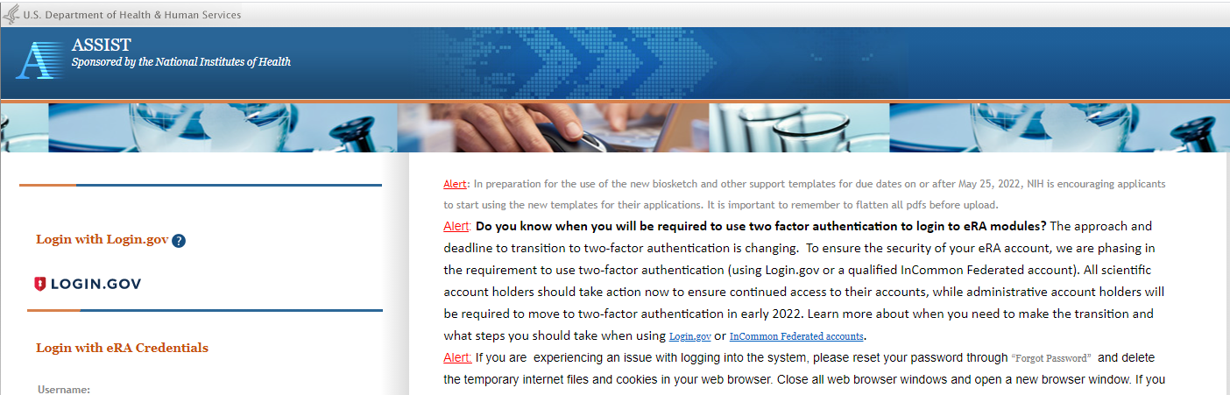
LRP Application Now in ASSIST
NEW in FY 2022
LRP Application is now in ASSIST

Slide 9
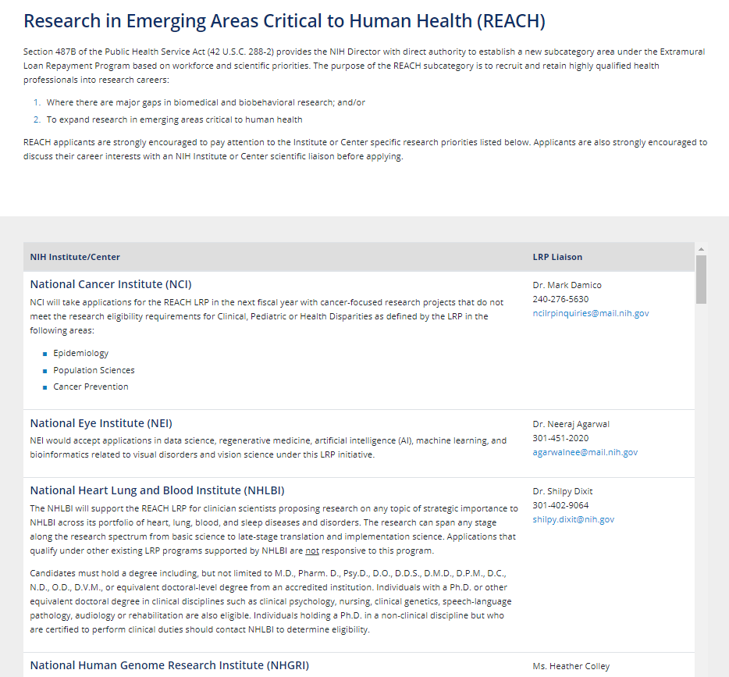
Research in Emerging Areas Critical to Human Health (L70)
NEW in FY 2022
24 Participating ICs
Emerging areas of research are determined by each NIH Institute/Center
Targets researchers who wouldn’t qualify under existing LRP subcategories
NOT-OD-21-144

Slide 10
LRP Application – Major Sections
Research Activities (‘meat and potatoes’)
Personal Statement
Highlight previous training, development of scientific interests; accomplishments; short and long-term career goals
Training/Career Development Plan
Skills acquiring along your path to independence (e.g., training, professional and leadership development opportunities; grantmanship workshops, conference attendance, etc.) – include 2-year timeline
Proposed Research Plans
Planned research activities, specific roles/responsibilities – include 2-year timeline
Research Environment
Why are you where you are? Who or what is important there?
Loan Information (new applicants only)
Lender and servicer information, loan number, total loan amounts, loan status (e.g., in repayment/forbearance)

Slide 11
Writing a Competitive LRP Application
Know the funding priorities of the NIH Institute or Center reviewing your application
Effectively demonstrate qualifications and commitment to research
Thoroughly describe research environment, resources and support
Show a strong research plan
Provide strong reference letters

Slide 12
What are Reviewers Looking For?
Evaluate an applicant’s potential to succeed in a research career by rating:
Applicant’s previous training and research experience
Applicant’s commitment to a research career
Strength and quality of letters of recommendation
Quality and appropriateness of the research environment
Research progress (for Renewal applications only)
THESE TIPS APPLY TO ANY FELLOWSHIP, GRANT, ETC.

Slide 13
LRP Resources

Slide 14
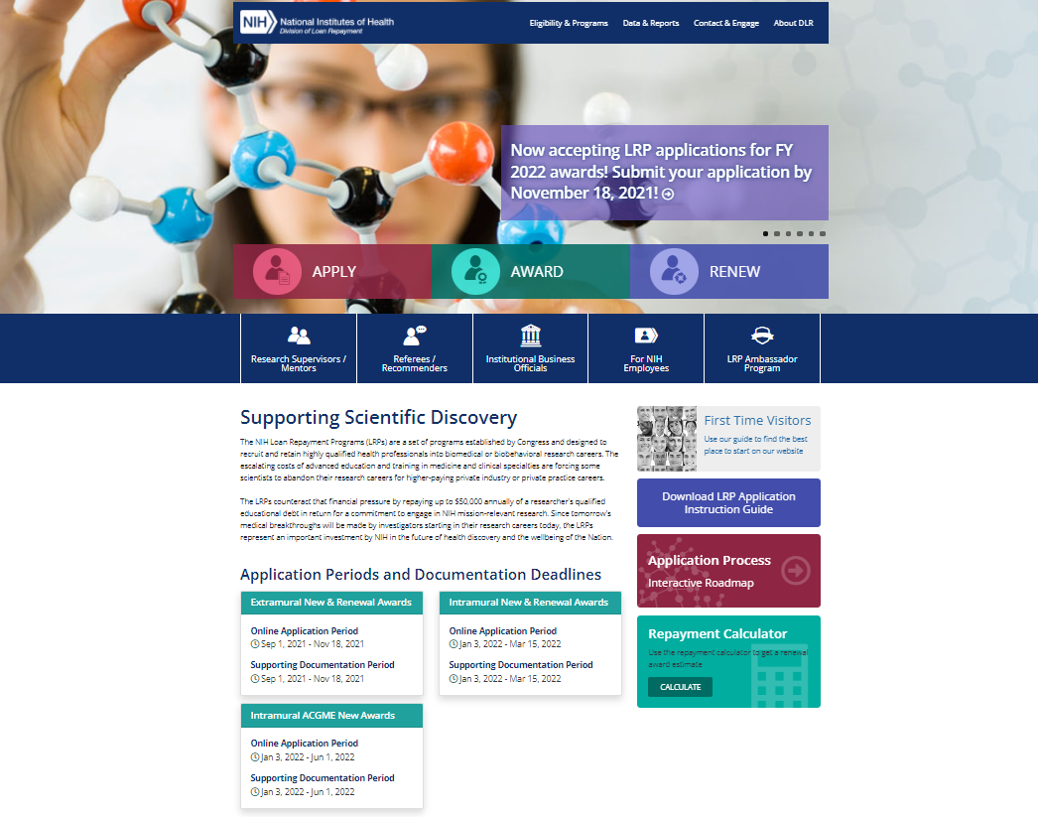
LRP Website

Slide 15
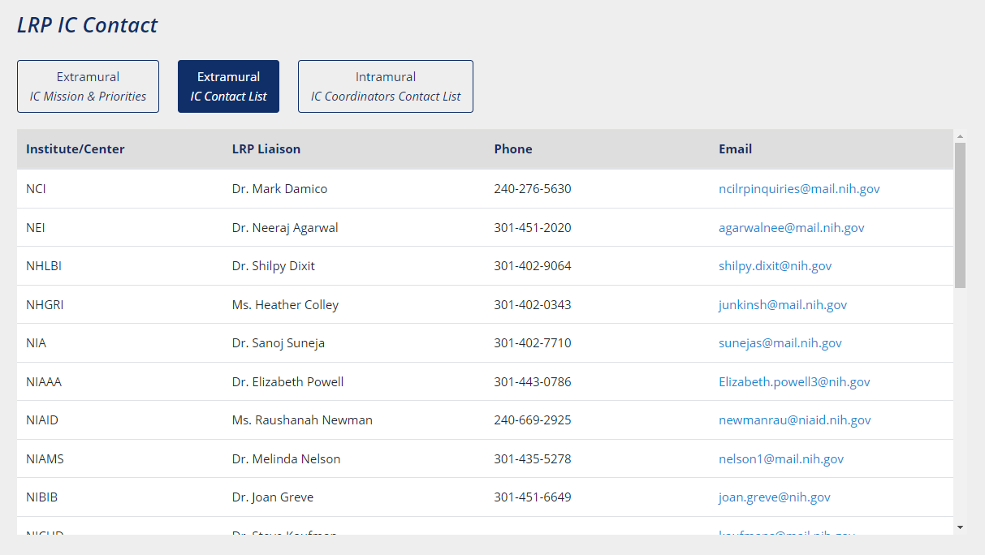
Connect with an LRP Program Officer

Slide 16
LRP Ambassador Network

Slide 17
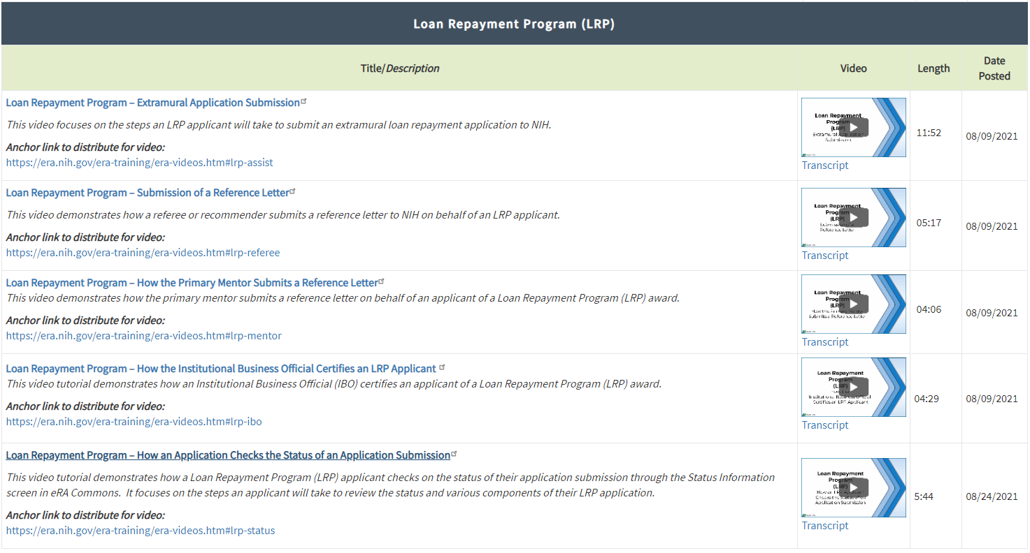
LRP Video Tutorials
https://era.nih.gov/help-tutorials/lrp

Slide 18
Key Takeaways
2-year Research Commitment
Up to $50,000/year
Plan Ahead
Use LRP Resources!
Extramural LRP
Application Deadline
November 18, 2021

Slide 19
Contact Us
www.lrp.nih.gov
(866) 849-4047
lrp@nih.gov
NIHLRP
@NIH_LRP

