Slide 1
Including Diverse Populations in NIH-funded Clinical Research Dawn Corbett, MPH NIH Inclusion Policy Officer Division of Human Subjects Research, Office of Extramural Research NIH Virtual Seminar November 4, 2021

Slide 2
Timeline of NIH Inclusion Policies
1986
1993
1998
NIH establishes policy encouraging researchers to include women in studies
PL103-43 requires inclusion of women and minorities in NIH clinical research
NIH issues policy requiring inclusion of children in NIH clinical research
NIH changes definition of child to individuals under 18
2016
21st Century Cures Act includes new requirements for inclusion
2015
2017
2019
NIH requires NIH-defined Phase 3 trials report results of analyses in Clinicaltrials.gov
Inclusion Across the Lifespan Policy becomes effective

Slide 3
Inclusion of Women and Minorities in NIH Research
Women and members of racial and ethnic minority groups must be included in all NIH-funded clinical research studies unless there is a compelling rationale for exclusion (NOT-OD-18-014)
NIH-defined phase 3 clinical trials must be designed to permit analysis by sex/gender, race and ethnicity
Applicable NIH-defined phase 3 clinical trials must report results of analyses in Clinicaltrials.gov

Slide 4
Inclusion Across the Lifespan
Individuals of all ages must be included in NIH human subjects research unless there are scientific or ethical reasons not to do so (NOT-OD-18-116)
Effective for applications submitted for due dates on or after January 25, 2019 (and for contract solicitations issued and intramural studies initiated after that date)
Submission of individual-level data on participant sex/gender, race, ethnicity and age at enrollment in progress reports required

Slide 5
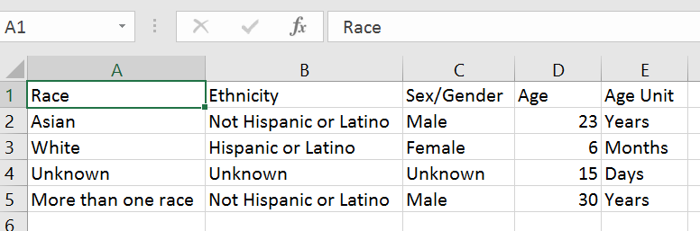
Individual-level Participant Data

Slide 6
Knowledge Check
Cost is an acceptable reason to exclude women from an NIH clinical research study
FALSE

Slide 7
What’s Required When Applying for Funding?
Plans for inclusion of women and minorities
Plans for analyses by sex/gender, race, and ethnicity for Phase III trials
Inclusion enrollment report
Data on sex/gender, race, and ethnicity of the sample (planned and/or actual)
Plans for inclusion of individuals across the lifespan
Age limits (if applicable) and justification

Slide 8
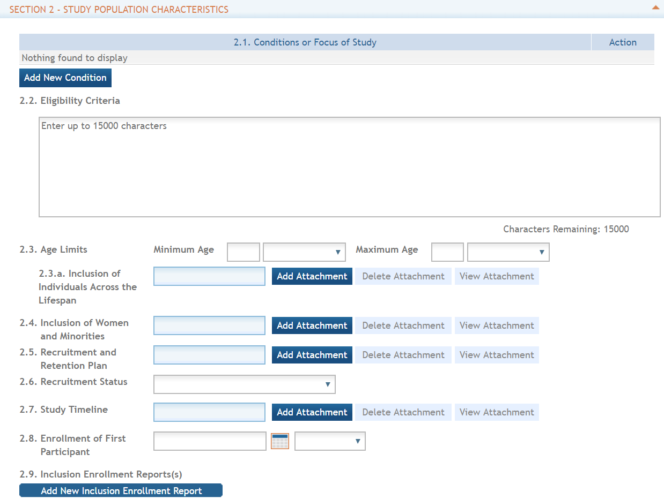
PHS Human Subjects and Clinical Trials Form
See the Application Guide for detailed information
PHS HS/CT Information Form
Study Record
Basic information
Study Population Characteristics
Protection and Monitoring Plans
Protocol Synopsis
Other Clinical Trial-related Attachments

Slide 9
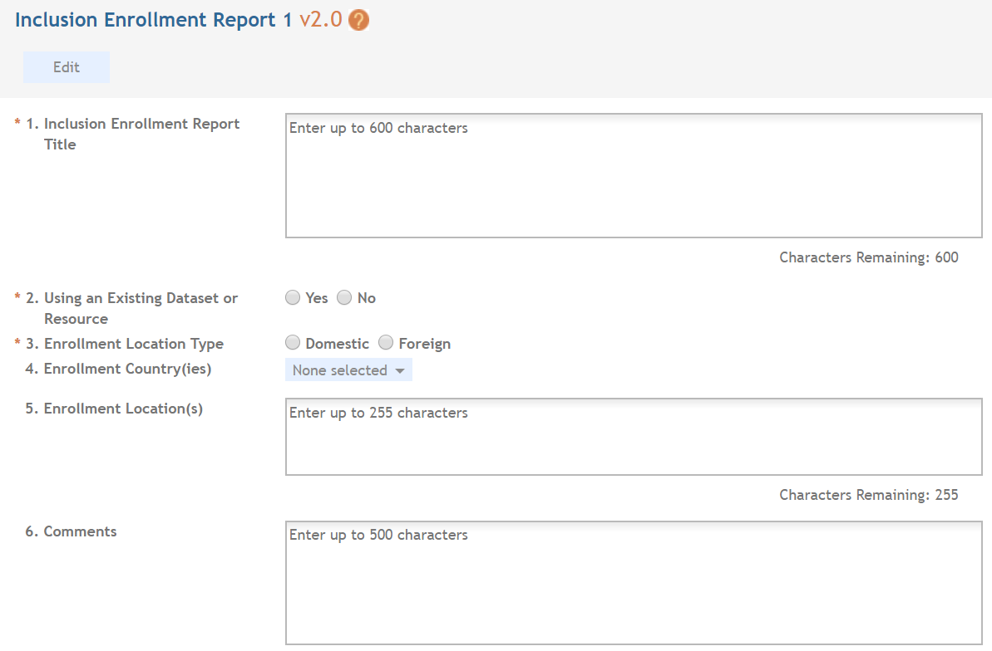
Inclusion Enrollment Report
NEW Inclusion Enrollment Report Title
Specify whether Existing Dataset or Resource will be Used
Include Separate Tables for Domestic/Foreign Populations

Slide 10
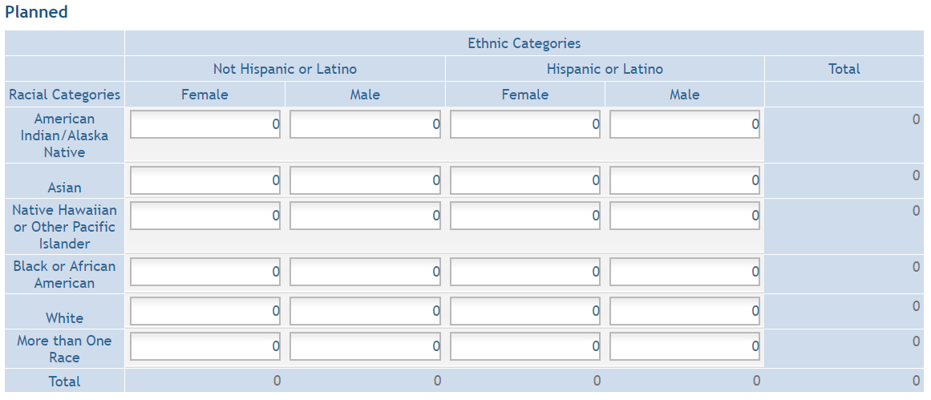
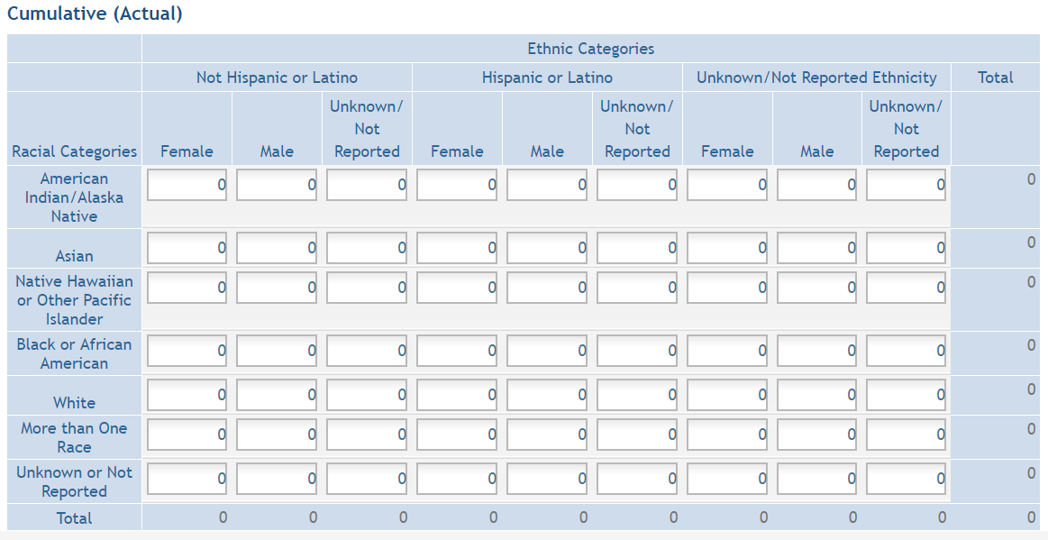
Inclusion Enrollment Reports
Notes:
And, there are separate tables for Planned and Cumulative enrollment data.

Slide 11
Peer Review of Inclusion
SUMMARY STATEMENT
PROGRAM CONTACT: (Privileged Communication) Release Date: 08/11/2020
Jane Doe
240 111-5555
janesmith@od.nih.gov
____________________________________________________________________________________
Application Number: 1 R01 IC12345-01
Principal Investigator
DOE, JOHN
Applicant Organization: ABC SCHOOL OF MEDICINE
Review Group: ZRG1 ABC-D(50)
Center for Scientific Review Special Emphasis Panel
Program for Collaborative Biomedical Research
Meeting Date: 07/20/2020 RFA/PA: IC 20-006
Council: OCT 2020 PCC: M51B B
Requested Start: 12/01/2020
Project Title: An Excellent Research Project
SRG Action: Impact Score: 24
Next Steps: Visit http://grants.nih.gov/grants/next_steps.htm
Human Subjects: 30- Human subjects involved
Animal Subjects: 30-Vertebrate animals involved - no SRG concerns noted
Gender: 1A-Both Genders, scientifically acceptable
Minority: 5A-Only foreign subjects, scientifically acceptable
Age: 3U-No children (only adults and older adults), scientifically unacceptable. Clinical Research - not NIH-defined Phase III Trial
Notes:
12

Slide 12
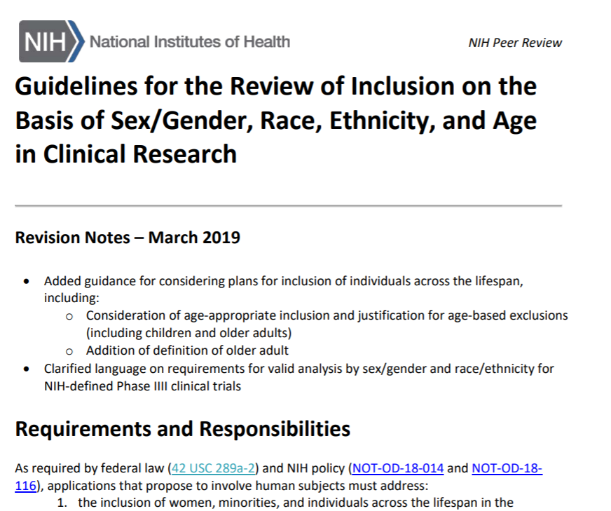
What Makes A Good Inclusion Plan?
Complete
Scientifically
Appropriate
Realistic!
Guidelines available at https://grants.nih.gov/grants/peer/guidelines_general/Review_Human_Subjects_Inclusion.pdf

Slide 13
NIH Inclusion Across the Lifespan II Workshop, September 2, 2020
Recurrent Themes
Select trial outcomes that reflect participant concerns
Limit use of unnecessary inclusion/exclusion criteria
Adequately weigh risks of excluding groups—like pregnant women and children —with that of their participation
Minimize participant and caregiver burden
Consider the diversity of individuals within a given group (e.g. size, comorbidities, diet, cognitive status)
Regularly assess recruitment and retention and make modifications as needed
Report available on Inclusion Across the Lifespan website https://grants.nih.gov/policy/inclusion/lifespan.htm

Slide 14
Inclusion Plans: Other Points to Consider
Demographics of source population
Family and community involvement
Language and participant communication
Staff expertise
Budget

Slide 15
Case Study #1
A researcher proposes a study to determine the efficacy of a novel treatment for prostate cancer. The study excludes individuals whose sex at birth is female.

Slide 16
Case Study #2
A researcher proposes a study to examine use of a smartphone app to improve glycemic control in diabetic individuals. The study excludes individuals who do not speak English because the consent form is available only in English.

Slide 17
Case Study #3
A researcher proposes a study in individuals 18 to 60. The study indicates children are excluded because the legal age to consent to research is 18 in the state where the research will be conducted. Individuals over 60 will be excluded because of the likelihood of co-morbidities in this group.

Slide 18
Just-in-Time Requirements
Work with Institute/Center staff to resolve unacceptable inclusion concerns
Provide inclusion enrollment report(s) if missing or needs updated as a result of peer review and/or programmatic adjustments
18

Slide 19
After the Award…Now What?
Provide actual inclusion enrollment data in progress reports
For NIH-defined Phase III Clinical Trials – report status/results of analyses by sex/gender, race, and ethnicity
For applicable NIH-defined Phase III Clinical Trials, report results by sex/gender and/or race/ethnicity in Clinicaltrials.gov within 1 year of primary completion date
Provide PHS Human Subjects and Clinical Trials Information Form for delayed onset studies

Slide 20
Uploading Participant-Level Data in HSS
Videos, Templates, and Other Resources on HSS Training Site!
https://era.nih.gov/help-tutorials/era-training-hss.htm

Slide 21
Knowledge Check
If funded, NIH recipients will need to provide data on participant race, ethnicity, sex/gender, and date of birth
FALSE

Slide 22
RESOURCES
WEB
Inclusion of Women and Minorities
https://grants.nih.gov/grants/funding/women_min/women_min.htm
Inclusion Across the Lifespan
https://grants.nih.gov/grants/funding/lifespan/lifespan.htm
inclusion@mail.nih.gov
EMAIL

