Slide 1


Simplifying Informed Consent
Yvonne Lau, MBBS, MBHL, PhD,
Director, Division of Education and Development
Misti Ault Anderson, MS, MA
Senior Advisor for Public Health Education
Division of Education and Development
HHS Office for Human Research Protections (OHRP)
October 30, 2020

Slide 2
Disclaimer
The opinions expressed are those of the presenter and do not necessarily reflect the policy of the U.S. Department of Health and Human Services

Slide 3
Learning Objectives
After this presentation, attendees will be able to
Explain why getting meaningful consent is critical to enrolling research participants
Describe important components for meaningful consent
  Explain new requirements in revised Common Rule
Identify techniques for simplifying and creating a meaningful consent document

Slide 4

Human Research : An Inherent Ethical Tension
Research: a systematic investigation… designed to develop or contribute to generalizable knowledge
Research promotes the common good
Research subjects are the means to achieve this goal; their support is vital!
Research subjects must be treated with respect and appropriately protected from harms

Slide 5

Why is Informed Consent Important for Research?
Purpose is to help people make
informed decisions about whether to participate
Ethical ideals:
  Individuals decide for themselves according to their own values and opinions (autonomy)
    Voluntariness
    Informed Consent
  Those whose autonomy is compromised should be protected
    Special attention to undue influence and coercion
    Additional protections

Slide 6
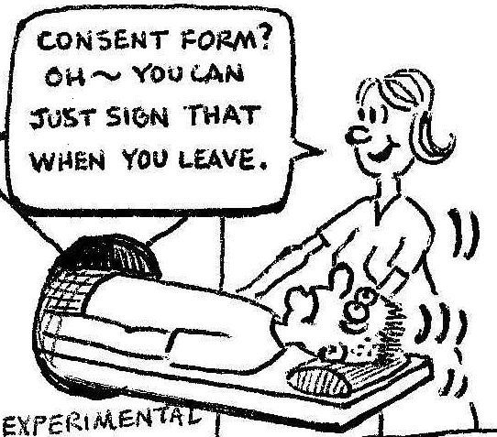
Informed Consent in the Common Rule
Must be obtained and documented before beginning any activities done for research purposes (unless waived)
Informed consent must provide information:
  Needed for an informed decision about participation
  In language understandable to the potential participant
  Under circumstances that promote voluntariness
  §46.116(a)

Slide 7

Informed Consent Empowers Participants & Builds Trust
Research is teamwork
Willing participants are key to success

Slide 8
The Important Question
How to make sure prospective participants have a fair chance of getting/understanding the information they need to make a decision about whether to be in a study?

Slide 9
New Informed Consent Requirements in the
Revised Common Rule
Focus on the information needs of prospective research participants, including:
Information that a reasonable person would want to have in order to make an informed decision about participation
Information presented in sufficient detail and organized and presented in a way that facilitates understanding of why one might or might not want to participate
46.116(a)(4) & §46.116(a)(5)(ii)

Slide 10
If you were asked to participate in a research study, ask yourself:
What information would you need to make an informed decision about participation and how should this information be presented?
CONTEXT
LANGUAGE
PRESENTATION
CONTENT

Slide 11

Which Context?
Context of where researchers are coming from, why they want to do the research, and what they hope to find
Context under which prospective participants receive and understand the information

Slide 12
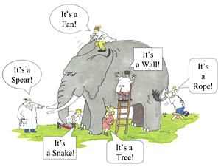
The Importance of Context in Health Research
People are unfamiliar with concepts about research
Decisions affecting one’s health are personal
Decisions to participate in health research add further complexity

Slide 13
Context Makes Content Easier to Understand
“Randomization means you will be assigned to a group randomly, like the flip of a coin”
Tell people what randomization means to them!
You cannot choose the group you are in
Assignment not based on what is better for you
You must be okay with being assigned to any of the study groups
If you have a strong preference for one group, you might not want to participate

Slide 14
Context Instructs on Content and Presentation
Neurological
Chronic nerve damage
Peripheral nerve damage
Psychological intolerance (fear of loss of LAP monitoring function)
Stroke/transient ischemic attack
Subdural, epidural hematoma
Cardiac
Acute coronary syndrome (sudden worsening of chest pain, heaviness or pressure)
Arrhythmias (irregular heart rhythm)
Acceleration of arrhythmia (make irregular heart rhythm go faster)
Atrial septal defect (hole in the tissue between upper chambers of the heart)
Cardiac arrest
Cardiac perforation
Cardiac tamponade
Damage to heart valves
Emergency heart surgery
Emergency vascular surgery
Low cardiac output state
Heart block
Hypotension
Providing a detailed list of isolated facts
Facilitating understanding

Slide 15
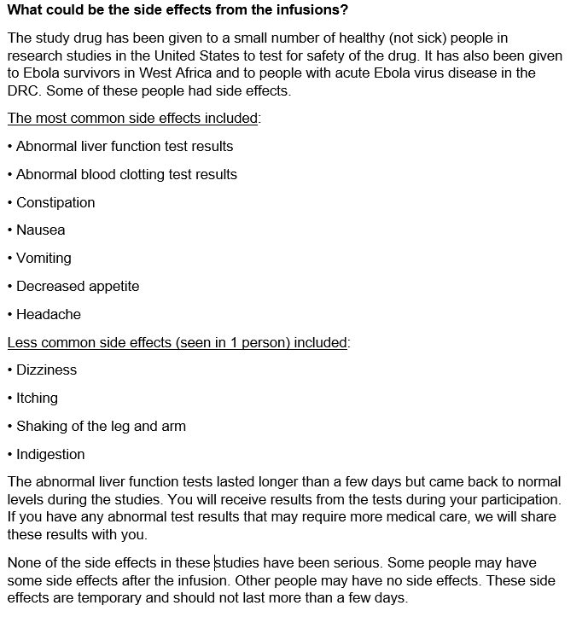
An Example of Providing Context and Grouping Information for Prospective Participants

Slide 16

Present Information in Context that Makes Sense
Consider framing information under headings of questions a prospective participant might ask
Examples:
What is the problem researchers want to study?
Why do researchers think that this drug might work?
What are researchers hoping to find out about this drug?
Why am I being asked to participate?
What does it mean for me to participate?

Slide 17

Know Your Audience and What Concerns Them
Examples of things that worry prospective participants:
If I participate in this study, can I still participate in another study that may offer an intervention that I prefer?
During my participation, what happens if important information about the study intervention becomes available?
What happens if my condition gets worse?

Slide 18

Be Specific With Important Information
Don’t just say “we are trying to find out if drug X is effective”
Instead, be specific, give details about what you mean, e.g.,
  “We want to find out if drug X might shorten how long you stay in the intensive care unit by a few days”

Slide 19
Potential Participant Perspective
What one patient said about his thoughts when an interventional treatment study was being explained:
“I didn't pay a lot of attention.
I was mostly thinking up questions I would need answered regarding my own care, the treatment plan being proposed, how I might be affected, etc.
After all, informed consent requires I be as informed as possible in order to make the best judgement for myself.”

Slide 20
What Would It Mean to Participate?
Explain information in a way that would help prospective participants understand the pros and cons, the why and why not
Consider this example:
  A randomized trial to study the use of back brace to prevent spinal curving in teenagers

Slide 21
What Would It Mean to Participate?
What to expect if your child is assigned to the group required to wear a back brace?
If the back brace prevents more curving of the spine, your child could benefit from a slowing the curving process and less chance of needing surgery.
Your child may find wearing a back brace inconvenient, restrictive, and uncomfortable. The brace could injure the skin and may lead to skin ulcers. Also, your child may feel stressed or embarrassed around others.
If the back brace does not prevent curving of the spine, then your child could experience these problems without receiving any benefits.

Slide 22
What Would It Mean to Participate?
What to expect if your child is assigned to the observation group (no back brace)?
Your child will not experience inconveniences, discomfort, skin problems, or stress that may result from wearing a back brace.
Your child’s spinal condition may or may not progress further before bone growth matures. If the curving continues to progress:
  You and your child’s doctor may not want to continue participating, and decide to treat your child’s condition outside of the study.
  If the back brace prevents more curving of the spine, it is possible that your child may miss the window of time to benefit from wearing it to prevent more curving.

Slide 23
What are Some of the Reasons You May or May Not Want Your Child to Participate in this Study?
Possible Reasons to Want to Participate
Possible Reasons to Not Want to Participate
I don’t know what’s best for my child and since doctors don’t know either, participating seems like a reasonable decision.
My child’s participation could help researchers find better treatment for other children with the condition.
Back braces are expensive. Participation would give my child a chance to get the braces for free.
My child doesn’t want to wear a brace at all if it can be avoided.
We want to take action now to prevent any chance of progression. We want a brace and do not want to be randomized.
We want to make the decision with our own doctor and don’t want to leave the matter to chance.

Slide 24
Another Example of Why Someone Might or Might Not Want to Participate
Possible Reasons to Want to Participate
Possible Reasons to Not Want to Participate
I don’t know if I want to get the studied drug. I don’t know how to choose. And since doctors don’t know either, I think that participating in the research study is reasonable.
I want to help advance science. I want to help researchers find out if the studied drug could help treat people with my condition.
I want to try the studied drug and participating in this research gives me a chance to get it.
Participating in this research is the only way that I get a chance to try out the study drug.
Participating in this research seems like a lot of fun. I think the experience will be valuable.
I don’t want to participate in research. I don’t want more uncertainties.
I don’t want any chance of getting an unproven treatment.
I know that the study drug may not work and may have unwanted side effects, but I really want to try it. I will see if I can get it without participating in the study.
I won’t be able to support my child through all the study visits and procedures.
I won’t have time even if I wanted to participate.

Slide 25
Presentation that Facilitates Understanding
How things are presented can help with reception and understanding!
For example,
Break up dense text with sectioning, pictures and icons
Compare by putting information side by side
Include a schematic diagram of the study
Presentation is not just about making something look pretty!

Slide 26



Example of Sectioning Using Colors & Icons
Who is the research study recruiting?
We are recruiting people like you who have been diagnosed with sudden onset inflammation of the pancreas, also called acute pancreatitis, to participate in a research study.
What’s the current treatment for acute pancreatitis?
There is no known treatment to block or reduce inflammation in the pancreas. Current treatment for acute pancreatitis is mainly supportive, to reduce symptoms. This includes providing IV fluids to rest the bowel, controlling pain, and monitoring the disease for the development of complications.
Why are we doing this research study?
We want to find out if a drug called Drug B can reduce the severity of pancreatic inflammation and related medical complications in patients just diagnosed with acute pancreatitis.

Slide 27
Compare What it Means to be Assigned to One Group Versus Another
If you receive the test drug (active) 50% chance
You will receive usual care + the test drug. You will NOT know it is the active test drug.
We do not know whether the test drug will help treat your opioid use problem. If it is effective, it may reduce your craving for opioids, lessen your withdrawal symptoms, and help you stay off of opioids.
If the test drug is not effective, then you will not get any benefits receiving it. It is possible that the test drug could worsen your opioid use problem.
Side effects from the test drug may include XXX. You may experience these regardless of whether the test drug is effective.
If you receive the placebo (inactive) 50% chance
You will receive usual care + the placebo. You will NOT know it is the inactive placebo.
You will receive no known medical benefit from the placebo. You will not benefit or be harmed by the test drug because you are not getting it.
The placebo you receive will not make your opioid use problem worse.
A placebo does not contain any drug. It does not have any side effects and is not a treatment for opioid use problems.

Slide 28
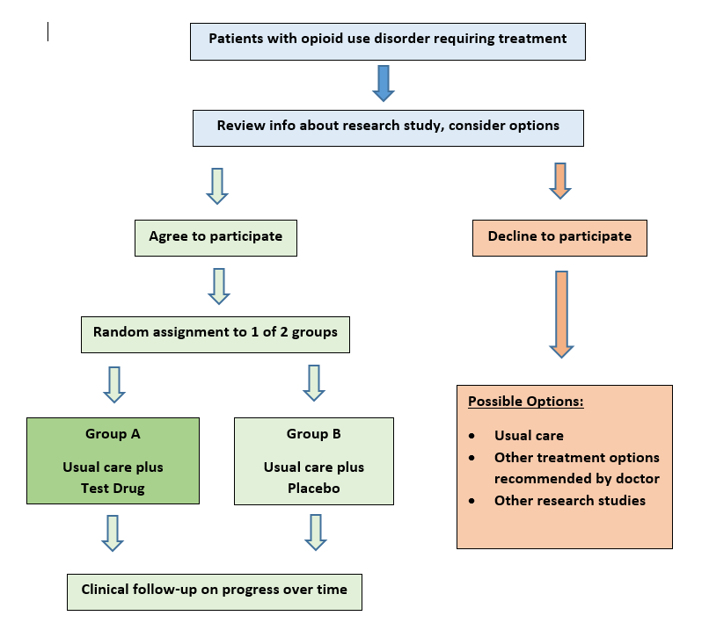
Provide Information Using a Diagram
Diagrams may help people better picture the design of the study and what it means to choose one option over another.

Slide 29
Write in Plain Language
Use common everyday words
Use shorter words with fewer syllables
Avoid jargon; explain terms
Use active voice if possible
Write it in conversational style
Use short sentences; keep paragraphs short
Break up complex concepts into sections

Slide 30
Is This Understandable Language?
On what the study drug is:
XXX is a human monoclonal antibody that blocks the interaction between PD-1, PD-L1 and PD-L2. Binding of these ligands to the PD-1 receptor found on T cells, inhibits T cell proliferation and cytokine production. Upregulation of the PD-1 ligands occurs in some tumors and signaling through this pathway can contribute to inhibition of active T-cell immune surveillance of tumors. XXX is a human immunoglobulin (IgG4) monoclonal antibody that binds to the PD-1 receptor and blocks its interaction with PD-L1 and PD-L2, releasing PD-1 pathway-mediated inhibition of the immune response, including the anti-tumor immune response, resulting in decreased tumor growth.
Can you convey this information more simply?

Slide 31
Is This Understandable Language?
On what the study drug is:
XXX is a human monoclonal antibody that blocks the interaction between PD-1, PD-L1 and PD-L2. Binding of these ligands to the PD-1 receptor found on T cells, inhibits T cell proliferation and cytokine production. Upregulation of the PD-1 ligands occurs in some tumors and signaling through this pathway can contribute to inhibition of active T-cell immune surveillance of tumors. XXX is a human immunoglobulin (IgG4) monoclonal antibody that binds to the PD-1 receptor and blocks its interaction with PD-L1 and PD-L2, releasing PD-1 pathway-mediated inhibition of the immune response, including the anti-tumor immune response, resulting in decreased tumor growth.
What about?
XXX works on the body’s defense system. It could help our body’s T-cells control and even reduce tumor growth.

Slide 32
Is This Understandable Language?
On why the research is being done:
The comprehensive treatment of cognitive impairment and other medical conditions may best be treated by lifestyle modifications (e.g., cognitive and exercise training).…Studies that implement both targeted neurocognitive and exercise training interventions (rather than each alone) are showing greater promise on improving cognitive function in older adults. Combining these two intervention modalities simultaneously may be more effective than either intervention alone…..
Can you convey this information more simply?

Slide 33
Is This Understandable Language?
On why the research is being done:
The comprehensive treatment of cognitive impairment and other medical conditions may best be treated by lifestyle modifications (e.g., cognitive and exercise training).…Studies that implement both targeted neurocognitive and exercise training interventions (rather than each alone) are showing greater promise on improving cognitive function in older adults. Combining these two intervention modalities simultaneously may be more effective than either intervention alone…..
What about?
We want to know if doing brain training together with physical exercise can help older adults improve brain function more than doing just one alone.

Slide 34
Simplifying Language -
On why a study is being done
Injection drug use is the leading risk for HIV infection. In addition, hepatitis C virus (HCV) infection among injection drug users (IDU) ranges from 30% to 90%. These infections are an enormous public health challenge because they involve a chronic carrier state, resulting in ongoing transmission and costly medical consequences for those infected. To date there are no vaccines to prevent these infections, so a critical type of prevention involves reducing the risk of exposure. Reducing risks such as syringe and drug paraphernalia sharing and sexual behaviors among IDU can reduce rates of infection. We know that some interventions to change behaviors have worked in IDU but there have been no thorough studies in younger people who have begun to engage in risky behaviors to determine whether specific education programs can reduce rates of HIV and HCV infections among IDU by changing risky behaviors. Specifically, this study will test whether a program focused on peers teaching peers about high-risk behaviors is effective in encouraging the “teachers” to also change their high-risk behaviors.
HIV and Hepatitis C are infections that commonly affect IV drug users because of their habits of sharing contaminated needles. These infections cause serious long-term health problems requiring long and expensive treatments that are not always effective.
The best option for IV drug users is to avoid getting infected in the first place by learning what they need to do to reduce the risks of infection.
We are doing this study to find out if teaching IV drug users how to teach others like themselves to avoid the risks of infection, could also help the teachers reduce their own risks.

Slide 35

Requirement for Key Information Section
Provide concise & focused presentation about why one might or might not want to participate (§46.116(a)(5)(i))
“…the key information summary as an opportunity to orient, guide, and assist potential subjects in the decision making process”
SACHRP Recommendation on Key Information (Oct.17, 2018)

Slide 36
What One Patient Advisory Panel* Said
The first page of a consent document is
critical “real estate” for communicating valuable information
It would be opportunity lost if they are filled with information that patients generally could not care less about, such as:
Headers with technical titles and information about funding agencies and investigators
Generic introductions and descriptions about research participation
*See Dickert NW, et al. 2020. Partnering with patients to bridge gaps in consent for acute care research. The American Journal of Bioethics 20(5): 7-17

Slide 37
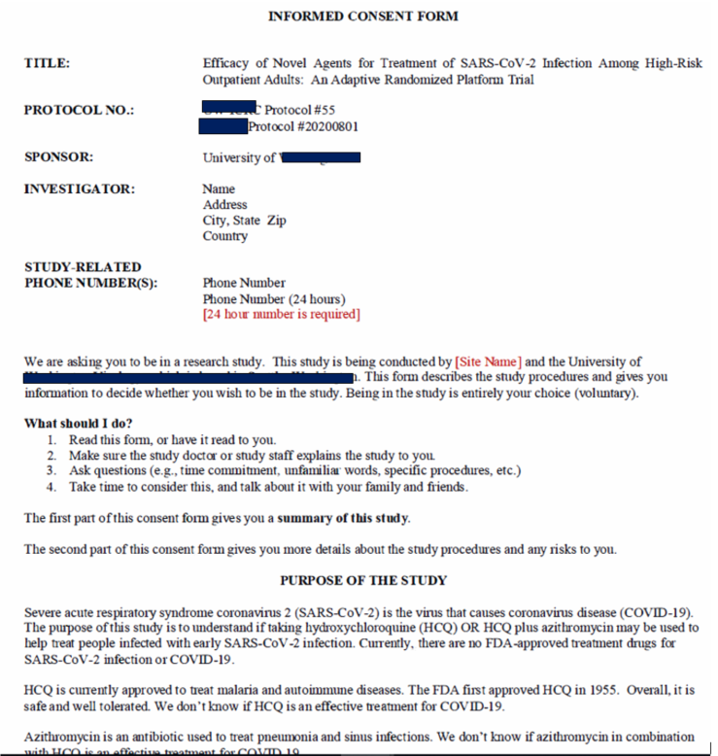
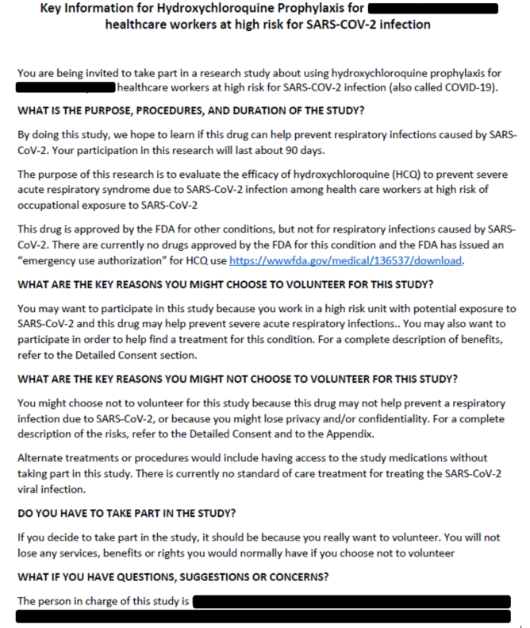
Informed Consent Form
vs

Slide 38
Example of Description of Study Procedures in a Key Information Section of an Actual Study
STUDY PROCEDURES
We are testing HCQ and HCQ+azithromycin in adults who have had a laboratory confirmed SARS-CoV-2 infection within the past 72 hours. We are inviting you to participate because you have been referred by your healthcare provider or have been self-referred. Here is what the study involves:
You will be contacted by our research team and asked to join this study. You will be in this study for approximately 28 days and no in-person visits are necessary - eve1y interaction will occur via telephone, telehealth, internet, or mail. If you are selected for a substudy you will complete extra sample collections throughout the study and 28 days after your first visit.
We will ask you to complete a brief enrollment survey about medical history, current & past symptoms, date of COVID-19 diagnosis, current use of medicines, and demographics. These questions will be asked either by telephone or answering questions in an online survey.
We will ask you to sign Health Insurance Portability and Accountability Act (HIPAA) forms so we may access your COVID-19 related medical records.
You will complete a short survey about your current health for 14 days. We will ask you to meet with study staff via telehealth roughly every 3-4 days during the study. You will have the option to request to meet with study staff via telehealth more frequently. We will ask you to check your temperature, oxygen saturation, pulse, and respiratory rate twice a day. We will also ask you to check your heart rhythm using a device. We will provide all supplies to you to do these assessments. The procedures will take about 30 minutes each day.
You will be asked to self-test for your current COVID-19 status by swabbing the inside of your nose with a special swab called a nasal swab. We will ask you to repeat this procedure with a new swab daily while in the study. Once you have swabbed the inside of your nose, you will put your swab in a special tube for storage.
You may also be asked to prick your finger to collect drops of blood called dried blood spots on a special card. We may ask you to collect these blood spots at enrollment, partway through the study, and at the end of the study.
We will provide you with all of the supplies you need to collect your samples. The supplies will arrive in a couriered package, and we will give you envelopes and postage to either mail them back or a courier will come collect them.
To test for novel coronavirus, the swabs will be sent to the XXX University. Your results may not be available for weeks after the study is completed. When your results are available, we will provide them to you. These swabs are not part of routine clinical care.
This study does not replace or affect any care you might receive from your doctor.
Questions:
Do participants need all this detail to make a decision about participation or not?

Slide 39
Example of Key Information on a Cancer Study
Why are we doing this study?
  The new idea is …
  Why might it help?
  The purpose of this study is to … No one knows the answer – that’s why the trial is being done.
What are the tradeoffs for you? A discussion of pros and cons integrating the most common and the most serious side effects, with the potential benefits the investigators are hoping to find
  Why would you not want to be in this study?
  Why would you want to be in this study?
How will the research be done? Include a discussion on randomization
(Extracted from presentation by S. Woloshin, Dartmouth Institute for Health Policy and Clinical Practice, Dartmouth Medical School, see Session Summaries at www.hhs.gov/ohrp/education-and-outreach/exploratory-workshop/2018-workshop/index.html)

Slide 40
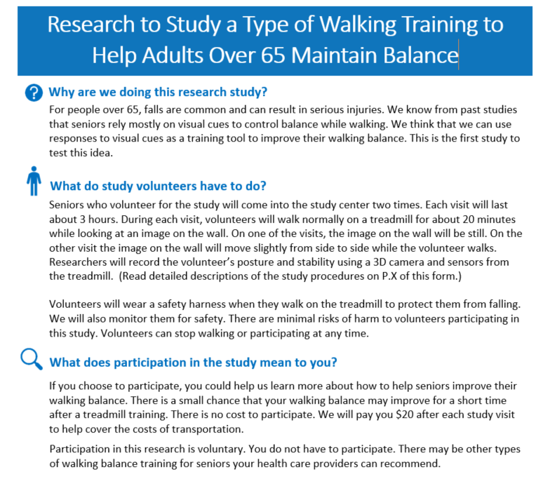
An example for conveying key information

Slide 41
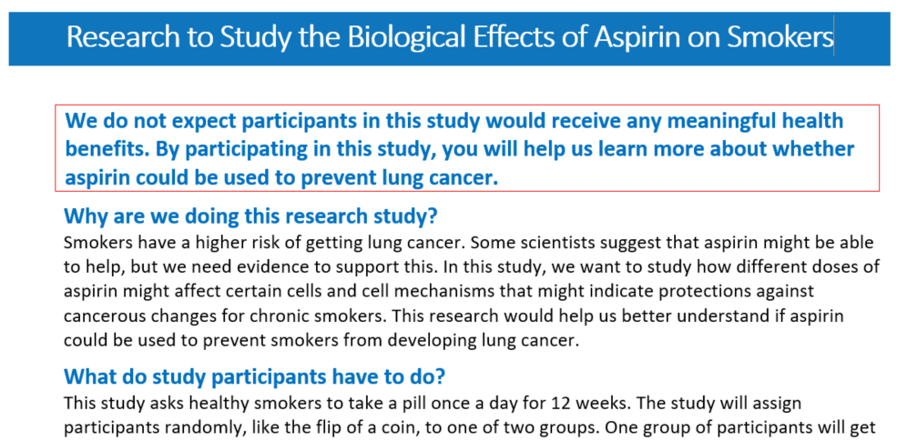
An example for conveying key information

Slide 42
Simplifying Consent Documents
Simplify complex information:
  Consider the context people seek and understand information
  Organize content to respond to their need and use of the information
Use plain language
Use visual aids to facilitate understanding
Review it and run it by patient research advocates
Make use of the new key information section to orient and guide people in decision-making

Slide 43
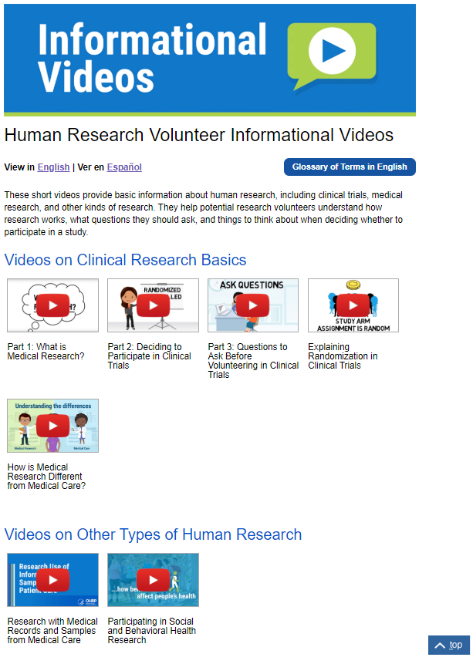

OHRP Public Outreach Resources
www.hhs.gov/About-Research-Participation
Educate prospective participants!
Resources also in Spanish!

Slide 44
Contacts and Resources
Contact us or submit your questions to OHRP@hhs.gov
Visit OHRP website at www.hhs.gov/ohrp
Bookmark this page for quick reference to OHRP resources on the revised Common Rule: www.hhs.gov/ohrp/education-and-outreach/revised-common-rule/index.html
Check out OHRP 2018 Exploratory Workshop Meeting new Challenges in Informed Consent in Clinical Research [September 7, 2018]
Check out OHRP Luminaries Lecture Series Use of eConsent in Human Subjects Research [February 4, 2020]

Slide 45

Remember!
Please refer to the text of the revised Common Rule available on OHRP’s website for a complete and accurate description of the regulatory requirements

