Slide 1
Mentoring: NIH and the National Research Mentoring Network (NRMN)
October 29, 2020
5:00 - 5:45 ET
Presenters:
Alison Gammie, Ph.D. (NIGMS/NIH)
Christine Pfund, Ph.D. (NRMN)
Mercedes Rubio, Ph.D. (NCATS/NIH)
Nicole Redmond, M.D., Ph.D., MPH (NHLBI/NIH)
Moderator:
Ericka Boone, Ph.D. (OER/NIH)
Notes:
EB

Slide 2
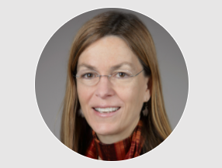

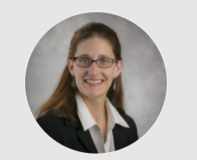

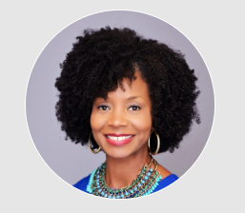
Presenters & Moderator
Presenters
Alison Gammie,Ph.D.
(NIGMS/NIH)
Mercedes Rubio, Ph.D.
(NCATS/NIH)
Christine Pfund, Ph.D.
(NRMN)
Nicole Redmond, M.D., Ph.D., MPH
(NHLBI/NIH)
Moderator
Ericka Boone, Ph.D.
(OER/NIH)
Notes:
EB

Slide 3
Session Goals:
Mentorship has been shown to be critical for the advancement of biomedical researchers. In this session, you will hear about national efforts to advance the science of mentorship. This session will help mentors and mentees improve their practice and expand their mentoring networks to advance their careers.
Objectives:
Upon completion of this session, participants will be motivated to:
Identify your mentoring needs and expand your network to meet those needs
Read about evidence-based approaches to mentoring
Use the resources at NRMN and other mentoring sites
Notes:
EB

Slide 4
Session Plan
Time | Topic | Presenter
5:00-5:05 | Introduction of Panelists | Ericka Boone
5:05-5:10 | State of Science of Effective Mentorship | Chris Pfund
5:10-5:15 | Cultivating your Mentoring Network | Nicole Redmond
5:15-5:20 | Creating a Mentoring Culture | Mercedes Rubio
5:20-5:25 | Resources to Support Mentees and and Institutions in Enhancing Mentorship | Alison Gammie
5:25-5:45 | Broad Q&A | All Panelists
Notes:
EB

Slide 5

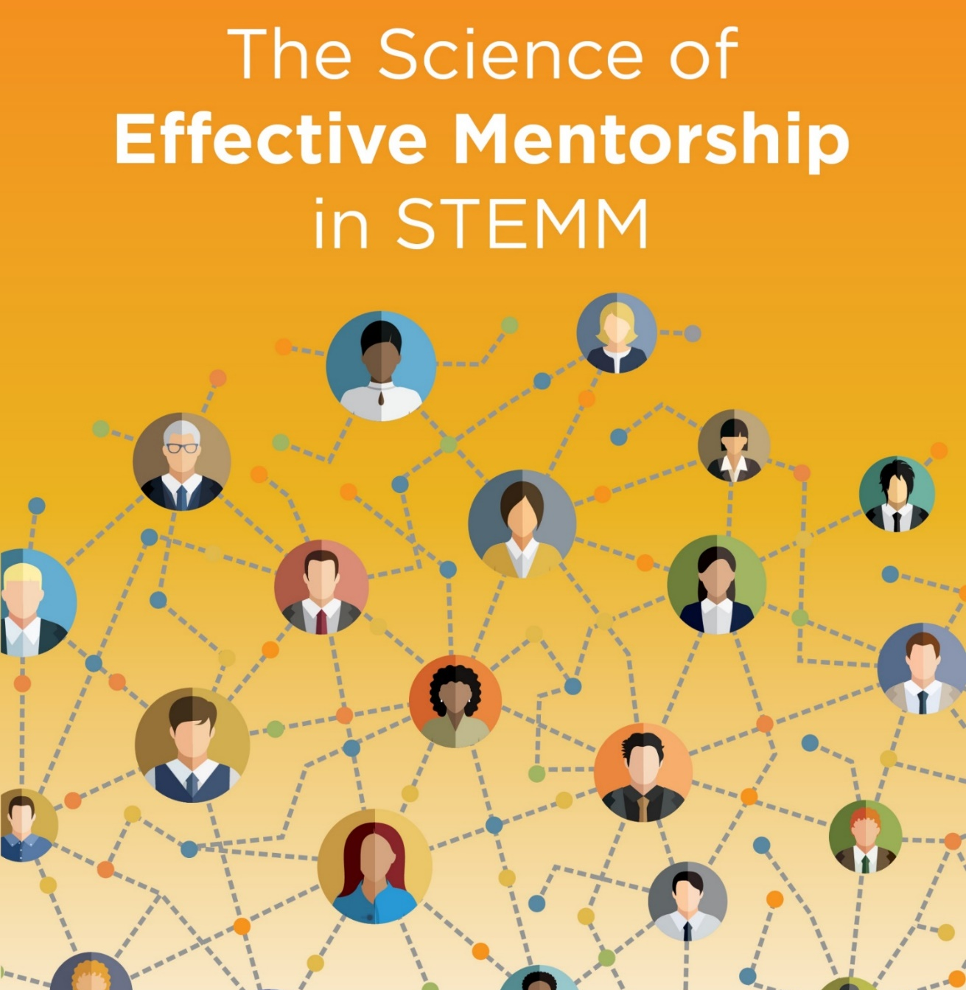
The Science of Effective Mentorship in STEMM
#NASEMmentoring
Notes:
CP

Slide 6

What is Mentorship?
Mentorship is a professional, working alliance in which individuals work together over time to support the personal and professional growth, development, and success of the relational partners through the provision of career and psychosocial support.
Mentorship includes career support functions (e.g., career guidance, skill development, sponsorship) and psychosocial support functions (e.g., emotional support or role modeling) aimed at mentee talent development.
It complements other developmental processes like teaching or coaching to support mentees in developing knowledge and skills, and is essential to holistic development of STEMM professionals, including STEMM identity development.
Notes:
CP

Slide 7
What is Mentorship? Elements
Trust
Trust develops when mentors and mentees work together to identify and respond to their mutual goals, needs, and priorities. These change over time and thus may require adjustment.
Self-reflection
Critical and honest self-reflection occurs at multiple stages of effective mentorship processes.
Expectations
Explicit declarations of the expectations of both mentors and mentees at the initiation of mentorship—revisited periodically and possibly recorded in writing—can help create an effective mentoring relationship.
Education
Mentorship is a learned skill, and mentorship education influences mentor and mentee attitudes, self-efficacy, and behaviors.
Notes:
CP

Slide 8
Attributes for Effective Research Mentoring Relationships
Research Development Teaching disciplinary knowledge Providing technical training Accurately assessing understanding of disciplinary knowledge and skills Promoting ethical behaviors and responsible conduct of research | Diversity/Cultural Cultural self-knowledge Advancing equity and inclusion Being culturally responsive Reducing impact of bias Reducing stereotype threat
Interpersonal Active listening/ effective communication Aligning expectations Building trusting relationships Active coaching | Sponsorship Fostering independence Promoting professional development Expanding mentee networks Actively advocating Fostering work-life integration
Psychosocial Providing motivation Developing mentee career self-efficacy Developing mentee research self-efficacy Developing science identity Developing a sense of belonging | Pfund et al, 2016
Notes:
CP

Slide 9
Cultivating Mentoring Networks
A range of structures support mentees’ development, including:
Dyad
Triads
Mentor
Mentee
Mentor
Mentee
Mentor
Mentee
Mentor
Mentee
Collective or Group
Network
Peer Mentor
Mentor
Mentor
Mentor
Mentee
Mentor
Sponsor
Mentee
Mentee
Mentee
Coach
Mentor
Notes:
Nicole R.
Mentorship as the committee defined it is not limited to a traditional dyadic structure—one mentor and one mentee. Rather, there are a wide range of structures of mentorship that are observed or will develop.
Dyad do still play a major role in mentorship and many mentoring relationships can be considered as dyads
Triads are the simplest, non-dyadic structure, can be two mentors and one mentee or one mentor and two mentees. They can also be open—like two connected dyads—or closed—connections between all three parties.
Collective or group mentorship involves multiple mentors and/or multiple mentees, with connections between and among them.
Network mentorship is a mentee-centric perspective that shows different mentors, mentoring nodes (e.g., groups of mentors, mentorship programs) and mentoring resources (e.g., mentorship education)

Slide 10
Types of Advisors
Navigator--organizational dynamics
Sponsor--resources and opportunities needed for advancement
Coach--skills and methods
Confidant--emotional support
Career Mentor
Co-Mentor(s)
Research Mentor
Advisors
Peer
Mentors
Mentee
Notes:
Nicole R
Mentors may take on multiple types of advising roles:
Navigator—may be a senior faculty member or div/dept chair, a named mentor on your career development award. Helps with alignment of career goals with advancement (which could be advancing to independent research funding, or advancing through promotion/tenure process
Sponsor—typically a senior leader with decision making capacity and/or influence. Connects you to other people and/or opportunities—award nominations, special committees/projects,
Coach—focused on specific skills—methods—speaking, writing, data collection, data analysis.
Im

Slide 11
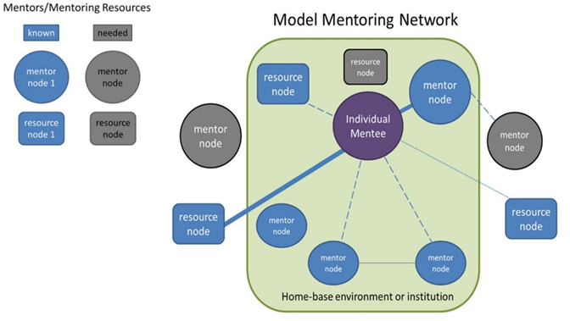
Mentoring Maps
Resourced from Montgomery, B. 2017 Mapping a Mentoring Roadmap and Developing a Supportive Network for Strategic Career Advancement, SAGE Open.
Notes:
Nicole
Mapping helps identify gaps in mentoring networks. Assess for diversity across multiple dimensions:
Demographic (e.g. race, gender, geographic origin)
Hierarchy (e.g., supervisor, peer, subordinate)
Career tenure (e.g., senior, peer, junior)
Within vs. outside org unit (e.g. division, department, institution)
Concordance between mentor/mentee in this area often facilitates emotional support, coping, navigating organizational culture
Discordance between mentor/mentees facilitates access to new opportunities, resources, information.

Slide 12
Creating a Culture and Cultivating Effective Mentorship
Support Multiple Mentorship Structures and Opportunities
Institutional leadership should support policies, procedures, and other infrastructure that allow mentees to engage in mentoring relationships with multiple individuals within and outside of their home department, program, or institution, such as professional societies, external conferences, learning communities, and online networks, with the ultimate goal of providing more comprehensive mentorship support.
Professional associations should proactively facilitate the development of mentoring relationships among individuals from different programs or institutions, as needed, who can provide complementary or supplementary mentorship functions.
  Membership Sections
  Committee on the Status of Groups in the Profession
  “Minority Action Committees”
Notes:
MR
Multiple mentorship
It is unreasonable to assume that one person can provide all the mentorship that is needed to a mentee. Therefore, multiple mentorship should be supported.
How can organizations support development of mentoring networks?
FOR EXAMPLE (read)

Slide 13
Creating a Culture and Cultivating Effective Mentorship (continued)
Foundations can and also play a role in facilitating mentoring and networking opportunities.
Ford Foundation
Doris Duke Charitable Foundation
Robert Wood Johnson Foundation
Alzheimer’s Association (partner with NIA Butler-William
Scholars Program)

Slide 14

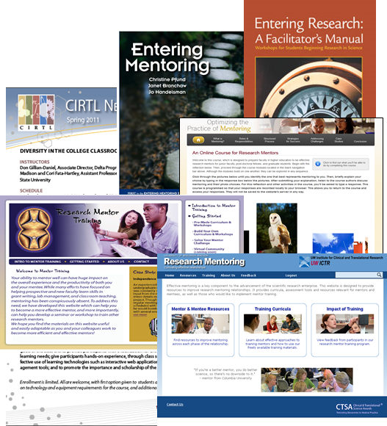
NRMN Mentor Training Core Phase I:
Expanded, Enhanced, and Studied Ways to Optimize Research Mentoring Relationships
Face-to-face mentor training workshops
Face-to-face mentee training workshops
Self-paced online training
Synchronous online training
Train-the-trainer workshops
Implementation workshops
Notes:
MR

Slide 15
Where can you learn more?
Read the Report
www.nap.edu/MentorshipInSTEMM
Use the Online Guide
www.nationalacademies.org/MentorshipInSTEMM
Learn about the Project
www.nas.edu/mentoring
Join the Conversation
#NASEMmentoring
Ask a Question or Make a Comment
mentoring@nas.edu
Notes:
AG
We also developed an online guide for those interested in moving creating cultures of intentional, inclusive, and effective mentorship in their own departments at their own institutions, or those who are just interested in improving their own mentorship practice

Slide 16

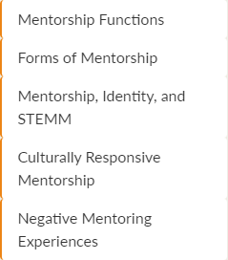
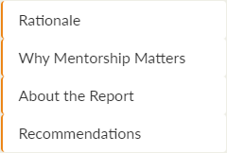
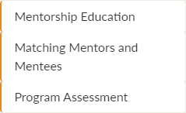
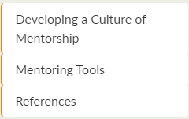
Where can you learn more?
Notes:
AG
The guide is structured to provide much of the same information as can be found in the report, but written for program leaders (grad student deans, T32 directors) as well as mentors and mentees themselves
For example…

Slide 17
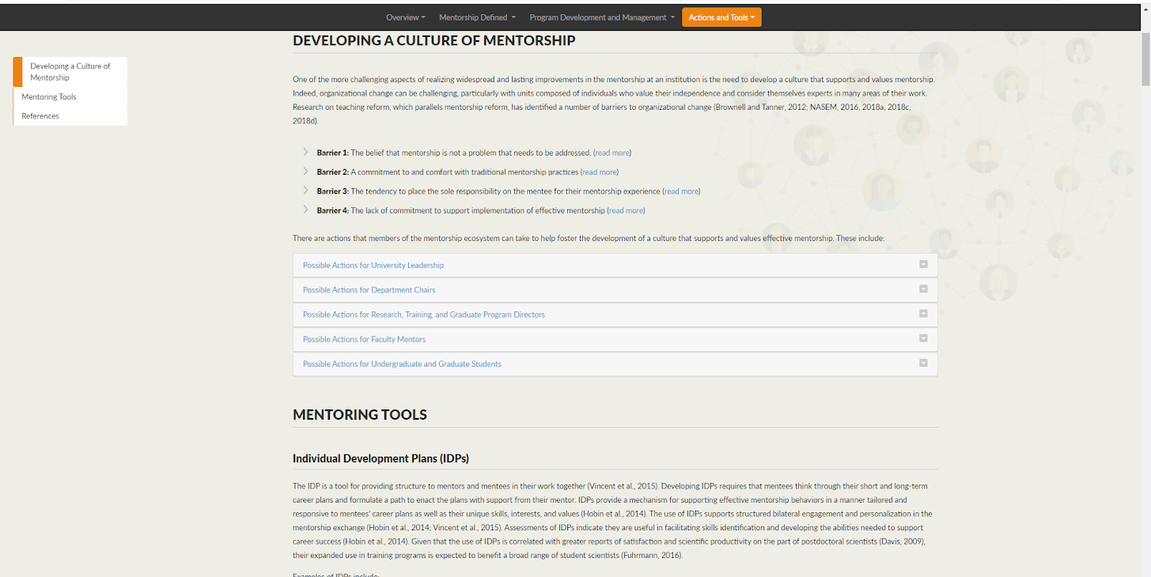
Mentoring Tools

Slide 18
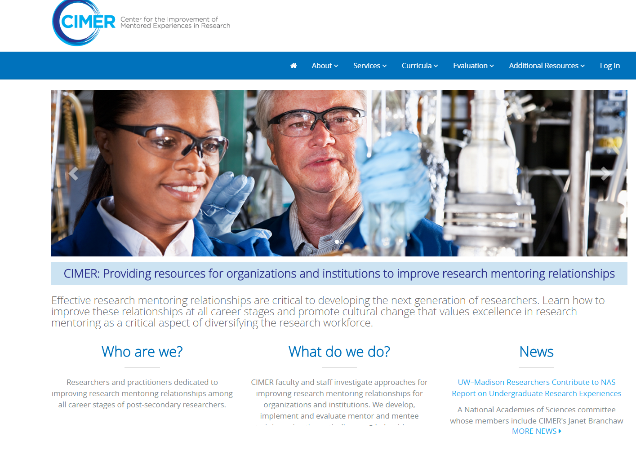
Center for the Improvement of
Mentored Experiences in Research (CIMER)
Notes:
AG

Slide 19
Resources to Support Mentees and Institutions in Enhancing Mentorship
Notes:
AG
Here--are we targeting resources for mentees, for institutions or for both?

Slide 20

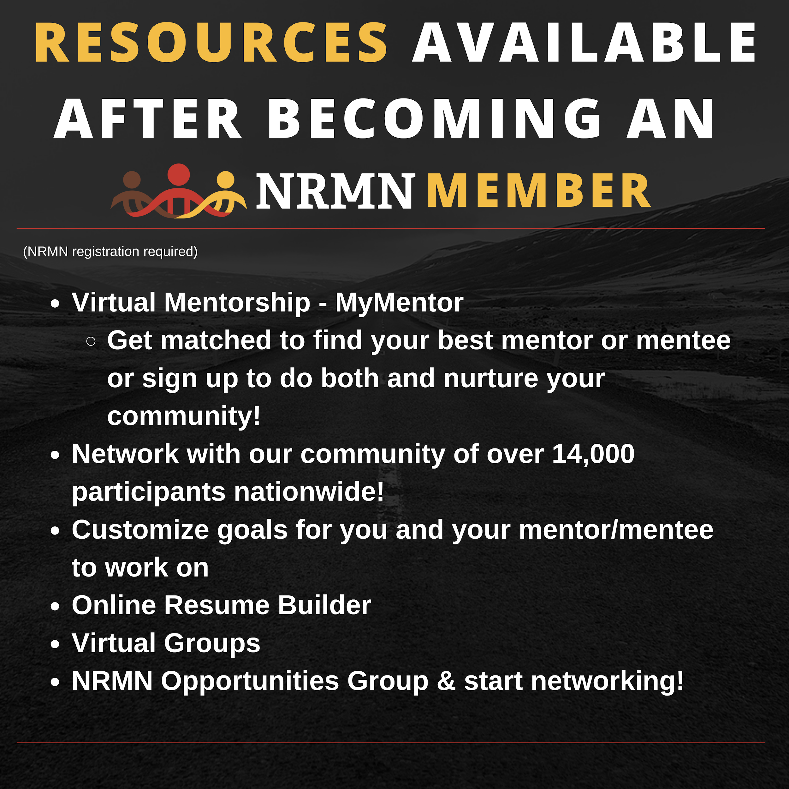
Resources
Notes:
AG

Slide 21
How to Leverage the NRMN Network, Part 1
Attend Webinars:
11/5/2020, 12-1:30pm CST: Mentoring Excellence Webinar Series
  The Trials and Tribulations of Grad School
  Register in Advance: https://unthsc.zoom.us/webinar/register/WN_YFdB5uW-Qpq1KdZKWrb1iw
11/16/2020, 11-11:45am CST: How to Leverage the NRMN Network Webinar
  Register in Advance: https://unthsc.zoom.us/webinar/register/WN_n1z5j_WDR2q0tvJF7HSvnw
Stay Current:
Share or review Diversity Funding Opportunities: https://nrmnet.net/diversity-funding-opportunities/
Sign up for the NRMN Newsletter: NRMNet.net/subscribe
Notes:
AG

Slide 22
How to Leverage the NRMN Network, Part 2
Join MyNRMN
Expand your network
  Connect within or outside your field for future collaborations
Engage in 2 forms of mentoring:
  1-on-1 guided virtual mentoring focused on culturally aware mentorship
  Self-structured mentoring (available to both mentors & mentees)
Create a My Group for your organization
  Make a private My Group for only your members
  Communicate in a discussion board or through video calls
Create a My Cohort for your organization to collect aggregate data
  Email info@nrmnet.net to request information
Notes:
AG

Slide 23
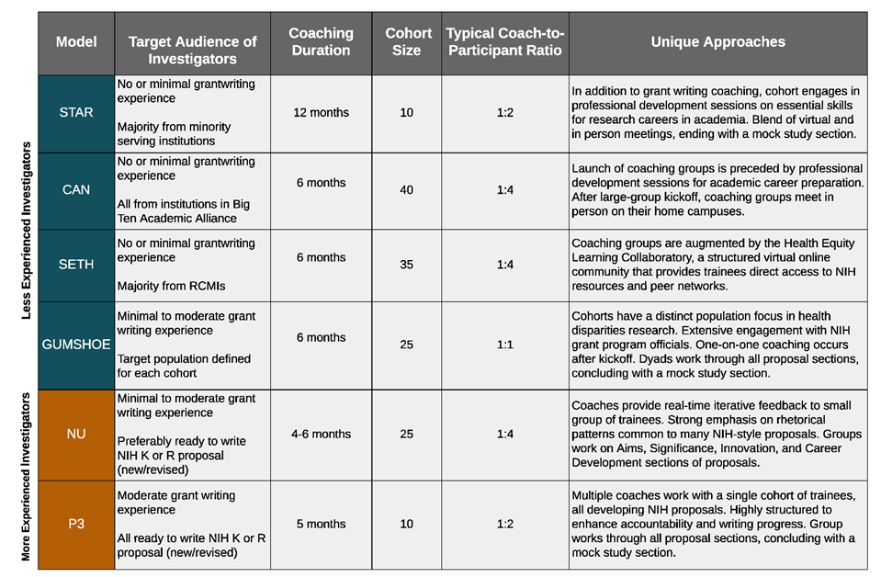
NRMN Phase I Grantwriting Coaching Programs
Notes:
AG

Slide 24
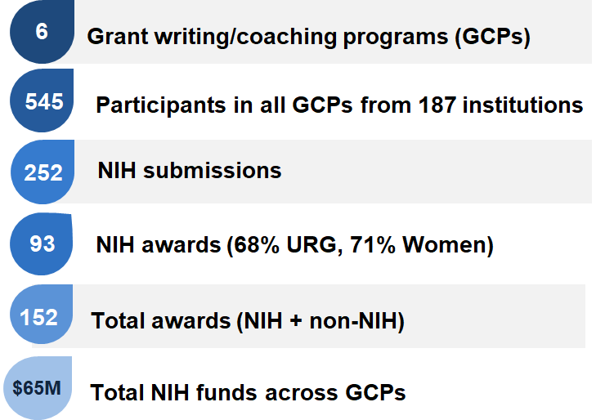
NRMN Phase 1 Grantwriting Coaching Programs
By the Numbers (Data as of March 31, 2019)
Notes:
AG

Slide 25
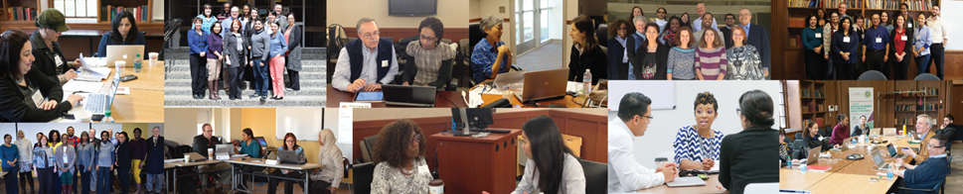
NRMN Phase II Opportunities to Enroll in GCPs (U01 Studies)
University of Utah Grant Writing Coaching Group Study | Information can be found at: https://nrmnet.net/university-of-utah-nrmn-u01/
Morehouse School of Medicine Grant Writing Coaching Group Study | Contact Kimberly Lawson, NRMN SETH Project Manager, at (404)756-5288 or NRMN.SETH@gmail.com
Notes:
AG

Slide 26
NRMN Grantwriting Coaching Program:
Morehouse School of Medicine
Study Title: A Randomized Controlled Study to Test the Effectiveness of Development Network Coaching in the Career Advancement of Diverse Early Stage Investigators
(PI: Elizabeth O. Ofili, Morehouse School of Medicine)
Program Overview: Structured grant writing plus developmental network coaching intervention that includes: grant writing coaching, peer-to-peer mentoring, bi-weekly proposal review sessions, access to the Health Equity Learning Collaboratory, and a mock study section with expert review panel.
Program Length: 9 months (Cohort 3: February - October, 2021)
Who can apply? Early stage investigators (faculty, postdocs, and new NIH investigators) who plan on submitting an NIH grant application within 12 months of program completion
Application Deadline: Rolling
Questions? Contact Kimberly Lawson, NRMN SETH Project Manager, at (404)756-5288 or NRMN.SETH@gmail.com

Slide 27
NRMN Grantwriting Coaching Program:
University of Utah
Study Title: Enhanced Grant Writing Coaching Intervention for a Diverse Biomedical Workforce (PI: Kolawole S. Okuyemi, University of Utah)
Program Overview: Grant writing skills training for underrepresented junior investigators to enhance their productivity and independence that includes: 2-day kickoff event, group coaching sessions, and a mock study section.
Program Length: 5 months (Cohort 3: January - May 2021)
Who can apply? Advanced postdoctoral fellows or faculty on a career trajectory to become an NIH-funded independent investigator who are actively developing a new or revised K-, R- or SC-series NIH proposal (or similar national-level proposal) with an intended submission date 6-10 months after the program kickoff.
Application Deadline: Cohort 3 is October 30; Cohorts 4-6 are TBD
Questions? Contact NRMNUtah@utah.edu or visit the study info page on NRMNet: https://nrmnet.net/university-of-utah-nrmn-u01/

Slide 28
Acknowledgements
NRMN Phase I (2014 - 2019):
U54GM119023
NRMN Phase II (2019 - 2024):
U24GM132176 (Coordination Center)
U24GM132217 (Resource Center)
Notes:
CP

Slide 29
Extra Slides

Slide 30
NRMN Phase II Centers
Coordination Center (PI: Christine Pfund, University of Wisconsin-Madison)
Resource Center (PI: Jamboor K. Vishwanatha, University of North Texas Health Science Center)

Slide 31
NRMN Phase II U01s
Boosting Mentor Effectiveness in Training of Research Scientists (MENTORS) Using Social Cognitive Career Theory to Support Entry of Women & Minorities into Physician-Scientist Careers (PIs: Vineet Arora and Rachel Wolfson (m-PI), University of Chicago)
Impact of Culturally Aware Mentoring Interventions on Research Mentors and Graduate Training Programs (PI: Angela Byars-Winston, University of Wisconsin-Madison)
Building a Diverse Biomedical Workforce Through Communication Across Difference (PI: Carrie A. Cameron, University of Texas MD Anderson Cancer Center)
Studying Inclusive Mentor Networks to Diversify the Biomedical Workforce (PIs: Mica Beth Estrada, University of California, San Francisco; Paul Hernandez, University of Texas A&M; Nichole Broderick, University of Connecticut; Jo Handlesman, University of Wisconsin-Madison)

Slide 32
NRMN Phase II U01s (continued)
Peer group mentoring for racially underrepresented early career biomedical researchers: Identifying the unique influence of psychosocial support on personal gains and objective career outcomes (PIs: Susan S. Girdler, University of North Carolina at Chapel Hill; Friederike Jayes, Duke University)
Intersection of Social Capital, Mentorship and Networking on Persistence, Engagement and Science Identity (PI: Manoj K. Mishra, Alabama State University)
A Randomized Controlled Study to Test the Effectiveness of Development Network Coaching in the Career Advancement of Diverse Early Stage Investigators (PI: Elizabeth O. Ofili, Morehouse School of Medicine)
Enhanced Grant Writing Coaching Intervention for a Diverse Biomedical Workforce (PI: Kolawole S. Okuyemi, University of Utah)

Slide 33
NRMN Phase II U01s (continued)
Career Advancement and Culture Change in Biomedical Research: Group Peer Mentoring Outcomes and Mechanisms (PI: Linda Pololi, Brandeis University)
Building Up a Diverse Pipeline for the Biomedical Research Workforce (PIs: Doris M. Rubio and Audrey Murrell, University of Pittsburgh; Natalia Morone, Boston University)
Effectiveness of Innovative Research Mentor Interventions among Underrepresented Minority Faculty in the Southwest (PI: Akshay Sood, University of New Mexico Health Sciences Center)

