Slide 1

Let’s Look at Peer Review
NIH Virtual Seminar
October 28, 2020
Sally Amero, Ph.D.
NIH Review Policy Officer
NIH Extramural Research Integrity Liaison Officer
NIH Office of Extramural Research
ameros@od.nih.gov
ReviewPolicyOfficer@mail.nih.gov

Slide 2

Problem
Currently NIH receives
> 80,000 applications/year
Some are funded.

Slide 3

If You Could
Design the System…
What would be important?
  Checks and balances
  Managing inappropriate influences
  Protecting ideas
  What will be evaluated
  How applications are graded
  Getting fast results
  Who decides
  Fairness
Let’s see what NIH does.

Slide 4
Understand the Process:
Checks and Balances
An application must go through two levels
of peer review in order for an award to be made.
CSR Division of Receipt & Referral
Scientific Review Groups (SRGs) “Study Sections”
Funding Institute
Receipt and Referral
Initial Peer Review
National Advisory Council
Submit your
application
Funding
decision
Special exceptions
are in place for
some COVID initiatives
Scientific Review
Officers (SROs)
4

Slide 5
Managing Influences:
Conflict of Interest (COI)*
Out of the SRG COI | Out of the room COI
Direct financial benefit | Employment
Personal (close relatives) | Professional associations
SRG membership | Appearance of COI
Reviewers must declare COI/sign COI certifications
Applicants may indicate COI in cover letter or ARF
Listen to the On Demand Master Class in Review Integrity
*For grant reviews

Slide 6
Protecting Ideas:
Maintaining Confidentiality
  All materials, discussions, individual
  reviewer scores, and assignments are confidential.
  Meetings are closed to the public.
  All questions must be referred to the SRO, until release of the summary statement.
    Should you contact a reviewer about your application? NO!
    Should you ask a friend to contact a reviewer about your application? – NO!
Listen to the On Demand Master Class in Review Integrity!

Slide 7
What Will Be Evaluated:
Review Criteria
Overall Impact = overall assessment
  Defined for each type of application
  For Research:
  Likelihood for the project to exert a sustained,
  powerful influence on the research field(s) involved
Review criteria are stated in Section V of each Funding Opportunity Announcement

Slide 8
Types of Review Criteria
Category* | Criteria (Research) | Criterion Scores? | Affect Overall Impact Score?
Scored Review Criteria | Significance Investigators Innovation Approach Environment | Yes | Yes
Additional Review Criteria | Study Timeline (CT only) Human Subjects** Vertebrate Animals** Inclusion** Biohazards | No | Yes
Additional Review Considerations | Foreign Institutions Select Agents Resource Sharing Authentication of Key Resources | No | No
* Found in every Funding Opportunity Announcement
** If Unacceptable, award cannot be issued until resolved

Slide 9
Grading Applications: Scoring
Numerical scores used for criterion scores and final impact scores (if discussed)
Impact | Score | Descriptor
High Impact | 1 | Exceptional
 | 2 | Outstanding
 | 3 | Excellent
Moderate Impact | 4 | Very Good
 | 5 | Good
 | 6 | Satisfactory
Low Impact | 7 | Fair
 | 8 | Marginal
 | 9 | Poor

Slide 10
Final Impact Scores
Each member (w/o COI) votes after discussion
  Not just assigned reviewers
  Voted by private ballot at the meeting
  Averaged and multiplied by 10
Range from 10 through 90
Percentiled for some mechanisms
90 – Lowest Impact
10 – Highest Impact

Slide 11
Streamlining Procedure
Allows discussion of more meritorious applications
  Less meritorious applications are tabled:
    Not discussed at the meeting
    Designated “Not Discussed” (ND)
ND requires full concurrence of the study section
Summary statements contain:
    Reviewer critiques
    Criterion scores
ND
Scored

Slide 12
Receipt and Referral (DRR):
What Happens?
Key decisions
  Policy compliance (format, timeliness, etc.)
  Assignment to study section for initial peer review
  Assignment to Institute(s) for funding consideration
DRR
Initial Peer Review:
Scientific Review Group
Council
IC
Director
Application
Funding Institute(s)
See Receipt and Referral On Demand

Slide 13
Understand the Process
Repeats three times a year (“Council rounds”)
Each step is managed by a different NIH official
CSR Division
of Receipt &
Referral
Scientific Review
Groups (SRGS)
“Study Sections”
Receipt and Referral
Initial Peer Review
National Advisory Council
Funding Institute
Submit your
application
Funding
decision
Scientific Review
Officers (SROs)
13

Slide 14
Scientific Review Groups:
Who’s Involved?
Scientific Review Officers (SROs) | Reviewers
PhD-level officials in the NIH Center for Scientific Review or NIH Institute/Center | Not government employees
Ensure compliance with government rules for peer review Manage COI Arrange the meeting Recruit reviewers Assign reviewers Preside at the meeting Prepare and issue summary statements | Scientific and technical expertise Stature in field Mature judgment Impartiality Ability to work well in a group Managed COI Balanced representation Availability
SROs do not engage in SRG evaluations! | SRGs do not make funding decisions!

Slide 15
Who Are the
“Assigned” Reviewers?
For each application:
      ≥ Three qualified reviewers are assigned for
      in-depth assessment = “assigned” reviewers
    The SRO recruits reviewers and assigns applications based on expertise, COI, workload balance
    Each assigned reviewer prepares a written critique and provides criterion scores
    After review, assigned reviewers are expected to adjust their criterion scores and written critiques to reflect the discussion at the meeting
  Assignments are confidential!

Slide 16
What Happens
At the Review Meeting?
    The SRO makes introductory comments.
    For each application that is not streamlined:
      Members with conflicts leave the room.
    Assigned reviewers discuss the application in turn.
    Eligible members join the discussion; Chair summarizes.
    Assigned reviewers provide final scores (setting range).
    All members provide final scores privately.
    Other issues are discussed: budget, data sharing plan, foreign applications, etc.
See the Mock Study Section Live!

Slide 17
When Do I Get My Results?
Go to the eRA Commons (https://public.uat.era.nih.gov/commons)
    Final Impact Score available within 3 days
    Summary statement available within 4 – 8 weeks, to:
            Funding Institute Program Officer
            Applicant Organization Signing Official
            PD/PI
            Other NIH Officials
            Advisory Council members
        A favorable score does not guarantee funding!

Slide 18
What’s in the
Summary Statement?
First Page | Subsequent Pages
NIH Program Official | Resumé and Summary of Discussion (if applicable)
Final Impact Score or ND | Description (from application)
Percentile (if applicable) | Criterion scores from assigned reviewers
Codes (HS, VA, Inclusion) | Reviewer critiques (largely unedited)
Budget request | Administrative Notes
 | SRG Roster*
*Unless part of an aggregate roster

Slide 19
Whom to Contact
After the Review?
After release of the Summary Statement,
your point of contact is your assigned
NIH Program Official.
But first, read and consider the summary statement.
You may need to:
  Submit Just-in-Time (JIT) information
  Consider your options:
    Submit a new application.
    Revise and resubmit your application.
    Appeal the review outcome (NOT-OD-11-064).

Slide 20
Understand the Process
Repeats three times a year (“Council rounds”)
Each step is managed by a different NIH official
CSR Division
of Receipt &
Referral
Scientific Review
Groups (SRGS)
“Study Sections”
Receipt and Referral
Initial Peer Review
National Advisory Council
Funding Institute
Submit your
application
Funding
decision
Scientific Review
Officers (SROs)
20

Slide 21
National Advisory Councils:
Who’s Involved?
Executive Secretaries (“Exec Secs”) | National Advisory Council (NAC) Members
Senior, PhD-level officials in the NIH funding Institute | Broad and diverse membership Basic/research scientists Clinician scientists “Public” members
 | Appointed as Special Government Employees, Chair is IC Director
Ensure compliance with government rules for Council review Manage COI | Make recommendations for funding Consider concepts for new initiatives Adjudicate appeals of initial peer review
Exec Secs do not engage in Council recommendations! | NACs do not make funding decisions!

Slide 22

Who Decides?
The Director of the funding Institute
makes the final funding decision.
Based on:
    Mission of the NIH Institute,
    program priorities, Congressional mandates
    Outcome of initial peer review
    Additional outside expertise, if needed
    Recommendation of IC Program Staff and Council
    Available Funds

Slide 23
Special Considerations:
COVID-19 Edition
 | August/October 2020 Council | January 2021 Council | May 2021 Council
Unilateral due date extensions? | Yes, to May 1 | By IC or FOA | By IC or FOA
Post-submission materials deadline | 14 days before SRG | 30 days | 30 days
Preliminary data allowed as post-submission materials | No | Yes | Yes
Guidance to reviewers | Assume that temporary, emergency situations due to the pandemic will be assessed before award
All virtual meetings? | Yes
https://grants.nih.gov/policy/natural-disasters/corona-virus/review-process.htm

Slide 24
Reminder: Core Values of Peer Review
Confidentiality
Integrity
Fairness
Security
Impartiality
Expert Assessment
Efficiency
Transparency
See NIH Peer Review Core Values On Demand
https://grants.nih.gov/grants/PeerReview22713webv2.pdf
Listen to the On Demand Master Class in Review Integrity!

Slide 25
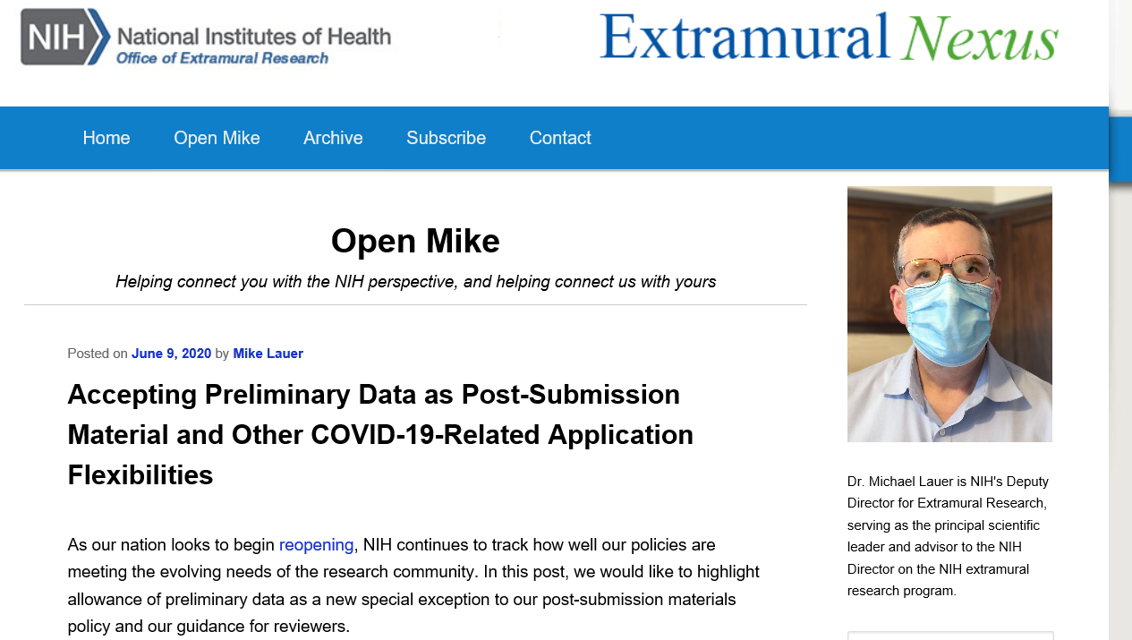
Be Informed!
  Read the Open Mike blog https://nexus.od.nih.gov/all/category/blog/open-mike/
  Join the Guide Table of Contents (TOC)
  http://grants.nih.gov/grants/guide/listserv.htm
    Issued weekly
    Funding Opportunity Announcements
    New Guide Notices/policy announcements

Slide 26

If You Could Design the System…
What would be important?
  Check and balances?
  Managing inappropriate influences?
  Protecting ideas?
  What will be evaluated?
  How applications are graded?
  Getting fast results?
  Who decides?
  Fairness? Integrity?

Slide 27
Additional Information
OER Peer Review Process
http://grants.nih.gov/grants/peer_review_process.htm
Peer Review Policies & Practices
http://grants.nih.gov/grants/peer/peer.htm
Center for Scientific Review
http://public.csr.nih.gov/Pages/default.aspx
NIH Guide to Grants and Contracts
http://grants.nih.gov/grants/guide/index.html

