Slide 1
eRA Commons:
Accounts, Roles, Profiles & Delegations
What is era Commons?
Accounts
Password policy
Roles
Institutional Profile (IPF)
Personal profile (PPF)
Delegations

Slide 2
What is eRA Commons?
The eRA Commons is an online interface where grant applicants, grantees and federal staff can access and share administrative information related to grant applications and awarded research grants.
Applications
eSubmission Errors/Warnings
Assurances
Assembled Application Image
Certifications
Review Assignment
Profile Data
Progress Reports
Priority Score
Financial Reports
Summary Statement
Invention Reports
Notice of Award
Training Appointment Actions
Post-award Correspondence

Slide 3
Organization Registration
Organizations must register in eRA Commons
Many organizations are already registered
  Check with your Administrative Office before starting the process
  Quick Query: http://era.nih.gov/commons/quick_queries/index.cfm#commons
For new registrations, complete the online Institution Registration Form
  Form: https://public.era.nih.gov/commons/public/registration/registrationInstructions.jsp
  Carefully follow ALL steps including printing/signing/faxing registration page and responding to email verification messages

Slide 4

Signing Official (SO)
During Commons registration, an applicant organization designates a Signing Official (SO)
  SO has authority to legally bind the organization in grants administration matters
  Equivalent to the Authorized Organization Representative (AOR) in Grants.gov
  SO is responsible for:
    maintaining institutional information
    submitting documents that require signature
    authority to act on behalf of the organization
    managing accounts

Slide 5

Account - Tips
Designate more than one Signing Official
  Certain Commons actions can only be taken by users with the SO role and you will want a back-up
Administrators should always check to see if a user already has a Commons account before creating a new account with a scientific role
  Ask the person if they already have an account, or search within the Commons
    If a user already has an account with a different organization,
    the SO should affiliate the existing account with the user’s
    new organization

Slide 6
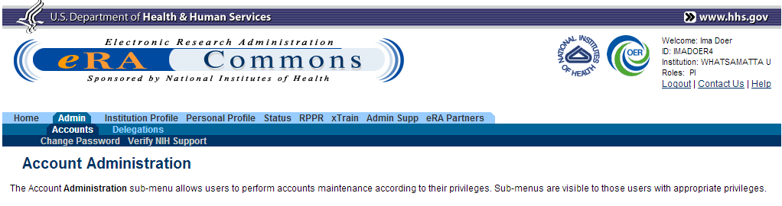
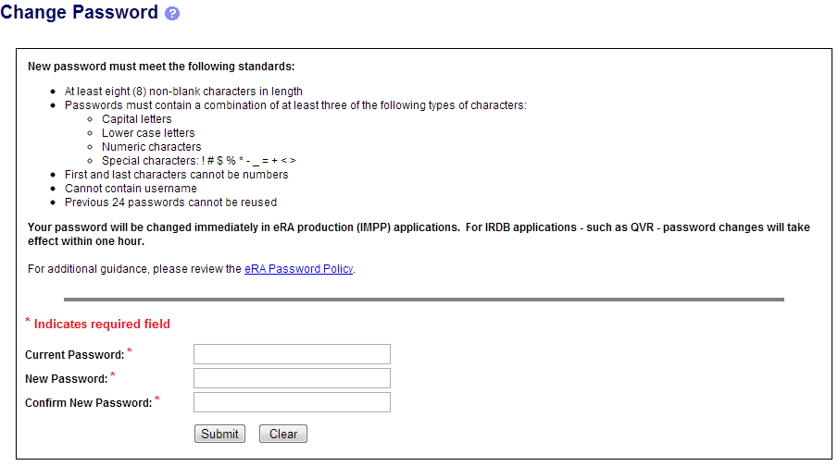
Changing a Password
Available to any logged-in user.
Enter current and new password. Click Submit.

Slide 7
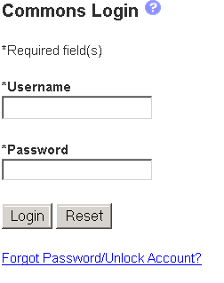
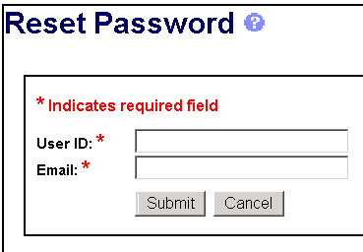
Forgot Password/Unlock Account
If the username and e-mail combination provided match what is in the system, a temporary password will be e-mailed to you.

Slide 8
Account Passwords
Password policy:
  http://era.nih.gov/files/NIH_eRA_Password_Policy.pdf
Passwords must:
  Contain at least eight (8) characters; no blank spaces
  Contain a combination of at least 3 of the following:
    Upper case letters
    Lower case letters
    Numbers
    Non-consecutive special characters: ! # $ % - _ = + < >
  Not begin or end with a number
  Not contain username
  Not be reused within one (1) year
  Be changed every 90 days

Slide 9
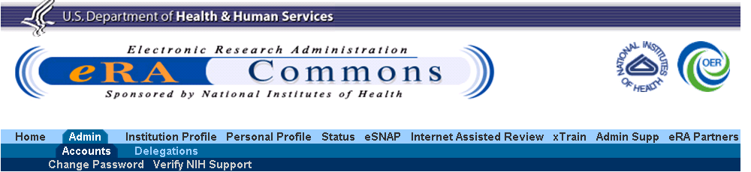
Navigating the eRA Commons
The eRA Commons navigation menu has three (3) levels. The top level displays the main functions (tabs) available. Clicking a top-level tab will display the second level; clicking a second-level tab will display the third level.
1
2
3

Slide 10
eRA Commons Roles
The functions that a user can perform in the Commons are based on the role(s) assigned to his or her Commons account
Full, printable list of eRA Commons roles:
  http://era.nih.gov/files/eRA_Commons_Roles.pdf

Slide 11

Roles
Administrative
  AA – Account Administrator
  AO – Administrative Official
  ASST – Assistant
  BO – Business Official
  SO – Signing Official
Scientific
  Graduate Student
  IAR – Internet Assisted Review
  PI - Principal Investigator
  Post-Doc
  Project Personnel
  Scientist
  Sponsor
  Trainee
  Undergraduate
PI
ROLES

Slide 12

Roles 2
Other
  FCOI (Financial Conflict of Interest)
  FCOI_ASST
  FCOI_VIEW
  FSR (Financial Status Reporter)
  PACR (Public Access Compliance Reporting)
IAR
PI
AA
FSR
SO
AO

Slide 13
Role - Tips
Don’t combine scientific roles with administrative or other roles on the same account
  Other combinations are fine (e.g., PI and IAR; AO and FSR)
  A person needing both scientific and administrative roles should have two separate accounts (one for scientific roles and another for other roles)

Slide 14

Institutional Profile File (IPF)
Each organization establishes and maintains their organization’s profile data
Depending on their role, users can view and/or update Institution Profile information
  Only SOs can edit IPF information
  IPF displayed as a read-only page for users with all other Commons roles
  Includes two sections: Basic and Assurances & Certifications
Central repository for registered organization information
Terminology Check:
‘Organization’ = ‘Institution’ = ‘Entity’

Slide 15
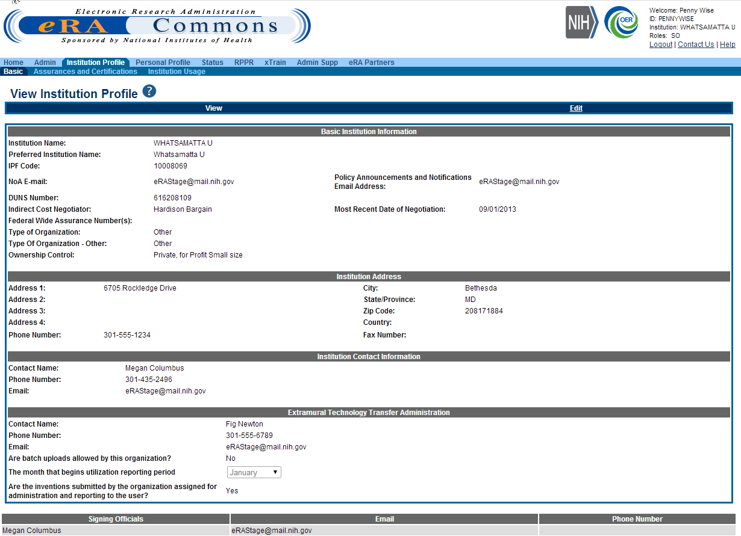
IPF - Basic
Basic: general information about the institution
  Name, address, Institution Contact information, list of Signing Officials, etc.
Only SOs can edit Institution Profile

Slide 16
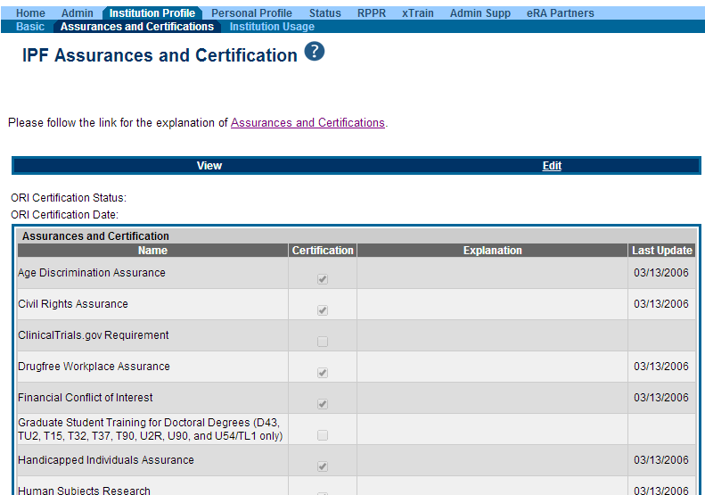
IPF – Assurances and Certifications
Assurances and Certifications: data elements that comprise assurance/certification information about an institution
  List of certifications
  (e.g., Financial Conflict of
  Interest, Human Subjects
  Research, Vertebrate
  Animals, etc.)
Understand what you are agreeing to!

Slide 17
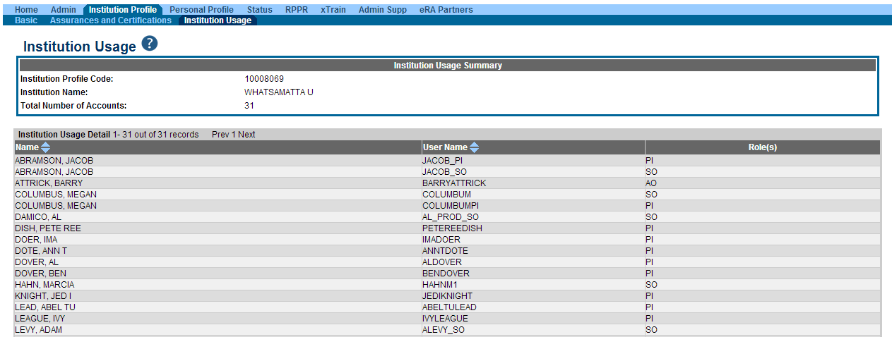
IPF Sections
Institution Usage: summary of institution’s users
  Lists Name, User Name and Role(s) of each user

Slide 18
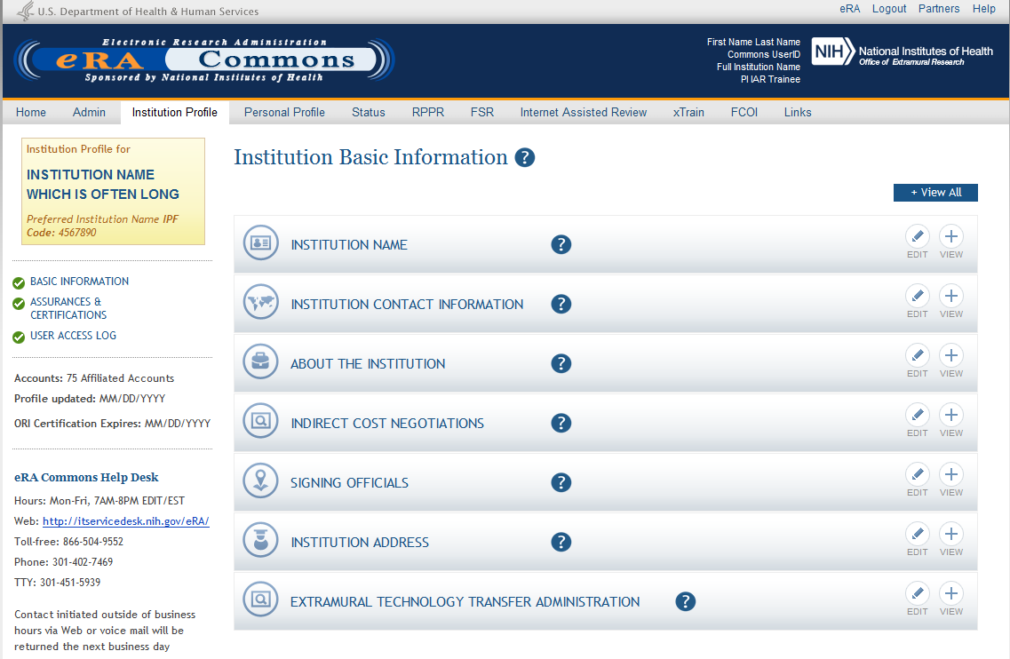
New IPF View

Slide 19



Personal Profile (PPF)
Individual Commons users are responsible for keeping their profile information accurate
Includes information such as:
  Name
  Demographics
  Employment history
  Education
  Reference Letters
  Publications
Very few staff members at NIH have access to change information (for emergencies only)
Central repository for individual user information

Slide 20
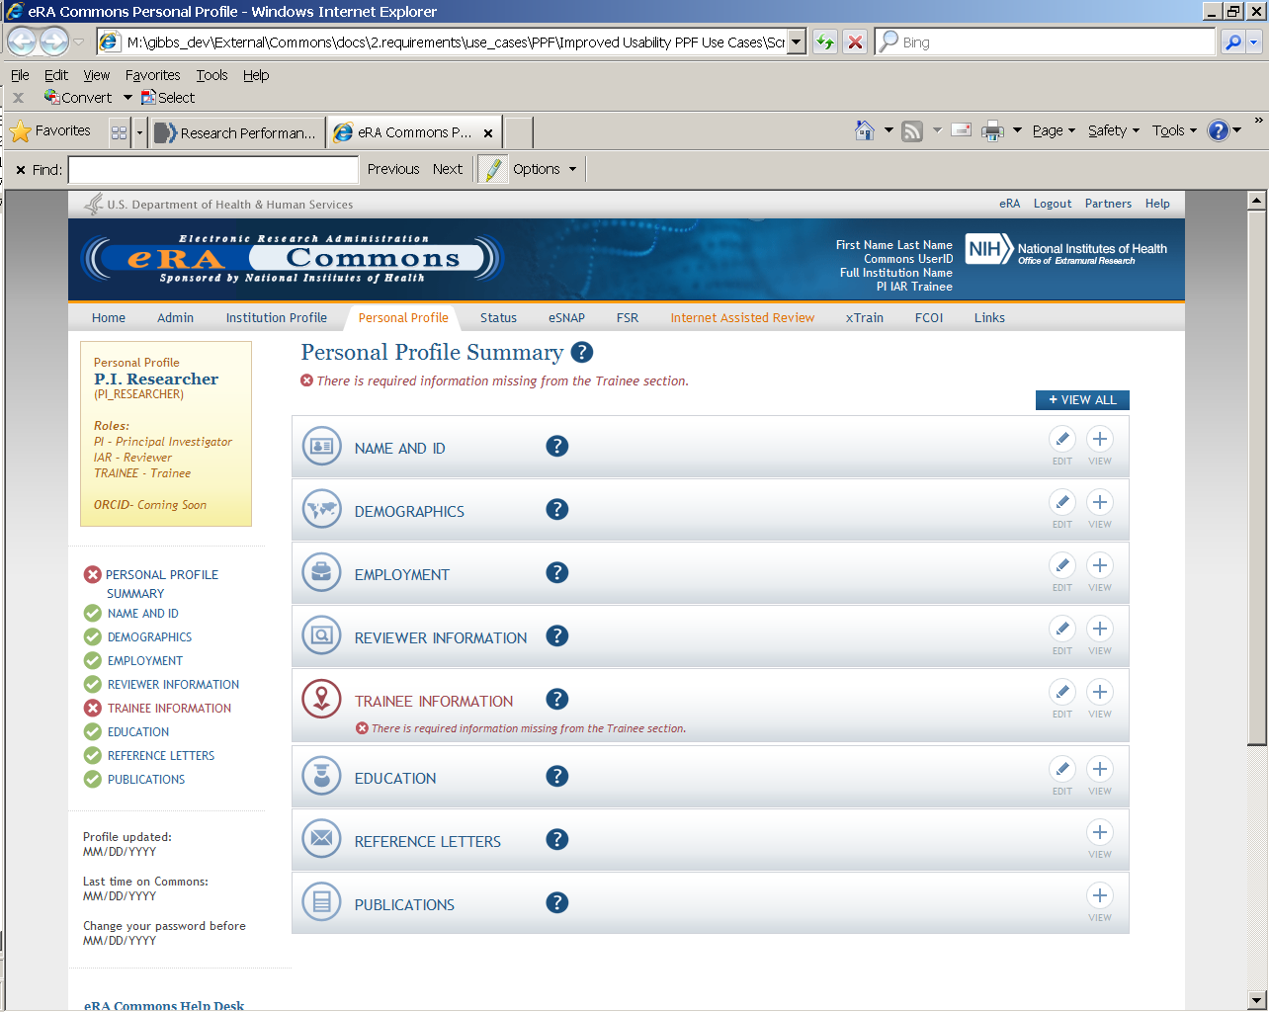
Personal Profile

Slide 21

Personal Profile Information is used to…
Verify information submitted in grant applications
Send you agency notifications
Complete aggregate reporting
Determine eligibility for Early Stage Investigator (ESI) and New Investigator (NI) status
Determine a reviewer’s eligibility for the Continuous Submission application submission policy

Slide 22

Terminology Check
New Investigator
  A PD/PI who has not previously competed successfully as a PD/PI for a substantial independent research award.
    See: http://grants.nih.gov/grants/new_investigators/index.htm
Early Stage Investigator
  An individual who is classified as a New Investigator and is within 10 years of completing his/her terminal research degree or is within 10 years of completing medical residency (or the equivalent).
Continuous Submission
  As a way of recognizing their service to NIH, reviewers with substantial review service are permitted to submit their research grant applications (R01, R21, or R34) on a continuous basis and to have those applications undergo initial peer review in a timely manner.
    See: http://grants.nih.gov/grants/peer/continuous_submission.htm

Slide 23
PPF- Tips
When you change your password, you will be automatically redirected to the Personal Profile tab—take a moment to review and update your information
Be especially diligent about keeping your email addresses current
  Email addresses are used to retrieve forgotten passwords and for communicating grants-related information

Slide 24

Delegations
PPF
Status
Progress Report
Submit
xTrain
Sponsor
eRA Commons allows users to give other users permission to do specific actions on their behalf

Slide 25
Delegations
PPF
  Any user can delegate to any other user at their institution the ability to edit their Personal Profile information
Status
  Any PI can delegate to any user at the PI’s institution with the ASST role the ability to access their status information, including the ability to check for application errors/warnings and to view their assembled application images
    Ability to view application summary statements and scores is specifically withheld

Slide 26
Delegations
Progress Report
  Any SO or a PI can delegate to any user at the PI’s institution with the ASST role the ability to complete progress report information for the PI’s grants
    Remember: SOs register assistants in Commons
    Ability to Route and Submit is specifically withheld
Submit
  SOs and BOs can delegate to a PI the authority and ability to submit their own progress reports to agency
    The PI will be listed as the authorized submitter on the
    submission

Slide 27
Delegations
xTrain
  A PI can delegate to any user at their institution with the ASST role the authority to perform most actions within xTrain on their behalf
    Ability to Submit appointments to agency is specifically withheld
Sponsor
  A SO or Sponsor can delegate to any user at their institution the ability to initiate and facilitate termination of a fellow
    Ability to Submit a termination is specifically withheld

Slide 28
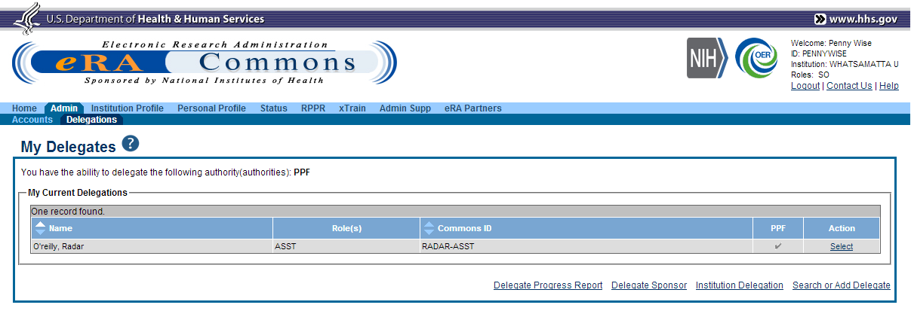
Delegation (SO)

Slide 29
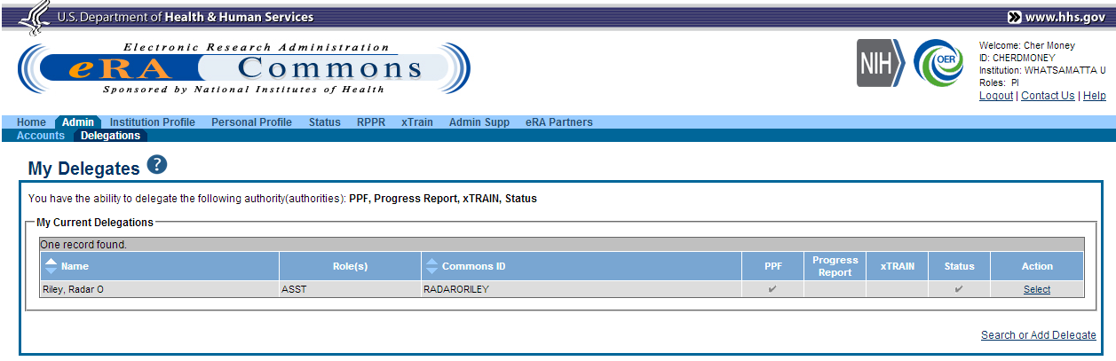
Delegation (PI)

Slide 30
Help Desks
eRA Commons Help Desk
Grants.gov Contact
Center
Web: http://era.nih.gov/help/index.cfm#era
Phone: 1-866-504-9552
TTY: 301-451-5939
Hours : Mon-Fri, 7a.m. to 8 p.m. ET
Toll-free: 1-800-518-4726
Hours : 24x7 (Except Federal Holidays)
Email : support@grants.gov
Resources: http://www.grants.gov/help/help.jsp

Slide 31

Web Sites
eRA Commons: https://commons.era.nih.gov/commons/
Electronic Research Administration: http://era.nih.gov/
Applying Electronically: http://grants.nih.gov/grants/ElectronicReceipt/
NIH About Grants: http://grants.nih.gov/grants/oer.htm

Slide 32

Thank you

