Slide 1
Data & Resource Sharing:
Firming Foundations
For Future Frontiers
NIH Virtual Seminar
NIH Office of Extramural Research (OER)
October 2020

Slide 2
Presenting Today
Julia Slutsman, PhD
Director, Genomic Data Sharing Implementation
julia.slutsman@nih.gov
J.P. Kim, JD, MBA, MSc, MPP, MA
NIH Extramural Data Sharing Policy Officer
jpkim@nih.gov
Office of Extramural Research (OER),
Office of the Director (OD),
National Institutes of Health (NIH), HHS

Slide 3
Overview
Background for NIH data sharing initiatives and focus on three policies
Overview of NIH Genomic Data Sharing (GDS) Policy
Update: Development of NIH Data Management and Sharing Policy
Refresher: NIH Research Tools Policy & Select NIH Grants Policy Excerpts
Resources: Links to NIH Data Sharing Policies & Notices

Slide 4






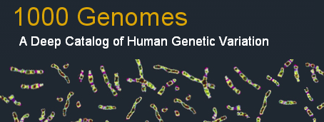




NIH Commitment to & Investment in Data Sharing
  “Consistent with both the NIH mission to improve public health through research and its longstanding legislative mandate to make available to the public the results of the research activities that it supports and conducts….”
  https://grants.nih.gov/grants/guide/notice-files/NOT-OD-07-013.html

Slide 5
NIH’s Data Sharing Initiatives & Milestones
NIH Intramural Human Data Sharing Policy
HHS Rule and NIH Policy on Clinical Trial Results Dissemination
White House Initiative
NIH Data Sharing Policy
Genome-wide Association (GWAS) Policy
Big Data to Knowledge (BD2K) Initiative
Genomic Data Sharing (GDS) Policy
All of Us Research Program
(RFI) on Proposed Provisions for a Draft Data Management and Sharing Policy
Model Organism Policy
Research
Tools Policy
NIH Public Access Policy (Publications)
NCI Cancer Moonshot
NIH Data Commons Pilot
Modernization of NIH Clinical Trials
1999
2003
2004
2007
2008
2012
2014
2015
2016
2017
2019

Slide 6

Benefits of Sharing Data & Research Resources
Accelerates ideas for future research inquiries and their application
Facilitates research integrity
Fosters rigor and reproducibility
Maximizes contributions of participants in research enterprise
Preserves scientific record
Increases efficiency and maximizes
investment and stewardship
Facilitates reuse of hard to generate data
or data from limited sources
Enables researchers to combine data
types to strengthen analyses

Slide 7
Ethical Considerations for Data Sharing
Making data as available as possible to maximize societal benefit from research participants’ contributions to research while maintaining participants’ privacy, respecting their autonomy, and ensuring that confidential/proprietary data are appropriately protected
  Controlled access for individual patient-level data
  Participant control of data
  Merging of datasets
  Review of data access requests to maintain public trust

Slide 8
Some Shared Challenges…
Time and effort
  Determine which data to preserve (not necessarily all data)
  Clean data, put in accessible format (consistency; standardized elements)
  Provide metadata
Requires infrastructure
  Repositories for long-term archiving
  Procedures for providing data access

Slide 9
Some Shared Challenges…
  Policy coordination
  Across agencies, funders, publishers, journals
  Lack of rewards/incentives
  Citations/publications used for academic credit
  How to cite/credit data collection and sharing
  Considerations for ethical, legal, and social implications, human participant protections, privacy, and trust

Slide 10
Some Shared Challenges…
Human Resources
  Limited training in data management and sharing
Proprietary Interests/Culture
  Investigators want to analyze and publish first
  Institutions/Investigators want to maintain competitive advantage
Compliance and Enforcement
  Especially after the award has ended

Slide 11

NIH Genomic Data Sharing Policy
Purpose
  Sets expectations and responsibilities for investigators and institutions to ensure broad, responsible, and timely sharing of genomic research data
Scope
  Applies to all NIH-funded research generating large-scale human or non-human genomic data and secondary research using these data
  Applies to all funding mechanisms (grants, contracts, intramural support) regardless of cost
Effective January 25, 2015
    NIH Intramural – August 31, 2015

Slide 12

Categories of Genomic Data
Two-tiered access for human data:
  Unrestricted-access: Data are publicly available to anyone (e.g., The 1000 Genomes Project)
  Controlled access: Investigators must obtain approval from NIH Data Access Committees (DACs) to use data from NIH-designated data repositories (e.g., dbGaP)

Slide 13
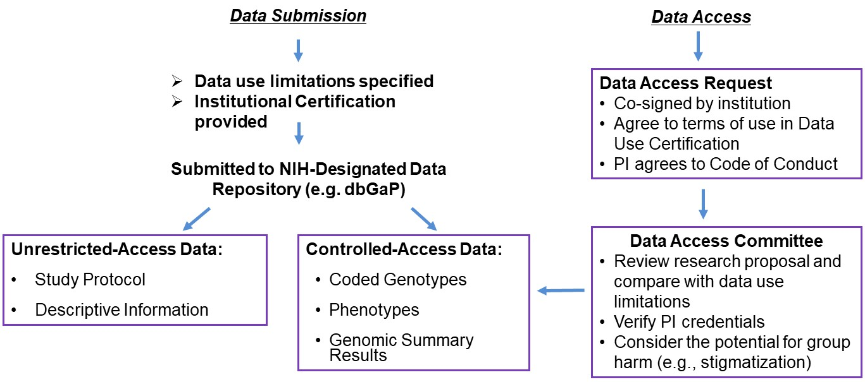
Process for Submitting or Accessing Data

Slide 14
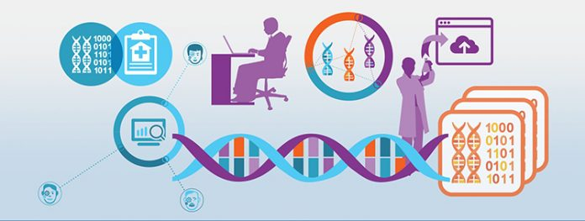
Responsibilities When Accessing/Using Data
To be approved for access, PIs submit a Data Access Request co-signed by their Institutional Signing Official agreeing to the Data Use Certification and Addendum
In the Data Use Certification & Addendum PIs agree to these terms and conditions:
  Use the data only for the approved research
  Protect data confidentiality
  Follow applicable laws, regulations, and policies for data use
  Not to attempt to re-identify individual participants
  Share the data only with individuals listed in the data
  access request
  Report immediately any GDS Policy violations
  to the appropriate NIH Data Access Committee
  Provide annual updates to NIH on research

Slide 15
Data & Resource Sharing - Continued
  J.P. Kim, JD, MBA, MSc, MPP, MA
  NIH Extramural Data Sharing Policy Officer
  jpkim@nih.gov
  Office of Extramural Research (OER),
  Office of the Director (OD),
  National Institutes of Health (NIH), HHS

Slide 16
NIH Plan for Increasing Access to Publications and Digital Scientific Data
February 2013: White House OSTP/Holdren Memo
February 2015: “NIH Plan” released
Publications: NIH Public Access Policy
Digital Scientific Data: Plan for Public Access to Digital Scientific Data
  Consider how to require data sharing
  Consider how to require and evaluate data management and sharing plans
  Encourage the use of existing repositories and standards
  Promote FAIR (Findable, Accessible, Interoperable, Reusable) principles
  Plan ≠ Policy; NIH to establish priorities for data sharing

Slide 17
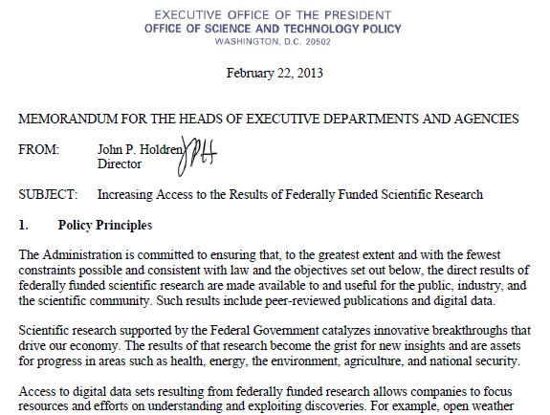
Trans-Agency OSTP Memorandum
Feb. 2013: White House Office of Science and Technology Policy (OSTP) released memorandum entitled “Increasing Access to the Results of Federally Funded Scientific Research”
  Development of agency Plans
  Applies to peer-reviewed
  publications and digital
  scientific data

Slide 18
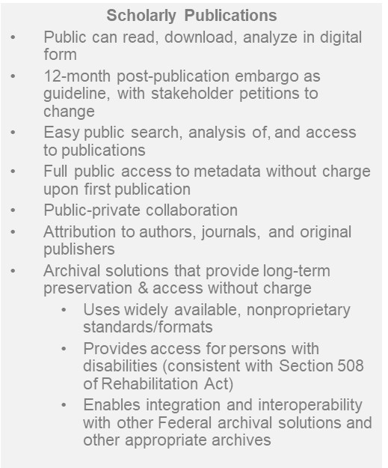

Objectives of the Holdren Memo
Digital Data
Maximize free access while
  Protecting privacy and confidentiality, national security
  Recognizing intellectual property rights
  Balancing costs & benefits of long-term preservation
Require data management plans (DMPs)
Allow inclusion of costs in applications for funding
Ensure appropriate evaluation of DMPs
Monitor compliance by investigators
Encourage deposit of data in public repositories, where possible
Cooperate with the private sector
Develop approaches for data citation & attribution
Support training, education and workforce development
Assess long-term needs for preservation and options for repositories

Slide 19
Development of an NIH Data Management and Sharing Policy
Policy Development Highlights
November 14, 2016: NIH Request for Information (RFI): Strategies for NIH Data Management, Sharing, and Citation (NOT-OD-17-015; Response by January 19, 2017)
October 10, 2018: Request for Information (RFI) on Proposed Provisions for a Draft Data Management and Sharing Policy for NIH Funded or Supported Research (NOT-OD-19-014; Response by December 10, 2018)
November 6, 2019: Request for Public Comments on a DRAFT NIH Policy for Data Management and Sharing and Supplemental DRAFT Guidance (NOT-OD-20-013; Response by January 10, 2020)
And now…..

Slide 20
Development of an NIH Data Management and Sharing Policy – BREAKING NEWS!
The Final NIH Policy for Data Management and Sharing (“DMS Policy”)
- RELEASED: October 29, 2020 / EFFECTIVE DATE: January 25, 2023
Final NIH Policy for Data Management and Sharing
  NOT-OD-21-013
  https://grants.nih.gov/grants/guide/notice-files/NOT-OD-21-013.html
What does the DMS Policy apply to?
  all research, funded or conducted in whole or in part by NIH, that results in the generation of scientific data
  extramural grants, contracts, Intramural Research Projects, or other funding agreements regardless of NIH funding level or funding mechanism
What will be required in funding applications starting January 25, 2023 under the policy?
  Submission of a Data Management and Sharing Plan outlining how scientific data and any accompanying metadata will be managed and shared, taking into account any potential restrictions or limitations
  Compliance with the awardee’s plan as approved by the NIH ICO
Questions – Email: SciencePolicy@od.nih.gov (NIH Office of Science Policy (OSP))

Slide 21
Development of an NIH Data Management and Sharing Policy – BREAKING NEWS!
Supplemental Information to the NIH Policy for Data Management and Sharing
- RELEASED: October 29, 2020
What should be in a Plan? Which costs are allowable? How are repositories selected?
Supplemental Information to the NIH Policy for Data Management and Sharing: Elements of an NIH Data Management and Sharing Plan
  NOT-OD-21-014
  https://grants.nih.gov/grants/guide/notice-files/NOT-OD-21-014.html
Supplemental Information to the NIH Policy for Data Management and Sharing: Allowable Costs for Data Management and Sharing
  NOT-OD-21-015
  https://grants.nih.gov/grants/guide/notice-files/NOT-OD-21-015.html
Supplemental Information to the NIH Policy for Data Management and Sharing: Selecting a Repository for Data Resulting from NIH-Supported Research
  NOT-OD-21-016
  https://grants.nih.gov/grants/guide/notice-files/NOT-OD-21-016.html

Slide 22
Summary: Common Goal Across Data & Resource Sharing Policies
Accelerated scientific inquiry
Sharing and dissemination
Data and research resources

Slide 23
NIH Research Tools Policy
NIH Research Tools Policy
“Sharing Biomedical Research Resources: Principles and Guidelines for Recipients of NIH Research Grants & Contracts” (1999)
Principles
Ensure Academic Freedom and Publication
Ensure Appropriate Implementation of the Bayh-Dole Act
Minimize Administrative Impediments to Academic Research
Ensure Dissemination of Research Resources Developed With NIH Funds
Guidelines
Appendix: Guidelines for Disseminating Research Resources Arising Out of NIH-Funded Research

Slide 24
Select NIH Grants Policy Excerpts
Grantees own the data they develop with federal funds.
  NIH Grants Policy Statement 8.2.1.
Public Access Policy Final peer reviewed manuscript, upon acceptance for publication must be published at: http://www.pubmedcentral.nih.gov.
  NIH Grants Policy Statement 8.2.2.
NIH Research Tools Policy requires sharing of unique research materials/biological materials (“research tools”).
  NIH Grants Policy Statement 8.2.3.

Slide 25
Resources
NIH Genomic Data Sharing
  https://osp.od.nih.gov/scientific-sharing/genomic-data-sharing/
NIH Research Tools Policy
  https://grants.nih.gov/grants/intell-property_64FR72090.pdf
NIH Public Access Policy
  http://publicaccess.nih.gov/
NIH Data Sharing Policies
  https://grants.nih.gov/policy/sharing.htm

Slide 26
Acknowledgements
We would like to thank Kristofor Langlais (NIH/OSP), Erin Luetkemeier (NIH/OD), Cheryl Smith (NIH/OSP), Ellen Wann (NIH/OSP), and Dina Paltoo (NIH/NHLBI) for their contributions to this presentation.

Slide 27

Questions?
Thank you!

