Slide 1


Common Compliance Pitfalls and Strategies for Success
Division of Grants Compliance and Oversight
Office of Policy for Extramural Research Administration, OER
National Institutes of Health, DHHS
NIH Virtual Seminar – October, 2020
Philip Smith, Assistant Grants Compliance Officer
Laura Gray, Assistant Grants Compliance Officer

Slide 2

Compliance is……
The effective management of public funds to maximize research outcomes
The avoidance of fraud, institutional mismanagement, and poor management of Federal funds

Slide 3
Recipient’s Responsibilities
Safeguarding all assets
Spending funds in accordance with the authorized purpose
Developing and implementing systems to ensure proper stewardship of funds
  Financial management systems
  Procurement systems
  Payroll Distribution systems
  Monitoring activities
  Adherence to terms & conditions of award

Slide 4

Compliance Requirements
Institutional Policies
Organizational Structure
Purchasing
Accounting/Budgetary Controls
Payroll Distribution
Travel
Consulting
Property Management
Ethics/Conflict of Interest

Slide 5
HHS Regulations
45 CFR Part 75 – Public Welfare, Uniform Administrative Requirements, Cost Principles and Audit Requirements for HHS Awards
  http://www.ecfr.gov/cgi-bin/text-idx?node=pt45.1.75&rgn=div5

Slide 6

Compliance Requirements
Administrative Requirements or Standards:
45 CFR Part 75 - Subpart C – Pre-Federal Award Requirements and Contents of Federal Awards (§ 75.200 – § 75.218)
45 CFR Part 75 - Subpart D – Post Federal Award Requirements
  (§ 75.300 – § 75.391)
  Standards for Financial and Program Management
  Property Standards
  Procurement Standards
  Performance and Financial Monitoring and Reporting
  Subrecipient Monitoring and Management
  Record Retention and Access
  Remedies and Noncompliance
  Closeout
  Post-Closeout Adjustments and Continuing Responsibilities
  Collection and Amounts Due

Slide 7
Compliance Requirements
Cost Principles:
  45 CFR Part 75, Subpart E (§ 75.400- § 75.477)
    Institutions of Higher Education (IHE), State, Local Governments and Indian Tribes, and Non-profit Organizations
  45 CFR Part 75, Appendix IX
    Hospitals
  48 CFR Subpart 31.2 (Federal Acquisition Regulation)
    For-Profit Institutions

Slide 8
Compliance Requirements
Audit Requirements:
  45 CFR 75.501: Institutions of Higher Education, States and Local Governments, and Non-Profit Organizations, including Non-Profit Hospitals
  45 CFR 75.501(h) through (k): For-Profit Organizations, including For-Profit Hospitals
  NIH Grants Policy Statement: Foreign Organizations must follow the same requirements as For-Profit Organizations

Slide 9

Audit Requirements
All NIH grant recipients that expend $750,000 or more within a year in Federal awards are subject to an audit requirement.
  For-Profit and Foreign Organization audit requirement:
      Expend $750,000 under one or more HHS awards (as a direct recipient and/or consortium participant)
Audits are due within the earlier of 30 days after receipt of the auditor’s report(s) or 9 months after the end of the recipient’s audit period.
Recipients delinquent in submitting audits risk the imposition of sanctions and potential loss of Federal funds.

Slide 10
Summary of Audit Requirements
Recipient Type | Source of Audit Requirement | Where to Submit Audit Reports
State & Local Governments | 45 CFR 75.501 | Federal Audit Clearinghouse (See contact information in NIH GPS Part III)
Institutions of Higher Education | 45 CFR 75.501 | Federal Audit Clearinghouse (See contact information in NIH GPS Part III)
Non-Profits (including non-profit hospitals) | 45 CFR 75.501 | Federal Audit Clearinghouse (See contact information in NIH GPS Part III)
For-Profits (including for-profit hospitals) | 45 CFR 75.501(h) through 75.501(k) and 45 CFR 75.215 | National External Audit Review Center (See contact information in NIH GPS Part III)
Foreign Organizations | NIH Grants Policy Statement (same as For-Profits) | National External Audit Review Center (same as For-Profits, see contact information in NIH GPS Part III)

Slide 11
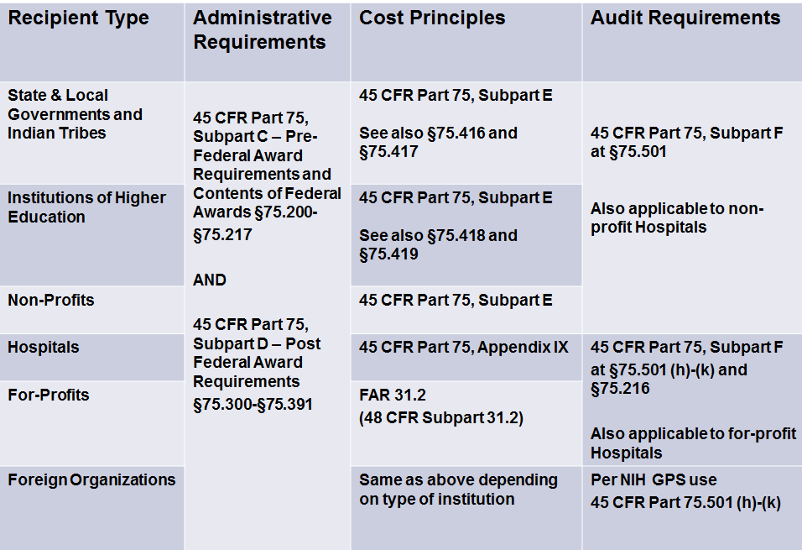
Summary of Federal Requirement References

Slide 12


Compliance Requirements
NIH Grants Policy Statement (GPS)
Including any addenda in effect as of the beginning date of the budget period
  https://grants.nih.gov/grants/policy/nihgps/nihgps.pdf
Notice of Award (NoA)
NIH Guide to Grants and Contracts (for new requirements)
http://grants.nih.gov/grants/guide/index.html

Slide 13
Compliance Pitfalls
Excessive cost transfers
Allowable Costs
Administrative & Clerical costs
Debarment

Slide 14

Compliance Pitfalls

Slide 15
Cost Transfers
Errors should be corrected within 90 days of when the error was discovered.
Transfers must be supported by:
    Documentation that fully explains how the error occurred
    Certification of the correctness of the new charge (by a responsible organizational official)
Transfers of costs from one project to another or from one competitive segment to the next solely to cover cost overruns are not allowable.
All charges to grants must be reasonable, allowable, allocable, and consistently applied.

Slide 16
Allowable Costs: Supplies and Entertainment
If the office supplies are not specifically allocable to the grant, they are considered general office supplies and should not be charged as a direct cost to the grant account.
Entertainment costs, such as food, are unallowable.

Slide 17
More References: Allowable Costs
Meals are allowable on a research grant when:
  they are provided to subjects or patients under study provided that such charges are not duplicated in participant’s per diem or subsistence allowances, if any;
  such costs are an integral and necessary part of a meeting or conference (i.e., a working meal where business is transacted), and
  such costs are specifically approved as part of the project activity, consistent with the terms of award.

Slide 18
Administrative and Clerical Costs
Salaries of administrative and clerical staff:
Direct charging of these costs should normally be treated as indirect (F&A) costs.
NIH GPS 8.1.1.5 provides that direct charging of these costs may be appropriate only if all of the following conditions are met:
  Administrative or clerical services are integral to a project or activity
  Individuals involved can be specifically identified with the project or activity
  Such costs are explicitly included in the budget, and
  The costs are not also recovered as indirect costs
Such charges must also meet the criteria for allowable costs as described in NIH GPS 7.2.

Slide 19
More References – Administrative and Clerical Costs
Salaries of administrative and clerical staff:
  NIH’s implementation of Uniform Regulation
  NIH prior approval is not required to rebudget funds for salaries of administrative and clerical staff if conditions provided in NIH GPS 8.1.1.5 are met.
  NIH prior approval required when:
    additional funds are requested for such a position or
    the incurrence of such costs constitutes a change in scope
  For Modular grants, these costs must be included in the Personnel Justification. Provide:
    the person’s name, percent effort and role.
    justification documenting how they will meet all four requirements in NIH GPS 8.1.1.5

Slide 20
Debarment
Immediately report the situation to your Office of Sponsored Research and to each NIH awarding component.
Individuals debarred from eligibility cannot be paid from NIH grant funds and such charges are unallowable.

Slide 21
More References - Debarment
Debarment and Suspension is implemented as a term and condition of award
  2 CFR Part 376 (HHS regulations that implement the government-wide debarment and suspension system guidance)
  2 CFR Part 180 (OMB guidelines on government-wide debarment and suspension (nonprocurement)

Slide 22
More References - Debarment
Prior to drawdown of funds for each grant award, recipients must report to the NIH funding IC if the recipient or any of its principals:
  Are presently excluded or disqualified;
  Have been convicted within the preceding three years of any of the offenses listed in 2 CFR 180.800(a) or had a civil judgment for one of those offenses within that time period;
  Are presently indicted for or otherwise criminally or civilly charged by a governmental entity (Federal, State, or local) with commission of any of the offenses listed in 2 CFR 180.800(a); or
  Have had one or more public transactions (Federal, State, or local) terminated within the preceding three years for cause or default.

Slide 23

Case Study 1….
A University employee transfers expenses from one account to another and annotates the cost transfer “to correct an accounting error.”
Internal Audit takes exception. Why?

Slide 24
Test your Knowledge
1. Because it has been too long since this error occurred.
2. Because there is no justification for this error.
3. Because the transfer did not certify to the correctness of the new charge by a responsible organizational official of the recipient.
4. All of the above

Slide 25

Case Study 2…
You are asked by a PI to stop at an office supply store on your way to work and pick up a few items (pens, envelopes and paperclips). The PI also asked you to get some donuts for a lab meeting that morning. When you arrive at work, the PI tells you that all of the items should be charged to the grant.
Your Departmental Administrator tells you that these purchases must come from Departmental funds. Why?

Slide 26
Test your Knowledge
1. Because these costs do not apply directly to the grant.
2. Because meals are never allowed to be charged to a grant.
3. Because donuts are always overhead costs.
4. Because this project couldn’t be done without more pens.

Slide 27


Case Study 3….
Dr. Admins from the University of Education submits a research grant application that seeks salaries of administrative and clerical staff as direct costs.
Are these costs appropriate?

Slide 28
Test your Knowledge
1. Yes, clerical staff are needed for all projects.
2. Yes, if the project didn’t have clerical staff nothing would get done.
3. Yes, charges to get the work done are allowable to the grant.
4. No, these are indirect costs generally.

Slide 29
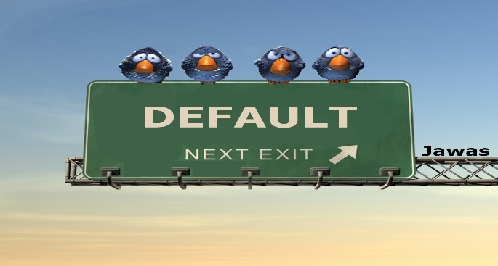
Case Study 4….
You recently learned that a post-doc working on an NIH grant had not disclosed that she was debarred for defaulting on her student loan. Unfortunately, you determined that this situation has gone unreported for a period of three years and during that time her salary has been paid by NIH grant funds.
Now what?

Slide 30
Test your Knowledge
1. Do not allow her salary to be charged to the NIH award going forward.
2. Make sure all funds for that individual are paid with University not Federal funds.
3. Immediately report the situation to your Office of Sponsored Research and the NIH ICs.
4. Tell that individual they owe the NIH money.

Slide 31

Questions?
GrantsCompliance@nih.gov

