Slide 1
Commitment Transparency
Office of policy for extramural research administration (OPERA)

Slide 2
Overview
Background on commitment transparency efforts across the government
What’s NOT changing?
Overview of Updates
  Biosketch
  Other Support
Timeline and Next Steps
Discussion/Questions

Slide 3
What is commitment transparency?
Transparency and reporting of all research activities, domestic and foreign
Openness and transparency enables productive collaboration and helps ensure appropriate disclosure of potential conflicts of interest and commitment
Failure by some researchers at NIH-funded institutions to disclose substantial contributions of resources from other organizations, including foreign governments, threatens to distort decisions about the appropriate use of NIH funds

Slide 4
Joint Committee on Research Environments (JCORE)
In May 2019, the National Science and Technology Council (NSTC) established JCORE to address issues related to research environment safety, integrity, and productivity.
The JCORE Subcommittee on Research Security brings together agencies from across the government to:
  Develop guidance for Federal departments and agencies
  Develop best practices for universities and other research institutions
  Develop education and outreach materials that highlight examples of risks to research

Slide 5
June 2020 JCORE Guidance
JCORE Subcommittee on Research Security issued public guidance on commitment transparency
Examples of conduct that violate funding agency policies:
  Failures to disclose:
    Financial conflicts of interest
    Conflicts of commitment
    External employment arrangements
    Financial support that overlaps with US funding
    Shadow labs or other parallel research activities
  Diversion of intellectual property
  Peer review violations

Slide 6
What about NIH?
We’ve had cases covering all these examples!
At least 201 scientists
90+ institutions, many fields of biomedicine, all over US
Denials despite documentation to the contrary; explanations
  “I allowed XXX to use my name as PI”
  “I knew nothing about this grant…”
  “I didn’t actually do the work…”
  “The affiliations [in published papers] were in error”

Slide 7
Myths re: Financial Conflict of Interest and Foreign Components

Slide 8
No changes to Foreign components or FCOI!

Slide 9
Identifying Foreign Components
Key measures for identifying foreign components are as follows:
Is a portion of the project being conducted outside the US?
  No – not a foreign component
  Yes – are the activities being conducted outside of the US significant?
  Indicators include:
    Collaborations with investigators at a foreign site anticipated to result in co-authorship;
    Use of facilities or instrumentation at a foreign site; or
    Receipt of financial support or resources from a foreign entity.
Foreign components require NIH prior approval

Slide 10
Financial Conflicts of Interest (FCOI)
Requirements found in 42 CFR Part 50, Subpart F
Investigators must disclose their significant financial interests to their institution
This requirement includes financial interests received from a foreign entity
Separate and distinct from other support and foreign components

Slide 11
So what is changing? Our Approach
To support the need for full transparency, NIH is clarifying policies and updating forms and instructions
Utilized JCORE guidance, and collaborated with other research agencies
Outcomes:
  Provided details on in-kind contributions, defined “gifts”, and outlined the purpose of the biosketch
  Updated application forms and instructions for Biosketch and Other Support
  Updated data format and data collections in collaboration with NSF to reduce applicant and recipient burden

Slide 12
Biosketch

Slide 13
Biosketch Updates – NIH GPS
Submission of a biosketch is a longstanding policy
Biosketch requirements are currently spread out throughout the NIH Grants Policy Statement (GPS)
NIH will include a new subsection in the GPS 2.3, to consolidate biosketch requirements for easier reference
  Who submits a biosketch: senior/key personnel
  When is it submitted: New apps, new senior/key personnel at RPPR, with prior approval requests for change in senior/key personnel
  How it’s used: reviewers utilize the biosketch to ensure that individuals included on the applications are equipped with the skills, knowledge, and resources necessary to carry out the proposed research.

Slide 14
Biosketch Updates – Form and Instructions
Updated to align with JCORE, minimize duplication of Other Support, and harmonize format with NSF
Updated title of Section B to capture all scientific appointments
  Clarify instructions for Section B to request details on all positions and scientific appointments, foreign and domestic
Removed Section D: Research Support, which duplicates information provided in Other Support
  Removed instructions for Research Support. Note: Scholastic Performance will remain in Section D for fellowship Biosketch. All research support information is now consolidated in the Other Support section of the application.

Slide 15
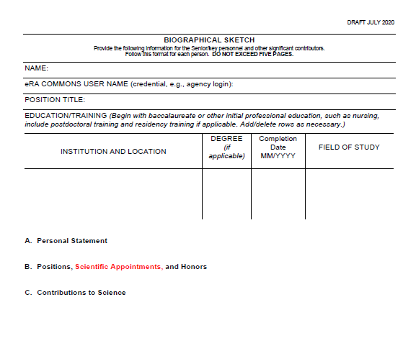
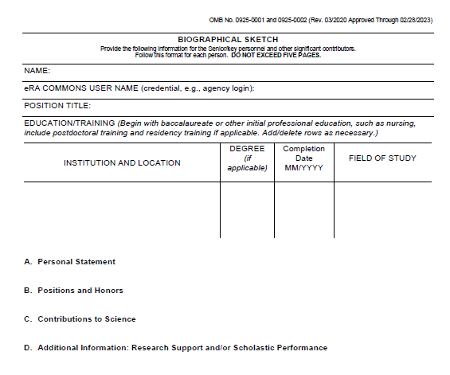
Biosketch Mock-Up– Non-Fellowship Format Page
CURRENT FORMAT (as of July 2020)
Mock-up with Proposed Changes (in red)

Slide 16
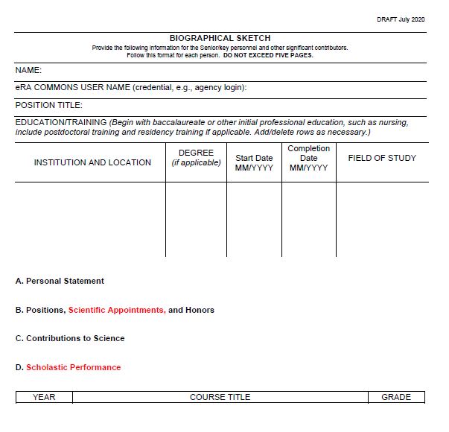

Biosketch Mock-Up – Fellowship Format Page
CURRENT FORMAT (as of July 2020)
Mock-up with Proposed Changes (in red)

Slide 17
Other support

Slide 18
Other Support Updates – NIH GPS
Other support policy language was updated in Dec 2019 to incorporate JCORE guidance and clarify requirement to report all resources in support of all research endeavors
Additional updates will clarify:
  Definition of gift: Gifts are resources provided where there is no expectation of anything (e.g. time, services, specific research activities, money, etc.) in return.
  Expectations for reporting in-kind resources: in-kind contributions, e.g. office/laboratory space, equipment, supplies, employees, students. If the time commitment or dollar value of the in-kind contribution is not readily ascertainable, the recipient must provide reasonable estimates.

Slide 19
Other Support Updates – Foreign Resources
IC scientific program and grants management staff will review Other Support information before award to ensure the following:
  Any foreign resources that meet the definition of a foreign component have received appropriate prior approval
Institutions are required to submit copies of foreign contracts and awards for all foreign activities and resources that are reported in Other Support. If they are not in English, recipients must provide translated copies.

Slide 20
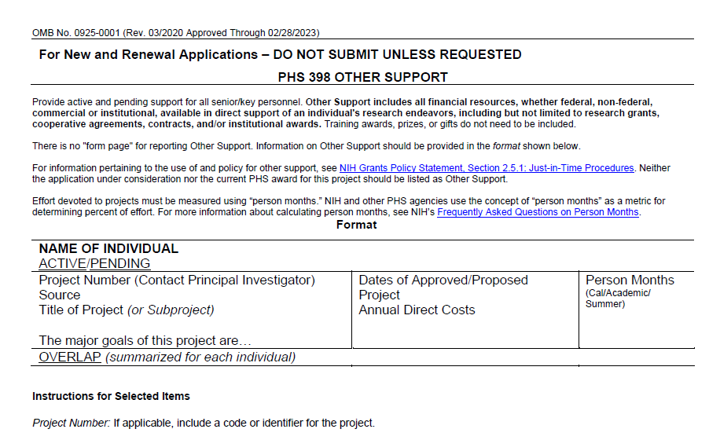
Other Support Updates – Format Page
CURRENT FORMAT (as of July 2020)
Current Other Support format page does not collect structured data or allow recipients to provide detail on in-kind contributions
New format page and detailed instructions document have been developed
Notes:
Do you have a slide that can come before this outlining the additions for context???

Slide 21
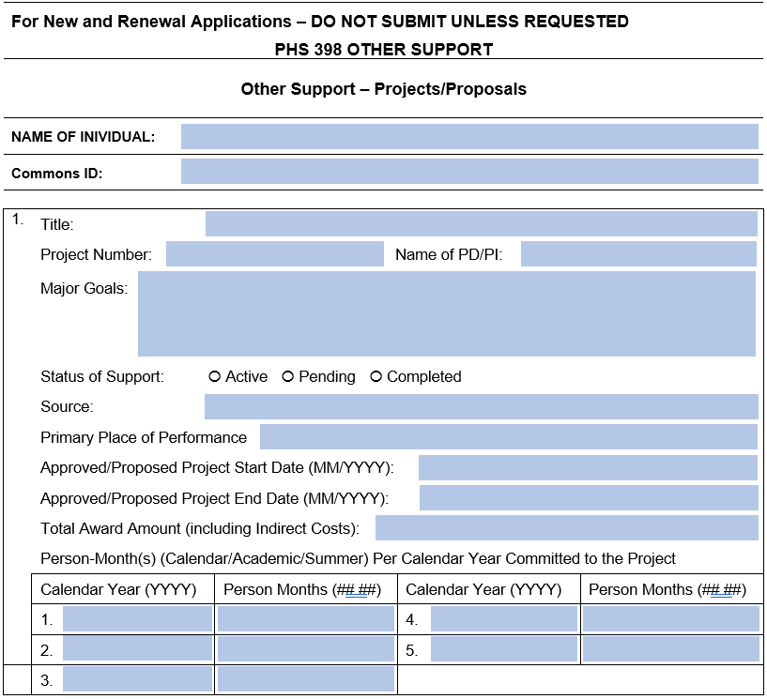
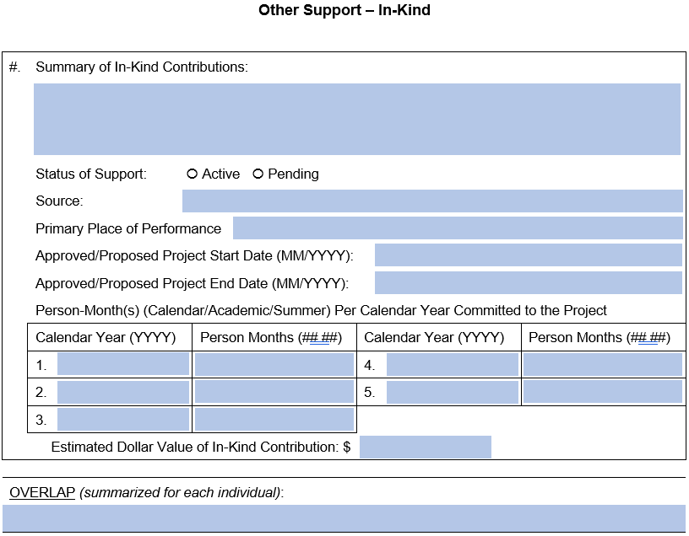
Other Support Updates – Format Page
New NIH mock-up with Proposed Changes

Slide 22
Other Support Updates – Instructions
Developed new, detailed instructions document to accompany the updated Other Support format page
Highlights:
  Includes updated definitions and terms as included in the NIH GPS
  Provided detailed instructions for how to complete each data element of the form.
  Added links to GPS for further details.

Slide 23
Timeline

Slide 24
Estimated Timeline
Oct/Nov 2020: Guide notice announcing policy, form, and instruction updates
Jan 2021: Begin requiring use of updated form templates
Later in 2021/2022: Integrating Other Support templates into ScienCV

Slide 25
Questions?

