Slide 1


Preparing, Submitting and Tracking Your Small Business Application Using ASSIST
November 2016

Slide 2

Today’s Topics
What is ASSIST?
Submission Options
Registration
Using ASSIST to Navigate the Submission Process
Finding Help & Resources
Questions

Slide 3

What is ASSIST?
ASSIST is NIH's
online system for the
preparation, submission & tracking
of grant applications through
Grants.gov to NIH

Slide 4
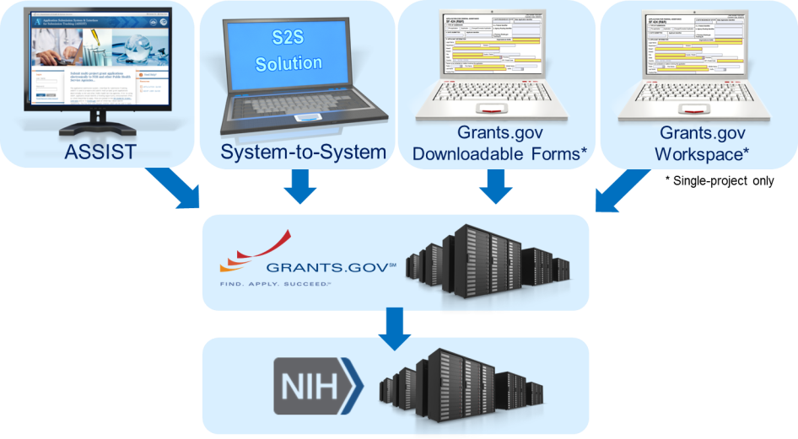
Application Submission Options
http://grants.nih.gov/grants/how-to-apply-application-guide/prepare-to-apply-and-register/choose-a-submission-option.htm

Slide 5






Your Application will be…
Subjected to the same registration requirements
Completed with the same data items
Routed through Grants.gov
Validated against the same NIH business rules
Assembled in a consistent format for review consideration
Tracked in eRA Commons
…regardless of submission option used.

Slide 6

Good Reasons to Use ASSIST
Secure web-based data entry
Leverages eRA Commons credentials
Collaboration of multiple users
Pre-submission validation of many NIH and Grants.gov business rules
Pre-population of data from eRA Commons profiles
Pre-submission print/preview of application in NIH format
Submission status tracking for both Grants.gov and eRA Commons within a single system
Ability to copy data from one application to another

Slide 7

Multiple Organization Registrations Required to Submit
Can take 6 weeks to complete all registrations. If not yet registered – start now!
http://grants.nih.gov/grants/how-to-apply-application-guide/prepare-to-apply-and-register/registration.htm

Slide 8


Organization Registration
DUNS – provides unique organization identifier
SAM (System for Award Management) – needed to do business with government
  Requires annual renewal
Grants.gov – required to submit grants
eRA Commons – required to do business with NIH
SBA (Small Business Administration) – required
for SBIR/STTR applications
http://grants.nih.gov/grants/how-to-apply-application-guide/prepare-to-apply-and-register/registration/org-representative-registration.htm

Slide 9



Understand Key Systems & Roles
Grants.gov
eRA Commons
E-Business Point of Contact (EBiz POC)
Authorized Organization Representative (AOR)
Signing Official (SO)
Principal Investigator (PI)
Anyone doing data entry in ASSIST needs an account
http://grants.nih.gov/grants/how-to-apply-application-guide/prepare-to-apply-and-register/registration/investigators-and-other-users.htm

Slide 10

eRA Commons Account Reminders
Do not combine administrative (e.g., SO) and scientific (e.g., PI) roles on single Commons account
  If the same person serves as both roles, two accounts are needed
PIs get one Commons account that follows them throughout their careers
If PI is already registered, “affiliate” their existing account rather than creating a new one
  PIs should update their Commons profile prior to submitting

Slide 11








Overview of Process
Find
Opportunity
Enter
application
data
Initiate
application
Submit
Find
Plan
Initiate
Build Team
Enter Data
Finalize
Submit
Track
Make a submission
plan
Finalize
application and prepare for submission
Define team
and provide application access
Track status and view final application image

Slide 12
Step 1: Find an FOA of Interest
NIH small business website
NIH Guide for Grants & contracts
Grants.gov
Find
Plan
Initiate
Build Team
Enter Data
Finalize
Submit
Track

Slide 13
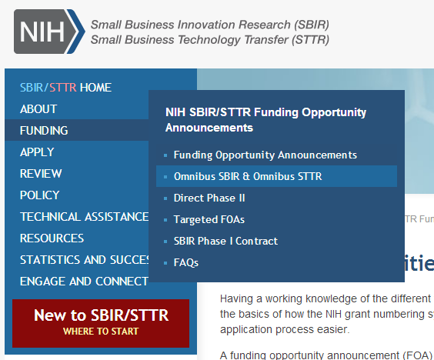
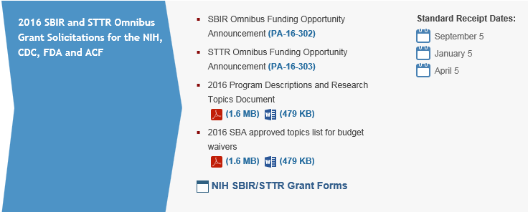
SBIR/STTR Parent Announcements
The SBIR/STTR website provides direct links to omnibus and other funding opportunity announcements.
SBIR: PA-16-302
STTR: PA-16-303
Standard Due Dates:
Sept 5
Jan 5
April 5
http://sbir.nih.gov/

Slide 14

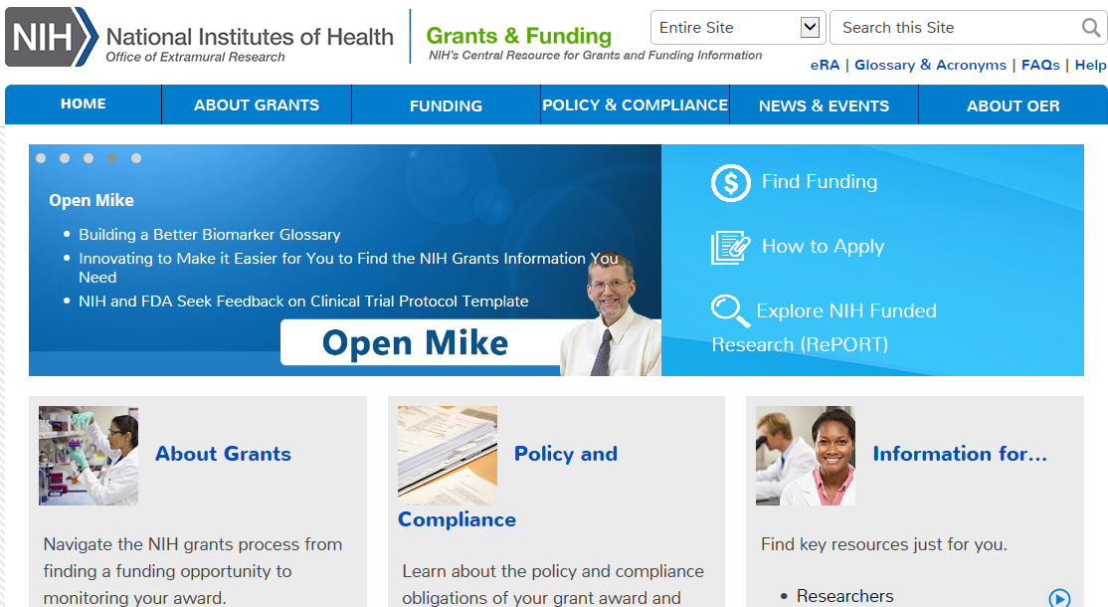
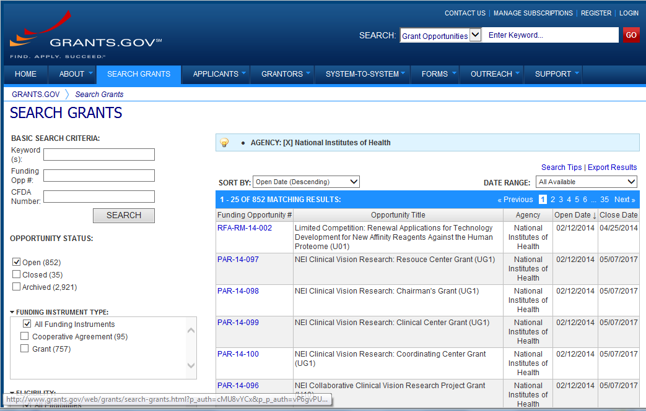
Find a Funding Opportunity Announcement (FOA)
Find Funding -
NIH Guide for Grants & Contracts
Grants.gov Search Grants

Slide 15
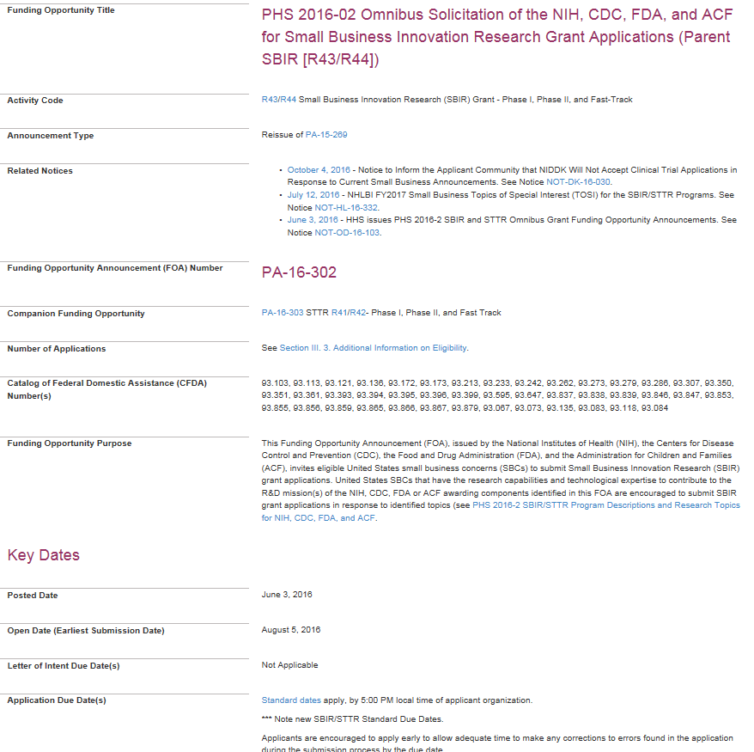
FOA
Carefully read full announcement
Check for updates in Related Notices
Due Dates section links to standard dates web page or lists specific due dates

Slide 16
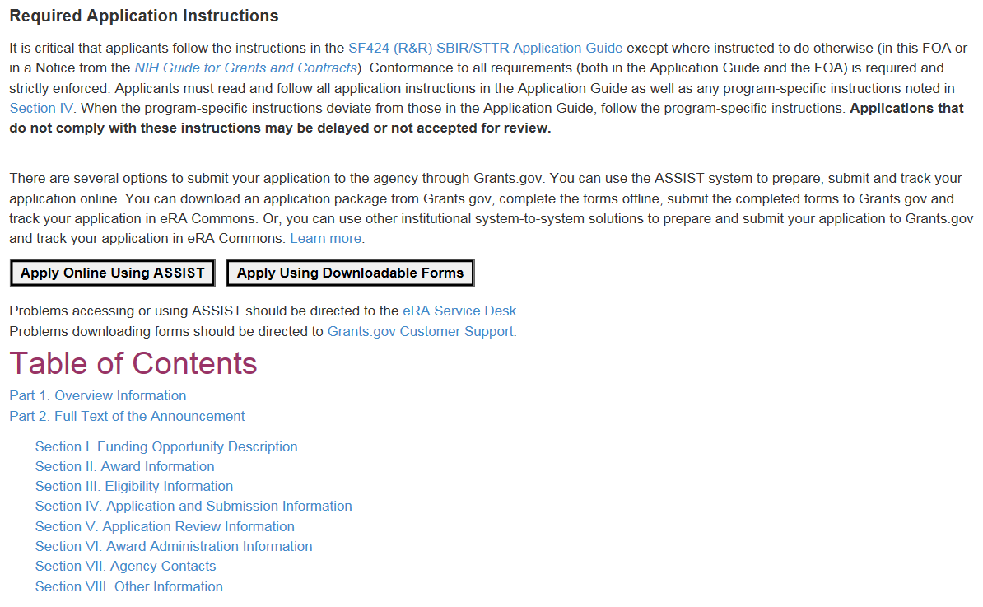
FOA & Application Guide Instructions
Link to Application Guide
Pay special attention to Section IV. Application and Submission Information
Includes any FOA-specific submission instructions

Slide 17
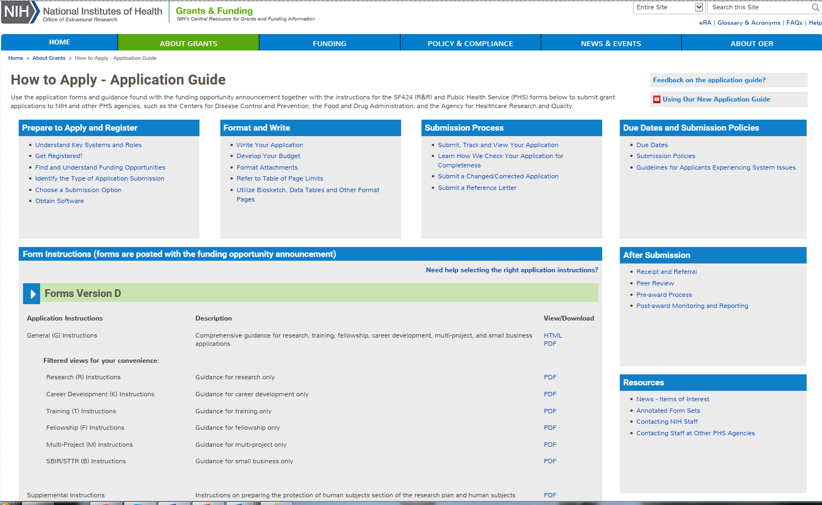
How to Apply – Application Guide
General Application Process Information
Form & Field Instructions
http://grants.nih.gov/grants/how-to-apply-application-guide.htm

Slide 18
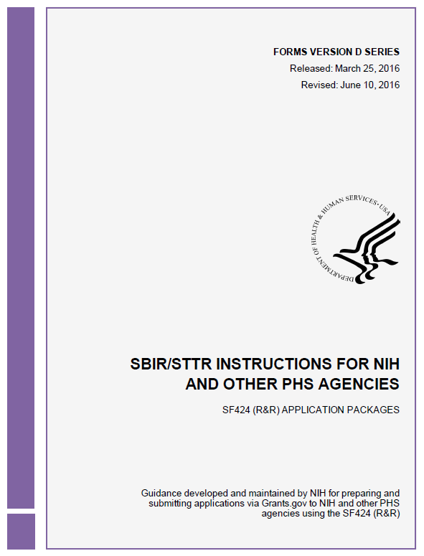
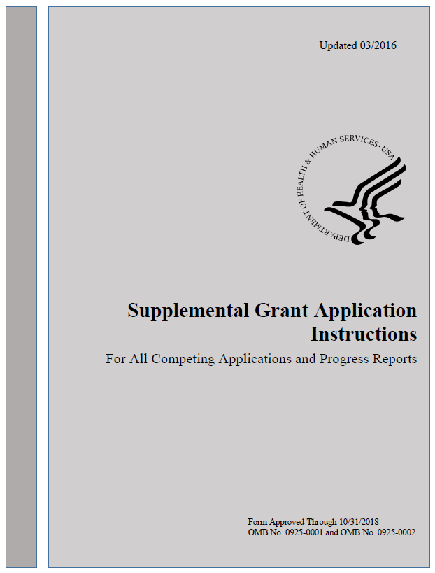
Form & Field Instructions
SBIR/STTR Instructions
(Application form instructions)
Supplemental Instructions
(Human Subjects, Policies, Assurances)

Slide 19
Follow All Guidance
Notices in the NIH Guide for Grants and contracts
Funding Opportunity Announcement
  Section IV. Application and Submission Information
Application Guide
  Including Supplemental Instructions
Precedence / Importance

Slide 20
Step 2: Make a Submission Plan
Verify registrations are in place
Determine application preparation responsibilities
Make sure everyone is aware
of the process
Find
Plan
Initiate
Build Team
Enter Data
Finalize
Submit
Track

Slide 21

Step 3: Login to ASSIST & Initiate Your Application
Login to assist with era commons username & password
Initiate application
Find
Plan
Initiate
Build Team
Enter Data
Finalize
Submit
Track

Slide 22
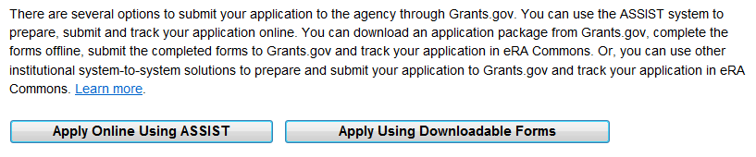

FOA “Apply” Button & ASSIST Login
Excerpt from FOA in NIH Guide…
https://public.era.nih.gov/assist
Login with eRA Commons Username & Password

Slide 23
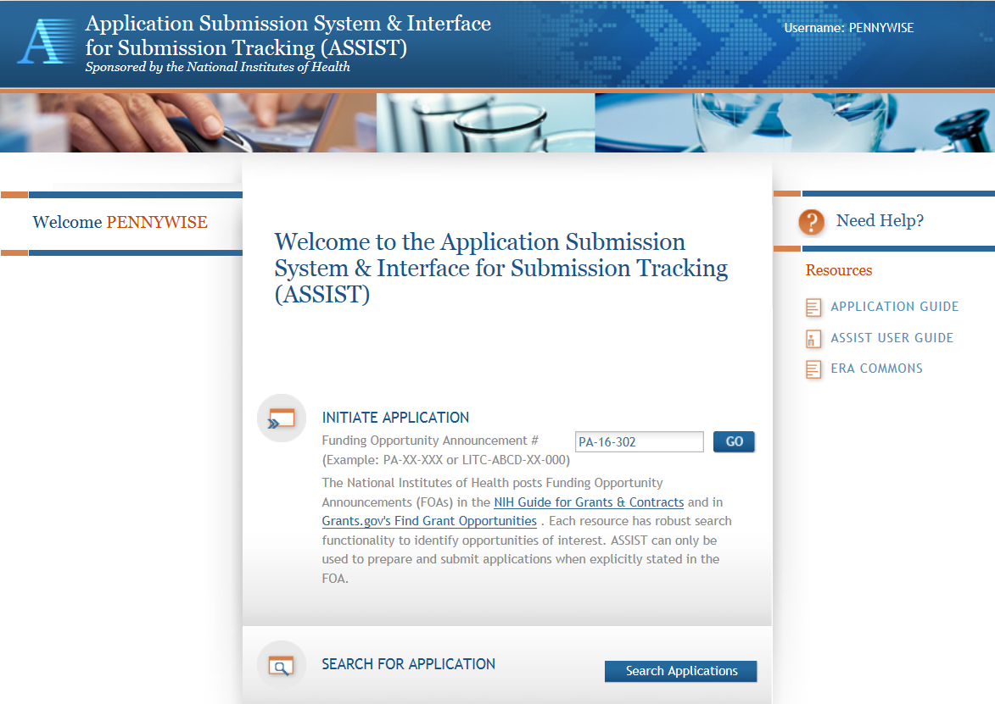
ASSIST Welcome Screen
Initiate Application
Search for Application

Slide 24
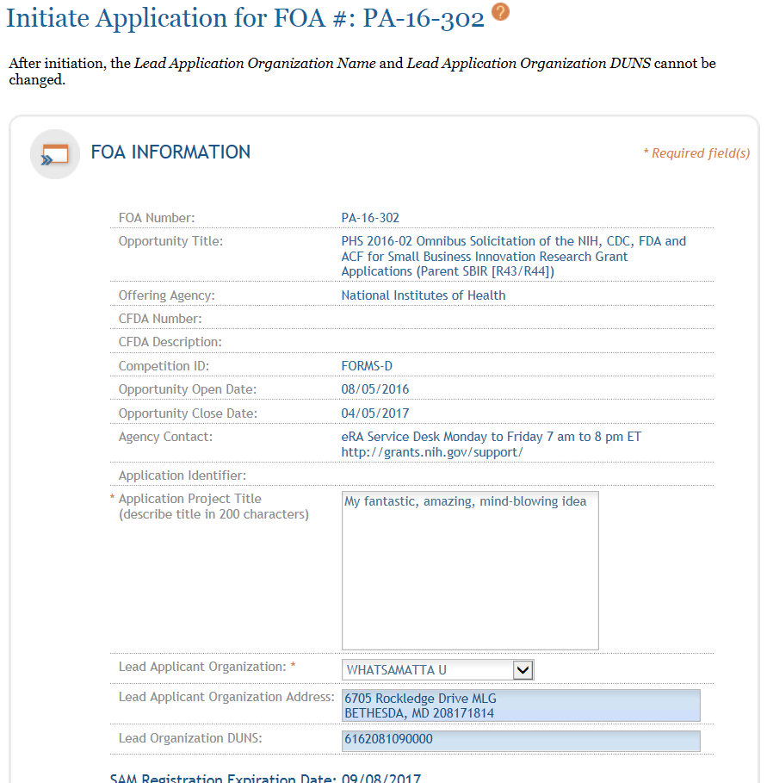
Initiate Screen
FOA information pulled from Grants.gov
Enter Project Title
Drop-down list of organizations affiliated with your eRA Commons account
Data pre-populated from organization selection

Slide 25
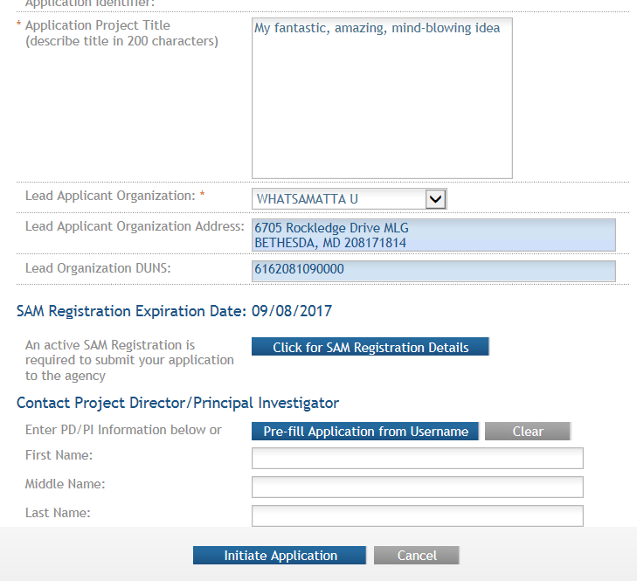
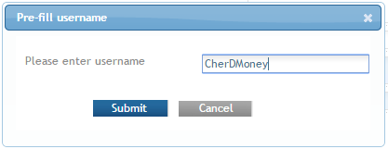
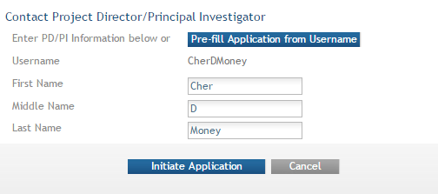
Initiate: Pre-population
Visibility to SAM registration expiration date & details
Can manually enter PD/PI information or provide
eRA Commons username to auto-populate

Slide 26
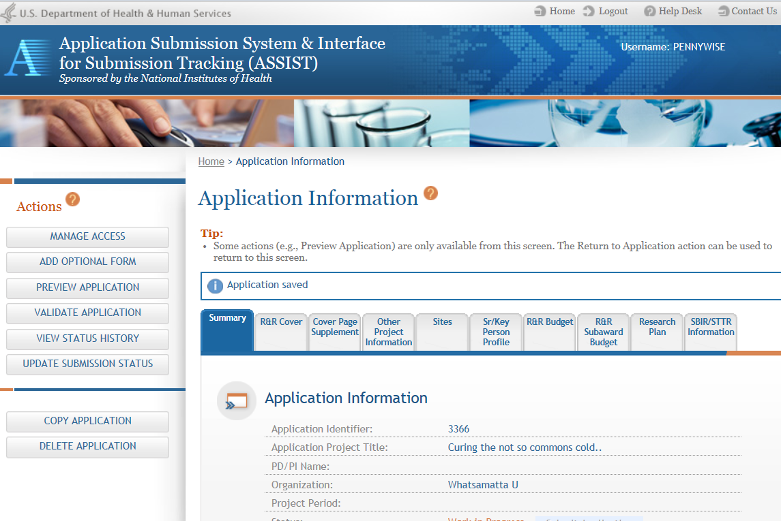
Screen Layout
Access online help
Screen tips
ASSIST messages
Form navigation
Actions - vary based on application context and access

Slide 27
Step 4: Provide Application Access to Your Team
Automatic application access
Manage access to additional users
Find
Plan
Initiate
Build Team
Enter Data
Finalize
Submit
Track

Slide 28

Automatic Application Access
ASSIST automatically provides application access to some individuals based on their Commons roles or role on the application
Examples:
  Users with eRA Commons accounts that have the Signing Official (SO) or Administrative Official (AO) role have access to all applications for their organization
  PD/PIs have access to all applications for
  which they have been given the PD/PI role
  Application initiator has automatic access

Slide 29

Manage Access Feature
Signing Officials (SOs) can provide application access to anyone with an eRA Commons account
  SOs can delegate Access Maintainer authority to others to manage application access for a specific application
Application access can be controlled across these variables:
  Read vs. Edit
  Budget vs. Non-budget data

Slide 30
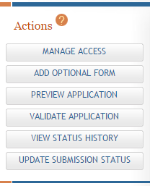
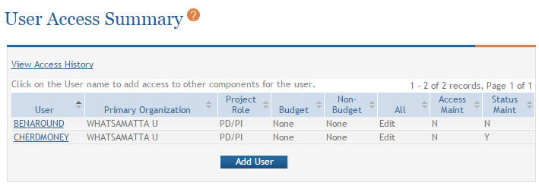
Manage Access Screens
Change current access
Provide access to additional users

Slide 31
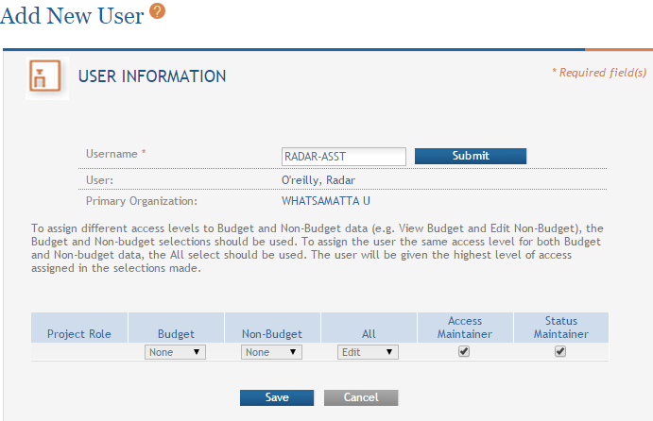
Add New User
Provide Commons ID
Delegate ability to control access to the application
Control access level
Delegate ability to change application status

Slide 32
Step 5: Enter Application Data
Data Entry screens
Avoiding Common Errors
Validate application
Find
Plan
Initiate
Build Team
Enter Data
Finalize
Submit
Track

Slide 33

Pre-population from eRA Commons & Application Data
DUNS and organization information is populated from the Commons institutional profile to the SF424 R&R form when you initiate your application
Organization information on the SF424 R&R form can be used to populate the primary site information on the Project/Performance Site form
Sr/Key person information on the Sr/Key person profile form can be populated from eRA Commons profiles
Budget period information carries from
one period to the next and is editable

Slide 34
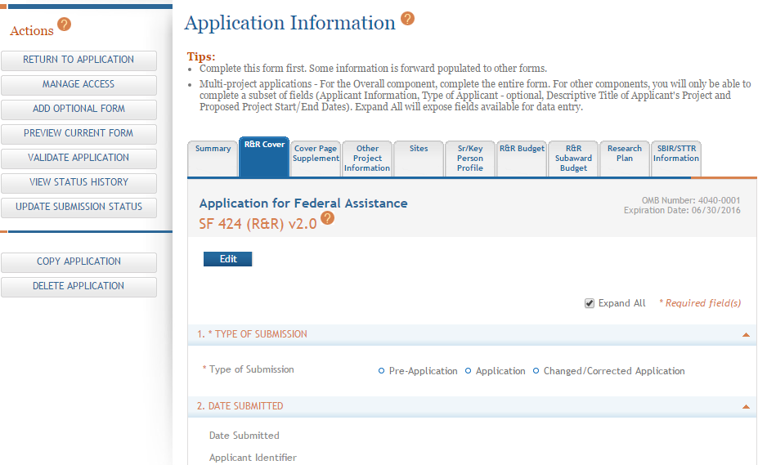
Data Entry Screens - Edit
Click each tab to access form data entry screens
Clicking Edit blocks other users from editing form

Slide 35
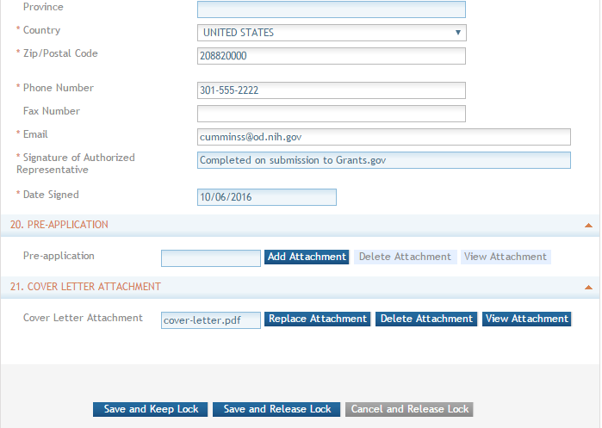
Data Entry Screens - Save
Save and continue to lock out others from editing this form
Save and release lock on form so others can edit this form

Slide 36
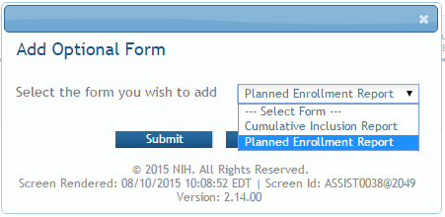
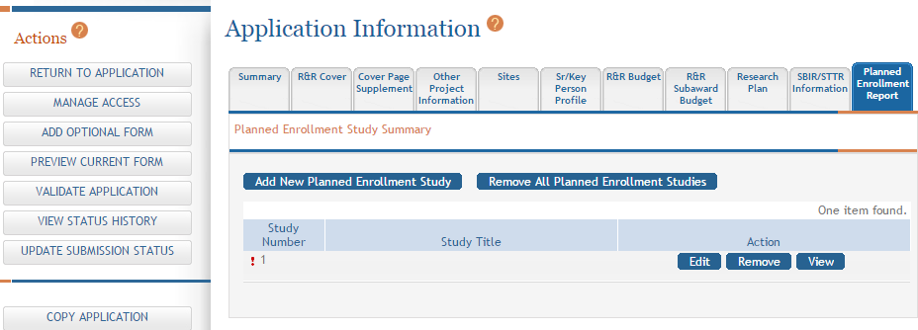
Add Optional Form Screen
Select form and click Submit
The form tab is added to navigation

Slide 37

Include All Required Attachments
Whether an attachment is required or not is often based on how you answer specific questions throughout the application
  Examples:
    Human Subjects = Yes, then Human Subjects section of the PHS 398 Research Plan is required
    Vertebrate Animals = Yes, then Vertebrate Animals attachment is required
    More than one entry on the R&R Sr/Key Person Profile form with the role of “PD/PI,” then the Multiple PD/PI Leadership Plan attachment on the PHS 398 Research Plan
    form is required

Slide 38
Special Small Business Attachments
In the Other Attachments section of the R&R Other Project Information form:
Attach proof of your SBA registration
Attach the “SBIR Application VCOC Certification.pdf” if your organization is venture capital backed
  Find it here: http://grants.nih.gov/grants/forms.htm#sbir

Slide 39
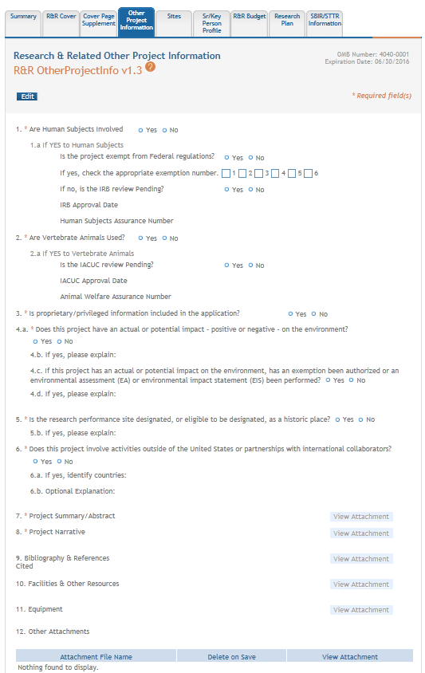
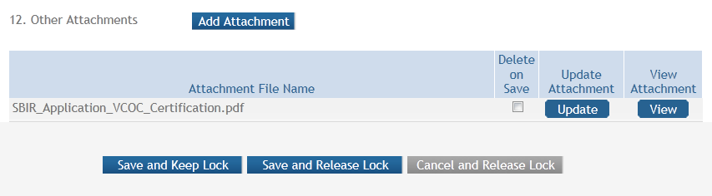
Avoiding Common Errors
Other Project Information form
Other Attachments section

Slide 40

Use PDF Format for All Attachments
Use simple PDF-formatted files
  Do not use Portfolio or similar feature to bundle multiple files into a single PDF
  Disable security features such as password protection
Keep file names to 50 characters or less
Use meaningful filenames
Do not include headers or footers
  Section headings as part of the text (e.g., Significance,
  Innovation, Approach) are encouraged
Follow guidelines for fonts and margins
Format Attachments: http://grants.nih.gov/grants/how-to-apply-application-guide/format-and-write/format-attachments.htm

Slide 41
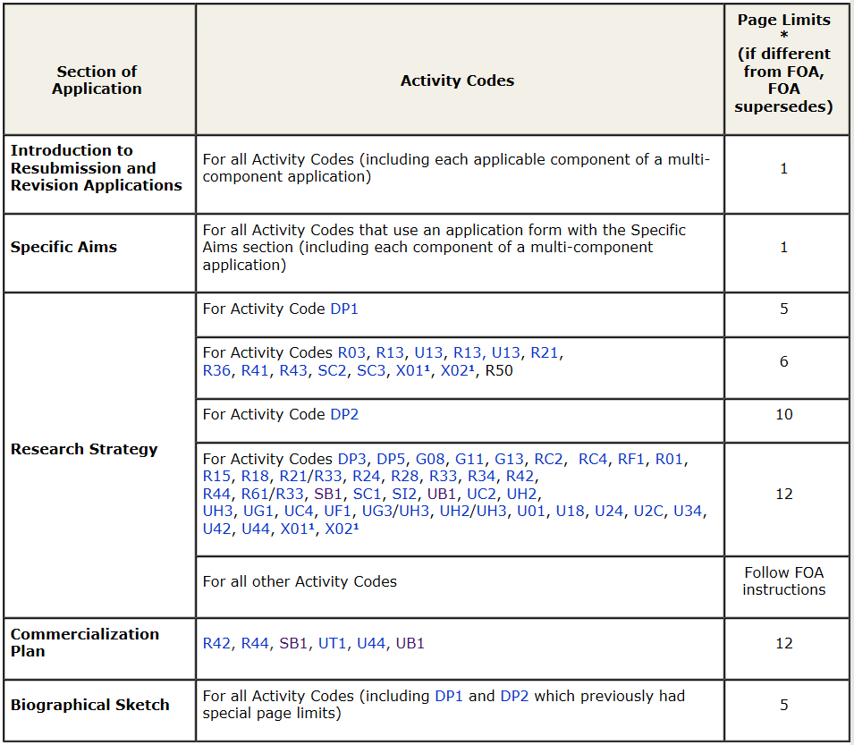

Follow Specified Page Limits
Page Limits: http://www.grants.nih.gov/grants/forms_page_limits.htm#other

Slide 42
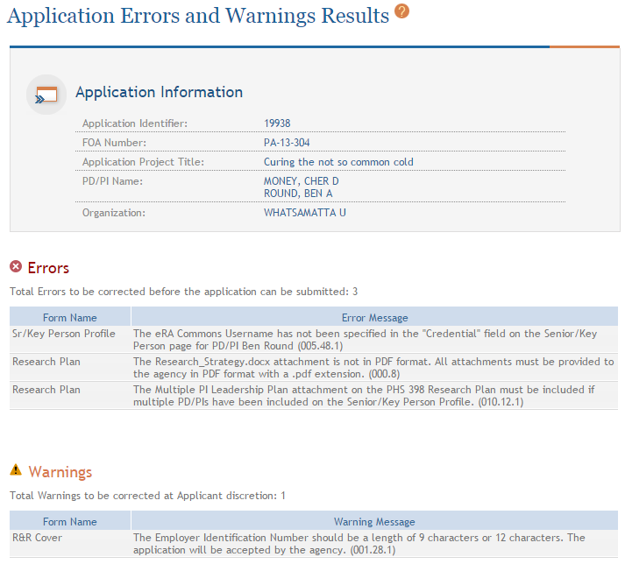
Validate Application Screen
Errors and Warnings are displayed

Slide 43



Corrective submissions must be made BEFORE the submission deadline and overwrite previous submissions.
Errors stop application processing and must be corrected
  You will be unable to submit in ASSIST until all identified errors are corrected
Warnings do not stop application processing and are corrected at the discretion of the applicant

Slide 44

Application Checks (Validations)
We really care about the details
Multiple levels of application checks for completeness
  Grants.gov
  eRA systems
  Agency staff
https://grants.nih.gov/grants/how-to-apply-application-guide/submission-process/check-your-application.htm

Slide 45
Validations Done by Grants.gov
Can you think of some examples?
  Active System for Award Management (SAM) registration
  Submitter has AOR role for DUNS on application
  Submission made to active opportunity and application package
  Virus check
  Filenames include only appropriate characters
    A-Z, a-z, 0-9, underscore, hyphen, space, period, parenthesis, curly braces, square brackets, ampersand, tilde, exclamation point, comma, semi colon, apostrophe, at sign, number sign, dollar sign, percent sign, plus sign, and equal sign

Slide 46
Validations Done by eRA Systems
Can you think of some examples?
  Fields required by agency, but not required federal-wide
    R&R Sr/Key form
      Credential for PD/PIs (and a few others)
      Organization name for all sr/key
      Biosketch attachment for all sr/key (Grants.gov only enforces for PD/PI)
    Project/Performance Site Location form
      DUNS for primary site
  Attachments in PDF format
  Adherence to page limits in our Table of Page Limits (unless otherwise specified in the announcement)
  Included appropriate attachments (eRA checks many but not all)

Slide 47
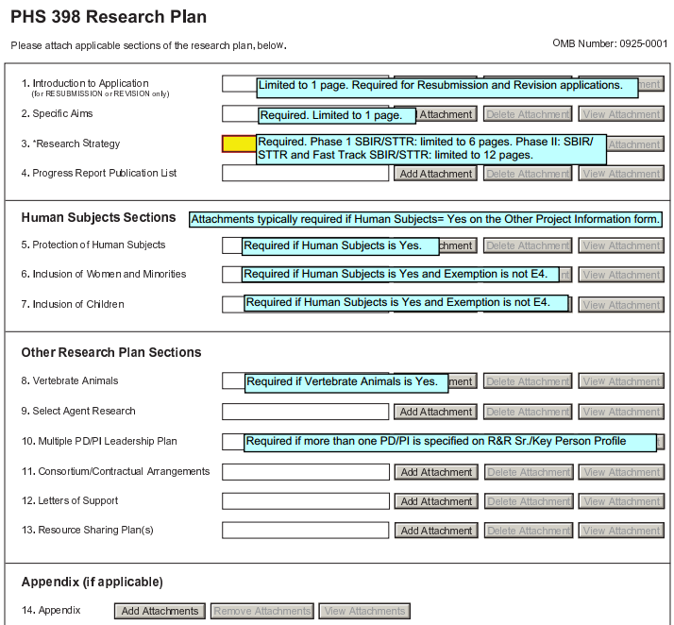

Avoiding Common Errors (cont)
Annotated form sets are a great resource for helping identify many conditional requirements.
http://grants.nih.gov/grants/how-to-apply-application-guide/resources/annotated-form-sets.htm

Slide 48

Checks Done by Agency Staff
Can you think of some examples?
  Fit with NIH's and participating institute’s mission
  Eligibility
  “Overstuffing” – application doesn’t include inappropriate information in attachments to get around page limits
  On-time submission
  Simultaneous review of essentially same application
  Adherence to funding opportunity announcement specific instructions
  Correct number of reference letters received by the due date (if applicable)
  Adherence to font and margin guidelines
  Agreement from institute to accept application requesting over $500K in direct costs in any budget period

Slide 49

Step 6: Finalize Your Application & Prepare for Submission
Preview Application
Update Submission status
Find
Plan
Initiate
Build Team
Enter Data
Finalize
Submit
Track

Slide 50
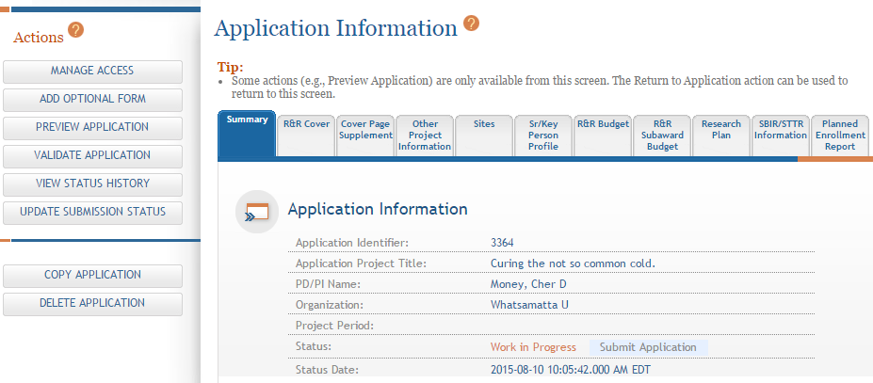
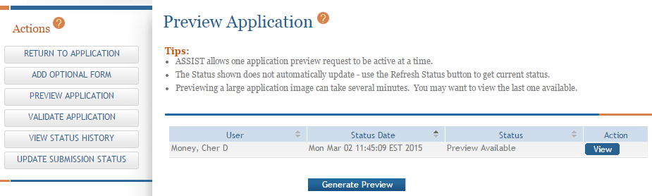
Generate Application Preview in Agency Format
View last preview
Generate new preview

Slide 51
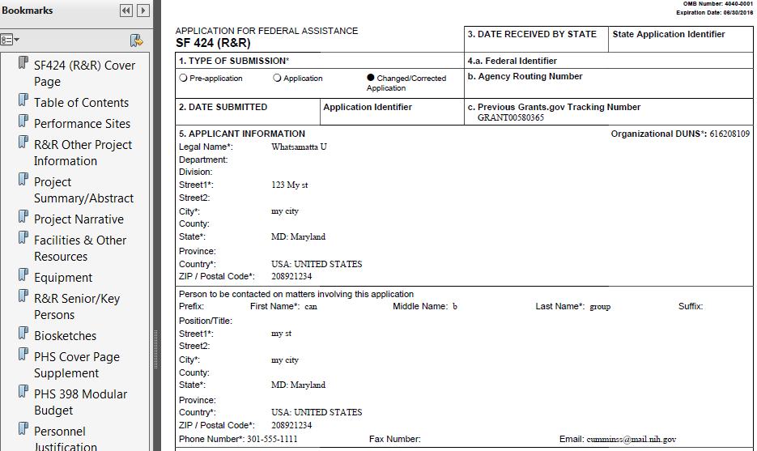
Application Preview in ASSIST
The preview is exactly how your application would be assembled upon submission, except a few items in the footer (Grants.gov submission ID and timestamp) are not filled in.

Slide 52
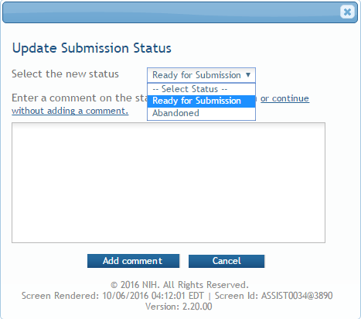
Update Submission Status
Select status
Enter comment to be added to status history

Slide 53
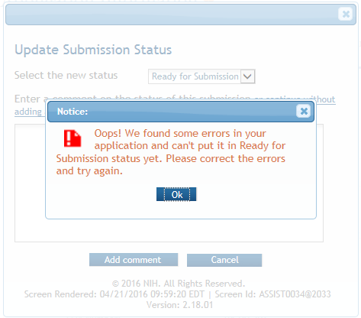

Final Check for Errors
Before an application is changed to Ready for Submission status, it must pass validations (Warnings are OK).

Slide 54
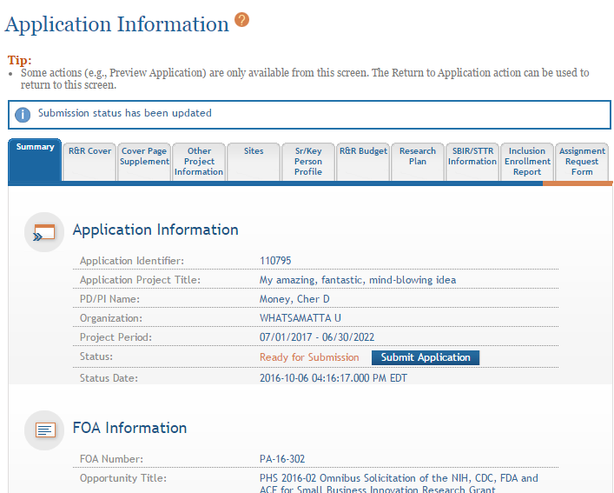
Updated Status Reflected in Summary Tab

Slide 55
Step 7: Submit Your Application
Submit early!
Find
Plan
Initiate
Build Team
Enter Data
Finalize
Submit
Track

Slide 56



Pop Quiz
The appropriate measurement for “early” in the context of application submission is…
Minutes
Hours
Days

Slide 57

On-time Submission
Important reminders:
  NIH recommends submitting early (days, not minutes!) to allow time for correcting any errors found during the application viewing window prior to the due date
  NIH’s late policy does not allow corrections after the due date
  All registrations must be completed before the due date
Error-free applications must be accepted by Grants.gov with a time stamp on or before 5:00 p.m. local time of the submitting organization on the due date.

Slide 58
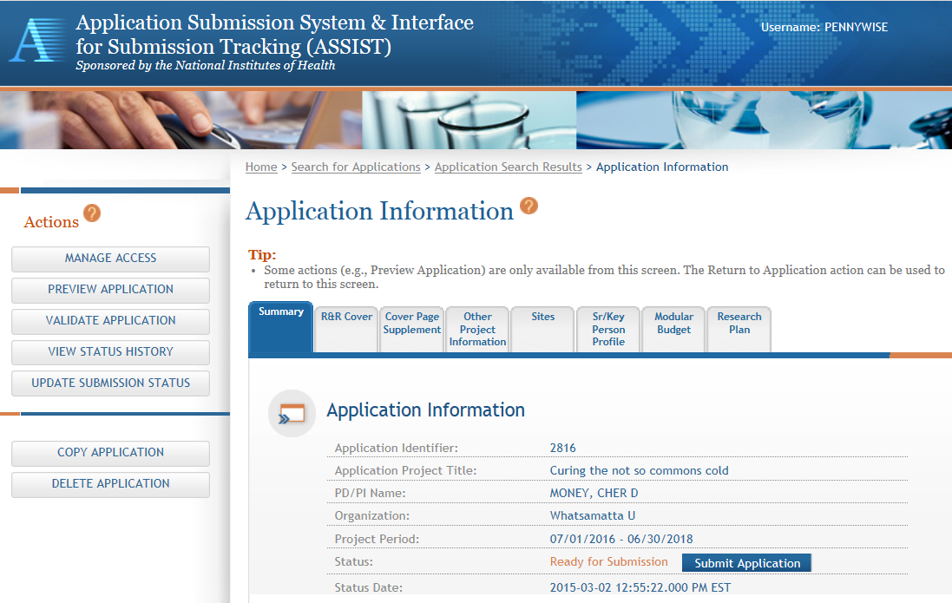
Submitting an Application in ASSIST
Must be an eRA Signing Official (SO) and a Grants.gov Authorized Organizational Representative (AOR) to submit
Application Status must be set to Ready for Submission.

Slide 59
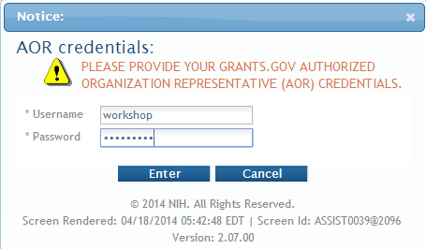
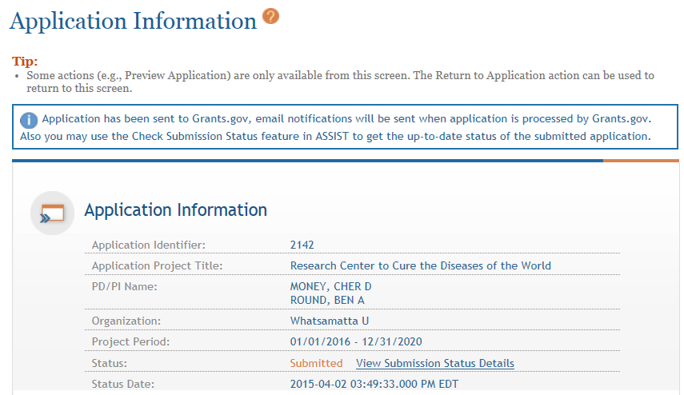
Submit Your Application
Applications are submitted from ASSIST to Grants.gov.
Enter your Grants.gov AOR credentials and click Enter.
Message will appear indicating the application was sent to Grants.gov.

Slide 60

You’re Not Finished Yet…
Application
Successfully
submitted
to NIH
Submitting to Grants.gov is NOT the last step in the process!

Slide 61
Step 8: Track Your Application & View Assembled Image
View Submission Status Details
Carefully check assembled application image
Find
Plan
Initiate
Build Team
Enter Data
Finalize
Submit
Track

Slide 62

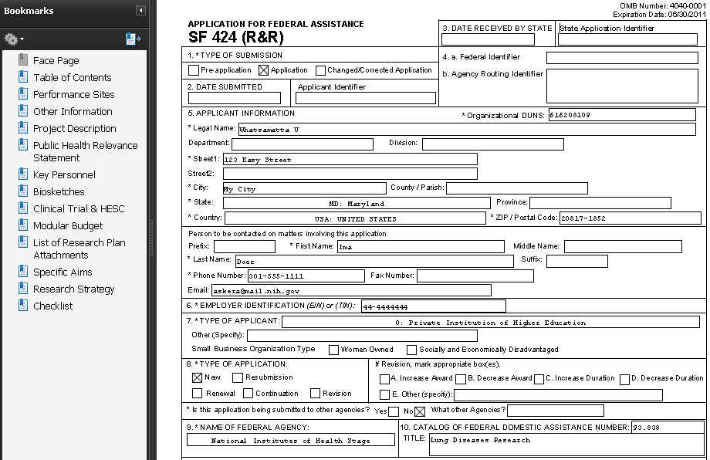
View Application Image
Once an error-free application is received by NIH, the eRA system will:
  Assemble the grant application image
  Insert headers (PI name) and footers (page numbers) on all pages
  Generate Table of Contents and bookmark important sections
  Post the assembled application image in the PD/PI’s eRA Commons account
  Send notification
    Email can be unreliable – proactively
    check application status

Slide 63

Tracking Submission Status
ASSIST provides the ability to track both Grants.gov and NIH status
  Links to the eRA Commons Detailed Status Information to view your assembled application

Slide 64
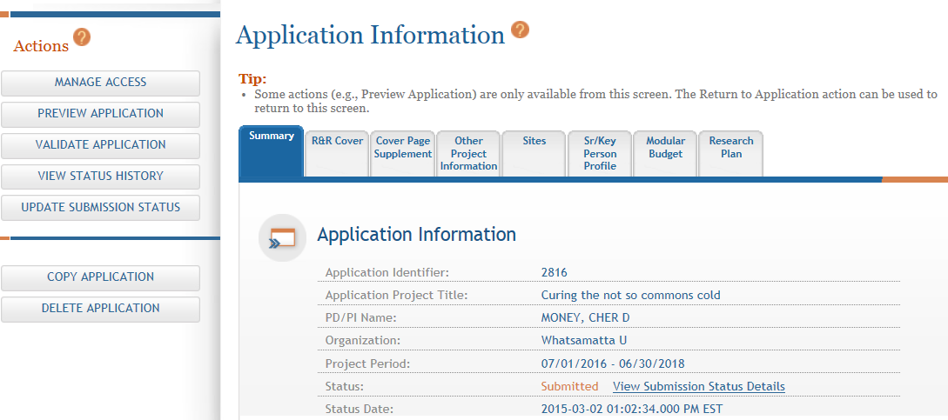
View Submission Status Details
Click View Submission Status Details
64

Slide 65
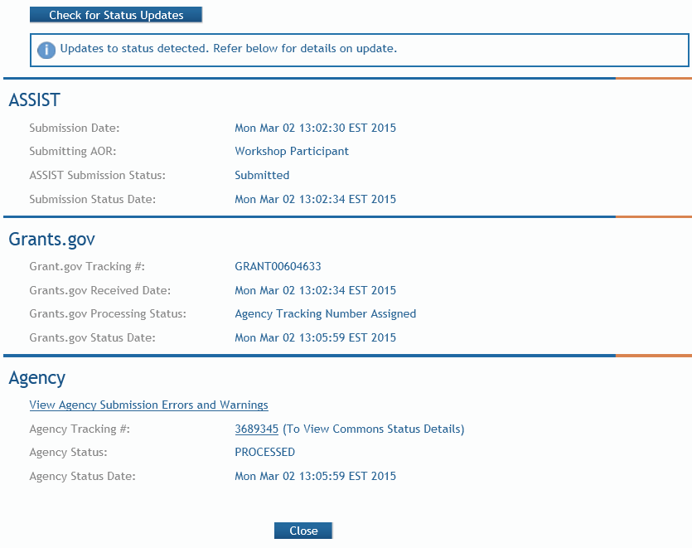
Track Submission Status within One System
Happy path…
ASSIST = Submitted
Grants.gov = Agency Tracking Number Assigned
Agency = Processed
Agency Tracking # link brings you to the detailed status screen in eRA Commons

Slide 66
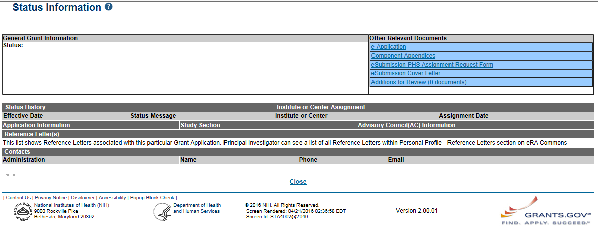
Accessing the Application in eRA Commons
eApplication is the application image reviewers use.
Cover Letter, PHS Assignment Request Form, and Appendices (when allowed) are stored separate from the image.

Slide 67
Final Assembled Application Image
TIP: This is the same application image that will be accessed by reviewers and staff, so check it carefully!

Slide 68

Application Viewing Window
Applicants have two (2) business days to view the assembled application image before the application automatically moves forward for further processing
Signing official can Reject application in eRA Commons within viewing window and submit a Changed/Corrected application before the submission deadline
If you can’t VIEW it, we can’t REVIEW it!

Slide 69

Submission Complete!
If no action is taken during the two business day viewing window, the application automatically moves forward for further processing at NIH

Slide 70

Dealing with System Issues
You must follow NIH’s standard ‘system issue’ procedure if you run into problems beyond your control that threaten your on-time submission: http://grants.nih.gov/grants/ElectronicReceipt/support.htm#guidelines

Slide 71

Finding Help & Resources
Help Desks
On-line resources &Web sites

Slide 72

eRA Service Desk
  Web: http://grants.nih.gov/support/
  Toll-free: 1-866-504-9552
  Phone: 301-402-7469
  Hours: Mon-Fri, 7a.m. to 8 p.m. Eastern Time
  (Except for Federal holidays)
Although we’ve worked closely with Grants.gov, ASSIST is a system developed and managed by NIH.
The eRA Service Desk should be your first stop for support.

Slide 73

Systems & Sites
NIH SBIR/STTR:
http://sbir.nih.gov/
How to Apply – Application Guide
http://grants.nih.gov/grants/how-to-apply-application-guide.htm
ASSIST: public.era.nih.gov/assist
Online help: era.nih.gov/erahelp/ASSIST/
Annotated form set
http://grants.nih.gov/grants/how-to-apply-application-guide/resources/annotated-form-sets.htm
eRA ASSIST Training page: http://era.nih.gov/era_training/assist.cfm

Slide 74

Questions?

