Slide 1
NIH Institutional Training Programs: Preparing a Successful T32 Application
Michael A. Sesma, Ph.D.
Chief, Postdoctoral Training Branch
Division of Training, Workforce Development and Diversity
National Institute of General Medical Sciences
National Institutes of Health
June, 2013

Slide 2
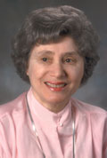
Ruth L. Kirschstein National Research Service Awards
Overview:
The overall goal of the NIH Ruth L. Kirschstein National Research Service Award (NRSA) program is to help ensure that a diverse pool of highly trained scientists is available in appropriate scientific disciplines to address the Nation's biomedical, behavioral, and clinical research needs.
funding to scientists, not health professionals
to enhance research training
in scientific areas with need for researchers
good curricula, facilities, program in addition to research
dedication to developing talent
NRSA Opportunities:
Training grants (Ts): Multi-slot awards that are used to support research training activities for several individuals selected by the institution.
Fellowships (Fs): Individual awards for graduate students pursuing a doctoral degree and researchers who have just earned their doctorates (postdocs).

Slide 3
Student “training” depends on funding
Research Grant | Training Grant | Fellowship
“Research work” | Early or Dissertation Phase Training | Dissertation phase training
Project Focused | Value-added for Trainee | Fellow’s project
Benefit to RPG PI | Benefit to program PIs | Trajectory for Independence
 | Institutional Change
T32 Institutional Training Grant (PA-14-015)
Predoctoral and/or Postdoctoral Traineeships
F30 (MD PhD) fellowship (PA-14-150)
F31 (PhD) fellowship (PA-14-147; PA-14-148 (diversity))
F32 Postdoctoral fellowship (PA-14-149)

Slide 4
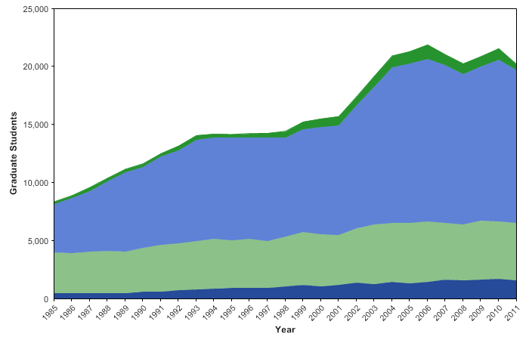
Predoctoral support is largely from research grants “Training” differences in apprenticeship vs a program
Primary mechanisms of NIH Predoctoral Training support

Slide 5
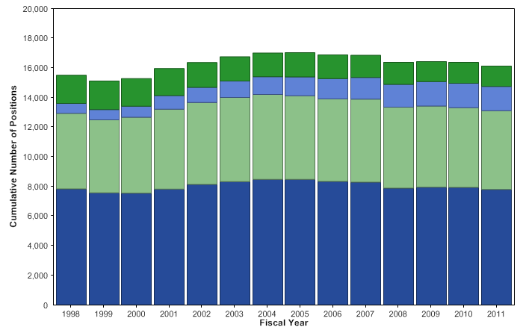
Kirschstein-NRSA Training Grants and Fellowships Distribution of FTTPs X Activity and Career Stage
Notes:
5
Data and chart description for this slide can be located at http://report.nih.gov/NIHDatabook/Charts/Default.aspx?showm=Y&chartId=180&catId=17

Slide 6
NIH Predoc Trainees finish the PhD, have earlier success
 | Median Time to Degree (TTD) | 10 Yr PhD Completion rate
NIH Trainees | 6.3 yrs | 80.1%
Life Science PhD | 6.9 yrs | 62.9%
Social Science PhD | 7.7 yrs | 55.9%
 | Applied for NIH RPG within 15 yrs of degree | Received NIH RPG Award within 15 yrs of degree
NIH Trainees & Fellows | 36.7% | 23.6%
Other PhDs: same fields, institutions | 12.8% | 7.0%
Other PhDs: same fields and institutions without NIH Training Grants | 5.9% | 2.6%
Encourage institutions to accelerate time to scientific independence
Sources: IMPAC II and the Doctorate Records File--Includes MSTP trainees

Slide 7
Training in light of limited diversity in workforce
US Population
Biomedical Workforce
Source: US Census; NSF, 2007

Slide 8
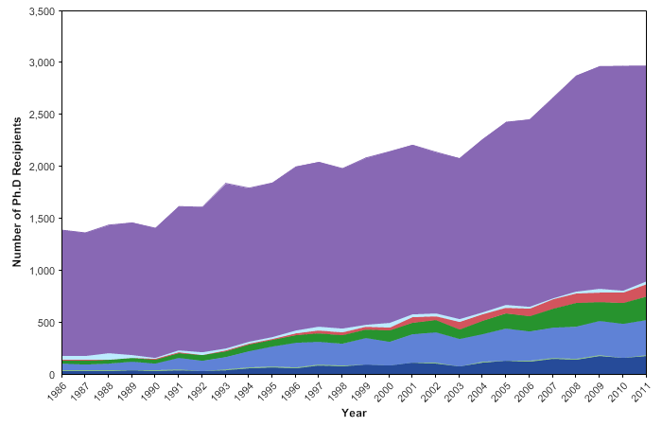
Trends in race/ethnicity of NIH-supported Ph.D. recipients
Notes:
8
Data and chart description for this slide can be located at http://report.nih.gov/NIHDatabook/Charts/Default.aspx?showm=Y&chartId=270&catId=21

Slide 9
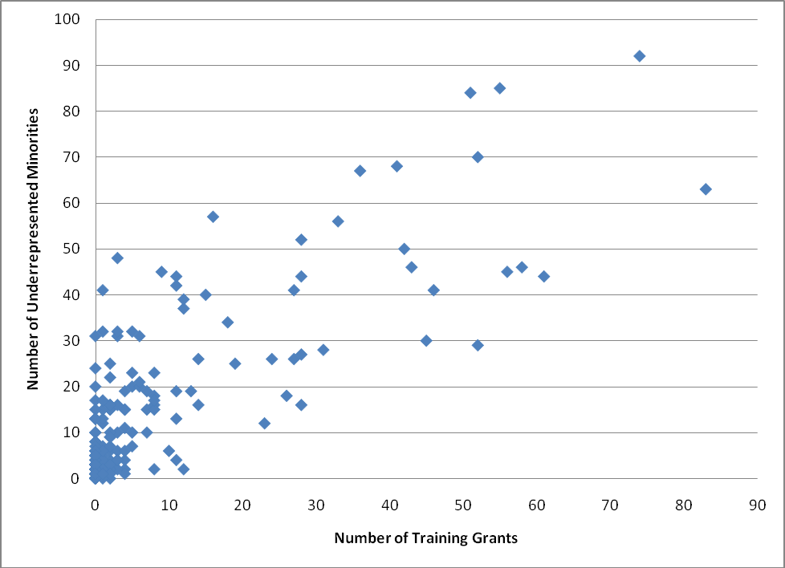
Do training grants help build diversity?
African American Other URM Hispanic Total Trainees
NIH 406 (5.6%) 46 517 (7.2%) 7212
as many as 969 URM trainees or 13.4%* supported by T32
*Some individuals may report multiple backgrounds;
T32 predoc appointees 2011; ImpacII, Off Res Info/Off Stat Anal & Report/ OER Stats
Comparison of the Number of Training Grant Awards and the Number of URM Trainees by Institution. The correlation between training grants and number of URM students is 0.748.
National Academies Press 2011; Research Doctorate Programs in the biomedical sciences: Selected findings from the NRC Assessment (2011) Board on Higher Education and Workforce

Slide 10
Snapshot of the PhD Biomedical Workforce
College Graduates
NOTE: The color of the numbers reflects the confidence in the accuracy of the data.
16,000 in 2009
Graduate Education & Training
2009 Total: 83,000
Time to Degree :5.5-7yrs
2009 Graduates: 9,000
4,000
in 2009
International
8% of graduates
leave the US
Of graduates who stay in the US
30% skip a postdoc
70% do a postdoc
5,800 in 2009
Postdoctoral Training
2009 Total: 37,000 to 68,000
Median Length: 4 years
1,900 to 3,900
in 2009
Post-Training Workforce
(128,000 Biomedical US-trained PhDs)
18%
Biomedical US- trained PhD, 2008
~24,000
6%
Biomedical US- trained PhD, 2008 ~7,000
43%
(23% tenured)
Biomedical US-trained PhD, 2008 ~55,000
18%
Biomedical US-trained PhD
2008~22,500
13%
Biomedical US-trained PhD,
2008 ~17,000
2%
Biomedical US-trained PhD, 2008 ~2,500
Science Related Non-Research
Government Research
Academic Research or Teaching
Industrial Research
Non-Science Related
Unemployed
http://acd.od.nih.gov/Biomedical_research_wgreport.pdf

Slide 11
Training In light of Multiple Career Outcomes Employment of Biomedical Science PhDs by Sector
Source: http://sestat.nsf.gov/

Slide 12
What’s Next? Attention to multiple careers
Graduate students in basic biomedical sciences
Initially have goal of academic research
Midway thru PhD consider multiple careers
Individual Development Plans (IDPs)
self assessment and planning
To be used in training, fellowships, RPGs…
Student and Mentor Engagement
myidp.sciencecareers.org
Fuhrmann et al 2011 CBE Life Sci Educn 10: 239-249

Slide 13
The IDP involves
The scholar The mentor
Self Assessment Familiarity with opportunities
Survey opportunities discuss opportunities
Write IDP Review IDP, help revise
Implement plan Assess New Tasks, Progress
in light of the plan
Skills assessment - strengths and weaknesses
Career match - do goals match skills and interest?
Do it again next year

Slide 14
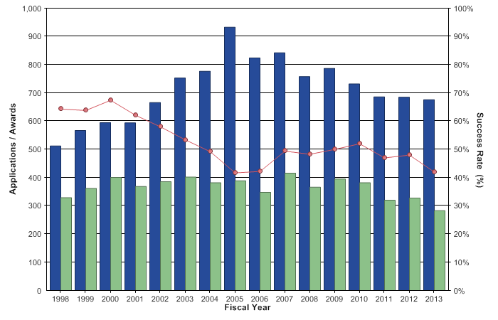
Kirschstein-NRSA institutional research training grants Applications, Awards, and Success Rates
Notes:
14
Data and chart description for this slide can be located at http://report.nih.gov/NIHDatabook/Charts/Default.aspx?showm=Y&chartId=60&catId=17

Slide 15
Institutional Training Grants FY2013
Competing:
672 Applications
57 Type 1 (new) awarded
223 Type 2 (renewal) awarded
Non-Competing:
1,409 Type 5 (non-competing) awarded
Total Number of T32s in 2013 = 1,689
Total Success Rate = 42%
23% for New Applications
49% for Competing Renewal Applications

Slide 16
Institutional Training Programs: Strategies for Preparing a Successful Application
Understand the role of training programs
Goal to enhance research training through a coordinated programmatic approach
Involve many faculty, multiple departments
Trainees selected by the institution
PA-14-015 T32 Parent Announcement
Clarify value-added, careers
Evolution of review criteria

Slide 17
Strategies to Develop a Competitive T32 Application
Start Early
Consider why a Training Grant is important
Be very sure there is a PROGRAM
Consider how your training is innovative
Complete tables before finalizing narrative
Read and respond to the review criteria
Explain, explain, explain.
Remember reviewers are expert faculty familiar with training

Slide 18
Strategy for T32 Preparation
Organize Faculty Group | Design the Program | Get Institutional Support | Review Table Data | Write the Narrative

Slide 19
Training Programs Rely on Faculty Strengths
Organize Faculty Group | Design the Program | Get Institutional Support | Review Table Data | Write the Narrative
Use NIH Reporter - search your School’s Faculty Research
Faculty in research area of proposal
Faculty funded by particular Institute
Examine Your Institution - Training History
Critical mass of Faculty
Current “pool” of potential trainees
Faculty history with pre- or post-doc training
Training career outcomes, fellowships, publications
Faculty mentor development

Slide 20
Organize Faculty Group | Design the Program | Get Institutional Support | Review Table Data | Write the Narrative
Who is the Program for?
Many interdisciplinary, not departmental
How to manage nomination, selection?
Why do you need a training program?
How will the trainee benefit from the program?
What are the Program Elements?
Every student will..
Can students complete what you outline?
What Outcome do you want and expect?
What is the most Important Outcome?

Slide 21
Organize Faculty Group | Design the Program | Clarify Institutional Support | Review your Tables | Write the Narrative
The “value added” from training is an
Intentional program beyond research in the PI labs
Active nomination, selection of candidates from pool
Planned research and academics, with flexibility
Seminars, enhancement activities
Longitudinal program beyond funding period
Faculty trainer responsibilities make program strong

Slide 22
Training Programs are Developmental, more than Selection of Talent
Potential Trainees
Select for TG and why
Program Activities
Planned interventions
Milestone/ Outcomes
Intended changes
Matriculant
UG major
Research Interest
Courses taken
Lab affiliation
PhD Program
Pilot research
Mentored Research
PI, advisory cmte
research design
new techniques
Planned Curriculum
knowledge
teaching
Skill building
oral communication
writing workshops
new collaborations
Contemporary science
meet new scientists
Career Exposure
know next steps
Short term
Research publications
Poster, meeting
Fellowship
Longer term
Next position
Biomedical career
Research grants
Mentoring others

Slide 23
Organize Faculty Group | Design the Program | Clarify Institutional Support | Review your Tables | Review Criteria, Get Advice | Write the Narrative
Who will “run” the program?
Effort, administrative support, record-keeping
interface with Grad Studies, PhD program, etc.
If trainees and mentors at different sites
where do they meet? Socialize? Retreat?
how do you form a cohort?
Student Council groups attractive

Slide 24
Organize Faculty Group | Design the Program | Clarify Institutional Support | Review your Tables | Review Criteria, Get Advice | Write the Narrative
Institutional Support
Grants and Contracts submits grant
need faculty data, postdoc office, student information
For PI/PD and faculty
effort (salary), research support
administrative support for training program
central graduate office support
For Trainees
top-up stipend, perks?
support for other students in program
access to resources (research cores, RCR courses, recruiting)

Slide 25
Organize Faculty Group | Design the Program | Clarify Institutional Support | Review your Tables | Review Criteria, Get Advice | Write the Narrative
12 required tables
Some schools have central office for data
PD is responsible for content, understanding
even if assistant helps prepare the tables!
Analyze information and describe in narrative
Be sure to have at least a paragraph on each table
explain, don’t bury, data. Have a plan!

Slide 26
Organize Faculty Group | Design the Program | Clarify Institutional Support | Review your Tables | Review Criteria, Get Advice | Write the Narrative
Scored Review Criteria:
1. Training Program and Environment
2. Training Program Director/Principal Investigator
3. Preceptors/Mentors
4. Trainees
5. Training Record
Overall Impact Score: 1-9

Slide 27
Review of Training Grants
Two Levels of Review:
Initial Review - Study Section- Scientific Merit
Appropriate Scientific Expertise
Established Scientists
Many Participate in Training Programs
Institute or Center Council- Program Relevance
Broader Scientific Coverage
Established Senior Scientists
Leaders in Community (Scientific, Business, Philanthropic)
Provide Guidance to Program Staff

Slide 28
Your Grant Application
Electronic Submission ---May (Sept, Jan)
Received Centrally by the Center for Scientific Review and Referred to Appropriate Institute
Assigned to Appropriate Initial Review Group (20 to 30 members) by the Institute
Each Application Assigned to Three to Four Primary Reviewers in Group
Initial Review Group Meeting --- September
Advisory Council --- January
Funding Decisions --- March
Award Issued --- July

Slide 29
4. Trainees
Is a recruitment plan proposed with strategies likely to attract well-qualified candidates for the training program?
Proactive recruitment or dependent on umbrella admissions?
Are there well-defined and justified selection and re-appointment criteria as well as retention strategies?
Nomination, re-appointment criteria, process
Is there evidence of a competitive applicant pool of sufficient size and quality, at each of the proposed levels (pre, post, short-term) to ensure a successful training program?
TG is catalytic, supports a third(?) of relevant TGE students

Slide 30
5. Training Record
To what extent do trainees’ subsequent positions in industrial, academic, government, non-profit, or other sectors benefit from their NRSA-supported research training and directly benefit the broader biomedical research enterprise?
Preparation for multiple career paths?
Does the program propose a rigorous evaluation plan to assess the quality and effectiveness of the training?
Annually assess outcomes? What do you measure?
Evidence that adapt to changes?
Are effective mechanisms in place for obtaining feedback from current and former trainees?
student council, social media, LinkedIn, etc.
alumni lectures
Is there a record of retaining health professional trainees in research training or other research activities for at least two years?

Slide 31
Additional Review Criteria & Considerations
Additional Review Criteria
Protection for Human Subjects
Inclusion of Women, Minorities, and Children
Vertebrate Animals
Biohazards
Resubmission, Renewal, Revision factors
Additional Review Considerations:
Diversity Recruitment Plan
Training in Responsible Conduct of Research
Select Agent Research
Budget and Period of Support

Slide 32
Additional Review Criteria & Considerations
Budget – FTTPs (Program Slots)
Most TGs support two years of training
slots are described per year
justify slots at about 25-33% of TGE trainee pool in a year
Responsible Conduct of Research
Mandatory; describe hours, topics, when occurs, refresh
Online is not sufficient
Institutional program okay, IF also
TG faculty participate in small groups
Rated as: Acceptable or Unacceptable
Each IC will review plans before funding

Slide 33
Additional Review Criteria & Considerations
DIVERSITY
Recruitment and retention plan to enhance diversity evaluated after the overall score has been determined
Goal is diversity and inclusion in the program especially for individuals from groups underrepresented in biomedical and behavioral science
US minorities, Individuals with disabilities
Be aware of NSF data, know your institutional record
Plans to recruit
Plans to retain
Report Progress
Rated as: Acceptable or Unacceptable
Each IC will review plans before funding

Slide 34
Table 2. Participating Faculty Members
Do right away, its easy to modify as you collect biosketches:
Start here

Slide 35
Table 1. Participating Departments
Finish this table last…its complicated
From the Table 1 Instructions -
Rationale: This table provides insight into the environment in which training will take place. It allows reviewers to assess whether the program has the "critical mass" (trainees, faculty and other research personnel, and representation/distribution of scientific disciplines) to be successful.
35

Slide 36
Table 3. Existing Institutional Training Grants
Explain overlapping faculty, esp if overlap trainee stage

Slide 37
Table 4. Grant Support of Faculty
current and pending research funding only. If none…worry

Slide 38
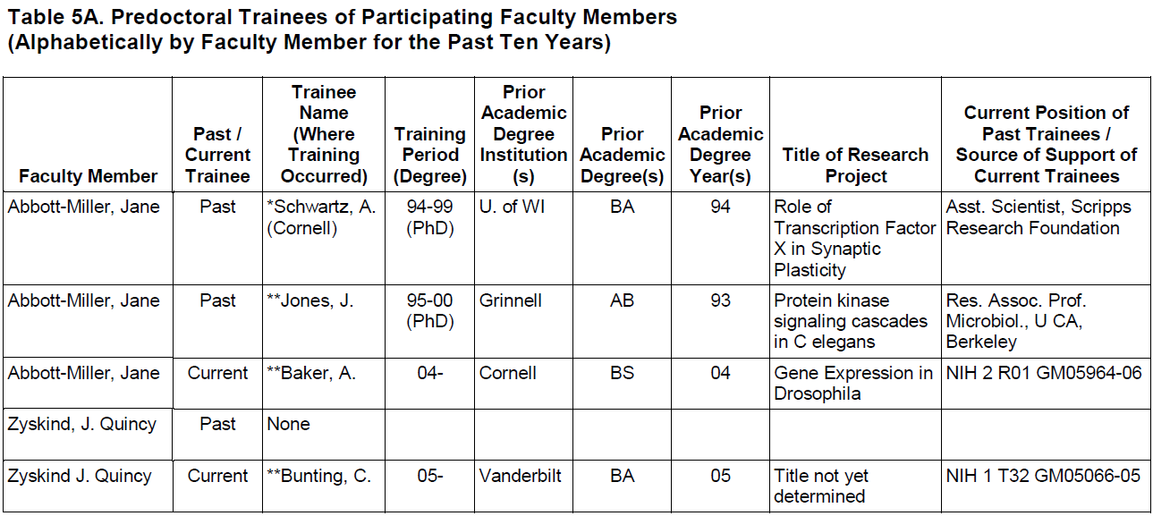
Table 5. Training Record of Faculty
If no previous trainees, what is plan to mentor initial trainer?
If poor outcomes, you may not want this trainer!

Slide 39
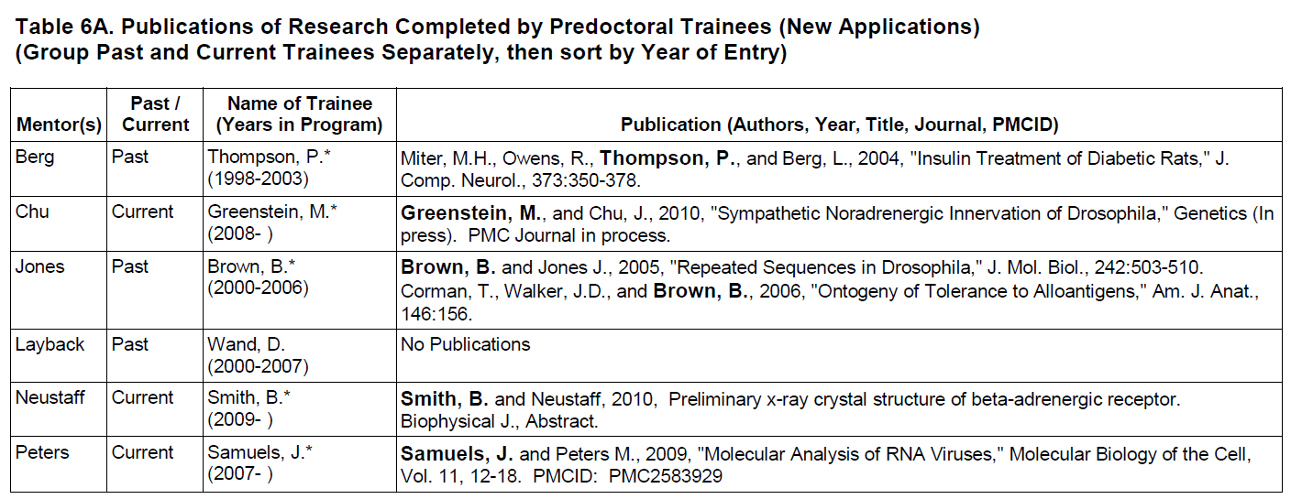
Table 6. Publications of Trainees
Comment on first author, and total publications with mentor
Discuss program policies on pubs
Notice TTD here…
For renewals attend to Public Access Compliance

Slide 40
Table 7A. Admissions and Completion Records for Participating Departments and Programs

Slide 41
Table 8A. Qualifications of Recent Predoctoral Applicants
Similar table (8B) for Postdoctoral Applicants

Slide 42
Table 9A. Qualifications of Current Predoctoral Trainees

Slide 43
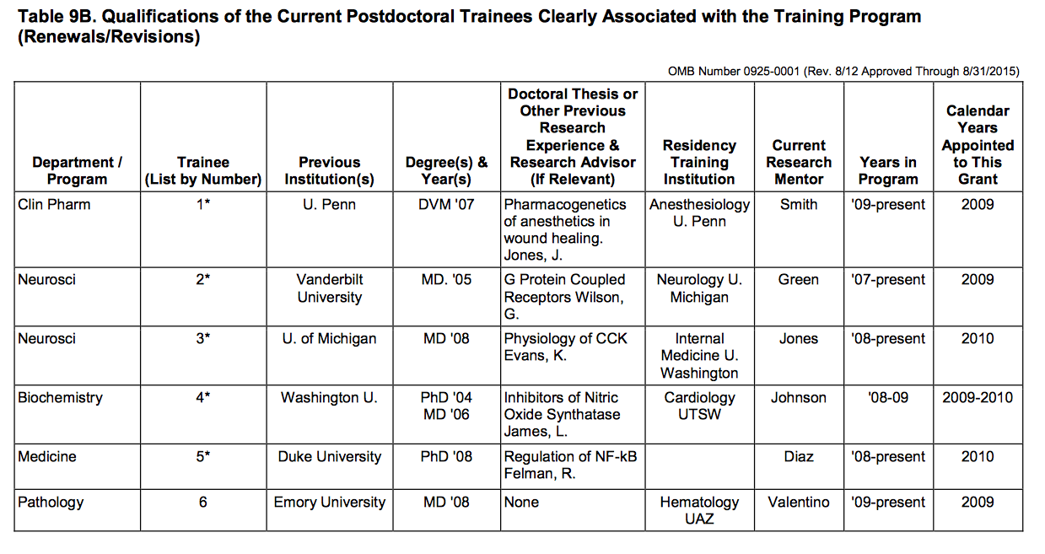
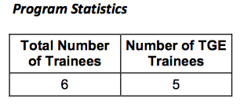
Table 9A. Qualifications of Current Postdoctoral Trainees

Slide 44
Table 10. Admissions and Completion Records of Underrepresented Individuals
A
B
C—usually not for grad, postdoc

Slide 45
Table 11. Appointments to the Training Grant for each Year of Past Award

Slide 46
12A. Predoc Trainees Supported by this Training Grant
TG1, TG2...Early, late…Explain use of slots!

Slide 47
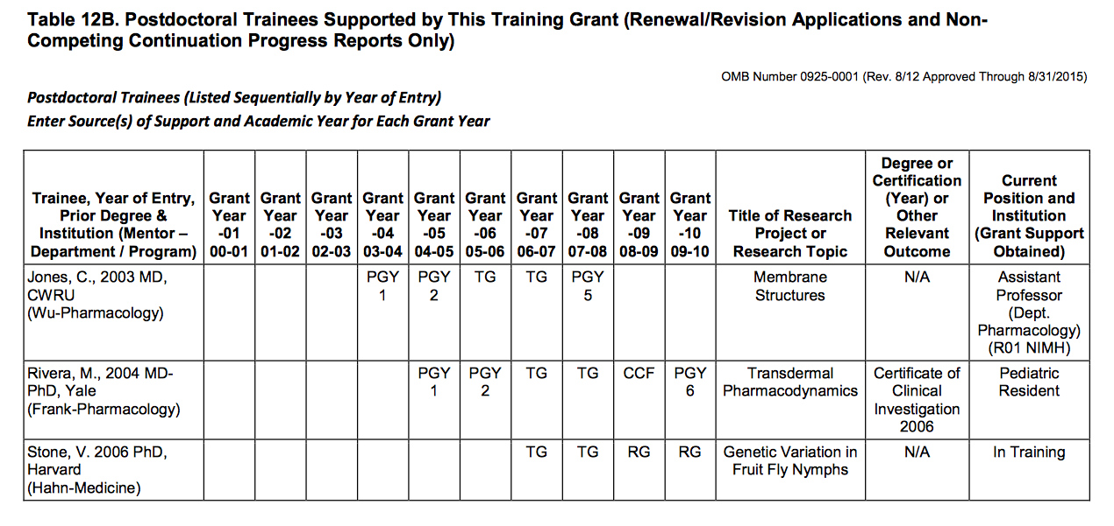
12B. Postdoc Trainees Supported by this Training Grant

Slide 48
Notes on the Narrative
Background
Describe a good environment for training
Describe data in Tables 1, 2, 3:
Departmental Membership, Participating Faculty Members, Other TG Support
Program Administration and Faculty
Describe data in Tables 4, 5, 6:
Faculty Grant Support, Trainees, Publication of Trainees
Program Plan
Who are students and how are they selected
What students will do & why
IDP?
Training Program Evaluation
the mechanisms to be used in evaluating the quality and success of the training effort, outcome measures?

Slide 49
Notes on the Narrative
Trainee Candidates - who are they
Recruitment, pool size, quality
Admissions and Completion Records of Trainees
Tables 7A and/or 7B
Qualifications of Trainee Applicants
Tables 8A and/or 8B
For Renewals, Current Trainee Qualifications
Table 9A and/or 9B
Institutional Environment and Commitment to the Program
Recruitment and Retention Plan to Enhance Diversity
Tables 1, 7A/B, Renewal application - Table 10
Plan for Instruction in Responsible Conduct of Research
For Renewal Applications
Progress report
Tables 11, 12A and/or 12B
Use advisory group to critique before submission

Slide 50
Notes on the Narrative
Competing Renewal Applications
describe the program success in recruitment, retention and graduation of individuals from underrepresented groups
highlight how the program has evolved in response to changes in relevant scientific and technical knowledge, educational practices, and to evaluation of the training program

Slide 51
Notes on the Narrative
NIGMS suggests ways to enhance the training experience of their programs. These activities would be appropriate to include in the program plan:
offer opportunities for interested trainees to obtain experience in teaching
if appropriate, offer opportunities for trainees to take industrial or other internships outside of the training institution.
provide information to trainees and prospective applicants about career outcomes of recent graduates; organize student seminars and workshops on career opportunities and options.
recruit trainees with a variety of undergraduate science backgrounds, including mathematics, engineering and the physical sciences.
Differentiate from the generic training program. Be unique.

Slide 52
Get up to Speed, then Innovate
Brass LF et al 2010 Are MD-PhD programs meeting their goals? An analysis of career choices made by graduates of 24 MD-PhD programs. Acad Med. 85: 692
Sambunjak 2006 Mentoring in Academic Medicine: A systematic review. JAMA 296: 1103
Andrews NC 2002 The Other Physician Scientist problem: Where have all the young girls gone? Nature Medicine 8: 439
Ciampa EJ et al. 2011 A workshop on leadership for MD/PhD students. Med. Ed Online 16: 7075
Dickler HB et al. 2007 New Physician Investigators Receiving National Institutes of Health Research Project Grants: A historical perspective on the “endangered species” JAMA 297: 2496

Slide 53
Look to NSF for PhD data
Survey of Earned Doctorates, 2011
http://www.nsf.gov/statistics/srvydoctorates/
Trends in earned PhDs in different biomedical fields
Trends in diversity in PhDs………. and beyond!

Slide 54
NIH Institute Resources for T32 Applicants
NIGMS - Answers to Institutional Predoctoral Training Grants (T32) Frequently Asked Questions
http://www.nigms.nih.gov/Training/InstPredoc/Pages/predoc-training-grants-faqs.aspx
NIAID - Advice on Research Training and Career Awards; Institutional Research Training Grants
http://www.niaid.nih.gov/researchfunding/traincareer/pages/advice.aspx#I
Guide For Understanding NINDS Institutional Training Grant (T32) Applications And Their Review
http://www.ninds.nih.gov/funding/areas/training_and_career_development/T32_guide.pdf

Slide 55
Strategies to Develop a Strong Proposal
Start Early
Consider why a Training Grant is important
Be very sure there is a PROGRAM
Consider how your training is innovative
Complete tables before finalizing narrative
Read and respond to the review criteria
Explain, explain, explain.
Remember reviewers are expert faculty familiar with training

Slide 56
Preparing a Successful T32 Application
Questions?
msesma@nigms.nih.gov

