Slide 1



2014 Regional Seminars
Baltimore, MD
Working with NIH Program Officials:
Pre-Award & Post-Award

Slide 2
Presentation
Duties of the Program Official
Pre-Award: NIH Grant Preparation & Submission
Post-Award: Monitoring the Grant Award & Research Progress

Slide 3
Take-Home Messages
Communicate with NIH Program Staff
    Our job is to provide administrative and technical assistance in preparing and submitting NIH grants and, when possible, facilitating your research
All Official Correspondence goes through the Institution, not You
    Awards are made to the Institution
    Correspondence becomes included in the official grant folder

Slide 4

NIH Program Staff:
Your Guide to Scientific Success

Slide 5


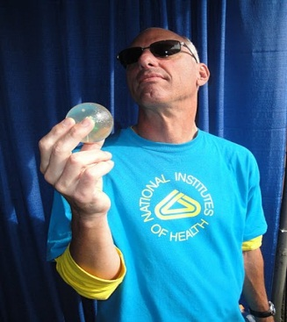

Do You Know These Players?
Grants Management Specialist
Scientific Review Officer
Program Official

Slide 6
Program Official
[aka Program Director or Project Officer]
Responsible for the
programmatic, scientific, and technical
aspects of a grant

Slide 7


Who/What is a
Program Official?
a Scientist …
… and an Administrator
Notes:
We have scientific and administrative responsibilities.

Slide 8
Responsibilities of the
Program Official
Scientific Responsibilities
Identifies opportunities and needs of science specific to an Institute’s mission
Stimulates interest in scientific areas of emphasis for each Institute
Reports on scientific progress and program accomplishments
Communicates program priorities & FOAs
-Program Announcements (PA)
-Request for Applications (RFA)

Slide 9
Responsibilities of the
Program Official
Administrative Responsibilities
Manages scientific research portfolio
Provides technical assistance to applicants
Observes scientific review meetings
Discusses review issues with applicant
Evaluates the programmatic merit and mission relevance of applications
Prepares funding recommendations
Reviews annual research progress of grantees

Slide 10
Program Official
An Important Resource for Applicants & Investigators
Principal liaison between Investigators and the NIH
The most important contact for Scientists
Call us early …
Contact us often!

Slide 11
Getting Started:
Contact a Program Official
At Your Favorite Scientific or Professional Meeting
  Institute Booths
  Mingling thru the Crowds
  Institute sponsored workshops
Ask a Colleague
  Surely somebody knows a Program Contact
Search NIH Institute Websites or Directory
Program Contacts listed on All FOAs

Slide 12
Why Contact:
Contact a Program Official
Why contact?
We can direct Your Science to:
  The appropriate Institute
    24 institutes have granting authority
  The appropriate Division/Office
    Basic, clinical, behavioral, translational
  The appropriate Program Official
    Extramural research portfolio

Slide 13
Benefits of Contacting:
Contact a Program Official
Benefits of Contacting:
Two most important reasons:
Develop a relationship with a potential program official
Program Officials have the inside scoop on all things NIH

Slide 14



Pre-Award: NIH Grant Preparation & Submission
Preparing a NIH Application

Slide 15
Types of Awards
Grant
  Financial assistance to carry out approved activities (e.g., research, training)
Contract
  Acquisition of goods or services
Cooperative Agreement
  Grant support that includes substantial Federal (Programmatic) involvement

Slide 16
Developing Research Applications
How the Program Official Can Help:
Direct you to appropriate program contact
Recommend appropriate grant mechanism
  For your need
  For your stage of career
Identify FOAs and application due dates
Critique draft research grant proposals
Answer all questions:
  NIH grant policies
  Peer review process

Slide 17
NIH Program Contacts
Research
Basic
Clinical
Epidemiology
Prevention/Treatment
Health Services
Medications Development
Specific Diseases
Other
Training
Career Development
Science Education
Conference Support

Slide 18

NIH Grant Award Mechanisms
R01
R21
K08
F33
R03
T32
K23
R43

Slide 19
NIH Funding Programs Support Scientists at Every Stage of Their Career
Stage of Scientific Career
Grant Support Mechanism
GRADUATE/
MEDICAL
STUDENT
Predoctoral Institutional Training Grant (T32)
Predoctoral Individual NRSA (F31)
Predoctoral Individual MD/PhD NRSA (F30)
POST
DOCTORAL
Postdoctoral Institutional Training Grant (T32)
Postdoctoral Individual NRSA (F32)
NIH Pathway to Independence (PI) Award (K99/R00)
Mentored Research Scientist Development Award (K01)
Mentored Clinical Scientist Development Award (K08)
Mentored Patient-Oriented RCDA (K23)
Mentored Quantitative RCDA (K25)
EARLY
Research Project Grant (R01)
Small Grant (R03)
MIDDLE
Independent Scientist Award (K02)
CAREER
Midcareer Investigator Award in
Patient-Oriented Research (K24)
Exploratory/Develop-mental Grant (R21)
SENIOR
Senior Scientist Award (K05)
*Graph represents a small sample of NIH funding mechanisms available.
Notes:
RPGs are appropriate for any stage of your independent research career.

Slide 20
Research Training and
Career Development Awards
Individual NRSA Training Fellowships – F
  Predoctoral – F31; Postdoctoral – F32
  Fellows must be U.S. citizens
Career Development Awards – K
  Candidates must have independent positions, except K99
Institutional Training Grants – T
  Predoctoral and Postdoctoral
  Trainees must be U.S. citizens
Notes:
20

Slide 21
Research Project Grants
Traditional – R01
Small Research – R03
Exploratory Development Grants – R21/R33
Program Project – P01
Research Center Grants – P20, P50, P60
Small Business – R41, R42 (STTR): R43, R44 (SBIR)
Notes:
21

Slide 22
Funding Opportunity Announcements (FOAs)
Unsolicited Parent Grant Announcements
  http://grants.nih.gov/grants/guide/parent_announcements.htm
Solicited Announcements
      http://grants.nih.gov/grants/guide/index.html
  Request for Applications (RFA)
    Identifies narrow program area with set-aside funds
    One receipt date only
  Program Announcements (PA, PAR, PAS)
    Identifies increased programatic priority or emphasis areas
    Three year life span – 3 annual receipt dates
Notes:
22

Slide 23
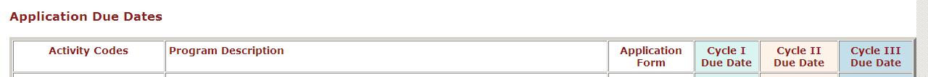
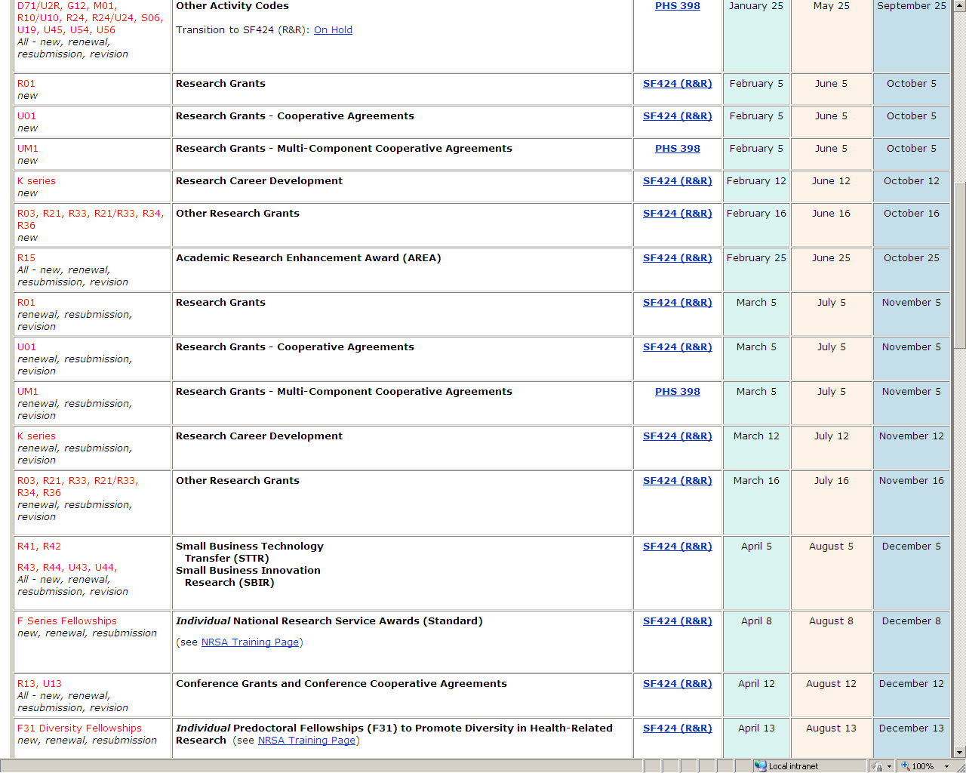
Application Due Dates
http://grants.nih.gov/grants/funding/submissionschedule.htm

Slide 24
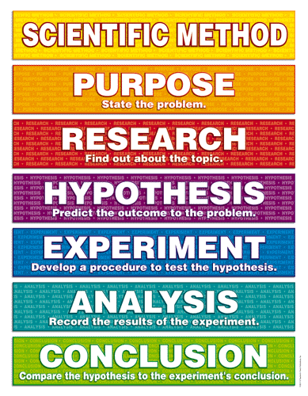


Critique Your Draft Proposal
Specific Aims
Figure this stuff out.
Break this stuff down.
Blow the door open on this stuff.

Slide 25




Answer All Your Questions
NIH

Slide 26


Pre-Award: NIH Grant Preparation & Submission
After Submitting Your Application

Slide 27

NIH Application Process Overview
Application
to NIH via CSR
CSR assigns
to IC, SRG
Summary
Statement (SS)
to Applicant
SRG: 1st level of Review
Council: 2nd level of Review
Fundable
Not
Fundable
Applicant Notified and Given Feedback
IC Makes Award
Applicant Evaluates SS
Progress Reports
Award Ends,
Renewal Application
Prepared
Revised
Application (x1)
Prepared
Time to Talk w/ NIH Program Officer

Slide 28
Institute Assignment and Peer Review
Role of the Program Official
Check for duplicate/overlapping proposals
  Assist SRO
Program Official assigned to application
Observes scientific review meetings
Discusses review issues with applicant

Slide 29
After Peer Review
Program Staff Funding Recommendations
Evaluates applications for programmatic merit and mission relevance
Identify grants addressing Institute Program Priorities
Identify grants filling gap in grant portfolio or specific program area
Review requested grant budgets
  Maximize the number of grants to fund without potentially hindering the research
  Consider grant portfolio balance

Slide 30




Post-Award: Monitoring the Grant Award & Research Progress

Slide 31
Program Official Responsibilities
Assist in Preparing First Year Award
Review Annual Progress Reports
Prior Approval – Program Evaluation
Administrative Supplements
Grant Termination

Slide 32

Program Officials ...
… can help with Preparing the Award
Consult with applicant on key issues:
  Budget
  Animal & Human Subjects
  Policy Requirements

Slide 33
Preparing Grant Awards
SRG Recommendations
  Study design changes
  Reduction of scientific scope, budget, or time
  Human subjects or animal welfare concerns
  Biohazards, Select Agents
  Grant Policy Issues

Slide 34
Preparing Grant Awards
Discussions with Investigator
Negotiate Funding Amounts
  Study Section Recommendations
  NIH and Institute Guidance
Approve Changes in Scientific Goals
Request Responses to Reviewer Concerns

Slide 35
Preparing Grant Awards
Just-In-Time
JIT information is requested for applications receiving an impact score of 40 or less.
  http://grants.nih.gov/grants/guide/notice-files/NOT-OD-12-101.html
JIT information requested includes:
  Current Other Support
  Certifications of
    Institutional Review Board (IRB) approval date
    IACUC approval date
    Human Subjects Research Training
    Human Embryonic Stem Cell (hESCs)

Slide 36
Preparing Grant Awards
Grants Management and
Program Official
Document Policy Compliance
  Animal and Human Subjects Approvals
    Animal Welfare
    Women, Minorities, Children Inclusions
    Check Required Human Subjects Training
  Review Other Grant Support for Scientific Overlap

Slide 37
Preparing Grant Awards
Grants Management and
Program Official
Document Policy Compliance
Data and Safety Monitoring of Clinical Trials
  http://grants.nih.gov/grants/policy/hs/data_safety.htm
NIH Data Sharing Policy
  http://grants.nih.gov/grants/policy/data_sharing/data_sharing_guidance.htm
NIH Model Organism Sharing Policy
  http://grants.nih.gov/grants/policy/model_organism/index.htm
  http://grants.nih.gov/grants/guide/notice-files/NOT-OD-04-042.html

Slide 38
Preparing Grant Awards
Grants Management and
Program Official
Document Policy Compliance
Genome-Wide Association Studies (GWAS)
  http://grants.nih.gov/grants/guide/notice- files/NOT-OD-08-013.html
Training in the Responsible Conduct of Research
  http://grants.nih.gov/grants/guide/notice-files/NOT-OD-10-019.html
Multiple PI Leadership Plan
  http://grants.nih.gov/grants/multi_PI/

Slide 39
Preparing Grant Awards
Foreign Institution Clearance
Awards to:
Foreign Institutions/Organizations
Domestic Institutions with Foreign Components
  http://grants.nih.gov/grants/foreign/
Requires State Department Clearance (internal)

Slide 40

Program Officials ...
can help Monitor Grant Progress
Serve as resource and liaison
Answer technical questions
Provide information about funding opportunities
Monitor progress of study

Slide 41
Annual Progress Report
Annual Non-Competing Renewal Applications
RPPR Progress Reports
  Monitor scientific progress
  Confirm policy adherence
  Evaluate changes in key personnel, levels of effort, or Changes in Other Support
  Approve Carry-over of Unspent Funds
  Communicate your exciting results

Slide 42
Annual Progress Report
The THREE Questions
Changes in Other Support
  New/terminated grant awards
  Check for scientific overlap
Changes in Level of Effort (>25%)
  New/lost personnel
  Briefly describe reason for change(s)
Anticipated Unobligated Balance greater than 25% of previous budget period
  Provide brief description on future use of these funds
  If replacing personnel, provide duties/expertise

Slide 43
Annual Progress Report
Publications
NIH Public Access Policy
  submit paper to PubMed Central (PMC)
  Include PMCID in all Citations
  List all publications citing your grant the previous year
  http://grants.nih.gov/grants/guide/notice-files/NOT-OD-09-071.html
  http://publicaccess.nih.gov/
Please don’t wait until progress report is due

Slide 44
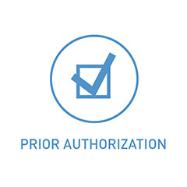

Prior Approval – program review

Slide 45
Prior Approval
Change of Grantee Institution
Program Officer assesses:
  Progress to date
  Adequacy of new resources and environment
  Availability of expertise (key personnel)
  Potential problems (e.g., equipment)
Requires Grant Close-out and New Grant Submission
Contact NIH Program and Grants Management Staff early!
Notes:
45

Slide 46
Prior Approval
Change in Scope
Significant change in aims, methodology, approach, or other aspects of project objectives
Reflects significant change from the project as reviewed and approved
Examples:
  Change in specific aims
  Change to a different animal model
  Any change from the approved use of animals or human subjects
  Shift of research emphasis to a different disease area
Final approval requires concurrence of the Program Officer and Grants Management Specialist.
Notes:
46

Slide 47
Prior Approval
Change in Status of PI
Death, retirement, new position where PI can’t take grant
>25% change in PI effort
PI absence of 90 days or more
Notes:
47
Also mention this applies to Key Personnel NAMED in the NGA

Slide 48


Grant
Supplements
Administrative
Revision

Slide 49
Administrative Supplements
“A request for additional funding for a current budget period to meet increased costs that are within the scope of the approved application but that were unforeseen…”
Funds would enhance or add value to current project
Internal (NIH IC) review
PA-14-077: Administrative Supplements to Existing NIH Grants and Cooperative Agreements (Parent Admin Supp) http://grants.nih.gov/grants/guide/pa-files/PA-14-077.html
Notes:
Because an administrative supplement is based on a change in financial need rather than a change in scientific work or plans, it is initiated with grants management and peer review is not needed (there’s no science to review). The request may be presented as a letter or on a PHS 398 and is sent directly to the Grants Management Branch of NIDA.

Slide 50
Administrative Supplements
Unanticipated Expenses Within Scope
Catastrophes or natural disasters
Critical equipment breakdowns
Loss of equipment originally available from other sources (a facility closes, earthquake damage)
Loss of source for critical reagents
Salary increases
Correcting errors in recommendations or awards
Generally one-time supplement
  Cannot be used for changes in scope.
  Not intended to cover inflationary increases in research costs
Notes:
50

Slide 51
Administrative Supplements
Closeout of Grant
VERY RARE!
Finish work or maintain resources that would be of clear benefit to NIH and research community
R01 Clinical Trials where termination without completion of studies is particularly undesirable
Notes:
51

Slide 52
Revision Applications
Formerly termed Competing Supplement
“A request for additional funding for a current grant award to expand (outside) the scope of the approved application”
Funds would support significant expansion of the current project’s scope or research protocol
Evaluated by peer review
Ask NIH staff for submission details
  Via parent grant FOA
  Via special programs
Notes:
Because an administrative supplement is based on a change in financial need rather than a change in scientific work or plans, it is initiated with grants management and peer review is not needed (there’s no science to review). The request may be presented as a letter or on a PHS 398 and is sent directly to the Grants Management Branch of NIDA.

Slide 53


Grant Termination

Slide 54
Grant Termination
No-Cost Extension:
  Grantee may extend at the end of the project period up to 12 months without prior approval
  Notify NIH
    Signing Official submits via link on eRA Commons account
    Submit from 90 days before till end of the budget period
  But Beware the Second No Cost Extension
    Requires Program AND Grants Management Approval
Notes:
54
MODIFIED to add link to section of NIH GPS...

Slide 55
Grant Termination
Early Termination
PI leaves research project without qualified and willing replacement
Failed to comply with Terms and Conditions of the award
Failed to carry out the purpose of the award
After Termination
Grantee legally bound to submit:
Final Financial Status Report
Final Invention Statement and Certification
Final Progress Report
Failure to submit timely final reports may affect future funding
Notes:
55

Slide 56

NIH Program Staff:
Your Guide to Scientific Success
Don’t Forget

Slide 57


Contact Info:
Roger Sorensen
Program Official
Division of Basic Neuroscience and Behavioral Research National Institute on Drug Abuse [NIDA]
Email: rsorense@mail.nih.gov
Phone: 301-443-3205

Slide 58

Notes:
58

