Slide 1
Using NIH’s Research Portfolio Online Report Tool (RePORT) to Your Advantage
June 2014
NIH Regional Seminar
Megan Columbus
Director, Division of Communications and Outreach
Nicole J. Garbarini, Ph.D.
Media and Communications Specialist, Division of Communications and Outreach

Slide 2
About RePORT
Providing access to reports, data and analyses on NIH supported research activities
Launched in 2008
New features continually implemented since then!
Past 25 years of project data available!
Notes:
Since RePORTER launched in 2008, project funding has been available for all NIH projects from FY2000 forward. This spring, we released project funding data for NIH projects for FY1989 - FY1999, meaning the full 25 years of funding data are now available through RePORTER.

Slide 3
Opening the black box…

Slide 4
On RePORT you can find…
Organizational
funding information
NIH staff contacts
Success rates
Award
trends
Which ICs fund research like yours
Projects similar to yours
NIH-funded workforce data
Potential collaborators
NIH grantees in your area
NIH grantees in your area
Potential collaborators
Which ICs fund
research like yours
Projects similar to yours
NIH-funded workforce data
Award
trends
Success rates
NIH staff contacts
Organizational
funding information

Slide 5
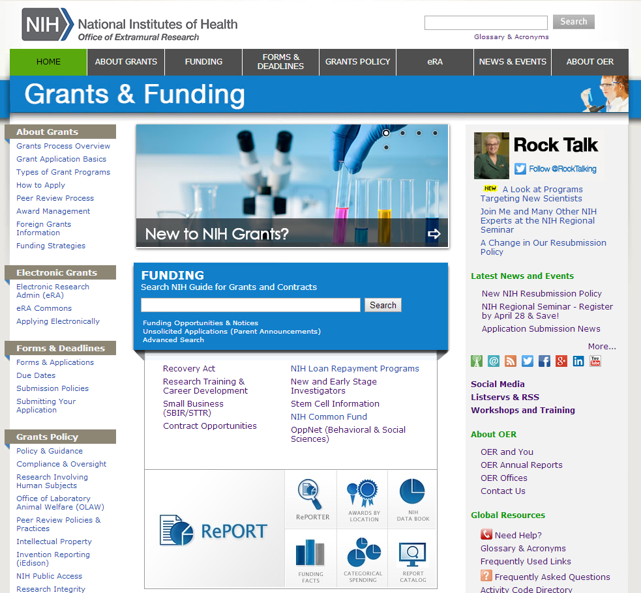
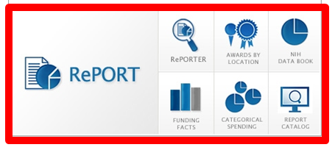
How to find RePORT
grants.nih.gov homepage links to RePORT

Slide 6
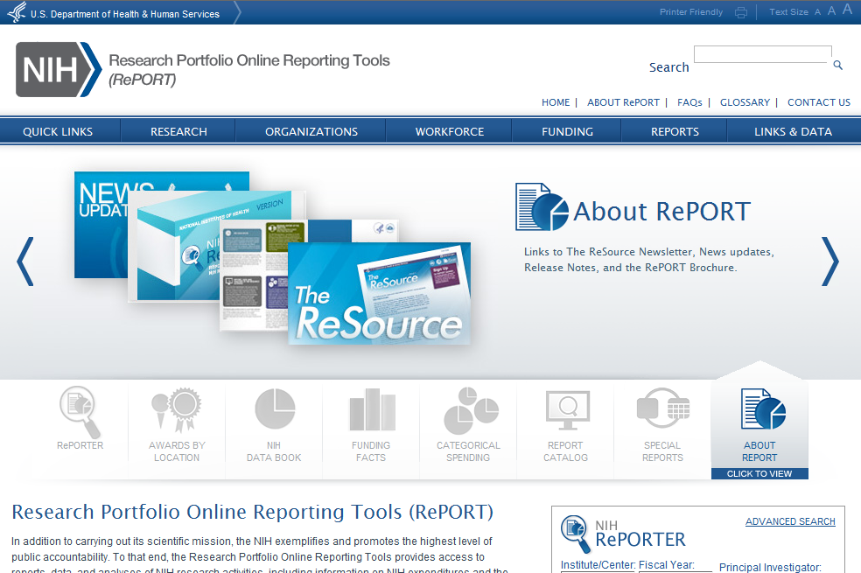
Screenshot of RePORT.NIH.GOV homepage
Main navigation bar
Main navigation bar

Slide 7
Let’s run through an example that shows the power of RePORT….
Let’s say I am interested in obesity research…

Slide 8
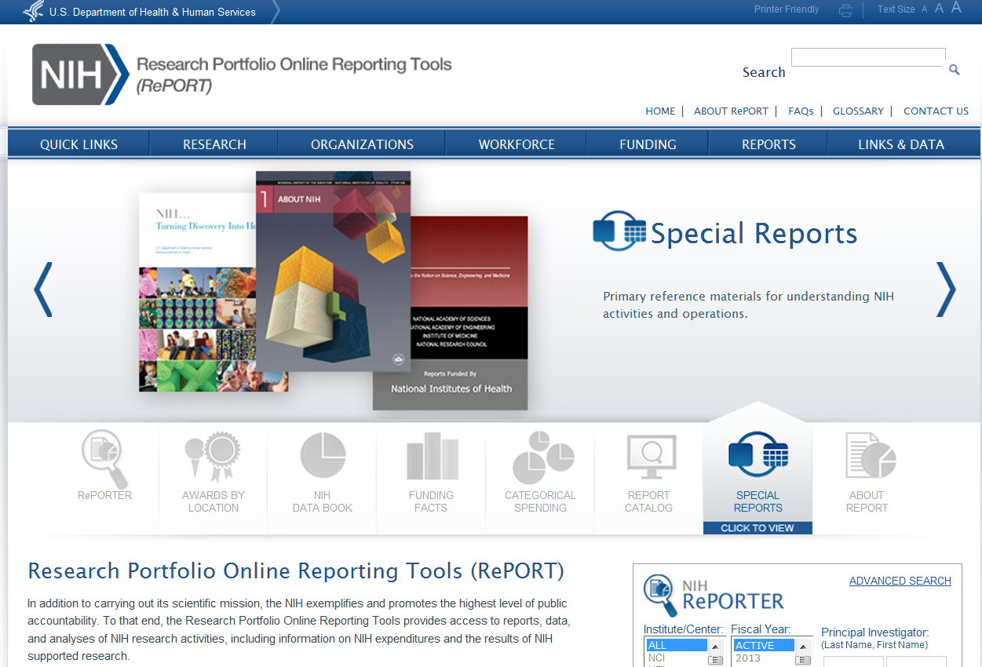
Start with the big picture
Any NIH reports on obesity research?

Slide 9
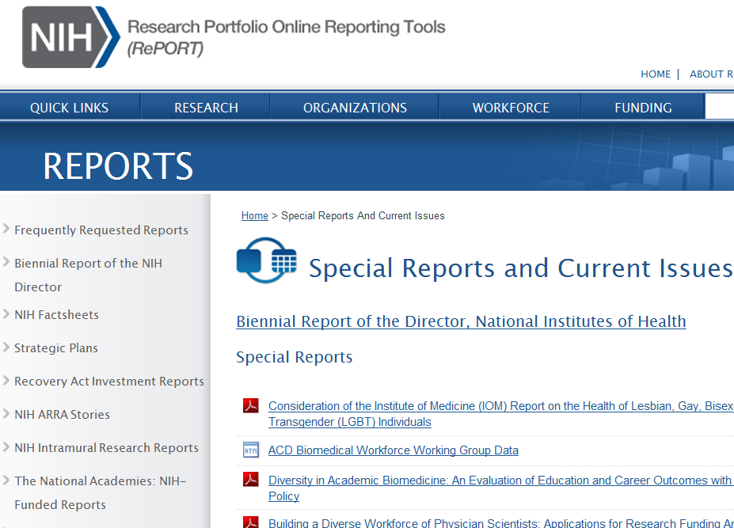
Let’s look at strategic plans
Screenshot of NIH RePORTS page

Slide 10
Here’s a strategic plan for obesity research!
Screenshot of NIH RePORT strategic plans page

Slide 11
What kind of information is in a strategic plan
Can provide long term view of NIH interests
Major Themes for Research Highlighted in the Strategic Plan:
Research Opportunities:
Discover fundamental biological processes that regulate body weight and influence behavior
Understand the factors that contribute to obesity and its consequences
Design and test new interventions for achieving and maintaining a healthy weight
Evaluate promising strategies for obesity prevention and treatment in real-world settings and diverse populations
Harness technology and tools to advance obesity research and improve healthcare delivery
Application of Research Findings:
Facilitate integration of research results into community programs and medical practice

Slide 12
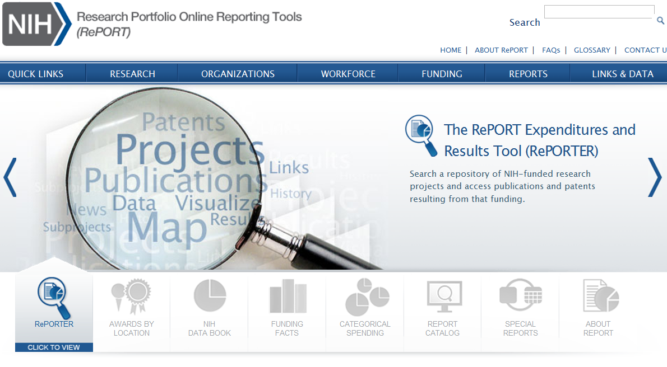
Using RePORTER to search NIH data
Let’s search to learn who and what NIH funds on this topic
Let’s search to learn who and what NIH funds on this topic

Slide 13
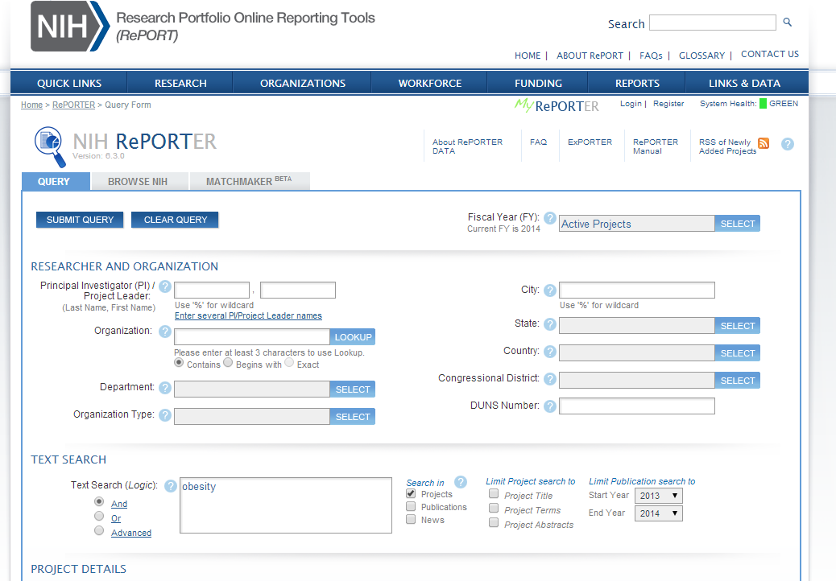
Simple text search of the RePORTER database
Text search for “obesity”

Slide 14
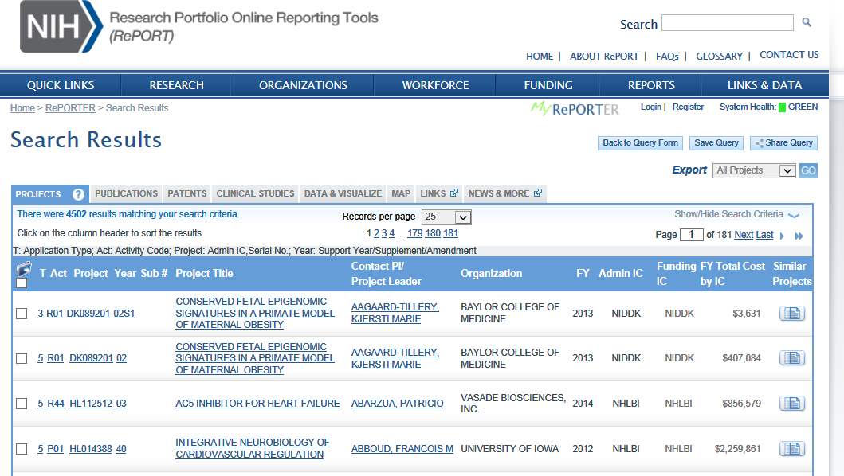
Project search results
4,502 active projects… yikes!
How to understand our result?
Try the Data and Visualize tab

Slide 15
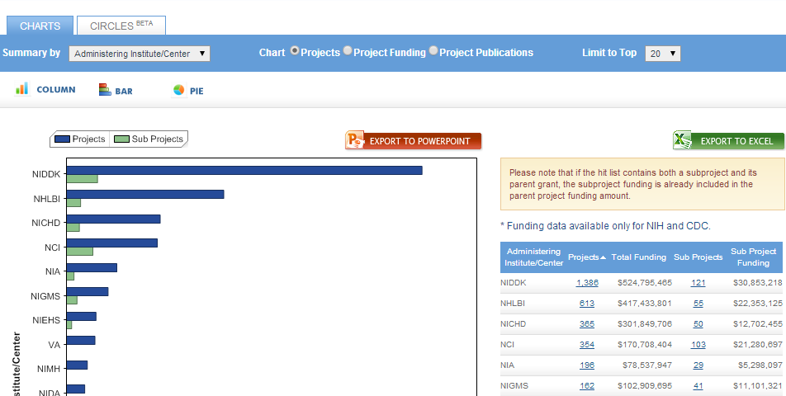
Search results as bar chart
Now it is more clear which ICs fund obesity research!

Slide 16
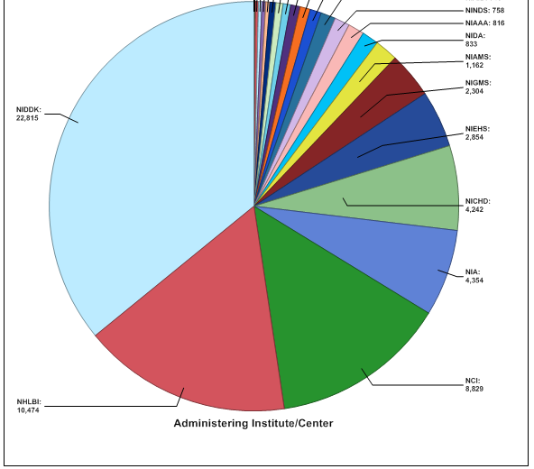
Search results as pie chart
Options to export information, transform into different chart types

Slide 17
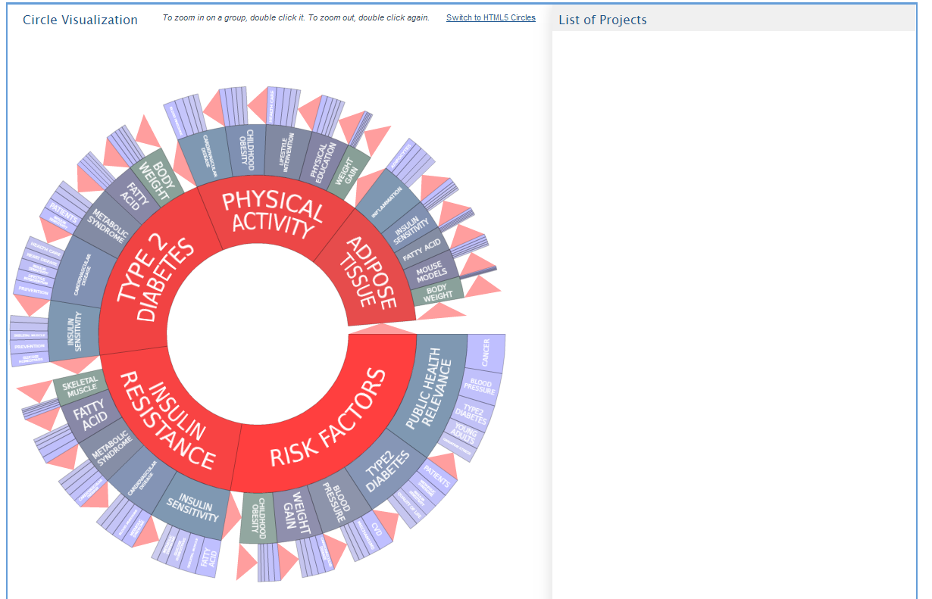
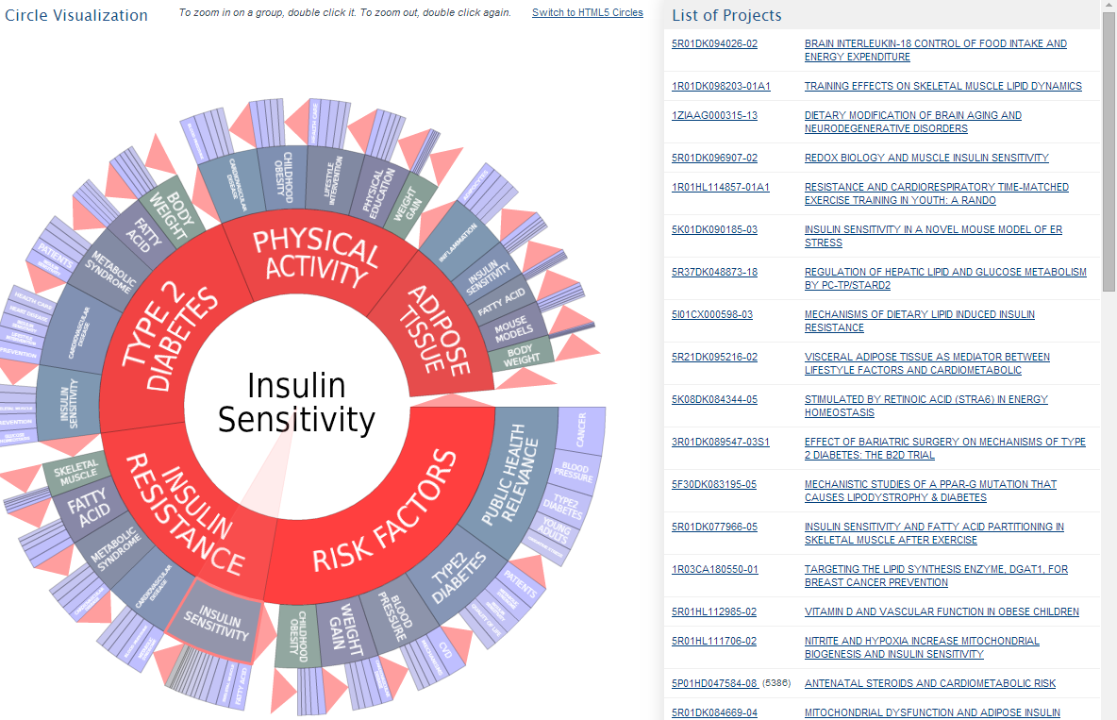
Search results in Circles
Circles helps visualize specific scientific areas
Drill down to narrow field of science and find individual grants
Circles helps visualize specific scientific areas

Slide 18
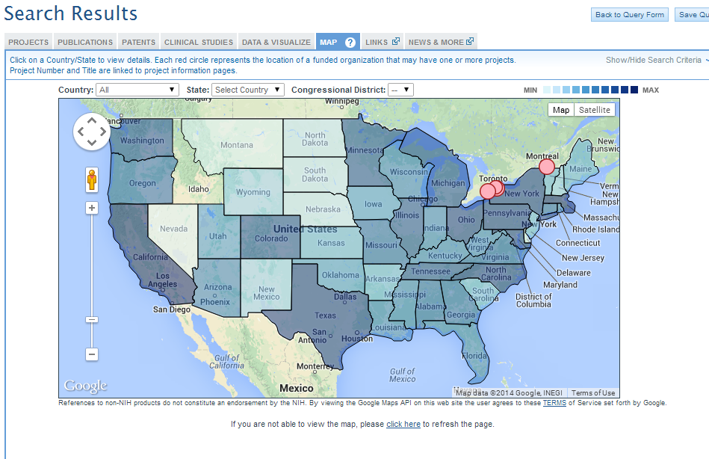
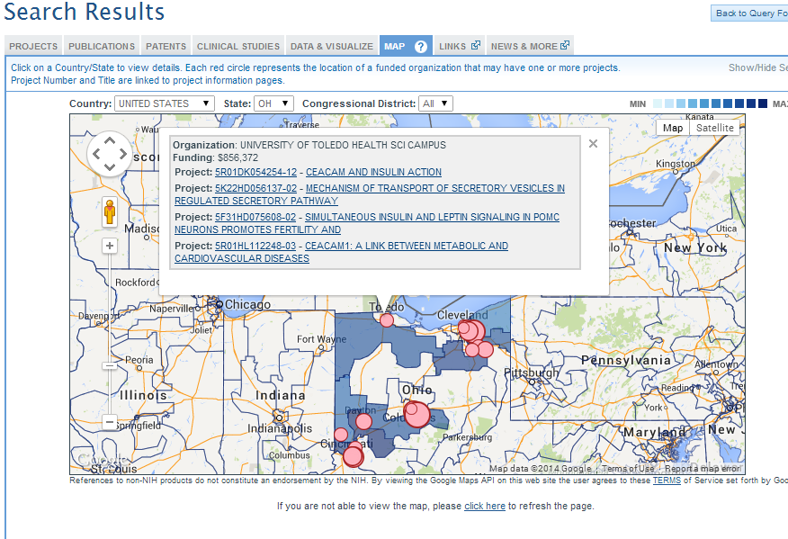
Search results mapped
Mapping tools show us where the research is being done
Input state to drill down
Input state to drill down

Slide 19
MatchMaker
Enter abstracts or other scientific text
100 similar projects from RePORTER
Matches are based on the terms and concepts used in the submitted text

Slide 20
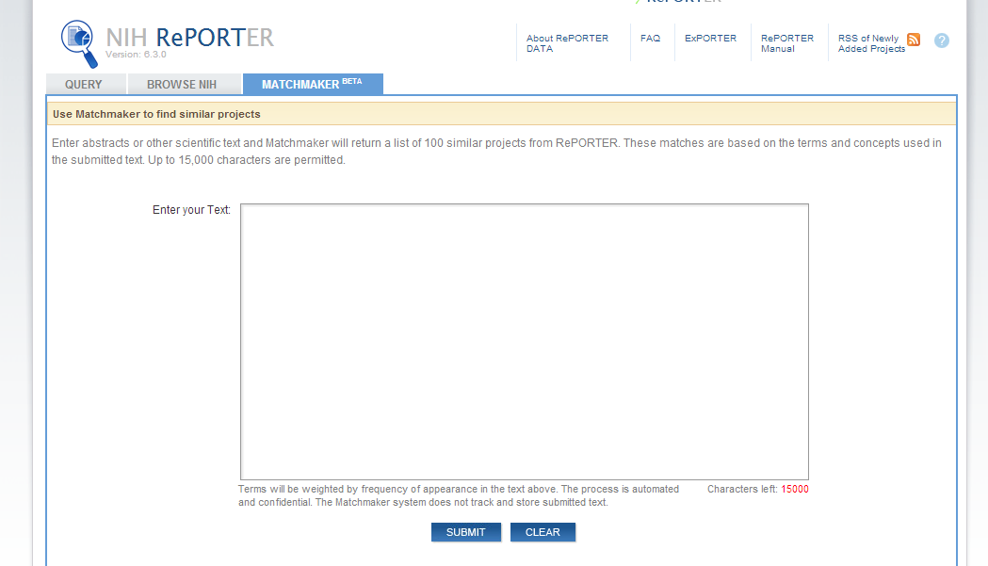
Enter text into Matchmaker
Hypothalamic neurons expressing Agouti-related peptide (AgRP) are critical for initiating food intake, but druggable biochemical pathways that control this response remain elusive. Thus, genetic ablation of insulin or leptin signaling in AgRP neurons is predicted to reduce satiety but fails to do so. FoxO1 is a shared mediator of both pathways, and its inhibition is required to induce satiety. Accordingly, FoxO1 ablation in AgRP neurons of mice results in reduced food intake, leanness, improved glucose homeostasis, and increased sensitivity to insulin and leptin. Expression profiling of flow-sorted FoxO1-deficient AgRP neurons identifies G-protein-coupled receptor Gpr17 as a FoxO1 target whose expression is regulated by nutritional status. Intracerebroventricular injection of Gpr17 agonists induces food intake, whereas Gpr17 antagonist cangrelor curtails it. These effects are absent in Agrp-Foxo1 knockouts, suggesting that pharmacological modulation of this pathway has therapeutic potential to treat obesity.

Slide 21
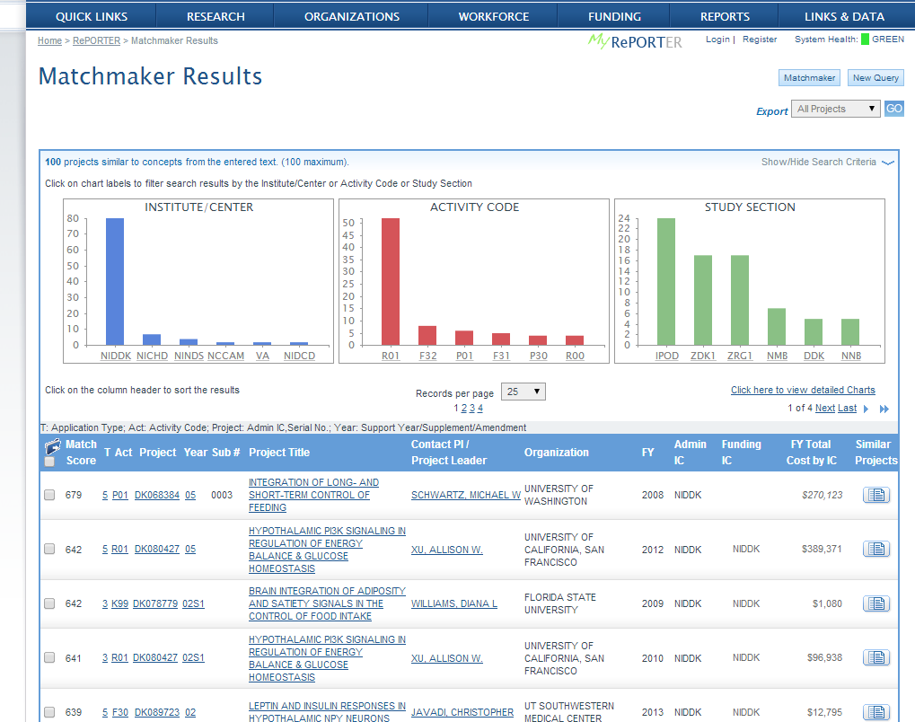
Matchmaker search results
Text mining. Higher match scores = more similar projects
Screenshot of Matchmaker search results
Text mining. Higher match scores = more similar projects
Notes:
You can filter further by any of the three graphed parameters and see the breakdown by the others. For example: select a study section and see the breakdown – of the projects in that study section, which are funded by a particular IC, or using a particular activity code)

Slide 22
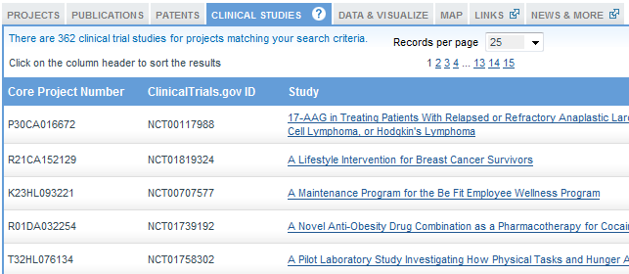
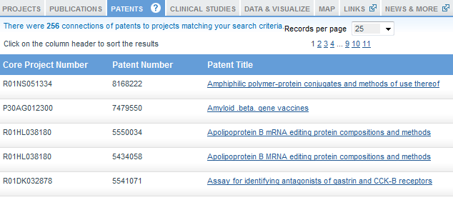
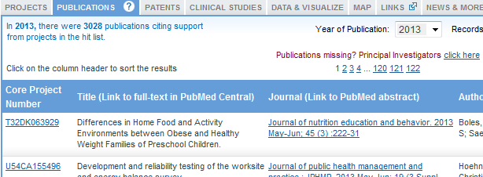
What information can I find in the project search results?
Search results screen also provides info on clinical studies,
patents
press releases and stories
and publications
Search results screen also provides info on clinical studies,
patents
press releases and stories
and publications

Slide 23
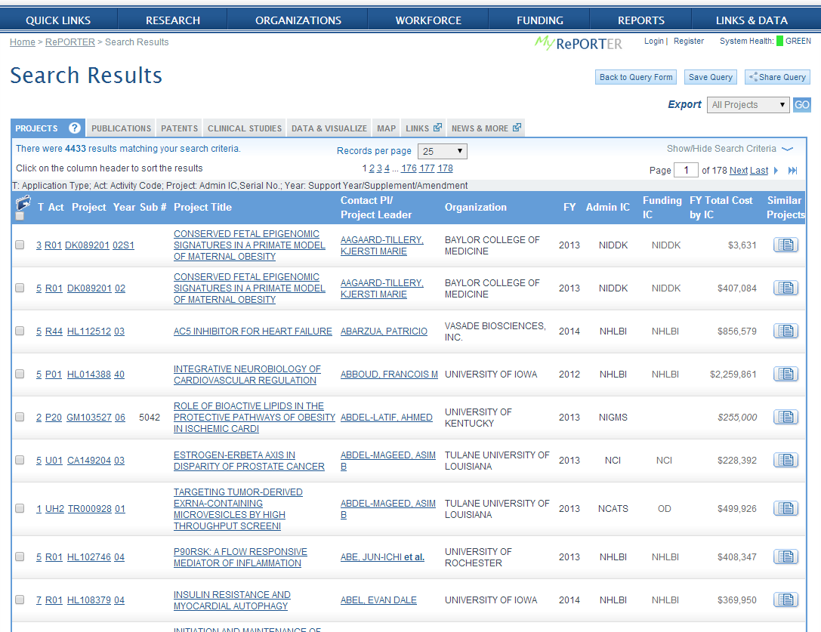
Delving back into individual projects…

Slide 24
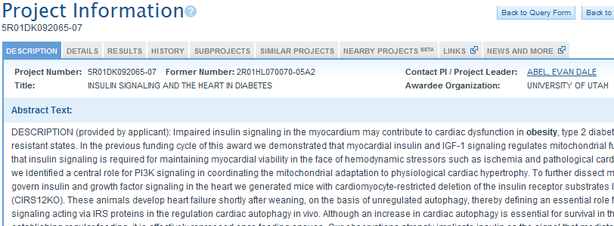
Description tab of project
Description tab – project abstract, terms and more
Description tab – project abstract, terms and more

Slide 25
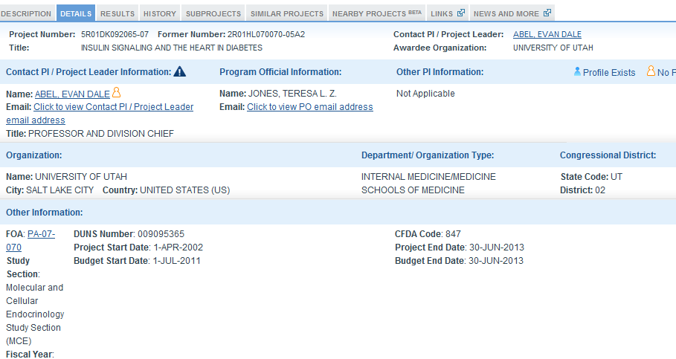
Details tab of project information
Details tab provides PI contact info and profile
(if this is you, add profile info by clicking on icon)
NIH program official for this grant
FOA
Review panel
Details tab provides PI contact info and profile
(if this is you, add profile info by clicking on icon)
NIH program official for this grant
FOA
Review panel

Slide 26
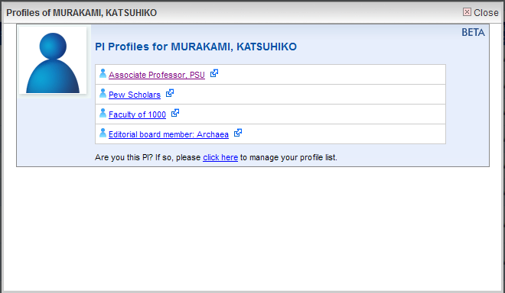
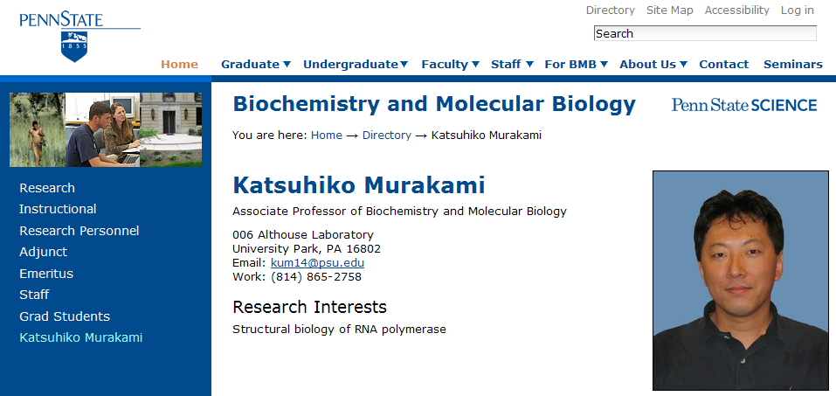
PI profiles: one example
PI profiles: one example
PI Profile and website of an NIH funded PI accessed through RePORT
Notes:
In RePORTER we also allow PIs to supplement the information on their NIH-funded grants by providing links to their lab or institution websites so that interested people can get a more complete picture of that PI’s work.

Slide 27
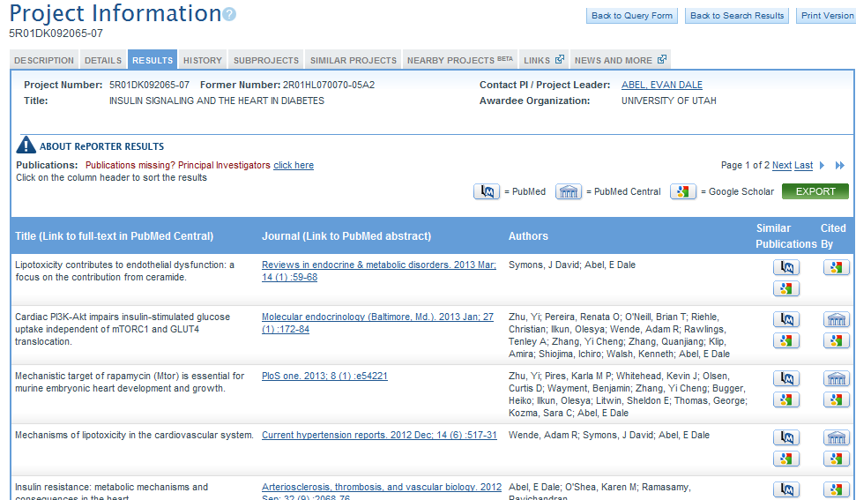
Results tab of project information
Results tab provides publications and patents resulting from the project
(Pubs missing? If you are the PI, add them!)
Results tab provides publications and patents resulting from the project
(Pubs missing? If you are the PI, add them!)

Slide 28
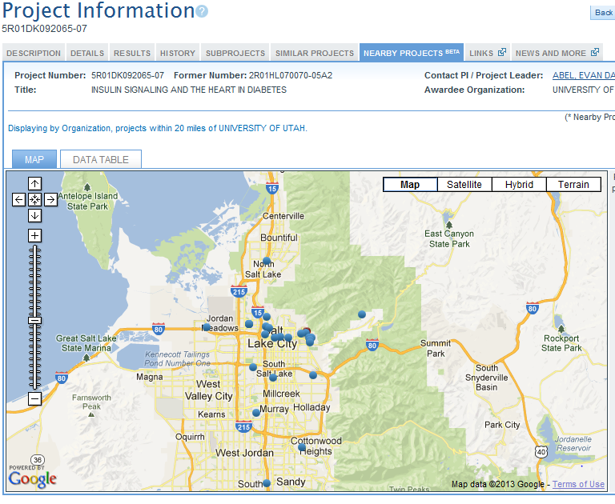
Nearby Projects tab
Use Nearby Projects tab to locate others who may be working locally on your topic of interest
Use Nearby Projects tab to locate others who may be working locally on your topic of interest

Slide 29
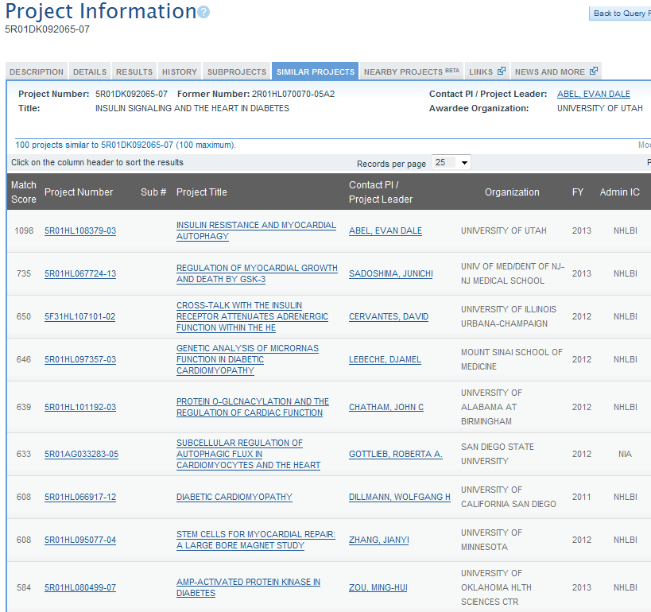
Similar projects tab
Use similar projects tab to find more projects like this one!
Text mining. Higher match scores = more similar projects
Is this project very close to your area of research interest? Use similar projects tab to find more projects like this one!
Text mining. Higher match scores = more similar projects
Notes:
*Includes a feature for modifying list (additional filter criteria)

Slide 30
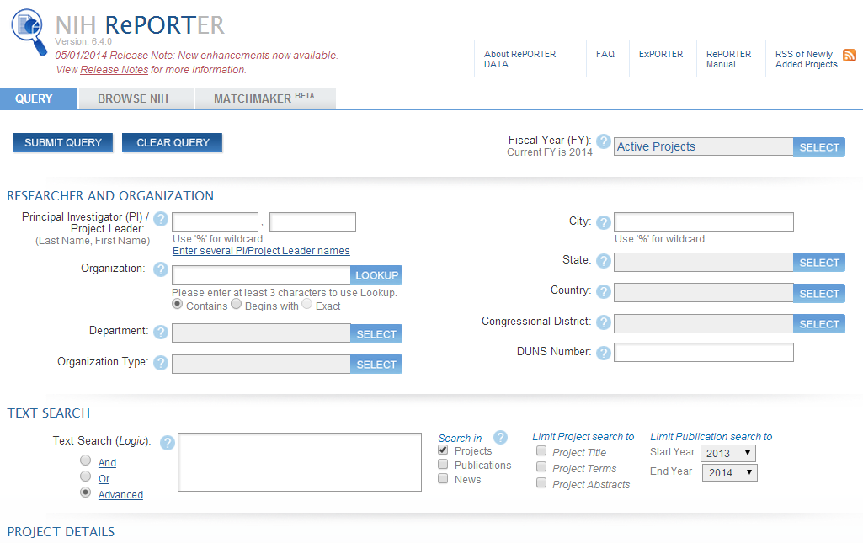
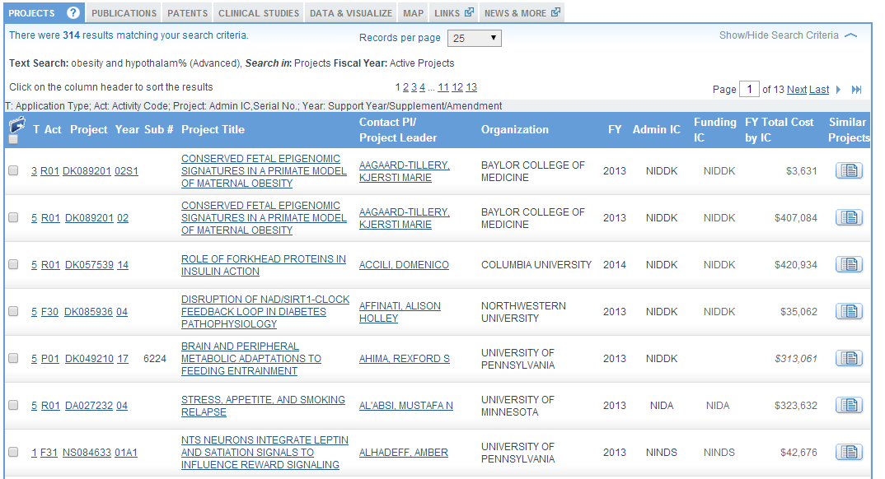
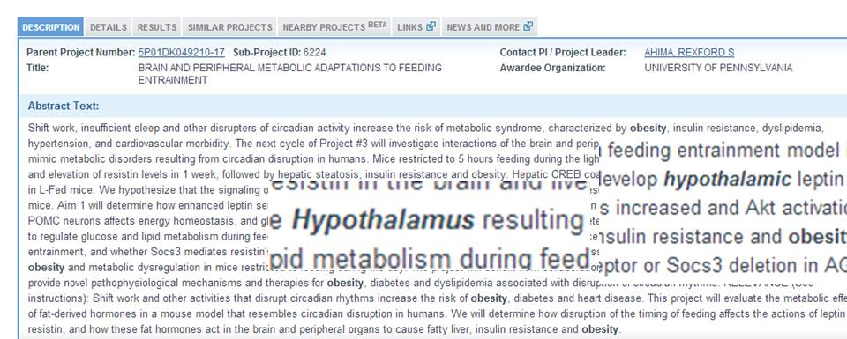
RePORTER allows advanced text searches
Obesity AND hypothalam%
Obesity AND hypothalam%

Slide 31
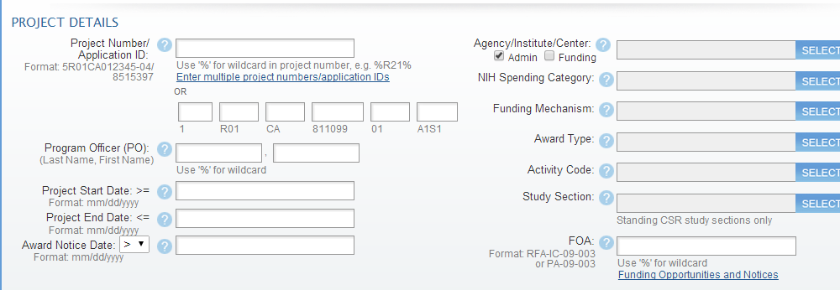
RePORTER allows you to search on many criteria.
Award notice date, FOA, study section, and more!

Slide 32
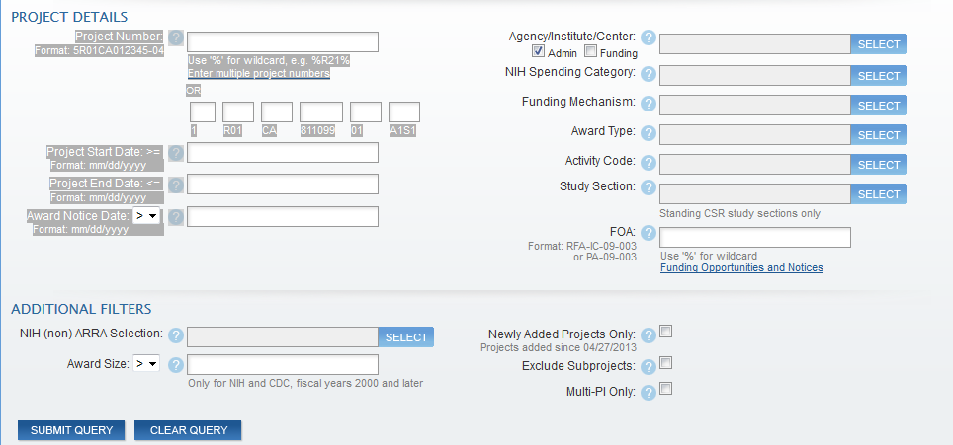
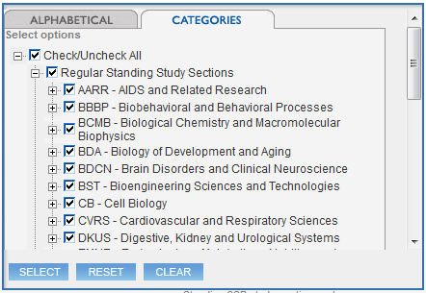
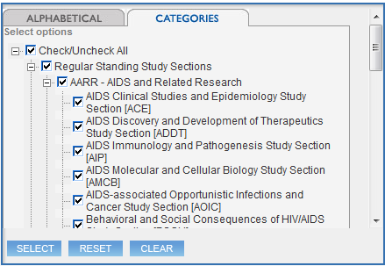
Study section drop-down menu
Select the study section field
Expand a category to drill down
* When you select the study section field
Expand a category to drill down

Slide 33
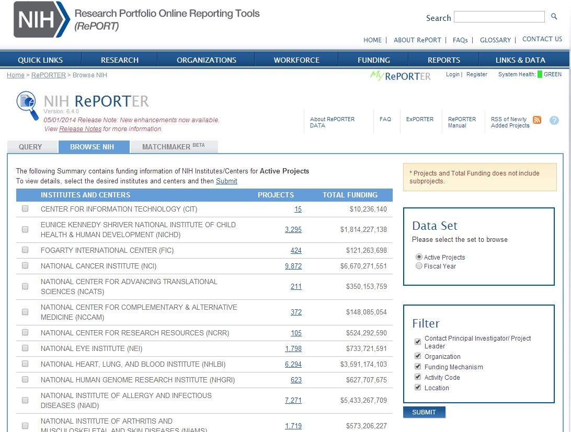
Learn more by browsing the NIH portfolio: use filters to narrow your view
Learn more by browsing the NIH portfolio: use
filters to narrow
your view

Slide 34
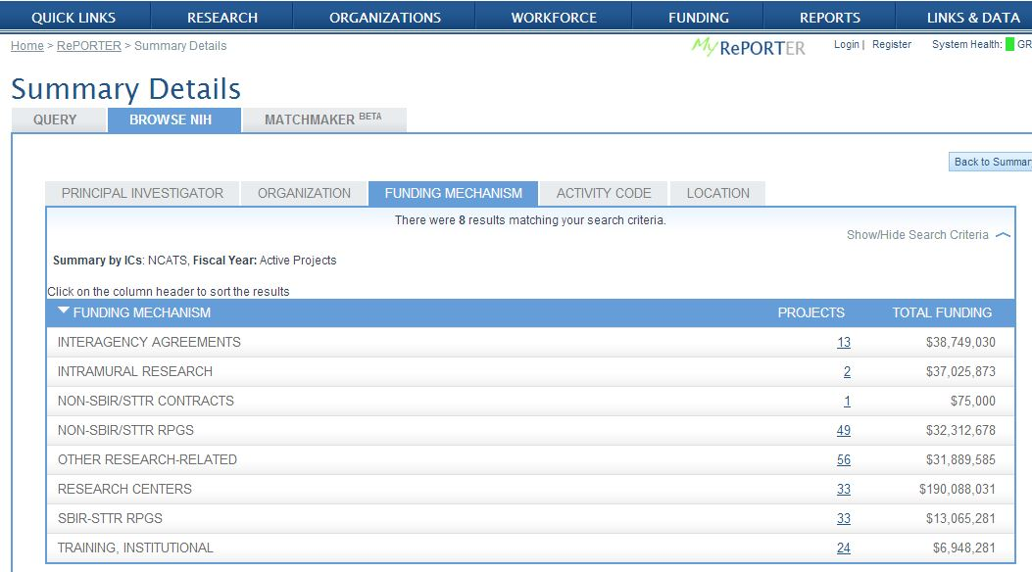
Funding Mechanism detail of “Browse NIH”
Pick an IC and see who and what they are funding.
What does their intramural program do?

Slide 35
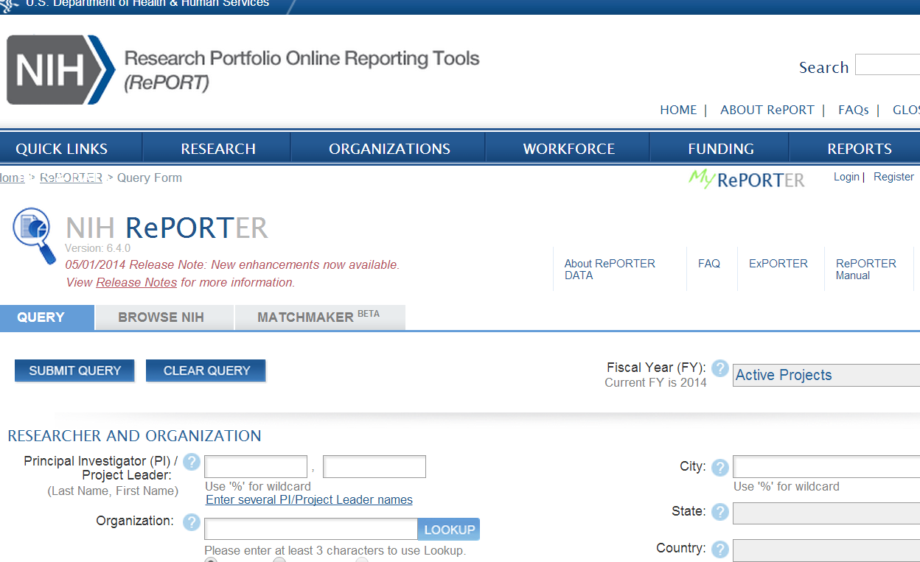
MyReporter for custom alerts
How can I monitor what NIH is funding in my field, in response to an FOA, or at my institution?

Slide 36
Save portfolios or queries with MyRePORTER
Save portfolios or queries
Set email alerts for updates to queries
Email results

Slide 37
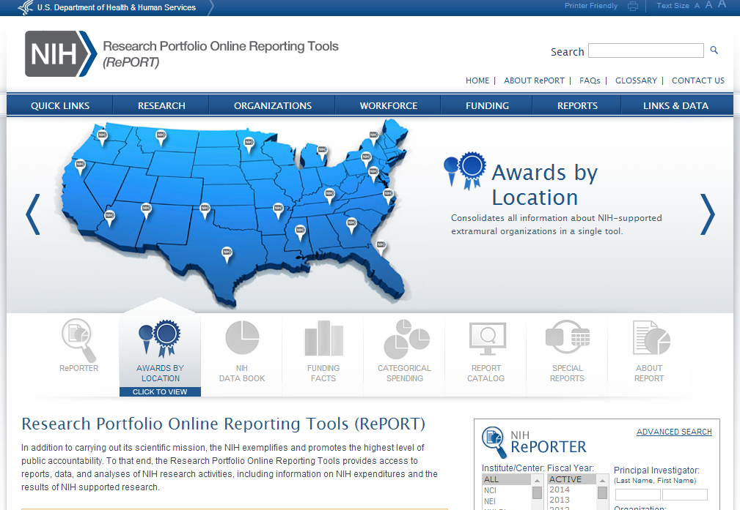
Awards By Location
How much funding in my state and congressional district?
What types of organizations does NIH fund?
Who has NIH funding in my university system?
What types of organizations does NIH fund?
Who has NIH funding in my university system?

Slide 38
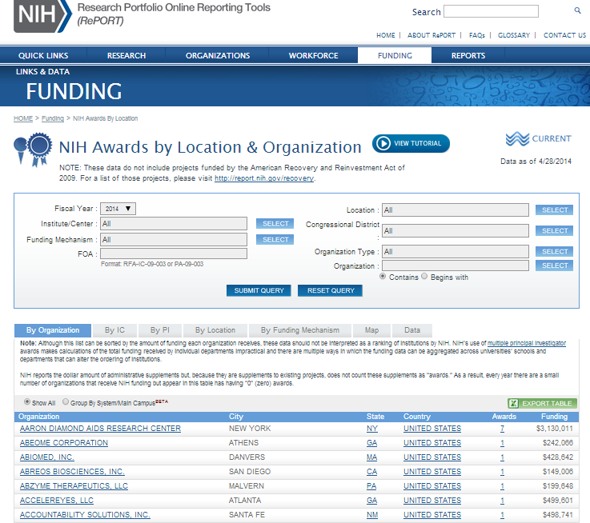
Awards by Location Search Page
Select criteria
Select output
Drill down to grant level data
Sort by heading
Select criteria
Drill down to grant level data
Sort by heading
Select output

Slide 39
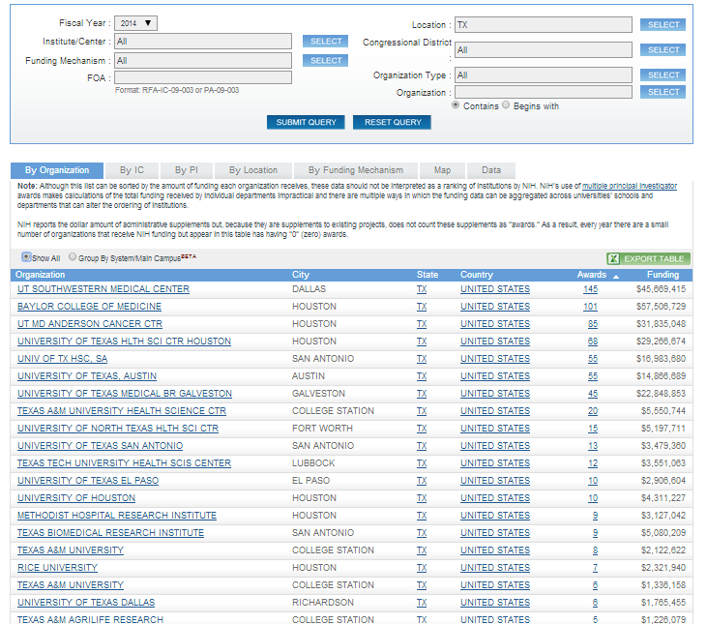
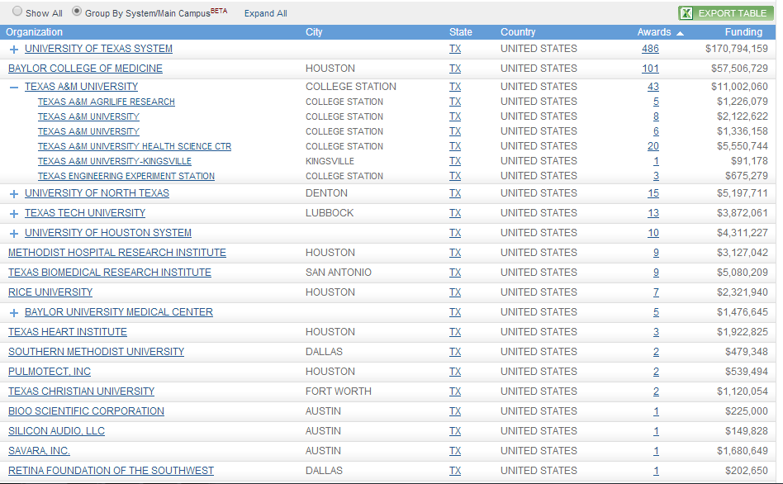
Awards by Location Search Example (State/Campus System)
Examples of searching by state and examining grantee organization data

Slide 40
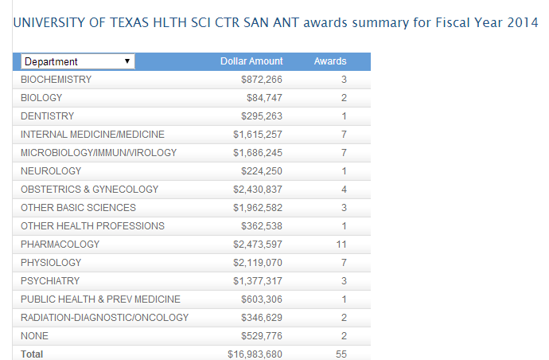
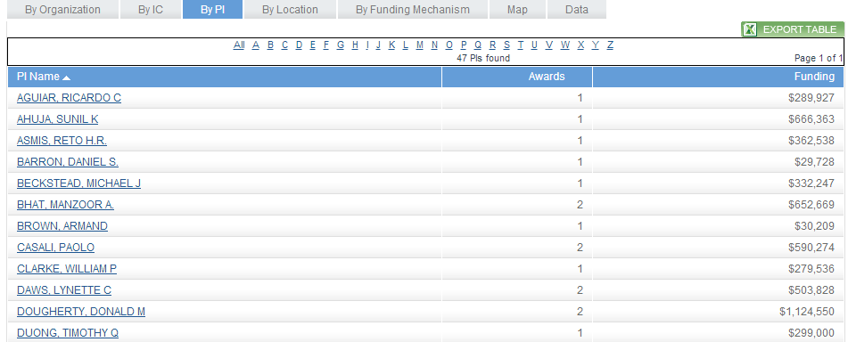
Drill down to Awards By Location data
For example, by PI…
For example, by PI
Notes:
*By PI
*Map
*Data tab for project list

Slide 41
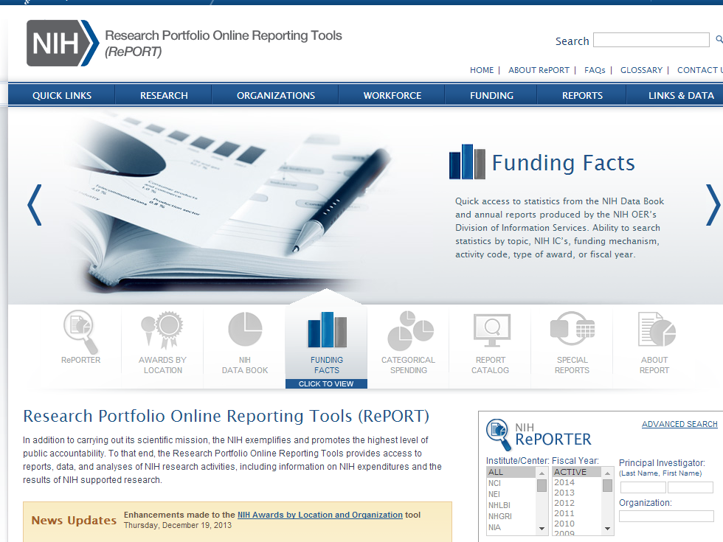
Quick statistics via Funding Facts
Quick access to stats on funding

Slide 42
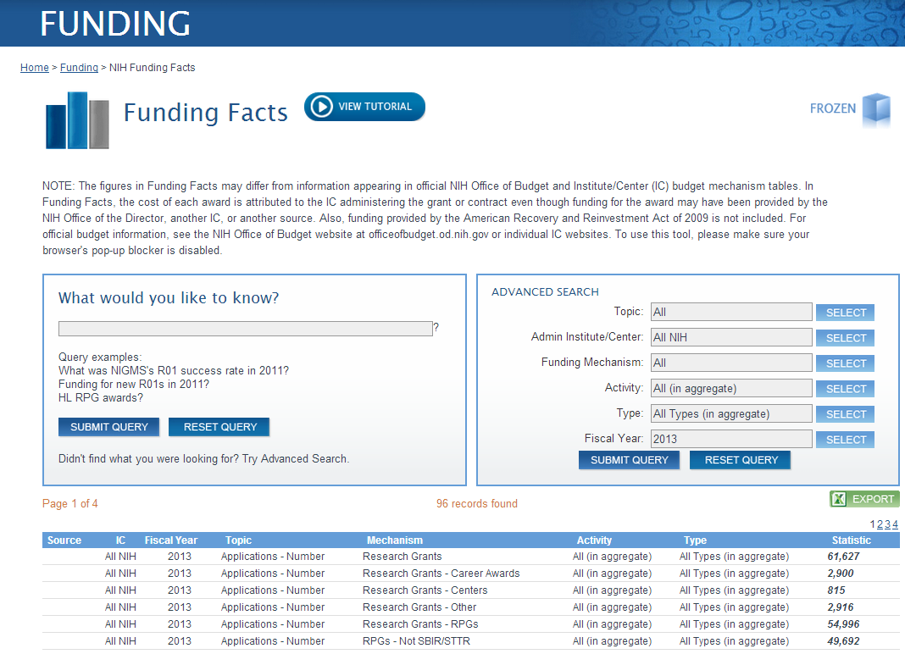
Why use Funding Facts?
In aggregate or by year, IC, mechanism, activity, new/continuing

Slide 43
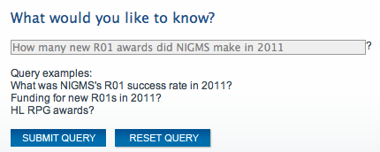
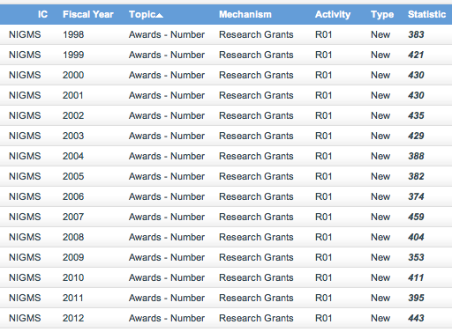
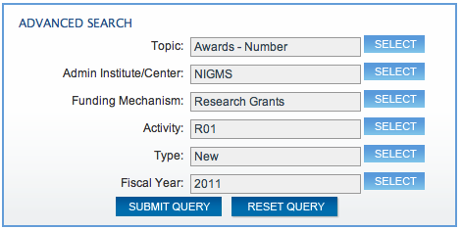
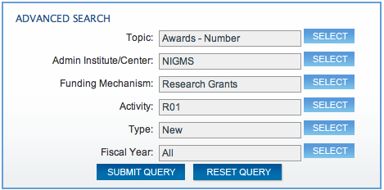
Funding Facts sample search
Quick searches for
a single answer…
…or retrieve all years and analyze trends over time

Slide 44
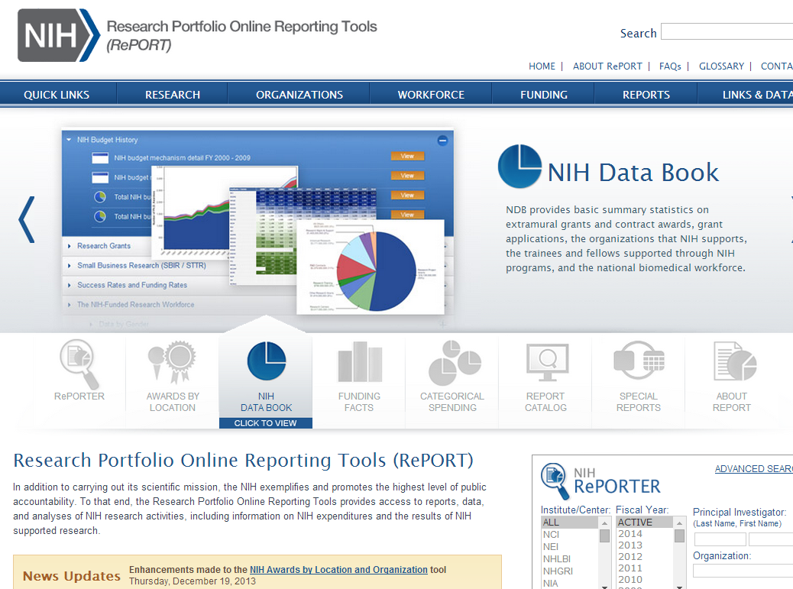
Quick access to NIH and workforce statistics: NIH Data Book
I’d like to learn more about NIH application and award trends over time
How can I learn more about the NIH-funded workforce?
I’d like to learn more about NIH application and award trends over time

Slide 45
NIH Data Book sections
Drill down for data on these topics
(updated annually)
NIH Data Book sections NIH Budget History
Research Grants
Small Business Research (SBIR / STTR)
Success Rates and Funding Rates
NIH Peer Review
The NIH-Funded Research Workforce
New NIH Investigators
Data by Gender
Trends in Research Career Development (K) Awards
NIH Research Training Grants and Fellowships
NIH-Supported Ph.D. Recipients
National Statistics on Graduate Students in the Biomedical, Behavioral, Social, and Clinical Sciences
National Statistics on Postdoctorates in the Biomedical, Behavioral, Social, and Clinical Sciences

Slide 46
Example of NIH Data Book chart and data
Export slides directly into PowerPoint
Show me the numbers!

Slide 47
Categorical Spending
Annual funding for various research, condition, and disease categories
How much did NIH spend on a particular disease or research area?

Slide 48
ExPORTER
Use ExPORTER to get the data to do your own detailed analysis
Notes:
http://exporter.nih.gov/

Slide 49
RePORT tutorials and help
Video tutorials are available to help you with the RePORT website and tools!
Notes:
Look for the tutorials page linked in the side navigation. Access direct links to videos available via the “View tutorial” buttons throughout RePORT. Or, use the “FAQ” or “About RePORT” links at the top of the site.

Slide 50
Explore!
I encourage you to explore…
information is power!
Let’s go live and see how RePORT does at answering some of your questions…
http://RePORT.nih.gov/

Slide 51
We Value Your Input!
Session Evaluations: http://surveymonkey.com/s/nihsessions
Overall Evaluations: http://surveymonkey.com/s/nihoverall

