Slide 1
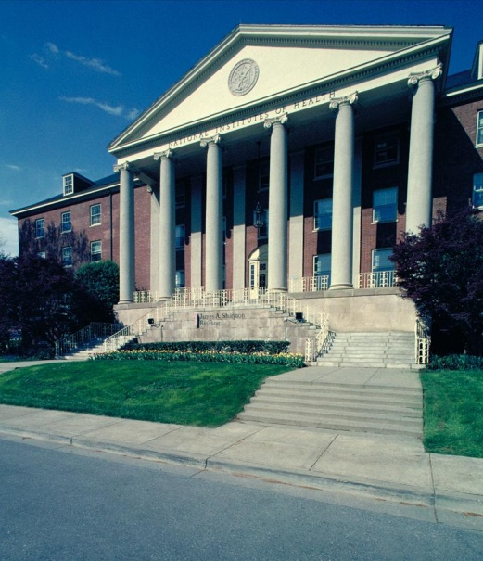
Rock Talk: NIH Support of Biomedical Research
June 2014
Sally J. Rockey, PhD
Deputy Director for Extramural Research
National Institutes of Health

Slide 2
Rock Talk Sample

Slide 3
Rock Talk Sample – Fiscal Policies

Slide 4
Fiscal Policies and More for FY 2014
Because of the increased NIH budget as compared to last year, and due to the cycle of out-year commitments, we expect to make more competing awards in FY 2014.
NRSA stipends:
Undergraduate and graduate student stipends will increase by 2%
Entry level postdoctoral stipends will be increased to $42,000 with 4% increases for additional years of experience. (More details are in NIH Guide Notice NOT-OD-14-046).
Salaries received from an NIH grant continue to be restricted to no more than Executive Level II of the Federal Executive Pay scale. The Executive Level II salary was increased to $181,500 as of January 12, 2014. (More details are in NIH Guide Notice NOT-OD-14-052)

Slide 5
Rock Talk – comparing success rates

Slide 6
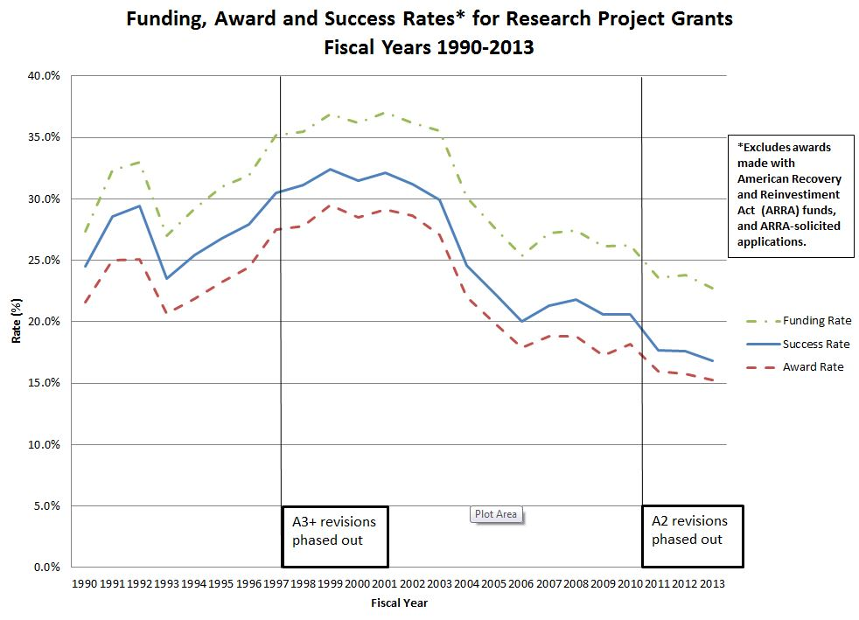
Funding, Award and Success Rate Graph

Slide 7
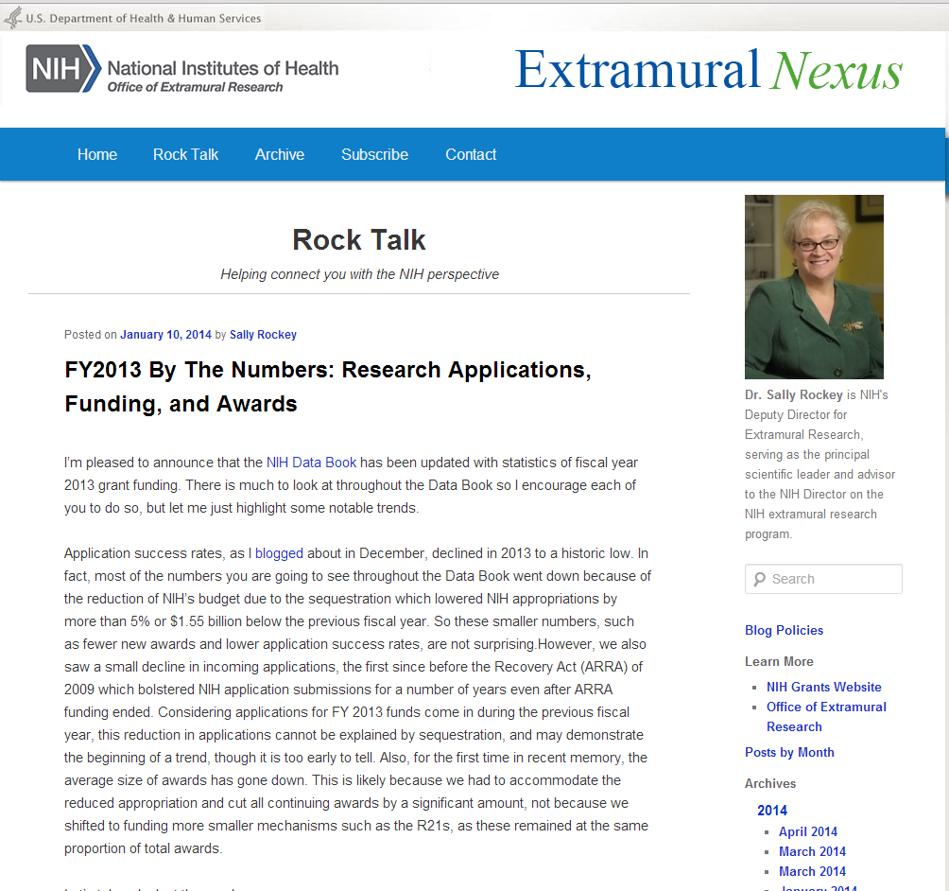
Rock Talk – FY2013 by the Numbers

Slide 8
FY 2013 by the Numbers: Research Applications, Funding, and Awards
 | 2012 | 2013
The overall success rate for competing RPGs declined | 17.6% | 16.8%
The average size of RPGs decreased | $454,588 | $441,404
The average size of RPGs in constant 1999 dollars is the lowest ever since 1999 | $290,869 | $277,653
There was a decrease in the total amount of funding that went to RPGs | $15,923,746,065 | $14,917,675,859
NIH received fewer R01 equivalent grant applications | 29,626 | 28,044
Success rates for R01 equivalent applications decreased | 18.4% | 17.5%
The average size of R01 equivalent awards decreased | $419,321 | $405,874
The number of R01 equivalent awards decreased | 5,436 | 4,902
The total number of research grant applications received by NIH decreased | 63,524 | 61,013

Slide 9
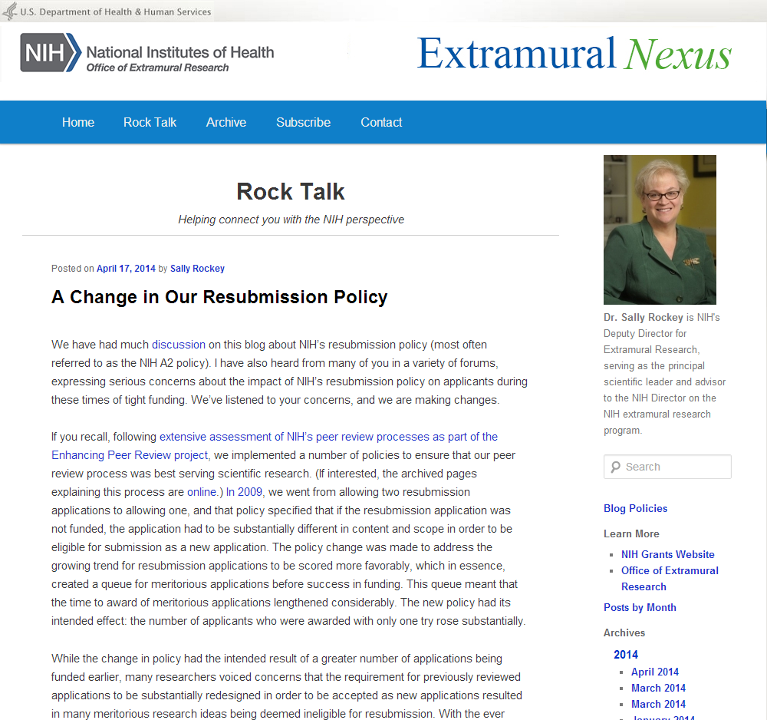
Rock Talk – A Change in our Resubmission Policy

Slide 10
NIH Policy on Resubmission (Amended) Applications NIH Guide Notice (NOT-OD-09-003) October 8, 2008
The NIH will accept only a single amendment to an original new or competing renewal application.
Failure to receive funding after two submissions (i.e., the original and the single amendment) will mean that the applicant should substantially re-design the project rather than simply change the application in response to previous reviews.
It is expected that this policy will lead to funding high quality applications earlier, with fewer resubmissions.

Slide 11
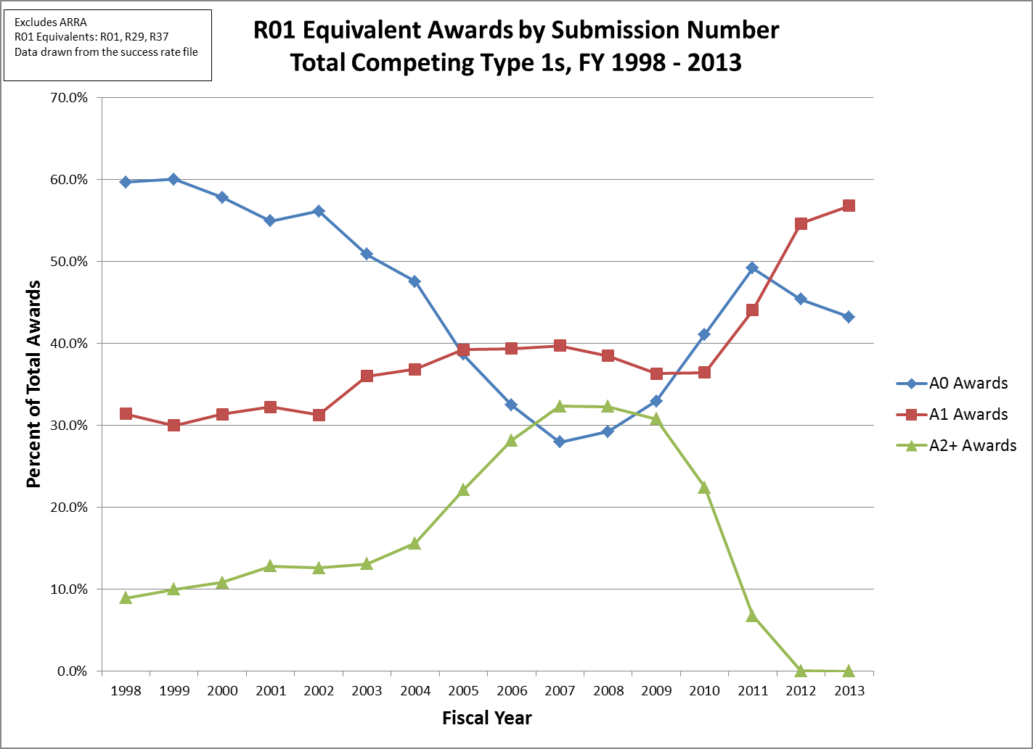
R01 Equivalent Awards by Submission Number

Slide 12
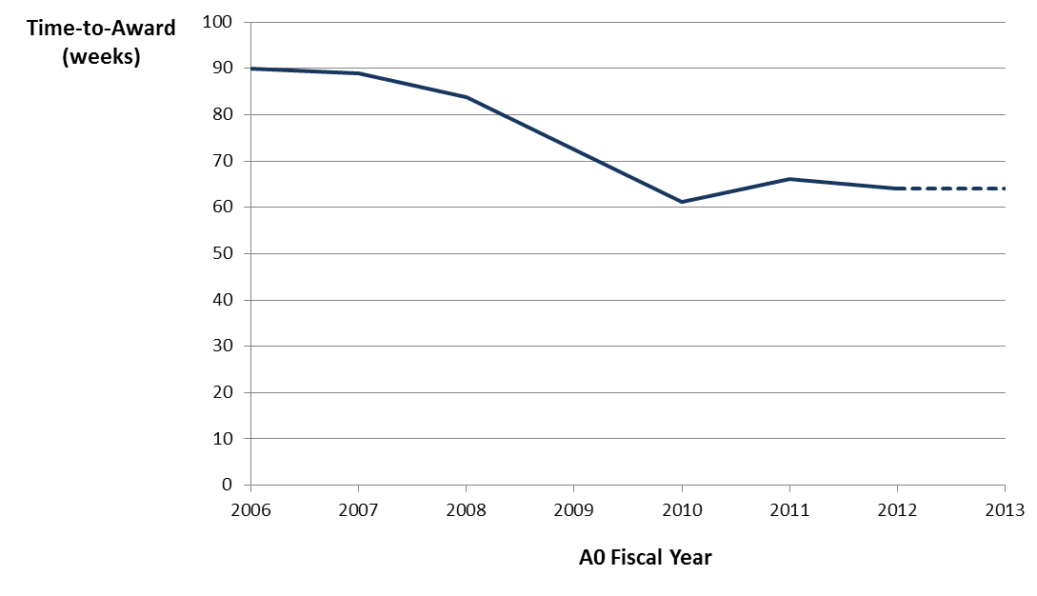
Time to Award

Slide 13
NIH Policy on Resubmission Applications
Since the 2008 A2 policy change:
Awards are being made to A0s more
frequently
Time-to-award and the average
number of submissions required to
obtain funding have decreased, despite falling success rates
Continuing concerns from the extramural community
NIH requires substantial change in the research idea when submitting next application, or the application will be deemed a “virtual A2”
New investigators may not have enough research experience/support to go in new directions
Established investigators must “give up” their careers’ work

Slide 14
NIH Guide Notice (NOT-OD-14-074) NIH and AHRQ Announce Updated Policy for Application Submission April 17, 2014
“Effective immediately, the NIH and AHRQ will accept a new (A0) application following an unsuccessful resubmission (A1) application. The subsequent new application need not demonstrate substantial changes in scientific direction compared to previously reviewed submissions, and must not contain an introduction to respond to the critiques from the previous review.”
We’re listening!

Slide 15
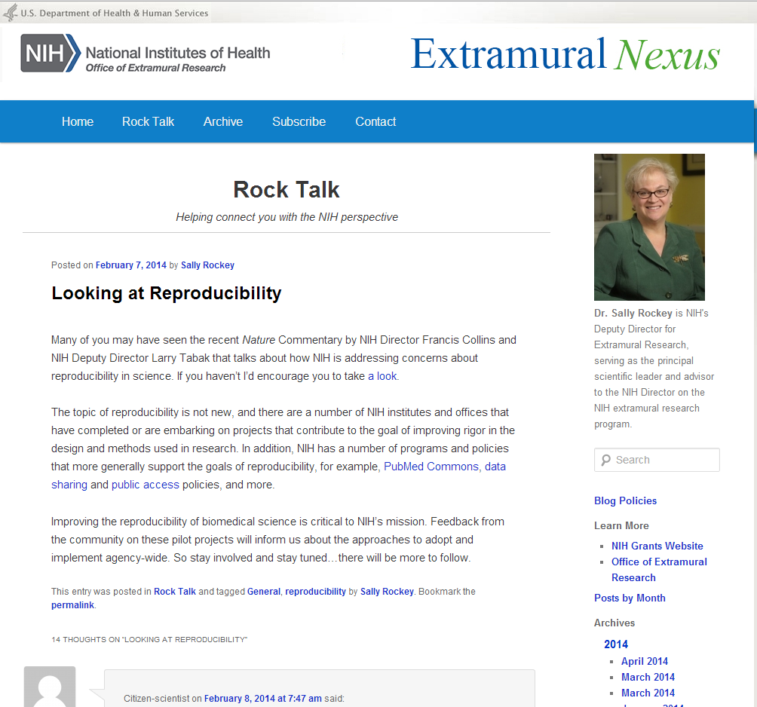
Rock Talk – Looking at Reproducibility

Slide 16
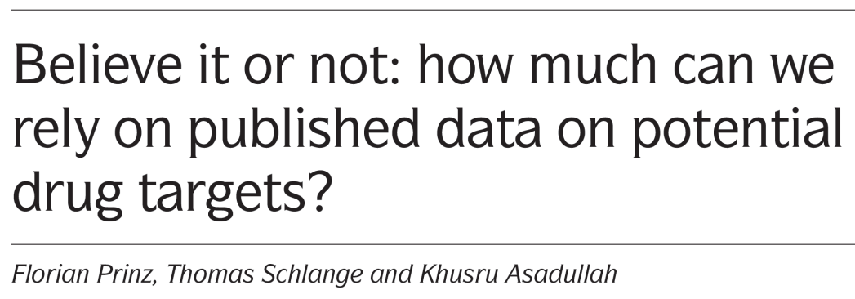
PreClinical Study Headlines

Slide 17
Possible Causes for Difficulties Reproducing Data
Poor experimental design: e.g., no blinding, randomization, insufficient power, variable experimental conditions, insufficient documentation of methods
Errors in analysis & interpretation: lack of replication, inappropriate use of statistics, misinterpretation of findings
Inadequate reporting of: detailed methods, failures to replicate, exclusion of outliers, changes to endpoints
Overemphasis on the “exciting” or “big picture” finding sometimes results in publications leaving out necessary details of experiments performed
Difficulty in publication of “negative” findings
Underlying issues of poor training in experimental design and perverse reward incentives

Slide 18
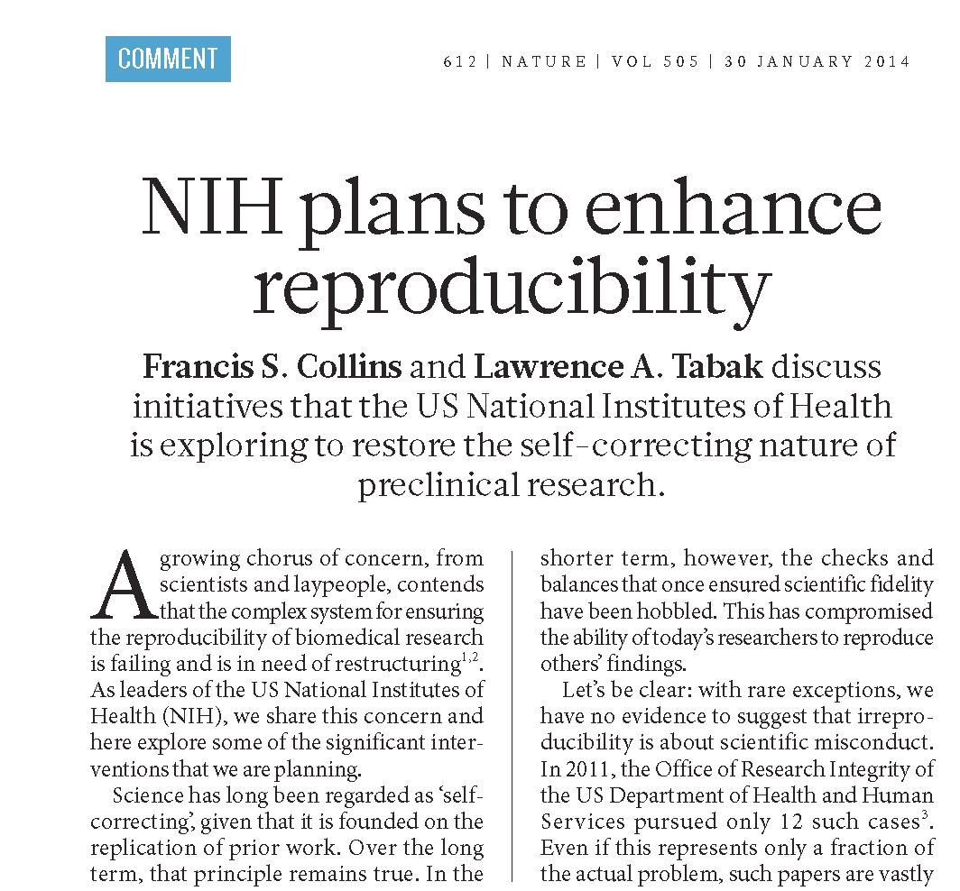
NIH Plans to Enhance Reproducibility

Slide 19
Trans-NIH Actions
Discussing reproducibility and transparency of research findings with stakeholder communities, such as journal editors
Creating a new training module on research integrity and experimental design
Implementing pilot studies to address key concerns, such as:
Developing a checklist to ensure more systematic evaluation of grant applications
Determining approaches needed to reduce “perverse incentives,” e.g., longer term support for investigators
Supporting replication studies
Considering approaches to encourage applicants to:
Authenticate cell lines and other unique research resources
Analyze and report sex differences in preclinical research

Slide 20
Rock Talk – More on Addressing Sex Difference in Pre-Clinical Studies

Slide 21
NIH to Balance Sex in cell and Animal Studies
Over the course of FY 2015, NIH plans to roll out policies that will require applicants to address inclusion of both sexes in biomedical research.

Slide 22
Rock Talk – changes to the biosketch

Slide 23
The Modified Biographical Sketch (Biosketch) in NIH Applications
A second round of Biosketch pilots (announced May 16, 2014) will:
Extend the page limit from four to five pages.
Allow researchers to describe up to five of their most significant contributions to science, their specific role in those discoveries, and the influence of their contributions on their scientific field.
The new Biosketch may start a culture shift to:
Emphasize accomplishments rather than a list of publications.
De-emphasize the focus of publishing in a small number of competitive journals.
Notes:
Notice: NOT-OD-14-091

Slide 24
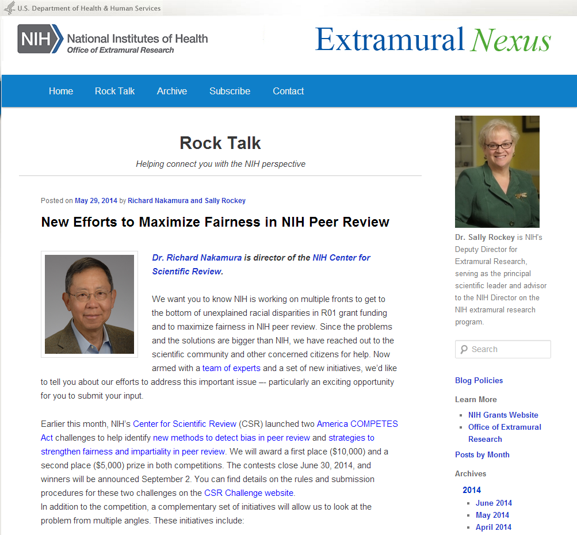
Rock Talk – New Efforts to Maximize Fairness in NIH Peer Review

Slide 25
What’s the problem?
Great application
Not great application
Payline
Study Section A
Study Section B
Courtesy of Dr. Jon Lorsch, NIGMS

Slide 26
What’s the problem?
Great application
Not great application
Payline
Study Section A
Study Section B
Courtesy of Dr. Jon Lorsch, NIGMS

Slide 27
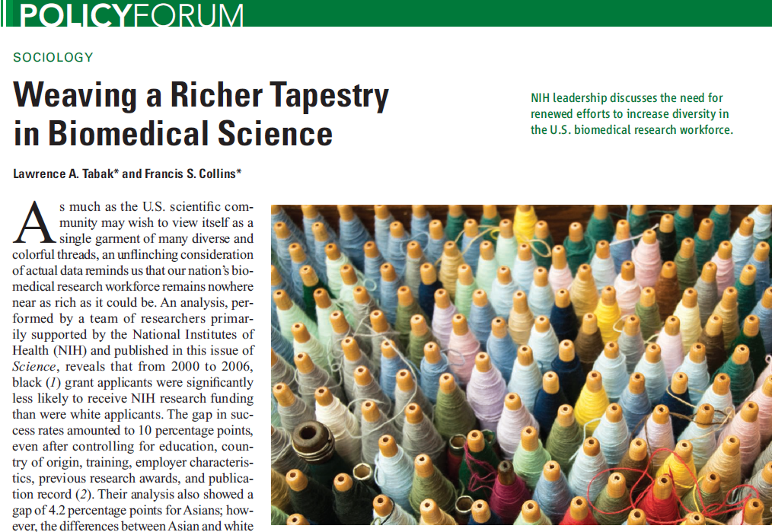
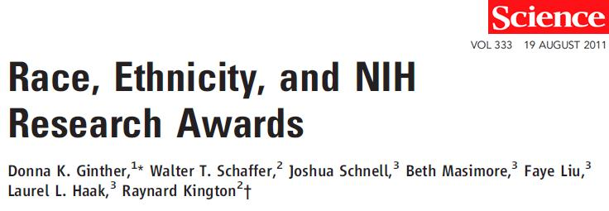
Greater Diversity in Research Workforce is Needed

Slide 28
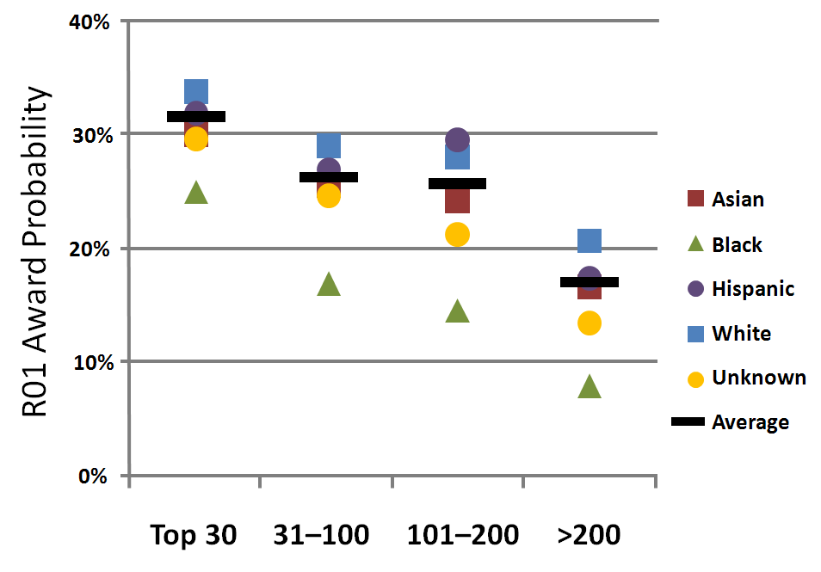
Award Probability – Institution and Race/Ethnicity*
*Courtesy of Dr. Donna Ginther

Slide 29
Greater Diversity in Research Workforce is Needed
NIH’s Plan for Action:
Evaluate current training programs
Phase out unsuccessful programs, expand successful ones
Increase number of early career reviewers, including those from underrepresented populations
Examine grant review process for bias and develop interventions
Improve support for grant applicants
Gather expert advice on additional action steps

Slide 30
Rock Talk – Keeping Up with the Biomedical Research Workforce initiative

Slide 31
Biomedical Research Workforce Working Group Implementation Update
A working group of the Advisory Committee to the NIH Director
Chaired by Shirley Tilghman (Princeton) and Sally Rockey (NIH)
Charge
Develop a model for a sustainable and diverse U.S. biomedical research workforce that can inform decisions about training of the optimal number of people for the appropriate types of positions that will advance science and promote health.
Based on this analysis and input from the extramural community, make recommendations for actions that NIH should take to support a future sustainable biomedical infrastructure.
Report
Executive Summary http://acd.od.nih.gov/bmw_report.pdf
Report http://acd.od.nih.gov/Biomedical_research_wgreport.pdf
Supplementary Web Site http://report.nih.gov/investigators_and_trainees/ACD_BWF

Slide 32
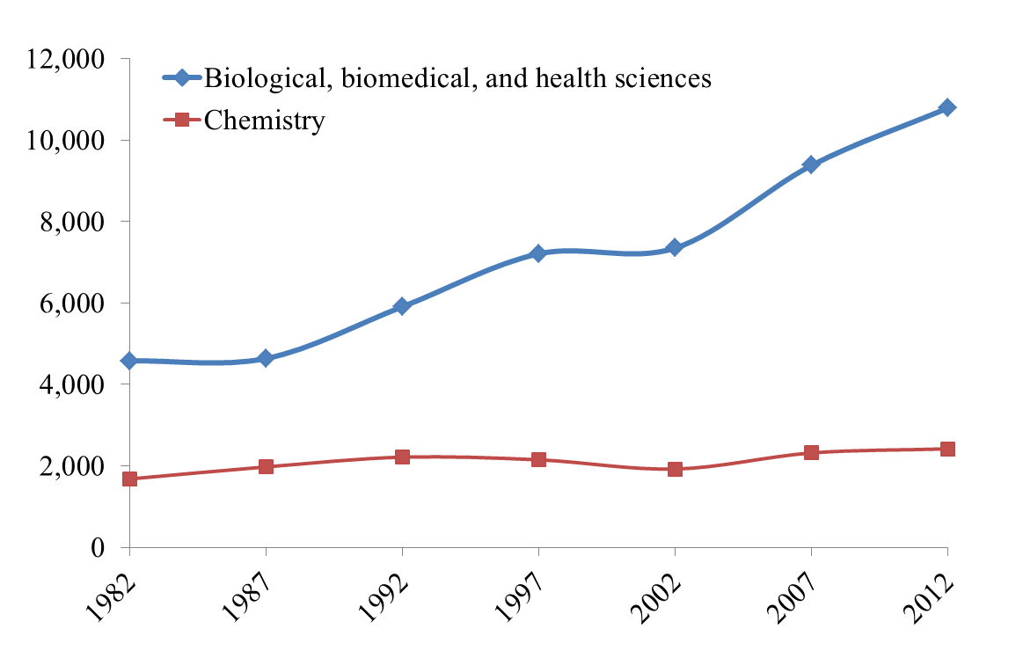
Doctoral Recipients by Major Field of Study, 1982-2012
Source: Survey of Earned Doctorates
(accessed May 10, 2014, http://www.nsf.gov/statistics/sed/2012/data_table.cfm)

Slide 33
Median Years to Doctorate Since Starting Graduate School, 1987-2012
Source: Survey of Earned Doctorates
(accessed May 10, 2014, http://www.nsf.gov/statistics/sed/2012/data_table.cfm)
Notes:
Note: Life sciences includes biology, biomedical sciences, and health sciences, agricultural sciences. and natural resources. Social sciences includes psychology.

Slide 34
Median Age of Doctorate Recipients by Field of Study, 2012
Source: Survey of Earned Doctorates
(accessed May 10, 2014, http://www.nsf.gov/statistics/sed/2012/data_table.cfm)

Slide 35
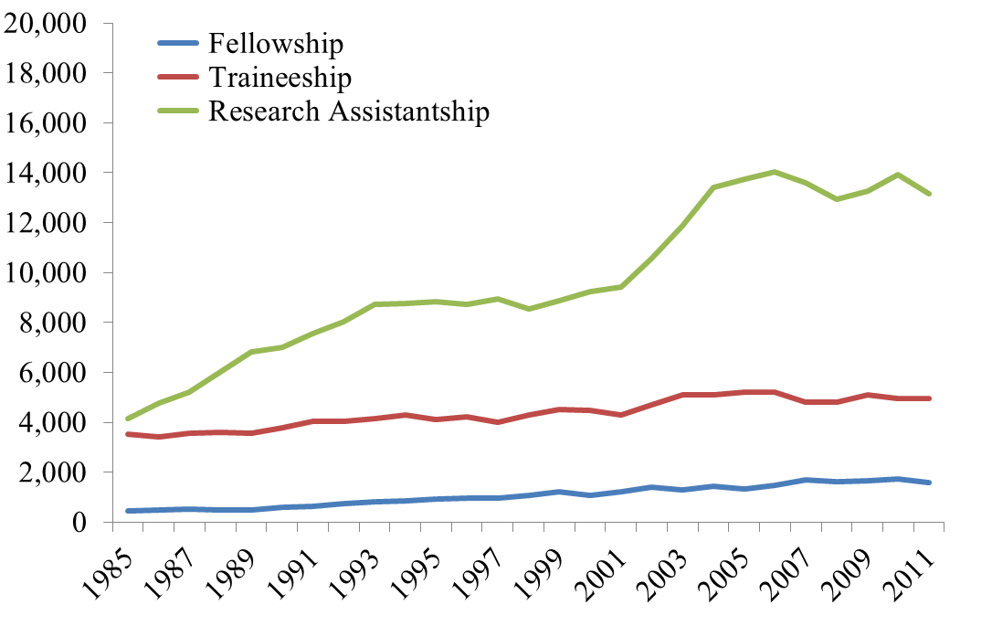
Number of Full-Time Graduate Students Receiving NIH Support by Mechanism (1985 to 2011)
Source: National Institutes of Health, NSF-NIH Survey of Graduate Students and Postdoctorates in Science and Engineering (accessed May 10, 2014 from the NIH Databook, report.nih.gov/nihdatabook/index.aspx)
Note: Students in the biomedical, behavioral and social, and clinical science
whose primary source of support is the NIH.

Slide 36
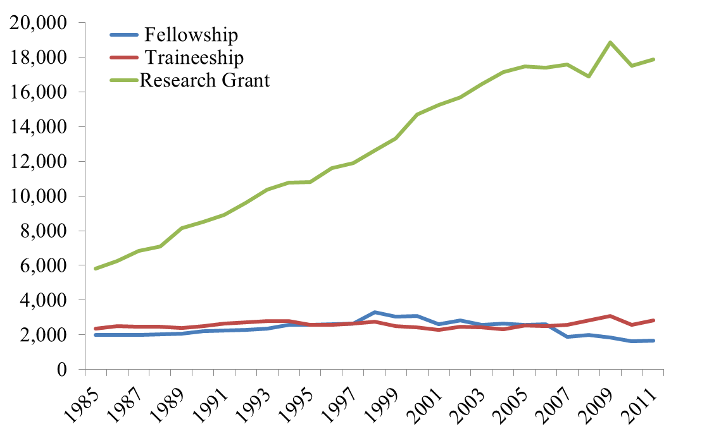
Number of Postdoctorates Receiving Federal Funding by Mechanism (1985 to 2011)
Source: National Institutes of Health, NSF-NIH Survey of Graduate Students and Postdoctorates in Science and Engineering (accessed May 10, 2014 from the NIH Databook, report.nih.gov/nihdatabook/index.aspx)
Note: Postdoctorates in the biomedical, behavioral or social, and clinical science
whose primary source of support is federal.

Slide 37
Biomedical Postdoctorates by Primary Source of Support, 2011
There were 42,478 biomedical research postdoctoral appointees in the United States in 2011.
Almost half (41.8%) of all postdoctoral appointees were funded by NIH.
Source: Survey of Graduate Students and Postdoctorates in Science and Engineering (accessed May 10, 2014, http://www.nsf.gov/statistics/nsf13331/pdf/nsf13331.pdf)

Slide 38
Age at First PhD, First Non Postdoctoral Job, First Tenure Track Job, for US trained Doctorates
Source: Survey of Earned Doctorates

Slide 39
“…runs in our family. My father and grandfather are also working as postdocs.”

Slide 40
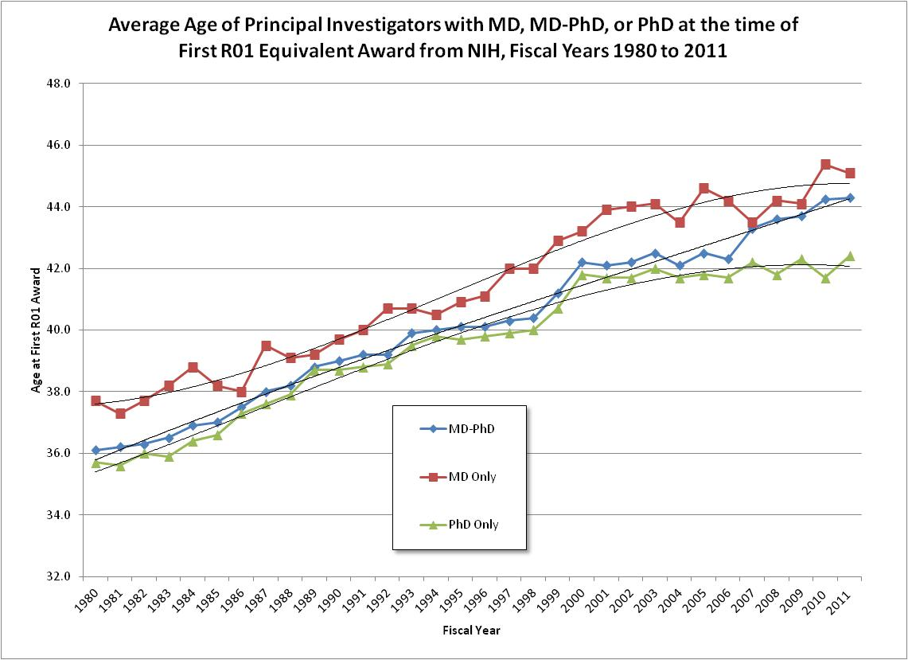
Average Age of Principal Investigators at the time of First R01 Equivalent Award from NIH

Slide 41
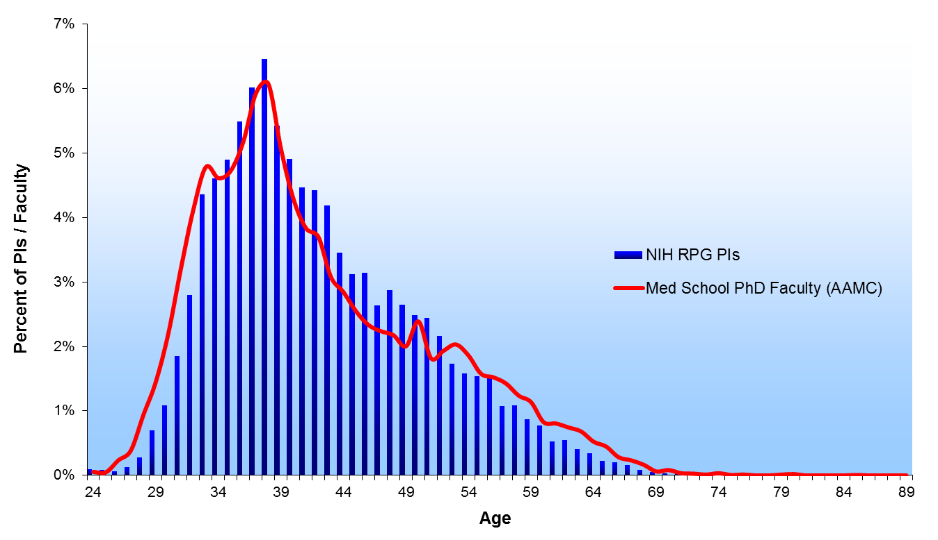
1980

Slide 42
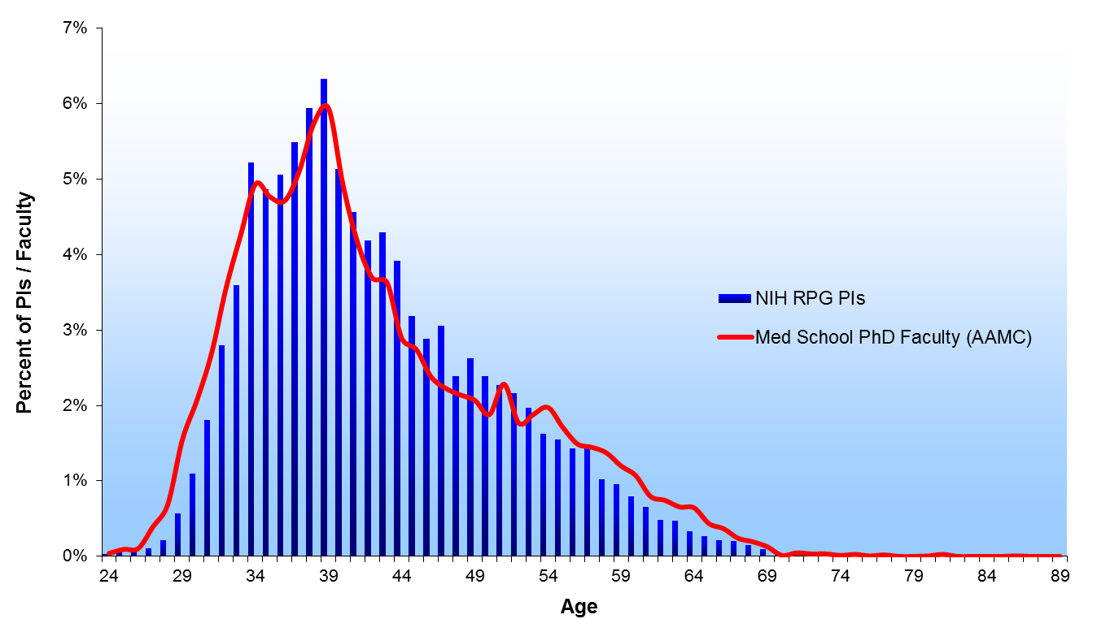
1981

Slide 43
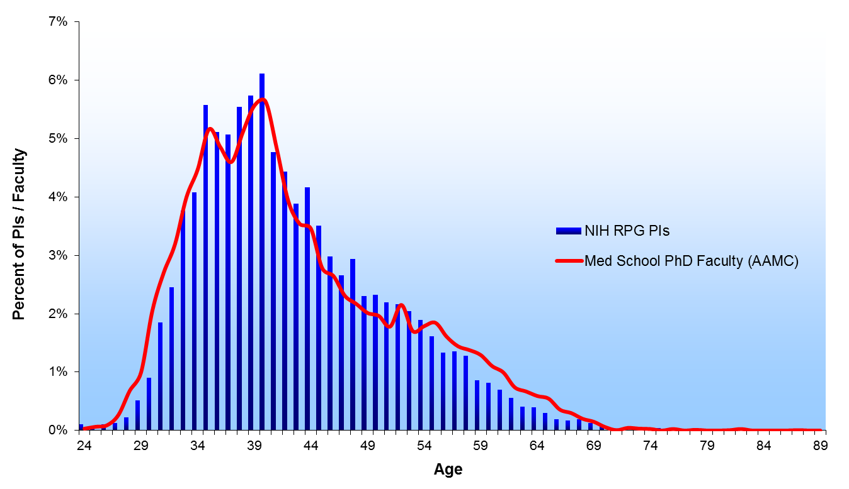
1982

Slide 44
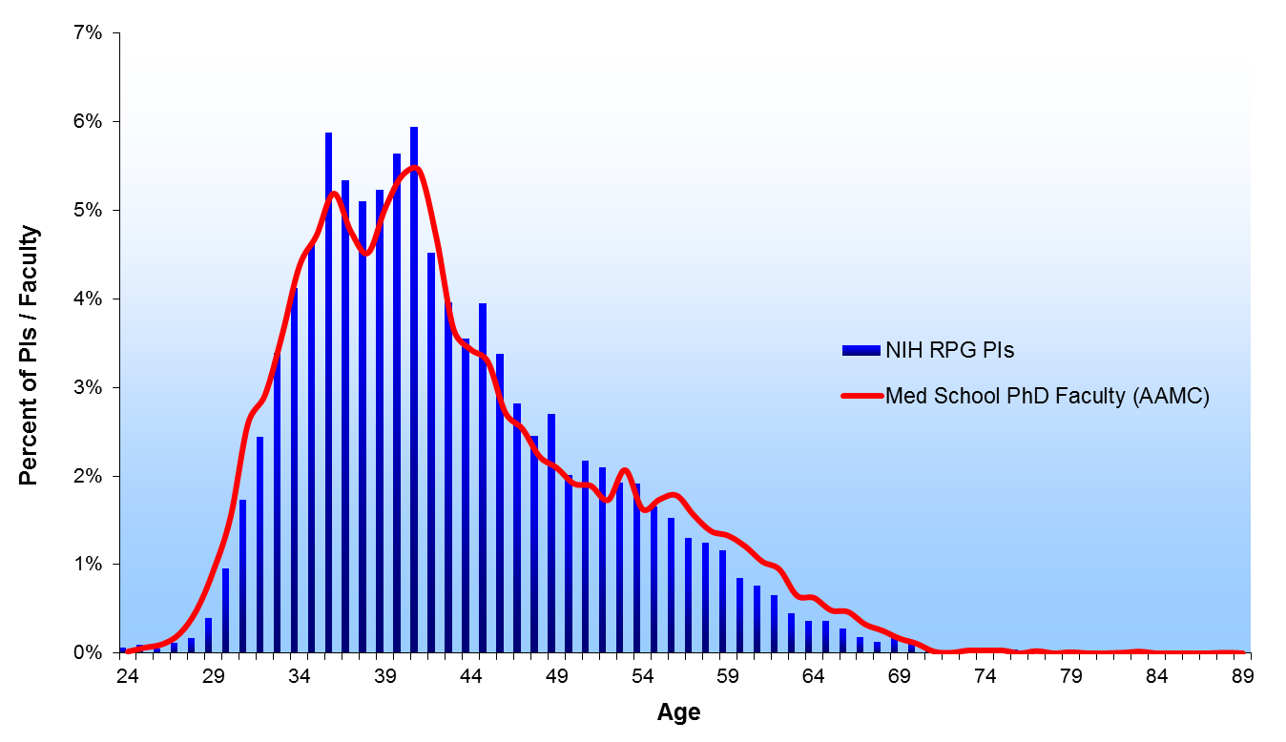
1983

Slide 45
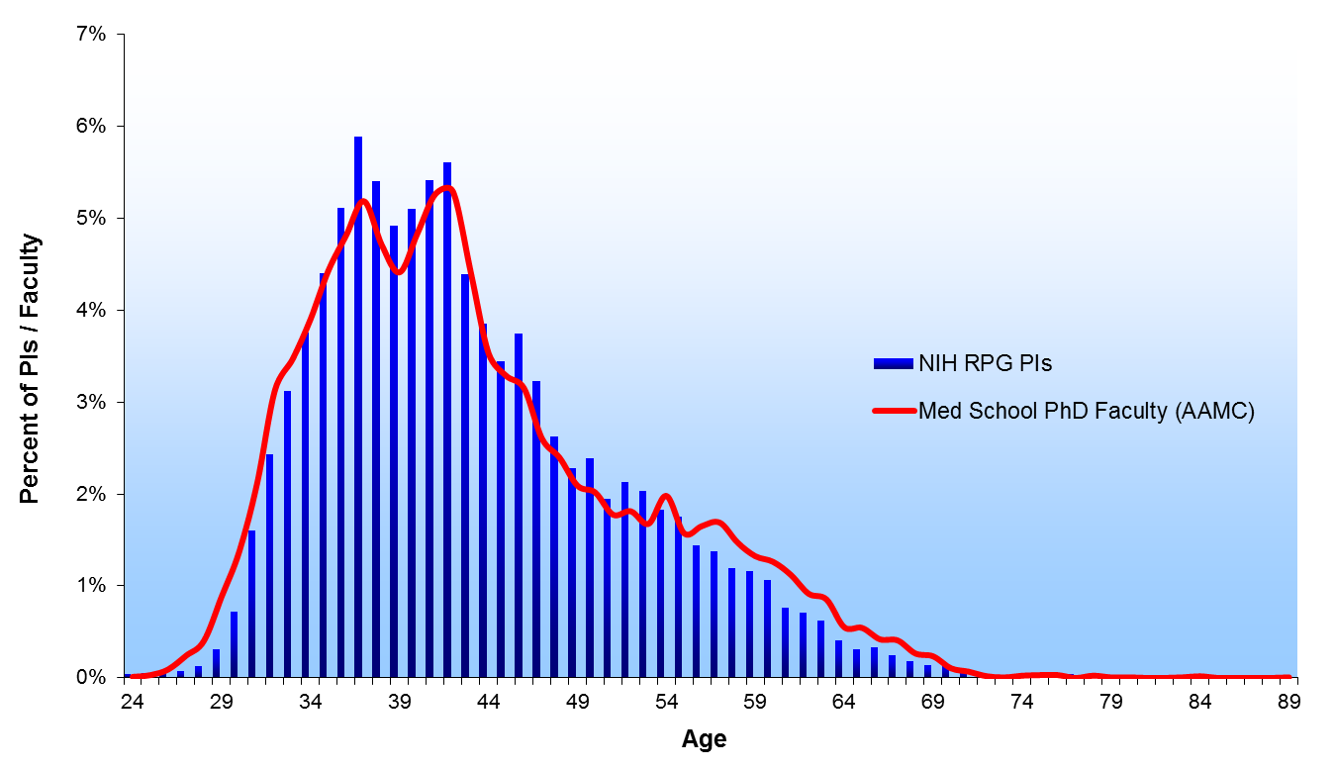
1984

Slide 46
1985
1985

Slide 47
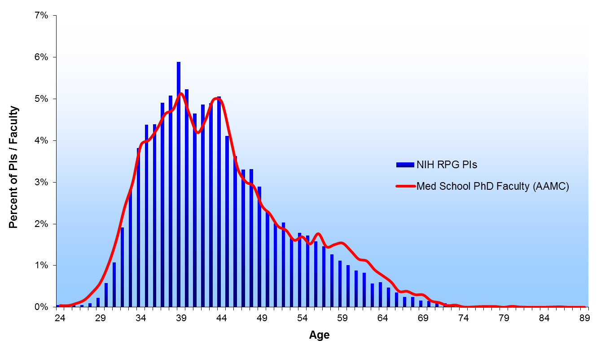
1986
1986

Slide 48
1987

Slide 49
1988

Slide 50
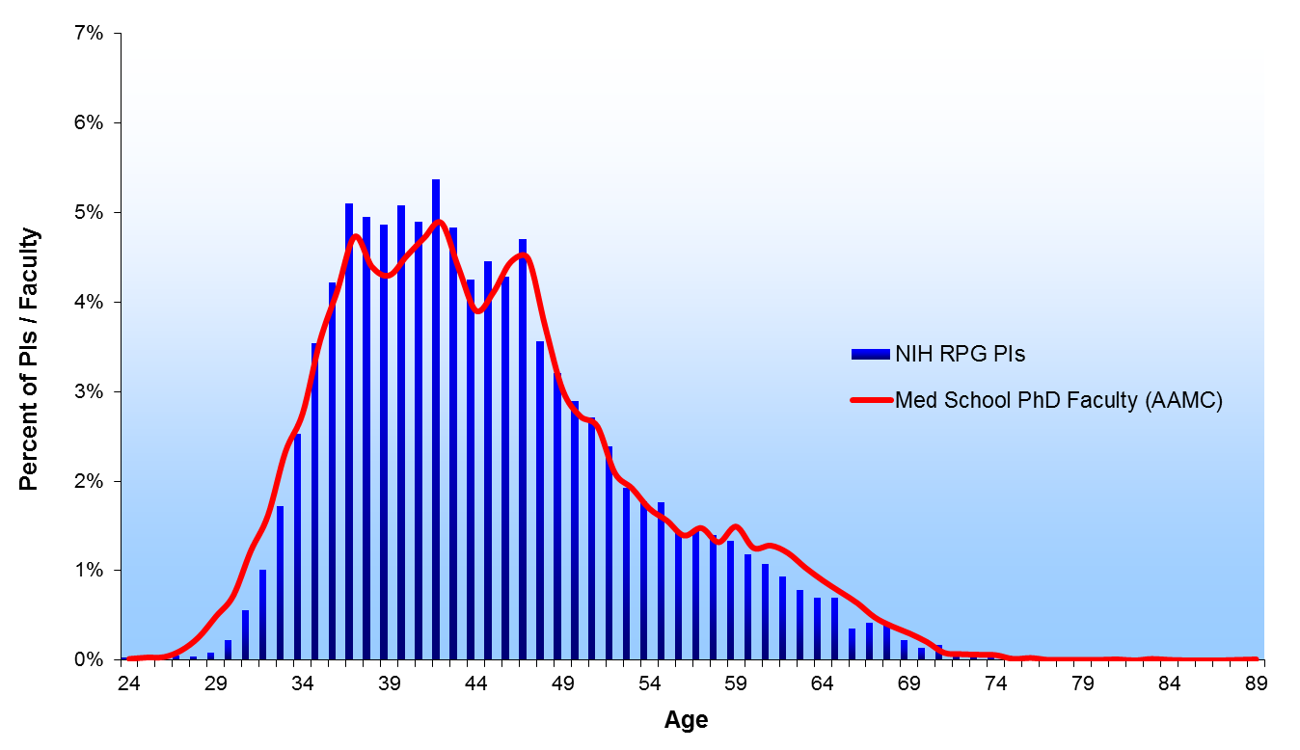
1989

Slide 51
1990

Slide 52
1991
1991

Slide 53
1992
1992

Slide 54
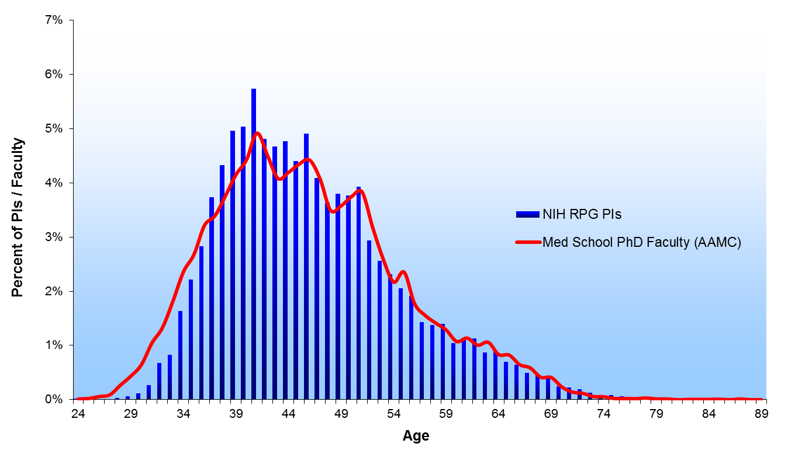
1993
1993

Slide 55
1994
1994

Slide 56
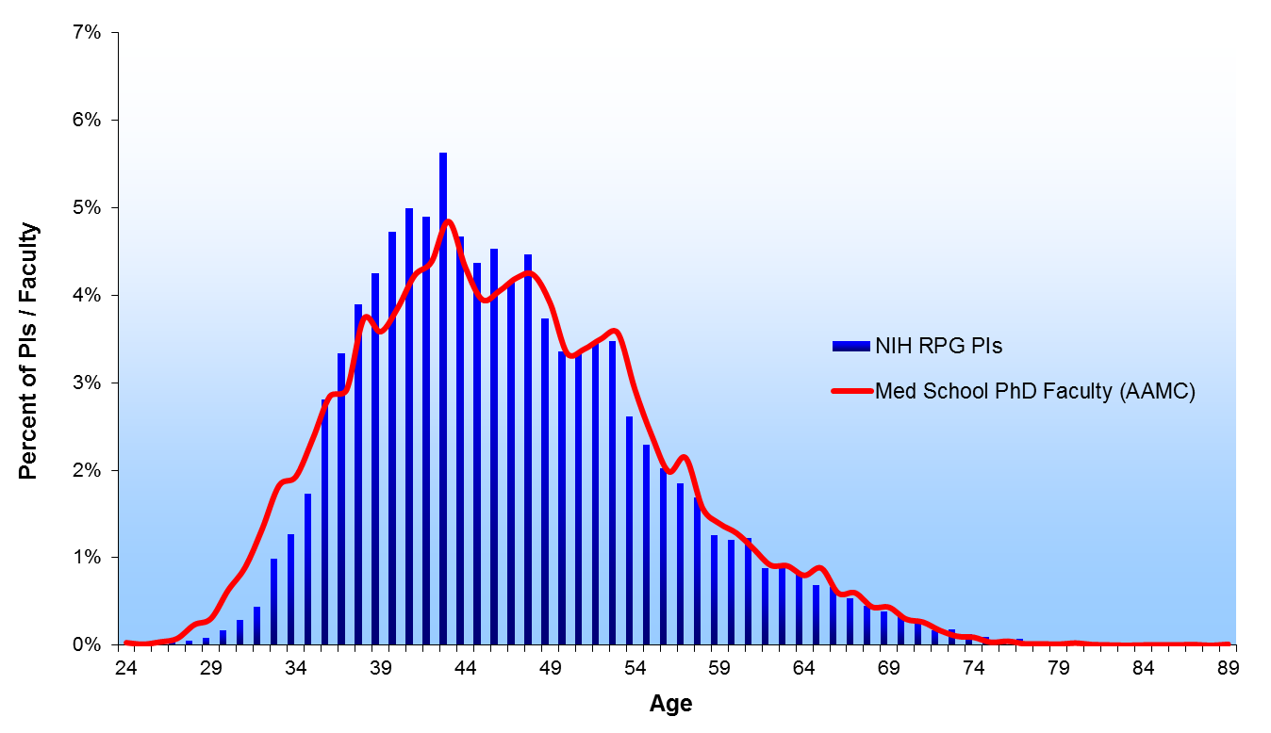
1995
1995

Slide 57
1996
1996

Slide 58
1997
1997

Slide 59
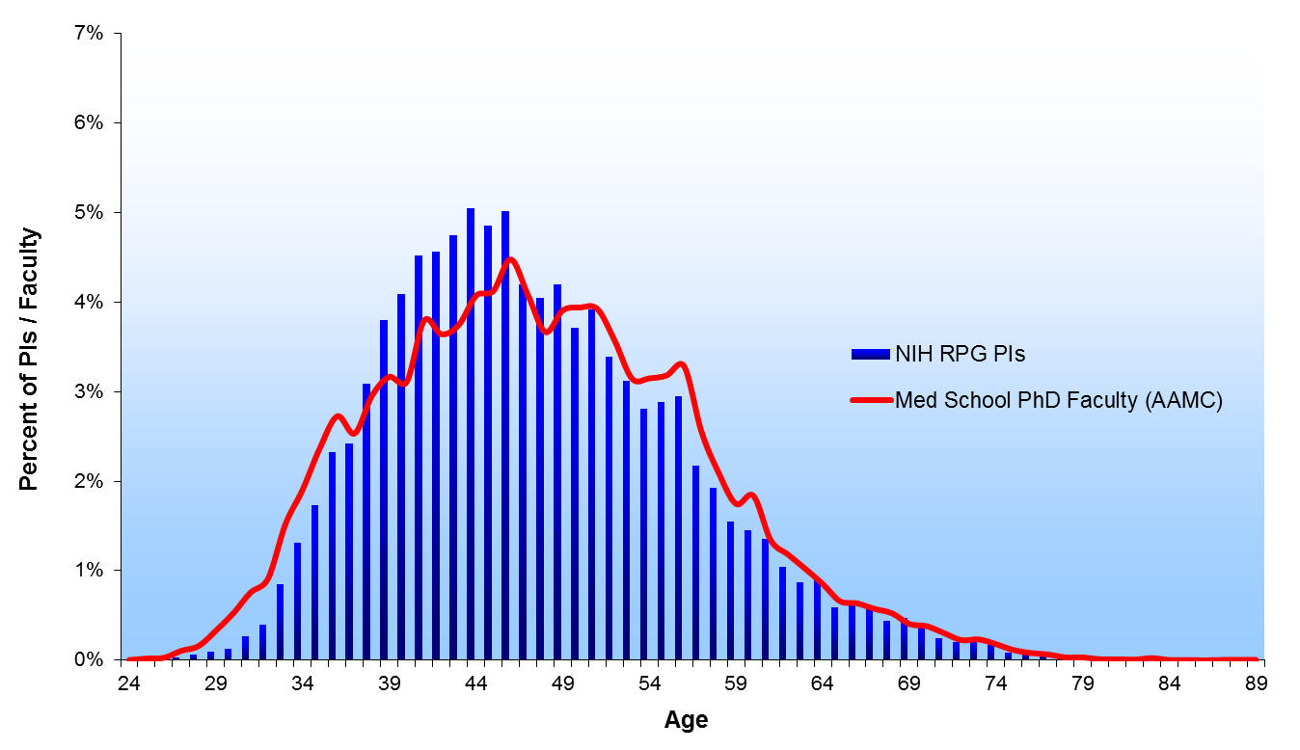
1998
1998

Slide 60
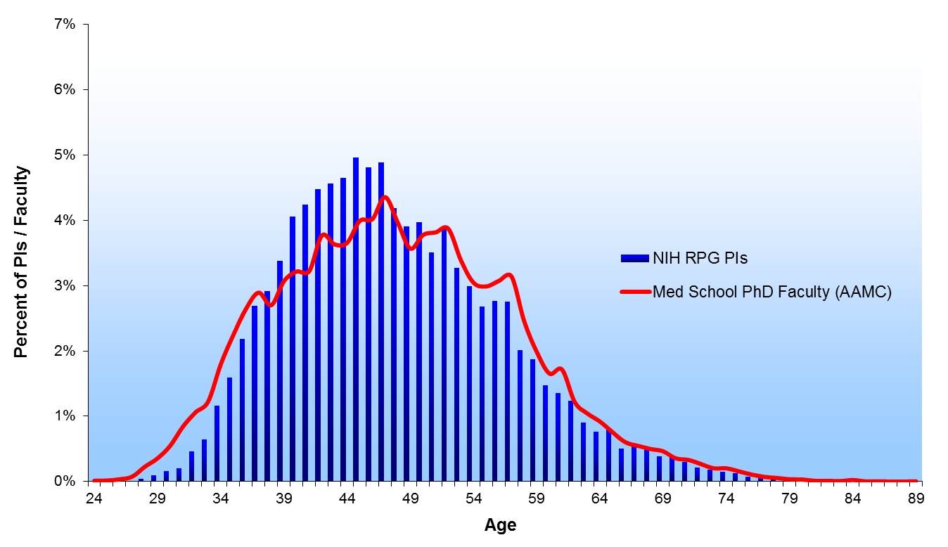
1999
1999

Slide 61
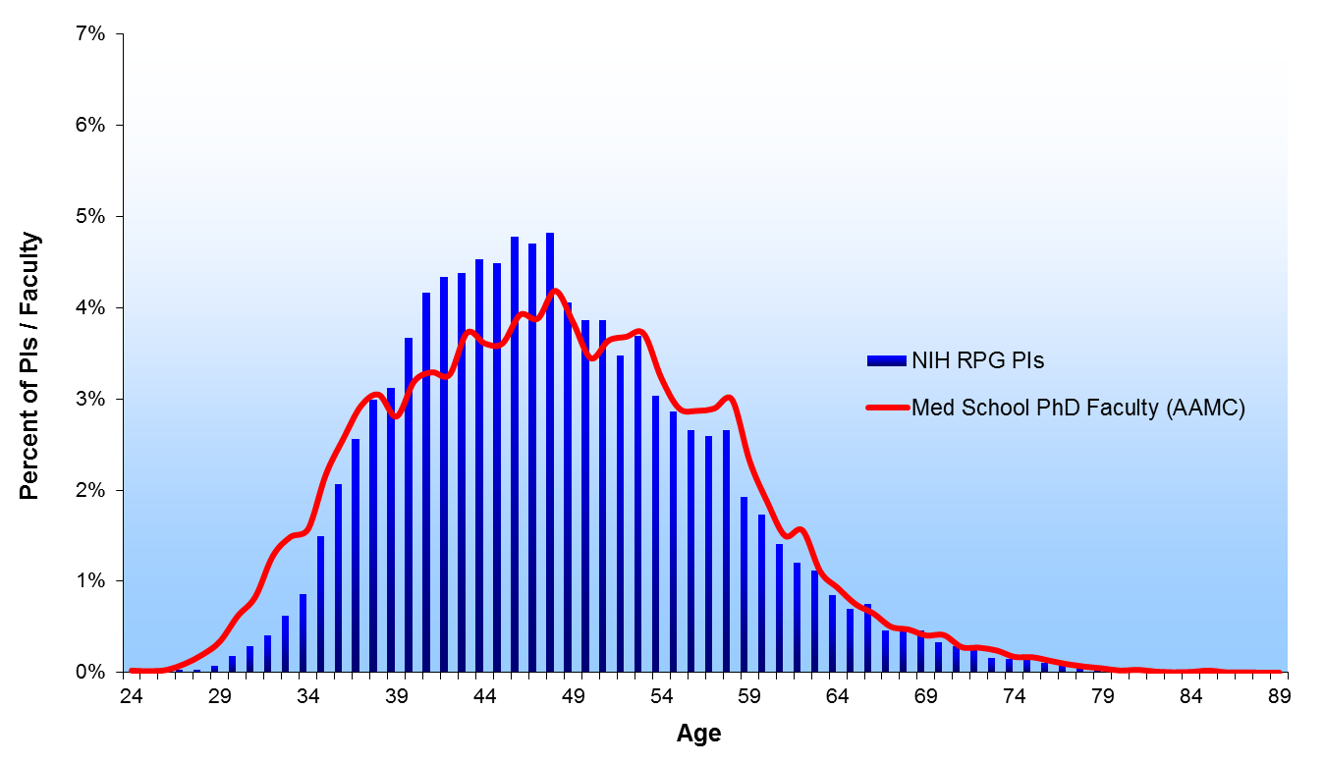
2000
2000

Slide 62
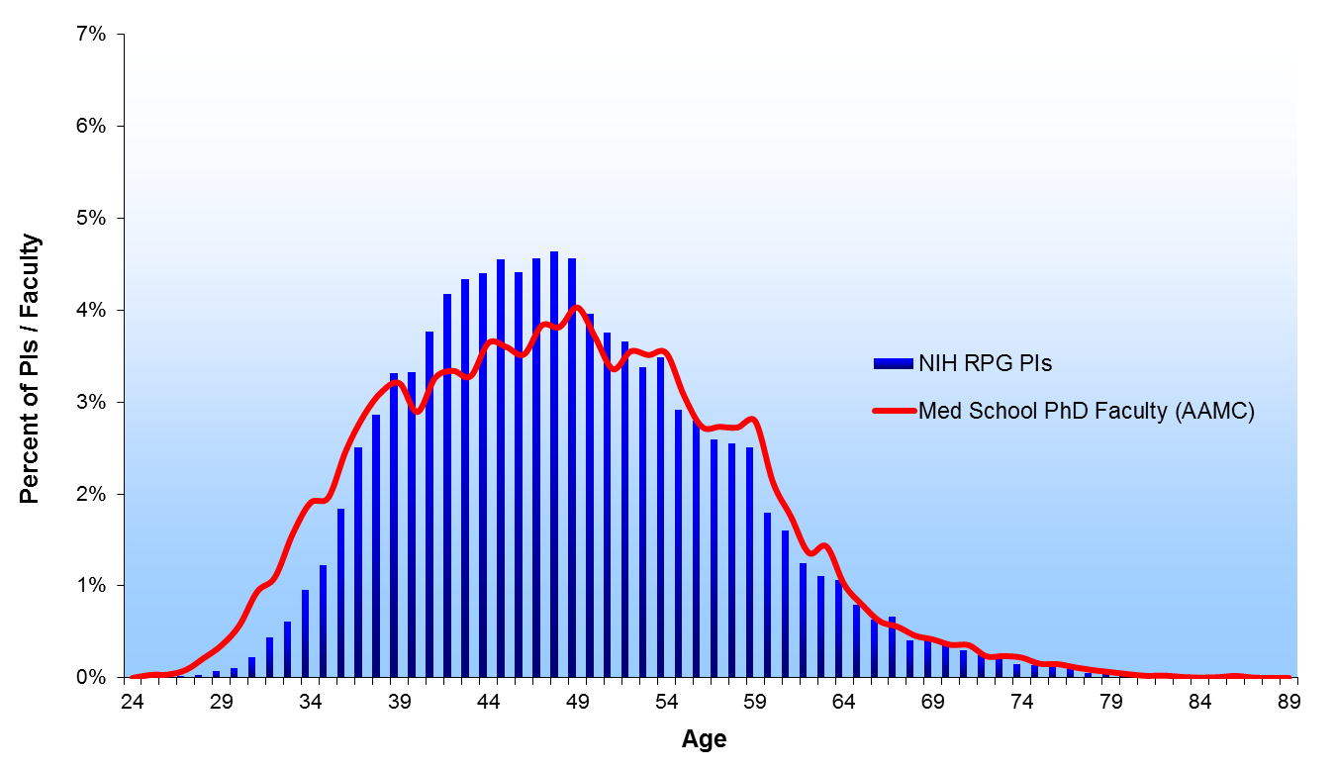
2001

Slide 63
2002
2002

Slide 64
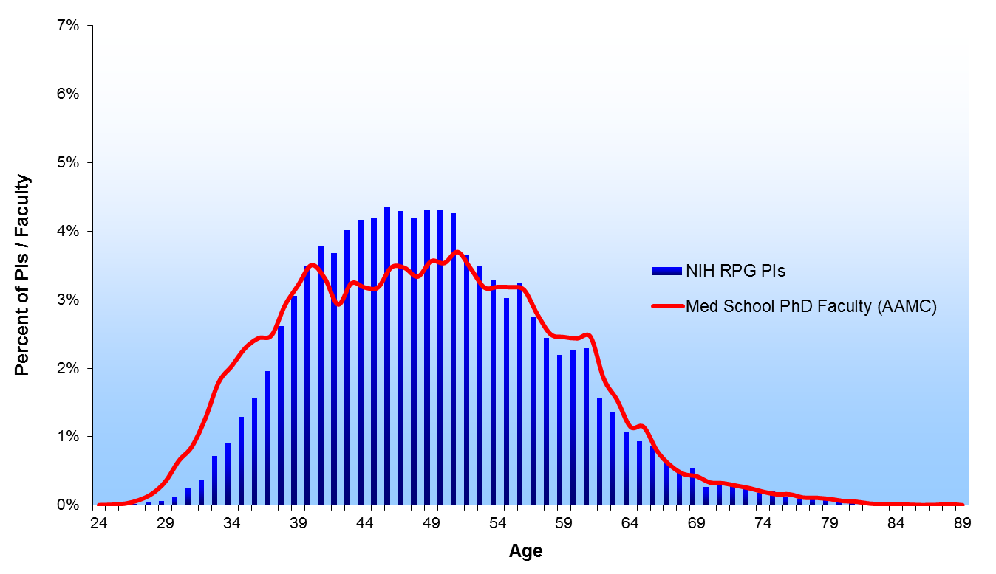
2003
2003

Slide 65
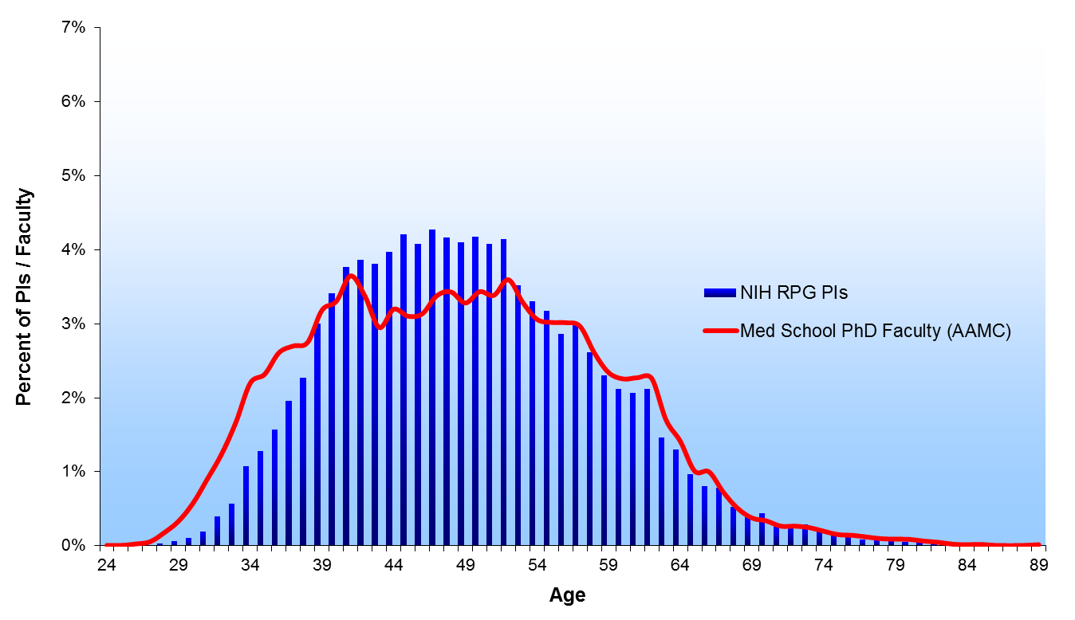
2004
2004

Slide 66
2005
2005

Slide 67
2006
2006

Slide 68
2007

Slide 69
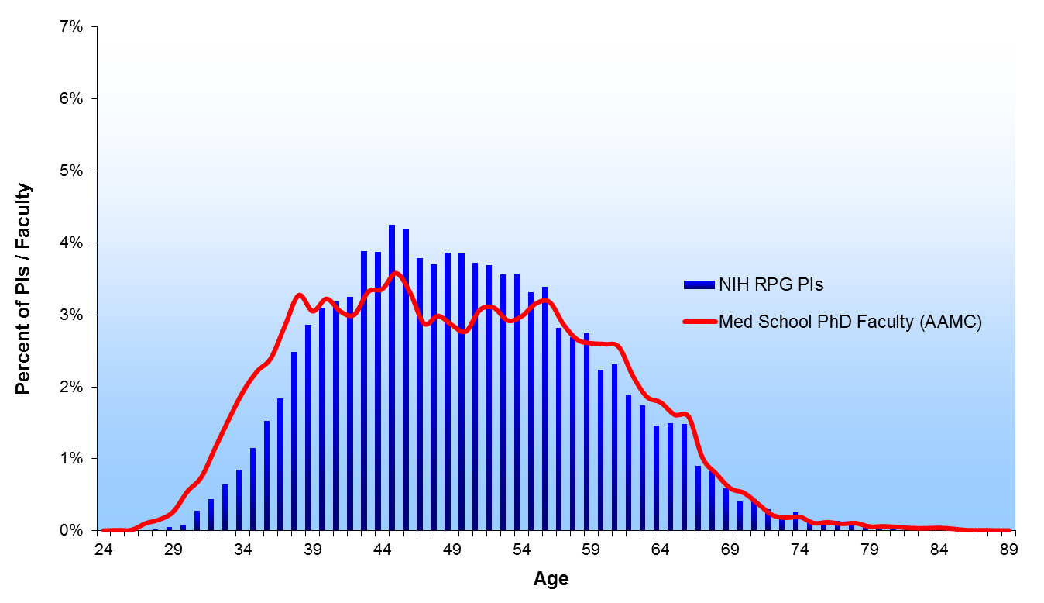
2008
2008

Slide 70
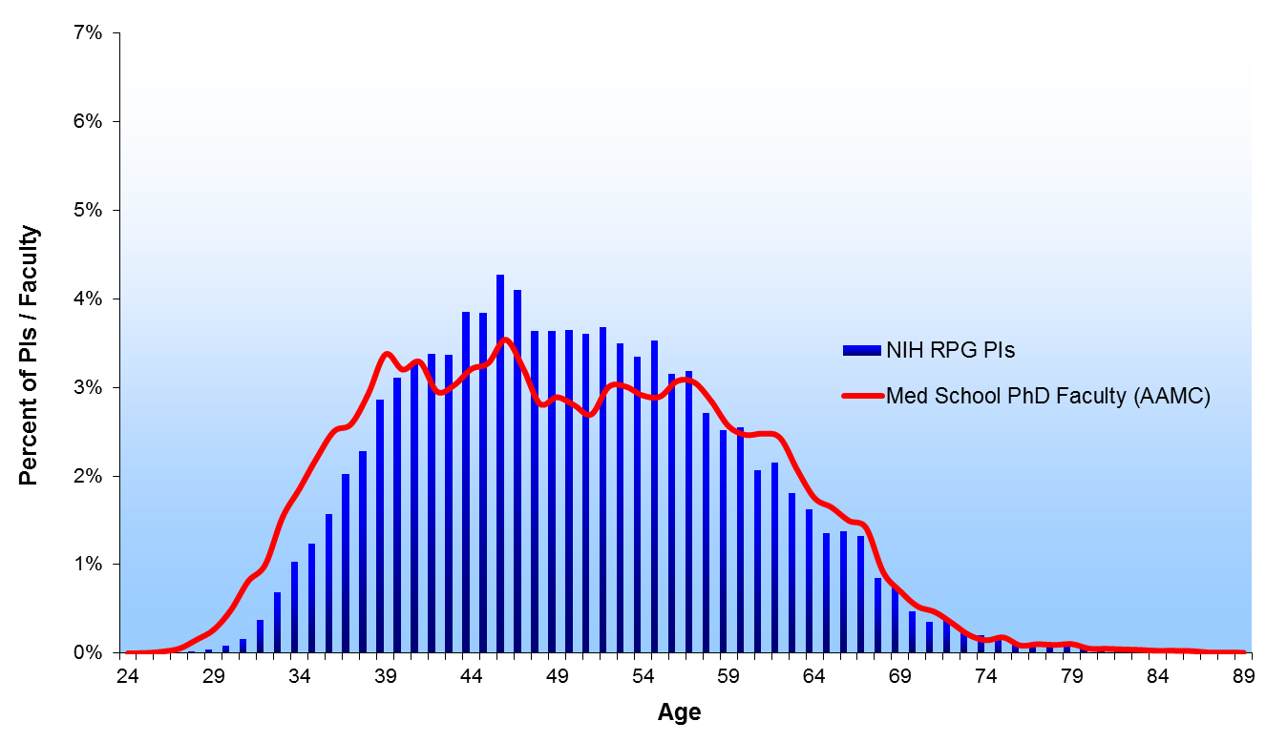
2009
2009

Slide 71
2010
2010

Slide 72
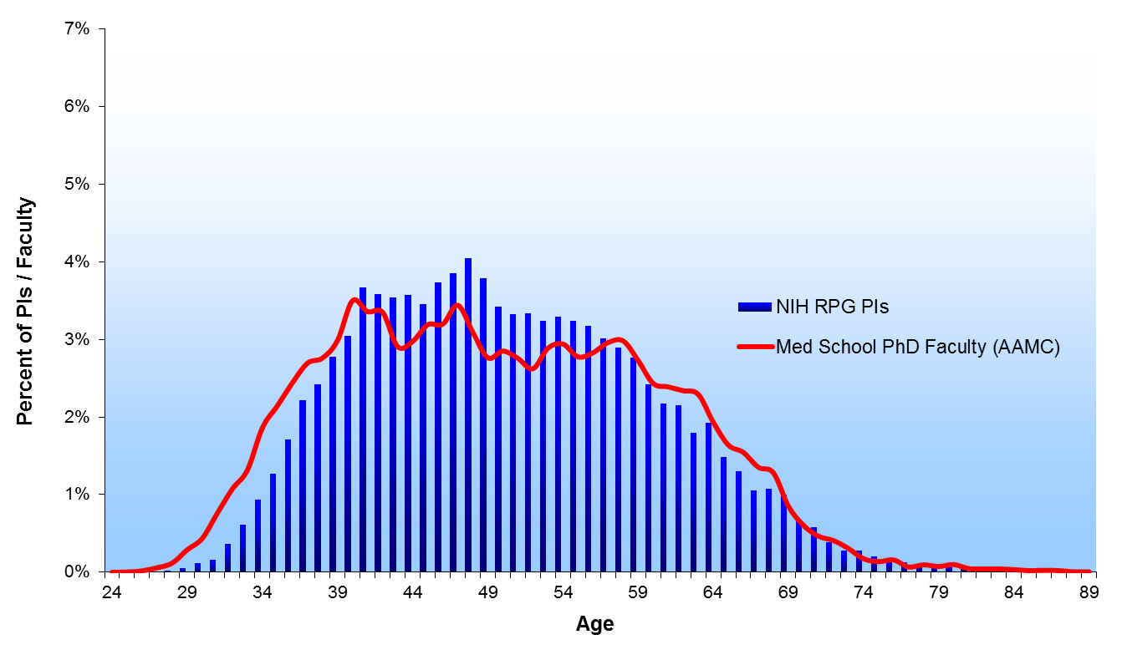
2011
2011

Slide 73
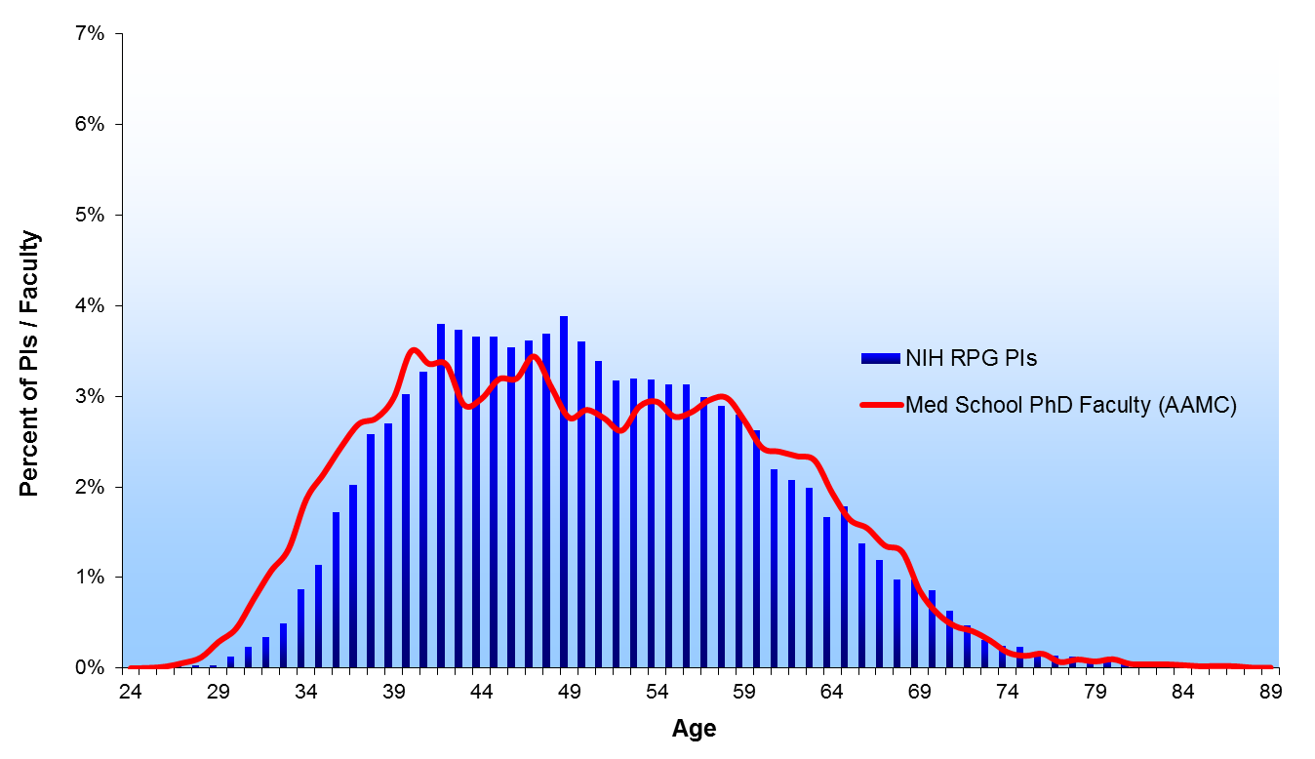
2012
2012

Slide 74
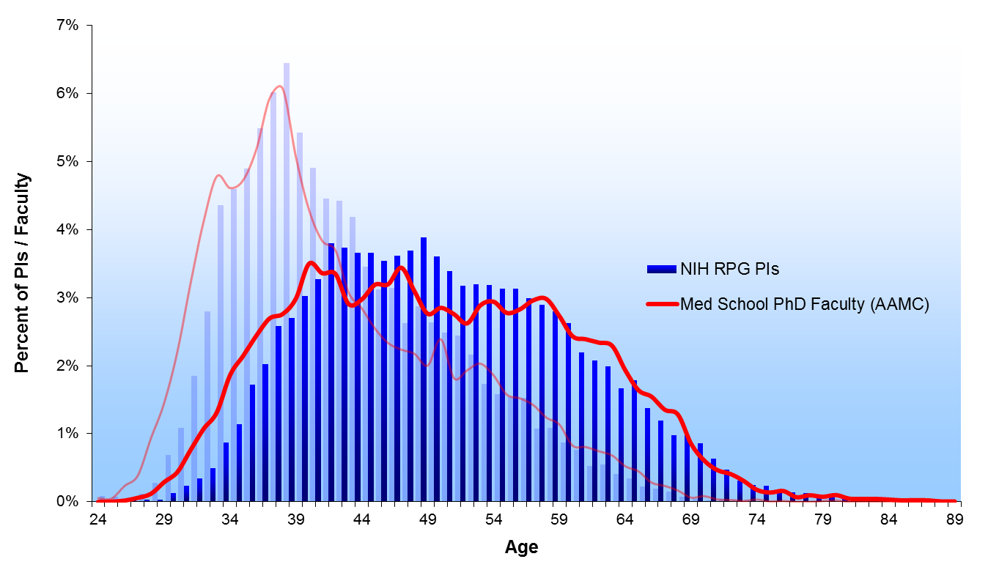
1980 & 2012
1980
2012

Slide 75
PhD Biomedical Research Workforce
PhD Biomedical Research Workforce
College Graduates
16,000 in 2009
Graduate Education & Training
2009 Total: 83,000
Time to Degree :5.5-7yrs
2009 Graduates: 9,000
International
4,000 in 2009
8% of graduates
leave the US
Of graduates who stay in the US
30% skip a postdoc
70% do a postdoc
5,800 in 2009
Postdoctoral Training
2009 Total: 37,000 to 68,000
Median Length: 4 years
1,900 to 3,900
in 2009
Post-Training Workforce
Total of ~150,000 Biomedical US-trained PhD’s
(128,000 Biomedical US-trained PhDs)
18%
Biomedical US- trained PhD 2008
~24,000
6%
Biomedical US- trained PhD 2008
~7,000
43%
(23% tenured)
Biomedical US- trained PhD
2008
~55,000
18%
Biomedical US- trained PhD 2008
~22,500
Non-Research Related
Government Research
Academic Research or Teaching
Industrial Research
13%
Biomedical US- trained PhD 2008
~17,000
2%
Biomedical US- trained PhD 2008
~2,500
Research- Related
Unemployed

Slide 76
WG Conclusions
Weighing all the data analyzed, the working group concluded that:
The large upsurge in US-trained PhDs, increased influx of foreign-trained PhDs, and aging of the academic biomedical research workforce make launching a traditional, independent, academic research career increasingly difficult.
The long training time and relatively low early-career salaries when compared to other scientific disciplines and professional careers may make the biomedical research career less attractive to the best and brightest of our young people.
The current training programs do little to prepare people for anything besides an academic research career, despite clear evidence that a declining percentage of graduates find such positions in the future.

Slide 77
WG Recommendations
The working group made specific recommendations on:
Graduate Students - diversify and shorten the PhD and increase support on training grants and fellowships.
Postdoctoral Researchers - shorten the pathway to an independent career, increase support on training grants and fellowships, enhance the training aspects of the postdoc, and improve pay and benefits.
Information Collection, Analysis and Dissemination - fill data gaps, routinely tracking of student and postdoc career outcomes, and institute ongoing analysis of the workforce
Physician Scientists - conduct a focused follow-on study.
Staff Scientists - study sections should be receptive to these positions in applications.
Salary Support – long term approach to gradually reduce the percent of funds from NIH.
Diversity – stronger coordination of programs and rigorous evaluation.

Slide 78
DP7 BEST Program - Broadening Experiences in Scientific Training
Common Fund program seeking innovative approaches to complement traditional research training in biomedical sciences at institutions that receive NIH funds.
http://grants.nih.gov/grants/guide/rfa-files/RFA-RM-12-022.html
One application per institution
Up to $250,000 in direct costs per year
Closed May 10, 2013
Over 100 applications
Awards were announced on September 23 - http://www.nih.gov/news/health/sep2013/od-23.htm
Encourage institutions to leverage funds with existing institutional offices and programs, local resources outside the institution, or that partner with industry or other entities.
Must include rigorous analysis to demonstrate impact.
Proven approaches will be widely disseminated throughout the biomedical research community; awardees will meet to exchange ideas.

Slide 79
Other initiatives
Improve graduate student and postdoctoral training by:
Putting IDPs in place for all trainees
http://grants.nih.gov/grants/guide/notice-files/NOT-OD-13-093.html
Reducing the length of graduate training
Providing F30s and F31s from all ICs – fully implemented for applications received after April 2014.
Increase postdoctoral stipends – to be implemented in FY2014
Consider policies on benefits – developing comprehensive survey
Shorten eligibility period and increase support for K99/R00 – implemented for applications received after February 2014

Slide 80
Other initiatives, cont.
Develop a simple and comprehensive tracking system for trainees
Automate training grant tables to include structured data
Develop SciENCV
Incorporate unique identifier
Initiate discussion with the community to assess NIH support of faculty salary – developing pilot survey
Create functional unit at NIH to assess the biomedical research workforce

Slide 81
Rock Talk – Individual Development Plans for NIH-Supported Trainees

Slide 82
Rock Talk – Collecting Data on Postdoc Benefits

Slide 83
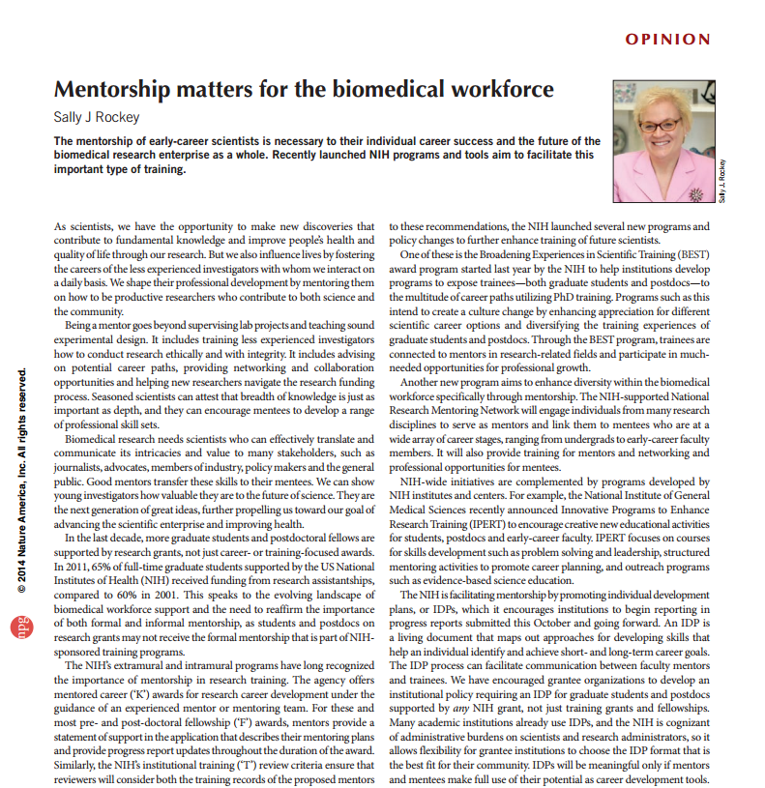
Mentorship matters for the biomedical workforce

Slide 84
Rock Talk – Test Drive SciENcv

Slide 85
Physician-Scientist Workforce (PSW) Working Group
The BMW WG recommended that NIH conduct a follow-on study that focuses on physician-scientists because:
Different economic and educational drivers affect the training and career paths of the physician-scientist workforce than the PhD workforce
The changing landscape of health care and its effects on academic medical centers will affect future physician-scientist workforce
Charge:
Develop approaches that can inform decisions about the development of the U.S. PSW
Analyze the size and composition of the PSW; consider impact of NIH funding policies
Assess needs and career opportunities for PS trainees
Identify incentives and barriers to entering the PSW

Slide 86
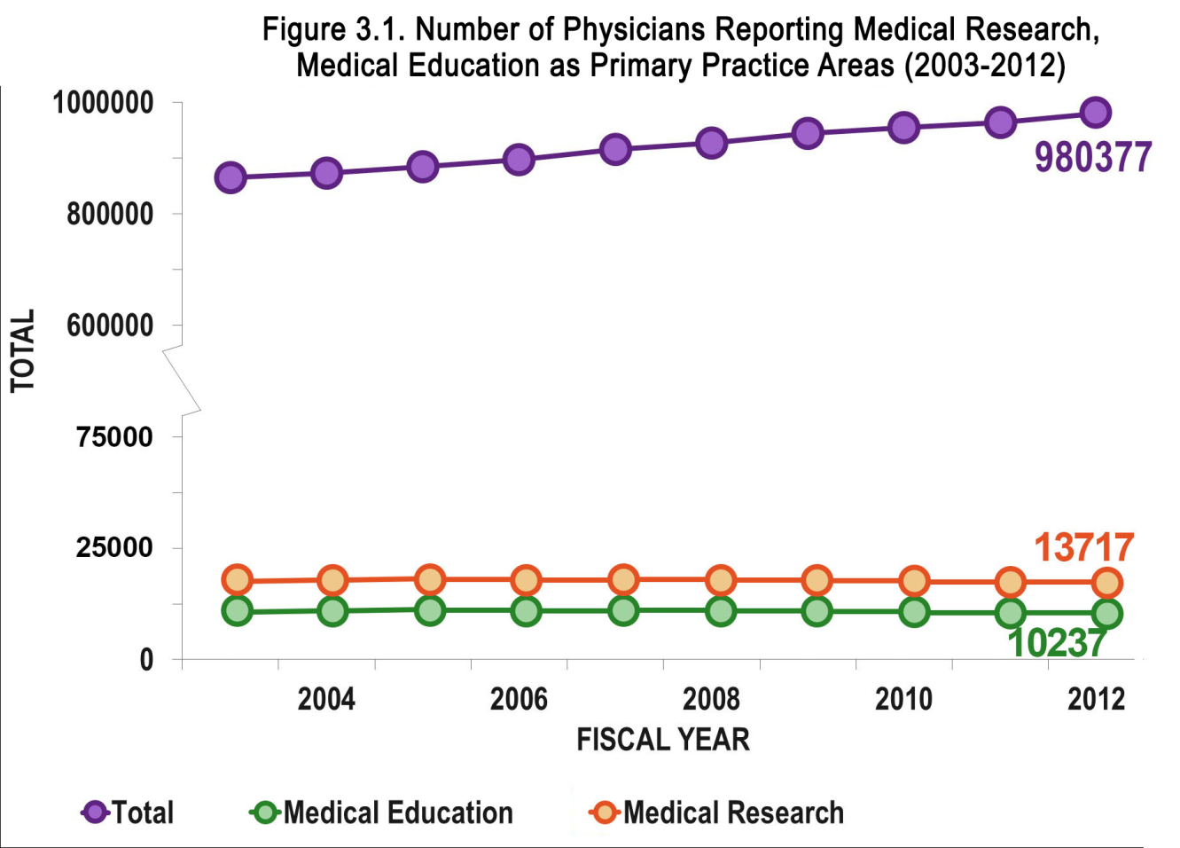
Total Number of Physician-Scientists Engaged in Research Is Unchanged over Past Decade

Slide 87
The Physician Scientist Pool is Aging

Slide 88
Recommendations from the PSW Working Group
Sustain strong support for MD/PhD programs
Shift NRSA postdoc training awards to support proportionately more individual fellowships vs institutional grants
Establish PS-specific K99/R00-equivalent granting mechanism
Expand loan repayment programs & increase dollar amounts of loan forgiven
Support pilot grant programs to test existing & novel approaches to improve and/or shorten research training
Intensify efforts to increase diversity in the physician-scientist workforce
Leverage the existing resources of the CTSA program to obtain maximum benefit for training and career development

Slide 89
Physician-Scientist Workforce Working Group Report
2014 PSW Working Group Report is accessible at http://acd.od.nih.gov/psw.htm
Full set of data and graphs of the PSW Report will be accessible from NIH RePORT website at http://www.report.nih.gov/workforce.aspx

Slide 90
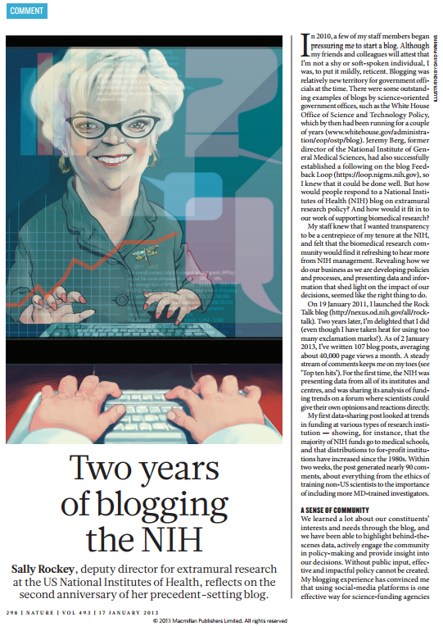
http://nexus.od.nih.gov/all/rock-talk
Get Connected
to the
Rock Talk Blog
I’m Tweeting!!
@RockTalking
Conference hashtag: #nihsem

Slide 91
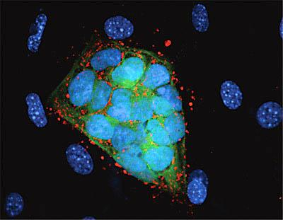
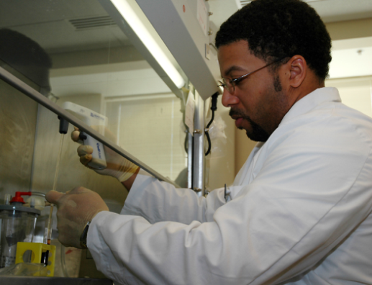
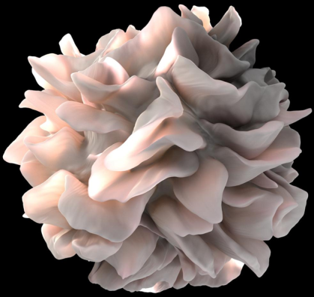
WE VALUE YOUR INPUT!
2014 NIH REGIONAL SEMINAR
Session Evaluations: http://surveymonkey.com/s/nihsessions Overall Evaluations: http://surveymonkey.com/s/nihoverall
NIH…
Turning Discovery Into Health

