Slide 1
NIH Research Training Awards
Presented By:
Henry Khachaturian, Ph.D., Office of Extramural Programs, OER, NIH
and
Tony Corio, Office of Policy for Extramural Research Administration, OER, NIH

Slide 2
FY 2014 President's Budget: $31.3 billion
~$783 M Training
~$657 M Career
~$1.44 billion
NIH Budget Office: http://officeofbudget.od.nih.gov/index.htm

Slide 3
Research Training and Career Development Timeframe
Research Awards
Career Stage
‘Formal’ Training/Career Awards
Pre-Bac
Pre-Bac Institutional Training Grant (T34)
GRADUATE/
MEDICAL
STUDENT
Predoctoral Institutional Training Grant (T32)
‘Informal’ Training
and Career
Development on
RPGs and
Supplements
Predoctoral Individual NRSA (F31)
Predoctoral Individual MD/PhD NRSA (F30)
Postdoctoral Institutional Training (T32)
Postdoctoral Individual NRSA (F32)
POST
DOCTORAL
NIH Pathway to Independence (PI) Award (K99/R00)
Mentored Research Scientist Development Award (K01)
Mentored Clinical Scientist Development Award (K08)
Mentored Patient-Oriented RCDA (K23)
Mentored Quantitative RCDA (K25)
EARLY
Small Grant (R03)
Research Project Grant (R01)
Independent Scientist Award (K02)
CAREER
MIDDLE
Midcareer Investigator Award in
Patient-Oriented Research (K24)
Exploratory/Develop-ment Grant (R21)
SENIOR
Senior Scientist Award (K05)

Slide 4
Approximate Numbers of Individuals in Research Training Supported with NIH Funds (FY 2011)
Career Stage of Students, Trainees, Fellows, or Scholars | NIH Formal Training, Fellowship or Career Programs | Research Project Grants | NIH's Own Laboratories
High School Students |  | 500+ | 450+
K-12, Community College, and College Science Teachers |  | 400+
College Students and Post-Baccalaureate Students | 3,000+ | 5,000+ | 700+
Pre-Doctoral Students | 10,000+ | 28,000+ | 500+
Post-Doctoral Fellows | 6,800+ | 28,000+ | 3,800+
Early Career Investigators | 5,000+ |  | 50+
Mid-Career and Senior Faculty | 50+

Slide 5
Research Training Programs
The Primary Formal NIH Research Training Programs
Ruth L. Kirschstein National Research Service Awards (NRSA)
Two Types of Awards:
Individual Fellowships (“F” Awards)
Institutional Training Grants (“T” Awards)

Slide 6
Research Training Programs
Individual Fellowship Awards
Predoctoral Students
Postdoctoral Fellows
Established Investigators

Slide 7
Research Training Programs
Institutional Awards
Undergraduate Students
Pre-doctoral Students
Post-doctoral Individuals

Slide 8
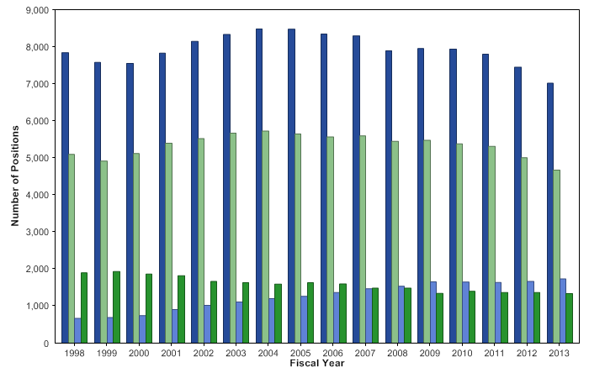
Kirschstein-NRSA training grants & fellowships: Distribution of training positions by activity and career stage

Slide 9
Citizenship Requirements
Must be Citizen, non-citizen national, or lawfully admitted for permanent residence
Permanent Residents:
Fellowships: Must have been admitted as a Permanent Resident by the time of award
Training Grants: Must have been admitted as a Permanent Resident at time of appointment

Slide 10
Degree Requirements
Pre-Baccalaureate: Currently enrolled as an honors undergraduate at designated institutions (MARC and COR trainees)
Predoctoral: Must have a baccalaureate degree and be enrolled in doctoral program leading to PhD or equivalent, or dual research/clinical doctorate such as the MD/PhD
Postdoctoral: Must have a PhD or MD or comparable doctoral degree from an accredited domestic or foreign institution

Slide 11
NRSA Limitations
Duration of Support:
Predoc: 5 years*
Postdoc: 3 Years
Aggregate limits apply: any combination from individual and/or institutional awards
Exceptions:
Physicians/Clinicians (*combined-degree F30 allows 6 years)
Interruptions (break in service)
Waiver request requires IC prior approval

Slide 12
Individual Fellowships: Predoctoral
F30: Individual Predoctoral MD/PhD (or other dual degree) fellowship
F31: Individual Predoctoral Fellowship
F31: Individual Predoctoral Fellowship to promote diversity in Health-Related Research

Slide 13
Individual Fellowships: Postdoctoral
F32: Postdoctoral Fellowship
F33: Postdoctoral Senior Fellowship
All active fellowship programs found at: http://grants.nih.gov/training/F_files_nrsa.htm

Slide 14
Fellowship Applications
Submitted electronically through Grants.gov using Application Package found with the FOA
Reference letter submission separate through the NIH eRA Commons system; are matched with application at NIH
Letters are due by the application receipt date
5-day grace period has been eliminated

Slide 15
Fellowship Review and Award
Two-level review
Initial review Group
Institute/Center program Staff
Generally 5-6 month period from receipt to earliest possible award
Check Funding Opportunity Announcements for variations

Slide 16
Fellowship Scored Review Criteria
Fellowship Applicant
Sponsor, Collaborators/Consultants
Research Training Plan
Training Potential
Institutional Environment and Commitment to Training

Slide 17
Additional Fellowship Review Criteria & Considerations
Additional Review Criteria
Protection for Human Subjects
Inclusion of Women, Minorities, and Children
Vertebrate Animals
Biohazards
Resubmission & Renewal factors
Additional Review Considerations
Training in the Responsible Conduct of Research
Select Agents Research
Resource Sharing Plans
Budget & Period of Support

Slide 18
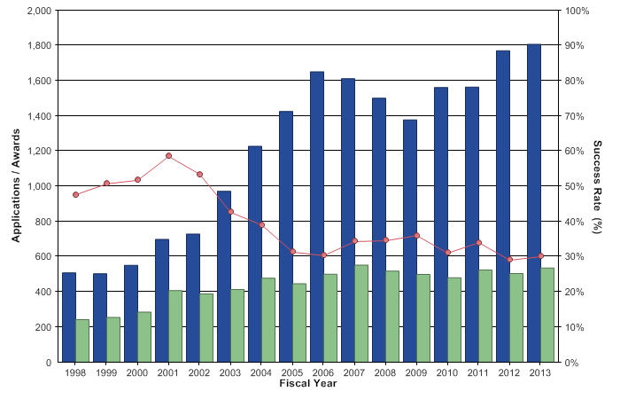
Kirschstein-NRSA pre-doctoral fellowships (F31s) Applications, awards, and success rates

Slide 19
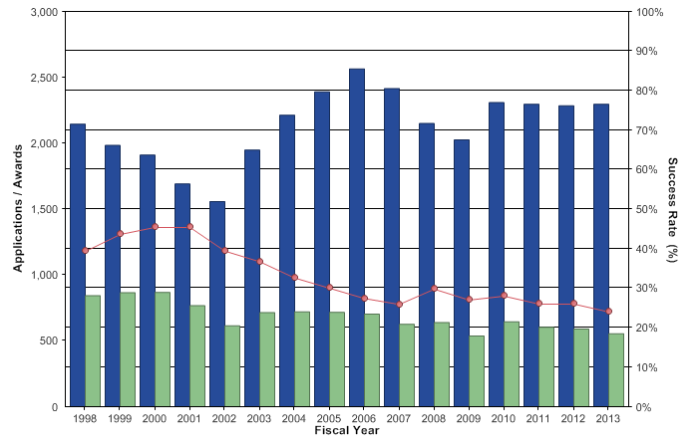
Kirschstein-NRSA post-doctoral fellowships (F32s) Applications, awards, and success rates

Slide 20
Institutional Training Grants
Purpose: To develop and enhance research training through a coordinated programmatic approach
Trainees and fellows are selected by the institution
Training usually provided in defined areas of science

Slide 21
Application
Uses an application package found with the Funding Opportunity Announcement
Submitted Electronically

Slide 22
Application (cont.)
Eligible Institutions = Domestic, non-profit public or private institutions
Research training must fall within the mission of the NIH awarding Institute or Center
Applicant Institutions must have:
Strong research program in the proposed area(s)
Competitive Applicant Pool
Program Director(s) is/are responsible for:
Overall direction of the training program
Selection and appointment of NRSA eligible trainees

Slide 23
Types of Institutional Awards
Full-term 12 month appointments (T32); programs can consist of Predocs, Postdocs, or combination
Short-term appointments (T35); generally 3-6 months’ training for medical students
Prebaccalaureate (T34)
MARC – NIGMS

Slide 24
Review for T’s
Two Levels of Review:
Initial Review - Study Section
Institute or Center Council

Slide 25
Institutional Training Review Criteria
Scored Review Criteria:
Training Program and Environment
Training Program Director/Principal Investigator
Preceptors/Mentors
Trainees
Training record

Slide 26
Institutional Training Additional Review Criteria & Considerations
Additional Review Criteria
Protection for Human Subjects
Inclusion of Women, Minorities, and Children
Vertebrate Animals
Biohazards
Resubmission, Renewal, Revision factors
Additional Review Considerations:
Diversity Recruitment Plan
Training in Responsible Conduct of Research
Select Agent Research
Budget and Period of Support

Slide 27
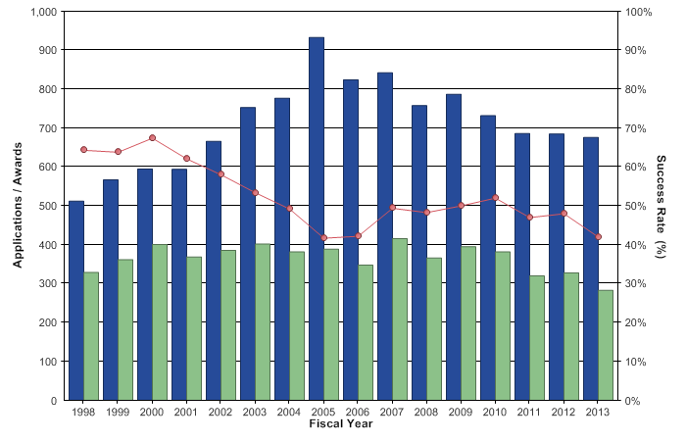
Kirschstein-NRSA institutional research training grant Applications, Awards, & Success rates

Slide 28
Predoctoral T32 and F Recipients’ Outcomes
Within 10 years of their degree*:
*1998-2008

Slide 29
Postdoctoral F32 Recipients’ Outcomes
Within 10 years of completing their fellowship*:
*1998-2008

Slide 30
Administration Issues:
For Both Ts and Fs

Slide 31
Stipends
Subsistence allowance to help defray living expenses during the period of training
Not a salary, not considered employees of either Government or Institution
NIH publishes levels in NIH Guide when increases are approved
Also see: http://grants.nih.gov/training/nrsa.htm
Predoctoral:
One level for all individuals, regardless of years of experience
FY 2014 Level = $22,476

Slide 32
Stipends (cont.)
Postdoctoral:
Dependent on number of years of relevant experience (0 – 7)
For Fs, level set at time of award (not activation)
For Ts, level set at time of appointment
Once set, no change mid-year
Subsequent year based on initial level + 1
Relevant Experience = research, teaching, internship, residency, clinical duties, or other time spend in a health-related field beyond the qualifying degree

Slide 33
Stipends (cont.)
Years of Relevant Experience; FY 2014 Levels*:
0 = $42,000
1 = $43,680
2 = $45,432
3 = $47,244
4 = $49,128
5 = $51,096
6 = $53,148
7 = $55,272
*See Guide Notice at:
http://grants.nih.gov/grants/guide/notice-files/NOT-OD-14-046.html

Slide 34
Stipend Supplementation
Grantees may supplement stipends
Amount determined according to formally established policies applied to all in similar training status
Consistent treatment is key
Non-Federal funds
Without additional effort or obligation to trainee/fellow

Slide 35
Compensation
Trainees/Fellows may receive additional compensation for services associated with employment; e.g., teaching assistant, lab assistant
Individual receives salary; not considered stipend supplementation
Can compensation be from a NIH research grant?
Yes, on a limited part-time basis
May not be same research that is part of training experience
Fellowship Sponsor or Training Grant Program Director must approve
May not interfere with, detract from, or prolong the approved NRSA training

Slide 36
Stipend Taxability
IRS (not NIH) has domain over interpretation & implementation
NRSA Guidelines provide minimal guidance but individuals should consult local IRS offices

Slide 37
Employee Benefits
Stipends are not provided as a condition of employment
At this time, it is inappropriate and unallowable to charge NRSA grants for employee benefits - FICA, workman’s comp, unemployment insurance, life insurance, union dues, even 401K contributions, etc.
Note, such charges may be deducted from stipend if the trainee/fellow requests such a service; however, such deductions cannot be automatic without the trainee/fellow approval

Slide 38
Leave
Vacations & Holidays: Both Predoc and Postdoc Fellows & Trainees may receive same vacations and holidays available to individuals in comparable training positions at the grantee or sponsoring institution. Trainees will continue to receive stipends.
Note, consistent treatment with Institutional policy is key

Slide 39
Leave (cont.)
Sick Leave: May continue to receive stipends for up to 15 calendar days (2 weeks) of sick leave per year
Parental Leave: May receive stipends for up to 60* calendar days (8 weeks) of parental leave per year for the adoption or birth of a child
Leave of Absence: Approval for leave of absence must be requested in advance from awarding component
Fellowship: award will be revised extending termination date by the number of months of leave
Trainee (T32): terminate & reappoint
Stipends may not be reimbursed during leave of absence
*http://grants.nih.gov/grants/guide/notice-files/NOT-OD-08-064.html

Slide 40
Part-time Training
Allowed in unusual and pressing personal circumstances (e.g., medical conditions, disability, child or elder care)
NIH prior approval required
Program Director/Sponsor must submit written request, countersigned by trainee/fellow & authorized institutional official
Must continue to be at least 50%. Less than 50% would require leave-of-absence from NRSA support

Slide 41
Payback Requirements
Predoctoral Trainees and Fellows: None for appointments 6/10/1993 and beyond
Postdoctoral Trainees and Fellows:
Incur obligation in first 12 months of Postdoc NRSA support
The 13th and subsequent months of Postdoc NRSA support can satisfy the Postdoc obligation
Normally, individuals with two years of NRSA postdoctoral support have no further obligation

Slide 42
Acceptable Payback Service
Health-related biomedical, behavioral, and/or clinical research
Health-related teaching
Direct administration or review of health-related research
Any combination of these activities
Definition of health-related has broadened
Range of activities related to the description, diagnosis, prevention or treatment of disease
From the most basic biomedical/behavioral research & teaching to applied clinical research & teaching
Also includes agriculture, environmental sciences, biotechnology & bioengineering

Slide 43
Acceptable Payback (cont.)
Activities must average > 20 hours per week
< 20 hours per week is allowable in cases of disability or other pressing personal circumstances
< 20 hour/week activity will be prorated
Exceptions are rare & require prior NIH approval

Slide 44
Payback Reporting Requirements
Annual Payback Activities Certification (APAC) (PHS Form 6031-1)
Mailed annually on the anniversary of termination of support
Report reflects activities performed during last 12 months
Service must begin within 2 years of termination

Slide 45
Financial Payback
Can be voluntary or involuntary
Amount owed is total stipend received (plus interest when applicable)
Most people pay back with service
Less that 2 percent of all NRSA recipients with obligations (more than 110,000 individuals) have had waivers or have engaged in financial payback

Slide 46
Waiver
Rare & requires NIH Director approval
Permanent or Total Disability
Substantial hardship & against equity
Any remaining obligation is cancelled upon death

Slide 47
Administrative Issues:
Individual Fellowships

Slide 48
Signatures, Assurances, & Certifications
Individual Fellow & Sponsor: No longer separate signatures; are now an institutional responsibility to secure & retain for each application submitted
Human Subjects:
Assurance # & IRB approval date (IRB Approval is Just-In-Time)
Education Requirement
Animal Subjects: Assurance # & IACUC date
IACUC Approval is Just-In-Time

Slide 49
Initiation of Support
Awarding component will notify individual of intention to make an award
The fellowship award will be issued
Fellow must start training within six months of the award issue date
Before the day Fellow begins training, Activation Notice and Payback Agreement (only for Postdoc fellows in first 12 months of NRSA support) must be completed and submitted to awarding component

Slide 50
Award Period
In general (F31, F32), may receive up to 5 years of aggregate NRSA support at the predoctoral level and 3 years of aggregate NRSA support at the postdoctoral level, including any combination from institutional research training grants and individual fellowships
For individual predoctoral MD/PhD or other dual-doctoral degree fellowships (F30), individuals may receive up to 6 years of aggregate NRSA support at the pre-doctoral level, including any combination from institutional research training grants and individual fellowships
Over the total duration of dual degree support, the majority mus be devoted to research training leading to the PhD.

Slide 51
Payment
Domestic, non-Federal sponsoring institutions receive an award for stipends, institutional allowance, and tuition and fees (when applicable)
Domestic institutions directly pay fellow and disburse all other awarded costs
Funds may not be expended until the fellowship is activated
Fellows training at Foreign institutions
Stipend paid directly to Fellow by NIH
Institutional Allowance awarded to Institution

Slide 52
Tuition & Fees
Individual Fellowships (F30, F31, F32, and F33)
Award Category | Predoctoral | Postdoctoral
Tuition/Fees | 60% up to $16,000 60% up to $21,000 for dual degree | 60% up to $4,500 60% up to $16,000 for additional degree
Excludes Health Insurance (awarded as part of Institutional Allowance)
For postdocs, allowable only when required for specific courses in support of research training
Notes:
policy phased in with FY2006 competing awards and beyond
Tuition & fees separately reimbursed when applicable

Slide 53
Institutional Allowance (including Health Insurance)
Award Category | Predoctoral | Postdoctoral
Institutional Allowance | $4,200* $3,100** | $7,850* $6,750**
*Non-profit institutions (Domestic & Foreign) :
Allowance intended to defray such expenses as research supplies, equipment, travel to scientific meetings, health insurance, and other administrative costs.
Family health insurance allowable (if allowed for all in similar status regardless of source of support)
**Federal & For-profit institutions:
Allowance is to cover scientific meeting travel, health insurance, and books.

Slide 54
Reporting Procedures
Activation Notice: (FORM PHS 416-5) Immediately upon initiation of training, fellow completes and returns this form to the NIH awarding component.
Payback Agreement: (FORM PHS 6031): Must be signed by each person who is to receive an individual Postdoctoral fellowship that covers their initial 12 months of NRSA postdoc support. Hard copy with original signature is required.
Termination Notice: (FORM PHS 416-7): For individual fellowships, this form is required upon completion of support. Electronic submission now required through eRA Commons xTrain.
Available in fill-able formats: http://grants.nih.gov/grants/forms.htm

Slide 55
xTrain and Fellowships
Required for all Fellowship Termination Notices submitted on/after 1/1/2011 regardless of actual termination date
Sponsor must hold the “Sponsor Role” in the eRA Commons to process these
If sponsor already has a Commons ID, the institution’s account administrator can assign this new role
Do not create a new Commons ID for this if the Sponsor already has one established
Quick Reference Guide available at: http://era.nih.gov/files/termination_fellowship.pdf

Slide 56
Changes in Project
A transfer of the award to another institution or a change in Sponsor requires the approval of the NIH awarding component. Should consult with NIH awarding component ASAP.
Any proposed change in the individual’s area of research training must be approved by the awarding component.

Slide 57
Progress Reports, FFR
Progress Reports: Progress reports must be submitted using the Research Performance Progress Report in the eRA Commons.
Final Progress Report: For individual awards, a final progress report is required as part of the Termination Notice. A separate final progress report is not required.
Financial Expenditure Reports: A Financial Expenditure Report is not required for individual fellowship awards. However, institutions should be mindful of documenting final cash transaction reports to PMS (SF425).

Slide 58
Administrative Issues:
Institutional Training Grants

Slide 59
Costs: Summary Chart
Award Category | Predoctoral | Postdoctoral
Tuition/Fees | 60% up to $16,000 60% up to $21,000 for dual degree | 60% up to $4,500 60% up to $16,000 for additional degree
Training Related Expenses | $4,200 (includes health insurance) | $7,850 (includes health insurance)
Trainee Travel | $400 - $1,000 (typical range; varies by NIH awarding component)
F&A | Rate = 8 Percent; Base = MTDC less Tuition/Fees and Equipment

Slide 60
Costs: Stipends, Tuition
Stipends at rates previously discussed
Grantees request full amount for tuition & fees
Formula applied to the combined cost of tuition & fees and used for award calculation only
Tuition/Fees per trainee basis: Predoctoral--60% up to $16,000, $21K if dual degree; Postdoctoral--60% up to $4,500; No escalation in future years
Grantees reimburse as needed (not restricted to formula for actual expenses)

Slide 61
Costs: Trainee Travel
Usually per/trainee formula based for award calculation
Varies among IC’s
Scientific meetings OK
Cost of travel from residence to institution (unallowable)
Training experiences away from institution OK but requires IC prior approval

Slide 62
Costs: Training Related Expenses
Formula based: $4,200/Predoc, $7,850/Postdoc
Formula is Per Trainee
Can be used for: Health Insurance, staff salaries, Consultant Costs, Equipment, Research Supplies, Staff travel, and Other Expenses directly related to the training program
Health Insurance OK if applied consistently (Family Health Insurance allowable, Dental & Vision coverage also OK as long as it is consistently applied)

Slide 63
Rebudgeting
No prior approval (unless otherwise restricted) for:
Stipends: Into Tuition & Fees only
Tuition: Into Stipends only
Trainee Travel: any category
TRE: any category
Prior approval required to rebudget stipends and/or tuition into travel or TRE

Slide 64
Period of Support/Appt.
Trainees are considered full-time participants in the training program
9-12 month appointments
Less than 9 months not allowed unless completing a planned training program
Appointment may begin anytime during the budget period

Slide 65
“Overlapping” Appointment
An appointment period may overlap budget periods. For example:
Year 9 | Year 10
7/1/2012 – 6/30/2013 | 7/1/2013 – 6/30/2014
Appointment Period
1/1/2013 – 12/31/2013
Stipend & Tuition $$ (6-months reported as unliquidated obligation)

Slide 66
Statement of Appointment (Form PHS2271)
Due on or before the start of the appointment period
No stipend or other allowance may be paid until submitted
Delinquent submissions (> 30 days) may result in disallowance
Electronic Submission through eRA Commons xTrain now required

Slide 67
Payback Agreement (Form PHS 6031)
Required only for Postdocs, entering their first 12-months of Postdoctoral NRSA support
Fillable form available at: http://grants.nih.gov/grants/forms.htm

Slide 68
Termination Notice (PHS 416-7)
Required at time an appointment is ending
Reflects total period of support & NIH stipend only (do not include any supplementation)
If there was a hiatus of support, report only current period
Do not include support already reported on a prior Term Notice
Electronic Submission through eRA Commons xTrain now required

Slide 69
xTrain—Electronic Submission of 2271s and Termination Notices—Now Required
The feature in the eRA Commons to electronically submit trainee appointments, reappointments, amendments, and Termination Notices
Takes advantage of stored data; minimizes data entry
Allows grantees to also track status and timing of trainee actions
Use now mandated beginning with submissions on/after 1/1/2011. See Guide Notice OD-11-026: http://grants.nih.gov/grants/guide/notice-files/NOT-OD-11-026.html

Slide 70
IRS Form 1099
For tax purposes, stipends paid to trainees may be reported annually using the Form 1099 - Statement of Miscellaneous Income (not a W-2)
Generated by Institutional Business Office

Slide 71
Reporting Requirements
Progress Report:
Due annually
Currently uses the PHS2590 forms/instructions
Will eventually transition to the RPPR
Financial Reporting
Use the Federal Financial Report [FFR]
Quarterly Cash Report in the Payment Management System
Expenditure reporting of FFR required annually to NIH through eRA Commons
Required annually 90 days after end of calendar quarter in which budget period ends
Example: Budget period ends 6/30; Expenditure report of FFR due 9/30
Unliquidated obligations can be used to report any stipends and tuition charges for “overlapping” appointments
Automatic Carryover of an unobligated balance is not generally allowed but awards are footnoted either way

Slide 72
Other Resources
NIH Training Website: http://grants.nih.gov/training/nrsa.htm#policy
T Kiosk (FOAs): http://grants.nih.gov/training/T_Table.htm
F Kiosk (FOAs): http://grants.nih.gov/training/F_files_nrsa.htm
NRSA Chapter in NIH GPS: http://grants.nih.gov/grants/policy/nihgps_2012/nihgps_ch11.htm#_Toc271265032
Fellowship Application Guide:
http://grants.nih.gov/grants/funding/424/index.htm
Training Grant Instructions: See Section 8 of the SF424 (R&R) Application Guide: http://grants.nih.gov/grants/funding/424/index.htm
xTrain Resources: http://era.nih.gov/training_career/index.cfm
Includes User Guide, quick reference sheets, online tutorials, presentations
Resources for Applying Electronically: http://grants.nih.gov/grants/ElectronicReceipt/index.htm
RPPR Information (including Instruction Guide): http://grants.nih.gov/grants/rppr/index.htm

Slide 73
Thank You
Questions?
Henry Khachaturian: hk11b@nih.gov or NIHTrain@mail.nih.gov
Tony Corio: tony.corio@mail.nih.gov or GrantsPolicy@od.nih.gov

