Slide 1
NIH Regional Seminar
Research Involving Human Subjects
Freda E. Yoder
Division of Education and Development
Office for Human Research Protections (OHRP)
Department of Health and Human Services (HHS)
Ann M Hardy, Dr.P.H.
NIH Extramural Human Research Protection Officer
Meredith D. Temple-O’Connor, Ph.D.
NIH Inclusion Policy Officer
Office of Extramural Research (OER)
National Institutes of Health (NIH), HHS
June 26, 2014

Slide 2
Outline
Part I
What is OHRP?
Ethical Principles
HHS Regulations & Applicability
Exempt Research
NIH human subjects policies and procedures
How to complete the Human Subjects Section of your NIH grant application

Slide 3
Outline
Part II
Protections Afforded by the Regulations: Assurances, IRB Review, Informed Consent
Reporting Requirements & Compliance Oversight
NIH Inclusion Policies
Post-award responsibilities
Certificates of Confidentiality
Case studies and Q & A

Slide 4
What is the
Office for Human Research Protections (OHRP)?
Provides leadership in protection of rights, welfare, and wellbeing of subjects involved in research conducted or supported by US Department of Health and Human Services
Provides clarification and guidance
Develops educational programs and materials
Maintains regulatory oversight
Provides advice on ethical and regulatory issues pertaining to biomedical and behavioral research
Notes:
4

Slide 5
Current Organizational Structure - OHRP
Secretary, HHS
Other HHS Entities (FDA, NIH, CDC, etc)
Assistant Secretary for Health
OHRP, Office of the Director
Jerry Menikoff, Director
International Activities
Secretary’s Advisory Committee on Human Research Protections (SACHRP)
Division of
Compliance
Oversight
Division of
Policy and
Assurances
Division of
Education and
Development
Notes:
5
5

Slide 6
Protecting Human Subjects is a
Shared Responsibility
Institution
IRB
Investigator
Subjects
Research Team
Sponsor
Advocates
Family
Government
Public
Notes:
Alt text: the subjects are the focus

Slide 7

Ethical Principles
Nuremburg Code
Declaration of Helsinki
The Belmont Report
Notes:
7
Alt text: ethical principles

Slide 8
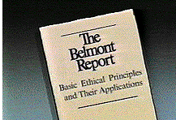
The Belmont Report
Ethical Principles and Guidelines for the Protection of Human Subjects of Research
The National Commission for the Protection of Human Subjects of Biomedical and Behavioral Research- April 18, 1979
Notes:
8
Alt Text: The Belmont Report laid out the ethical principles that undergird the regulations for protecting human subjects

Slide 9

The Belmont Report
Three Basic Principles:
Respect for Persons
Beneficence
Justice
Notes:
Alt text: balance among the three ethical principles of the Belmont Report

Slide 10
Common Rule Department & Agencies
Department of
Agriculture
7 CFR 1c
Department
of Commerce
15 CFR 27
Department of Defense
32 CFR 219
Department of
Veterans Affairs
38 CFR 16
Department of Education
34 CFR 97
Department of Energy
10 CFR 745
Department of Housing
& Urban Development
24 CFR 60
Federal Policy for
the Protection of
Human Subjects
(Common Rule
45 CFR 46,
Subpart A)
Central
Intelligence
Agency
Department of Health
& Human Services
45 CFR 46, subpart A
Plus subparts B, C, D
Department of
Transportation
49 CFR 11
Department
of Homeland
Security
Food & Drug
Administration
Social Security
Administration
Department of
Justice 28 CFR 46
Corporation for National and Community Services - pending
National Aeronautics
& Space Administration
14 CFR 1230
Consumer Product
Safety Commission
16 CFR 1028
National Science
Foundation
45 CFR 690
Agency for
International
Development
22 CFR 225
Environmental
Protection Agency
40 CFR 26
Notes:
Alt Text: Chart showing 18 Departments and Agencies that have adopted the Common Rule, also known as the Federal Policy for protecting human subjects of research. Three have adopted 45 CFR part 46 and all of its subparts.

Slide 11

Additional HHS Protections
Subpart B - Pregnant Women, Human Fetuses, and Neonates
Subpart C - Prisoners
Subpart D - Children
Subpart E - IRB Registration
Notes:
11
Alt Text: an image of a pregnant, possibly incarcerated, teen

Slide 12

Other ‘Oversight’ Entities…
.
  IRB- 21 CFR 56
  Informed Consent- 21 CFR 50
Other Dept/Agencies
State and Local Laws
Funding entities
Institutional Policies
Notes:
12
Kevin L. Nellis, MS, MT(ASCP)
February 8, 2008
12

Slide 13
HHS vs. FDA Regulations
Basic requirements for IRBs and for informed consent are congruent
Differences in applicability
  HHS regulations based on HHS conducting or supporting research
  FDA regulations based on use of FDA regulated product: drugs, devices, or biologics
Detailed differences at FDA Website

Slide 14
  Applicability of HHS Regulations
Notes:
14

Slide 15
The Regulations Apply When:
Research involving human subjects conducted or supported by HHS that is not otherwise exempt
-OR-
Non-exempt human subject research covered by Assurance of Compliance
Notes:
15
Kevin L. Nellis, MS, MT(ASCP)
February 8, 2008
15
Alt Text: the image represents money support as a way to trigger applicability of the regulations
Alt Text: the box with a check mark represents an institution voluntarily applying the regulation to all research regardless of the source of support

Slide 16

Do the Regulations Apply?
Does activity involve Research?
Does research involve Human Subjects?
Is human subjects research Exempt?
ASK QUESTIONS IN THIS ORDER!
See Human Subject Regulations Decision Charts
Notes:
16
Kevin L. Nellis, MS, MT(ASCP)
February 8, 2008
16
Alt Text: image of a book depicting government regulations

Slide 17
Does the Activity Involve Research?
Research – a systematic investigation designed to develop or contribute to generalizeable knowledge
  includes research development, testing, evaluation, pilot studies
Notes:
Alt Text: image of a microscope depicting an instrument used in research

Slide 18
Does the Research Involve
Human Subjects?
Human subject – a living individual about whom an investigator conducting research obtains
  data through intervention or interaction with the individual, or
  identifiable private information*
  * Identity of the subject is or may readily be ascertained by the investigator or associated with the information
Notes:
18

Slide 19
Is the Human Subject Research Exempt?
Categories of Exempt Research*
1. Normal educational practices in established educational settings
2. Educational tests, surveys, interviews, or observation of public behavior -unless identified & sensitive**
3. Research on elected or appointed public officials or candidates for public office
* Exception for prisoners
** Exception for children
4. Research using existing data, if publicly available or recorded without identifiers
5. Evaluation of public benefit service programs
6. Taste and food quality evaluation and consumer acceptance studies
46.101(b)(1-6)
Notes:
19

Slide 20
NIH POLICIES AND GRANT APPLICATION INSTRUCTIONS FOR HUMAN SUBJECTS RESEARCH
Ann Hardy, Dr.P.H.
NIH Extramural Human Research Protection Officer
NIH Office of Extramural Research (OER)

Slide 21
Sponsoring Agency Responsibilities
45 CFR 46 requires that Agencies evaluate all applications and proposals involving human subjects for
    Risks to human subjects
    Adequacy of protections
    Benefits
    Importance of knowledge to be gained
21
21
Notes:
21
21
The Department or Agency head will evaluate all applications and proposals involving human subjects submitted to the Department or Agency through such officers and employees of the Department or Agency and such experts and consultants as the Department or Agency head determines to be appropriate. This evaluation will take into consideration the risks to the subjects, the adequacy of protection against these risks, the potential benefits of the research to the subjects and others, and the importance of the knowledge gained or to be gained.
(b) On the basis of this evaluation, the Department or Agency head may approve or disapprove the application or proposal, or enter into negotiations to develop an approvable one.
Federal funds administered by a Department or Agency may not be expended for research involving human subjects unless the requirements of this policy have been satisfied.

Slide 22
Sponsoring Agency Responsibilities
On the basis of this evaluation [NIH] may approve or disapprove the application … or enter into negotiations to develop an approvable one (45 CFR 46.120).
  Human Subjects evaluation can affect grant application score
Federal funds… may not be expended for research involving human subjects unless the requirements of this policy have been satisfied (45 CFR 46.122)
  Grant cannot be funded if there are human subjects problems
22
22

Slide 23

Human Subjects Section of
Grant Application
Risks to Human Subjects
  Human subjects involvement and characteristics
    Characteristics
    Inclusion / exclusion
    Rational for vulnerable populations
  Sources of materials
    What materials/info
    How collected
    Who has access
  Potential Risks
    Physical, psychological, financial,
    legal or other risks
    Alternative treatments/procedures
23
Notes:
Alternate text: Graphic illustrates a person walking on a high wire.

Slide 24

Human Subjects Section (con’t)
Adequacy of Protection Against Risks
  Recruitment
  Informed consent/assent
  Protections against risk
    Procedures to minimize risk and protect confidentiality
    Additional protections for vulnerable subjects
    Ensure necessary medical/professional intervention
    Data and safety monitoring
24
24
Notes:
Alternate text: The picture illustrated folders with a padlock over them.

Slide 25
Human Subjects Section (con’t)
Potential Benefits of Research to Human Subjects and Others
  May not be direct benefit
  Compensation is not a benefit
  Discuss risks in relation to anticipated benefits
Importance of Knowledge to be Gained
  Discuss in relation to risks
25
25

Slide 26
Additional NIH Requirements
Justification if NO human subjects but are using human specimens and/or data
For Clinical Trials:
  Data and Safety Monitoring Plan or Board
  Registration in ClinicalTrials.gov as appropriate
For NIH-Defined Clinical Research
  Inclusion of Women, Minorities, and Children
  Inclusion Enrollment Reports
26
26

Slide 27
NOT Required for Application
After peer review, for grants likely to be funded, NIH requests (just-in-time):
  OHRP Assurance Number
  Certification of IRB review and approval
  Certification that Key Personnel have completed appropriate human subjects research education
27
27

Slide 28
Preparing the Human Subjects Section
Use SF 424 Instructions
Select one of 6 scenarios:
  A. No Human Subjects
    B. Non-Exempt Human Subjects Research
    C. Exempt Human Subjects Research
    D. Delayed-Onset of Human Subjects Research
    E. Clinical Trial
    F. NIH-defined Phase III Clinical Trial
28
28

Slide 29
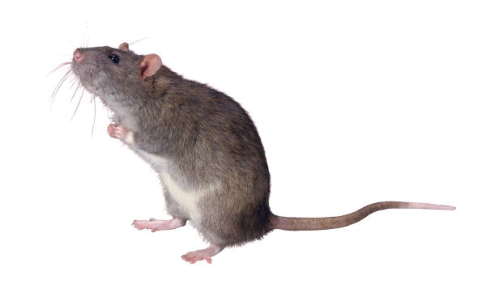
Scenario A: No Human Subjects
Are Human Subjects Involved? Yes X No
PHS 398
Heading “Protection of Human Subjects”
“No Human Subjects research is proposed in this application”
SF 424 Human Subjects
No Human Subjects section is required
Provide justification if using human specimens/data
29
29
Notes:
Alternate text: The figure is a mouse sitting on the part of the slide that indicates “no human subjects.”
29

Slide 30
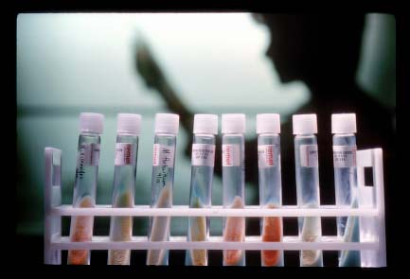
Research Involving Coded Data or Specimens
OHRP Policy Guidance 2004, 2008
If research involves only secondary analysis of coded data/specimens it is NOT human subjects research if:
  Collected for other reason
  None of investigators can readily ascertain the identity of subjects (Provider has no other role in research and does not release key)
Notes:
Alternate text: A picture of a set of test tubes in a rack with the shadow of a scientist behind it.

Slide 31

Scenario B: Non-Exempt Research
Are Human Subjects Involved? X_ Yes ___ No
Research Exempt? ___ Yes _X_ No
Clinical Trial? ___ Yes _X_ No
NIH-Defined Phase III CT? ___ Yes _X_ No
Human Subjects Section- no page limitations
  Address 4 required points (risk, protections, benefits, knowledge)
Inclusion of Women and Minorities
  Inclusion Enrollment Reports
Inclusion of Children
31
31

Slide 32
Scenario C: Exempt Research
Are Human Subjects Involved? X Yes No
Research Exempt X Yes No
Exemption Number _X_1 __2 __3 __4 __5 __6
Clinical Trial? ___Yes _X_ No
NIH-Defined Phase III CT? ___Yes _X_ No
Human Subjects Section
  Justify selection of exemption(s)
  Sources of research materials
Inclusion of Women and Minorities*
  Inclusion Enrollment Reports*
Inclusion of Children*
  *Not required for Exemption 4
32
32

Slide 33
Scenario D: Delayed Onset HS Research
Are Human Subjects Involved? _X__ Yes ___No
Research Exempt? ___ Yes ___ No
Clinical Trial? ___ Yes ___ No
NIH-Defined Phase III CT ? ___ Yes ___No
Delayed Onset: Human subjects research anticipated but specific plans can’t be described in the application (45 CFR 46.118)
Human Subjects Section – explain why delayed onset
If funded, awardee must provide human subjects protections and inclusion sections to NIH for prior approval and have FW and IRB approval before involving human subjects
33
33

Slide 34
Scenarios E & F: Clinical Trial
Definition of Clinical Trial: Prospective research study designed to answer questions about efficacy of biomedical or behavioral interventions
NIH Defined Phase III Trial - broad-based, prospective trial, often to provide scientific basis for change in health policy or standard of care (Scenario F)
All other Phases (Scenario E)
34
34

Slide 35
Scenario E: Clinical Trial (not Phase III)
Are Human Subjects Involved? _X_ Yes ___ No
Research Exempt? ___ Yes _X_ No
Clinical Trial? _X_ Yes ___ No
NIH-Defined Phase III CT? ___ Yes _X_ No
Provide information required for Scenario B (Non-Exempt Human Subjects Research)
Must have a Data and Safety Monitoring Plan
ClinicalTrials.gov
35
35

Slide 36
Data and Safety Monitoring Plan
Data and Safety Monitoring Plan includes:
Overall framework for data and safety monitoring
Responsible party for monitoring
Procedures for reporting Adverse Events/Unanticipated Problems
Data and Safety Monitoring Board (DSMB) required for multi-site trials > minimum risk and generally for Phase III trials
IRB and funding IC approval before enrollment begins
36
36

Slide 37
Scenario F: NIH-def. Phase III
Clinical Trial
Are Human Subjects Involved? _X_ Yes ___ No
Research Exempt? ___ Yes _X_ No
Clinical Trial? _X_ Yes ___ No
NIH-Defined Phase III CT? _X__ Yes ___ No
Provide information required for Scenario E
Generally requires DSMB
Additional inclusion policy requirements
need to be addressed related to study
design (e.g., “valid analysis”)
37
Notes:
37
37
Clinical trials are used to determine whether new biomedical or behavioral interventions are safe, efficacious, and effective.
Behavioral human subjects research involving an intervention to modify behavior

Slide 38
CASE STUDIES
Q & A

Slide 39
Am I Doing Human Subjects Research?

Slide 40
Applying the Regulations:
Case Study 1
An application describes the following proposed research activities:
  The investigator receives autopsy specimens from a pathologist.
  The investigator also collects identifiable private information about the individuals from medical records.
  You Decide…
  Is this Human Subjects Research?
40

Slide 41
Case Study 1 (con’t)
No, this is not Human Subjects Research
Research involving only specimens and data from deceased individuals is not human subjects research
41

Slide 42
Case Study 2
An application describes the following proposed research activities:
  Investigator receives coded data from another researcher’s ongoing clinical trial (provider)
  Provider has access to patient identifiers
  Investigator will perform analyses on the coded data
  The Provider will provide clinical expertise to guide analyses, help interpret the results and will be co-author on research publications
  You Decide…
  Is this Human Subjects Research?
42

Slide 43
Case Study 2 (con’t)
Yes, this is Human Subjects Research
Provider has access to identifiers and is considered an investigator on this project because he/she is doing more than providing data/specimens.
43

Slide 44
Case Study 3
  Study will test efficacy of on-line system that provides tailored diet and exercise information to reduce weight and blood pressure compared with standard medical advice about diet and exercise in overweight adult subjects.
  Is a Data and Safety Monitoring Plan required?

Slide 45
Case Study 3 (con’t)
Yes, this study is considered a clinical trial and a DSMP is required

Slide 46
Case Study 4
  Study involves pregnant women in prison
  Which parts of 45 CFR 46 are applicable?
    Subpart A
    Subpart B and C
    Subparts A, B, and C

Slide 47
Case Study 4(con’t)
Subparts A, B, and C would apply

Slide 48
End of Part I
Questions?

Slide 49
Part II Outline
Protections Afforded by the Regulations: Assurances, IRB Review, Informed Consent
Reporting Requirements & Compliance Oversight
NIH Inclusion Policies
Post-award responsibilities
Certificates of Confidentiality
Case studies and Q & A

Slide 50
Regulatory Protections for
Research Subjects
Freda Yoder
  Division of Education and Development
  Office for Human Research Protections (OHRP)

Slide 51
Basic Protections
A
Federalwide Assurance
Institutional Review Board
Informed Consent
B
C

Slide 52
Institutional Assurance
A
Required when engaged in non-exempt human subject research
Documentation of institution’s commitment to comply with applicable regulations - §46.103(b) & (f)
Principal method of compliance oversight
Federalwide Assurance (FWA) - only option
Designate only registered IRB(s)
Notes:
52

Slide 53

IRB Review and Oversight
B
Institutional Review Board (IRB):
A committee charged with the review of human subject research to ensure that the rights and welfare of research subjects are adequately protected.
Regulations detail IRB membership requirements - §46.107
Notes:
Alt Text: Picture depicting an IRB meeting with members seated around a table

Slide 54

Membership Requirements
Number of Members
  minimum of 5 members - §46.107(a)
Experience and Expertise - §46.107(a)
Diversity of Members - §46.107(a) & (b)
At least one:
  scientist - §46.107(c)
  nonscientist - §46.107(c)
  nonaffiliated - §46.107(d)
Prisoner Representative - §46.304(b)
Notes:
54
Alt text: Photo depicting IRB meeting with members seated around a table

Slide 55
Flexibility & Efficiency
Expert Consultant - §46.107(f)
  provides supplement review
  does not vote
Alternate members
  appropriate expertise
  substitute for entire meeting or any portion of meeting
Notes:
55

Slide 56

IRB Member Conflict of Interest - §46.107(e)
May provide information requested by the IRB
Recusal from IRB’s deliberations and voting
Conflicted members do not contribute to the quorum
Notes:
Alt Text: Photo depicting IRB members who have a conflict of interest who are not allowed to vote

Slide 57
Types of IRB Review
Convened meeting of IRB – §46.109
Expedited review – §46.110
  minor changes to approved research
  no greater than minimal risk and on “list” at: http://www.hhs.gov/ohrp/policy/expedited98.html
Notes:
57

Slide 58
IRB Review
Initial – prior to enrolling subjects
Continuing review – at least annually
Prior to initiating changes to approved research
Sufficient information to make required findings at §46.111 and any relevant subpart(s)
Notes:
58

Slide 59
Criteria for IRB Approval
Findings under §46.111
Risks minimized
Risk/benefit ratio reasonable
Subject selection equitable
Informed consent – obtained & documented (unless waived)
Notes:
59

Slide 60
Criteria for IRB Approval, cont’d
Findings under §46.111
Data monitored
Privacy and confidentiality
Safeguards for vulnerable subjects
Notes:
60

Slide 61
Additional Findings under
Applicable Subparts
Categories of permissible research
Informed consent, assent, permission
Other considerations
-- e.g., IRB composition, Secretarial panel process, expert consultants

Slide 62
Informed Consent
C
Key principles of the informed consent process:
Full disclosure of the nature of the research and the subject's participation
Adequate comprehension on the part of the potential subjects or legally authorized representative (LAR)
The subject's voluntary choice to participate or not
Notes:
62

Slide 63
Basic Elements of Informed Consent
Research
  - purpose
  - duration
  - procedures
Risks, discomforts
Benefits
Alternatives
Confidentiality
Compensation for injury
Whom to contact
Right to refuse, or withdraw without penalty §46.116(a)
Note: Additional elements, when appropriate
§46.116(b)
Notes:
63

Slide 64

The Consent Process
Informed consent is not a single event or just a form to be signed -- rather, it is an on-going process that takes place between the investigator and the prospective subject.
Notes:
64
Alt Text: Photo depicting an investigator seeking consent from a potential subject

Slide 65
When is Informed Consent Not Required?
Provisions for waiver or alteration
  consistent with §46.116(c) or (d)
  waiver of child assent & parental permission - §46.408 (subpart D)
  Secretarial waiver §46.101(i) – e.g., research conducted in emergency setting

Slide 66
Reporting Requirements & Compliance Oversight Procedures

Slide 67
Reporting Requirement - §46.103(b)(5)
Unanticipated problems involving risks to subjects or others
  Unanticipated problems vs. adverse events
  Guidance available at: http://www.hhs.gov/ohrp/policy/AdvEvntGuid.htm
Suspension of termination of IRB approval
Serious or continuing non-compliance

Slide 68
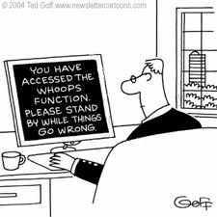
What is an Unanticipated Problem?
Notes:
Alt Text: Cartoon of person at a computer when a message pops up on the screen indicating "You have accessed the ‘whoops’ function. Please stand by while things go wrong."

Slide 69
What is an Unanticipated Problem?
Incident, experience, or outcome that is:
Unexpected (nature, severity, frequency)
Related or possibly related to research, AND
Suggests greater risk of harm than previously known or recognized

Slide 70
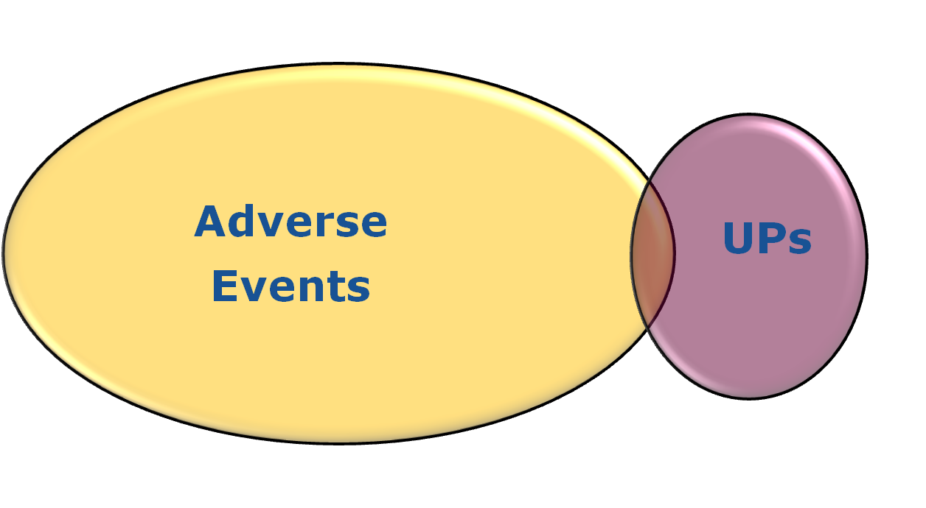
Most Adverse Events are not
Unanticipated Problems
Do Not Report AE that are not UP to OHRP
Report all UP
Notes:
Alt Text: Venn diagram demonstrating that a small number of adverse events are also unanticipated problems - only those that are unanticipated problems must be reported to OHRP
Kevin L. Nellis, MS, MT(ASCP)
4/28/2014February 8, 2008
70

Slide 71
AE? UP? Report to OHRP?
Clinical trial enrolls subjects with GERD
Tests new drug to block acid release in stomach
Subject develops acute renal failure
Acute renal failure was not an anticipated risk described in study documents or informed consent
This is an AE that also represents an UP…
MUST REPORT!
Notes:
Kevin L. Nellis, MS, MT(ASCP)
4/28/2014February 8, 2008
71

Slide 72
AE? UP? Report to OHRP?
Subject enrolls in a phase III oncology clinical trial
Subject develops neutropenia, sepsis, multi-organ failure and dies
Anticipated events were described in Investigator’s Brochure and informed consent documents
This is an AE that does not represent an UP…
Do not report to OHRP
Notes:
Kevin L. Nellis, MS, MT(ASCP)
4/28/2014February 8, 2008
72

Slide 73
AE? UP? Report to OHRP?
Investigator conducts research on sexual behaviors & drug use
Collects and stores sensitive data on laptop
Data are not encrypted
Laptop is stolen
This is an UP, but it does not involve AE …
Report to OHRP!
Notes:
Kevin L. Nellis, MS, MT(ASCP)
4/28/2014February 8, 2008
73

Slide 74

Compliance Oversight
Notes:
74
Alt Text: Cartoon of man looking at eye chart and asked if what he sees is right or wrong

Slide 75

Compliance Oversight Jurisdiction
45 CFR 46.103(e)
OHRP approved Assurance
Notes:
75
Alt Text: image of gavel to indicate jurisdiction/oversight

Slide 76
Compliance Oversight Procedures
Written complaint/allegation
Jurisdiction determination
OHRP initiates inquiry – asks institution to investigate & provide report
OHRP receives written report, and evaluates report and other relevant documents
Additional correspondence/telephone interviews/site visit
Issue final determination
Procedures on our website

Slide 77
Possible Determinations/Outcomes
In compliance
  no recommendations
  recommend improvements
Noncompliance
  need corrective actions
  FWA restricted or withdrawn, pending corrective actions
  recommend additional actions by HHS
  recommend debarment - 45 CFR part 76

Slide 78
What Can Happen?
Restriction
Suspension
Termination
of FWA
Institution/IO Held Responsible
Notes:
Alt Text: dollar sign with an X over it - indicating that no funding when the actions noted on slide are taken by OHRP

Slide 79
Key Points
OHRP is available to help
Belmont Report
How and when the HHS regulations apply
Basic protections afforded by HHS regulations
How OHRP conducts compliance activities

Slide 80
OHRP Resources & Contact Information
OHRP website: http://www.hhs.gov/ohrp
Recent Announcements: http://www.hhs.gov/ohrp/newsroom/index.html
OHRP e-mail: ohrp@hhs.gov
OHRP telephone: 866-447-4777, 240-453-6900
Join the OHRP ListServ! http://www.hhs.gov/ohrp/newsroom/index.html
Notes:
80

Slide 81
NIH POLICIES AND AWARDEE RESPONSIBILITIES
Meredith Temple-O’Connor, Ph.D.
NIH Inclusion Policy Officer
Ann Hardy, Dr.P.H.
NIH Extramural Human Research Protection Officer
NIH Office of Extramural Research (OER)

Slide 82
NIH Inclusion Policies
Inclusion of Women and Minorities
  Must be included in NIH-defined clinical research unless exclusion is justified for scientific reasons
  Justify the proposed sample in the context of who is at risk for the disease/condition and the scientific goals of the specific study
  Plans for Outreach and Recruitment
  Proposed Composition of Study Population Using Inclusion Enrollment Report form(s)
82
Notes:
82

Slide 83
Enrollment Report Forms
Inclusion Enrollment Report Forms
  Now a structured data form in Forms C
  Need to consider race and ethnicity separately
  Which form to use? Planned or Cumulative?
Separate report forms for US and International participants (even if part of the same study)
83

Slide 84
NIH Inclusion Policies (con’t)
Inclusion of Children
  Children must be included in clinical research unless there are scientific or ethical reasons not to do so
  “Children” are defined by the NIH as individuals <21 years
  Applicants should justify the proposed age range with specific attention to individuals under 21
84

Slide 85

Protection of Children Against Research Risks
Subpart D of HHS regulations defines “Children”
  Less than legal age of consent for treatment/procedures involved in the research;
  According to local law where research will be conducted
85
Notes:
Alternate text: This graphic depicts a health care professional (a woman) with an otoscope looking in the ear of a child.

Slide 86


Peer Review of Human Research Protections and Inclusion
Each reviewer will assess human subjects protections and inclusion
  Actual or potential unacceptable risks, or inadequate protections, or insufficient information, or inclusion not justified in context of science
Peer review group will determine overall rating of “acceptable” or “unacceptable”
Summary Statement:
    PROTECTION OF HUMAN SUBJECTS/INCLUSION: UNACCEPTABLE (Code 44/W,M,C U codes)
    Code 44 and Inclusion “U” codes are bar to award
86
Notes:
86
Alternate text: The picture depicts a stack of dollars and a stack of gold coins with a red “X” through them.

Slide 87
Common HS Concerns Identified in Peer Review
Source of specimens/data unclear OR inadequate justification for no human subjects research
Risks not described; physical, psychological, financial, reputation
Missing/inadequate DSMP
Confidentiality of data
Additional protections for vulnerable populations missing
Incidental findings not addressed
Notes:
In order from most to least common in FY2002

Slide 88
Common Inclusion Concerns Identified in Peer Review
Inadequate information describing the sex/gender, race, and ethnicity of the sample
  Missing enrollment reports
Inadequate justification for proposed sample
  Sex/gender, race, and/or ethnicity breakdown not appropriate for the scientific goals of the study
  Inadequate description of age range and inclusion/exclusion of children (or subsets of children)
Notes:
In order from most to least common in FY2002

Slide 89
Just-in-Time Requirements
After peer review, for grants likely to be funded, NIH requests (just-in-time):
  OHRP Assurance Number
  Certification of IRB review and approval
  Certification that Key Personnel have completed appropriate human subjects research education
  Resolution of unacceptable HS or inclusion
89
Notes:
Alternate text: The graphic on this page is a clock with a smiley face and feet.

Slide 90
Resolving Unacceptable Applications
Human Subjects: Work with Program Official
  Written resolution
  IC approval
  NIH Office of Extramural Programs (OER) concurrence
Inclusion: Work with Program Official
  Written resolution
  IC approval
90

Slide 91
After the Award…
Now What?
Human Research Protections :
  Annual IRB approval
  UP/AE Reports – within 3 days or as required
Inclusion:
  Annual Cumulative Inclusion Enrollment reports
  For NIH-defined Phase III CT – report any analysis or findings related to outcomes by sex/gender, race, and ethnicity
91
Notes:
Alternate text: The graphics at the top of this slide are dollar bills with a $ and smiley face and feet.

Slide 92
After the Award…
Now What?
2012 Policy – Prior NIH Approval for changes in human subjects research that increase risk
  Changes the project from no to yes for human subjects involvement or from no to yes for clinical trial
  New enrollment of vulnerable subjects covered by subparts B, C, D
  Any change that is greater than minimal risk
  New info indicating greater risk for study procedure or intervention
Discuss plans with NIH PO before starting!
92
Notes:
Alternate text: The graphics at the top of this slide are dollar bills with a $ and smiley face and feet.

Slide 93
Certificates of Confidentiality (CoC)
Purpose:
  to encourage participation
  protects investigators/institutions from compelled release of info that could identify research subjects
For IRB approved studies that collect personal identifiers and sensitive info
DHHS Agencies that issue: CDC, IHS, SAMHSA, HRSA, FDA, and NIH
NIH funding not required but research must be health related
Notes:
Alternate text: This graphic illustrates a shadow of a man’s head with a lock over it.

Slide 94
Limitations of CoCs
Does not prevent voluntary disclosure by researchers or subject
Cannot be used to refuse to provide data to subject or to others that subject has requested in writing
Researchers are expected to voluntarily report harm to self/others and communicable diseases
Can protect data from foreign subjects only if maintained in US, from US legal system demand

Slide 95
CoC Administration
CoCs issued by individual NIH Institutes/Centers (IC)
Some ICs use an on-line application process
CoC Kiosk on Web – FAQs, IC contacts, application instructions:
http://grants.nih.gov/grants/policy/coc/

Slide 96
Re-Engineering Inclusion at NIH
Update on changes related to NIH Policy on the Inclusion of Women and Minorities in Clinical Research

Slide 97

Updates on Inclusion Re-Engineering:
Investigator Perspective
Enhanced electronic integration
  New NIH inclusion data system
  Structured data forms for investigators
  Investigator access to their inclusion data via Commons
  Changes in layout of the planned and actual enrollment forms
Clarifying expectations for different stakeholder groups (e.g., investigators, peer reviewers, staff in different roles, etc.)
  FAQs and other resources to provide guidance
    http://grants.nih.gov/grants/funding/women_min/women_min.htm
  Updated reviewer guidelines and critique templates
    http://grants.nih.gov/grants/peer/peer.htm
Notes:
Alternate text: This figure depicts a graphic of a “screen bean” person looking at the words through a long distance scope.

Slide 98
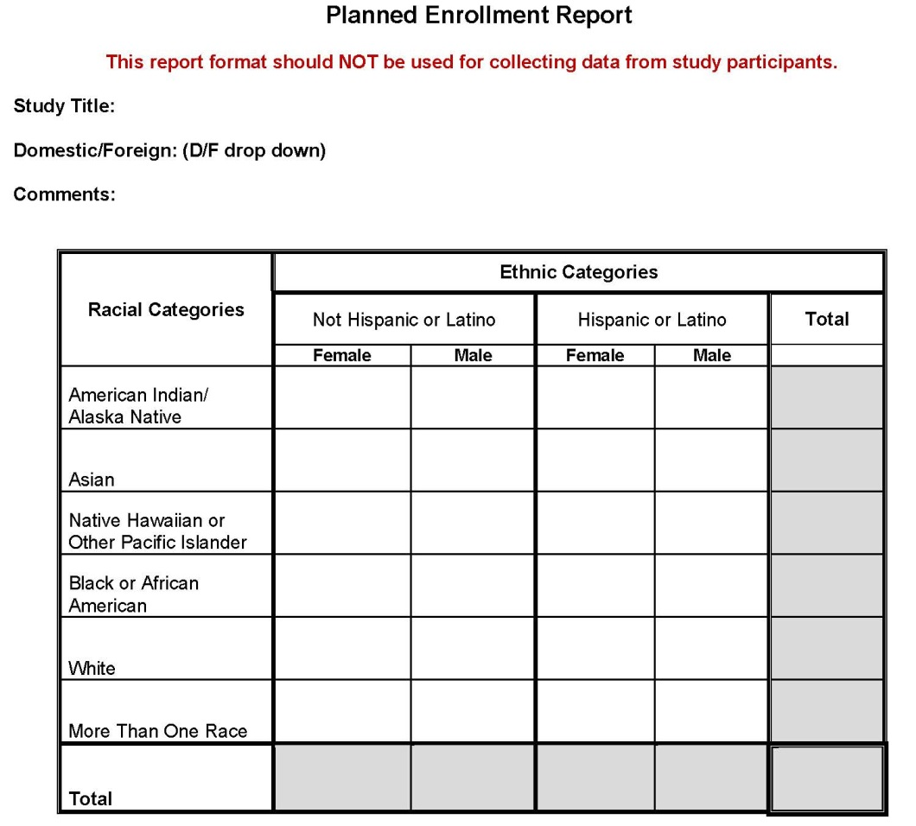
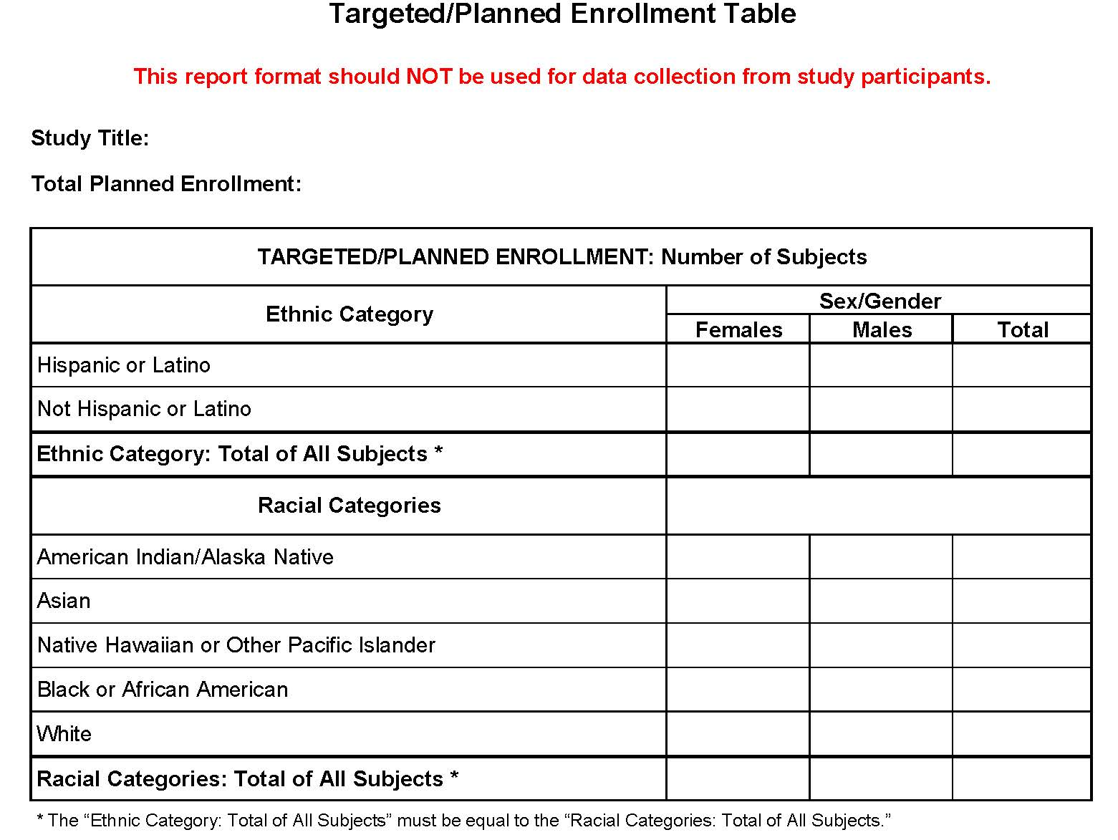
Planned Enrollment Report
Modified to:
  Add “More than One Race” category
  Make foreign/domestic a structured field
  Simplify layout
Notes:
Alternate text: This slide illustrates the current Targeted/Planned Enrollment Table which includes separate sections for ethnicity (Hispanic/Latino or Not Hispanic/Latino) and race (American Indian/Alaska Native, Asian, Native Hawaiian or Other Pacific Islander, Black or African American, and White). Both sections are broken out into male and female columns. The NIH is transitioning to an updated inclusion reporting format entitled the Planned Enrollment Report. It will include an additional racial category of More Than One Race and race and ethnicity will be integrated into one table rather than separate sections. This simpler approach will make it clear that participants in a clinical research study need to be accounted for in terms of sex/gender, race, and ethnicity. Also, on the new Planned Enrollment Report format, there will be fields for the Study Title, a drop down box to indicate whether the study involves US or international participants (labeled as foreign or domestic), and a comments box for investigators to use to communicate any additional information.

Slide 99
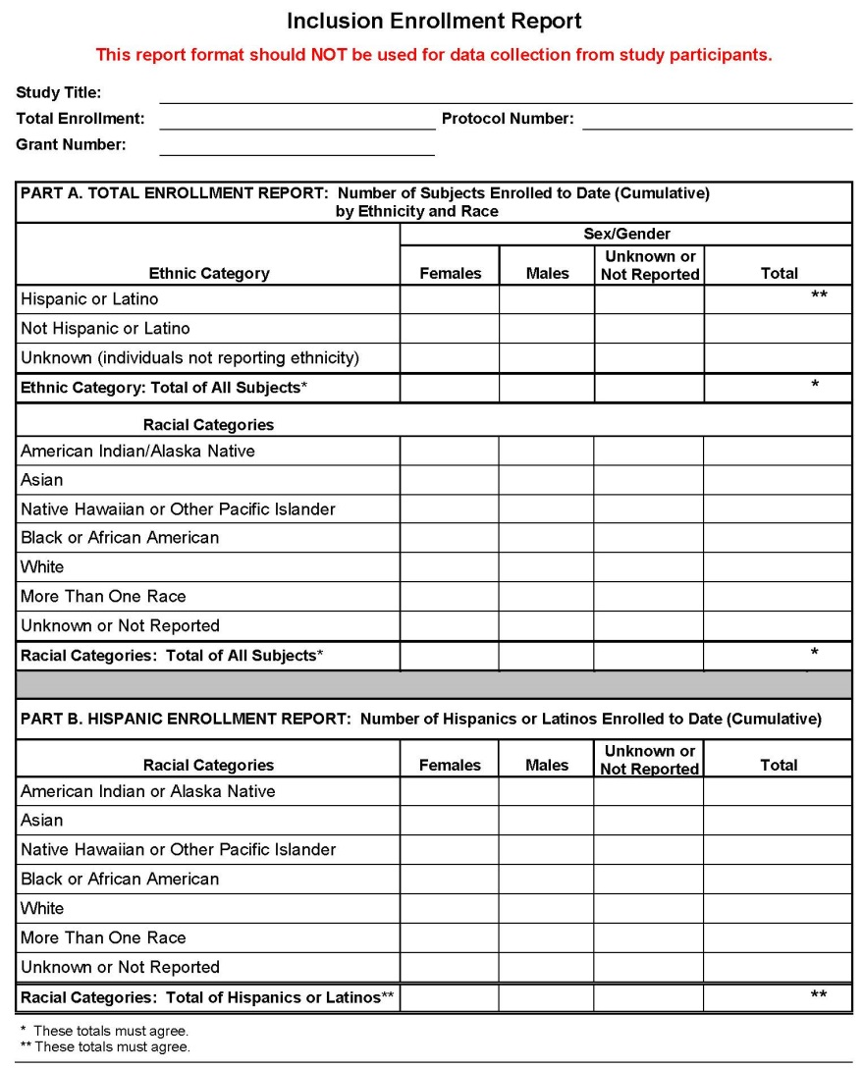
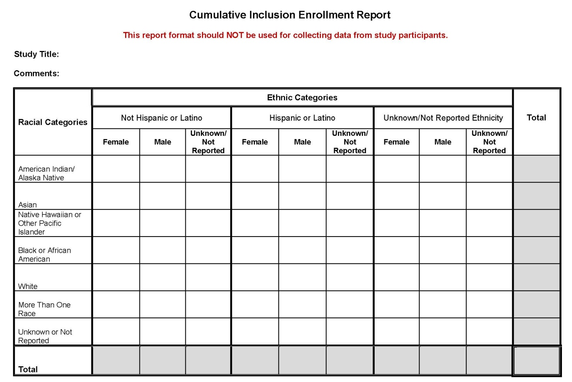
Cumulative Inclusion Enrollment Report
Modified to:
  Simplify the layout
  Align with the Planned Enrollment Report form
Notes:
Alternate text: This slide illustrates the current Inclusion Enrollment Report which is used for reporting actual recruitment. This format includes separate sections for ethnicity (Hispanic/Latino or Not Hispanic/Latino) and race (American Indian/Alaska Native, Asian, Native Hawaiian or Other Pacific Islander, Black or African American, and White) as well as a section specific to the race of the Hispanic/Latino participants. Both sections are broken out into male and female columns as well as unknown/not reported columns for sex/gender, race, and ethnicity. The NIH is transitioning to an updated inclusion reporting format entitled the Cumulative Inclusion Enrollment Report. On this form, sex/gender, race, and ethnicity will be integrated into one table rather than separate sections. This simplified layout should make it clear that participants in a clinical research study need to be accounted for in terms of sex/gender, race, and ethnicity. Also, on the new Planned Enrollment Report format, there will be fields for the Study Title and a comments box for investigators to use to communicate any additional information.

Slide 100

Transition Plans:
When to Use Which Form?
Competing applications
  Modified forms for receipt dates on/after September 25, 2013
Progress reports/RPPR
  Use previous form through FY2014
  Transition to modified forms starting with FY2015 progress reports
  More guidance will come as we approach transition and IMS deployment
  For more information, see:
  http://grants.nih.gov/grants/funding/women_min/women_min.htm
Notes:
Alternate text: The illustration depicts a hand holding a puzzle piece as other puzzle pieces float in the air.

Slide 101

Inclusion Resources for Investigators
Training and Guidance
  FAQs
  Podcasts
  Narrated slide decks
Public website
  http://grants.nih.gov/grants/funding/women_min/women_min.htm
Guide notices
  Transition in forms for competing applications (posted)
  Reporting race and ethnicity (posted)
  Transition to the Inclusion Management System (IMS) (coming)
  Transition in forms for RPPR (coming)
  Updated policy documents (coming)
  Stay tuned….
Notes:
Alternate text: This figure depicts a graphic of a “screen bean” person with a light bulb over their head and their hand raised by the light bulb.

Slide 102
Resources for NIH Policies
SF 424 & Electronic Submission Page
http://grants.nih.gov/grants/funding/424/index.htm
NIH OER Human Subjects Website:
http://grants.nih.gov/grants/policy/hs/
NIH Human Subjects Protection Education http://phrp.nihtraining.com/users/login.php
Inclusion: http://grants.nih.gov/grants/funding/women_min/women_min.htmhttp://grants.nih.gov/grants/funding/children/children.htm
Notes:
102

Slide 103
Contact Information
Human Subjects:
Ann Hardy Maria Stagnitto
301-435-2690 301-435-0945
hardyan@od.nih.gov stagnitm@od.nih.gov
Inclusion Policy:
Meredith Temple-O’Connor
301-435-7124
inclusion@od.nih.gov
Notes:
103

Slide 104
CASE STUDIES
Q & A

Slide 105
Case Study 5
A study that involves only focus groups and interviews on perceived barriers to cancer screening is determined to be Exemption 2
Does the application need to describe inclusion of women, minorities and children?

Slide 106
Case Study 5 (con’t)
Yes, plans for Inclusion must be described; only studies that qualify for E4 do not have to provide inclusion information.

Slide 107
Case Study 6
Dr. I will be conducting a study to understand what brain signals are illuminated during decision-making in healthy individuals.
Question: Does this study meet the requirements for inclusion?

Slide 108
Case Study 6 (con’t)
Answer: Yes. This research meets the NIH definition for clinical research.
There is a lot of confusion about what is subject to inclusion policy. The NIH definition for clinical research includes research on health volunteers as well as other studies with human subjects. It does not have to be a clinical trial to be subject to the policy.

Slide 109
Questions?

Slide 110
THANK YOU
for Protecting
Human Subjects!
Notes:
Kevin L. Nellis, MS, MT(ASCP)
February 8, 2008
110

