Slide 1
NIH Regional Seminar on Program Funding and Grants Administration
Research Involving Animals
Office of Laboratory Animal Welfare (OLAW)
Doreen H. Bartlett
Senior Assurance Officer,
Division of Assurances
Office of Laboratory Animal Welfare
National Institutes of Health
June 27, 2014
Baltimore, MD

Slide 2
OLAW Mission
OLAW provides guidance and interpretation of PHS Policy, supports educational programs, and monitors compliance with the Policy by Assured institutions and PHS funding components to ensure the humane care and use of animals in PHS-supported research, testing, and training and thereby contributing to the quality of research.

Slide 3
OLAW Responsibilities
Oversee implementation of PHS Policy
Provide interpretation and guidance
Negotiate Animal Welfare Assurances
Evaluate compliance
  Institutional self reporting
  Third party allegations
Educational activities
  Workshops
  Resources
  Training sessions
  Webinars

Slide 4
OLAW Educational Programs
Partnerships with organizations and institutions
Workshops, meetings, conferences
On-line courses, webinars
IACUC 101 training program
Web-based tutorial, resources
Published articles, FAQs, commentary
Policy interpretations published in the NIH Guide for Grants and Contracts
Notes:
4

Slide 5
Authorizing Legislation
Public Law 99-158 (11/20/85)
Health Research Extension Act
NIH Director to establish guidelines for research funded by NIH and other PHS agencies
Animal Welfare Assurance mechanism
Institutional Animal Care and Use Committee (IACUC) with oversight authority
Institutional opportunity to correct deficiencies
Notes:
5

Slide 6
OLAW’s Philosophy
“It is far preferable to place primary responsibility for assuring compliance with NIH guidelines on committees within institutions rather than relying on intrusive Federal inspections.”
Congressional committee report accompanying
the 1985 Health Research Extension Act

Slide 7
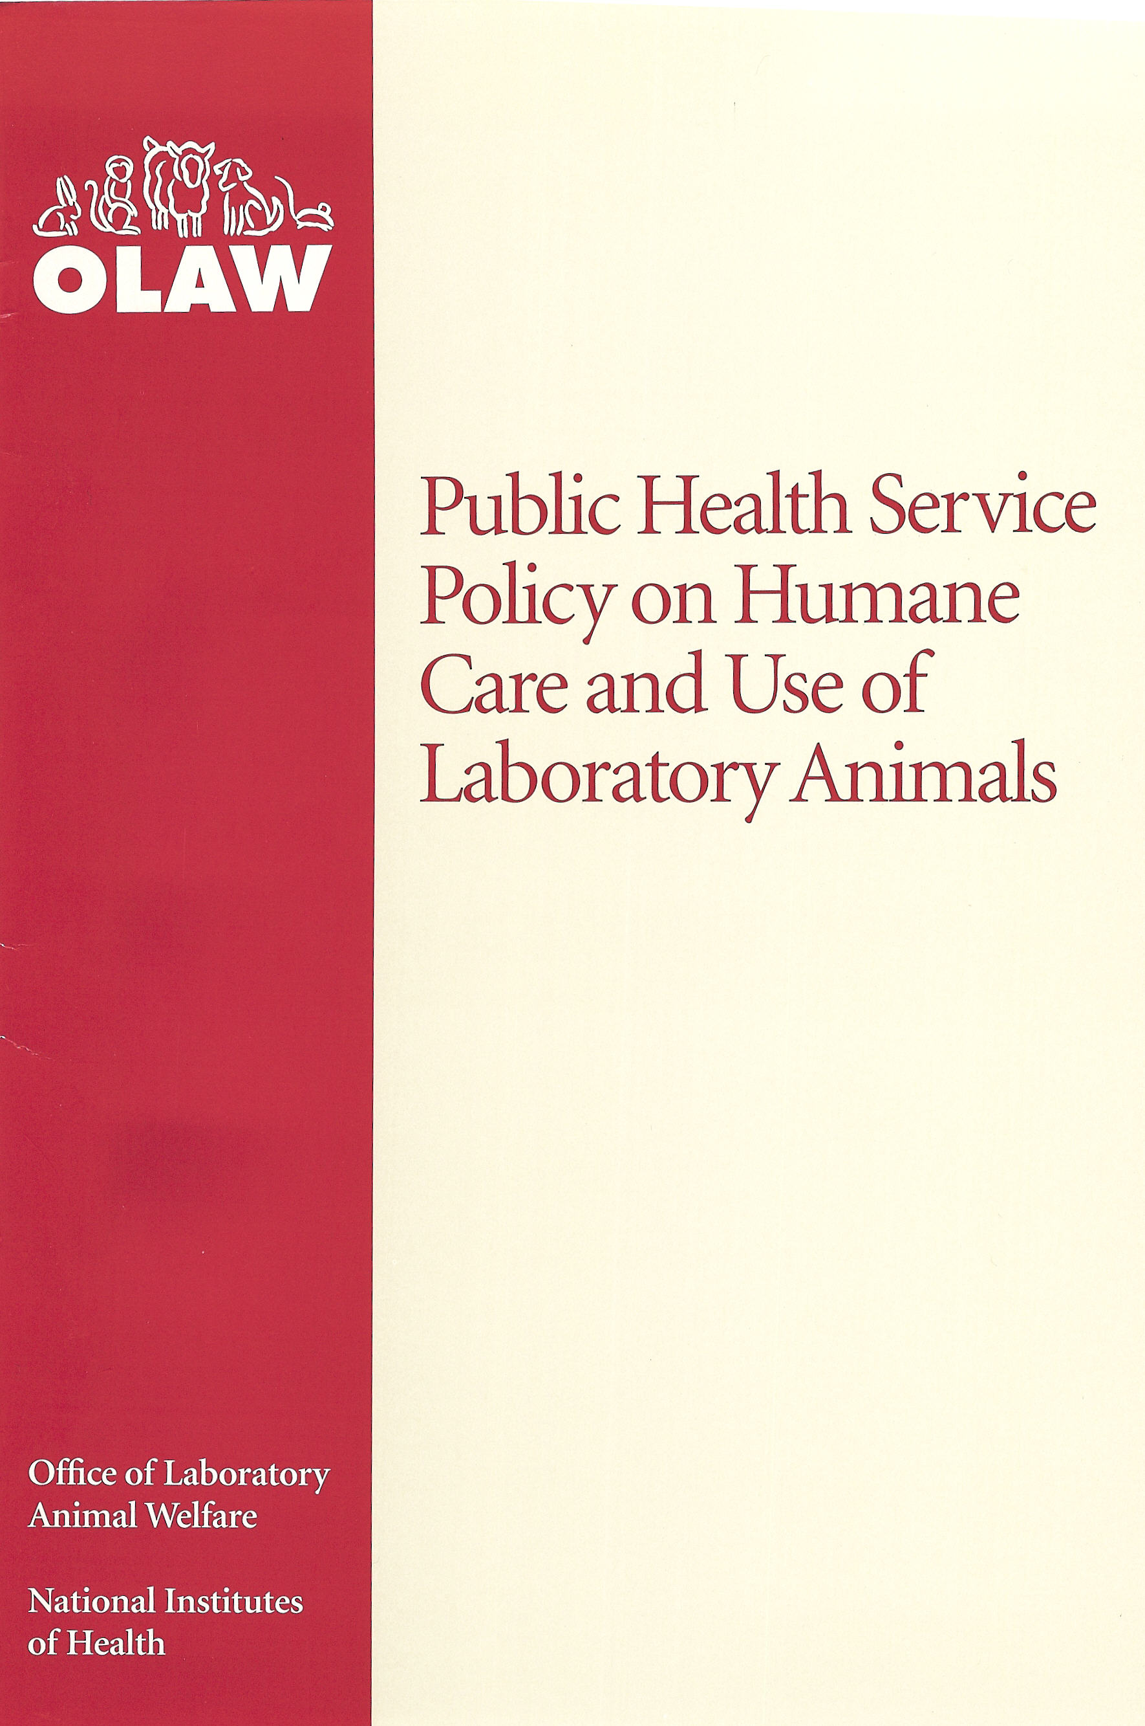
Key Elements of the PHS Policy
All vertebrate animals
Animal Welfare Assurance
Institutional program of animal care and use
Institutional Animal Care and Use Committee
Self-regulation by institution
Requirements
  Record keeping – program and IACUC records
  Reporting – annual and non-compliance

Slide 8
PHS Policy Applicability
Applicable to all PHS-conducted or supported activities involving animals
Animal- any live vertebrate animal used or intended for use in research, training, experimentation, biological testing
PHS agencies- CDC, FDA, NIH

Slide 9
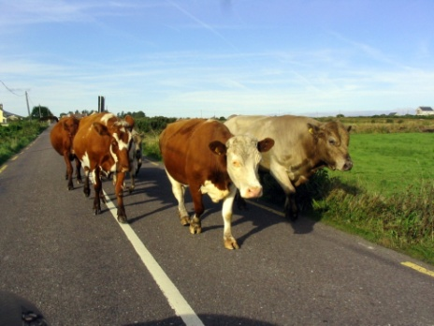
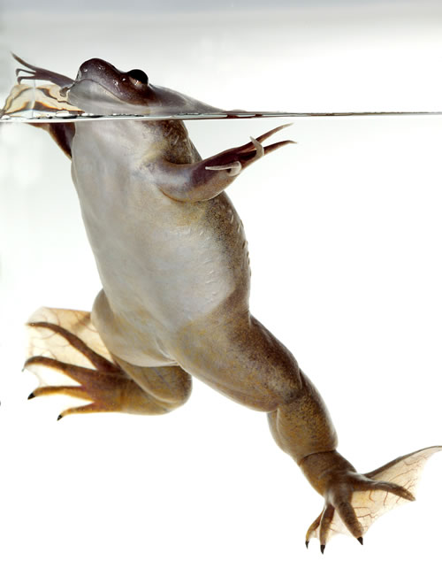
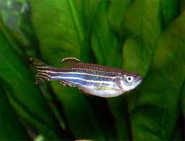
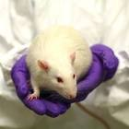
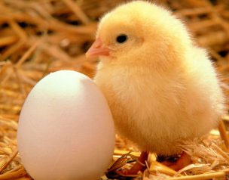
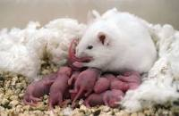
PHS Policy
Animal is defined as:
“any live vertebrate animal used or intended for use in research, research training, experimentation, or biological testing or for related purposes”.

Slide 10
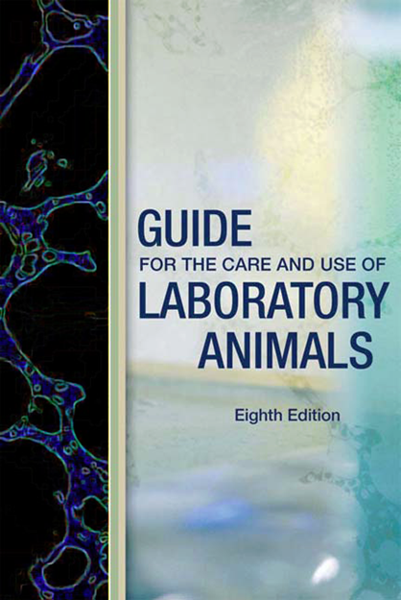

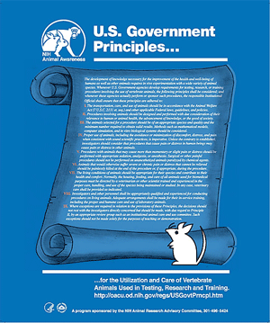
PHS Policy Standards for Animal Care & Use
AVMA Guidelines on Euthanasia (Formerly Report of the AVMA Panel on Euthanasia) _________________________________
2013 Edition
Notes:
10

Slide 11
Animal Welfare Assurance
Contract with Federal Government
Description of the institutional program of animal care and use
Documents institutional commitment
Principal method for compliance oversight

Slide 12
Animal Welfare Assurance
No activity involving animals may be conducted or supported until an Assurance is in place
Assurance sets forth compliance with Policy
Animal program must be based on Guide
No Assurance= No PHS support for animal work

Slide 13
Types of Animal Welfare Assurances
Domestic Assurance
Inter-Institutional Assurance
Foreign Assurance

Slide 14
Domestic Animal Welfare Assurance
Institution controls their own animal facilities
Has a complete animal care and use program
  Institutional Official (IO)
  IACUC
  Veterinarian
Remains in effect for up to 4 years
Assurance signed by IO
Requires PHS funding
Requested by grant management personnel
Renewed if PHS funded **NEW**

Slide 15
Domestic Animal Welfare Assurance
Describes animal care and use program
Lines of authority and responsibility
Institutional Animal Care and Use Committee
Procedures to implement the PHS Policy
Program of veterinary care
Occupational safety and health program for personnel
Training of personnel (investigators, technicians, IACUC)
Facilities
Species

Slide 16
IACUC Responsibilities
Oversight of animal care and use program
Review animal use protocols and procedures
Review concerns
Review program/and inspect facilities
semi-annually and report to Institutional Official
Advise Institutional Official
Suspend PHS-supported activity if necessary
Prompt reporting by Institution to OLAW

Slide 17
Reporting Requirements
Annual Report
Reporting of Non-compliance
  Serious or continuing noncompliance
  with the PHS Policy
  Serious deviations from the Guide
  Any suspension of an activity by the IACUC

Slide 18
Inter-institutional Assurance
Grantee organization does not have animal care and use program
Animal work conducted at Assured Institution
Good for life of grant (project specific)
Requested by grants management personnel

Slide 19
Foreign Animal Welfare Assurance
Negotiated when
  Prime awardee is foreign institution
  Domestic awardee conducting animal work at foreign site
  Domestic awardee’s IACUC approves animal activities performed at foreign site
Guided by International Guiding Principles for Biomedical Research Involving Animals (CIOMS)
Requires list of titles of governing laws, regulations and policies from the country of origin (in English)

Slide 20
Consortium Agreements: Sub-awards
Prime awardee is accountable and must confirm:
  Assurance
  IACUC approval (dated within 3 years)
  Approval only required from one Assured entity
Animal welfare requirements apply to all consortium participants and sub-projects
Notes:
20

Slide 21
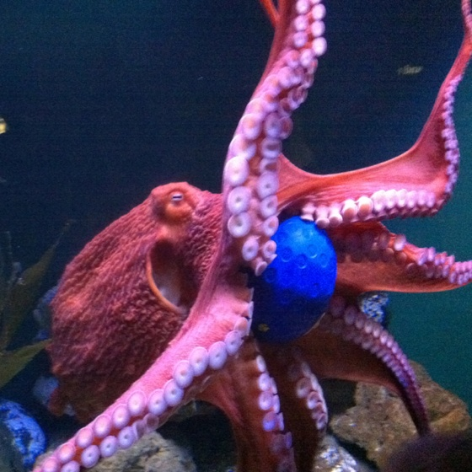
Which Study Should Be Checked “Yes” for Vertebrate Animal?
Embryonated egg
Tadpole
Zebrafish
Cow spleen from slaughterhouse
Antibodies from goat
Chimpanzee behavior study
Octopus nerve study
Mosquito malaria study
(host vertebrate?)

Slide 22
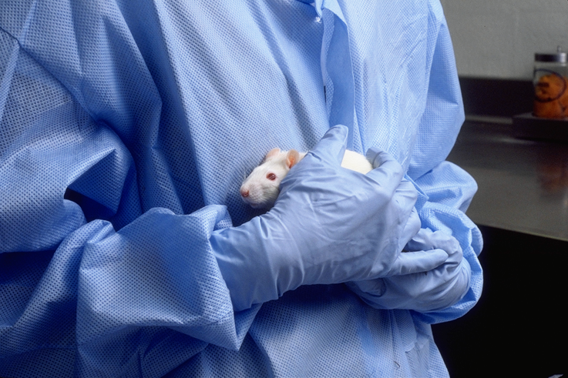

Slide 23
NIH Grants Policy Requirements
Animal Welfare Assurance for the applicant organization and all performance sites.
Verification that the IACUC has reviewed and approved those sections of the application that involve the use of vertebrate animals.
A complete Vertebrate Animal Section (VAS)
Notes:
23

Slide 24
Grant Applicant to Address Vertebrate Animal Use (electronic submission)
SF 424 ~ Research & Related Application
  Project / Performance Site Location(s)
  Other Project Information (Section 2 & 2a)
PHS 398 ~ Research Plan
  Research Plan Attachments
    Other Research Plan Sections (11. Vertebrate Animals)
    PDF format
    Five Points of Vertebrate Animal Section (VAS) addressed

Slide 25
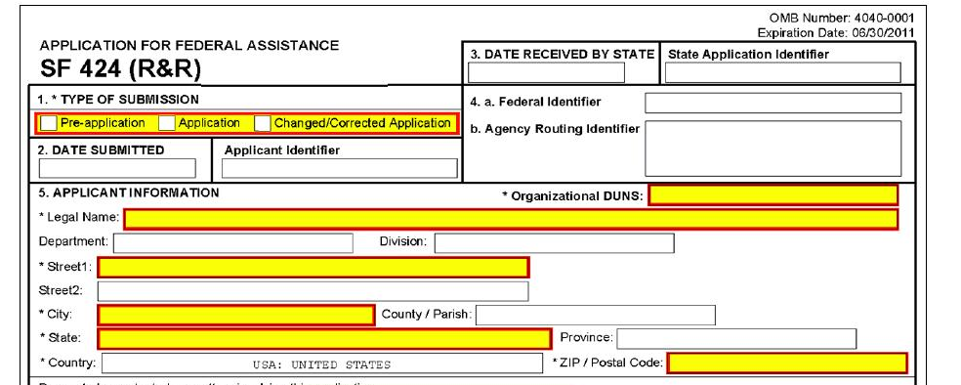
Notes:
25

Slide 26
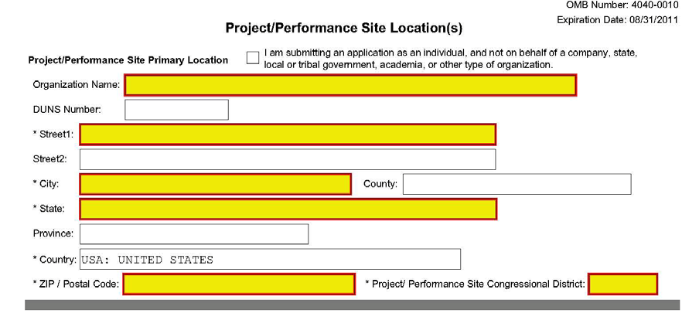
Notes:
26

Slide 27
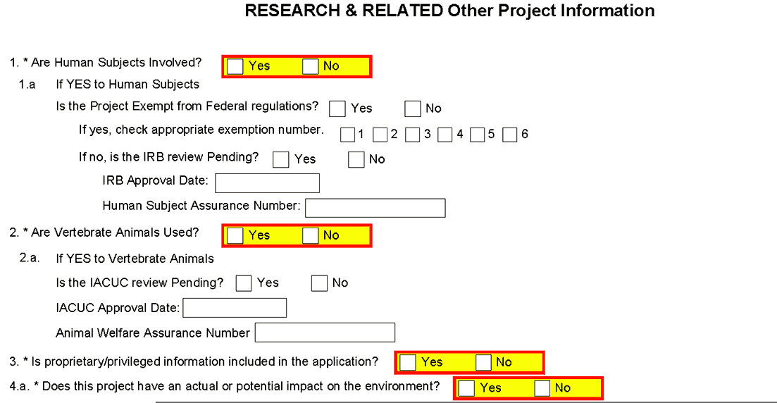
SF424
Grantee Information needs to be reflected
Reflects grantee information

Slide 28
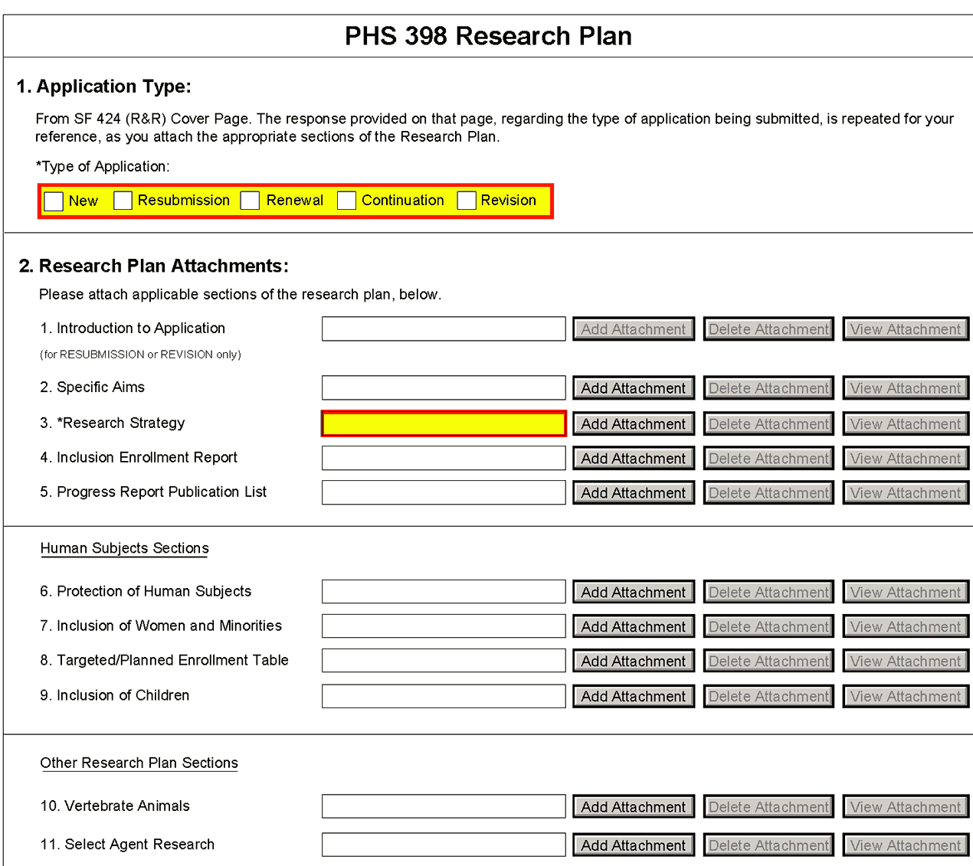

Slide 29
Grant Applicant to Address Vertebrate Animal Section (Five Points)
Describe proposed use and list species, strains, ages, sex, and numbers of animals to be used
Justify: use, species, and numbers
Veterinary care to include Performance site (separate VAS required for each Performance site)
Procedures to minimize pain and distress
  Pain and distress will be limited to that which is unavoidable
  Describe use of analgesics, anesthetics, etc.
Describe method of euthanasia
  Reasons for selection of method
  If not consistent with AVMA Guidelines - provide justification.

Slide 30
VAS Worksheet Purpose
Help applicant to include needed information to address animal welfare
Help reviewer determine if the applicant has appropriately addressed the required five points
Ensure weaknesses identified during review are included in the summary statement and addressed prior to award
Encourage consistency in review
http://grants.nih.gov/grants/olaw/VAScontracts.pdf

Slide 31
VAS Review by OLAW
Assurance Officer reviews VAS for grants and contracts submitted to OLAW with request for:
  Assurance
  or resolution of animal welfare concerns.
Assurance Officer reviews and accepts VAS or requests additional information be provided.
OLAW administrative personnel send Specialist questions to provide to PI for response.
Specialist gets PO or Grants Officer approval for updated VAS and sends to OLAW Division of Assurance email box for review and acceptance.

Slide 32
Funding Component (IC) and Peer Review Responsibilities
Consideration of animal welfare in the grant proposal should be evaluated (Review of VAS)
If evaluation identifies concerns with animal care and use, the concerns must be resolved prior to funding (Animal Welfare Concerns)
Ensure that institution has an Assurance
If no Assurance, Grants Management requests that OLAW negotiate Assurance
Verify IACUC approval – valid date for 3 yrs.

Slide 33
NIH Regional Seminar on Program
Funding and Grants Administration
Research Involving Animals
Office of Laboratory Animal Welfare (OLAW)
Barton Weick, MS, DVM, PhD, DACLAM
Animal Welfare Program Specialist,
Division of Compliance Oversight
Office of Laboratory Animal Welfare
National Institutes of Health
June 27, 2014
Baltimore, MD

Slide 34
Enforced Self-regulation
Performance standards
Flexibility
Self-monitoring
Self-correcting
Self-reporting
OLAW oversight

Slide 35
PHS Policy IV.F.3.
The IACUC, through the IO, shall promptly provide OLAW with a full explanation of the circumstances and actions taken with respect to:
  Any serious or continuing noncompliance with PHS Policy
  Any serious deviation from the Guide
  Any suspension of an activity by the IACUC

Slide 36
Health Research Extension Act
If the Director of NIH determines that:
Animal care conditions at PHS funded site do not meet applicable guidelines
The entity has been informed of this and given a reasonable opportunity to take corrective action, and
If no corrective action has been taken NIH shall suspend or revoke the grant or contract

Slide 37
OLAW’s Authority
May request, negotiate, approve or disapprove Assurance
May limit the effective period of approval
May restrict, condition, or withdraw approval
May review, approve, disapprove waivers to the PHS Policy
OLAW is responsible for administration and coordination of PHS Policy

Slide 38
IACUC Authority
The IACUC may suspend an activity that it previously approved if not in accordance with Animal Welfare Act, Guide, Assurance, PHS Policy
IACUC must review matter at convened meeting of quorum, suspension vote of majority of quorum present
Suspension cannot be overturned by IO or other officials

Slide 39
Institutional Accountability
The institution is accountable for:
Financial, administrative aspects of award
The animal care and use program, IACUC
The investigator is accountable for:
The research
Compliance with animal care and use program
The IACUC, together with the IO, exercises oversight over institutional animal care and use

Slide 40
Institutional Official
Designated representative of grantee organization in matters related to the award and administration of PHS grants
Accountable for appropriate use of funds and performance of activities resulting from application
Signs Assurance- commits institution to meet requirements of PHS Policy

Slide 41
Principal Investigator
Designated by grantee as responsible for scientific and technical aspects of project
Member of grantee team responsible for ensuring compliance with financial and administrative aspects of award

Slide 42
Language from face page of 398/SF 424
Signature and Assurance of Principal Investigator/Program Director Assurance:
I certify that the statements herein are true, complete and accurate to the best of my knowledge. I am aware that any false, fictitious, or fraudulent statements or claims may subject me to criminal, civil, or administrative penalties. I agree to accept responsibility for the scientific conduct of the project and to provide the required progress reports if a grant is awarded as a result of this application.

Slide 43
Policy on Allowable Costs for
Grants Activity Involving Animals
Office of Management and Budget Cost Principles and NIH Grants Policy Statement do not permit charges to grant awards for animal activities during periods of time that terms and conditions are not upheld
If work is conducted under noncompliant conditions, the expended grant funds may need to be refunded
Notes:
43

Slide 44
Policy on Allowable Costs for
Grants Activity Involving Animals
Institutions are not permitted to charge for animal activities when terms and conditions are not upheld
  Absence of a valid Assurance on file with OLAW
  Absence of valid IACUC approval
    Failure to obtain IACUC approval for animal activity
    Failure to obtain IACUC approval for significant changes prior to implementing
    Continuing animal activities after IACUC approval has expired
    Continuing animal activities after suspension of IACUC approval
Notes:
44

Slide 45
Policy on Allowable Costs for
Grants Activity Involving Animals
Institutions are required to report noncompliant situations
  OLAW (olawdco@mail.nih.gov or 301-594-2061)
  Institute/Center (IC) supporting the award
NIH expects grantees to continue to maintain and care for animals during periods of noncompliance
Funding components may allow expenditure of NIH grant funds for maintenance and care of animals on a case-by-case basis
NIH Policy on Allowable Costs for Activities with Animals when Terms and Conditions are not Upheld
[http://grants.nih.gov/grants/guide/notice-files/NOT-OD-07-044.html]
Notes:
45

Slide 46
Reportable Issues Data Analysis
OLAW opened 3,111 cases from 2009 – 2012
Institutional self-reports
Allegations from employees
Reports from other oversight agencies
OLAW review of Assurance, Annual Report
Reports from funding components
Allegations from other sources
OLAW opened 867 cases in 2012

Slide 47
Reportable Issues by Institution Type
Commercial
3%
Government
12%
Institution of
Higher Learning
70%
Other
15%

Slide 48
Types of Reportable Issues
No Violation Found 1%
Institutional Responsibility 1%
IACUC Responsibility 2%
Physical Plant 2%
Investigator &
Research Team 4%
Animal Study
Protocol Issues
32%
Animal Husbandry 11%
Clinical Issues 14%
Other
Issues 18%
Failure to Follow
Institutional Policies 15%

Slide 49
Types of Reportable Issues (continued)
Animal Study Protocol Issues
45% Failure to follow protocol
37% Unapproved significant change
8% Inadequate oversight
5% Work on expired protocol
4% Work before protocol approval
4%
32%
Investigator & Research Team Issues
Unauthorized laboratory or animal housing
Unauthorized or unqualified personnel
Food and water restriction issues

Slide 50
Types of Reportable Issues (continued)
Other
Human error, accident
Natural disaster
Equipment failure
Training failure
Crime, neglect, abuse
18%
15%
Failure to Follow Institutional Policies

Slide 51
Types of Reportable Issues (continued)
Animal Husbandry Issues
38% Food and water issues
27% Inadequate records or ID
22% Other husbandry
5% Space issue
4% Escaped animal(s)
3% Sanitation failure
11%
14%
Clinical Issues

Slide 52
Types of Reportable Issues (continued)
No Violation Found 1%
Institutional Issues 1%
IACUC Issues 2%
Physical Plant 2%
44% HVAC
31% Other
15% Construction & maintenance
4% Aseptic surgery
4% Sanitation
2% Emergency power & light

Slide 53
Types of Animals Involved
Carnivores 2%
Fish 3%
Ungulates 3%
Not Specified by Institution 4%
All Other
Species 6%
NHPs 8%
Rodents 74%

Slide 54
Individual Responsible for
Reportable Issue
Institution 1%
Other 3%
Vet Staff 3%
IACUC 4%
None 6%
Animal Care
Staff 12%
PI & Research
Team 72%

Slide 55
Institutional Corrective Action
Retrain personnel
Counsel, reprimand, terminate employment
Modify institutional policies
Repair or modify facility
Enhance PI and study oversight, probation
Modify, suspend, or terminate animal study protocol

Slide 56
Institutional Reporting Guidance
Guidance on Prompt Reporting to OLAW under the PHS Policy on Humane Care and Use of Laboratory Animals
NOT-OD-05-034 Feb 24, 2005
OLAW Online Seminar
Reporting Noncompliant Events to OLAW
  https://webmeeting.nih.gov/p31061868/

Slide 57
Contact OLAW for Advice or Help
Not sure if an issue is reportable? It is better to ask:
    Division of Compliance Oversight
    301-594-2061 or 301-594-2921
    olawdco@mail.nih.gov
Consequences are less desirable if reportable
issue is withheld and discovered later
OLAW needs information on serious reportable
issues to represent institution to PHS, Congress,
and the media

Slide 58
Reporting is a Cooperative Process
OLAW will provide assistance and guidance
Institution must demonstrate that corrective actions are being implemented
OLAW will evaluate appropriateness of the actions
in correcting and preventing the reportable issue
Self-reporting is part of enforced self-regulation

Slide 59
Implications of Reportable Issues
Corrective actions and improved systems
Special terms and conditions of awards
Enhanced reporting requirements
Cost disallowance
Suspension or termination of award
Restriction or withdrawal of Assurance
Criminal prosecution

Slide 60
Other Possible Ramifications
Negative publicity for the institution
Damage to reputation, assessment of peers
Retract or withdraw scientific publication
Institutional standing with alumni
Institutional loss of personnel, inability to
attract new staff
Inquiries from Congress, other Federal regulators

Slide 61
NIH-supported research is a partnership
  Collaborative relationship exists between BARDA and awardee institution
  The partners share a mutual need to assure compliance
  Each partner has responsibilities and obligations as stewards of public funds
  Institutional self-governance
  is the foundation of PHS Policy

Slide 62
Guidance to Grantees

Slide 63
Workshops and Conferences - 2014
IACUC 101/201 PLUS
    June 18-19 - Madison, WI
    October 1-2 - Rochester, NY
    November 4-5 - Richmond, VA
SCAW IACUC Workshops & Conferences
    May 15 - Bethesda, MD
    December 8-9 - San Antonio, TX
  USDA AWIC Workshop
    May 21-22
    November 13-14
  http://grants.nih.gov/grants/olaw/workshop.htm

Slide 64
Online Seminars and Podcast
Seminars now at 1pm ET on Thursdays:
  March – Oversight of Research Involving Wildlife
  June – Alternative Searches
  September – Optimizing IACUC Effectiveness
  December – IACUC Review of Aquatics
All About Grants Podcasts:
  Writing Your Vertebrate Animal Section
    (May 2011), 11 minute MP3 and transcript
http://grants.nih.gov/podcasts/All_About_Grants/index.htm

Slide 65
SCENARIO 1: What Would You Do ?
Bob’s Biotech will be the prime grantee for an award involving animal research.
Bob’s Biotech does not have their own animal facility but has made preliminary plans with Citywide University to conduct the animal studies in Citywide’s facility.
What are the requirements for the grant to allow the animal activities to proceed?

Slide 66
SCENARIO 1: Outcomes
What are the requirements for the grant to allow the animal activities to proceed?
Complete VAS for animal work at Citywide University
List Citywide University as a performance site
Both sites need an Assurance (Citywide University needs domestic, Bob’s Biotech need an interinstitutional agreement with Citywide University and OLAW)
IACUC approval from Citywide University
All of the above

Slide 67
SCENARIO 2: What Would You Do ?
Anywhere University will be subcontracting some of its proposed animal activities to a foreign performance site at May-Oui Institute.
What are the requirements for the grant to allow the animal activities to proceed?

Slide 68
SCENARIO 2: Outcomes
What are the requirements for the grant to allow the animal activities to proceed?
Complete VAS for both sites
List May-Oui Institute as performance site
Both sites need an Assurance
IACUC approval from Anywhere University for work at both sites
All of the above

Slide 69
SCENARIO 3: What Would You Do ??
The PI at Research University indicates that he will not be performing any animal activities but in the application he indicates he will be obtaining custom rabbit antibodies from Alpha Omega Enterprises.
What are the requirements for the grant to allow the animal activities to proceed?

Slide 70
SCENARIO 3: Outcomes
What are the requirements for the grant to allow the animal activities to proceed?
Complete VAS for Alpha Omega activity
List Alpha Omega as performance site
Both sites need an Assurance (domestic for Alpha Omega & domestic or interinstitutional assurance for Research University)
IACUC approval from Alpha Omega or Research University, if RU has its own animal program
All of the above

Slide 71

OLAW Educational Outreach
FAQs at http://grants.nih.gov/grants/olaw/faqs.htm
OLAW online free quarterly webinars series:
  OLAW Online http://grants.nih.gov/grants/olaw/e-seminars.htm
  Recordings of past webinars http://grants.nih.gov/grants/olaw/educational_resources.htm

Slide 72
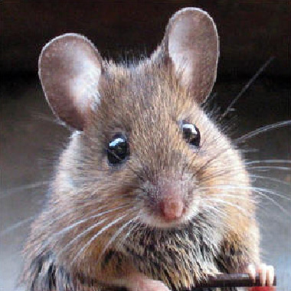
Contacting OLAW
OLAW: 301-496-7163
    olaw@od.nih.gov
Division of Policy and Education
    olawdpe@mail.nih.gov
Division of Assurances
assurances.olaw@od.nih.gov
Division of Compliance Oversight
    olawdco@mail.nih.gov

Slide 73
Questions? Please Ask!
ListServ or
RSS Feed:
Subscribe through the OLAW webpage
for current announcements, notices, policy interpretations.
OLAW Website: http://olaw.nih.gov
Notes:
73

