Slide 1
Post-Award Electronic Process
Victoria Bishton
Division of Grants Policy (DGP)
Office of Policy for Extramural Research Administration (OPERA)
June 2014

Slide 2
Today’s Topics
Administrative Supplements
Change of Grantee Institution
Change in Grantee Status (Successor-in-Interest)
Relinquishing Statements
RPPR

Slide 3
Today’s Topics
Administrative Supplements - pilot
Change of Grantee Institution - pilot
Change in Grantee Status (Successor-in-Interest) – pilot
Relinquishing Statements – pilot
RPPR – pilot AND Requirement

Slide 4
Post-Award Electronic Process
Administrative Supplement
Requests

Slide 5
Administrative Supplement (Type 3) Requests
Administrative Supplements are used to request additional funds for existing grants to support:
Adding personnel, particularly candidates for the diversity and re-entry programs
Replacing or upgrading equipment
Purchasing additional supplies
The PI/PD should contact the NIH Program Official to discuss before beginning the application

Slide 6
Administrative Supplement (Type 3) Requests
Parent FOA PA-14-077
FOAs for Diversity PA-12-149 and Reentry PA-12-150
Grantees currently not required to use eSubmission options
Current paper process and existing IC submission systems remain available for Parent FOAs.
ICs may refuse requests submitted outside their deadlines, outside stated areas of interest, or lacking information required by IC.
Guide Notice NOT-OD-12-043 for additional information

Slide 7
Administrative Supplement Submission Options
Two Options available for electronic submissions
eRA Commons Module
Web-based data entry based on SF 424 (R&R) forms
Grants.gov submission
Uses the SF 424 (R&R) package
Recommended for System-to-System institutions
Either option may be used for single-project grants, multi-project grants require paper process

Slide 8
eRA Commons Administrative Supplement Request
PD/PIs or PI Delegate with authority to access Status in eRA Commons can initiate
But shouldn’t begin until the PI/PD has discussed the request with NIH staff
Signing Official will submit completed request
Application is routed directly to awarding IC staff who determine whether to accept or refuse to consider
notification will be sent if the application is refused
Status is also updated in Commons

Slide 9
eRA Commons : Initiate Request
PI/PD or authorized PI Delegate accesses parent award in Commons by clicking “Status” then “Admin Supp” to see list of grants eligible for supplements.

Slide 10
eRA Commons Initiate Request

Slide 11
eRA Commons : Applicant View
Clicking “Yes” makes Diversity/Reentry fields available.
Accepts any FOA-specific or IC-requested uploads as PDF files

Slide 12
eRA Commons : Applicant View
Commons Username required both to allow pre-population AND to collect for future reporting.
Corresponds to data elements in existing FOAs.

Slide 13
eRA Commons : Applicant View
No form available for subawards. Subrecipients attach PDF file in any appropriate format.
“Go” opens budget pages for selected year

Slide 14
eRA Commons : Applicant View
Tabs for navigating budget forms.
All Budget Pages include running total requested at top.
List each equipment item and funds requested separately, and click Add. Screen updates with requested funds and clears fields for next entry.

Slide 15
eRA Commons : Applicant View

Slide 16
eRA Commons : Applicant View
Step 3: See running total increase each time.
Step 1: Add Sr./Key Person or Other Personnel Role.
Step 2: Click Add to see each item and allow next entry.
Step 4: Click on next budget line item.

Slide 17
eRA Commons : Applicant View
Indirect Costs auto-calculated from base and rate provided.

Slide 18
eRA Commons : Applicant View
Complete each budget period, return to this main menu, and add any additional budget periods (up to the current project period end date)
Total budget request appears on main screen as entered in budget tabs.
Options Menu

Slide 19
Completing the eRA Commons Request
Return to “Home” tab to view summary of all budget and administrative data.
“Save” stores request information in Commons
“View” displays a printable PDF of the draft request
“Check for Errors” identifies errors and warnings that need to be addressed
PD/PI may “Route to SO” for review and submission
SO may “Route to PD/PI” with comments
“Cancel” clears the screen without saving data
“Delete” removes draft request from Commons
“Submit” routes official submission to NIH (SO only)

Slide 20
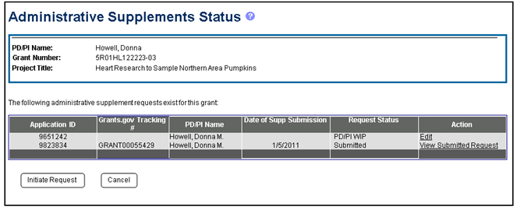
eRA Commons : Applicant View
Once submitted, status viewable in Commons by SO, PD/PI, and delegate
Awarded type 3s visible but those awarded as part of a Type 5 will not be visible

Slide 21
Grants.gov Supplement Request: Applicant View
Finding opportunities
Review NIH Guide (or Grants.gov) for FOAs describing supplement opportunities
If none exist, request funds through the supplement parent FOA.
Review FOA for any special application criteria or instructions

Slide 22
Forms-Based Submission through Grants.gov
Requests will be submitted through Grants.gov and will be viewable in eRA Commons (usual process)
Application will route directly to the awarding IC that will consider the request
Packages include all SF424 (R&R) forms grantees potentially need:
Utilize minimal validations since it would apply to so many activity codes
Budget will be based on new request, not based on original budget, and will always be non-modular

Slide 23
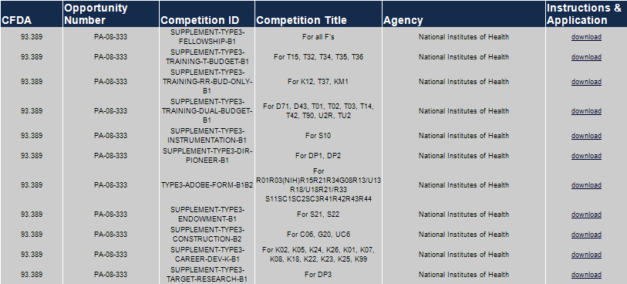
Grants.gov Supplement Request: Applicant View
Click on
Download application package based on the parent award’s Activity Code.

Slide 24
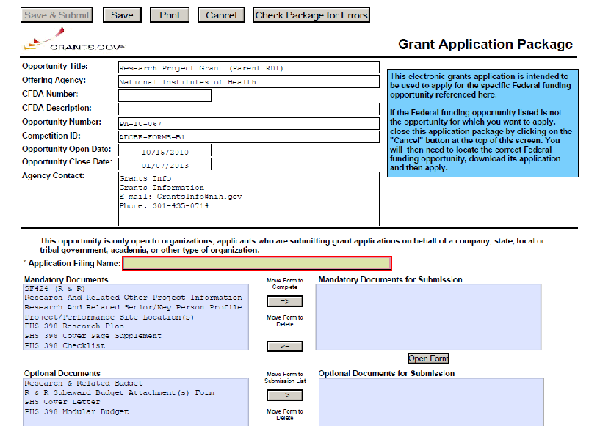
Grants.gov Supplement Request: Applicant View
Complete following FOA and Application Guide instructions.

Slide 25
Post-Award Electronic Process
Grant and Organizational
Changes

Slide 26
Relinquishing Statement PHS 3734 – Commons
Relinquishing Statement PHS 3734
NOT-OD-12-132
Grantees are encouraged to contact NIH IC staff before submitting
Processed in eRA Commons
To relinquish any awarded grant

Slide 27
Relinquishing Statement PHS 3734 – Commons
Original institution
Submits relinquishing statement
Can select new grantee organization or enter contact information if organization is not Commons Registered
IC can return for correction or accept for consideration
New institution
Receives eNotification from eRA Commons
Can view in eRA Commons
IC
Reviews and accepts or returns for correction

Slide 28
Relinquishing Statement PHS 3734

Slide 29
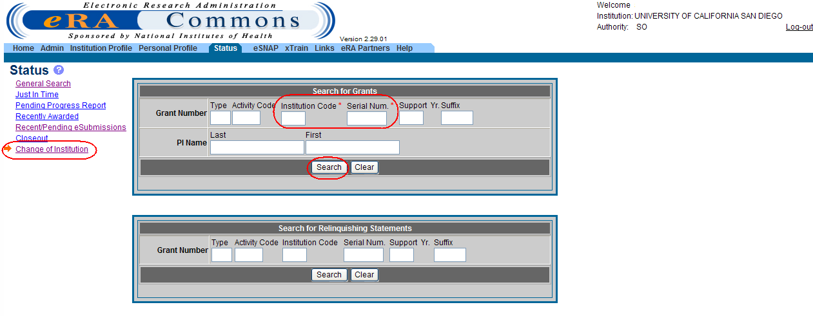
Relinquishing Statement PHS 3734
Enter search criteria for the grant you wish to relinquish.

Slide 30
Relinquishing Statement PHS 3734
If a Relinquishing Statement already exists it will be displayed. Otherwise, you can Start a new RS.

Slide 31
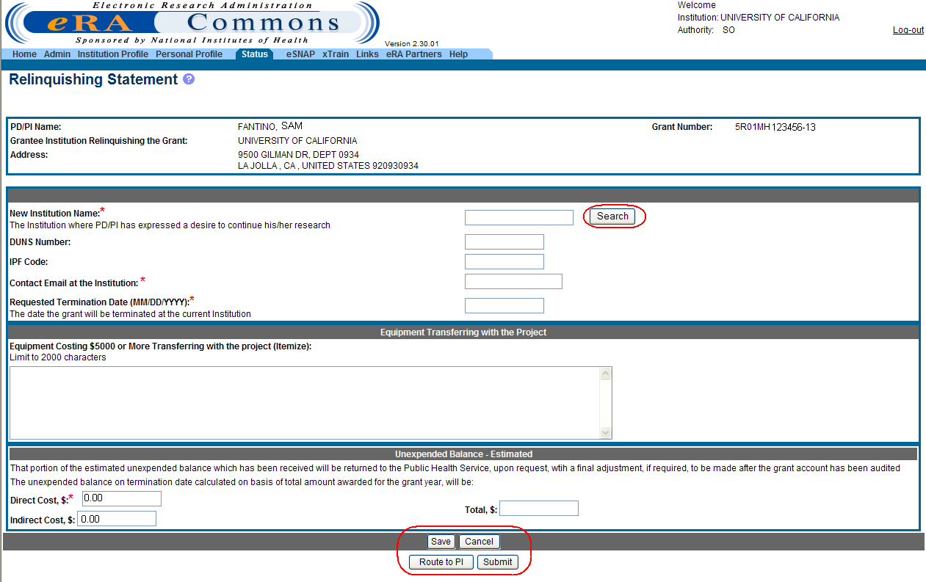
Relinquishing Statement PHS 3734
Use the Search feature to identify the new institution and populate the institution information

Slide 32
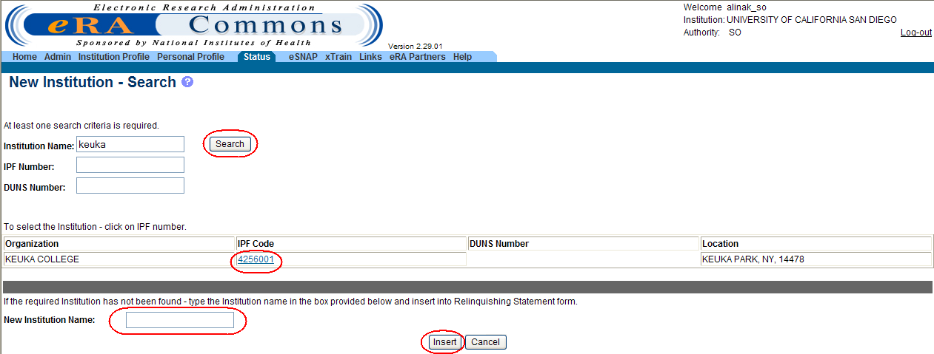
Relinquishing Statement PHS 3734
Search can be done using the Institution Name, IPF Number (NIH’s Institution Profile number) or DUNS Number.
Clicking on the new institution’s IPF Code populates the institution info in the RS and ensures the new institution will receive notifications and be able to view the RS.

Slide 33
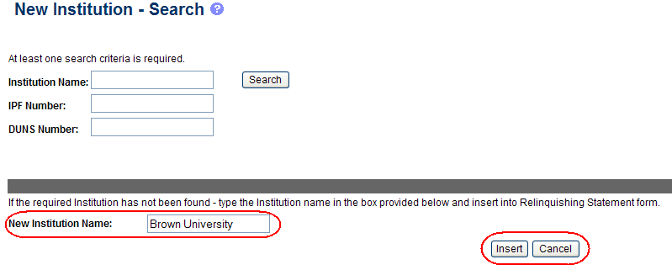
Relinquishing Statement PHS 3734
If you can’t identify the new institution through the search feature, simply enter the Institution Name. The new institution , once registered in Commons, can work with the Help Desk to gain access to the RS.

Slide 34
Relinquishing Statement PHS 3734
The RS can be routed to the PI to identify the new institution.
Once all information is complete, the SO can Submit the RS to the NIH for consideration.
Notes:
Submit and certification

Slide 35
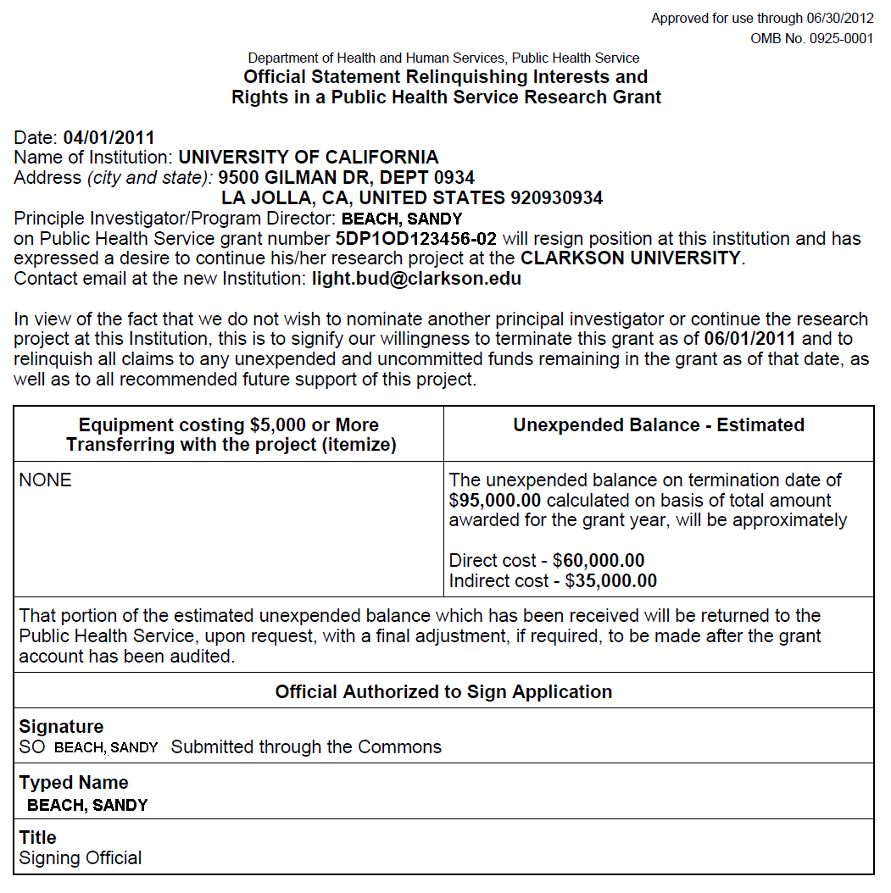
Relinquishing Statement PHS 3734

Slide 36
Change of Grantee (Type 7) – Grants.gov
Also referred to as change of institution or transfer application
Limited to:
Post-award Change of Grantee Institution
Available for post-award requests for single-project activity codes for which competing applications are submitted through Grants.gov. See Section IV of PAR-14-078 for details.
NOT-OD-12-134 for additional information

Slide 37
Change of Grantee (Type 7) Process
New institution
Uses Parent FOA application package
Submits application through Grants.gov
After 2-day viewing window, eNotification sent and application is routed directly to IC
IC reviews application
If approved, issues revised NoA for old grantee institution and new NoA for new grantee institution

Slide 38
Change in Grantee Organizational Status (Type 6) Applications
Also referred to as Successor-in-Interest or Name Change (Type 6)
NOT-OD-12-133
PA-14-079
Follows process for Type 7 EXCEPT:
Separate Parent FOA for Type 6s
Packages for Type 6s require only limited information
Grantees are encouraged to discuss potential change of organization status with the awarding IC
ICs may have policies and procedures in addition to those detailed in NIH Grants Policy Statement Section 8.1.2.8

Slide 39
Post-Award Electronic Process
Research Performance
Progress Report (RPPR)

Slide 40
Research Performance Progress Report
Federal-wide research and research-related progress report
Mandated by OMB and OSTP, after years of development under the Research Business Models Subcommittee
Standardizes information required by federal agencies
Goal to reduce administrative burden on grantees
http://www.nsf.gov/bfa/dias/policy/rppr/index.jsp
Notes:
Through the White House Office of Science and Technology Policy (OSTP) Research Business Models Subcommittee, a federal wide progress report for research and research-related activities was developed to standardize grantee reporting on federally-funded research projects.

Slide 41
Public Access Compliance Monitor
Public Access Compliance Monitor A web-based tool that institutions can use to track compliance of publications that fall under the NIH Public Access Policy.
By providing efficient and flexible methods for retrieving, viewing, and organizing public access compliance information, the compliance monitor supports the efforts of grantee organizations to ensure their awards are compliant.
For additional information, see NOT-OD-13-020.

Slide 42
NIH RPPR Implementation Timeline
SNAP and F RPPR - Pilot
April 2012
SNAP and F RPPR - Required
July 2013
Non-SNAP RPPR - Pilot
November 2013
Multi-Year Funded RPPR - Required
January 2014
Non-SNAP RPPR - Required
October 2014
Fed-wide Final RPPR
TBD
SBIR/STTR Fast-Track Phase I RPPR (T-4)
TBD

Slide 43
Which Progress Report Should I Use?
TYPE OF PROGRESS REPORT | PROGRESS REPORT FORMAT
SNAP | RPPR – required see NOT-OD-13-061
Fellowship | RPPR – required see NOT-OD-13-061
Non-SNAP | RPPR or PHS 2590 - at discretion of institution RPPR - REQUIRED for all type 5s submitted on or after October 17, 2014 see NOT-OD-14-092
Multi-Year Funded (MYF) | RPPR – required see NOT-OD-14-026
Phase I Final Year (Type 4) | PHS 398 or PHS 2590 - defined by terms of award

Slide 44
RPPR Format
8 screens, one for each RPPR section
A. Cover Page
B. Accomplishments
C. Products
D. Participants
E. Impact
Changes
Special (Agency) Reporting Requirements
Budget – SF424 (R&R) forms
Pre-populates data where possible
Uses check boxes, including Nothing to Report, text entry, and PDF uploads
Indicates Agency specific instructions with

Slide 45
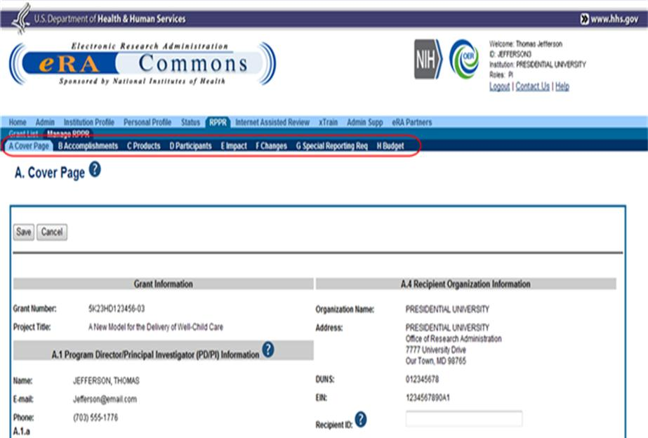
Navigation Screen Shot

Slide 46
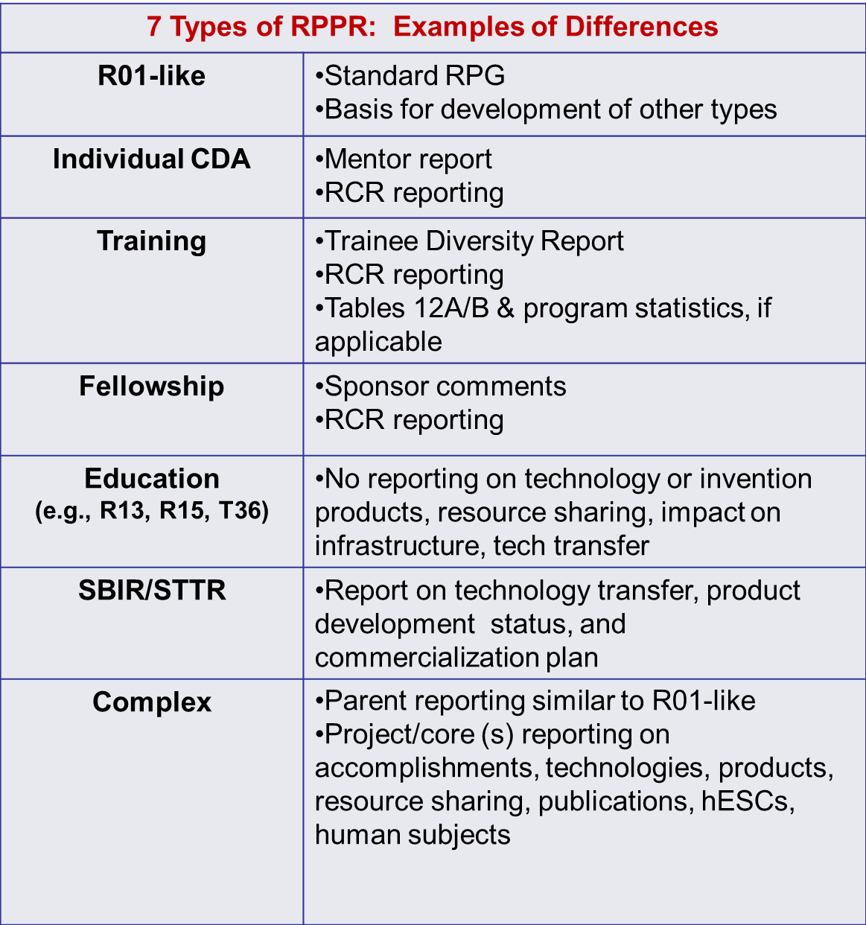
Input on NIH RPPR

Slide 47
RPPR Different Reporting Elements
Information collections:
Description of foreign components
Dollars to foreign countries
Foreign affiliation of personnel
Person months rounded to nearest whole number in participant section
Other support will only be required if a change
Other support instructions for progress reports revised
Include the award for which the progress report is being submitted and effort for next budget period

Slide 48
RPPR Features
Prior approval – Indication of reduction of effort for PI/PD or other senior key personnel designated in NoA constitutes a prior approval request
Content of RPPR will vary depending upon activity code
SF424 (R&R) budget (non-SNAP awards only)

Slide 49
PDF of RPPR
System will generate PDF of report upon submission to NIH
PDF follows the order and organization of RPPR
PDF provides high level questions and grantee responses
PDF is available in eRA Commons

Slide 50
RPPR Resources
RPPR Webpage: http://grants.nih.gov/grants/rppr/
RPPR Instruction Guide
Screen shots
Archived training
FAQs
Background
NIH Guide Notices:
NOT-OD-14-092, NOT-OD-14-079, NOT-OD-12-083, NOT-OD-13-035, NOT-OD-13-061

Slide 51
Questions
Division of Grants Policy:
E-Mail: GrantsPolicy@mail.nih.gov
Phone: 301-435-0949
eRA Commons Helpdesk:
Web: http://era.nih.gov/help/
Toll-free: 1-866-504-9552
Phone: 301-402-7469
TTY: 301-451-5939
Hours: Mon-Fri, 7a.m. to 8 p.m. Eastern Time

Slide 52
Session Evaluations: http://surveymonkey.com/s/nihsessions Overall Evaluations: http://surveymonkey.com/s/nihoverall
We Value Your Input!

