Slide 1



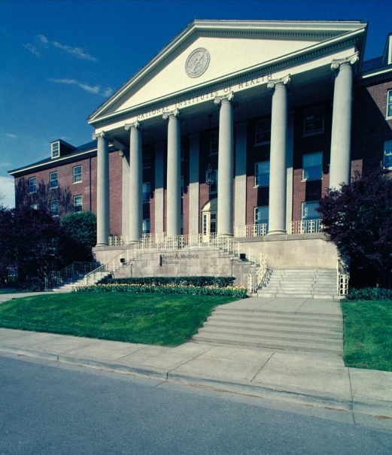
NIH: The View from 10,000 Feet
NIH Regional Seminar
June 2014
Sally J. Rockey, PhD
Deputy Director for Extramural Research
National Institutes of Health

Slide 2

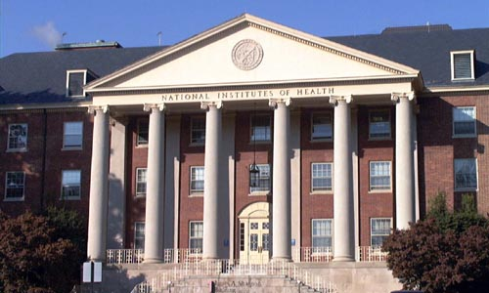
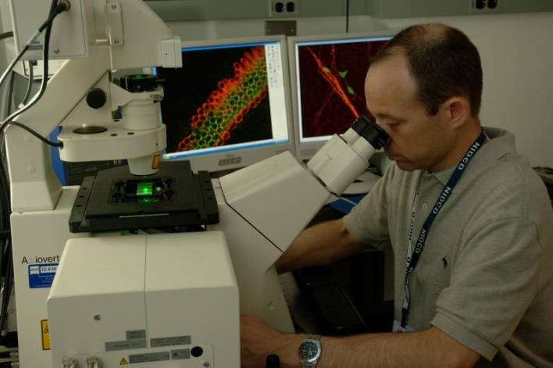
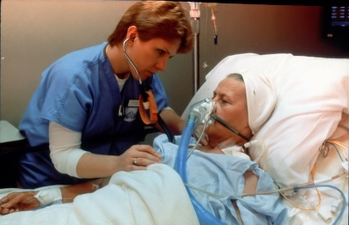
NIH: Steward of Biomedical & Behavioral Research for the Nation
NIH’s mission is to seek fundamental knowledge about the nature and behavior of living systems…
…and the application of that knowledge to enhance health, lengthen life, and reduce illness and disability.
Notes:
2
[Animated, 1 click]
There are two broad categories contained in the NIH Mission Statement.
The first relates to biomedical research
[Click] And the second, to the health of the nation – and, indeed, of all humanity, here at home and throughout the world
These, then, are the main categories of our analysis.
Note: The first picture (right) was provided by NIDCD. Dr. Mathew Kelley, Developmental Neuroscience Sect, NIDCD.

Slide 3
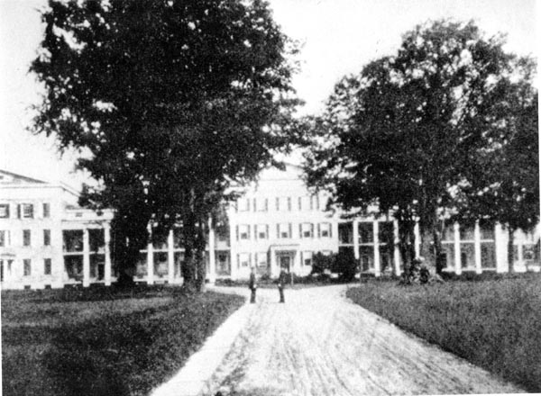
Birthplace of the NIH: 1887
Marine Hospital -- Staten Island, NY
Notes:
3

Slide 4
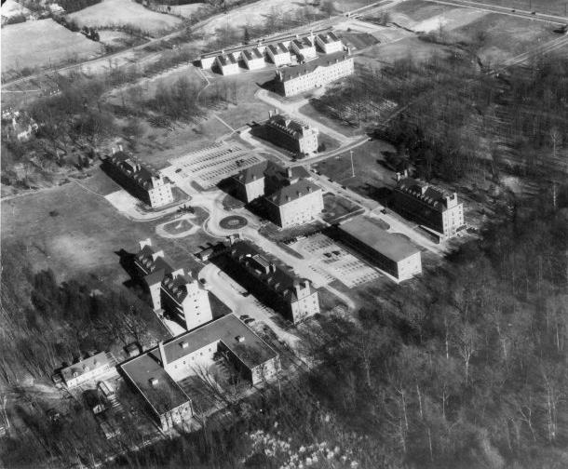
NIH Campus 1948
NIH Campus -- 1947
Notes:
4

Slide 5
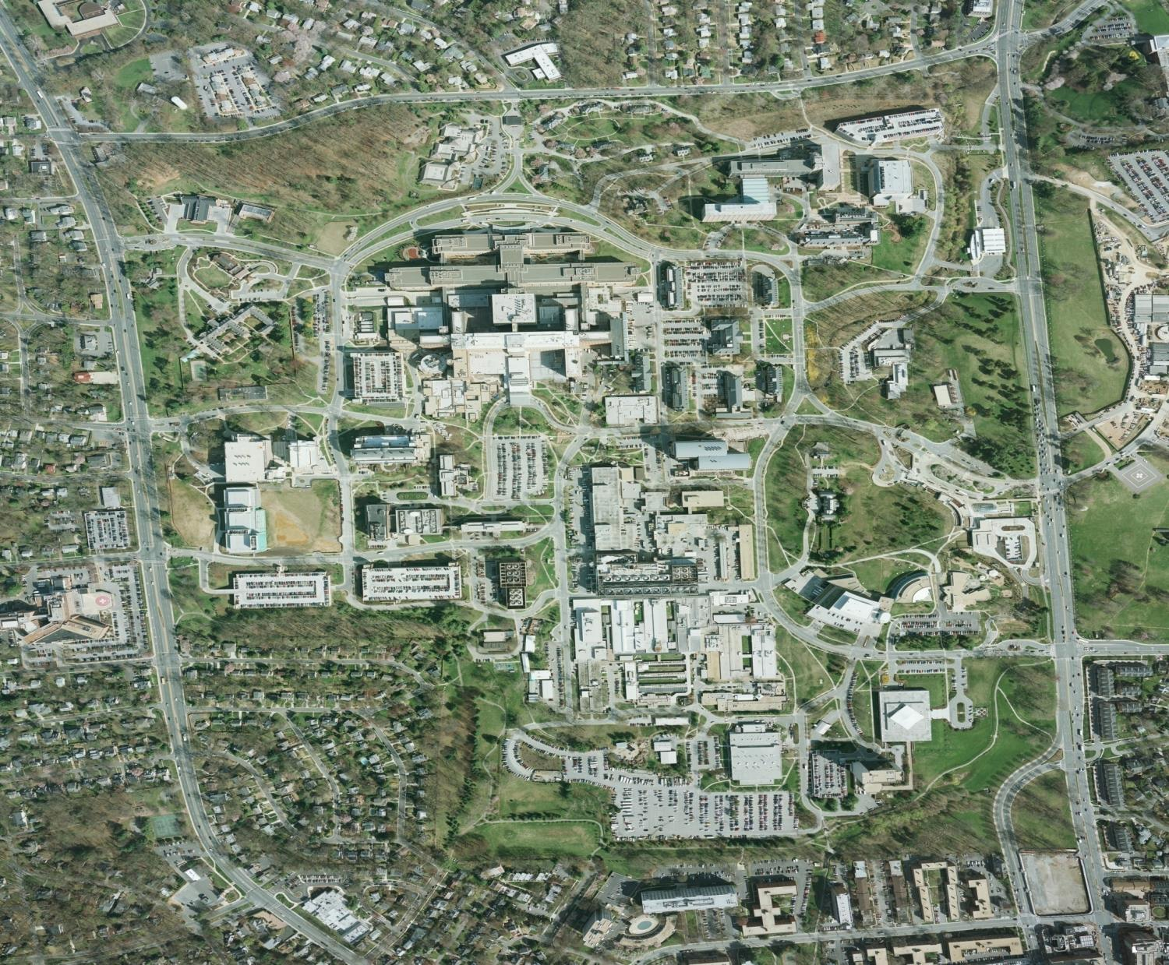
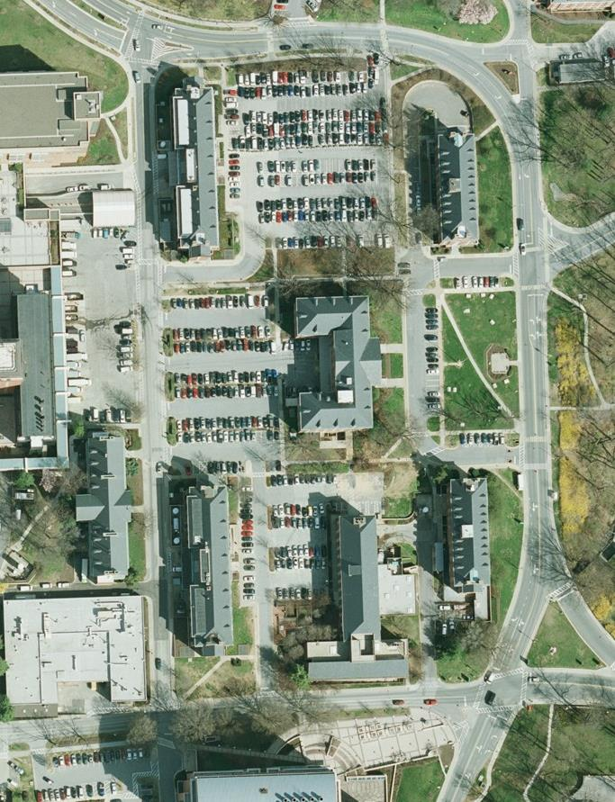
NIH Campus Today

Slide 6
U.S. Dept. of Health & Human Services
Secretary of Health and Human Services
Administration for
Children and Families
(ACF)
Administration on
Aging
(AoA)
Food and Drug
Administration
(FDA)
Health Resources
and Services
Administration
(HRSA)
Center for Medicare & Medicaid Services
(CMS)
Agency for
Healthcare Research and Quality
(AHRQ)
Indian Health
Services
(IHS)
National Institutes
of Health
(NIH)
Centers for
Disease Control
and Prevention
(CDC)
Agency for Toxic
Substances and
Disease Registry
(ATSDR)
Substance Abuse and
Mental Health Services
Administration
(SAMHSA)

Slide 7





















National Institutes of Health
Office of the Director
Office of
Extramural Research
National Institute
on Aging
National Institute
on Alcohol Abuse
and Alcoholism
National Institute
of Allergy and
Infectious Diseases
National Institute
of Arthritis and
Musculoskeletal
and Skin Diseases
National Cancer
Institute
National Institute
of Child Health
and Human
Development
National Institute on
Deafness and Other
Communication
Disorders
National Institute
of Dental and
Craniofacial
Research
National Institute
of Diabetes and
Digestive and
Kidney Diseases
National Institute
on Drug Abuse
National Institute
of Environmental
Health Sciences
National Eye
Institute
National Institute
of General
Medical Sciences
National Heart,
Lung, and Blood
Institute
National Human
Genome Research
Institute
National Institute
of Mental Health
National Institute
of Neurological
Disorders and
Stroke
National Institute
of Nursing Research
National Center on
Minority Health
and Health
Disparities
National Center
for Complementary
and Alternative
Medicine
Fogarty
International
Center
National Center
for Advancing
Translational
Sciences
National Library
of Medicine
National Institute
of Biomedical
Imaging and
Bioengineering
NIH
Clinical Center
Center
for Information
Technology
Center
for Scientific
Review
No funding
authority

Slide 8

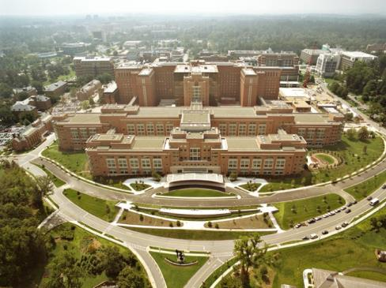
Understanding the Dual Nature of NIH
NIH is an institution
(Intramural Research)
~Approx. 6,000 scientists
~Approx. 10% of NIH
budget
NIH supports institutions & people
(Extramural Research)
>4,000 institutions
>300,000 scientists & research personnel
~Approx. 80% of the NIH budget

Slide 9










OER Preserves Public Trust in Biomedical Research
Scientific
Integrity
Public Accountability
Program Stewardship
Policy & Procedures
Development,
Implementation, and Oversight
Systems & Data
Communications
Admin Support
Education & Training
Services and Infrastructure

Slide 10

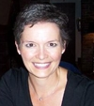




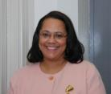
OER Organizational Structure
Office of the Director
OER Deputy Director
Office of Planning & Communication Director, Della M. Hann, PhD
Divisions of Communications & Outreach
AND
Planning & Evaluation
Director Sally J. Rockey, PhD
Office of Extramural Programs
(OEP)
Office of Policy for Extramural Research Administration (OPERA)
Office of Research Information Systems (ORIS)
Office of Laboratory Animal Welfare (OLAW)
Office of Administrative Operations (OAO)
Director:
Sherry Mills, MD,MPH
Director: Michelle Bulls
Director:
Rick Ikeda, PhD
Director: Patricia Brown, VMH
Director: Mitzi Diley
Division of Research Training Programs Division
Division of Grants Policy
Electronic Research Administration
Division of Assurance
Division of Administrative Services
Division of Extramural Staff Training and Information Dissemination
Division of Information Services
Division of Compliance Oversight
Division of Quality Assurance
Division of Extramural Inventions and Technology Resources
Division of Scientific Program Management and Policy
Division of Policy and Education
Division of Extramural Activities Support
(*MEO ends FY12)
Division of Grants Compliance Oversight
Division of Loan Repayment
10
NRSA Payback Center
Notes:
10

Slide 11

NIH Leadership
Here are some known (and little known) facts about the leader of NIH:
NIH Director as of August 17, 2009
Former Director of the National Human Genome Research Institute, NIH
Leader of the Human Genome Project
Dr. Collins’ own lab discovered a number of important genes, including those responsible for cystic fibrosis, neurofibromatosis, Huntington's disease, a familial endocrine cancer syndrome, and most recently, genes for type 2 diabetes and the gene that causes Hutchinson-Gilford progeria syndrome.
New York Times best selling book author
Interest in the interface of science and faith.
Believes the value of the NIH community is one where hard work, laughter, and compassion allow the imagination to soar.
Francis S. Collins,
Ph.D., MD
No one can whistle a symphony; you need a team to make that kind of music!

Slide 12
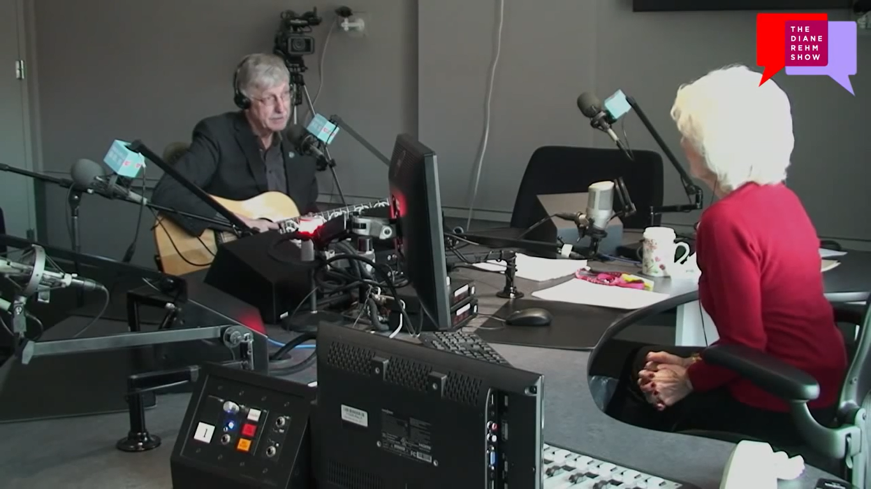
NIH Director Dr. Francis Collins sings
Knock Out Disease on the Diane Rehm Show
Diane Rehm Video

Slide 13

Challenging times!!!!!

Slide 14
Compound Annual Growth Rate of Biomedical R&D Expenditures by Country, Adjusted for Inflation
2007–2012
Canada
United States
Europe
Taiwan
Japan
India
Australia
Singapore
South Korea
China
Compound Annual Growth Rate of Biomedical R&D Expenditures (%)
Source: N Engl J Med. 2014 Jan 2;370(1):3-6

Slide 15

Biomedical Research and Development Price Index (BRDPI)
Measures changes in the weighted-average of the prices of all the inputs (e.g. personnel services, various supplies, and equipment) purchased with the NIH budget to support research.
Weights within the price index reflect the actual pattern or total NIH expenditures on each of the
types of inputs purchased every year.
Annual change indicates how much
NIH expenditures would need to grow to
maintain NIH-funded research activities
at the previous year’s level.

Slide 16
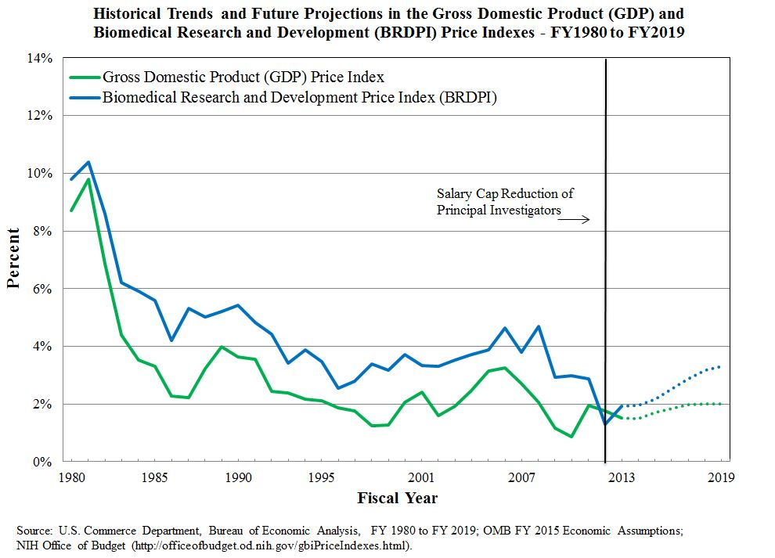
Trends Over Time in Growth Rates of BRDPI and GDP Price Index, 1959 to 2012

Slide 17
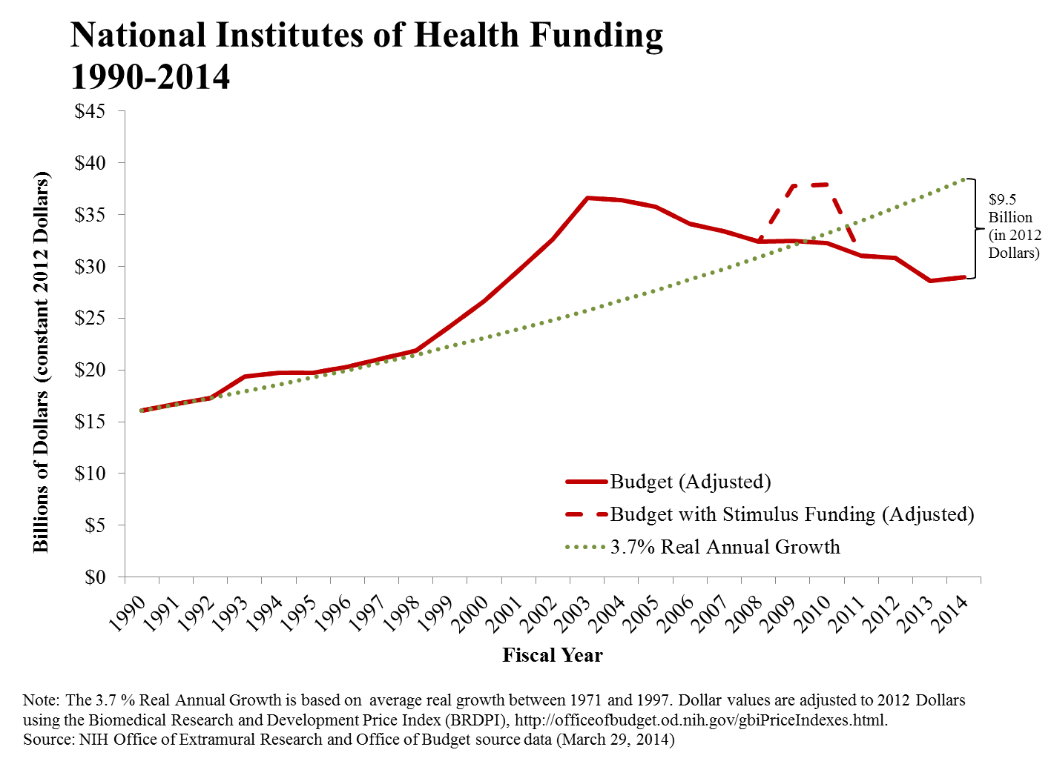
National Institutes of Health Funding
1990-2041

Slide 18
NIH Program Level in Nominal Dollars and Constant 1998 Dollars, FY1998 – FY2014
(In Billions)
Appropriation
Appropriation in 1998 Dollars

Slide 19
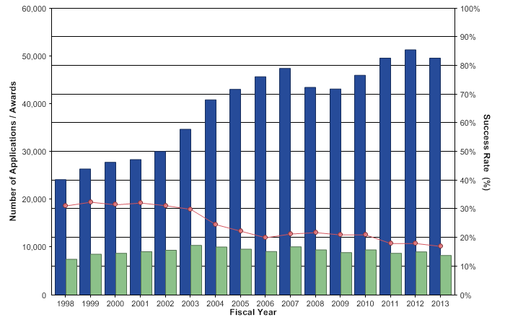
Research Project Grants: Competing
Applications, Awards, and Success Rates
Notes:
19

Slide 20
Shutdown

Slide 21
Thank You

Slide 22

Policy & Program News

Slide 23
NIH Application Resubmission Policy
NIH Guide Notice (NOT-OD-14-074)
NIH and AHRQ Announce Updated Policy for Application Submission, April 17, 2014
“Effective immediately, the NIH and AHRQ will accept a new (A0) application following an unsuccessful resubmission (A1) application. The subsequent new application need not demonstrate substantial changes in scientific direction compared to previously reviewed submissions, and must not contain an introduction to respond to the critiques from the previous review.”

Slide 24
The Modified Biographical Sketch (Biosketch) in NIH Applications
NIH has been piloting changes to the Biosketch in grant applications
A second round of Biosketch pilots (announced May 16, 2014) will:
  Extend the page limit from four to five pages.
  Allow researchers to describe up to five of their most significant contributions to science, their specific role in those discoveries, and the influence of their contributions on their scientific field.
The new Biosketch is intended to emphasize accomplishments rather than a list of publications.

Slide 25
Upcoming Changes: New HHS Closeout Requirements
GAO audits on HHS closeout activities reported that billions of dollars were unobligated in the Payment Management System.
HHS has issued new policies for closeout of grant awards.
No changes are expected to the current NIH Standard Terms of Award provision allowing grantees to initiate a one-time, no-cost extension in the last year of the award.
Anticipated changes:
  Must initiate “unilateral” closeout—i.e., without cooperation of the grantee—if reports are missing or unacceptable.
  Must consider possible enforcement actions when unilateral closeout conducted.
  When there are discrepancies between grantee’s final federal financial report and cash transaction report—must adjust award to lower amount, which may result in a debt obligation to the grantees.

Slide 26
Upcoming Changes: Subaccounts
Most payments for NIH domestic awards are
currently made via pooled accounts in the Payment
Management System.
Per HHS directive, NIH will transition payment for grant awards from pooled payments to subaccounts where funds can be expended and monitored by each individual grant.
FY 2014 – transition all awards with new document numbers (Types 1, 2, 4, 6, 7, & 9).
FY 2015-2016 – transition continuing awards (Types 5 & 8).
Administrative supplements will be awarded to the same type of account (subaccount or pooled) as the parent award.
Carryover authority will not change as a result of this transition.

Slide 27
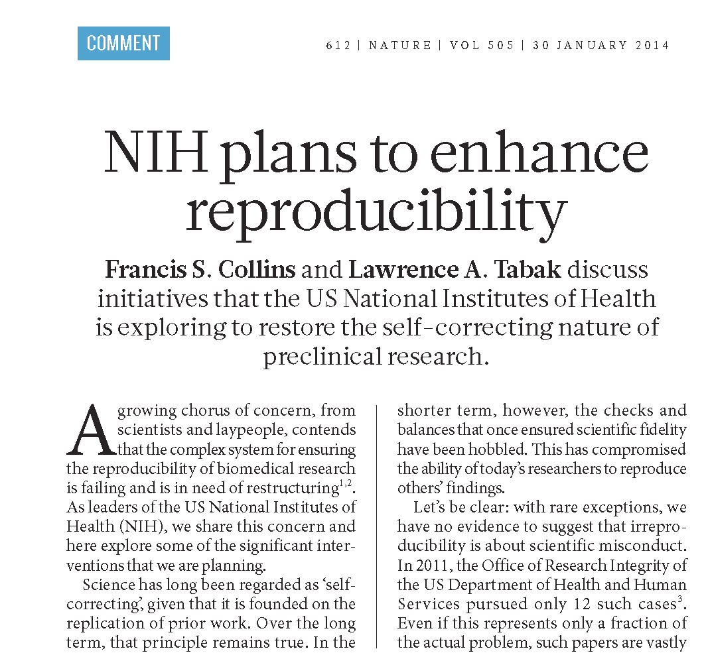


Slide 28
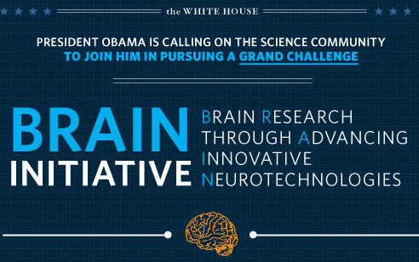
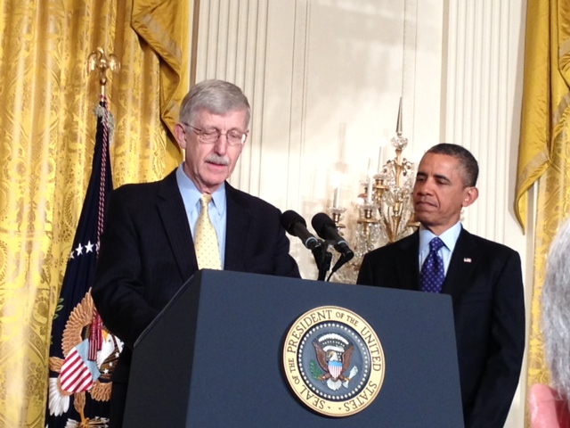
BRAIN Initiative
“The Next Great American Project”
Learning the Language of the Brain

Slide 29
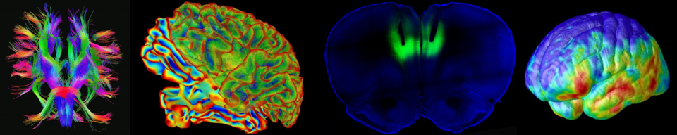
Brain Research through Advancing Innovative Neurotechnologies (BRAIN) Initiative – NIH goals
Generate a Census of Cell Types
Create Structural Maps of the Brain
Develop New Large-Scale Network Recording Capabilities
Develop A Suite of Tools for Circuit Manipulation
Link Neuronal Activity to Behavior
Integrate Theory, Modeling, Statistics, and Computation with Experimentation
Delineate Mechanisms Underlying Human Imaging Technologies
Create Mechanisms to Enable Collection of Human Data
Disseminate Knowledge and Training

Slide 30



FY 2014 Investments
Government Agencies | $ in Millions
National Institutes of Health | $40 .7
Blueprint for Neuroscience Research | $10M
NIMH | $12.85M
NINDS | $12.85M
NIDA | $4M
NIBIB | $1M
Defense Advanced Research Projects Agency | $50
National Science Foundation | $20
Food and Drug Administration | N/A
+ Private
Investments

Slide 31
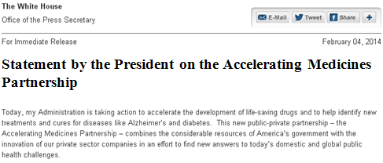
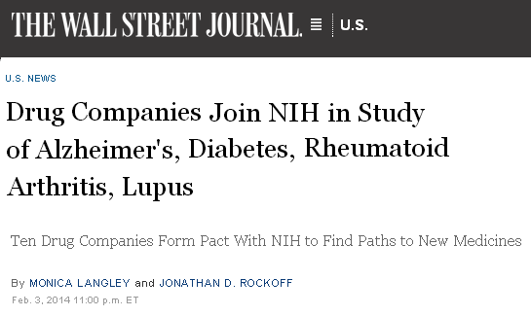

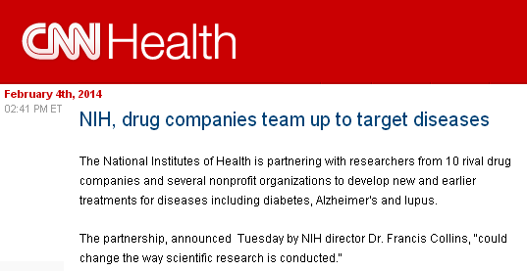
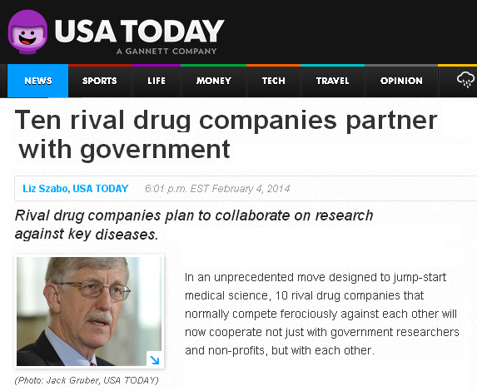
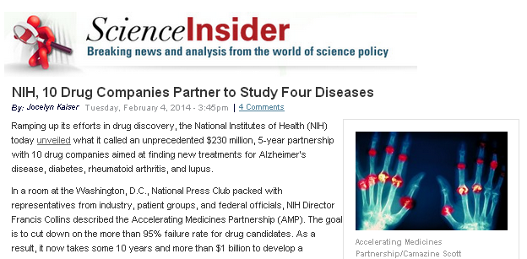
Accelerating Medicines Partnership (AMP) www.nih.gov/amp

Slide 32
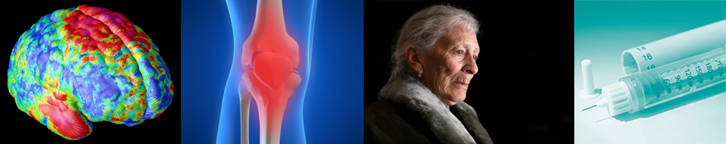
Accelerating Medicines Partnership (AMP) www.nih.gov/amp
Aims to distinguish targets of disease most likely to respond to new therapies
Will invest >$230M over five years on pilot projects:
  Alzheimer’s disease
  Type 2 diabetes
  Autoimmune disorders (systemic lupus erythematosus and rheumatoid arthritis)
Costs are shared equally between NIH and the private sector

Slide 33
Accelerating Medicines Partnership
Government | Industry | Non-Profit Organizations
NIH FDA | AbbVie Biogen Idec Bristol-Myers Squibb GlaxoSmithKline Johnson & Johnson Lilly Merck Pfizer Sanofi Takeda | Alzheimer’s Association American Diabetes Association Arthritis Foundation Foundation for the NIH Geoffrey Beene Foundation Juvenile Diabetes Research Foundation Lupus Foundation of America Lupus Research Institute / Alliance for Lupus Research PhRMA Rheumatology Research Foundation USAgainstAlzheimer’s

Slide 34
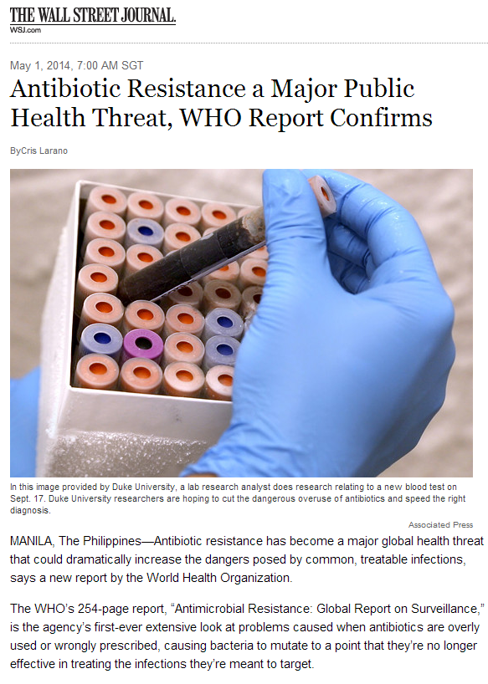

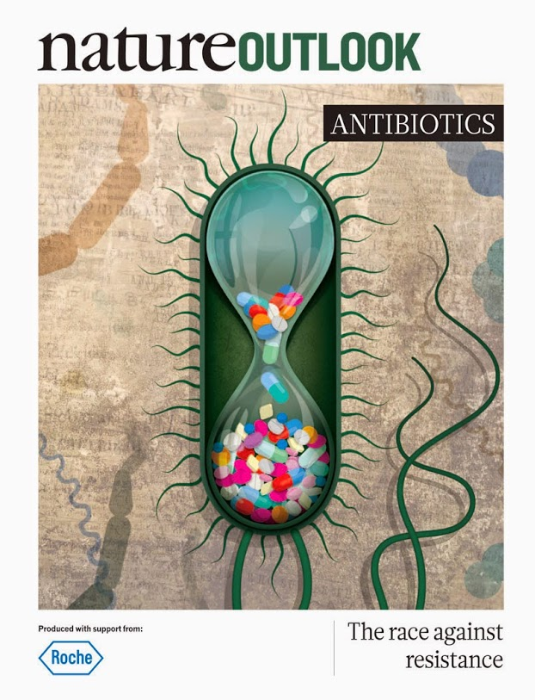
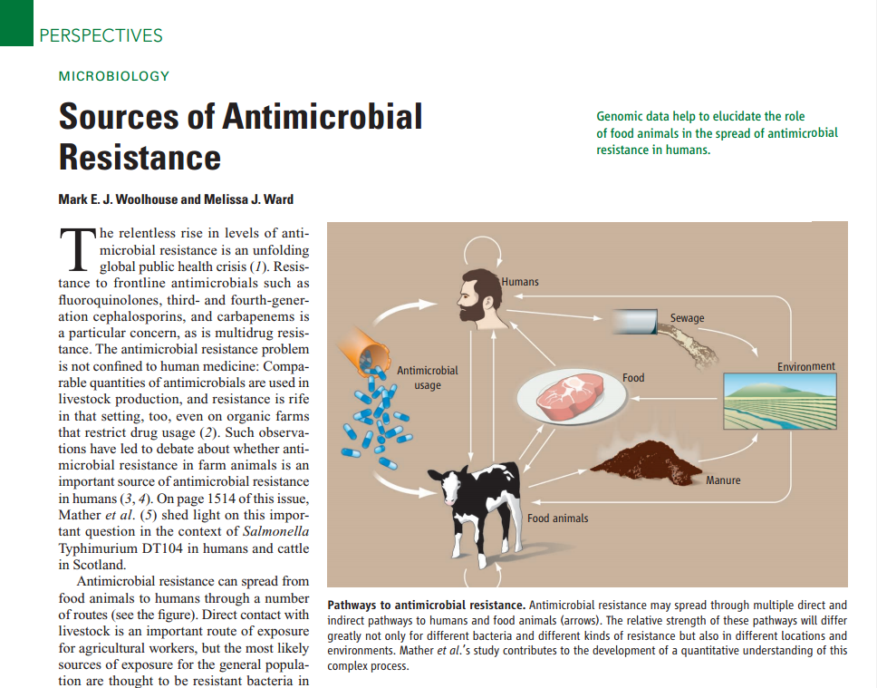

Antimicrobial Resistance

Slide 35
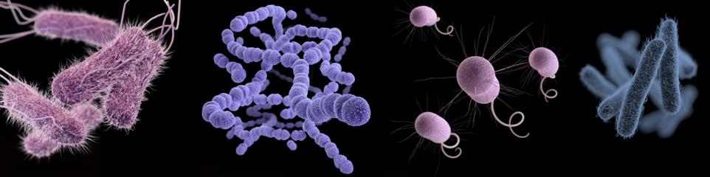
Antimicrobial Resistance:
Obama Administration Activities
President’s Council of Advisors on Science and Technology (PCAST) is developing recommendations for presidential-level actions
Interagency Policy Committee (IPC) on Combating Antibiotic Resistant Bacteria (CARB) is a trans-U.S. government initiative led by the White House to unite all departments and agencies in developing a blueprint for tackling this public health issue

Slide 36
Antimicrobial Resistance:
NIH-FDA Joint Leadership Council (JLC)
The JLC ensures that regulatory considerations inform biomedical research planning and the latest science is integrated into the regulatory review process
Workshop July 30-31 on Antimicrobial Resistance
  Industry, federal agencies, academia, advocates
  Develop the template for a common clinical protocol
  Promote the use of common control groups

Slide 37
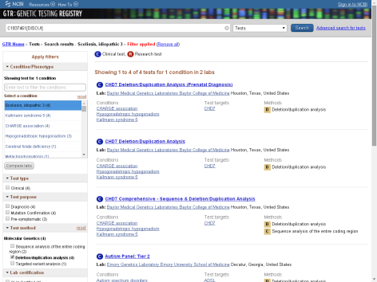
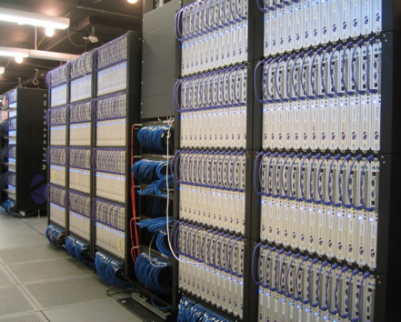
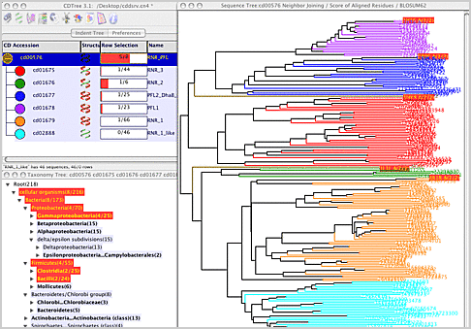
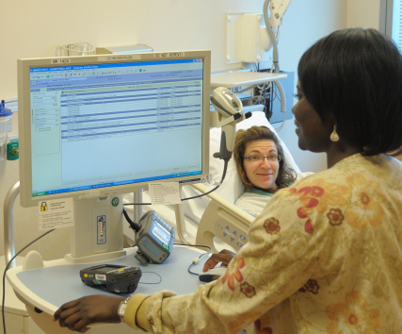
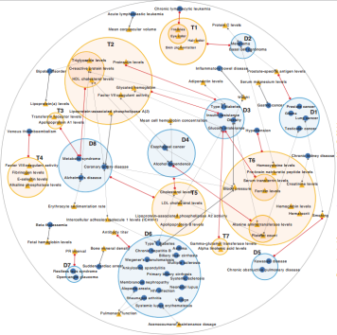
Big Data and Biomedical Research
The promise – and the challenges
Big Data and NIH
Partnerships: national, and international

Slide 38


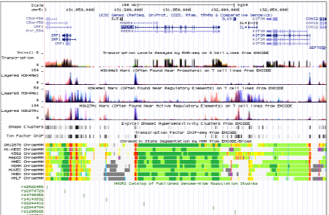
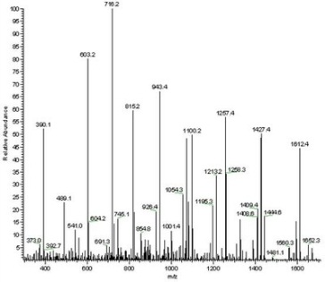
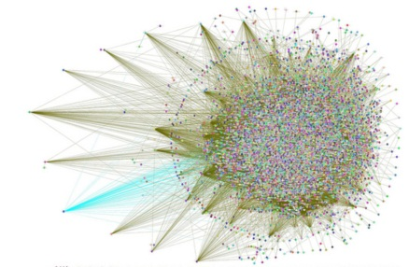
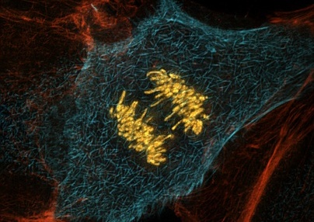
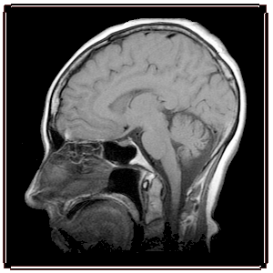




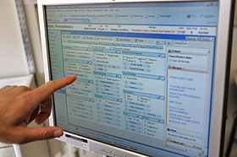

Myriad Data Types
Genomic
Other ‘Omic
Imaging
Phenotypic
Exposure
Clinical

Slide 39
Growth of Biological Databases
Number of Databases
Source: Michael Bell, Newcastle University, U.K.

Slide 40
Daily Data Processing at NCBI
Interactive
Web
126 Petabytes/year
3TB/day
4 Terabytes (TB)/day
35 TB/day
Data
Downloads
365TB/day

Slide 41

NIH Is Tackling the “Big Data” Problem:
The NIH Digital Enterprise
New leadership position: Associate Director for Data Science (ADDS), Dr. Philip Bourne
Scientific Data Council and External Advisory Board
Big Data to Knowledge (BD2K)
Data Commons

Slide 42
Big Data to Knowledge (BD2K)
Initiative to develop innovative, transformative approaches and tools – to make Big Data a more prominent component of biomedical research
Will lead to:
  Appropriate access to shareable biomedical data
  Development of, and access to, appropriate algorithms, methods, software, and tools
  Appropriate protections for privacy and intellectual property
  Development of a sufficient cadre of skilled researchers

Slide 43
BD2K: Activities
Data sharing
  Data Discovery Index
  Data/metadata standards
Software development
Training, including
  K01 Mentored Career Development awards; new training grants
Centers of Excellence
  Applications have been received; reviewed
  Awards FY 2014

Slide 44

Biomedical Workforce

Slide 45
Biomedical Research Workforce Working Group
Implementation Update
A working group of the Advisory Committee to the NIH Director
Chaired by Shirley Tilghman (Princeton) and Sally Rockey (NIH)
Charge
  Develop a model for a sustainable and diverse U.S. biomedical research workforce that can inform decisions about training of the optimal number of people for the appropriate types of positions that will advance science and promote health.
  Based on this analysis and input from the extramural community, make recommendations for actions that NIH should take to support a future sustainable biomedical infrastructure.
  Report
  Executive Summary http://acd.od.nih.gov/bmw_report.pdf
  Report http://acd.od.nih.gov/Biomedical_research_wgreport.pdf
  Supplementary Web Site http://report.nih.gov/investigators_and_trainees/ACD_BWF

Slide 46
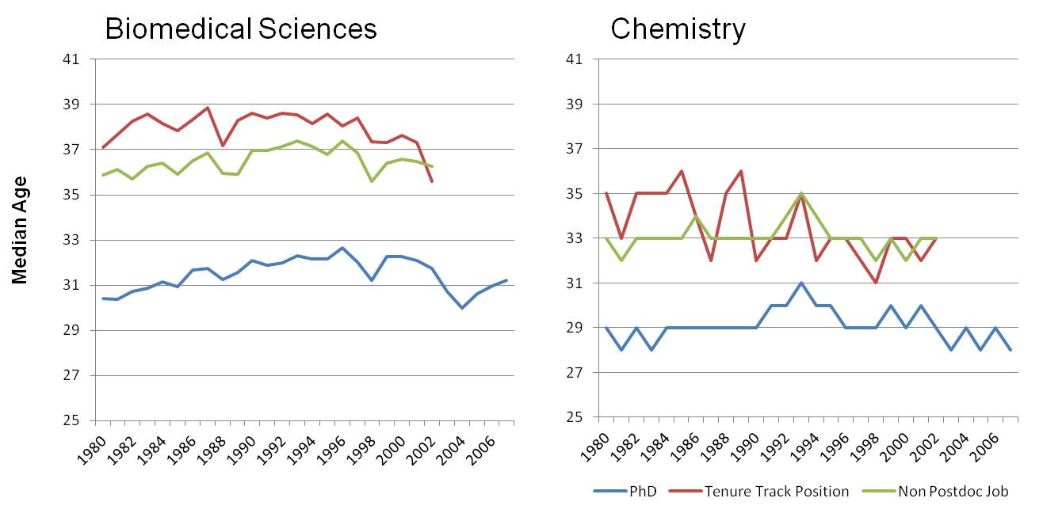
Age at First PhD, First Non Postdoctoral Job, First Tenure Track Job, for US trained Doctorates
Source: Survey of Earned Doctorates

Slide 47
PhD Biomedical Research Workforce
College Graduates
16,000 in 2009
Graduate Education & Training
2009 Total: 83,000
Time to Degree :5.5-7yrs
2009 Graduates: 9,000
International
4,000 in 2009
8% of graduates
leave the US
Of graduates who stay in the US
30% skip a postdoc
70% do a postdoc
5,800 in 2009
Postdoctoral Training
2009 Total: 37,000 to 68,000
Median Length: 4 years
1,900 to 3,900
in 2009
Post-Training Workforce
Total of ~150,000 Biomedical US-trained PhD’s
(128,000 Biomedical US-trained PhDs)
18%
Biomedical US- trained PhD 2008
~24,000
6%
Biomedical US- trained PhD 2008
~7,000
43%
(23% tenured)
Biomedical US- trained PhD
2008
~55,000
18%
Biomedical US- trained PhD 2008
~22,500
Non-Research Related
Government Research
Academic Research or Teaching
Industrial Research
13%
Biomedical US- trained PhD 2008
~17,000
2%
Biomedical US- trained PhD 2008
~2,500
Research- Related
Unemployed

Slide 48

Recommendations from the BMW Working Group
  The working group made specific recommendations on:
  Graduate Students - diversify and shorten the PhD and increase support on training grants and fellowships.
  Postdoctoral Researchers - shorten the pathway to an independent career, increase support on training grants and fellowships, enhance the training aspects of the postdoc, and improve pay and benefits.
  Information Collection, Analysis and Dissemination - fill data gaps, routinely tracking of student and postdoc career outcomes, and institute ongoing analysis of the workforce
  Physician Scientists - conduct a focused follow-on study.
  Staff Scientists - study sections should be receptive to these positions in applications.
  Salary Support – long term approach to gradually reduce the percent of funds from NIH.
  Diversity – stronger coordination of programs and rigorous evaluation.

Slide 49
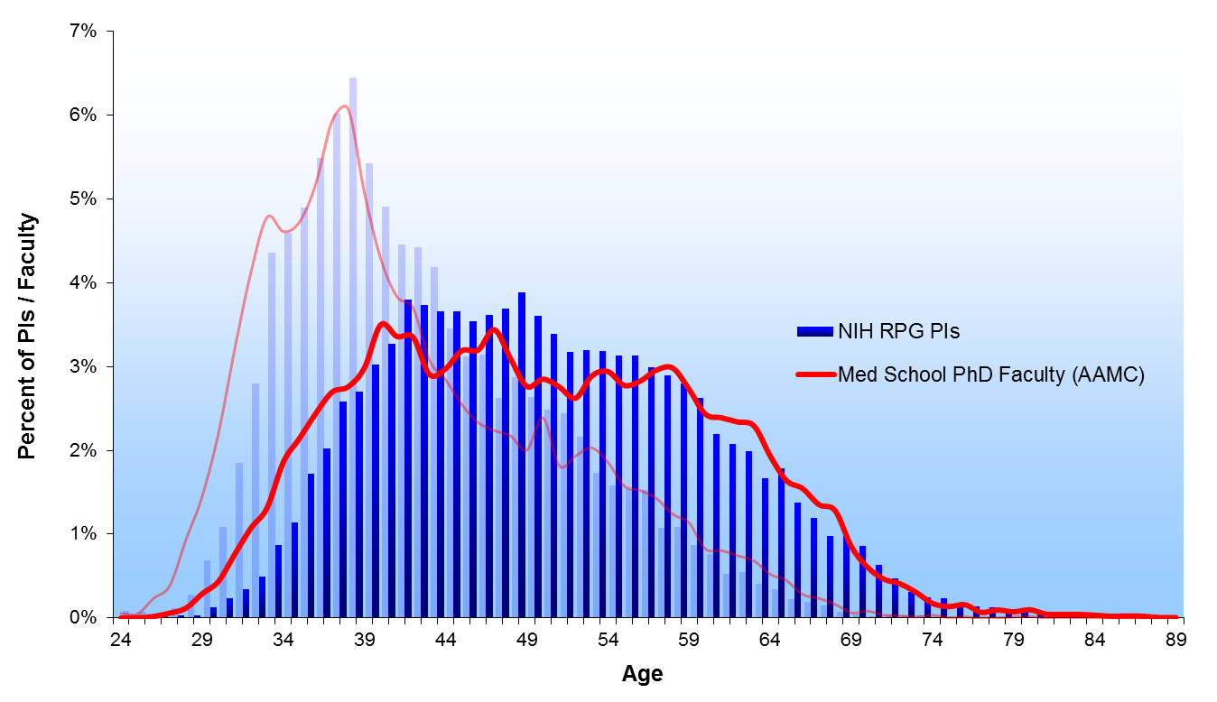
1980 & 2012
1980
2012

Slide 50
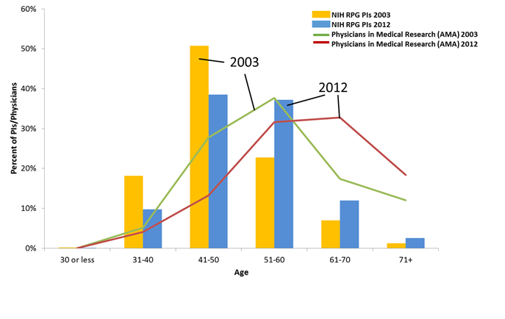
The Physician Scientist Pool is Aging

Slide 51
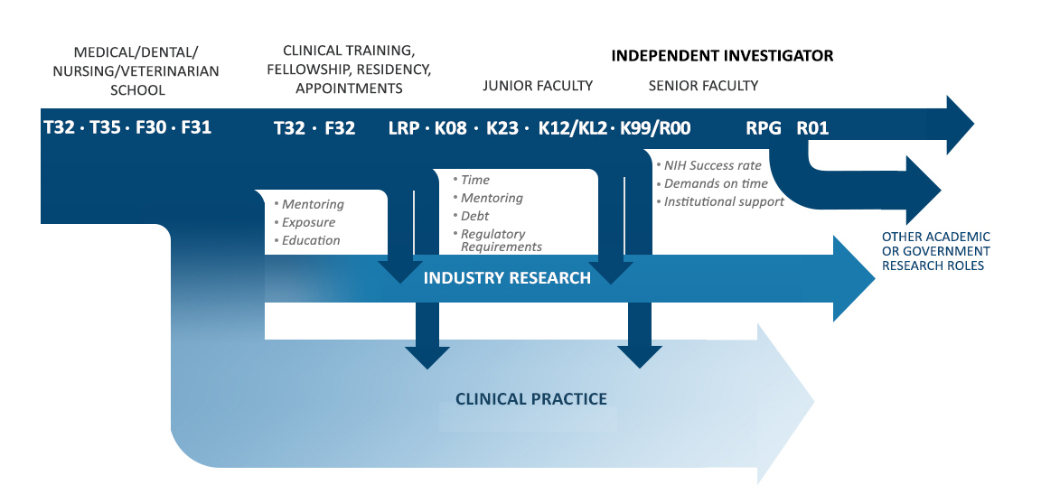
Physician-Scientist Pathway

Slide 52
Recommendations from the PSW Working Group
Sustain strong support for MD/PhD programs
Shift NRSA postdoc training awards to support proportionately more individual fellowships vs institutional grants
Establish PS-specific K99/R00-equivalent granting mechanism
Expand loan repayment programs & increase dollar amounts of loan forgiven
Support pilot grant programs to test existing & novel approaches to improve and/or shorten research training
Intensify efforts to increase diversity in the physician-scientist workforce
Leverage the existing resources of the CTSA program to obtain maximum benefit for training and career development

Slide 53

Webpage of Grants and Funding

Slide 54
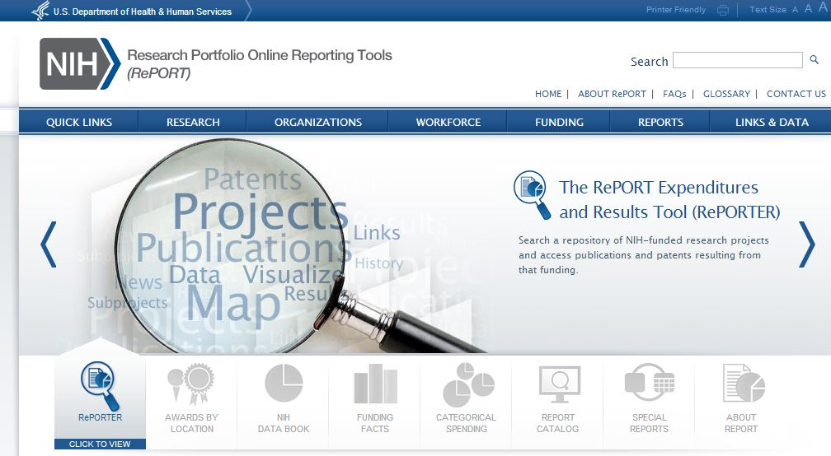
Finding Funded Research: http://RePORT.NIH.Gov
  Quick access to “Frequently Requested Reports” (e.g. Funding by State,
  Funding by Award Mechanism, etc.)
  Efficient search tools for locating data and reports
  Links to funding estimates for certain research areas, conditions, & diseases.

Slide 55
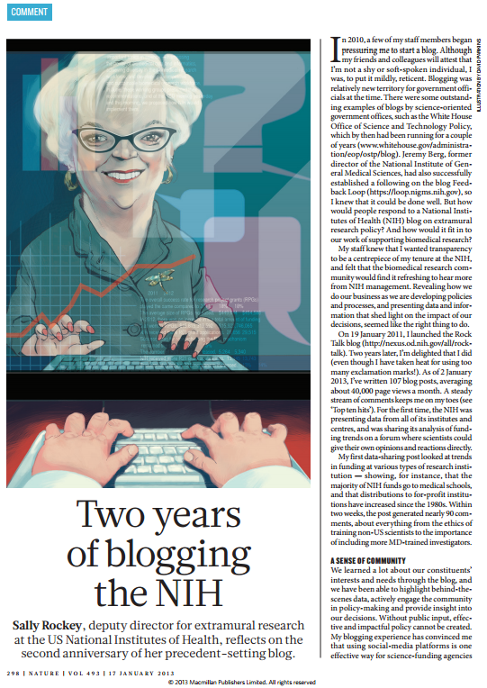

http://nexus.od.nih.gov/all/rock-talk
Get Connected
to the
Rock Talk Blog
I’m Tweeting!!
@RockTalking
Conference hashtag: #nihsem

Slide 56

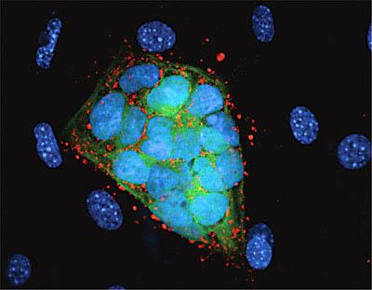
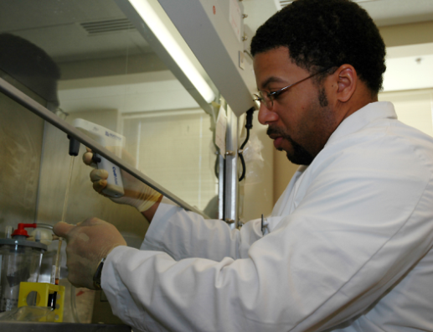
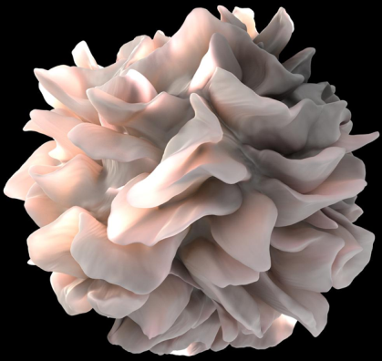

WE VALUE YOUR INPUT!
2014 NIH REGIONAL SEMINAR
Session Evaluations: http://surveymonkey.com/s/nihsessions
Overall Evaluations: http://surveymonkey.com/s/nihoverall
NIH…
Turning Discovery Into Health

