Slide 1

The Nuts and Bolts of NIH Funding
NIH TOP 10
Megan Columbus

Slide 2

Finding the Right Fit

Slide 3
Top 10 Questions
#1: Where’s the money?
#2: How do I get some?
#3: Do I call NIH before applying?
#4: How long does it take to get funded?
#5: What’s the right type of grant for my idea (and me)?
#6: Got Funded! Now What?
#7: Not Funded! Now What?
#8: How do I track my application?
#9: Where is my “go-to” place for info?
#10: Final Pieces of Advice?

Slide 4

#1 Where is the Money?

Slide 5

Understanding NIH
NIH is the steward of medical and behavioral research for the Nation
Our mission: to acquire new knowledge to help prevent, detect, diagnose, and treat disease and disability …
… from the rarest genetic disorder to the common cold

Slide 6


























27 Institutes and Centers (IC)
Each with a different:
  mission & priorities
  budget
  funding strategy
NIGMS
International Center
Clinical Center

Slide 7

Funding Opportunities
Advertised through
  Grants.gov
  NIH Guide for Grants and Contracts
Issued by
  Each IC
  “Parent” announcements span the breadth of the NIH mission, include many ICs

Slide 8
Types of
Funding Opportunity Announcements (FOA)
Type of FOA | Description
Program Announcements (PA, PAR, PAS) | Highlights areas of focus Usually ongoing (3 yrs) Often use standard receipt dates
Requests for Applications (RFA) | Narrowly defined scope Usually single receipt date Set aside funds IC usually convenes review panel
Parent Announcements | Type of program announcement Generally span the breadth of NIH mission By activity code (R01, R03, etc) For “investigator initiated” or “unsolicited” research ideas

Slide 9

#2: How Do I Get Some?

Slide 10

Where to start
Develop your research idea
  Should be important (have high impact)
  Needs to align with an IC mission
Identify a funding opportunity
  If no FOA specific to your area, look for a “parent” announcement.
Talk with NIH staff about your idea and where it fits
Write a strong proposal that addresses review criteria
Nuts and Bolts:
- Grants Writing for Success
- Writing an Effective K Application
- Working with Program Pre and Post Award
and more….

Slide 11
Where to start (cont.)
Complete/renew required registrations (Start now!)
  Institutions are requireWhere to start (cont.)d to register in multiple systems
  Investigators must register in the eRA Commons
Develop the application
  Carefully read the funding opportunity and application instructions!!
  Download application from funding opportunity announcement
Learn about the electronic application submission process well before the application due date
Nuts and Bolts:
- Interacting Electronically with NIH

Slide 12
Know Your Institution
What is your role?
What roles do other people play?
  Authorized Organizational Representative
  Principal Investigator
  Administrator
Coordination and respect for each other’s roles is key
Understand your institutional processes and timelines for grant related activities

Slide 13
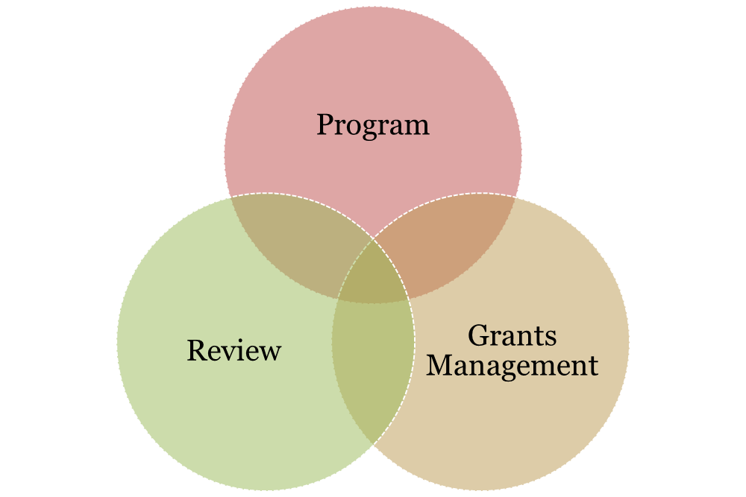
Understand the NIH Extramural Team
Notes:
13
Review, programt and grants management each have a role in the application/award process, so we’ll go into those a little bit now.

Slide 14
Program Official
Responsible for the programmatic, scientific, and/or technical aspects of a grant
Provides scientific guidance to investigators pre- and post-award
Develops initiatives
Provides post-award oversight
Nuts and Bolts:
Working with Program Officials Preaward & PostAward
Notes:
14

Slide 15
Scientific Review Officer
Responsible for scientific and technical review
  Ensures fair and unbiased evaluation of scientific and technical merit
  Provides a summary of the evaluation
  Reviews applications for completeness and conformance with application requirements
Point of contact for applicants during the review process
Nuts and Bolts:
- The NIH Peer Review Process
- For Your Review – Inside a NIH Study Section Meeting
Notes:
15

Slide 16
Grants Management Officer
Responsible for completion of business management requirements
  Evaluates applications for administrative content and compliance with policy
  Negotiates Awards
  Interprets grants administration policies
Nuts and Bolts:
- Budget Basics for Administrators
- All About Costs Primer
Notes:
16
Just as an official request must come from the aor, the official response must come from grants management.

Slide 17

#3: Do I Contact NIH Before Applying?
#3: Do I Contact NIH Before Applying?

Slide 18
Do I Contact NIH Before Applying?
Yes!
Mandatory
Application with budget >$500,000 direct costs for any single year
R13 Conference Grants
Optional
When RFA’s request a Letter of Intent
Always Recommended
When you think about applying for any grant
Notes:
18

Slide 19

#4: How Long Does It Take to Get Funded?

Slide 20

How does a grant get funded?
National Institutes of Health
Center for Scientific Review
Assigns to IC & IRG / Study Section
Great Research Idea!
Institution
Study Section
Submits Application
Reviews for Scientific Merit
Institute
Allocates Funds
Evaluates for Relevance
Investigator
Advisory Councils & Board
Performs the Research
Recommends Action
Institute Director
Makes Funding Decision

Slide 21
Ready for Award…When?
All pre-award issues are resolved
  Budget Negotiation
  Certification on Education on Human Subjects
  Animals & Human Subject Protection Issues
  Other Support Documentation
Application to award takes ~9-10 months
Nuts and Bolts:
- Budget Building Blocks for Investigators
- All About Costs
- Working with Program Officials: PreAward & PostAward

Slide 22

#5: What’s the Right Type of Grant for My Idea (and Me)?
Research Projects
Small Business
Training & Career Development
Research Centers
Nuts and Bolts:
- Mapping Your Career with NIH, Part I & II
- Primetime with NIH Program: Understanding RPGs
- Working with Program Officials Preaward & PostAward

Slide 23

#6: Got Funded…Now What?

Slide 24

You’ll Receive a Notice of Award (NoA)
Legally binding document
  Award data and fiscal information
  Grant payment info
  Terms and conditions of award
Grantee accepts terms and conditions of award when draws down funds
Notes:
24

Slide 25

NIH Grants Policy Statement
Is a term and condition of all grant awards
Explicitly defines roles, responsibilities
  grants.nih.gov/grants/policy/nihgps_2013
Notes:
The standard terms and conditions are located in the NIHGPS. The NIHGPS incorporates the applicable grant regulations that apply to NIH awards.
An award that includes a conditional restriction should include the appropriate details as to how to lift that restriction, eg who to submit info to
The award-specific terms are located on the awards document, including a mention of the appropriate use of unobligated funds, and whether or not those funds are available for automatic carryover.
There are informational terms, including appropriate URLs and addresses for submitting information.
And the most helpful information bits are the names and contact information of your grants management specialist and program official. The contact information will include the telephone number and e-mail address

Slide 26

Post Award Management
Annual progress reporting
Annual federal financial reporting
Invention reporting
Yearly audits (as applicable)
Closeout reporting
Nuts and Bolts:
- After the Award is Made…Then What?
- All About Costs Primer
- Working with Program Officials: PreAward & PostAward

Slide 27

#7: Not Funded! Now What?
RESUBMISSION AVENUE
NEW PROPOSAL LANE

Slide 28

Regroup
Take a deep breath
Read summary statement
Read it again
Talk with your NIH program official
Evaluate your options
  Revise & submit again?
  Choose a new research direction?
Nuts and Bolts Sessions:
- Grant Writing for Success
- Working with Program Officials: PreAward & PostAward

Slide 29

#8: How do I track my application?

Slide 30

Commons.era.nih.gov
In Commons you can find:
Application image
Application status
Assignments (institute, review group)
NIH staff contacts (SRO, program, grants management)
Scores
Summary statement (PI only)
Notice of Award
Links to tools for reporting, no cost extensions, etc.
and more…

Slide 31
commons.era.nih.gov
Work with your institution’s office of sponsored research to be sure you are registered and your account is affiliated with your institution BEFORE you apply.
2 weeks lead time – PI registration in Commons
6-8 weeks – All institutional registrations and renewals

Slide 32

#9: Where is my “go-to” place when I get home?
eRA
Web-
sites
NIH Guide
NoA
Application
RePORT
Grants Policy
Statement

Slide 33

Bookmark NIH.gov
Bookmark NIH.gov

Slide 34

Bookmark Grant.nih.gov
Bookmark GRANTS.nih.gov

Slide 35

Trying to make heads or tails of the grants process?

Slide 36

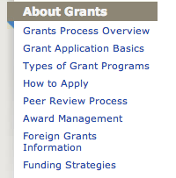
Check out grants process overview
Notes:
36

Slide 37
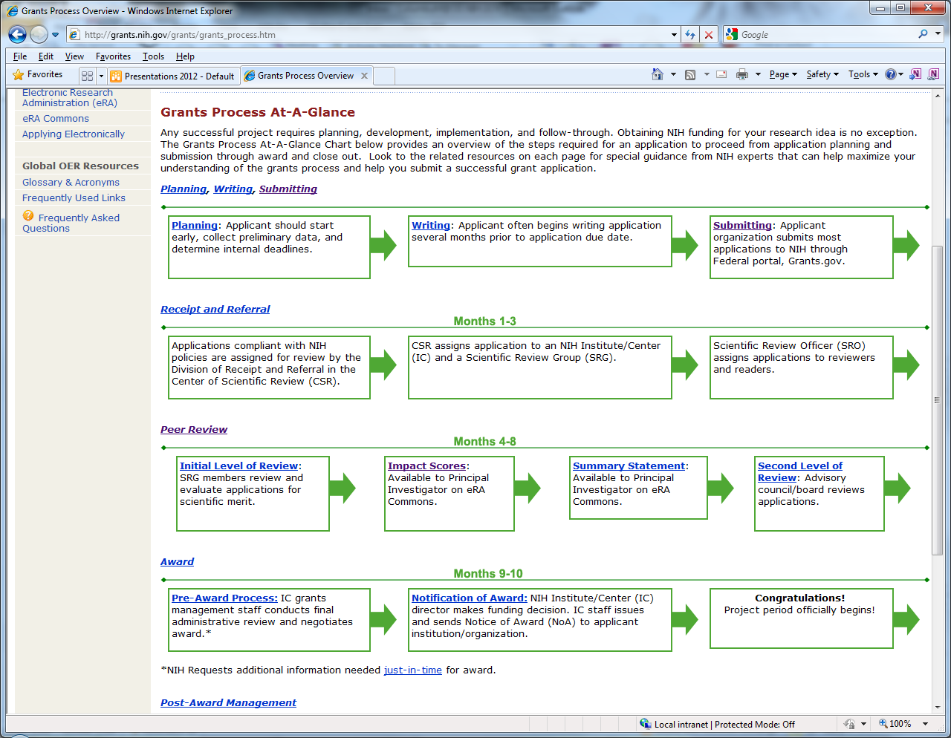
Grants process overview chart
grants.nih.gov/grants/grants_process.htm
Notes:
37

Slide 38
Types of grant Programs link
Find Grants Info at: http://www.grants.nih.gov/
Notes:
38

Slide 39
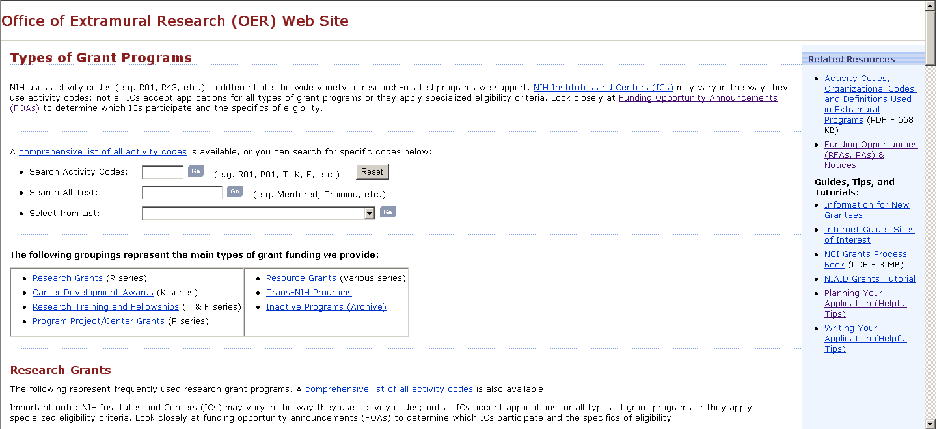
Types of grant programs page
What is an R03, F31, X02, etc?
Find out here!
grants.nih.gov/grants/funding/funding_program.htm

Slide 40
Looking for the latest grants policy changes or funding announcements?

Slide 41
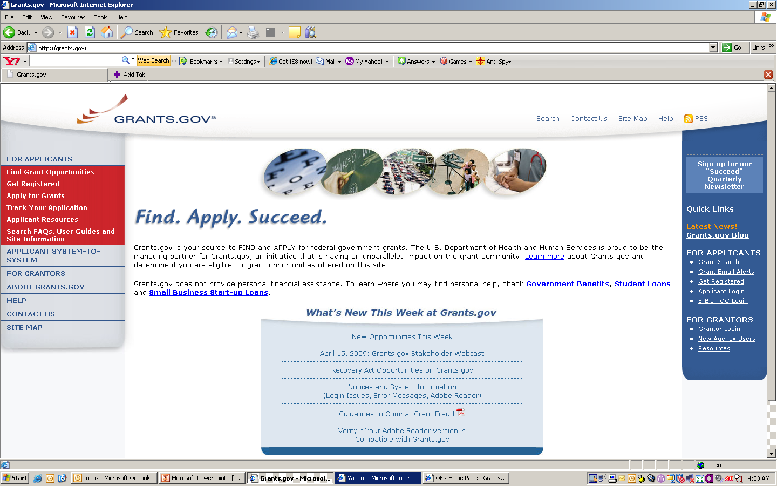
Search Grants.gov to Identify
Potential Funding Agencies
www.grants.gov
Fed-wide portal for finding grant opportunities

Slide 42

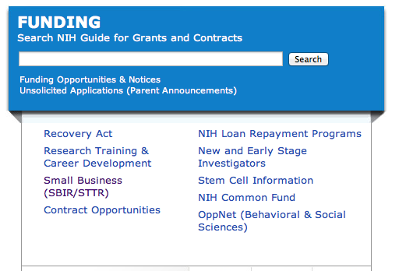
NIH Guide Grants.nih.gov

Slide 43
What can I find in the NIH Guide to Grants and Contracts?
  NIH specific funding opportunity announcements
  NIH policy notices
  Other announcements
    Changes to FOAs
    Events like this regional seminar
    NIH response to natural disasters or electronic system problems
    Etc.

Slide 44
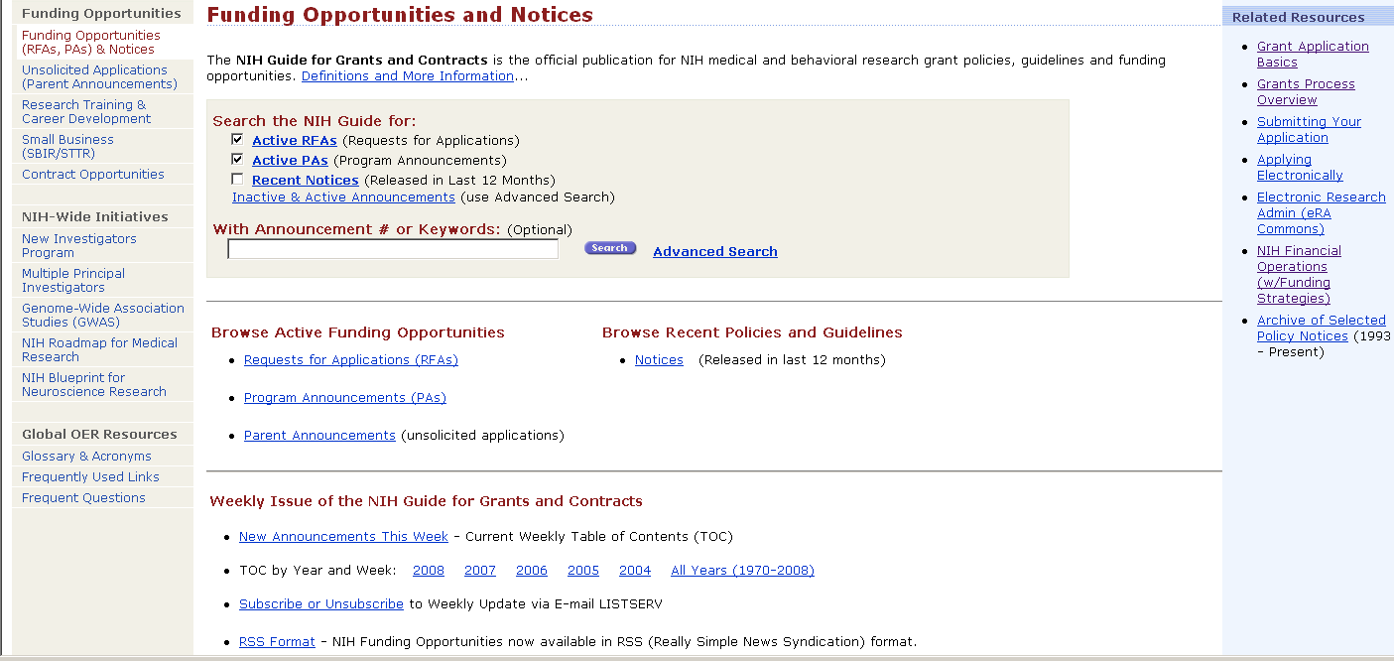
NIH Guide is published daily.
Subscribe to listserv to receive table of contents each Friday…
or subscribe to our RSS feed or follow us on Twitter

Slide 45

When are applications due?

Slide 46


Slide 47
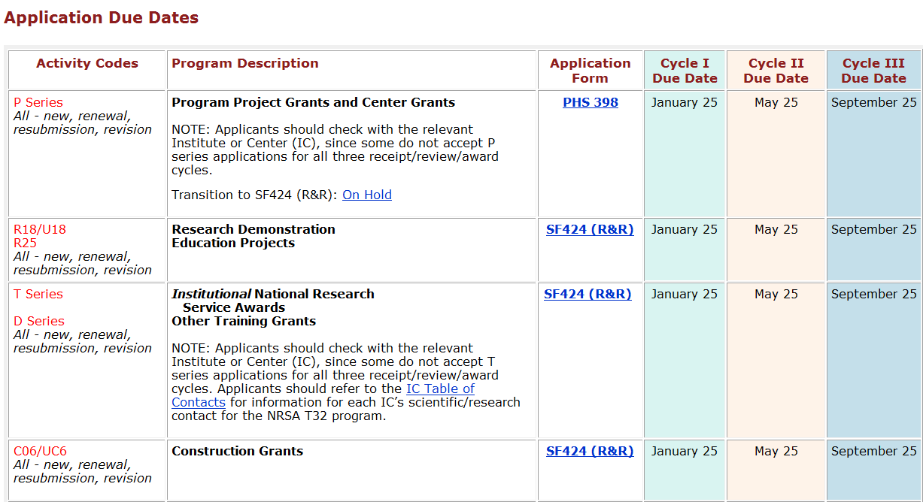
3 standard receipt dates a year.
Standard receipt dates for each type of grant
Scroll further on page for timelines for each “round”

Slide 48
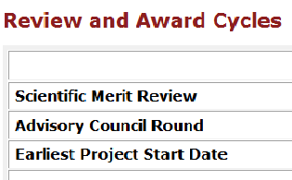
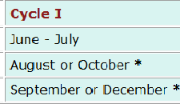
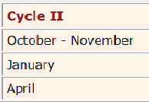
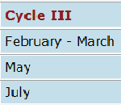
grants.nih.gov/grants/funding/submissionschedule
Review dates and earliest start date by submission round

Slide 49
Submission Policy Page
Answers common questions on:
On time submission
Standard due dates falling on a weekend or holiday
Late applications
Post submission application materials
Time limits for resubmitting application
Resubmission timelines for new investigator R01 applications
Etc…
grants.nih.gov/grants/funding/submissionpolicies.htm

Slide 50

Doing the right thing

Slide 51

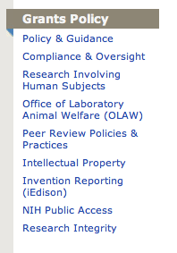
Grants Policy Resources
http://www.grants.nih.gov/

Slide 52

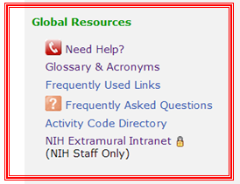
Global Resources
grants.nih.gov

Slide 53

Who speaks acronymese?!
    NIH FOAs (RFAs, PAs, PARs) issued by our ICs (NIAID, NCI, NIAAA, NIDA, NCI, NICHD, etc.) for AREA, SBIR and other programs reflect updates to GWAS, multiple PI, EPR and other policies.

Slide 54

Get a sense of who and what NIH funds
Organizational
funding information
Potential collaborators
Which ICs fund
research like yours
NIH-funded workforce data
Award
trends
NIH staff contacts
NIH grantees in your area
Success rates

Slide 55
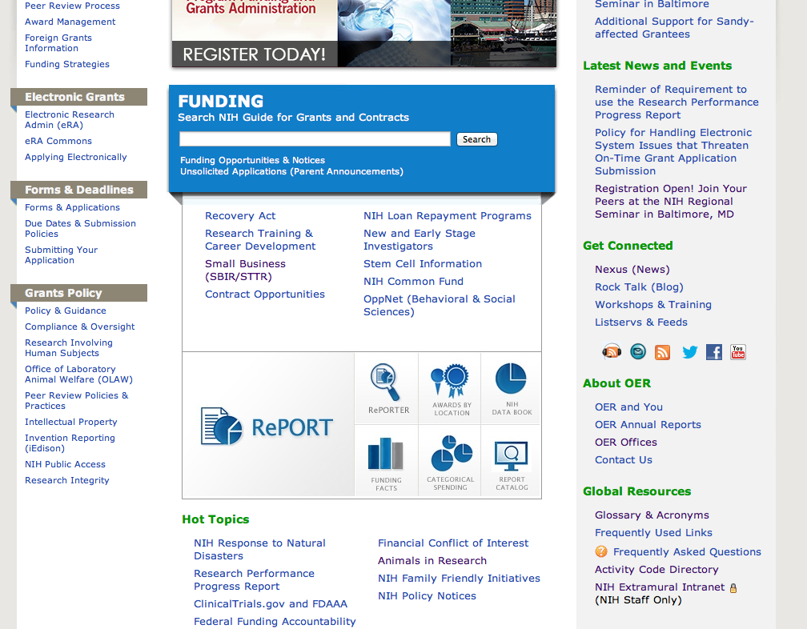

Finding RePORT
www.grants.nih.gov/

Slide 56
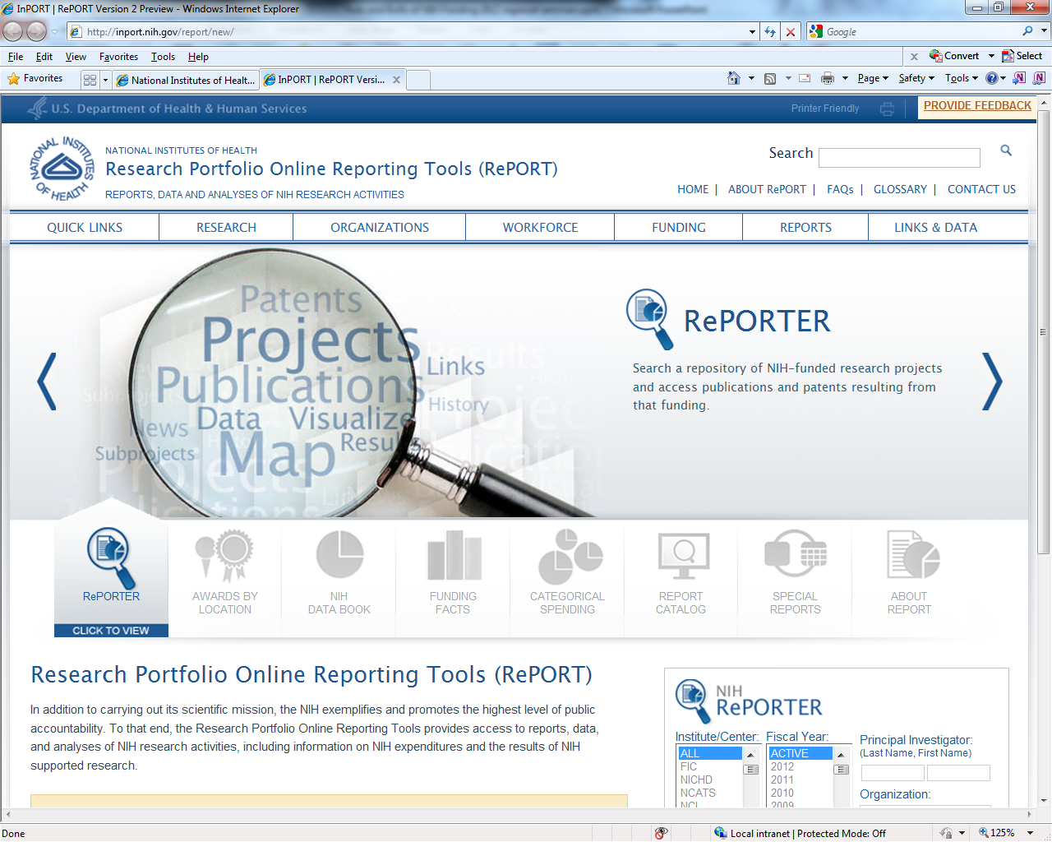
Report Website
RePORT.nih.gov

Slide 57

Make sense of our ever changing environment

Slide 58
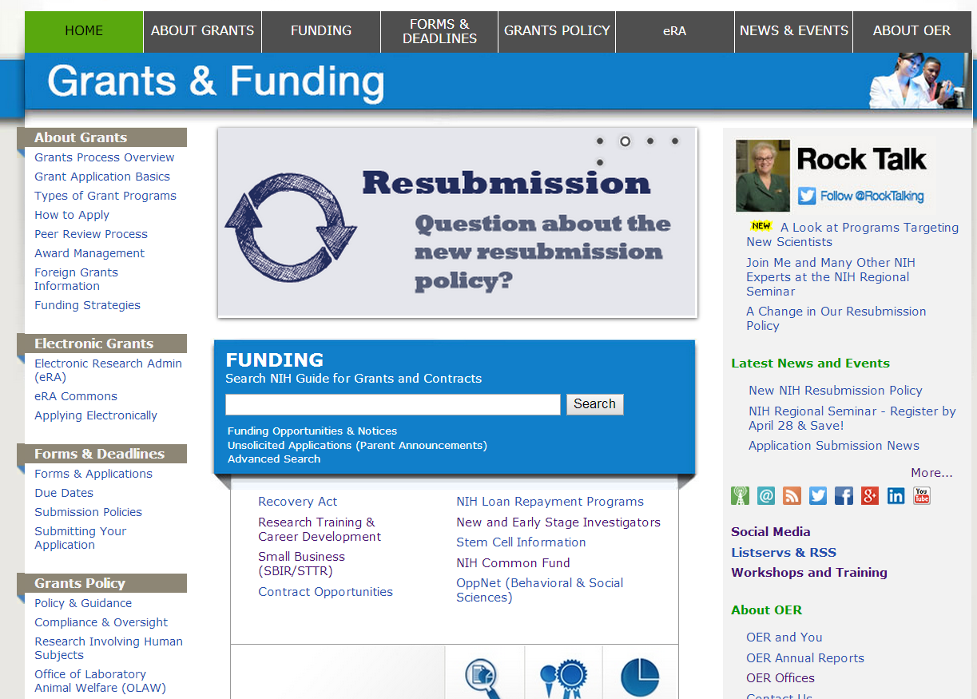

Get Connected @ Grants.nih.gov
Get Connected @ grants.nih.gov

Slide 59
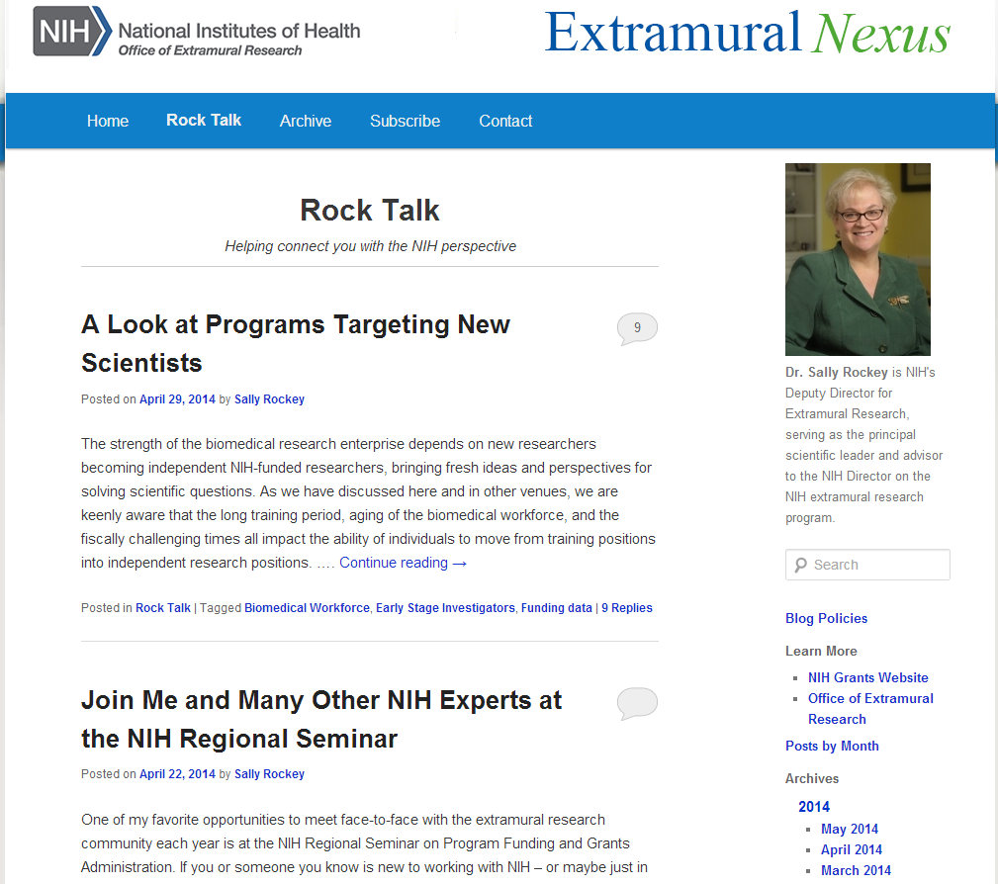
Extramural Nexus and Rock Talk Blog
Subscribe to the monthly Nexus for a summary of NIH grant happenings, resources, events.
Join the discussion on the Rock Talk blog!
http://nexus.od.nih.gov
http://nexus.od.nih.gov

Slide 60







OER’s social media presence grants.nih.gov/grants/social_media.htm
Rock Talk
All About Grants
NIH Grants
@NIHgrants
@NIHfunding
@RockTalking …
Loan Repayment Program
AREA
NIH Office of Extramural Research
NIHgrants

Slide 61
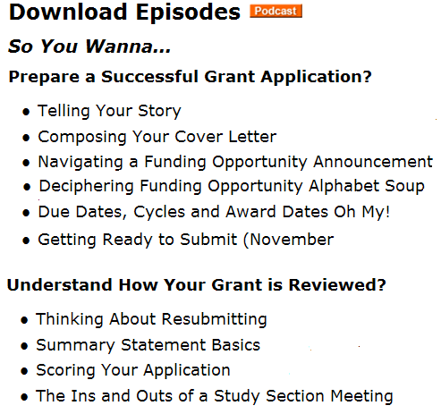

All About Grants Podcast
All About Grants Channel on iTunes or download directly from webpage
grants.nih.gov/podcasts/All_About_Grants

Slide 62
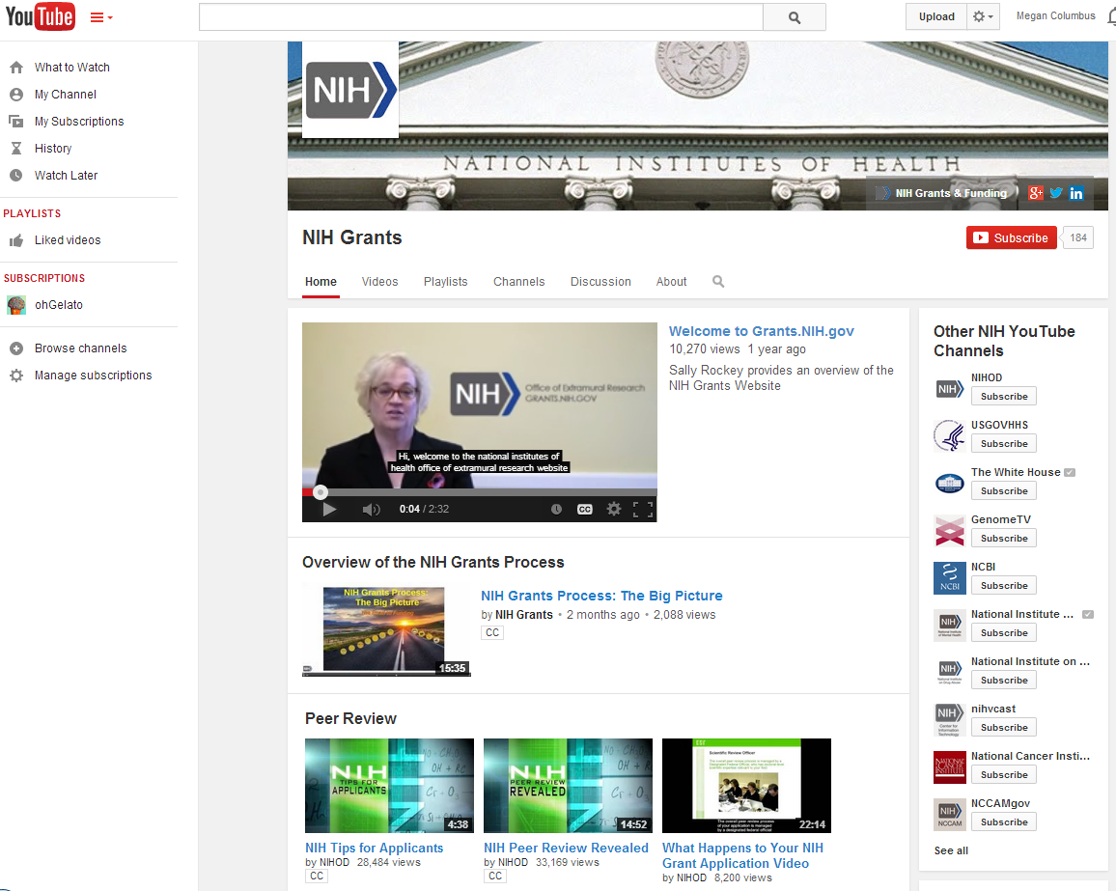
NIH Grants YouTube Channel
NIHGrants Channel on YouTube

Slide 63
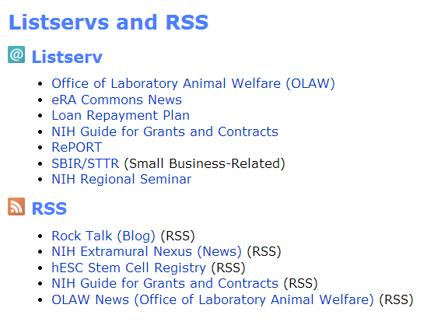
Listservs and RSS feeds provide valuable info

Slide 64

#9: Who do I talk to?

Slide 65
Finding the Right Staff Contacts
FOAs include contact names for program, review and grants management staff.
Institute websites have org charts or contact lists so to help you find a name. www.nih.gov
RePORTER provides the NIH program official’s name for funded projects. projectreporter.nih.gov
Use the NIH Staff Directory if you already have a name ned.nih.gov

Slide 66
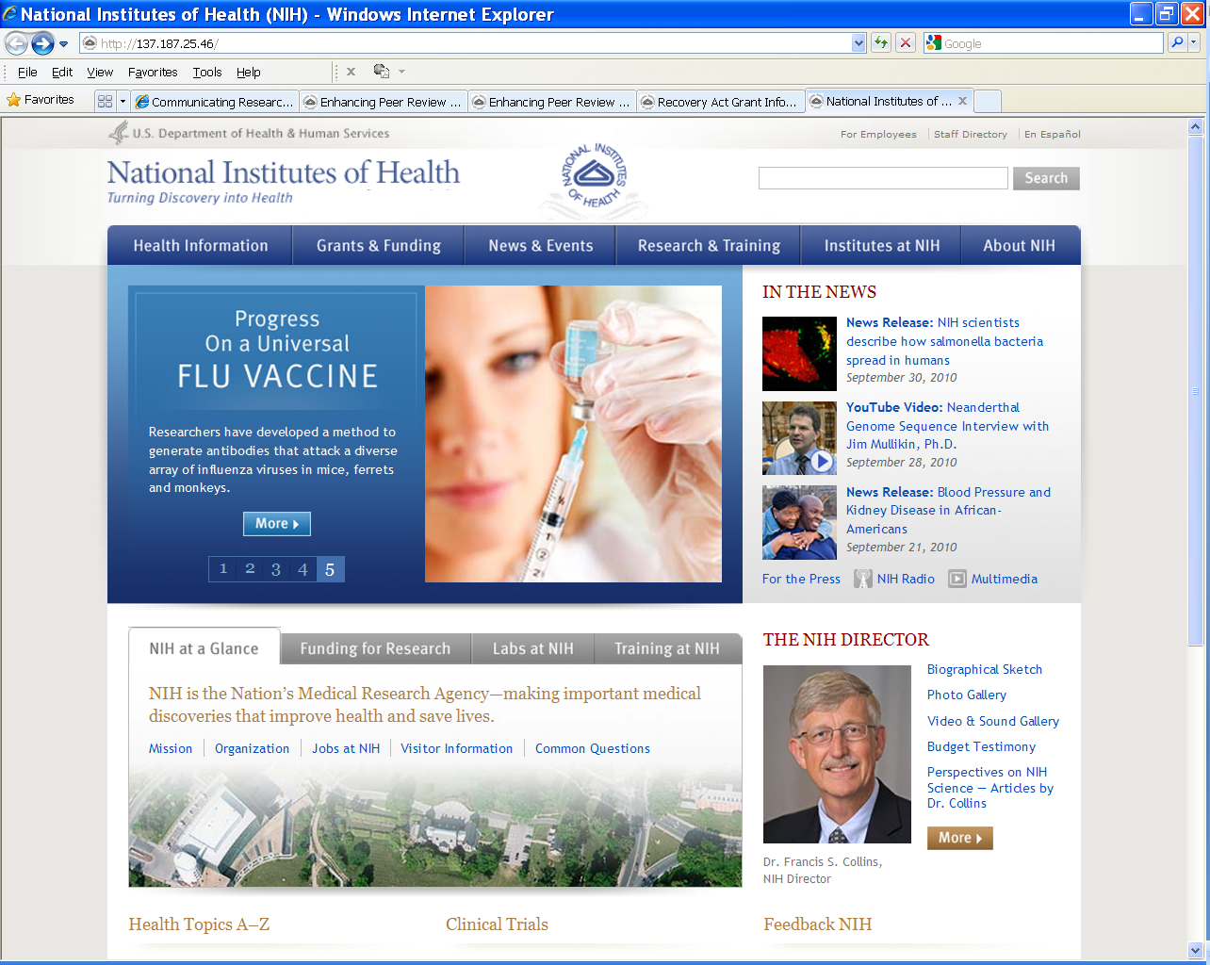
NIH Home page
www.nih.gov

Slide 67
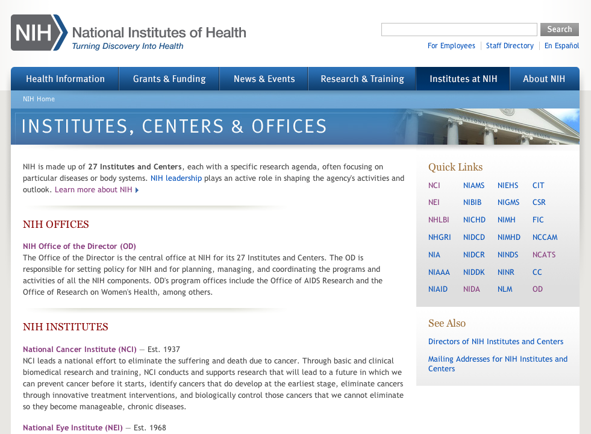
Central institute, center and office info
Bookmark your favorite Institute!
www.nih.gov/icd

Slide 68

#10: Final Pieces of Advice?
You will be successful

Slide 69
Remember
Do your research
  Understand the NIH process, policies, & expectations
Build support
  Learn who can help you at your institution
Reach out
  Contact us
  Stay connected and monitor what is happening at NIH

Slide 70
  Make the most of this conference!
Ask questions
Get answers
Make connections.

Slide 71
I am here for you, both during and after this conference, if you need help navigating NIH
Megan Columbus
Director, Division of Communiction and Outreach, NIH Office of Extramural Research
and
NIH Program Manager for Electronic submission of grant applications
301-435-2496
Megan.columbus@nih.gov

