Slide 1
The NIH Peer Review Process
NIH Regional Seminars 2014
Sally A. Amero, Ph.D. Dana Plude, Ph.D.
NIH Review Policy Officer Biobehavioral and Behavioral Processes IRG
National Institutes of Health NIH Center for Scientific Review

Slide 2

NIH Peer Review
Cornerstone of the NIH extramural mission
Standard of excellence worldwide
Partnership between NIH and the scientific community
Per year:
  ~ 70,000 - 80,000 applications
  ~ 25,000 reviewers

Slide 3
National Institutes of Health
Office of the Director
National Institute
on Aging
National Institute
on Alcohol Abuse
and Alcoholism
National Institute
of Allergy and
Infectious Diseases
National Institute
of Arthritis and
Musculoskeletal
and Skin Diseases
National Cancer
Institute
Eunice Kennedy
Shriver National Institute
of Child Health and
Human Development
National Institute on
Deafness and Other
Communication
Disorders
National Institute
of Dental and
Craniofacial
Research
National Institute
of Diabetes and
Digestive and
Kidney Diseases
National Institute
on Drug Abuse
National Institute
of Environmental
Health Sciences
National Eye
Institute
National Institute
of General
Medical Sciences
National Heart,
Lung, and Blood
Institute
National Human
Genome Research
Institute
National Institute
of Mental Health
National Institute
of Neurological
Disorders and
Stroke
National Institute
of Nursing Research
National Institute of
Biomedical Imaging
and Bioengineering
National Center
for Complementary
and Alternative
Medicine
John E. Fogarty
International
Center
National Center
for Research
Resources
National Library
of Medicine
National Institute on
Minority Health and
Health Disparities
Clinical Center
Center for
Information
Technology
Center for
Scientific Review

Slide 4
Review Process
Receipt and Referral
Initial Peer Review
National Advisory Councils
Submit your
application
Funding
decision

Slide 5

NIH Peer Review Revealed
Video
Overall Mission
Receipt & Referral
Level 1 – review of scientific merit
  SRO, Study Section and Review
  Summary Statement
Level 2 – funding decisions
  Program Officer
  National Advisory Council
  IC Director

Slide 6

President Obama on Peer Review
"To maintain our edge . . . we've got to protect our rigorous peer review system and ensure that we only fund proposals that promise the biggest bang for taxpayer dollars . . . that's what's going to maintain our standards of scientific excellence for years to come."
President Obama
April 29, 2013
National Academy of Sciences

Slide 7
Division of Receipt and Referral
Key decisions
  Format compliance
  Timeliness
  Assignment to study section for initial peer review
  Assignment to IC(s) for funding consideration
Study Section
IC(s)
Scientific focus & mission relevance
Initial peer review (CSR or IC)
Scientific Review Officers
Program Officials
DRR
Council
Application
IC
Director

Slide 8

Requesting a Study Section
Locus of review is usually stated in the FOA.
Descriptions of CSR study sections: http://public.csr.nih.gov/StudySections/IntegratedReviewGroups/Pages/default.aspx
Rosters are available on NIH websites http://era.nih.gov/roster/index.cfm
http://www.csr.nih.gov/committees/rosterindex.asp
eRA Like (A Thesaurus-based Search Tool)
  http://era.nih.gov/services_for_applicants/like_this/likethis.cfm

Slide 9

Submit a Cover Letter
The cover letter conveys important information:
Application title
FOA # and title
Suggested Institute/Center assignment
Suggested review assignment
Individuals in potential conflict and explain why
Areas of expertise needed to evaluate the application
Any special situations
It is NOT appropriate to use the cover letter to suggest specific reviewers.
Not all study section/IC requests can be honored.

Slide 10


Conflict of Interest
Bases for Conflict of Interest (COI)
  Financial - Professional
  Employment - Study Section membership
  Personal - Other interests
Appearance of COI
Depending on nature of COI, individual with a COI:
  must be excluded from serving on the Study Section, or
  must be recused from discussion and scoring of application.

Slide 11

Level 1 of NIH Peer Review
Review of Scientific Merit
This part of NIH peer review is
managed by the Scientific Review Officer (SRO).
  Identifies and recruits reviewers
  Assigns reviewers to individual applications
  Manages conflicts of interest
  Arranges and presides at review meetings
  Prepares summary statements –
  the official written outcome
  of initial peer review

Slide 12


Confidentiality
All confidential materials, discussions, documents
are deleted, retrieved or destroyed.
All questions must be referred to the SRO.
Applicants: Do not contact reviewers directly!

Slide 13



Study Sections
Make recommendations on:
  Scientific and technical merit
  Impact
    Impact scores
    Criterion scores
    Written critiques
  Other review considerations

Slide 14


Reviewers
  Expertise
  Stature in field
  Mature judgment
  Impartiality
  Ability to work well in a group
  Managed conflicts of interest
  Balanced representation
  Availability

Slide 15

Reviewer Assignments
For each application:
  ≥ Three qualified reviewers are assigned for in-depth assessment
  Assignments are made by the SRO
    Expertise of the reviewer
    Suggestions from the PI on expertise – not names!
    Suggestions from Program staff and Study Section members
    Managing conflicts of interest
    Balancing workload
Assignments are confidential

Slide 16

Before the Meeting
Reviewers
  Examine assignments (~ six weeks in advance)
  Often participate in an SRO orientation teleconference
  Sign Conflict of Interest and Confidentiality certifications
  Read applications, prepare written critiques
  Enter preliminary scores and critiques into secure website
  Read and consider critiques and preliminary scores from other Study Section members

Slide 17
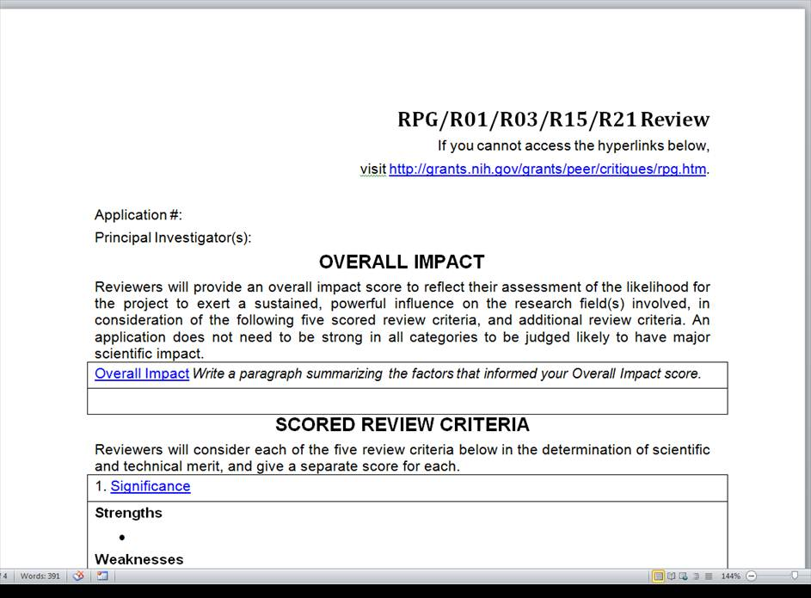
Critique Templates
Links to
definitions
of review
criteria

Slide 18

Overall Impact
Overall consideration for all NIH applications
Defined differently for different types of applications
  Research grant applications: Likelihood for the project to
  exert a sustained, powerful influence on the research
  field(s) involved
  See “Review Criteria at a Glance” http://grants.nih.gov/grants/peer/reviewer_guidelines.htm

Slide 19
Scored Review Criteria
Receive individual, numerical scores from assigned
reviewers.
For research grant applications:
  Significance - Approach
  Investigator(s) - Environment
  Innovation

Slide 20

Additional Review Criteria
Are considered in determining the impact score, as applicable for the project proposed
For research grant applications:
  Protections for Human Subjects
  Inclusion of Women, Minorities and Children
  Vertebrate Animals
  Resubmission, Renewal and Revision Applications
  Biohazards

Slide 21

Additional Review Considerations
Are not considered in determining impact score but
are for Program Officials to consider
For research grant applications:
  Applications from Foreign Organizations
  Select Agent Research
  Resource Sharing Plans
  Budget and Period of Support

Slide 22
NIH Scoring System
Reviewers give numerical scores
  1 (exceptional) to 9 (poor)
  Integers
Used for:
  Final impact scores
  Individual criterion scores
1 – high impact
9 – low impact

Slide 23
Score Descriptors
Impact | Score | Descriptor
High Impact | 1 | Exceptional
 | 2 | Outstanding
 | 3 | Excellent
Moderate Impact | 4 | Very Good
 | 5 | Good
 | 6 | Satisfactory
Low Impact | 7 | Fair
 | 8 | Marginal
 | 9 | Poor

Slide 24
Final Impact Scores
Voted by all eligible (w/o COI) SRG members
Voted by private ballot at the meeting
Calculated by:
  Averaging all reviewers’ votes
  Multiplying by 10
Range from 10 through 90
Percentiled for some mechanisms
10 – Highest Impact
90 – Lowest Impact

Slide 25
Criterion Scores
Minimum of five scored criteria
Given by assigned reviewers in their critiques
Generally not discussed at the meeting
Reported on the summary statement
1 – high impact
9 – low impact

Slide 26
Not Discussed Applications
Allows discussion of more meritorious applications
  Less meritorious applications are tabled
  Designated Not Discussed (ND)
Requires full concurrence of the entire study section
Summary statements contain:
  Reviewer critiques
  Criterion scores
1
ND

Slide 27
After the Review
eRA Commons (http://era.nih.gov/commons/index.cfm)
  Final Impact Score within 3 days
  Summary statement available within 4 – 8 weeks to:
      PD/PI
      NIH Officials
      Advisory Council members
      NIH Program Officer (Point of Contact)

Slide 28
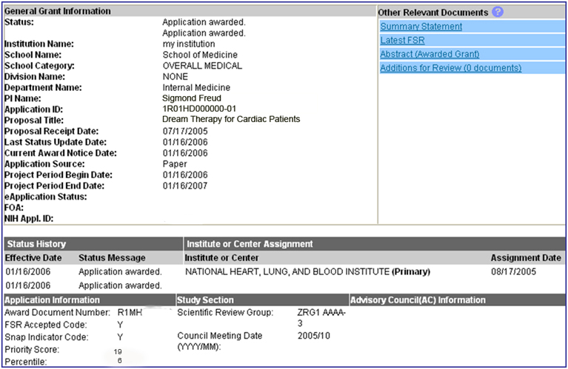
Check the Status of Your Application in the NIH Commons

Slide 29
Summary Statement
First page
  NIH Program Officer (upper left corner)
  Final Impact Score or other designation
  Percentile (if applicable)
  Codes (human subjects, vertebrate animals, inclusion)
  Budget request
A favorable score does not guarantee funding!

Slide 30

Summary Statement - continued
Subsequent Pages
  Resumé and Summary of Discussion (if discussed)
  Description (provided by applicant)
  Reviewer critiques – essentially unedited
  Administrative Notes
  Meeting roster

Slide 31

Review Outcome
If the outcome is favorable, congratulations!
If the outcome is unfavorable, consider your options:
  Submit a new application
  Revise and resubmit your application
  Appeal the review outcome
    Acceptable reasons (NOT-OD-11-064)
    Differences of Scientific Opinion Cannot be Appealed

Slide 32

Level 2 of NIH Peer Review
Funding Recommendations
National Advisory Councils
  Broad and diverse membership
    Basic/research scientists
    Clinician scientists
    “Public” members
  Nominated by Institutes; approved by HHS (or the President in a few cases)
  Awards cannot be made without Council approval
  Council procedures vary across IC’s

Slide 33

National Advisory Councils
Advise IC Director about
  Research priority areas
  Diverse policy issues
  Concept Clearance for future initiatives
  Funding priorities
Recommend applications for funding
  Expedited awards
  En bloc concurrence
Consider unresolved appeals and grievances

Slide 34
Additional Information
Office of Extramural Research Peer Review Process
http://grants.nih.gov/grants/peer_review_process.htm
Peer Review Policies & Practices
http://grants.nih.gov/grants/peer/peer.htm
Center for Scientific Review
http://public.csr.nih.gov/Pages/default.aspx

