Slide 1
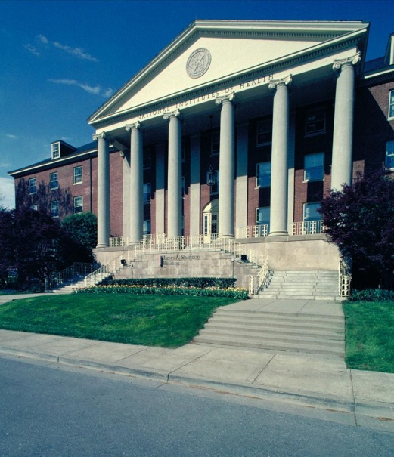
NIH Loan Repayment Programs
June 27, 2014
Sherry Mills, M.D., M.P.H.
Director, Office of Extramural Programs
NIH Office of Extramural Research

Slide 2
NIH Loan Repayment Programs (LRPs)
Summary
Up to $35k/year in educational loan repayment
Depending on debt level
Coverage of most Federal taxes resulting from the NIH LRP
2 year initial contracts
1 or 2 year competitive renewal
Approximately 1,600 researchers funded yearly
50% application success rate

Slide 3
Five Extramural LRPs
Clinical Research
Clinical Research for Individuals from Disadvantaged Backgrounds
Pediatric Research
Health Disparities Research
Contraception and Infertility Research

Slide 4
LRP Applicant General Eligibility Requirements
Citizenship: U.S. citizen, U.S. national or permanent resident
Doctoral degree: biomedical professional degree (M.D., Ph.D. or equivalent)
EXCEPTION = Contraception & Infertility Research LRP
Qualified educational debt: Educational loan debt > 20% of your annual salary
Domestic, non-profit research funding: including university or government organization
Qualified research: must be conducting > 20 hours/week (50% effort)

Slide 5
Other Eligibility Issues
Individuals are not eligible for the NIH LRPs if they:
Have a Federal judgment lien against their property arising from a Federal debt
Are a full-time Federal government employee or VA Fellow
Owe an obligation of health professional service to the Federal government, a state, or other entity, unless deferrals are granted for the length of their LRP service obligation
NRSA T32, T90 and F32 awardees are eligible. NIH grants a deferral of the NRSA service obligation.

Slide 6
Qualified Educational Debt
NIH will repay educational loans that are:
Guaranteed by the U.S. Government
From accredited U.S. academic institutions and commercial lenders
NIH will not repay:
Non-education loans (e.g., home equity loans)
Loans consolidated with another individual (e.g., spouse or child)
PLUS loans to parents
EXCEPTION: PLUS loans disbursed to graduate and professional students on or after July 1, 2006, qualify for LRP repayment
Loans that have been converted to a service obligation
Delinquent loans, loans in default, or loans not current in repayment

Slide 7
Extramural LRP for Clinical Research
Purpose:
Recruit and retain highly qualified health professionals as clinical investigators.
Qualifying research:
Must have direct interaction with patients
Patient-oriented clinical research
Research on the causes and consequences of disease
Clarify a problem in human physiology, pathophysiology or disease,
Epidemiologic or behavioral studies
Outcomes research or health services research
Develop new technologies, therapeutic interventions, or clinical trials

Slide 8
Extramural Clinical Research LRP for Individuals from Disadvantaged Backgrounds
Purpose:
Recruit and retain highly qualified health professionals from disadvantaged backgrounds as clinical investigators.
An individual from a disadvantaged background:
Comes from an environment that inhibited the individual from obtaining the knowledge, skill and ability required to enroll in and graduate from a health professions school; or
Comes from a family with an annual income below a level based on low-income thresholds according to family size.
Qualifying research:
As described for Extramural LRP for Clinical Research

Slide 9
Extramural Pediatric Research LRP
Purpose:
Recruit and retain highly qualified health professionals as clinical investigators.
Qualifying Research:
Directly related to diseases, disorders, and other conditions in children, including pediatric pharmacology.

Slide 10
Extramural LRP for Health Disparities Research
Purpose:
Recruit and retain highly qualified health professionals to research careers that focus health disparity issues.
50% of awards to applicants from health disparity populations
Qualifying research:
Within health disparity populations
Causes of health disparities
Methods to prevent, diagnose, and treat such conditions

Slide 11
Extramural LRP for Contraceptive and Infertility Research
Purpose:
Recruit and retain highly qualified health and/or allied health professionals as contraception and/or infertility investigators.
Qualifying research:
Evaluate, treat or ameliorate conditions which result in the failure of couples to either conceive or bear young
Provide new or improved methods of preventing pregnancy

Slide 12
Review Process
Division of Loan Repayment
Center for Scientific Review
NIH Institute or Center
Peer Review
Notes:
.

Slide 13
Peer Review Criteria
Panels evaluate each applicant’s potential to succeed in a research career by rating:
Applicant’s previous training and research experience
Applicant’s commitment to a research career
Current research environment
Research progress (for Renewal applications only)

Slide 14
The Application
The LRP application is divided into three sections:
Personal Information
Research
Loans (new applicants only)

Slide 15
Tips for Writing a Competitive LRP Application
These tips will help you strengthen your application.
Know the funding priorities of your NIH Institute or Center.
Effectively demonstrate your qualifications and commitment to research.
Describe resources and support thoroughly.
Write a strong research plan.
Provide strong letters of recommendation.
To download this complete document, visit http://www.lrp.nih.gov/pdf/0310_1_application_tips.pdf

Slide 16
Common Mistakes to Avoid
The following conditions often weaken an applicant’s competitiveness.
Weak or lukewarm recommendation letters
Questionable research commitment
Mediocre research plan
Rushed application
Inadequate research environment
Slim publication record

Slide 17
Application Cycle Timeline
September 1 – November 15: Application Cycle
November 15: Application Deadline
December 1: Colleague Deadline
December 31: Contract and Online Certification & Citizenship Forms Deadline
February – May: Application Peer Review
May: Initial Selection
May – July: Financial Vetting
July 1: Contract Start Date
Mid-July: Final Funding Decisions and Recipient Notification
August – September: Contract Signing
October: First Payment to Lender

Slide 18
Additional Resources
LRP Information Center
Open each weekday from 9 a.m. to 5 p.m. ET
(866) 849-4047 or LRP@nih.gov
Webinar: Overview of Loan Repayment Programs
http://go.usa.gov/aHx
LRP Web site: http://www.lrp.nih.gov
Twitter: @NIH_LRP
Facebook: http://www.facebook.com/nihlrp

Slide 19
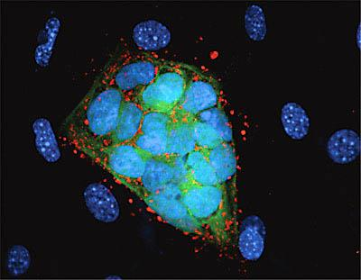
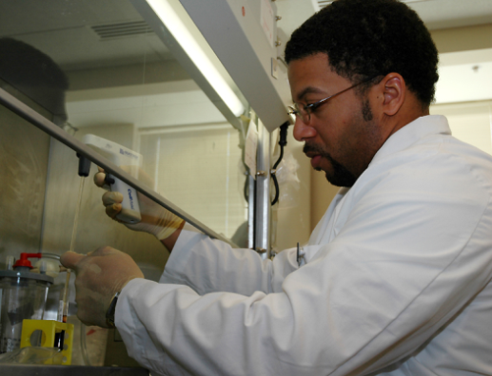
WE VALUE YOUR INPUT!
2014 NIH REGIONAL SEMINAR
Session Evaluations: http://surveymonkey.com/s/nihsessions Overall Evaluations: http://surveymonkey.com/s/nihoverall
NIH…
Turning Discovery Into Health

