Slide 1
The NIH Public Access Policy
Neil Thakur, Bart Trawick, Katie Funk
June 26, 2014
Posted at http://publicaccess.nih.gov/communications.htm

Slide 2
Today’s Discussion: The NIH Public Access Policy
The Basics
Awardee Tasks
Enhancing Compliance
NIHMS: Processing Manuscripts
My NCBI Features: A Primer
Compliance Monitoring for Institutions
Ways Institutions Can Ensure Compliance

Slide 3
The NIH Public Access Policy
        1) The Basics:
        The Policy
        Its Implications

Slide 4
The NIH Public Access Policy Is Mandatory
The Policy implements Division G, Title II, Section 218 of PL 110-161 (Consolidated Appropriations Act, 2008) which states:
The Director of the National Institutes of Health shall require that all investigators funded by the NIH submit or have submitted for them to the National Library of Medicine’s PubMed Central an electronic version of their final, peer-reviewed manuscripts upon acceptance for publication, to be made publicly available no later than 12 months after the official date of publication: Provided, That the NIH shall implement the public access policy in a manner consistent with copyright law.
Where to Make Public
What to Submit
When to Submit
When to Make Public
4
4
Notes:
4
NIH must implement this policy because it is the law.
Making published research funded by NIH publicly available is an important opportunity to advance science and improve human health.
What to submit? Final, peer-reviewed manuscripts
When to submit? Upon acceptance for publication
When to make public? No later than 12 months after the official date of publication
Where to make public? The National Library of Medicine’s Pubmed Central
Speakers notes Revised 9/29/08
3/9/09- updated with new guide notice

Slide 5
The Policy Applies to Any Manuscript That…
Is peer-reviewed;
Is accepted for publication in a journal on or after April 7, 2008;
And, arises from:
  Any direct funding from an NIH grant or cooperative agreement active in Fiscal Year 2008 or beyond, or;
  Any direct funding from an NIH contract signed on or after April 7, 2008, or;
  Any direct funding from the NIH Intramural Program, or;
  An NIH employee.
5
5
Notes:
5
The Policy applies to all final peer-reviewed manuscripts. The Policy does not apply to non-peer-reviewed materials such as correspondence, book chapters, and editorials.
The NIH Public Access Policy applies to all final peer-reviewed manuscripts that arise from the NIH intramural program or any amount of direct costs1 funded by NIH, regardless of the source or amount of other funding.
1 Costs that can be specifically identified with a particular project or activity. NIH Grants Policy Statement, Rev. 12/2003; http://grants.nih.gov/grants/policy/nihgps_2003/NIHGPS_Part2.htm#_Toc54600040.
Updated 4/22/08
Updated 3/23/09 to comply with Division F Section 217 of PL 111-8 (Omnibus Appropriations Act, 2009)
Updated 11/16/09
** Until further notice, papers written in scripts other than Latin (e.g., Russian, Japanese) cannot be processed by the NIHMS. These papers are not required to be posted on PubMed Central and do not require evidence of compliance on applications, proposals or reports. The NIHMS continues to process papers written in Latin (Roman) script that contain characters and fonts used in standard mathematical notation. See http://grants.nih.gov/grants/guide/notice-files/NOT-OD-10-009.html for details.
Updated 11/19/09 to include Guide Notice Link

Slide 6
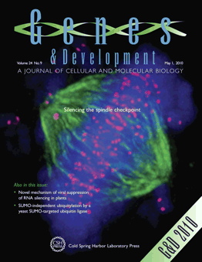

Definitions: Article Types
Final Published Article
Journal’s authoritative copy of the paper
Includes peer review modifications plus copyediting and formatting changes
Submitted by Publishers/Journals to PMC (Methods A&B)
Final Peer-Reviewed Manuscript:
Author’s final manuscript of a peer-reviewed paper accepted for journal publication
Includes all modifications from the peer review process
Submitted by Authors and Publishers/Journals to PMC (Methods C&D)
Notes:
Through out the presentation and website, we use the word ‘paper’ as a generic word for all versions of a scientific peer-reviewed article, including final peer review manuscripts and final published articles
Genes and Development is a “Method A Journal” (5/17/20100

Slide 7

PubMed vs PubMed Central (PMC)
  Free resources developed by the U. S. National Library of Medicine
Biomedical journal citations + abstracts
Some links to full text articles at PMC and publisher websites.
Unique identifier: PMID followed by a series of numbers.
vs
Digital archive of full-text, peer-reviewed journal papers.
Unique identifier: PMCID followed by a series of numbers.
Notes:
PubMed and PubMed Central (PMC) are free resources that are developed and maintained by the National Center for Biotechnology Information (NCBI), at the National Library of Medicine (NLM), at the National Institutes of Health (NIH).
PubMed comprises more than 19 million citations for biomedical literature from MEDLINE, life science journals, and online books. Citations may include links to full-text content from PubMed Central and publisher web sites.

Slide 8


PubMed vs PubMed Central (PMC)
  Or, another way to think about it:
vs
vs
is analogous to
Notes:
PubMed and PubMed Central (PMC) are free resources that are developed and maintained by the National Center for Biotechnology Information (NCBI), at the National Library of Medicine (NLM), at the National Institutes of Health (NIH).
PubMed comprises more than 19 million citations for biomedical literature from MEDLINE, life science journals, and online books. Citations may include links to full-text content from PubMed Central and publisher web sites.

Slide 9
2) Awardee Tasks
        Address Copyright
        Posting Papers
        Documenting Compliance

Slide 10
Address Copyright
  Institutions and investigators are responsible for ensuring full compliance with the Public Access Policy.
Make sure the copyright transfer agreement allows the final peer-reviewed manuscript to be submitted to NIH.
We encourage authors to consider
Who will submit the paper and/or approve the submission?
What version of the paper will be made available on PMC?
When will it be submitted and when will the paper be made public on PMC?
10
10
Notes:
Authors own the original copyrights to materials they write. Consistent with individual arrangements with authors' employing institutions, authors often transfer some or all of these rights to the publisher when the journal agrees to publish their paper. Some publishers may ask authors to transfer copyrights for a manuscript when it is first submitted to a journal for review.
Authors should work with the publisher before any rights are transferred to ensure that all conditions of the NIH Public Access Policy can be met. Authors should avoid signing any agreements with publishers that do not allow the author to comply with the NIH Public Access Policy.
Federal employees always may submit their final peer-reviewed manuscript to PubMed Central, because government works are not subject to copyright protection in the United States.
Points to consider section added 3/11/09

Slide 11
Posting Papers
The 4 ways papers make their way into PMC:
  Method A: Publish in a PMC-participating journal.
  Method B: Arrange to have a publisher deposit the final published article in PMC.
  Method C: Submit the final peer-reviewed manuscript to the NIHMS.
  Method D: A publisher begins the submission process for a manuscript via the NIHMS.
11
11
Notes:
The first thing awardees must do is address copyright.
Revised 9/17/08 to reflect clarifications on deposit methods, as described at http://publicaccess.nih.gov/submit_process.htm
Revised 3/18/09 to include the Citation Methods Page

Slide 12
Posting Papers: Methods A and B straight to PMC
Journal deposits the published version of all NIH-funded articles in PMC.
A
Final published article in PMC
Author arranges for Publisher to deposit published version of specific article in PMC.
B
Notes:
http://publicaccess.nih.gov/submit_process_journals.htm#journals
Over 800 journals participate in the Method A process
PMC ID generally assigned in a week.

Slide 13
Posting Papers: Methods C&D via the NIHMS
Methods C&D: Manuscript submission to the NIHMS
Who can deposit manuscripts in the NIHMS?
An Author
A Delegate: anyone given access to the author's files
The Publisher
Remember:
Only Authors can approve the submission and web versions of the manuscript.
Awardees need an NIHMSID upon acceptance for publication.
Notes:
Manuscript files may be submitted to NIHMS by the author, the publisher, or anyone given access to the author's files (administrative personnel, graduate students, librarians, etc.).
Approval of the PDF Receipt and web version of the manuscript requires author review and authorization.
NIHMS accounts will be kept separate between login routes. For this reason, submitters must continue to use the same login method for subsequent visits to NIHMS. For example, manuscripts that are submitted via your NIH login will not be viewable if you were to subsequently log in to NIHMS through an eRA Commons account.

Slide 14
Posting Papers
Methods C&D: Manuscript submission to the NIHMS
Deposit manuscript files - An NIHMSID is assigned to the submission.
Author or delegate submits final peer reviewed manuscript to the NIHMS.
C
Journal publisher submits final peer reviewed manuscript to the NIHMS.
D
Notes:
http://publicaccess.nih.gov/submit_process_journals.htm#journals
Two Routes to deposit a final peer-reviewed author manuscript in PMC: Methods C and D through NIHMS

Slide 15
Posting Papers: Methods C&D via the NIHMS
Methods C&D: Manuscript submission to the NIHMS
  2. Author approves PDF receipt, gives permission to NIH to process the manuscript: Methods C and D.
Author Approval
Author or delegate submits final peer reviewed manuscript to the NIHMS.
C
NIHMS sends author an email asking author to approve the submitted materials for processing.
Journal publisher submits final peer reviewed manuscript to the NIHMS.
D
Notes:
http://publicaccess.nih.gov/submit_process_journals.htm#journals
Over 800 journals participate in the Method A process

Slide 16
Posting Papers: Methods C&D via the NIHMS
Methods C&D: Manuscript submission to the NIHMS
3. Author approves PMC-formatted manuscript for public display: Methods C and D.
Author Approval
Author or other submits final peer reviewed manuscript to the NIHMS.
C
Manuscript archived in PMC
NIHMS sends author an email asking author to approve the submitted materials for processing.
Author reviews and approves the PMC-formatted manuscript .
Journal publisher submits final peer reviewed manuscript to the NIHMS.
D
After submission is complete, NIHMS emails the citation with PMCID to author and PIs
Notes:
http://publicaccess.nih.gov/submit_process_journals.htm#journals
Over 800 journals participate in the Method A process

Slide 17
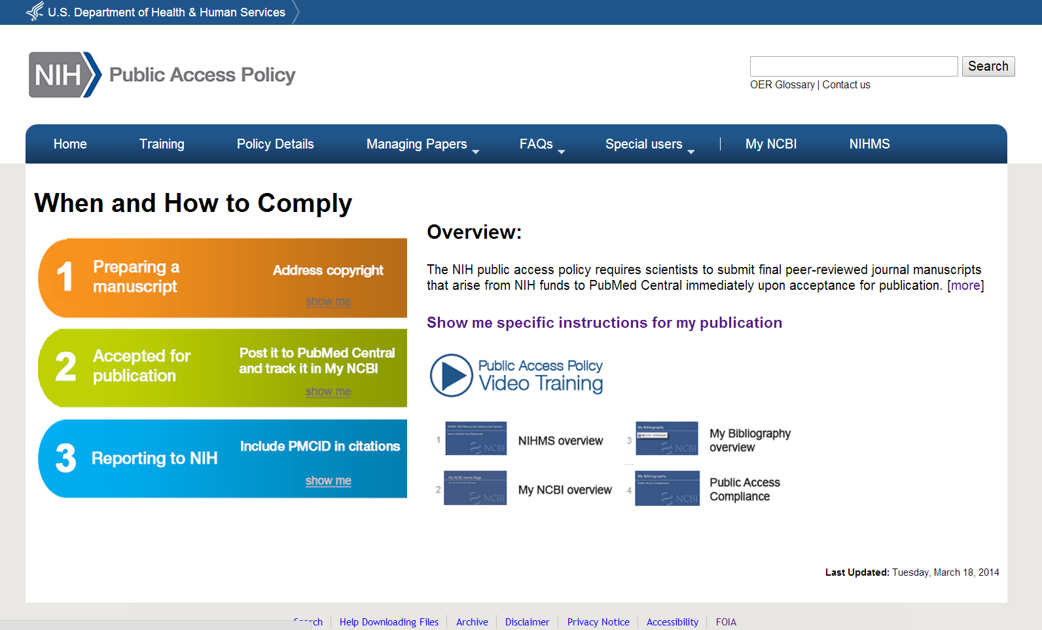
Identifying Submission Method by Journal Name
http://publicaccess.nih.gov

Slide 18
How to cite papers in press (epub ahead of print), or within 3 months of publication…
Documenting Compliance
For Method A and B Journals, use “PMC Journal - In Process”.
  Example: Sala-Torra O, et al. Connective tissue growth factor (CTGF) expression and outcome in adult patients with acute lymphoblastic leukemia. Blood. PMCID: PMC Journal - In Process
For Method C and D Journals, use the NIHMSID.
  Example: Cerrato A, et al. Genetic interactions between Drosophila melanogaster menin and Jun/Fos. Dev Biol. In press. NIHMSID: NIHMS44135
NIHMSIDs will not be accepted 3 months after publication.
    PMCIDs are assigned around the time of publication.
    Use the PMCID once it is assigned.
18
18
Notes:
18
See http://publicaccess.nih.gov/citation_methods.htm for more information
Updated for SF424 Compliance 11/26/08
Website updated 3/19/09
Updated 9/4/09 to reflect NOT-OD-09-136, Clarification on the Use of an NIHMSID to Indicate Compliance with the NIH Public Access Policy

Slide 19
How to cite papers archived in PMC
Documenting Compliance
  When citing a paper in NIH applications, proposals, and progress reports, include the PMCID at the end of the full citation.
  Applies to papers that fall under the Policy and are authored or co-authored by you.
  Example
    Varmus H, Klausner R, Zerhouni E, Acharya T, Daar A, Singer P. 2003. PUBLIC HEALTH: Grand Challenges in Global Health. Science 302(5644): 398–399. PMCID: PMC243493
19
19
Notes:
If a PMCID is not yet available, include the NIH Manuscript Submission system reference number (NIHMS ID) instead.
Please use the PMC prefix in front of a PubMed Central reference number
Revised 9/29/08 to include Guide Notice reference
Revised 11/26/08 to include all authors in example citation
Revised 3/19/09 to change reference from a guide notice to Citation methods Page

Slide 20
3) Enhancing compliance
        Scope
        My NCBI, RPPR and PHS 2590

Slide 21
For non-competing continuation awards
(NOT-OD-12-160) For non-competing continuation with a start date of July 1, 2013 and beyond
Awards will be placed on hold until grantees have demonstrated compliance
My NCBI is required to report papers, when electronically submitting progress reports using the Research Performance Progress Report (RPPR)
PDF reports generated from My NCBI are required, when submitting paper progress reports using the form PHS 2590 (replaces publication section)

Slide 22
RPPR and E Notification
Trigger: When a grantee submits a RPPR to NIH that associates 1 or more publications with the award for which the public access compliance status is “Noncompliant”.
Recipients: to the PD/PI, with a cc to the AO, SO, GMS, IC mailbox, and PO.
Response: The grantee may respond to the eNotification via email or through the Progress Report Additional Materials (PRAM) link.

Slide 23
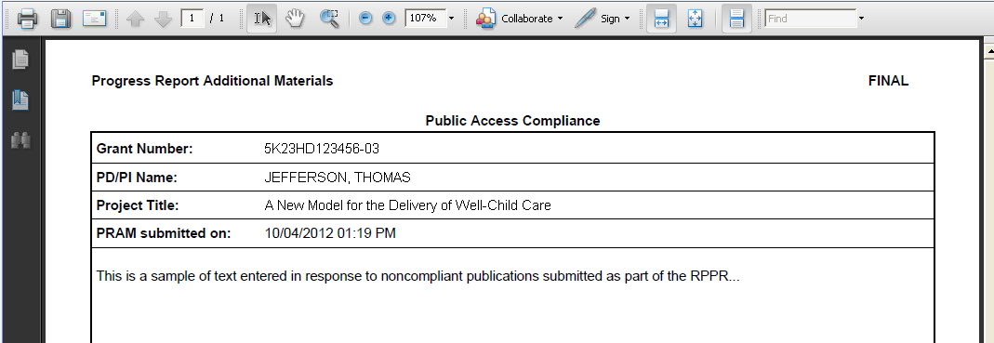
Example: PRAM for Public Access

Slide 24
4) NIH Manuscript Submission System: Processing manuscripts

Slide 25
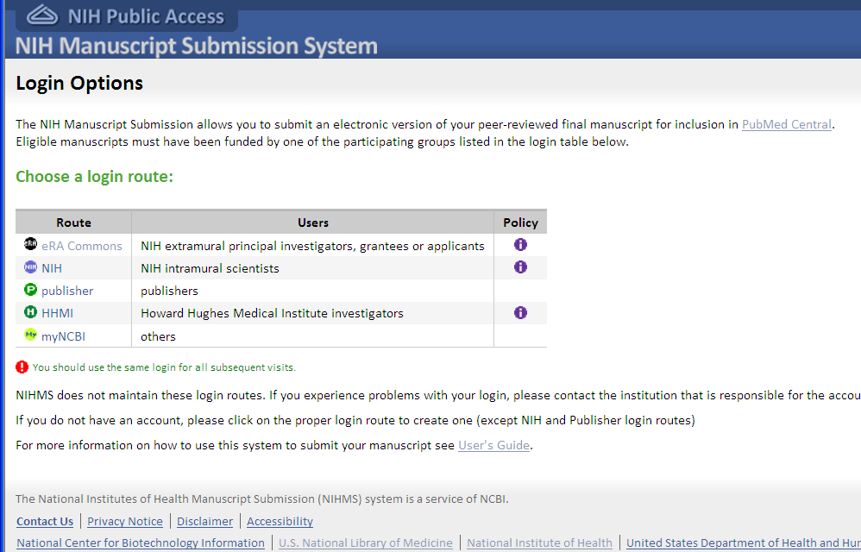
NIHMS Login Options
Each Login route has its own NIHMS account
Submitters must continue to use the same login method for subsequent visits to NIHMS.
Notes:
NIHMS accounts will be kept separate between login routes.
Submitters must continue to use the same login method for subsequent visits to NIHMS.

Slide 26
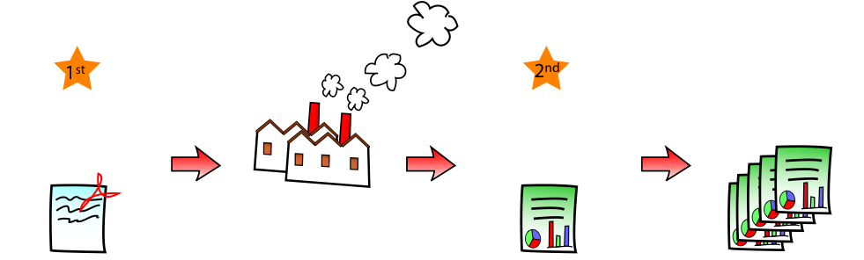
NIHMS Processing Overview
Notes:
Chose reviewer section of NIHMS Review and Approve Submission

Slide 27
NIHMS: Methods C & D
Method C
Author or delegate deposits manuscript files in NIHMS
Which articles?
Associate funding
Approve deposit
Review & approve PMC web version
Deposit files
Author responsibility?
At the time the paper is accepted for publication
When?
Manuscripts that meet the criteria of the NIH Public Access Policy
Method D
Publisher deposits manuscript files in NIHMS
Which articles?
Manuscripts that meet the criteria of the NIH Public Access Policy
When?
At the time the paper is accepted for publication
Author responsibility?
Notify publisher of NIH support
Associate funding
Approve deposit
Review & approve PMC web version

Slide 28
Document processing overview
Manuscript files submitted to NIHMS
Manuscript tagged in XML
Manuscript in available in PMC (after embargo)

Slide 29
Three Steps for Authors in NIHMS
Submitter deposits files
Author approves submission
QA of submitted materials
Taggers convert files to XML
NIHMS generates standard format documents
QA of XML/HTML/PDF versions
Author reviews PMC web version
Approved documents are sent to PMC (once final citation information available)
Notification sent to assigned reviewing author
Conversion Process
Notification sent to assigned reviewing author

Slide 30
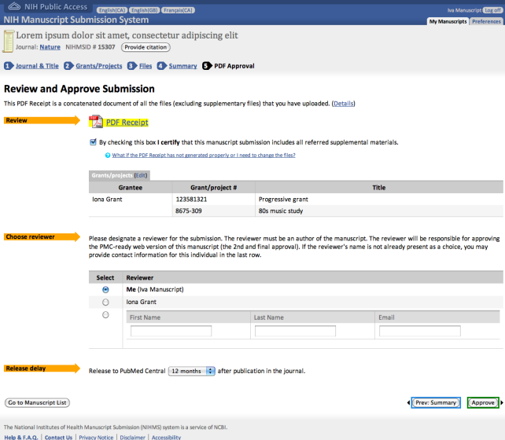
Submitter Deposits Files

Slide 31
Author Approves Submission

Slide 32
Author Reviews PMC Web Version

Slide 33
5) My NCBI: a Primer

Slide 34
What is My NCBI?
My NCBI is a free account system that provides customized services for many NCBI databases, such as PubMed.
Key features for our discussion:
Can be linked to eRA Commons accounts
Commons-linked users can associate publications with NIH grants
Tracks NIH Public Access compliance
The only way to enter publications into RPPR
Creates the publications section (Section E) of PHS 2590s
Notes:
Neil will ask Bart

Slide 35
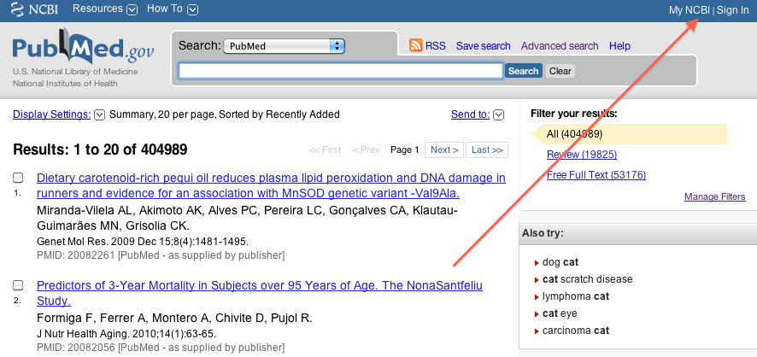
Signing in to My NCBI

Slide 36
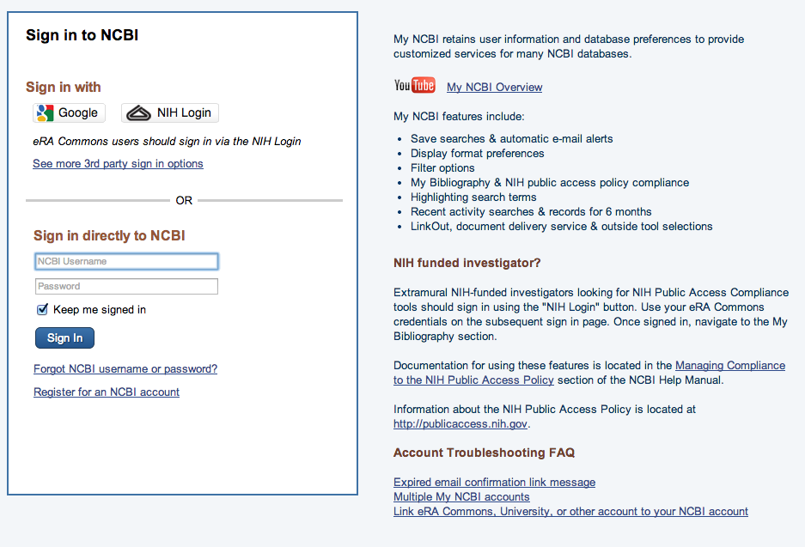
Signing in to My NCBI

Slide 37
Which eRA users should have linked My Bibliography accounts?
Principal Investigators
Anyone else with NIH support who is or was an author
  Post-Doctoral Role
  Graduate Student Role
  Scientist Role
  Project Personnel Role
http://era.nih.gov/files/eRA_Commons_Roles.pdf

Slide 38
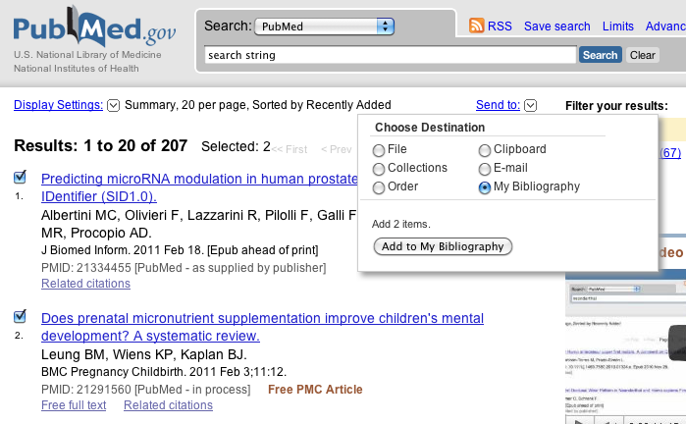
Adding PubMed Citations

Slide 39
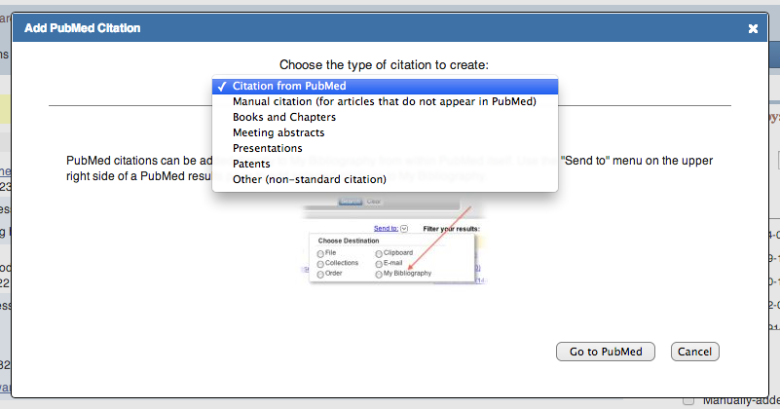
Adding non-PubMed citations

Slide 40
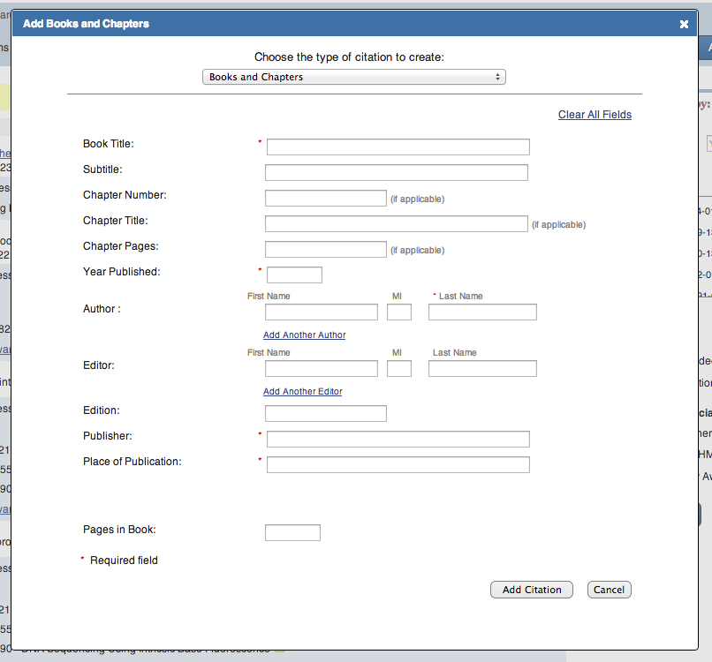
Adding non-PubMed citations

Slide 41
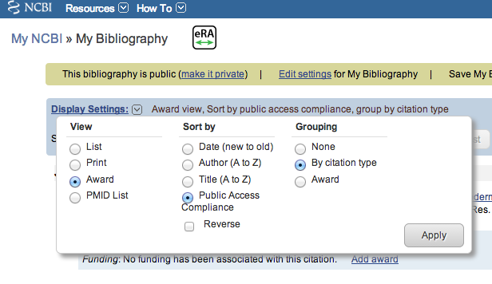
Award View option for eRA-linked users

Slide 42




Award View NIHPA compliance codes

Slide 43
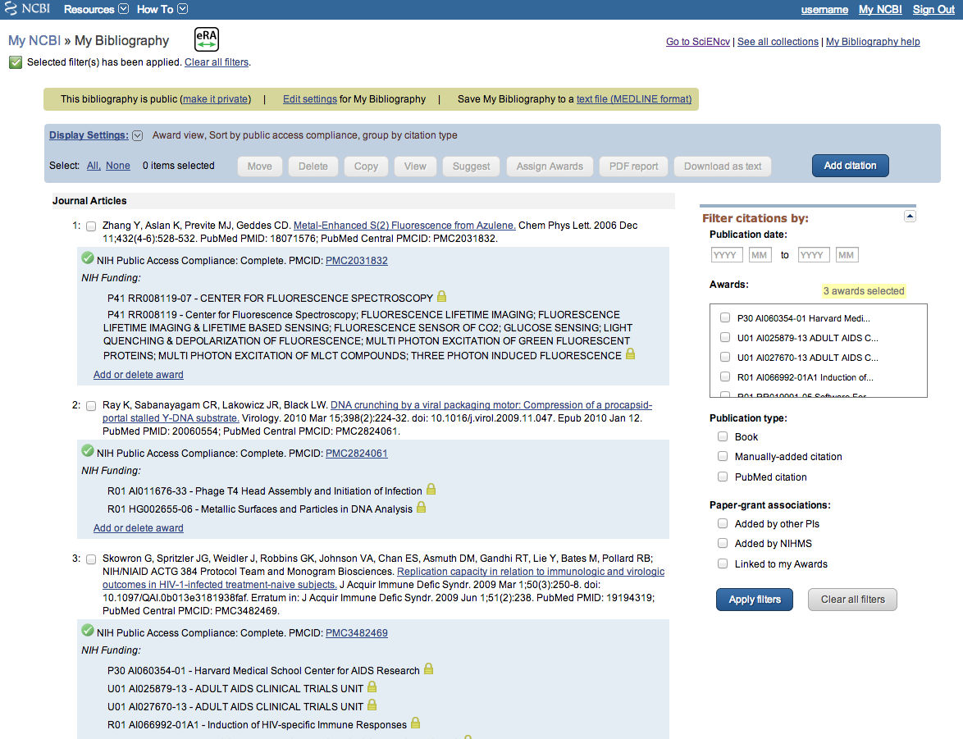
My Bibliography, Award View

Slide 44
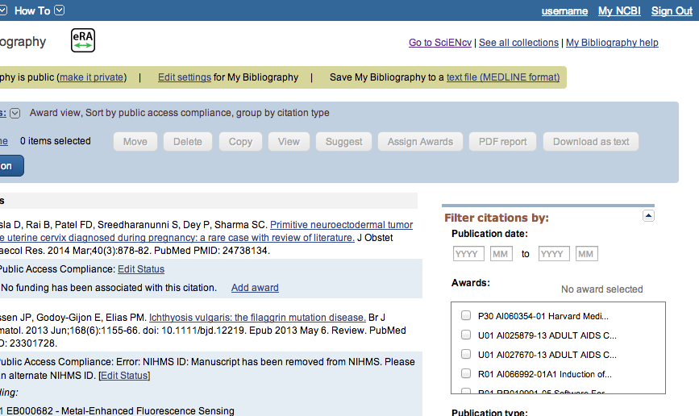
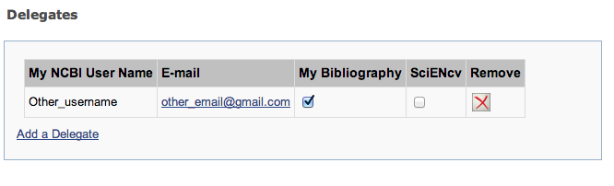
Delegation in My Bibliography

Slide 45
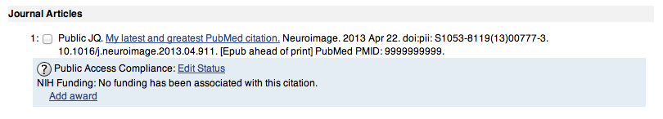
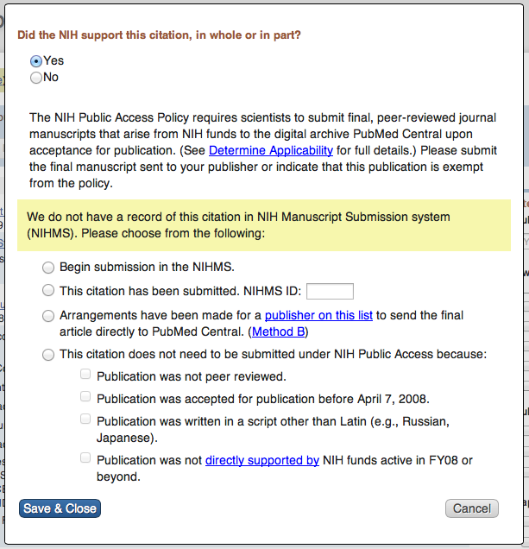
PI adds a new citation to their My Bibliography

Slide 46
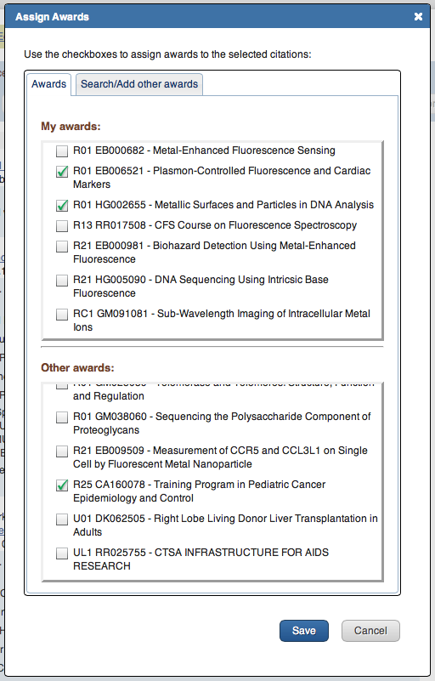
PI adds a new citation to their My Bibliography

Slide 47
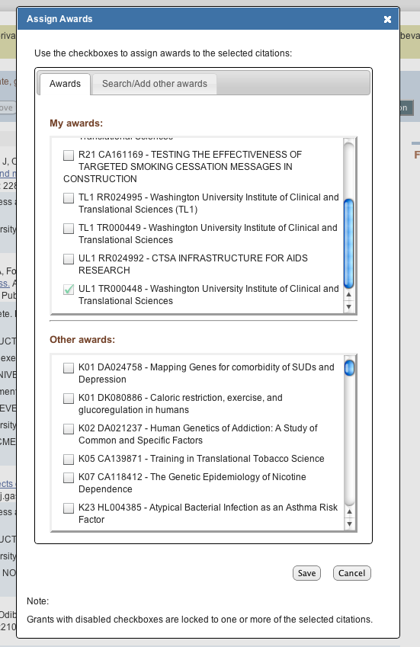
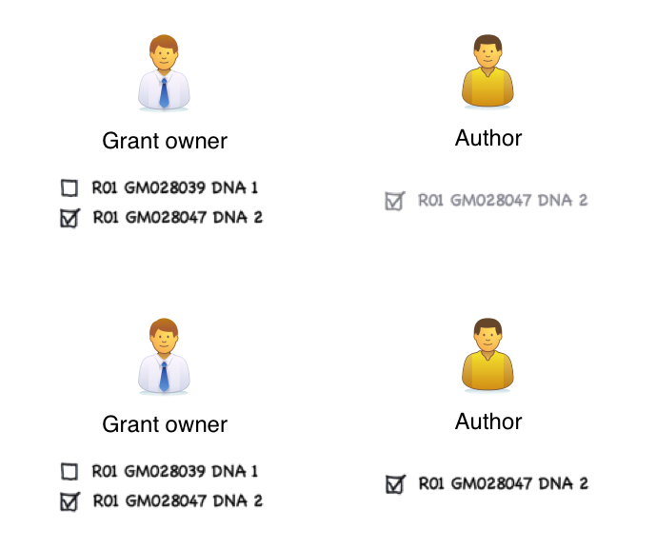
PI/author collaboration

Slide 48
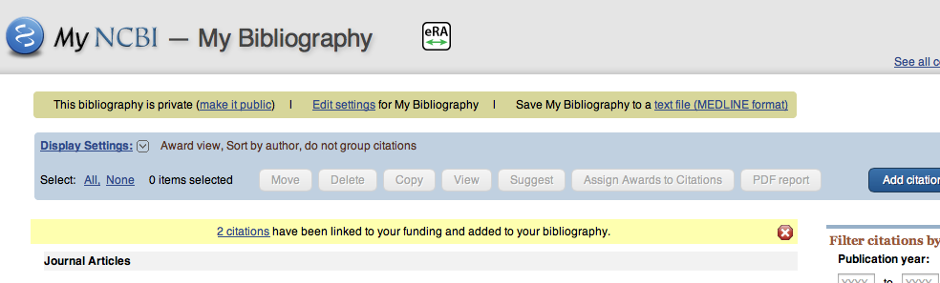
Another user links a PI’s grant to a citation

Slide 49
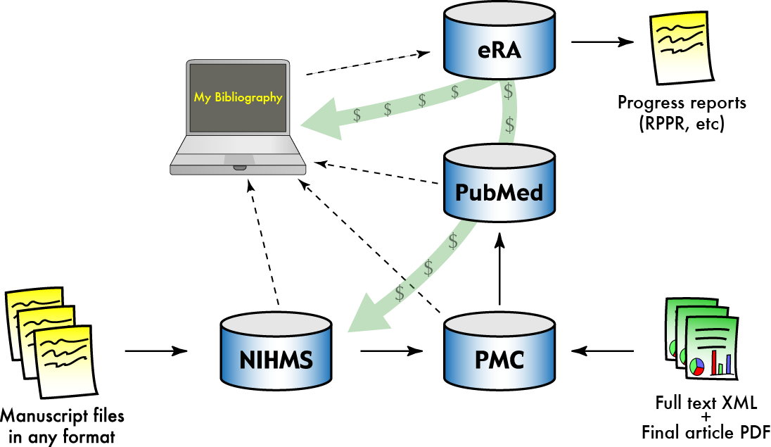
Compliance management with My NCBI

Slide 50
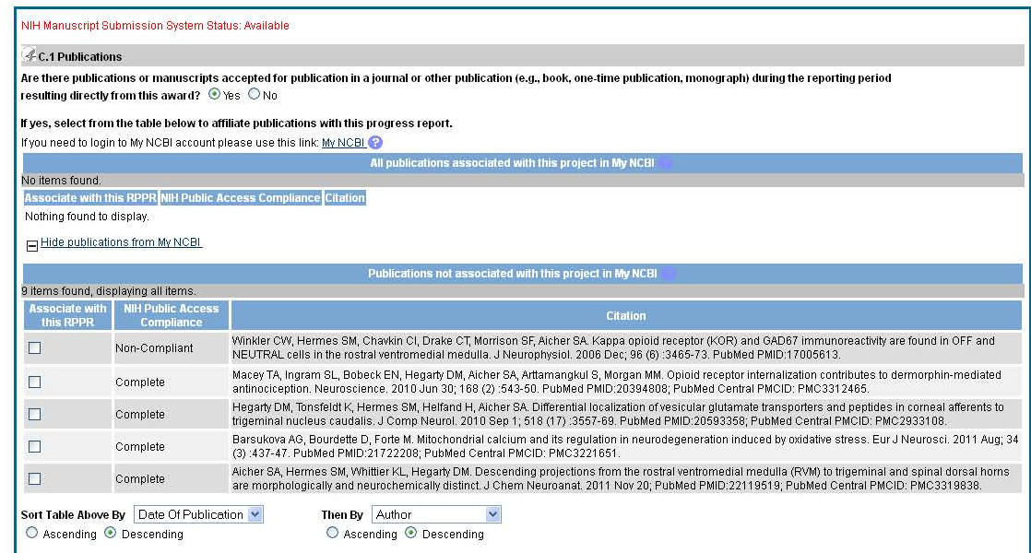
Display on RPPR
10
Notes:
Note, this slide is drawn from early test data, and labeled the first citation as non-compliant, when it should be N/A because it was published in 2006. However, to make it clear how an Non-Compliant paper will display, I changed the publication year on the slide to 2010.

Slide 51
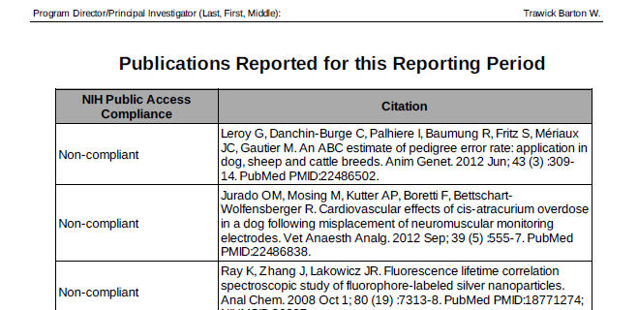
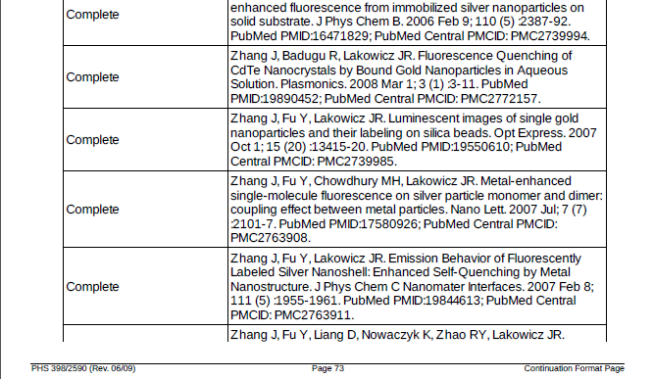
My NCBI PDF reports

Slide 52
How My NCBI Reduces PI Workload
Automated and Collaborative Methods to Track Publications
  Import citations directly from PubMed
  Automated matches of manuscript citations to PubMed records
  NIHMS paper-grant suggestions
  Recommendations from other authors
  Paper- grant associations by other PI authors
Year round management
Live Public Access compliance status for every record
Delegation

Slide 53
6) Public Access Compliance Monitor

Slide 54
What is the Compliance Monitor?
Database of articles, including current compliance status, that are associated with an institution’s (IPF) grants and fall under the NIH Public Access Policy
PACM
MEDLINE Indexing
My Bibliography
NIHMS
Notes:
The compliance monitor contains a list of all articles that NIH believes a particular grantee institution (IPF number) is responsible for under the terms of the Public Access Policy. An article published in 2008 or later is included in the list if it has been associated with NIH funding (a grant, contract, etc.) provided to the institution. The funding connection may come from an acknowledgement statement in the article or from a separate association made by an author, e.g., during the process of submitting the manuscript to the NIH Manuscript Submission (NIHMS) system, or through the My Bibliography feature (http://www.ncbi.nlm.nih.gov/sites/books/NBK53595/) of the My NCBI service.
These inclusion criteria are not perfect, and this database may miss papers that are NIH supported and fall under the NIH Public Access policy (e.g. papers posted to PMC without being associated with your institution’s award). It also may include papers that do not fall under the policy, such as papers that are directly supported by NIH but are not peer reviewed. For information on how to correct these errors, please see the Q&A section at the end of this guide.
The compliance monitor classifies articles according to compliance status and provides detailed information about each article—a full citation; associated grants and principal investigators (PIs); the PubMed ID and related IDs where available; and a link to the PubMed record.

Slide 55
Who has access to the Compliance Monitor?
PACR role
Assigned by administrator authorized to assign roles in eRA Commons
Gives user access to PACM to run compliance reports for institution
Notes:
To gain access to the compliance monitor, users must first be assigned a “PACR” role by an administrator at their institution who is authorized to assign roles in NIH’s eRA Commons grants administration system. Users with a PACR role have access to the compliance reports for their institution. The reports are organized by IPF (Institutional Profile File) number, the unique ID assigned to a grantee organization in the eRA system. If your institution has multiple IPF numbers, you must be assigned a PACR role for each IPF that you wish to monitor and you must log in to the compliance monitor separately for each IPF number.

Slide 56
Logging in to the Compliance Monitor
http://www.pubmedcentral.nih.gov/utils/pacm/

Slide 57
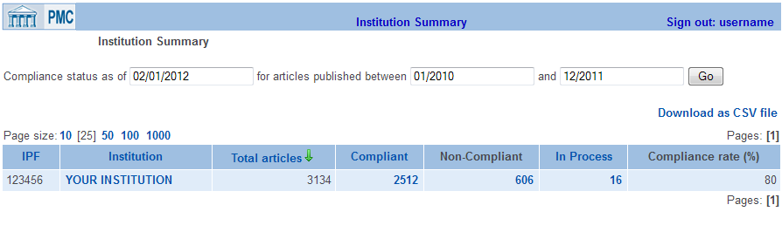
Institution Summary
Notes:
Set timeframe
By default, the report shows compliance status for articles published in the last year (current month plus 12 months). Use the date boxes at the top of the page to change the date range.
2. Total articles
3. Compliant
The article has a PMCID (PubMed Central ID), indicating that it has been or is ready to be made public on PubMed Central,
OR the article has been published in a Method A journal (see http://publicaccess.nih.gov/submit_process.htm).
4. In Process
The article is NOT from a Method A journal,
AND it is less than 3 months past its final publication date,
AND it is still somewhere in the NIHMS processing cycle, i.e., manuscript files have been deposited, but the cycle has not been completed and the article does not yet have a PMCID.
5. Non-Compliant
The article is NOT from a Method A journal,
AND it does not have a PMCID,
AND it is not “in process” as defined above. (This includes articles less than 3 months past publication that have not yet begun the NIHMS submission process.)
6. Compliance Rate
Click on the Compliant, Non-Compliant, or In Process number to go to an Institution Details page that lists the articles that are in each of these three states.

Slide 58
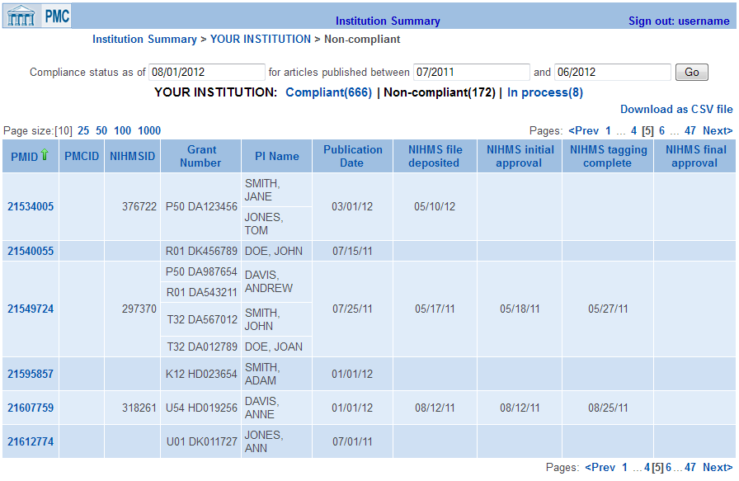
Institution Details
Notes:
Hold your cursor over any PMID to see the corresponding article title, authors, and journal name. Click the PMID to get a full Article Details page for the article.
Click any column heading in the table to sort the list by that field.
Use Page size, at the top left of the table, to change the number of lines that are displayed on each page of the report.
The “Download as CSV file” link in the upper right corner lets you download the current list to an Excel spreadsheet. Items in the file will be sorted in the same order as you have them in the online display. In addition to the columns in the Institution Details table, the CSV file also includes sortable columns identifying article title, first author name and affiliation, journal title and publisher, and the person who is currently responsible for any actions needed to complete the NIHMS submission process.
Click on PMID to view Article Details
Additional notes:
PMID, PMCID, and NIHMSID are the unique article identifiers assigned to each article in PubMed, PMC, and the NIHMS, respectively. Every article in the list has a record in PubMed, and therefore a PMID. If an article does not show a PMCID or an NIHMSID, it means the article does not exist (has not been deposited) in the respective system.
Under submission methods A and B (http://publicaccess.nih.gov/submit_process.htm), a publisher deposits the final published version of an article directly in PMC, without ever going through the NIHMS. In this case, the article will get a PMCID without having an NIHMSID.
Under submission methods C and D, an article receives an NIHMSID when the accepted manuscript files are first deposited in the NIHMS system. The four “NIHMS” columns on the right end of the Institution Details table mark progressive stages in the submission process described for methods C and D at http://publicaccess.nih.gov/submit_process.htm#c. Each date represents the completion of that stage:
NIHMS file deposited – author or publisher has deposited the accepted manuscript files.
NIHMS initial approval – author / PI has linked the manuscript to specific NIH funding and authorized NIH to begin processing the manuscript.
NIHMS tagging complete – NIH has converted the manuscript files to the standard PMC format and sent the author an email request to review this version in the NIHMS and approve its release to PMC.
NIHMS final approval – author has approved release of the PMC-formatted manuscript.
The article receives a PMCID after the completion of the last stage.

Slide 59
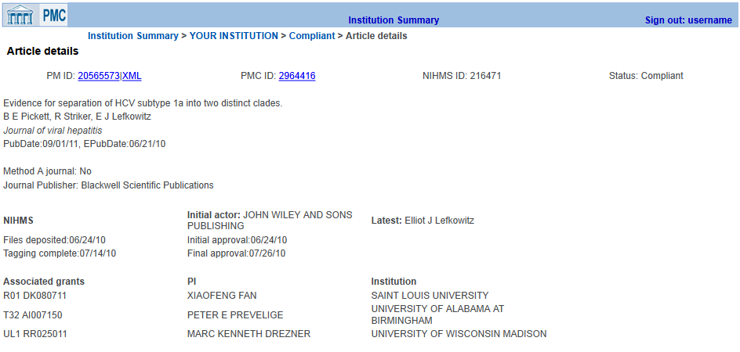
Article Details
Notes:
When you click on a PMID in the Institution Details table, you get an Article Details page with more information about the article. From here:
Associated IDs and Compliance Status
Click the PMID number to see the PubMed record for this article. (Click “XML” to get the XML version of the record.)
If a PMCID is shown, click it to get the complete article in PMC. (An article receives a PMCID as soon as it is deposited in PMC, but it may still be embargoed for public release for up to 12 months after publication. In the event that the article is still embargoed, PMC will display a message with the date on which the article will be publicly available.)
2. Lists all grants, PIs, and institutions associated with the article.
Explanation of terms used on the Article Details page
The Article Details page repeats many of the terms used on the Institution Details page. Those terms are not explained again here.
3. Method A/Publisher
Method A journal – a “Yes” here means that the article was published in a journal during the active period of a Method A agreement between the journal and NIH. See http://publicaccess.nih.gov/submit_process_journals.htm for the effective start dates (and, in a few cases, end dates) of participation for each Method A journal. Papers published in Method A journals are automatically marked compliant because the publisher has committed to providing PMC with the final published version of all articles that fall under the NIH Public Access Policy. However, if you know of a paper that has been published in a Method A journal but has not received a PMCID more than three months after publication, please inform the public access helpdesk (PublicAccess@nih.gov).
Journal Publisher – the publisher name on the Article Details page is taken from the NLM catalog and may be different from the publisher name you commonly associate with the journal.
4. NIHMS
In the NIHMS section of the page, the “Initial actor” is the person or organization that made the initial deposit of manuscript files in the NIHMS. The “Latest” actor is the person who currently is responsible for any actions needed to complete the processing of a manuscript. If the page shows a Final approval date, processing of the manuscript has been completed and the article is considered to be compliant. So in the Article Details page shown above, the Latest actor is the person who completed the process.

Slide 60
Benefits of using the Compliance Monitor
Quick summary of institution’s compliance rate
Download reports on non-compliant publications
Locate associated IDs for a citation
Track progress of papers in NIHMS
View status changes made in My NCBI, e.g., if a citation is marked as not applicable

Slide 61
7) Ways institutions can ensure compliance

Slide 62
Preparation is Key to Avoiding Delays in Funding
  Do you have a plan that can withstand
    Miscommunication among authors, and between publishers and authors?
    Forgetfulness?
  Encourage your investigators to:
    Use My NCBI now to track public access compliance
    Associate papers with awards today
    Ensure compliance well before their annual reports are due, to avoid a last minute scramble
    Determine their compliance plan as they write their papers
  Resources at http://publicaccess.nih.gov/

Slide 63
Ways Institutions Can Ensure Compliance
Training
  Policy awareness, submitting papers, preparing citations
Author Support
  Submitting manuscripts
  Answering questions
  Sending out reminders for reports early
  Means to ensure collaborators do not prevent compliance
Support on Publishing Agreements
  Policies
    Coversheets/ Addenda (NIH’s Example: http://publicaccess.nih.gov/nih_employee_procedures.htm)
  Questions/discussion with publishers
Ensuring compliance
  Checking applications, proposals and reports

Slide 64
Questions?

Slide 65
Appendices

Slide 66
Resources
About the Public Access Policy:
  http://publicaccess.nih.gov/
  For Sponsored Programs: http://publicaccess.nih.gov/sponsored.htm
  Training materials for PIs and other communications: http://publicaccess.nih.gov/communications.htm
  Questions: PublicAccess@NIH.GOV
The NIH Manuscript Submission System:
  http://www.nihms.nih.gov/
  Tutorials: http://www.nihms.nih.gov/web-help/
PubMed Central:
  http://www.pubmedcentral.nih.gov/
  Information for Publishers: http://www.pubmedcentral.nih.gov/about/pubinfo.html

Slide 67
Relevant Guide Notices
NIH Guide Notice NOT-OD-08-033
  http://grants.nih.gov/grants/guide/notice-files/NOT-OD-08-033.html
NIH Guide Notice NOT-OD-09-071 announces the policy is permanent, per the Consolidated Appropriations Act, 2009
  http://grants.nih.gov/grants/guide/notice-files/NOT-OD-09-071.html

Slide 68
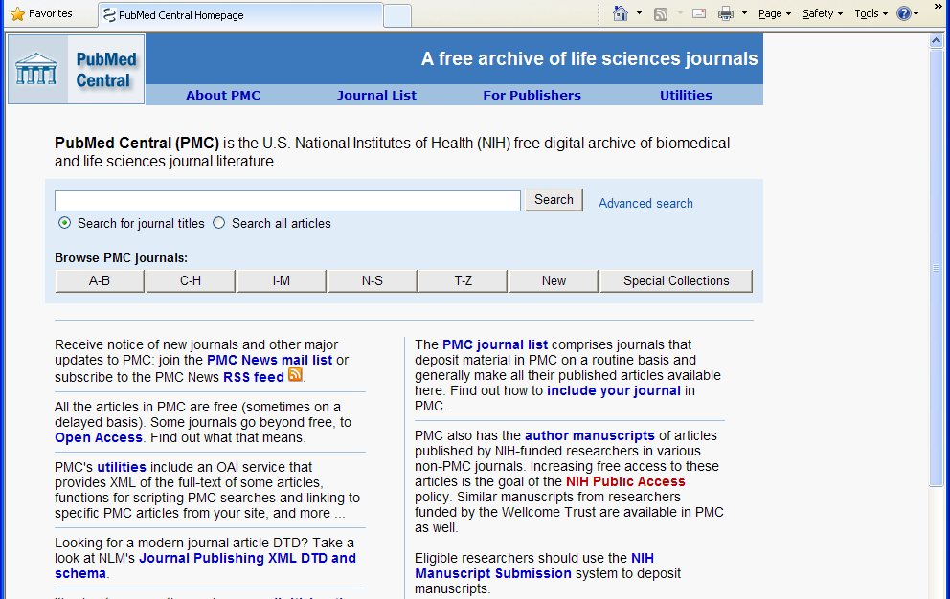
What is PubMed Central?
http://www.pubmedcentral.nih.gov/
Search the PMC database
View the PMC Journal List
Submit manuscripts to NIHMS for inclusion in PMC
Notes:
PubMed Central is a free digital archive of biomedical and life sciences journal literature at the U.S. National Institutes of Health (NIH), developed and managed by NIH's National Center for Biotechnology Information (NCBI) in the National Library of Medicine (NLM).
PubMed Central homepage with links to PMC information and resources, including search.

Slide 69
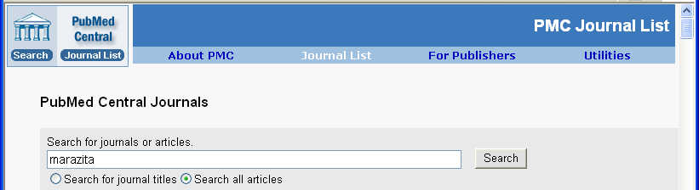
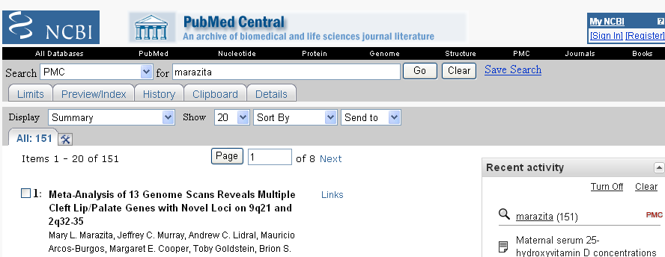
Search PubMed Central
Search all articles by name
151 Results

Slide 70
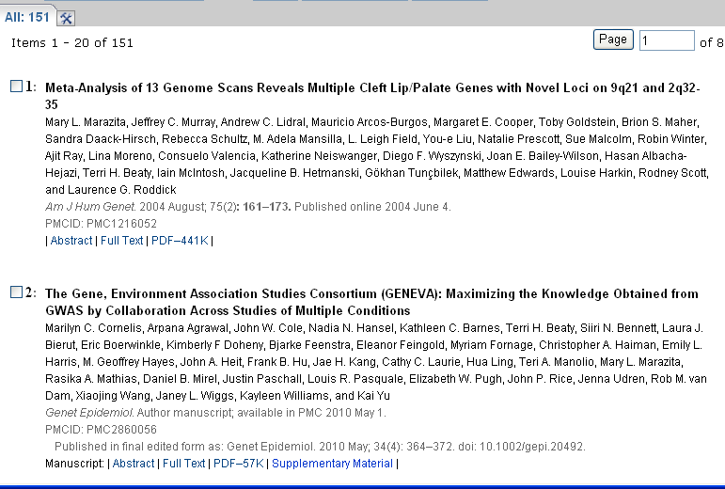
Search Results Identify PMCID & Paper Version
Final published version, PMCID
Author manuscript, PMCID & final published version

Slide 71
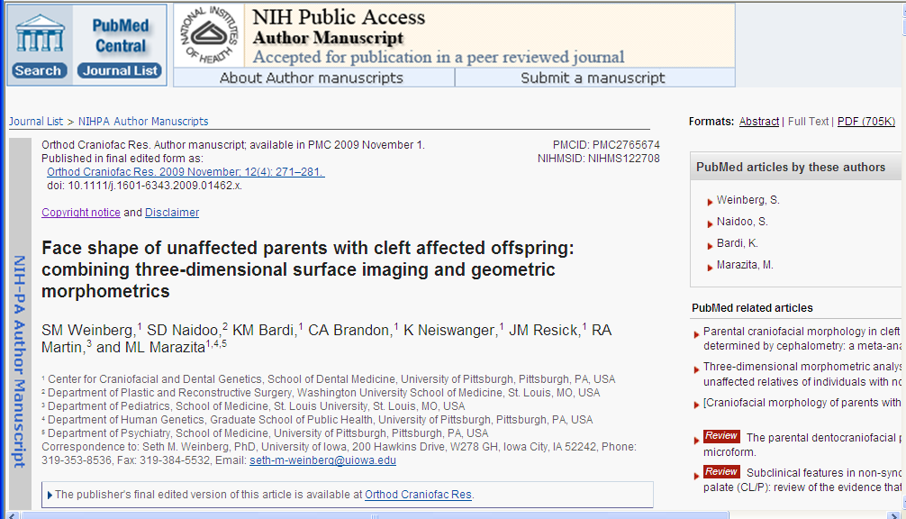
PMC Full Text View Identifies Final Peer Reviewed
Author Manuscripts
PMCID & NIHMSID
Link to publisher’s final edited version online
Notes:
PMC full text view identifies that text is the final peer reviewed manuscript
Provides link to publisher’s online version – addresses author’s concerns about access to final version of paper

Slide 72
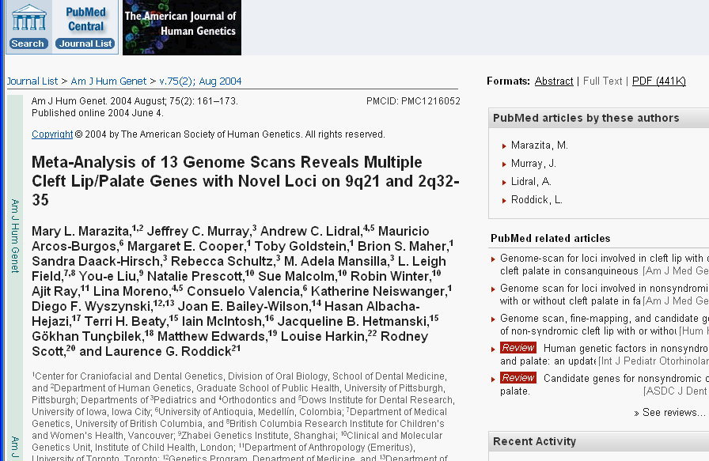
PMC Full Text View Identifies Final Published Paper
Journal Banner
Link to PDF
PMCID
Full Text view in PMC
Notes:
Method A Journal deposits directly to PMC.
Final published paper version will show Journal Banner

Slide 73
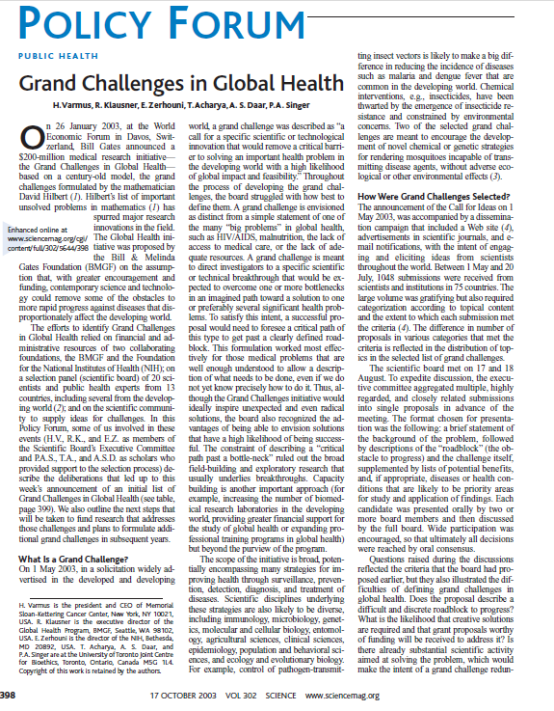
PDF Science

Slide 74
Finding PMCIDs and Using Them in Searches

Slide 75
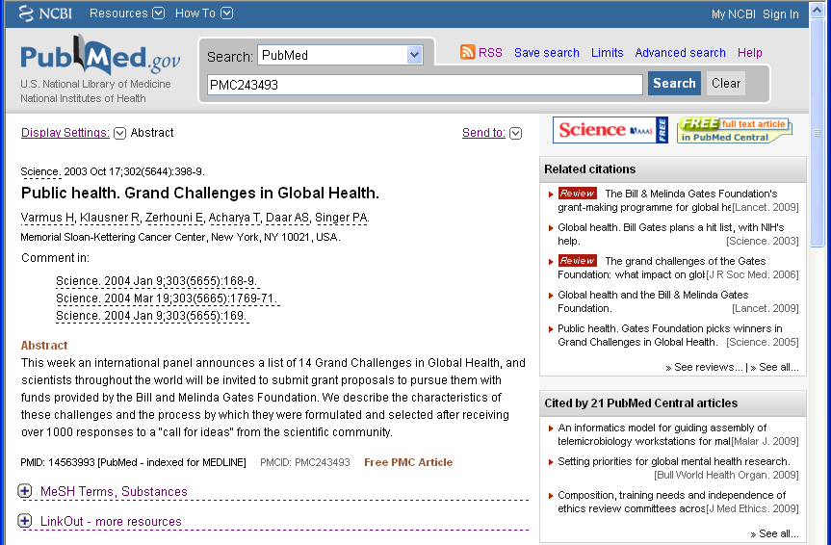
Look up articles with PMCIDs in PubMed
Use the ‘PMC’ Prefix
Full text available in PMC
Notes:
Entering PMCID in the PubMed search window will look up the abstract.
This article has been posted to PubMed Central.
From the abstract view, the user can see links to the Journal webpage and the PMC article on the right side. The PMCID is in the left corner.

Slide 76
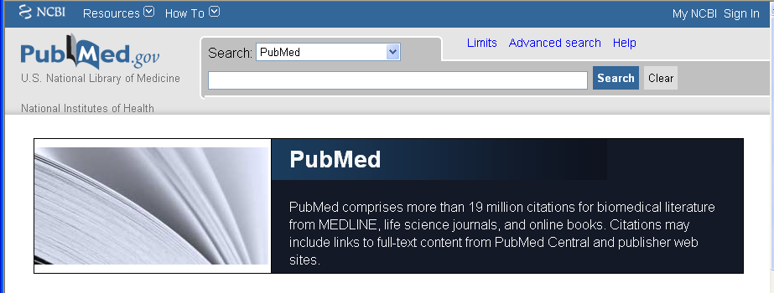
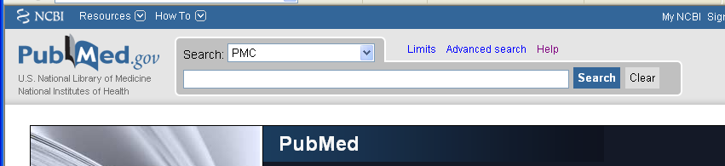
Look up articles with PMCIDs in PubMed/PMC
http://www.ncbi.nlm.nih.gov/pubmed
Enter PMCID
Notes:
http://www.ncbi.nlm.nih.gov/pubmed

Slide 77
Look up articles with PMCIDs in PubMed
Use the ‘PMC’ Prefix
Full text available in PMC
Notes:
Entering PMCID in the PubMed search window will look up the abstract.
This article has been posted to PubMed Central.
From the PubMed Abstract view, the user can see on the upper right side of the page, links to the Journal webpage and the full text of the article in PMC.
The PMCID is located to the right of the PMID underneath the Abstract text.

Slide 78
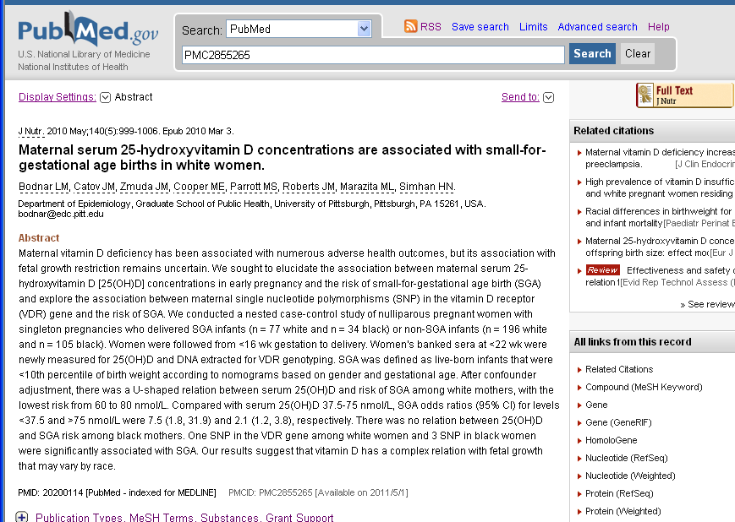
Find PMCIDs in PubMed’s Abstract View
Link to Publisher web site, not yet available in PMC
PMC2855265 [Available on 2011/5/1]
Notes:
This Journal fulfills the submission requirement of the Public Access Policy on behalf of its authors [Method A]. It posts its NIH funded content to PubMed Central to be made publicly available after a delay period.
Note there is a link to the Journal website that the publisher provided in the upper right. There is no link to PMC, as the article is not publicly available on PMC yet.
** The presence of a PMC ID does not necessarily mean journal fulfills the Public Access submission requirement on behalf of their authors

Slide 79
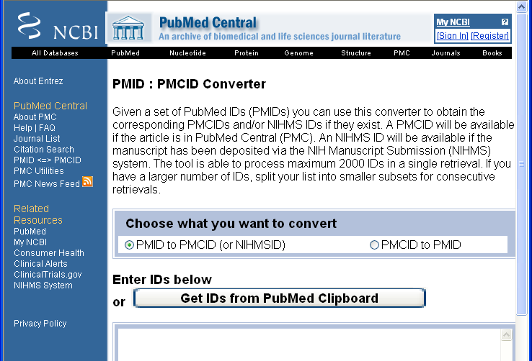
Working in Batches: PMID – PMCID Converter Tool
http://www.ncbi.nlm.nih.gov/sites/pmctopm
79

Slide 80

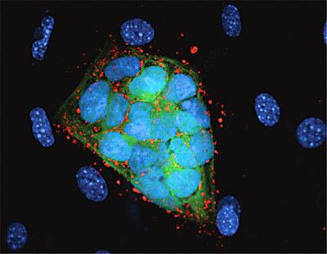

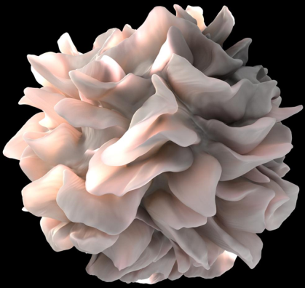

WE VALUE YOUR INPUT!
2014 NIH REGIONAL SEMINAR
Session Evaluations: http://surveymonkey.com/s/nihsessions
Overall Evaluations: http://surveymonkey.com/s/nihoverall
NIH…
Turning Discovery Into Health

