Slide 1
Office of Research Integrity
Research Misconduct or Difference of Opinion?
William C Trenkle, Ph.D.
Scientist-Investigator, Division of Investigative Oversight
Office of Research Integrity, HHS

Slide 2
ORI’s Mission
Mission: To promote the integrity of Public Health Service supported extramural and intramural research programs
Respond effectively to allegations of research misconduct
Promote research integrity
Deter research misconduct through public disclosure of findings and penalties.

Slide 3
Definition of Research Misconduct
Title 42: Public Health
PART 93—PUBLIC HEALTH SERVICE POLICIES ON RESEARCH MISCONDUCT
Subpart A—General
§ 93.103 Research misconduct.
Research misconduct means fabrication, falsification, or plagiarism in proposing, performing, or reviewing research, or in reporting research results.
(a) Fabrication is making up data or results and recording or reporting them.
(b) Falsification is manipulating research materials, equipment, or processes, or changing or omitting data or results such that the research is not accurately represented in the research record.
(c) Plagiarism is the appropriation of another person's ideas, processes, results, or words without giving appropriate credit.
(d) Research misconduct does not include honest error or differences of opinion.

Slide 4
Proof of Research Misconduct
A finding of misconduct requires -
That there be a significant departure from accepted practices of the relevant research community, and
The misconduct be committed intentionally, knowingly, or recklessly; and
The allegation be proven by a preponderance of the evidence, (42 CFR Part 93.104)

Slide 5
Additional ORI Activities
Administer the Assurance program, a database of all institutions eligible to receive
PHS funds
Correct or retract research publications to protect the integrity of the scientific literature
Protect the confidentiality of respondents, complainants, and witnesses
Protect witnesses from retaliation
(42 CFR 93.300 (d) )

Slide 6
ORI Activities (cont)
Provide education in RCR
Collaborate with the research community to improve biomedical research
Exclude dishonest investigators from PHS and Federal agency funded research
Make public findings of misconduct so that institutions and individuals will be aware of wrongdoing

Slide 7
ORI lacks jurisdictions for many types of inappropriate behavior: some are referred to other agencies
Misuse of human or animal subjects
Misconduct and other complaints involving FDA-regulated research
Financial mismanagement
Radiation or biosafety hazards
Conflict of interest

Slide 8
Other issues not within ORI’s jurisdiction:
Honest error or honest differences in interpretations or judgments of data
Authorship or credit disputes
Duplicate publication
Collaboration agreements or research-related disputes among collaborators
Intellectual property

Slide 9

Supporting Coordination & Collaboration
International Universities
American Association for the Advancement of Science
Association of American Medical Colleges
NIST/DOC
DOE
DOD
CDC
Medical
Centers
FDA
OIG
USDA
Council of Graduate Schools
AHRQ
OGC
Biotech
Companies
NSF
SAMHSA
OHRP
DOI
Public Health Service
Association of American University Professors
HRSA
IHS
National Academy of Science
VA
NIH
DOJ
NASA
US Colleges & Universities
IRB/RIO meeting co-sponsored with OHRP
Clinical sites

Slide 10

Handling Cases of Research Misconduct
Institution assesses allegation
Institution conducts an inquiry
Institution investigates
Allegation
DIO reviews
DIO opens case
DIO oversight review
Finding?
Appeal
Yes
ORI issues a
charge letter
ORI settles*
No
Yes
Admin. Law Judge
No
End
ASH Review & Findings of Misconduct Published
End
*2007-2013 - 93% settled

Slide 11
For Whom Does ORI Serve?
Frequency
FFP
QRP
RCR
ERP
Research Performance Level

Slide 12
Key Metrics – Division of Investigative Oversight
Queries versus Open Cases
Type of Findings

Slide 13
Some ORI Statistics
1992 to 2010 statistics:
Total misconduct findings 224
Findings involving clinical research ~30%
Total accessions from 1992 4377
Total cases opened from 1992 580
Total cases closed from 1992 630

Slide 14
A few key issues that ORI has found contribute most significantly to allowing misconduct
1. Inadequate record keeping and lack of guidance from mentors on how to record and retain research data;
2. Failure of mentors to regularly review raw data; overreliance on derivative data (PowerPoint presentations) at lab meetings
3. Unquestioning acceptance of data that others consider “too good to be true”

Slide 15
More issues that facilitate misconduct
4. Lack of transparency within the laboratory and among the staff
5. Labs so large that authority becomes diffuse
6. P.I.s are spread too thin, and do not provide adequate training and guidance to students
The bottom line – good mentorship and the consistent review of raw data can profoundly reduce the likelihood of research misconduct.

Slide 16
Conclusions
Research Misconduct can happen at any level.
Evaluation of the raw data is critical for early detection of problems.
ORI can provide advice confidentially regarding potential Research Misconduct questions.

Slide 17
ORI can provide assistance
240 453 8800; AskORI@hhs.gov
Telephone or on site assistance available
Allegation assessment
Advice on policies and procedures, for example :
  Sequestration of evidence
  Acquisition of digital information (forensic imaging of hard drives)
Properly getting an inquiry or investigation under way
Analysis of the evidence, such as assisting with analysis of questioned images
Investigative strategy and legal problems

Slide 18
A Major Misconduct Case:
‘
Eric Poehlman
University of Vermont

Slide 19
The initial allegations arose when Dr. Poehlman provided a colleague, about a week apart, two versions of a spreadsheet containing physical, dietary, energetic, and metabolic data on elderly men and women seen twice, on average, about six years apart.
In the complainant’s own words:
Initial Allegations

Slide 20
Initial allegations (cont)
The incident that triggered my suspicions occurred in late September, 2000 - I was asked by Dr. Poehlman to write a paper from a longitudinal database (Protocol #678). The paper was to examine the effects of age on lipids in men and women… When I presented him with the data, he was not satisfied with the results and asked for the database in order to verify data entries and check for what he described as "reversed" datapoints, … It was my belief that I was mistakenly given a “true” version of the dataset originally and then given the manipulated version the second time…

Slide 21
The Scope of the Misconduct
The following two slides provide a glimpse of the massive scope of Dr. Poehlman’s alterations in the data base for the longitudinal study of aging, protocol #678.

Slide 22
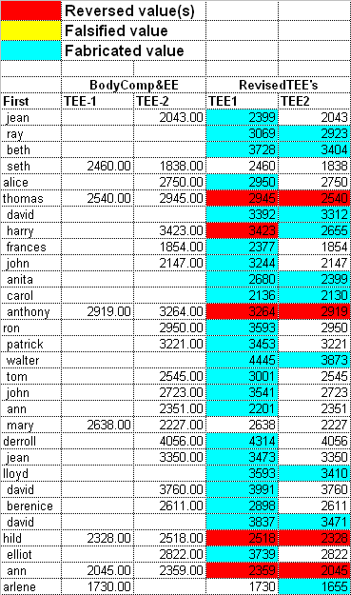
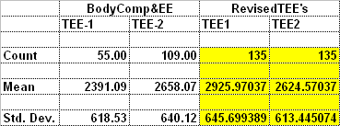
Correct TEE values
Dr. Poehlman’s TEE values
Dr. Poehlman’s changes to total energy expenditure values included many fabrications (blue) and reversals of visit one and visit two values (red)
The net effects were to greatly inflate the number of subjects and to reverse the apparent effect of aging.

Slide 23
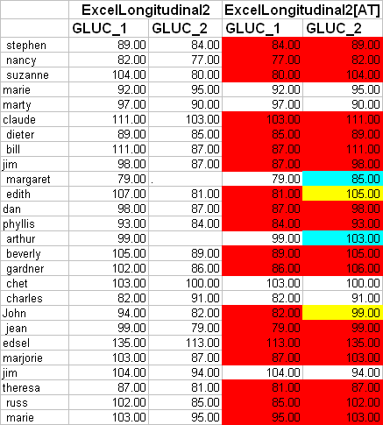

Dr. Poehlman’s changes to glucose involved near complete reversal of T1 and T2 values, allowing him to claim that glucose levels rose with age when the real data showed the opposite.

Slide 24
Tip of the iceberg
The total number of reversals, falsifications and fabrications made by Dr. Poehlman to the 467 database was greater than 4000, all in a small fraction of the hundreds of fields of data.
Although he had reported data from this study in three unfunded grant applications, almost nothing was published, and the “harm done,” by itself, was not extensive.
However, much more was subsequently revealed….

Slide 25
Additional Issues
Dr. Poehlman claimed to have conducted a longitudinal study of the menopause transition involving 35 women seen twice six years apart.
This study was reported in a 1995 paper in the Annals of Internal Medicine and five follow-up papers as well as in many grant applications.
The study was not conducted: Dr. Poehlman falsified the number of subjects at T1 and never saw the women a second time.

Slide 26
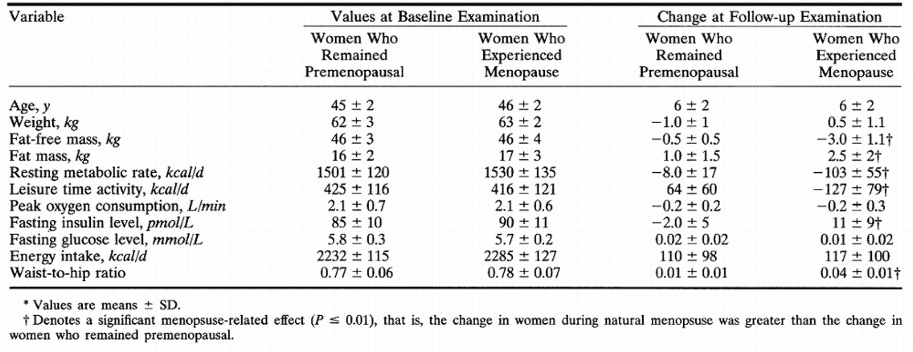
The data from the Annals paper claimed to show that the menopause transition quickly leads to undesirable changes in weight, fat mass, resting metabolic rate, leisure time activity, and waist-to-hip ratio.
None of these conclusions were legitimate (although cross-sectional studies have suggested that changes do occur eventually).
Additional fabricated results from this study were reported in later papers and grant applications.

Slide 27
Additional Issues (cont)
The UVM investigation, ORI, and the U.S. Attorney’s office determined that Dr. Poehlman falsified data in additional papers and grant applications in areas as wide ranging as Alzheimer’s disease, the effect of endurance training on RMR, and the effects of hormone replacement therapy on post-menopausal women.
Many of these false claims were also made in talks given by Dr. Poehlman, some of which were documented, allowing additional findings of scientific misconduct to be made.

Slide 28
Dr. Poehlman’s obstruction efforts
Starting immediately after being accused of misconduct, Dr. Poehlman aggressively attempted to obstruct the University investigation, and subsequently the Government’s review.
He accused his young colleagues of having falsified the 678 database.
He went to Federal court to attempt to block UVM from notifying ORI of the pending investigation.

Slide 29
Obstruction (cont)
During the investigation, he solicited letters of support from collaborators and former technicians who claimed that they had helped with the longitudinal menopause study; these claims resulted from Dr. Poehlman’s false assurances and edits of the letters, and they placed these witnesses in legal jeopardy.
Dr. Poehlman submitted falsified and fabricated documents to the UVM committee in an effort to show that the 35 women in the menopause study had visited the GCRC a second time.

Slide 30
Why did it take so long to discover?
“The reality is that an established and renowned principal investigator with this volume of complex data could easily generate and propagate false values for months, even years, without anyone catching on” (UVM Report, p. 19)

Slide 31
Summary
Dr. Poehlman falsified and fabricated data in NIH grant applications and in published articles over a 10 year period with NIH funding of almost $3 million
Counting two USDA applications, he provided falsified and fabricated preliminary data to government agencies in 17 different competitive and non-competitive applications.
Falsifications and fabrications were made in applications worth over $11,000,000 if funding would have been approved.

Slide 32
Summary
The misconduct affected studies related to disease prevention, including research on the health of older men and women, the effect of diet, exercise, menopause status, hormone replacement, and disease status.
The University of Vermont made 22 findings of scientific misconduct in areas represented by 3 GCRC protocols.
ORI confirmed 21 of the findings made by UVM and made 35 additional findings in the same plus 2 additional areas ( 5 protocols).

Slide 33
The role of the Justice Department: ORI Assurance
Assurance on application form PHS 398, #15
Principal Investigator/Program Director Assurance: I certify that the statements herein are true, complete and accurate to the best of my knowledge. I am aware that any false, fictitious, or fraudulent statements or claims may subject me to criminal, civil, or administrative penalties. I agree to accept responsibility for the scientific conduct of the project and to provide the required progress reports if a grant is awarded as a result of this application.

Slide 34
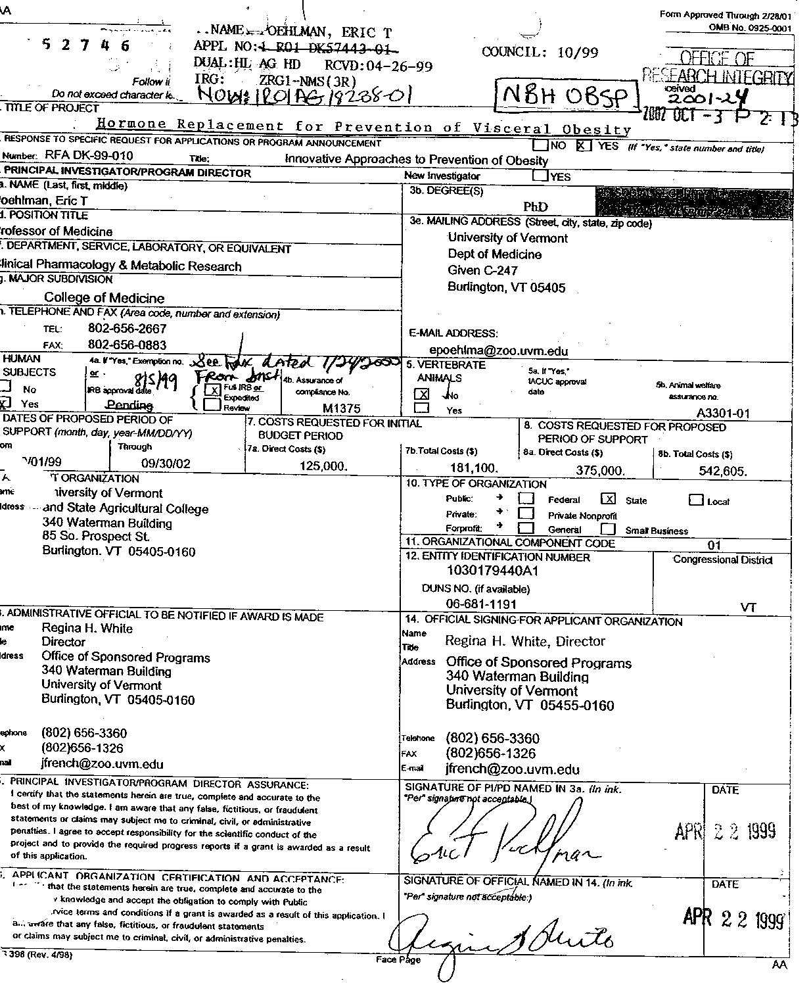
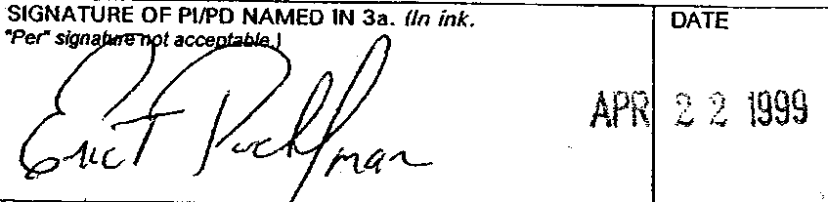
This is what led to Dr. Poehlman pleading guilty to a felony

Slide 35
What Was the involvement of the Vermont U.S. Attorney
Defended civil litigation brought by Dr. Poehlman to prevent mandatory reporting of misconduct investigation to ORI
Opened civil and criminal fraud investigations into Dr. Poehlman’s research activities, assisted by ORI and HHS OIG
Decided that false claims of Dr. Poehlman warranted a criminal charge and personal monetary settlement of $180,000
Dr. Poehlman sentenced to jail term of one year and a day based on admission to one felony count and ordered to a federal prison work camp in Maryland

Slide 36
ORI actions and the Whistleblower’s role
ORI/ASH actions against Dr. Poehlman include lifetime debarment from Federal research funding and retraction/correction of ten published papers
The whistleblower in this case later filed a qui tam suit under Federal fraud laws and received a relator’s share of 12% ($22,000) of the Federal recovery of $180,000

Slide 37
Impact of Dr. Poehlman’s Actions in the Scientific Community
Millions of dollars in Federal grant money have been mis-spent.
The careers of Dr. Poehlman’s students and collaborators have been damaged or impaired.
Other researchers have wasted their time and laboratory resources trying to reproduce and extend the false claims made by Dr. Poehlman.

Slide 38
Impact of Dr. Poehlman’s Actions on the General Public
Dr. Poehlman’s research attempted to identify ways to modify life style to lengthen life and improve its quality.
The loyal and dedicated volunteers in the Vermont community felt betrayed and may be reluctant to continue volunteering for studies at UVM.
Dr. Poehlman’s actions had a negative impact on the level of trust in science for health care consumers who rely on honest research results for improved health care.

Slide 39
Lessons Learned
Research misconduct can go undetected for years, even when the misconduct is massive
A determined cheater can mislead collaborators indefinitely
Institutional commitment and careful adherence to policies and procedures are needed for successful investigations
ORI and the research community rely heavily on honest scientists in the lab to come forward with evidence of misconduct

Slide 40
DIO Oversight: Forensics
During the 20 years that OSI/ORI have existed, investigators have developed a number of computer-assisted tools and approaches to help strengthen institutional findings.
The following slides will provide a few examples of this.

Slide 42
Examples of analyzing images
Several examples follow which illustrate how ORI can examine images provided by institutions during their investigation.
Many of ORI’s cases involve images that are duplicated from paper to paper or paper to grant application. This may be duplicate publication, but when such images are said to be the result of different experiments, one of the images, at minimum, has been potentially falsified.
The first example, however, is a little different.

Slide 43
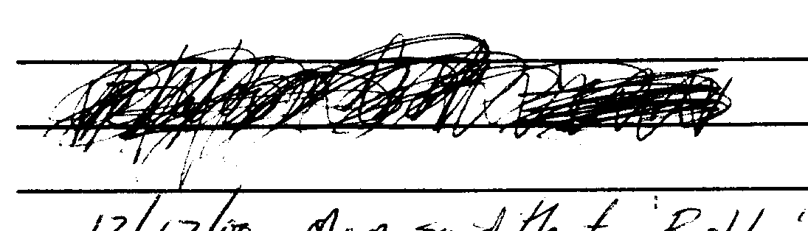
ORI 4/05
43

Slide 44
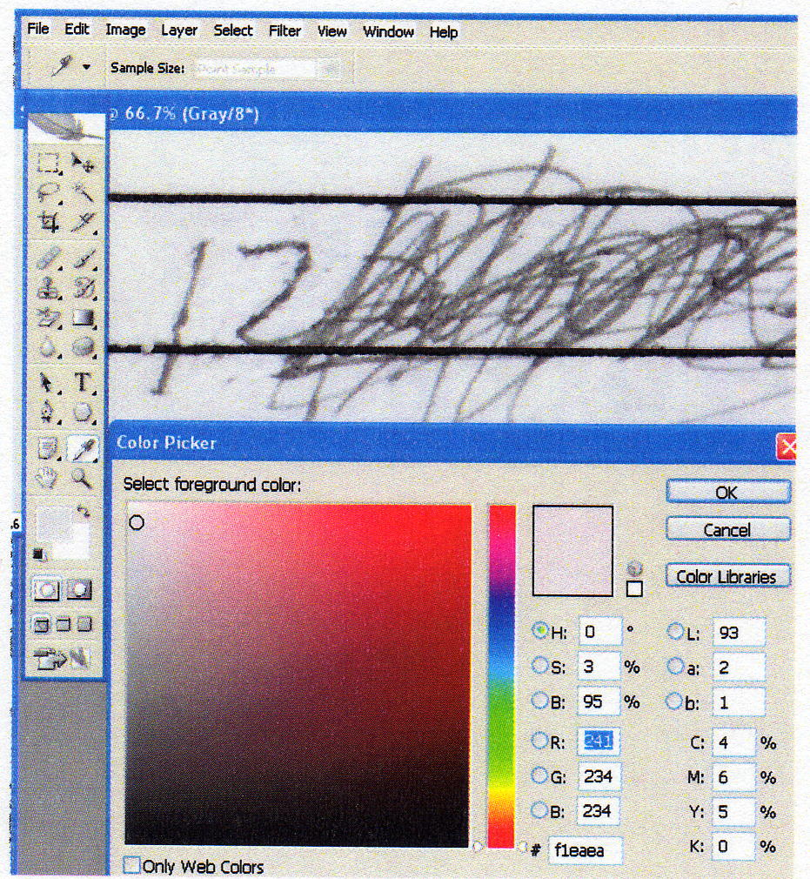
Screen shot from Photoshop showing analysis under way – the small circle in the Color Picker is the brush size moved to a color approximately matching the image’s background.
ORI 4/05
44

Slide 45
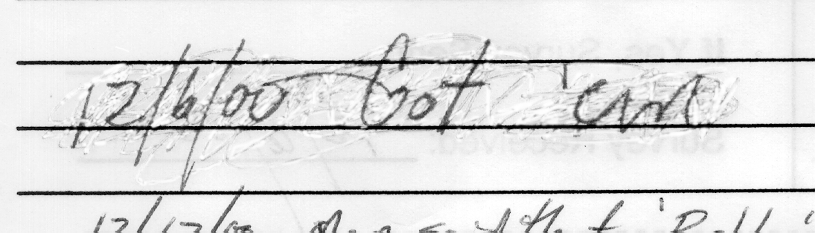
The result of removing most of the “scribbling.”
ORI 4/05
45

Slide 46
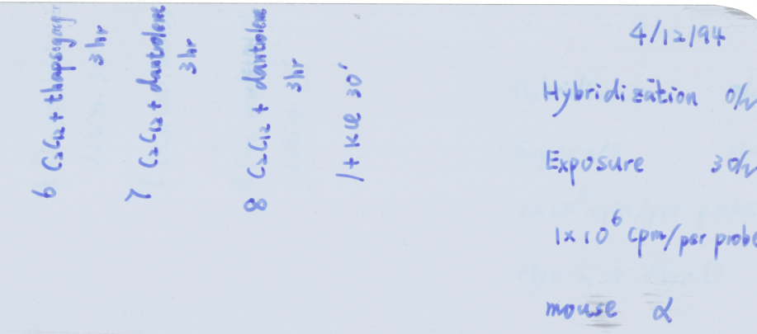
This is why the RIO sent the previous
sample to ORI for Review
In this case, 1 film was used to represent 2 experiments
Corner of Film
the same film used for mouse a and mouse Myo D and Myo G

Slide 47
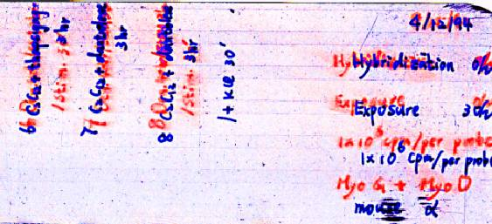
Scanned film separated by hue
Result: writing in red erased from film then re-labeled

Slide 48
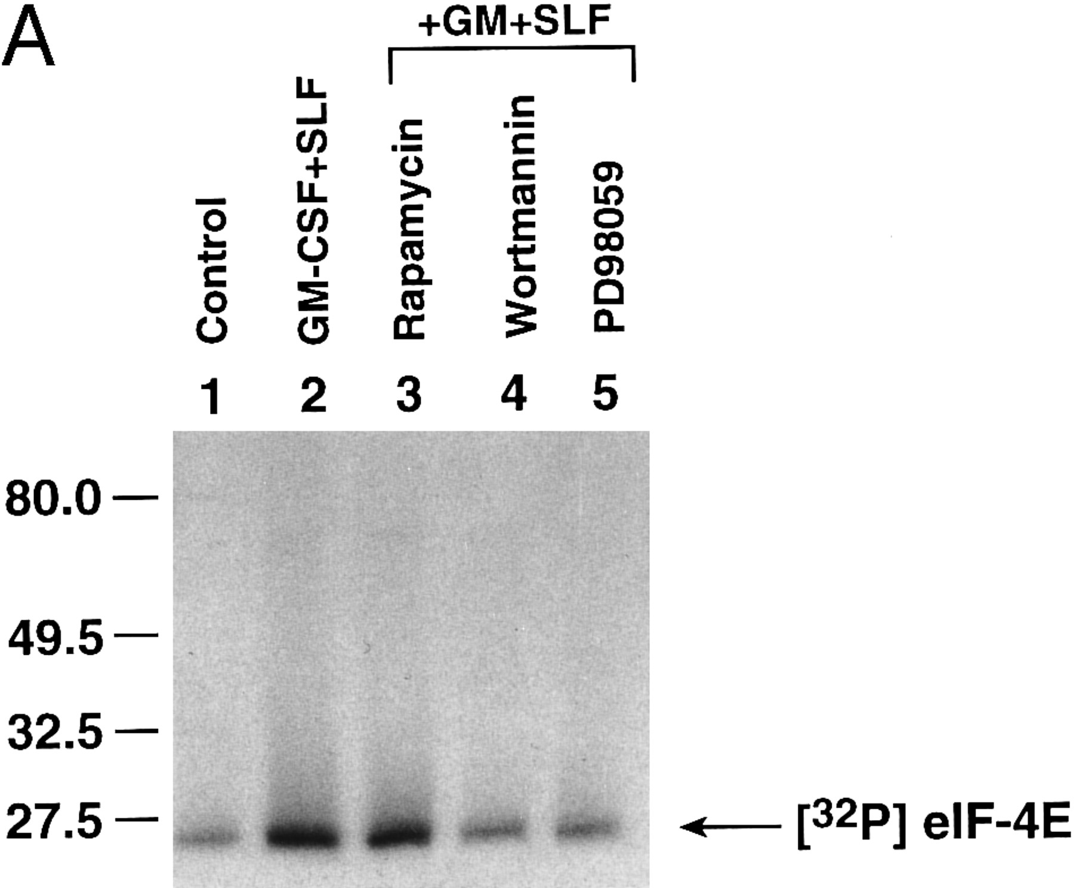
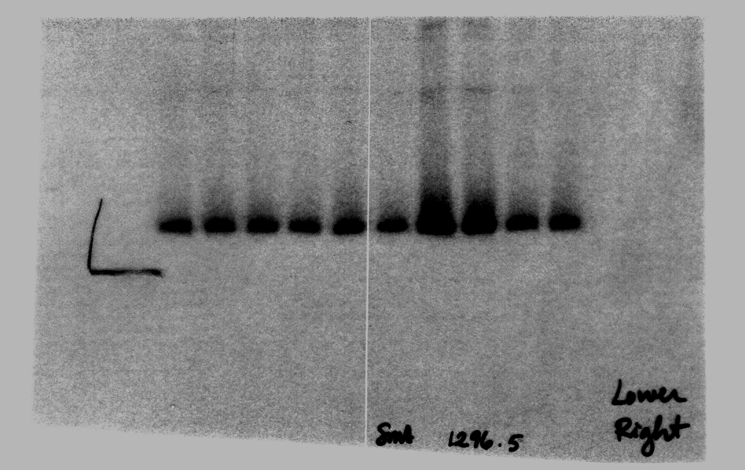
In this example, the respondent published a figure (shown to the right) and claimed that the blot had been stripped and re-probed to provide a loading control (not shown). ORI’s review of the notebook showed that she had cut a film into two fragments and claimed that one-half was the loading control. However, forensic examination clearly established that the two films were cut from a single exposure of a blot.

Slide 49
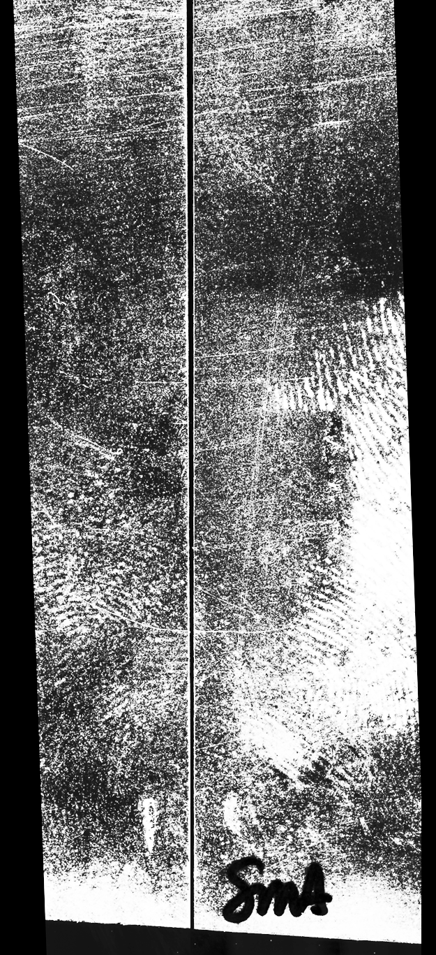
When the films were aligned and scanned in reflection mode:
Image processing tools bring out hidden features:
common edge
scratches and prints crossing edge

Slide 50
Moving to the digital age
The next examples illustrate the importance of the eye to detect evidence of inappropriate image manipulation.
In addition, many ORI cases rely on prompt sequestration of evidence, including hard drives and portable storage media, to ensure that manipulated images can be shown to have originated with a particular individual.
Time-date stamps are often probative with respect to how and when the manipulations occurred.

Slide 51
A Slippery Slope
The next few slides show how difficult it can be to determine if a manipulation is appropriate, possibly inappropriate, or obviously fraudulent.
Generally, ORI is reluctant to make findings of misconduct when an image has been “beautified” by altering background, or by reuse of loading controls, when the actual data verifies the factual findings claimed in the grant or paper.
However, adding or removing important elements of a figure can often be considered evidence for intentional falsification.

Slide 52
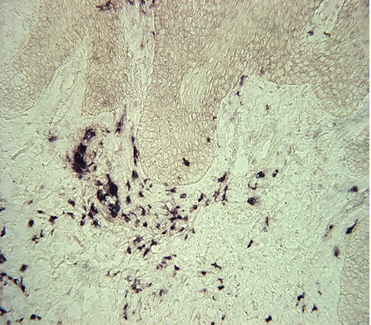
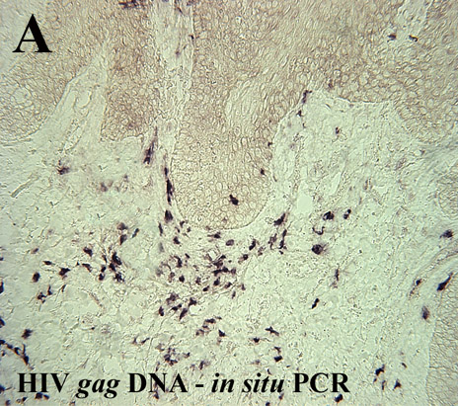

Slide 53
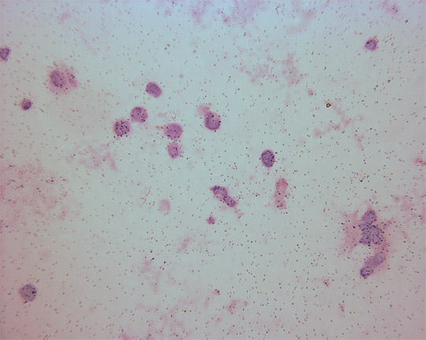
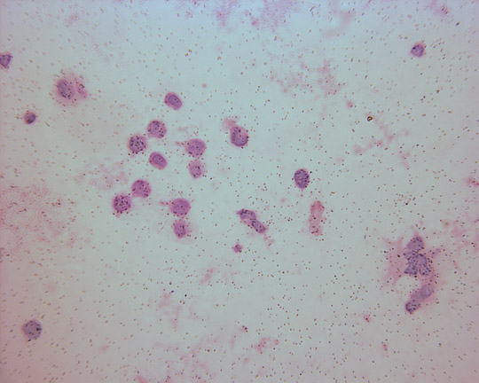
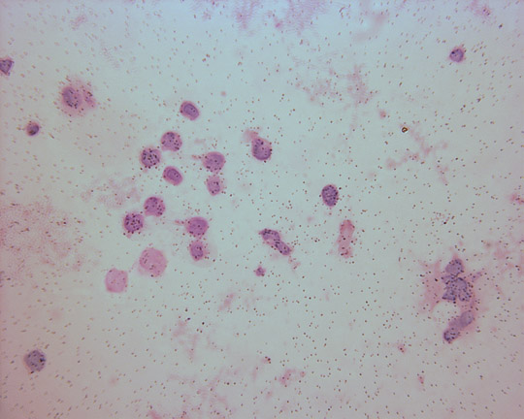
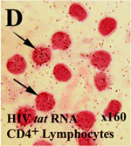

Slide 54
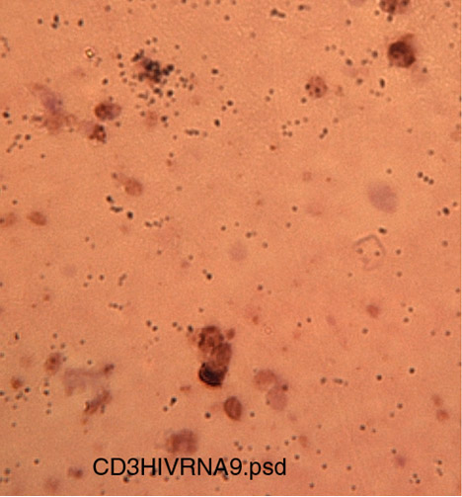
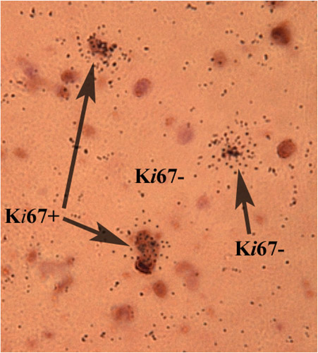

Slide 55
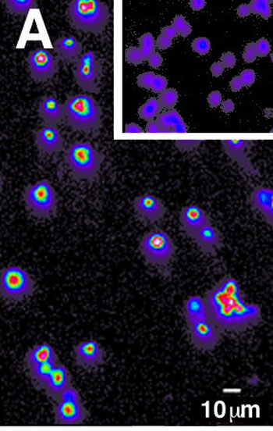
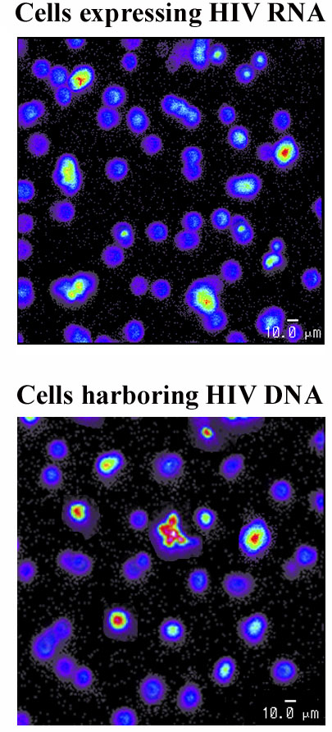
An example of unique images that alerted the institution to apparent falsification. The original images were of all positive or all negative cells positive for a gene different from HIV DNA or RNA.

Slide 56
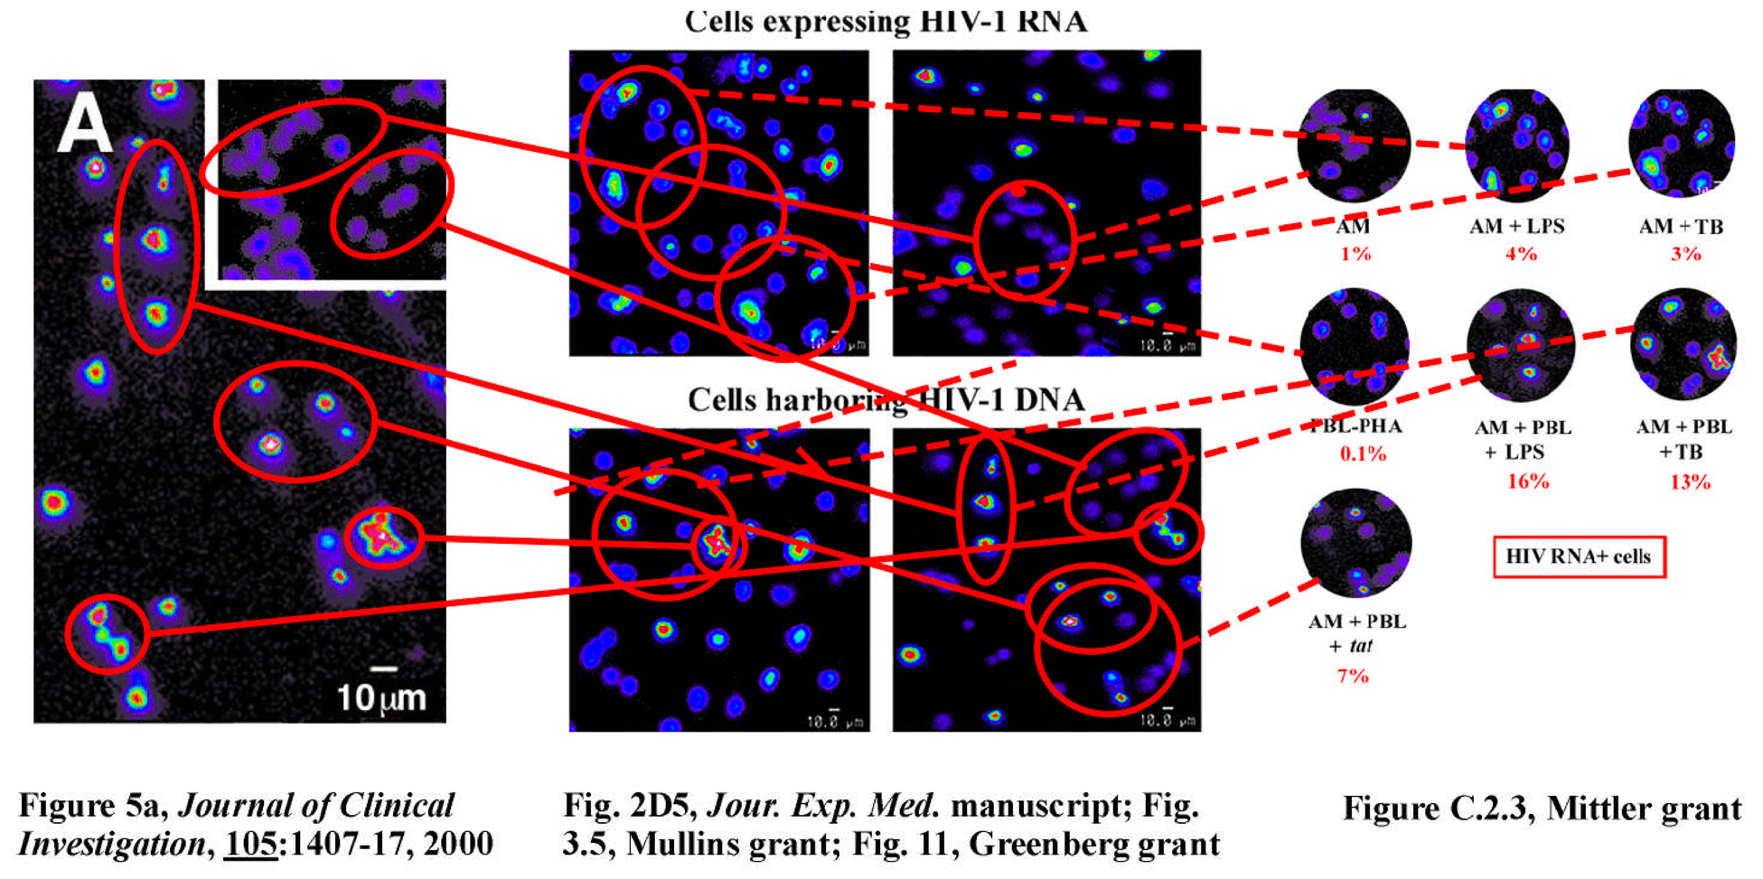

Slide 57
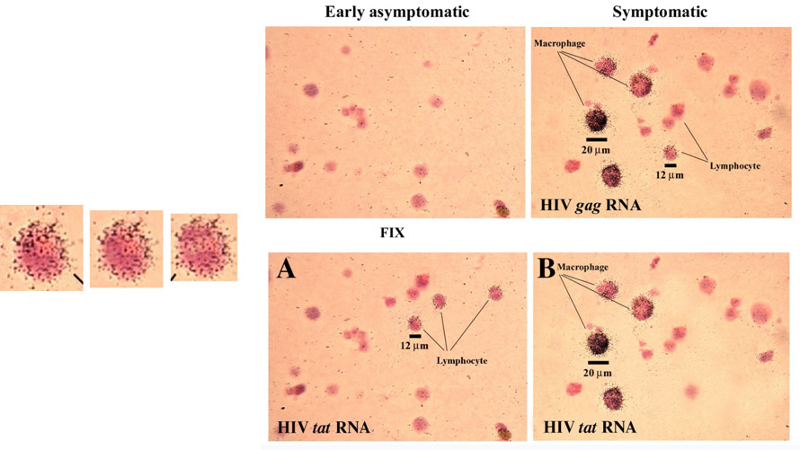

Slide 58
How to detect non-obvious changes
Some of the following slides will illustrate how Photoshop can be used to help our eyes visualize alterations to images, and verify suspected duplications, through the use of specific tools such as the gradient map, contours, and various enhancements such as contrast and intensity.

Slide 59
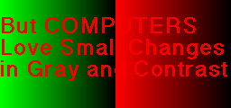
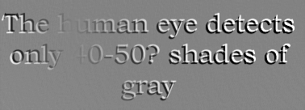
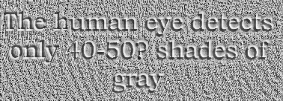
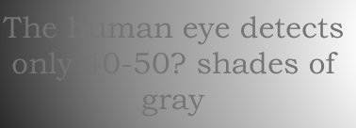
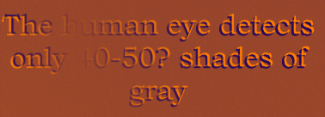
Principles/Methods
DETECTION
Increase Visibility of “Hidden” Details
Notes:
59

Slide 60
Forensic Examination of Scientific Images
Contrast Enhancement (“Curves”) - human eye is not very good at detecting small differences in gray scale
Texture, Variance – examination for erasures
Histogram Equalization – quick look for background inconsistencies
Gradient Map – powerful tool to reveal many similarities in background and band morphologies
Embossing – shadowing makes the image slightly dimensional to reveal borders in background or edges
Overlay of Images – shows similarities of images

Slide 61
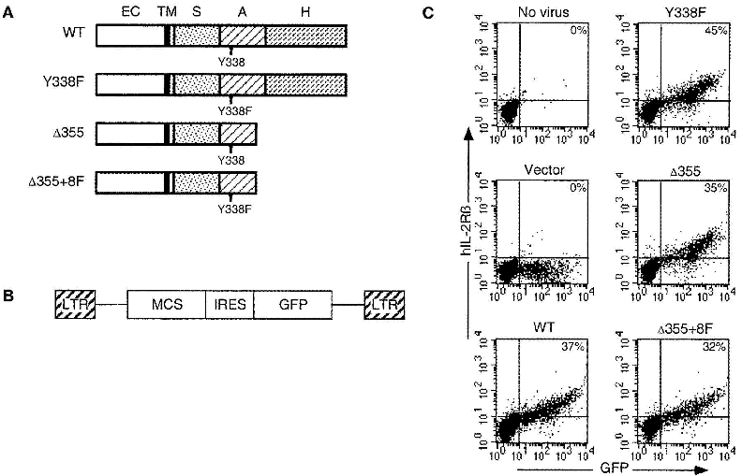
Page 1
Use of the Image Overlay procedure
Immunity, Figure 1
panel1
panel 2
panel 3
panel 4
panel 5
panel 6
Allegaton: bottom two panels
Appear extremely similar
questioned panels

Slide 62
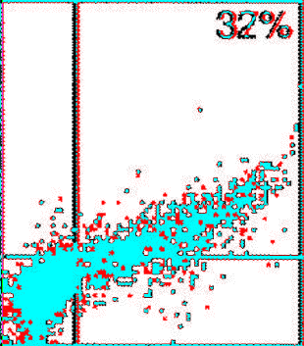
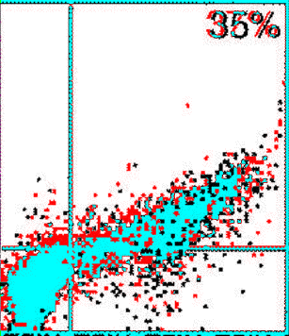
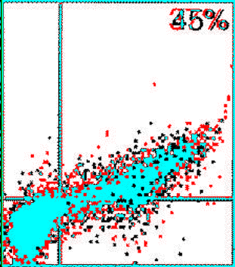
Figure 1 (panel 5 vs 6)
panel 6 (black) is a subset of panel 5 (red)
Only unique cells are red; none are black
red and black = unique blue = overlap
no overlap
panel 5 vs 4
panel 5 vs 2

Slide 63
ORI can provide assistance
240 453 8800; AskORI@hhs.gov
Telephone or on site assistance available
Allegation assessment
Advice on policies and procedures, for example :
  Sequestration of evidence
  Acquisition of digital information (forensic imaging of hard drives)
Properly getting an inquiry or investigation under way
Analysis of the evidence, such as assisting with analysis of questioned images
Investigative strategy and legal problems

