Slide 1
Handling Allegations & Promoting Research Integrity at the NIH
NIH OER Regional, 2014
Yvonne Lau, MD, PhD, MBHL
NIH Extramural Research Integrity Officer
OD/OER/OEP
National Institutes of Health

Slide 2
Overview
Research Misconduct Allegations – what happens to those reported to the NIH?
Promoting Research Integrity – NIH Initiatives

Slide 3
PHS Policies on Research Misconduct
42 C.F.R. Part 93
HHS Office of Research Integrity (ORI) oversees and directs PHS research integrity activities
Institution Responsibilities (§93 Subpart C)

Slide 4
What Constitutes Research Misconduct?
  42 CFR §93.103
  Fabrication
  Falsification
  Plagiarism
  - In proposing, performing or reviewing research or in reporting research results
  d. does not include honest error or differences of opinion.*

Slide 5
Where do Allegations of Research Misconduct come from?
PEER REVIEWERS
_______________
EXTRAMURAL RESEARCH COMMUNITY
_______________
PUBLIC
_______________
CONTROLLED CORRESPONDENCES
_______________
OTHER NIH POLICY & ADMINISTRATIVE OFFICES
NIH Staff
IC RIO
OER-RI
ORI

Slide 6
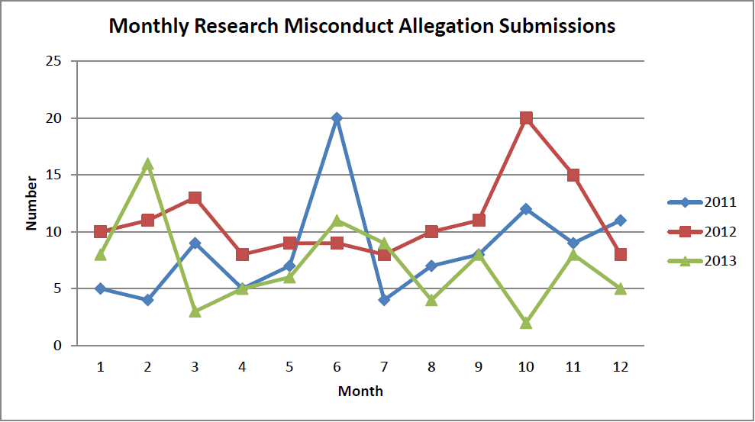
OER-RI Allegations Statistics

Slide 7
Handling Allegations – NIH Extramural
OER-Research Integrity
Preliminary Review
Institution RIO
Allegations
NON FFP
ALLEGATIONS OR COMPLAINTS -
INCLUDE HUMAN SUBJECTS /IRB OVERSIGHT ISSUES; MISUSE OF FUNDS; FRAUD -
MAY BE REFERRED TO
OTHER FEDERAL AGENCIES/NIH OFFICES
ORI DETERMINES
JUDRISDICTION –
ORI performs oversight
& review of Institutional inquiry/investigation
OUTSIDE ORI
JURISDICTION
Institution RIO
Legend
FFP = Falsification, Fabrication, Plagiarism

Slide 8
Other Allegations & Issues
NIH Office of Policy for Extramural Research Administration (OPERA) – grants management policy and compliance
NIH Office of Management Assessment (OMA) – fraud, waste & abuse investigations
NIH Office of Laboratory Animal Welfare (OLAW)
Other Federal Agencies: OHRP, FDA

Slide 9
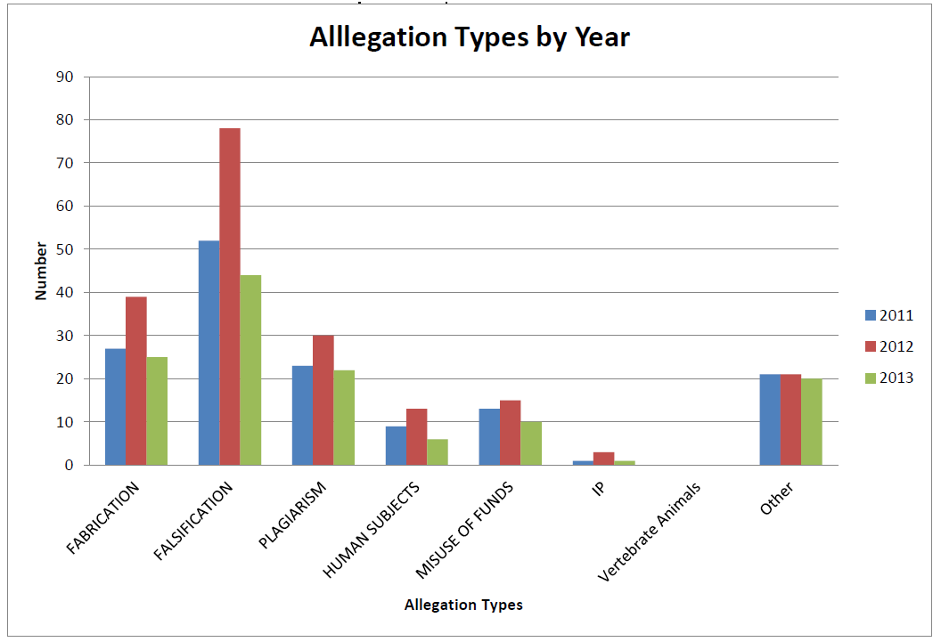
OER-RI Statistics Allegation Types

Slide 10
ORI - Policy on Plagiarism
Excludes:
the limited use of identical or nearly-identical (general) phrases
  not substantially misleading or of great significance.
disputes among former collaborators
  issues of IP rights – ‘authorship disputes’

Slide 11
Why is Plagiarism ‘Wrong’?
Stealing (Theft) – taking someone else’s ideas and using them without permission; depriving someone of their proper rights.
Cheating (Fraud) – misrepresenting other’s ideas as if they were the authors’ own. Deceitful, untruthful.

Slide 12
Plagiarism or Coincidence?
Podcast: “Happy Birthday Mr. Darwin”, 2/12/2009
http://www.world-science.org/podcast/2009-02-12-charles-darwin-birthday-alfred-russel-wallace-south-africa/
(Acknowledgement: PRI The World)

Slide 13
Research Misconduct - Consequences
ORI Administrative Actions
Termination of grant
Debarment
Prohibition from participating on advisory role
Requirement for supervision
Certification from institution
Retraction
Permanent record kept
Special conditions on the grant
Suspension of grant

Slide 14
NIH Role in Enforcing PHS Actions
PHS Administrative Actions
NIH’s Role in Implementation
Prohibition from participating on advisory role
Debarment
Requirement for supervision
Certification from institution
Retraction
Selecting peer reviewers
Receiving applications for funding/making awards
Ensuring conditions are met before releasing funds
Announcing the retraction in PubMed

Slide 15
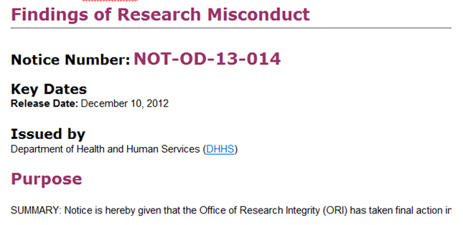
Notice in the NIH Guide

Slide 16
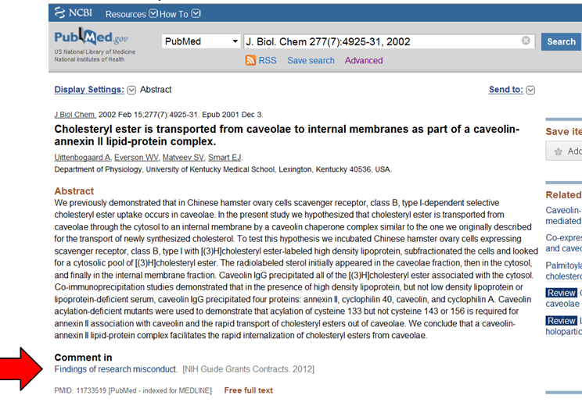
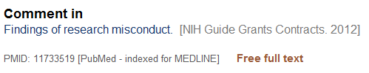
Role of Pub Med

Slide 17
What is Research Integrity?
Research integrity includes:
the use of honest and verifiable methods in proposing, performing, and evaluating research
reporting research results with particular attention to adherence to rules, regulations, guidelines
following commonly accepted professional codes or norms

Slide 18
Why does research integrity matter?
Scientific progress is a team effort; the scientific enterprise is built on a deep foundation of trust
‘Team’ members must abide by the same rules
Failure to do so leads to breakdown of the system

Slide 19
Trust & the Scientific Enterprise
Trust in the scientific enterprise
“will endure only if the scientific community devotes itself to exemplifying and transmitting the values associated with
ethical scientific conduct"
The Committee on Science, Engineering, and Public Policy, The National Academies, (Committee on Science et al., 2009)

Slide 20
Stakes from Losing Public Trust
Loss of Trust in Science
Loss of Respect for Scientists
Loss of Scientific Autonomy
Loss of Public Funding for Science and Scientists
Arrest of Progress that would improve peoples’ lives
Research Integrity is
Everyone’s Responsibility

Slide 21
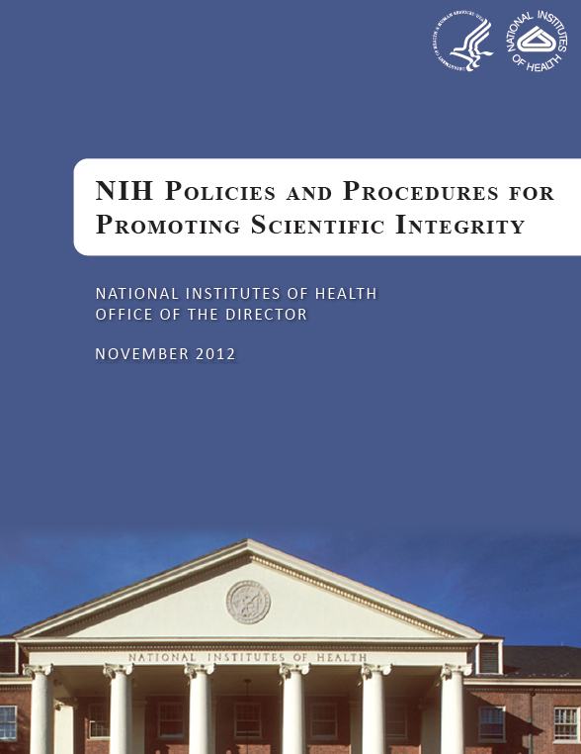
NIH Agency Goal
Agency Goal – to exemplify and promote the highest level of scientific integrity, public accountability, and social responsibility in the conduct of science
Document: Consolidates summaries of and references to existing NIH policies and procedures on scientific integrity to promote public transparency

Slide 22
Promoting Research Integrity - NIH Initiatives
Responsible Conduct of Research (RCR)
  Recipients of any NIH training, career development award, research education grant, and dissertation research grant must receive instruction in RCR
  9 subject matter: Conflict of Interest; Human and animal research; Mentor/mentee responsibilities and relationships; Collaborations in research; Peer review; Data handling and management; Research misconduct; Authorship and publication; Scientist as a responsible member of society

Slide 23
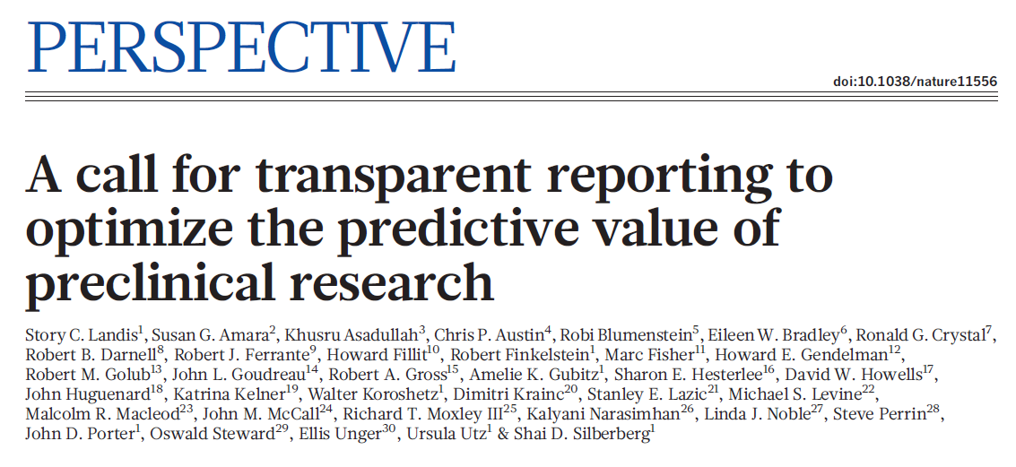
Landis, S. C., S. G. Amara, et al. (2012). "A call for transparent reporting to optimize the predictive value of preclinical research." Nature 490(7419): 187-191

Slide 24
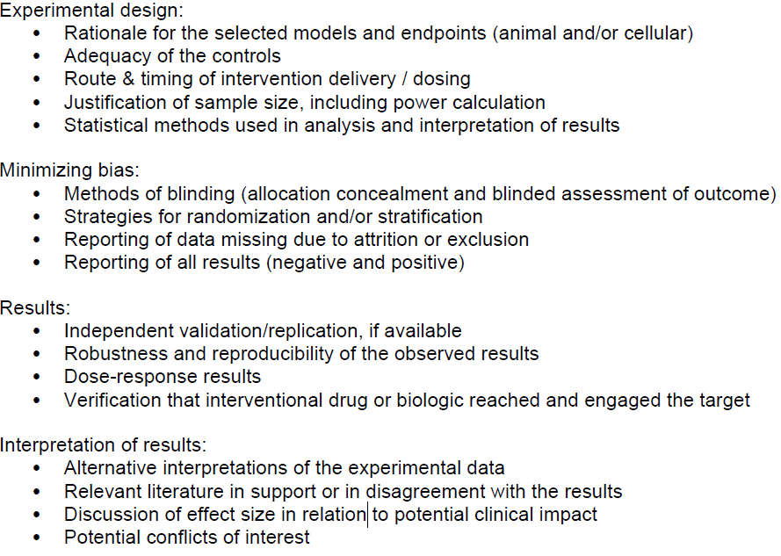
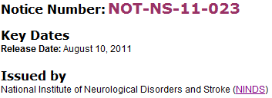
Promoting Research Integrity - NIH Initiatives
Rigorous Study Design & Transparent Reporting

Slide 25
Tabak (2013) “Enhancing Reproducibility & Transparency in Research Findings”
Accessible at http://acd.od.nih.gov/presentations/RIGOR-Update.pdf
NIH will discuss with stakeholder communities and solicit feedback on reproducibility and transparency of research findings
Office of Intramural Research will create & pilot a new training module on research integrity, as it relates to experimental biases and study design, for its fellows; NIH will consider making this available to the public.
Notes:
At the 107th Meeting of the Advisory Committee to the Director in December 2013, Dr. Lawrence Tabak’s (NIH’s Principal Deputy Director) gave the presentation “Enhancing Reproducibility & Transparency in Research Findings where he outlined numerous trans-NIH actions.

Slide 26
Tabak (2013): NIH will implement pilots to address key concerns
Evaluate the ‘scientific premise’ of grant applications
Develop a checklist to ensure more systematic evaluation of grant applications
Determine approaches needed to reduce ‘perverse incentives’ e.g. changes to bio-sketch requirements; provide longer term support for investigators
Support replication studies

Slide 27
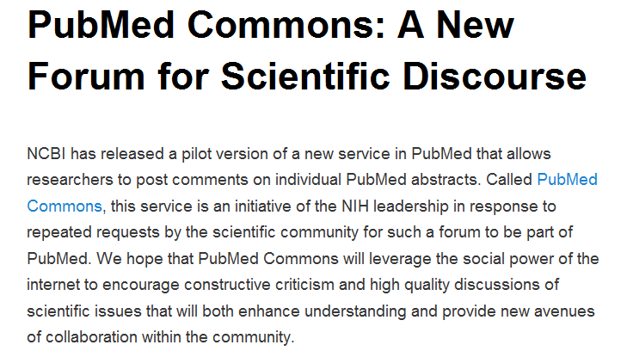
Promoting Research Integrity - NIH Initiatives
http://ncbiinsights.ncbi.nlm.nih.gov/2013/10/22/pubmed-commons-a-new-forum-for-scientific-discourse/
Notes:
This slide talks about PubMed Commons – a new forum for scientific discourse – released by NCBI of the National Library of Medicine. Aim is to “leverage the social power of the internet to encourage constructive criticism and high quality discussions of scientific issues that will both enhance understanding and provide new venues of collaboration within the community”.

Slide 28

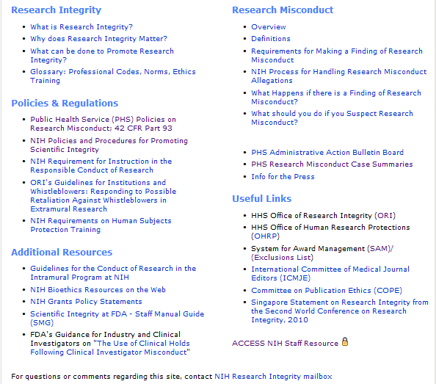
http://grants.nih.gov/grants/research_integrity/

