Slide 1



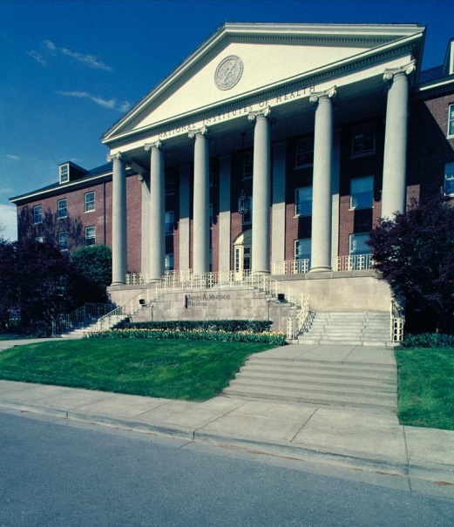


Grant Writing for Success
GRANT WRITING FOR SUCCESS
Michael A Sesma, Ph.D., NIGMS/NIH
Roger G Sorensen, Ph.D., NIDA/NIH

Slide 2

Or as some may call it… Diving into the Unknown

Slide 3

Grant Writing for Success
Writing the Application:
Start Planning EARLY
Develop your good idea
Use the NIH webpage (www.nih.gov)
Talk to your NIH Program Official(s)
Provide a good presentation
Align with review criteria
Identify collaborators
Seek advice and feedback from colleagues
Funding & peer review
Notes:
3
3

Slide 4
Grantsmanship Tips
101
START PLANNING YOUR APPLICATION
EARLY
Notes:
4
4

Slide 5


Application Development Strategy
Act (Plan)
Think
Write

Slide 6
So WHY Plan?
You’re more likely to get …
A compelling scientific question
Appropriate NIH Institute
Appropriate review committee
Adequate time to complete
  A major stress reducer!
…a better grant application

Slide 7
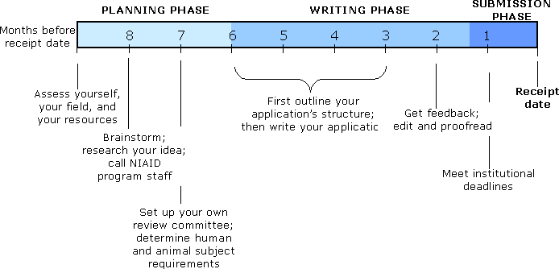
Pre-Submission Planning Timeline
call NIH

Slide 8
Grantsmanship Tips
101
DEVELOPING YOUR GOOD IDEA INTO:
STRONG SCIENCE
A COMPETITIVE APPLICATION
Notes:
8
8

Slide 9

Getting out of the Deep and to the Top:
Components of Successful Applications
Strong Idea
Strong Science
Strong Application

Slide 10
Good Idea
Does it address an important problem?
Will scientific knowledge be advanced?
Does it build upon or expand current knowledge?
Is it feasible …
  to implement?
  to investigate?
  in my hands/lab?

Slide 11
Grantsmanship Tips
101
FURTHER DEVELOPING YOUR GOOD IDEA
UNDERSTAND the MISSION of the NIH
Notes:
11
11

Slide 12
Understanding the Mission
Mission of each NIH IC is based and defined in law
  Authorizations (create/continue an agency – periodic)
  Appropriations ($ for the agency – annual)
ICs establish specific research emphases
  Legislative mission
  Current state of science
Use the Web to find out!

Slide 13

www.nih.gov

Slide 14
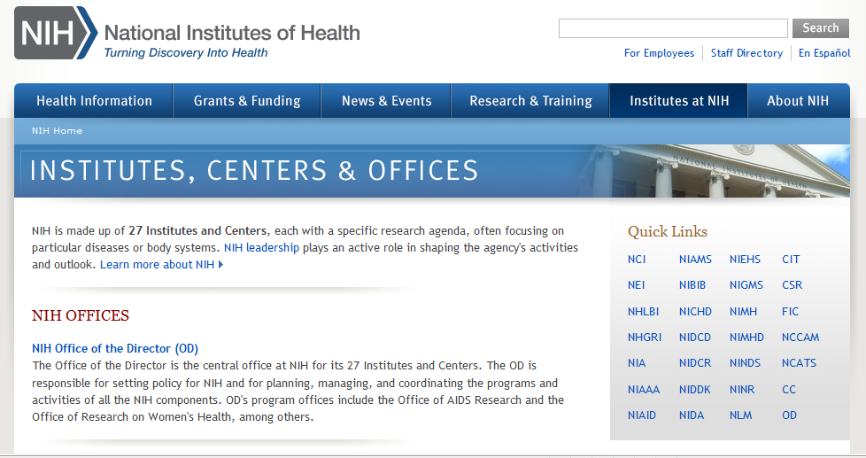
Look for the IC Website of Interest

Slide 15

GRANTS.NIH.GOV

Slide 16
Identifying NIH Initiatives
Most NIH Institutes establish specific research Initiatives and Priorities
Funding Opportunity Announcements (FOAs)
  Must respond to a FOA via Grants.gov
Notes:
16

Slide 17
NIH Guide for Grants and Contracts
Official publication listing NIH funding opportunities and policy notices
  Request for Applications (RFA)
  Program Announcements (PA, PAR, PAS)
  Request for Proposals (RFP)
  Notices (NOT)
Published daily, distributed weekly
Notes:
17

Slide 18

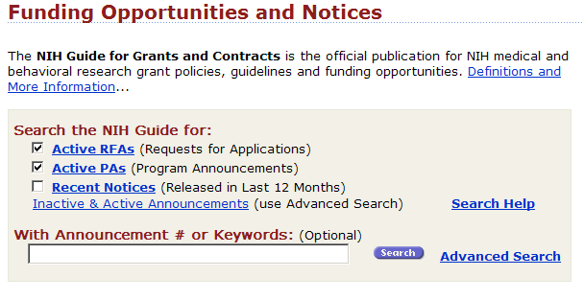
NIH Guide for Grants and Contracts
http://grants.nih.gov/grants/guide/index.html

Slide 19
Identify NIH Funded Grants
See what research projects the NIH or any Institute has funded
Find potential collaborators for your Project
Notes:
19

Slide 20






Research Portfolio Online Reporting Tool (RePORT) http://report.nih.gov
A searchable database of federally supported biomedical research
Access reports, data, analyses, expenditures, results of NIH supported research activities
Identify, analyze IC research portfolios, funding patterns, funded investigators:
    Identify areas with many or few funded projects
    Identify NIH-funded investigators and their research
    Identify potential mentors/collaborators
Notes:
20

Slide 21
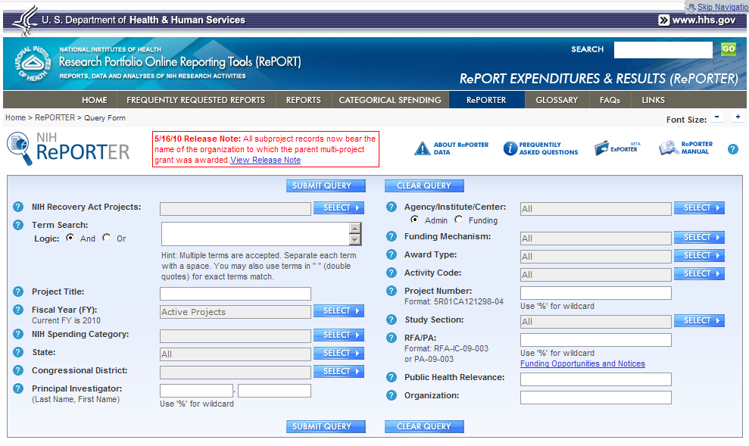
NIH RePORTer
http://projectreporter.nih.gov/reporter.cfm

Slide 22
Grantsmanship Tips
101
Searching NIH web sites is a good start
but follow up with personal contact
  Contact NIH program staff early
  Ask what information would help them advise you about IC interest & “goodness of fit”
  Are there related FOAs?
Notes:
22
22

Slide 23
Grantsmanship Tips
101
ARE YOU READY TO WRITE?
Grant writing is a learned skill
  Writing grant applications, standard operating protocols and manuals of procedures that get approved are learned skills
  Writing manuscripts that get published in peer reviewed journals is a learned skill
Grantsmanship is a full time job
  Learn about the grant application process

Slide 24

Principles of Success
Understand the agency mission
  Every IC is different!
Understand the peer review process
Secure collaborators (mentors) to complement your expertise and experience
  Don’t compete … collaborate!
Learn and practice the skills of writing applications for grant funds
Notes:
24
24

Slide 25

Remember … Before you start
Talk to Program Staff at appropriate IC
Read instructions for application form
  SF 424 R & R
Are you a New or Early Stage Investigator?
  http://grants.nih.gov/grants/new_investigators/index.htm
Know your audience
  Which Integrated Review Group (IRG) is most likely to get your application?
Propose research about which you are passionate and totally committed to doing
Notes:
25
25

Slide 26

Diving Deeper into Good Grantsmanship

Slide 27
Grantsmanship Tips
101
Good ideas,
presented clearly,
is paramount

Slide 28
3 Simple Steps
Presentation Matters
3 Simple Steps
Read the application instructions carefully
Read the application instructions carefully
Don’t forget …
... read the application instructions carefully

Slide 29
Develop a Strong Research Plan
Presentation Matters
Specific Aims
Grab the reader immediately
State long-term objectives AND expected impact
Explicitly state hypotheses and research question

Slide 30
Develop a Strong Research Plan
Presentation Matters
Preliminary Studies/Progress Report
How previous work -- by you, your team, and others -- leads to this study
Demonstrate your experience, competence and likelihood of continued success
Must flow logically from literature review and major themes of the problem area

Slide 31
Develop a Strong Research Plan
Presentation Matters
Approach
Does your plan flow logically from the literature review and prior studies?
How will each hypothesis be tested?
Do your measures capture the variables needed to test hypotheses?
Why did you choose those measures?
Methods and analyses must match

Slide 32
Develop a Strong Research Plan
Presentation Matters
Approach
For clinical studies be explicit and thorough in discussing
  intervention or system to be studied
  target population
  inclusion and exclusion criteria
  independent and dependent variables
  all measures and instruments
  power analyses

Slide 33
Develop a Strong Research Plan
Presentation Matters
Common Miscues:
Failure to …
Document why the problem is important
Distinguish empirical findings from speculation
Critically analyze key themes in literature
Consider alternative perspectives
Read, understand, and cite the crucial studies

Slide 34
Grantsmanship Tips
101
Align your application with the review criteria to maximize impact:
  Significance
  Investigator
  Innovation
  Approach
  Environment

Slide 35
Align with Review Criteria
Overall Impact
5 Core Review Criteria:
  Significance
  Investigator
  Innovation
  Approach
  Environment
http://grants.nih.gov/grants/guide/notice-files/NOT-OD-09-025.html
http://grants.nih.gov/grants/guide/notice-files/NOT-OD-09-024.html

Slide 36
Review Criteria for Career Development Awards
Candidate
Career Development Plan Goals and Objectives
Research Plan
Mentor(s), Co-mentor(s), Consultants, Collaborators
Environment & Institutional Commitment to Candidate
Review Criteria compared: http://grants.nih.gov/grants/peer/guidelines_general/Review_Criteria_at_a_glance.pdf

Slide 37
Final Priority Score
OVERALL IMPACT
The likelihood for the project to exert a sustained, powerful influence on the research field(s) involved:
  in consideration of the following five core review criteria, and
  additional review criteria (as applicable for the project proposed)
Address this on your Specific Aims page!

Slide 38
Align with Review Criteria
Scored Criteria | Application
Significance | Research Strategy Significance
Investigator(s) | Biosketch - Personal Statement Letters of Support
Innovation | Research Strategy b. Innovation
Approach | Research Strategy c. Approach
Environment | Facilities & Other Resources
Notes:
38

Slide 39

Core Review Criterion #1
SIGNIFICANCE
Does this study address an important problem?
If the aims are achieved, how will scientific knowledge be advanced?
What will be the effect on concepts or methods that drive this field?

Slide 40
Core Review Criterion #2
INVESTIGATOR
Are the investigators appropriately trained and well suited to carry out this work?
Is the work proposed appropriate to the experience level of the principal investigator and other researchers?
Does the investigative team bring complementary and integrated expertise to the project (if applicable)?
Notes:
40

Slide 41
Core Review Criterion #3
INNOVATION
Does the project employ novel concepts, approaches or methods?
Are the aims original and innovative?
Does the project challenge existing paradigms or develop new methodologies or technologies?
Notes:
41

Slide 42
Core Review Criterion #4
APPROACH
Are the conceptual framework, design, methods, and analyses adequately developed, well-integrated, and appropriate to the aims of the project?
Does the applicant acknowledge potential problem areas and consider alternatives?

Slide 43
Core Review Criterion #5
ENVIRONMENT
Does the scientific environment in which the work will be done contribute to the probability of success?
Do the proposed experiments take advantage of unique features of the scientific environment or employ useful collaborative arrangements?
Is there evidence of institutional support?

Slide 44
Other Review Considerations
Human subjects
Animal care and use
Select agents
Model organism sharing plan
Data sharing plan
The FOA will list the review criteria and any additional issues that reviewers will be asked to evaluate.

Slide 45

Grantsmanship Tips
101
IDENTIFY COLLABORATORS
Collaborate with other investigators
  Fill gaps in your expertise and training
  Add critical skills to your team
“Team Science” can be powerful

Slide 46
Multiple Principal Investigators
Single PI model does not always work well for multi-disciplinary, collaborative research
Recognizes contributions of full team
In place for most submissions to Grants.gov
Implications for “New Investigator” status
A complex issue – Talk to NIH program staff if you are considering multiple PIs !
grants.nih.gov/grants/multi_pi

Slide 47
Grantsmanship Tips
101
GET FEEDBACK
Show your draft application to a colleague
Show your draft application to a colleague… who does not already know what you intend to do
Show your draft application to a colleague… who is not your best friend

Slide 48
Grantsmanship Tips
101
Your draft reviewers need to understand
  What you intend to do
  Why you believe it is important to do
  Exactly how you are going to do it
If they don’t get it, you must revise your application.
Leave enough time for revisions

Slide 49
Grantsmanship Tips
101
PROVIDE A GOOD PRESENTATION
TO ACHIEVE A GOOD REVIEW
Notes:
49
49

Slide 50
Keys to Good Presentation
Be realistic … not overly ambitious
Discuss potential problem areas and possible solutions
Be explicit
  Reviewers cannot read your mind!
  Don’t expect reviewers to read between the lines
  Don’t assume they know what you intend!

Slide 51
Good Review
Get to the right review group
Title, abstract, specific aims all point to the main goals of your project
Attach a cover letter for the Center for Scientific Review Division of Receipt and Referral
  suggest IC and review group assignment*
  outline areas of key expertise needed for appropriate review
  do not name specific reviewers
  * Consult with Program Official

Slide 52
Good Review
Understand the dynamics of peer review:
Reviewers will review many applications
Make your application easy to read and easy to understand
The impact and significance should be clear throughout the application
Convince them to be your advocate
  Get them on your side!

Slide 53
Grantsmanship Tips
101
GUIDANCE for a COMPETITIVE GRANT APPLICATION
Notes:
53
53

Slide 54
Hallmarks of an Outstanding Grant Application
Strong significance to an important problem in public health: IMPACT is high
High degree of novelty and innovation
Strong track record by a well qualified applicant
Clear rationale
Relevant and supportive preliminary data
Clear and focused approach that provides unambiguous results
Careful attention to details
  Spelling, punctuation, grammar, fonts, clarity of data, error bars, spelling, etc

Slide 55
How to assure that your application is competitive?
Good ideas, well presented always win
Think clearly
Write clearly
Be complete but not verbose
Never lose sight of the significance
Point to the impact
Pay attention to details

Slide 56
Common Reasons Cited for a Weak Application
Lack of or weak impact
Significance not obvious or weak
Too ambitious, lacking focus
Unclear or flawed hypothesis or rationale
Applicant track record weak or lacking appropriate expertise
Feasibility unsupported
Approach flawed
Poor writing

Slide 57
Grantsmanship Tips
101
FUNDING DECISIONS
Notes:
57
57

Slide 58
What Determines Which Applications Are Funded?
Scientific merit
Program considerations
Availability of funds

Slide 59
Remember how applications become grants
Funding Decisions are based on:
  scientific merit and impact
  program considerations
  available funds
Funding Decisions are made by the Institute Director

Slide 60
Grantsmanship Tips
101
AFTER PEER REVIEW
Notes:
60
60

Slide 61
After the Review
Read the summary statement
Reread the summary statement
Contact your program officer and be prepared to discuss:
  what the reviewers said about your application (after you have summary statement)
  Scores and percentiles
  the likelihood of funding
  the prospects of a revised application
Wait for the AWARD, or
Listen to advice from Program Officer about options

Slide 62
If Not Funded, Try Again!
You are in good company
Know your options
Get advice, Regroup
Contact your Program Officer

Slide 63
Revise and Resubmit
Properly Revised applications can receive fundable scores and subsequent $$
  Score can inform degree of revision necessary
Update Preliminary Results
Maintain communications with Scientific Review Officer and Program Official
Notice NOT-OD-14-074: NIH and AHRQ Announce Updated Policy for Application Submission

Slide 64
Revising and Resubmitting
Write A Clear Introduction Section
Address All Criticisms Thoroughly
Respond Constructively
Acknowledge and Accept the Help of Reviewer Comments
Don’t Be Argumentative!
Don’t be Abrasive or Sarcastic!

Slide 65
Responding to reviewer comments
Q: What if you know that you are “Right” and the reviewers are “Wrong”, is it appropriate to argue your position in your resubmission
A: NO!
Remember
An application for funding is not about the facts of your completed research.
It is about ideas and potential research
DO NOT be Argumentative !
DO NOT be Abrasive !
DO NOT do longterm damage to yourself

Slide 66
Revise and Resubmit
Prepare a REVISION COVER LETTER
For Revisions, Indicate Review History
Request Same Or Different Study Section
Provide Justification for your request
Don’t be Argumentative ! Never!
Don’t be Abrasive ! Never!

Slide 67

"Simple can be harder than complex. You have to work hard to get your thinking clean to make it simple. But it's worth it in the end, because once you get there, you can move mountains."

Slide 68
Three Simple Rules to remember when planning, writing and submitting your application
Notes:
68

Slide 69
#1
DO NOT write the application for yourself
Unless you are going to fund it yourself
You MUST convince
the entire review committee
and the funding agency the proposed research will be of high impact and feasible

Slide 70
#2
Reviewers are never wrong, Reviewers are never right:
they simply provide an assessment of material that you provided in your application
Don’t Take the Criticism Personally!

Slide 71
#3
If you are revising the application the comments in the summary statement only list some of the weaknesses …. not all of the weaknesses.
When you revise your application use the time as an opportunity to improve the entire application.

Slide 72
Where Do I Get More Information?
NIH homepage: http://www.nih.gov/
Office of Extramural Research (OER): http://www.grants.nih.gov
CSR website: http://www.csr.nih.gov/

Slide 73
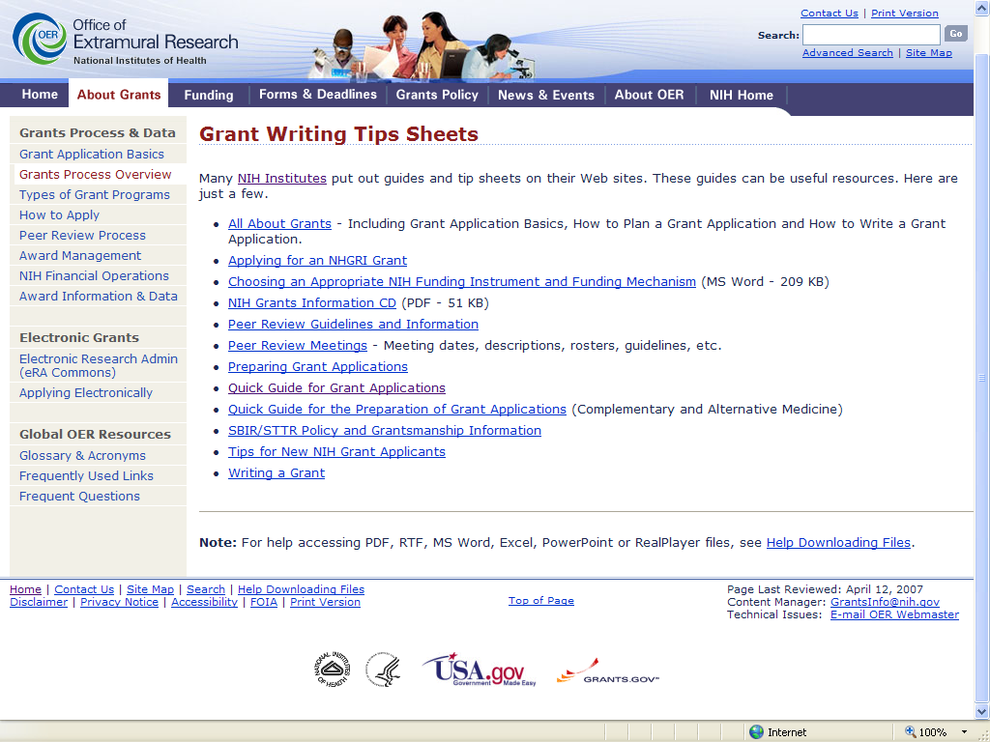
grants1.nih.gov/grants/grant_tips.htm

Slide 74
Additional Supporting Material
Examples
Reviewers’ Concerns taken from Grant Applications and Summary Statements

Slide 75


Top 10
Common Reviewer Concerns
…..or How Not To Get DINGED!
Notes:
75

Slide 76
# 1
There is not a
CLEAR HYPOTHESIS, or
WELL DEFINED GOALS
Provide a focused hypothesis, objectives
Describe the importance and relevance of your problem
Be clear on how your project will move the field forward
Notes:
76

Slide 77
# 2
The specific aims do NOT TEST the Hypothesis, or
the specific aims DEPEND on results from previous aims
The best proposals are those with independent specific aims that address your hypothesis using different approaches
Notes:
77

Slide 78
# 3
The proposal is
NOT MECHANISTIC, or
NOT SCIENTIFICALLY RELEVANT
Do not propose correlative studies, propose strong associations
Do not propose general observations, propose specific manipulations
Notes:
78

Slide 79
# 4
This application is not APPROPRIATE for the
GRANT MECHANISM
A R21 is NOT a R01
A Career Development Award (K) is NOT a Research Project Grant (R)
Notes:
79

Slide 80
# 5
The proposal is
OVERLY AMBITIOUS
Set realistic goals for the budget and project period you propose
Notes:
80

Slide 81
# 6
PRELIMINARY DATA is lacking
Include preliminary data for all aims
Use preliminary data to show knowledge of methods and data analyses
But DO propose more than just confirming preliminary results
Notes:
81

Slide 82
# 7
I’m not sure that the
Investigator can do the
PROPOSED EXPERIMENTS
Don’t propose what you can’t do
Include Collaborators and Consultants on your project
Describe the value of datasets and experimental models
Notes:
82

Slide 83
# 8
The background section is MISSING KEY publications and experimental findings
Thoroughly describe the literature, especially controversies, but….
  Support your views and ideas
  Be sure you have found key references
Notes:
83

Slide 84
# 9
Experimental details,
alternative approaches, or interpretation of data
are INADEQUATELY DESCRIBED
Don’t assume the reviewers know the methods
Provide other experimental directions you might use should you encounter problems
Show the reviewers that you have thought about your research plan
Notes:
84

Slide 85
# 10
The Proposal is
NOT RELEVANT to the MISSION of the Institute
Make your application FIT the Mission of a particular Institute
Don’t FORCE your application on an Inappropriate Institute
Notes:
85

Slide 86
Additional Supporting Material
Examples
BAD & GOOD GRANTS

Slide 87




BAD GRANT

Slide 88

Grant Example
Hypothesis: The goals of this proposal are to identify microRNAs (miRNAs) and elucidate gene networks that regulate limb regeneration. These studies will (1) identify miRNAs that contribute to the regulation of regenerative capacity; (2) identify miRNA-target mRNA pairs involved in limb regeneration; and (3) test selected microRNAs for their ability to promote regeneration.
Purpose: Elucidation of microRNA-dependent regulation during amphibian regeneration should identify key molecular components and regulatory steps that could potentially permit the therapeutic activation of regenerative processes in mammals.
Notes:
88
Specific, novel hypothesis

Slide 89
Grant Example
SA #1: Identification of microRNAs expressed in intact, regenerating, and non-regenerating limbs.
SA #2: Characterization of miRNA-mRNA regulatory interactions
SA #3: Functional analysis of selected miRNAs in limb regeneration
Notes:
89
Disconnect between hypothesis/goals and Specific Aims
Elaborate characterization and study of KO mouse

Slide 90

Grant Example
Reviewer Comments:
Unfocused screen for potential miRNAs that participate in limb regeneration.
The functional characterization is less focused and thus more uncertain in outcome. The potential unique assay offers a tantalizing opportunity, but it would be stronger if a more comprehensive analysis of all candidates were proposed.
The functional analysis is diffuse and overly ambitious. There is a major concern that the results will not lead forward to a more mechanistic understanding of limb regeneration.

Slide 91
Grant Example
Reviewer Comments:
Study in cells is very promising but extrapolation to limbs and tissues may be technically challenging.
Need discussion of controls/quantitative effects of method on normal regeneration.
The method of incorporating agents into specific tissues is a very new method. None of the PIs have used this method previously; preliminary experiments would strengthen the feasibility of this approach.
The PI is new to the regeneration field and has no funding or publication history in this area

Slide 92
GOOD GRANT

Slide 93

Grant Example
Hypothesis: Chronic drug exposure upregulates the expression of Factor X, which triggers and sustains the exocytotic trafficking and surface expression of functional Receptor A
Purpose: To investigate the molecular mechanisms for Factor X-induced Receptor A trafficking
Notes:
93
Specific, novel hypothesis

Slide 94
Grant Example
SA #1: Determine the signaling pathways mediating Factor X-induced Receptor A trafficking
SA #2: Determine Factor X involvement in drug-induced Receptor A trafficking
SA #3: Determine the synaptic sites of Receptor A trafficking and Receptor A-B interactions
SA #4: Determine the behavioral significance of emergent Receptor A and behavioral Receptor A-B interactions
Notes:
94
Disconnect between hypothesis/goals and Specific Aims
Elaborate characterization and study of KO mouse

Slide 95

Grant Example
Reviewer Comments:
Strengths are numerous and include novel and innovative hypotheses, sound experimental design using multidisciplinary approaches, a highly qualified investigator and research team, and a high likelihood of meaningful findings
Strengths include the significance of the central hypothesis, the well-designed experimental plan, supportive preliminary data ….
..the rationale for the studies are clearly delineated, appropriate controls are in place, scope of the studies is appropriate, and there is … complete discussion of possible limitations of some approaches and how findings will be interpreted

Slide 96
Use all your NIH Resources
…And WE HOPe YOU find success with NIH funding!

