Slide 1
Finding an NIH
FUNDING OPPORTUNITY
Rosemarie Hunziker, PhD
Program Director,
Tissue Engineering/Regenerative Medicine,
and Biomaterials
NationaI Institute of Biomedical Imaging and Bioengineering (NIBIB)
National Institutes of Health (NIH)
301-451-1609 hunzikerr@mail.nih.gov

Slide 2
Four Take Aways
There is an NIH Funding Mechanism for just about every type of research with biomedical impact. But first, get the science right:
Wow the reviewers
Fill a programmatic niche

Slide 3
Four Take Aways
There is an NIH Funding Mechanism for just about every type of research with biomedical impact. But first, get the science right:
Wow the reviewers
Fill a programmatic niche
Don’t neglect other useful tools:
Research Portfolio Online Reporting Tools (RePORT)
IC Strategic Plans and Concept Clearances
NIH staff are knowledagble and accessible. Find them via IC web sites and send a brief e-mail.
NIH issues Funding Opportunity Announcements (FOAs) regularly. Sign up for updates in the NIH Guide.

Slide 4
Trends in Nondefense R&D
(in billions of constant FY12 dollars)
Federal Agencies in Science and Technology have different
missions
cultures
rules
levels of support
expectations
Research Support by Agency
(in billions of constant FY12 dollars)
But the same overall goal
protect the security, health, and well being of Americans
maintain knowledge and application superiority
fuel the engine of US economic growth
Federal R&D as % of GDP
(in constant FY12 $)
Total US R&D Investment
(in $B)
Source:
http://www.aaas.org/spp/rd/guihist.shtml
Notes:
Charts updated October, 2013.

Slide 5
NIH FY14 Budget
NIH Divides most of its investment according to the interests of the component parts (i.e. Institutes or Centers), with ~5% allocated to trans-NIH initiatives.
NLM
Total = $30.9 B
NIAAA
NIDCD
NIMHD
NHGRI
NIDCR
NIBIB
NINR
NIAMS
NCCAM
OD/CF
FIC
NCATS
NCI
NIEHS
NEI
NIDA
NIAID
NIA
NICHD
NHLBI
NIDDK
NIGMS
NIMH
NINDS

Slide 6
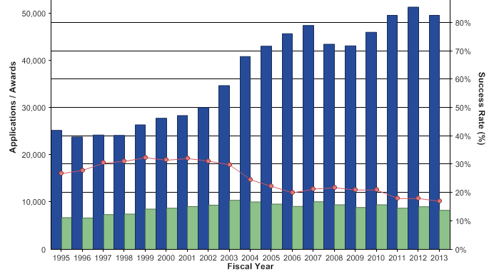
Applications, Awards, Success Rates
More info available at: http://report.nih.gov/success_rates/index.aspx
NEDB 6
Notes:
6
Data and chart description for this slide can be located at http://report.nih.gov/NIHDatabook/Charts/SlideGen.aspx?chartId=20&catId=2
The number of applications for competing RPG awards increased during the “Doubling period” (FY 1998 – 2003) and has continued. The drop in the number of funded competing awards since then has resulted in lower success rates.
Source: Success rate files

Slide 7
When there are fewer salmon in the river…

Slide 8
Four Take Aways
There is an NIH Funding Mechanism for just about every type of research with biomedical impact. But first, get the science right:
Wow the reviewers
Fill a programmatic niche
Don’t neglect other useful tools:
Research Portfolio Online Reporting Tools (RePORT)
IC Strategic Plans and Concept Clearances
NIH staff are knowledagble and accessible. Find them via IC web sites and send a brief e-mail.
NIH issues Funding Opportunity Announcements (FOAs) regularly. Sign up for updates in the NIH Guide.

Slide 9
What Does NIH Already Support
in My Interest Area?
http://report.nih.gov/quicklinks.aspx

Slide 10
https://loop.nigms.nih.gov/index.php/2012/12/03/how-to-use-reporter-when-preparing-new-grant-applications/

Slide 11
Institute/Center (IC) Strategic Plans
http://report.nih.gov/strategicplans/

Slide 12
Peering into the Funding Future:
Concept Clearances
Google “Concept Clearance” and the IC to find the revelant site
“…alert researchers to NIMH interests and potential funding opportunities.”

Slide 13
Four Take Aways
There is an NIH Funding Mechanism for just about every type of research with biomedical impact. But first, get the science right:
Wow the reviewers
Fill a programmatic niche
Don’t neglect other useful tools:
Research Portfolio Online Reporting Tools (RePORT)
IC Strategic Plans and Concept Clearances
NIH staff are knowledagble and accessible. Find them via IC web sites and send a brief e-mail.
NIH issues Funding Opportunity Announcements (FOAs) regularly. Sign up for updates in the NIH Guide.

Slide 14
Need Help with Your Proposal… Who Ya’ Gonna’ Call?
about the scientific and technical aspects of your application
Find them on the solicitation
See also the IC’s programmatic descriptions (http://www.nih.gov/icd/index.html).
for questions during the review
Listed on the eRA Commons link to your submitted proposal
See also the review group rosters at the CSR web site
for help with the business aspects of a proposal
Listed on the eRA Commons link to your submitted proposal
See also the IC’s programmatic descriptions (http://www.nih.gov/icd/index.html).
Program Director
Scientific Review Officer
Grants Specialist

Slide 15
Four Take Aways
There is an NIH Funding Mechanism for just about every type of research with biomedical impact. But first, get the science right:
Wow the reviewers
Fill a programmatic niche
Don’t neglect other useful tools:
Research Portfolio Online Reporting Tools (RePORT)
IC Strategic Plans and Concept Clearances
NIH staff are knowledagble and accessible. Find them via IC web sites and send a brief e-mail.
NIH issues Funding Opportunity Announcements (FOAs) regularly. Sign up for updates in the NIH Guide.

Slide 16
Funding Opportunity Announcements (FOAs)
Contracts vs. Grants
FOAs are the Vehicle for NIH Funding
Types of FOAs
Sign Up for Regular Updates
Parent Announcements
Grants.gov is the portal
NIH Websites are a Rich Resource
Anatomy of an FOA
NIH is a dynamic environment
Beyond the ICs to Common Fund (trans NIH) Opportunities
Non-hypothesis driven research

Slide 17
What’s the Difference Between Grants and Contracts?
GRANT
$
$
$
$
$
$
$
$
$
$
$
$
$
$
CONTRACT
Assistance
Acquisition
Government is Patron or Partner
Government is Purchaser
Purpose: support and stimulate research
Purpose: acquire goods or services
Benefit and use of the government
Benefit a public purpose
Follows a general path
Milestone-driven
Investigator initiated
Government initiated
Notes:
17

Slide 18
How Does NIH Solicit Applications?
Federal Opportunity Announcement (FOA)
a publicly available document by which a Federal agency makes known its intentions to award grants or cooperative agreements, usually as a result of competition for funds
published through
the NIH Guide (http://grants.nih.gov/grants/guide/)
grants.gov

Slide 19
Types FOAs
Program Announcement (PA)
Areas of increased priority/emphasis without committed funds
Multiple application receipt dates, generally over three years
Specifies only standard review criteria
Request for Applications (RFA)
Allows NIH to promote a defined area of science by committing funds (i.e., set-aside $$)
Usually a single receipt date
Specifies standard plus special review criteria
Led by a specific IC, but often joined by others
Request for Proposals (RFP)
Contract solicitation

Slide 20
Different Flavors of Program Announcements
PAR
PA with special receipt, referral and/or review considerations, as described in the PAR announcement
PAS
PA that included set-aside funds (not often used)

Slide 21
Distribution of FOAs
In May, 2014 there were 922 active NIH-issued FOAs, of which 794 (86%) were PAs/PARs and 128 (14%) were RFAs.
The number of active FOAs issued by specific NIH institutes or centers (ICs) ranged from 0 to 84 and the number of active RFAs issued by specific ICs ranged from 0 to 14.

Slide 22
Notices (NOTs)
Notices in the NIH Guide are used to announce:
Policies and procedures
Changes to FOAs
Some contract solicitations
Requests for Information
Other general information items
A Notice that announces a change to an FOA is always added as a hyperlinked “Related Notice” on the first page

Slide 23
How to Recognize an FOA
Examples of PA Numbering:
PA-13-008 or PAR-12-249 or PAS-11-101
Examples of RFA Numbering:
RFA-CA-13-005 or RFA-HL-12-010
Examples of Notice Numbering:
NOT-OD-13-125 or NOT-DK-12-023
Includes the lead IC in the name
Not all ICs
Participate!
Read the FOA.

Slide 24
NIH Guide for Grants and Contracts Updates
New Announcements This Week - Current Weekly Table of Contents (TOC)
TOC by Year and Week: 2013 2012 2011 2010 2009 2008 2007 All Years (1970-Present)
Subscribe or Unsubscribe to Weekly Update via E-mail LISTSERV
RSS Format - NIH Funding Opportunities now available in RSS (Really Simple News Syndication) format.
Follow NIH Funding Opportunities on Twitter

Slide 25
“Parent” Program Announcements
All applications to NIH must submit via an FOA using grants.gov (and the eRA Commons)
Parent Announcements are used for “unsolicited” or “investigator-initiated” applications (i.e. not submitted through special interest PAs or RFAs)
Insures that application package is linked to the correct mechanism, activity code, and Initiative
NIH currently has 26 active Parent Announcements, each for a specific type of grant (i.e. activity code)
Research projects (R01, R03, R/U13, R15, R21, R41, R42, R43, R44)
Training (T32, T35)
Career Development (K01, K02, K07, K08, K23, K24, K25, K99/R00)
Fellowship (F30, F31, F32, F33)
Administrative Supplements (all activities)

Slide 26
http://grants.nih.gov/grants/guide/parent_announcements.htm

Slide 27
Twp
Two roads diverged in a wood, and I—
I took the one less traveled by,
And that has made all the difference.
- Robert Frost
R21 ($275K spread over 2 yrs, non-renewable)
High(er) risk and reward
Little/no supporting data
R03 (2 yrs, $50K per year, non-renewal)
Little/no supporting data
succinct task(s)
R01 (4-5 yrs, $250 - 400K+, renewable, a “real” grant)
Convincing preliminary data for each aim
Longer term questions
Multiple complexities

Slide 28
NCI
R21 “Players”
NIAID
FIC
NHLBI
NCCAM
NINR
NIMHD
NIGMS
NLM
NIDDK
NIBIB
NIDCD
NINDS
NIDCR
NIMH
NIAAA
NICHD
NHGRI
NIA
NIAMS
NIDA
OD/CF
NCATS
NIEHS
NEI
Read the IC Mission Statement
Better yet: contact the Program Director!

Slide 29
“Family Tree” for Research Grants
R01
(standard grant)
P20, P34
(planning grant)
Other Funding
R01
(standard grant)
P30, P50, P41, U54, etc.
(large collabortives)
R03
(small grant)
R01
(standard grant)
P01
(collection of grants)
R21 (exploratory/ developmental)
R01
(standard grant)
R03
(small grant)
R21
(exploratory/ developmental)
R01
(Biological Research Partnership)
R41
R43
(feasibility)
R42
R44
(development)

Slide 30
Your Portal to NIH: grants.gov

Slide 31
Search screen at grants.gov
Clickable menus offer instant results

Slide 32
Remember to
Register and Affiliate to Submit
Even more info at: http://grants.nih.gov/grants/ElectronicReceipt/faq_full.htm

Slide 33
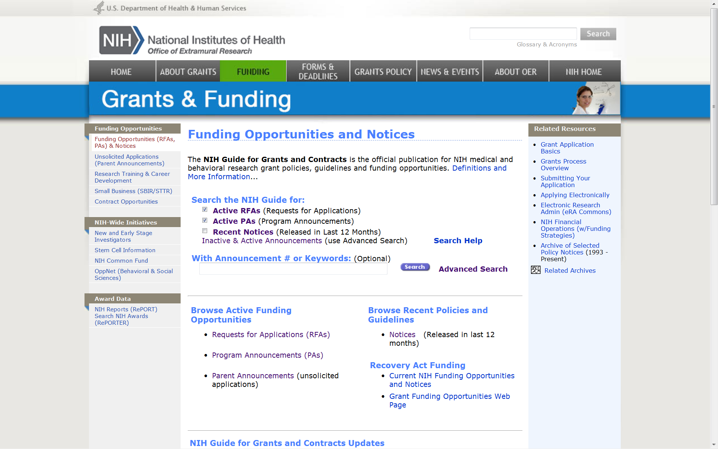
NIH Gate to FOAs…
http://grants.nih.gov/grants/guide/index.html

Slide 34
http://grants.nih.gov/grants/guide/search_guide.htm

Slide 35
What’s in the FOA?
Pretty much everything
The What and Why
Science
Infrastructure
Resource
Public Health
The How…
Much (time and money)
To propose and submit
Reviewed
Awarded
Administered
The Which and Who
Inside NIH (sponsors)
Institutes and Centers (ICs), other Agencies
Program/Review/Grants Managements contacts
Outside NIH (applicants)
Eligible institutions and persons
The When
Due Dates
Reviewed
Awarded
Project duration

Slide 36
Inside the FOA
Department of Health and Human Services
Part 1. Overview Information
Participating Organizations/Components, Title and Activity Code, Announcement Type, Related Notices (updated) and Companion FOA Numbers, Number of Applications, CFDA numbers, FOA purpose, Key Dates
Part 2. Full Text of the Announcement
Section I. Funding Opportunity Description
Section II. Award Information
Section III. Eligibility Information
Section IV. Application and Submission Information
Section V. Application Review Information
Section VI. Award Administration Information
Section VII. Agency Contacts
Section VIII. Other Information

Slide 37
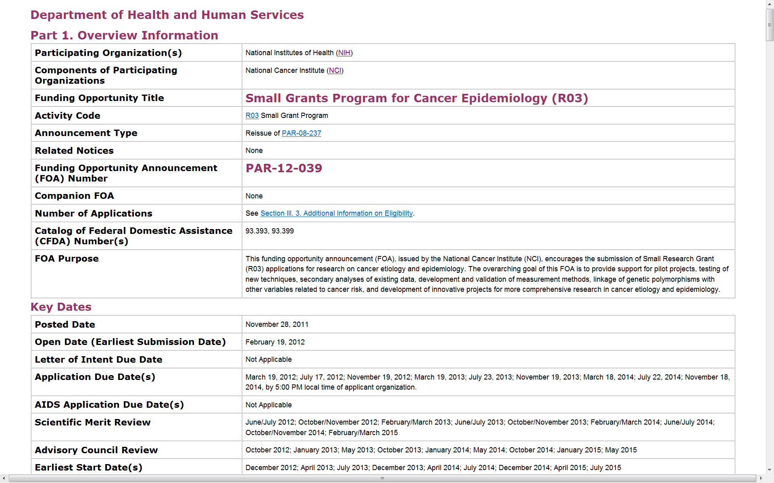

Slide 38
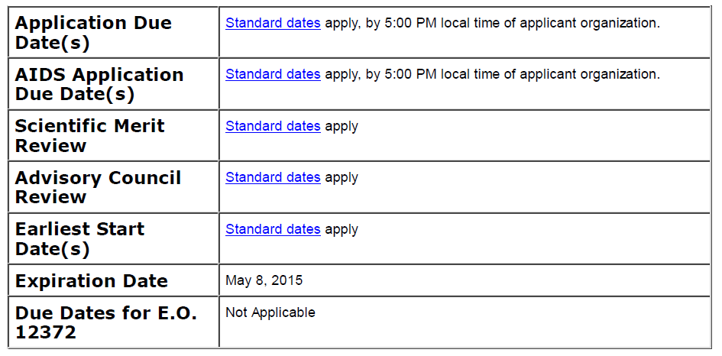
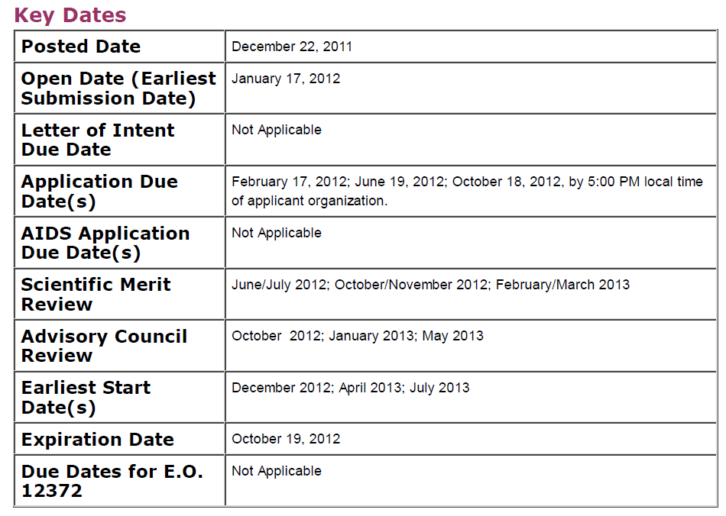
KEY DATES
PA
http://grants.nih.gov/grants/funding/submissionschedule.htm
PAR

Slide 39
Required Application Instructions
It is critical that applicants follow the instructions in the SF 424 (R&R) Application Guide, except where instructed to do otherwise (in this FOA or in a Notice from the NIH Guide for Grants and Contracts)…
A compatible version of Adobe Reader is required for download. For assistance downloading this or any Grants.gov application package, please contact Grants.gov Customer Support at http://www07.grants.gov/contactus/contactus.jsp.
Apply for Grant Electronically

Slide 40
Section VII. Agency Contacts
We encourage inquiries concerning this funding opportunity and welcome the opportunity to answer questions from potential applicants.
Application Submission Contacts
Grants.gov Customer Support
GrantsInfo
eRA Commons Help Desk
Scientific/Research Contact(s)
Program Officer(s) – name(s) and contact information
(sometimes through hyperlinks to NIH web pages)
Peer Review Contact(s)
Scientific Review Officer or Referral Officer – name and contact info.
Financial/Grants Management Contact(s)
Grants Management Officer or Specialist – name and contact info.

Slide 41
We’re not your grandfather’s NIH!

Slide 42
Cross-Cutting, trans-NIH Programs
Gulf Oil Spill
Long Term
Follow Up
Molecular
Libraries
and Imaging
Health
Economics
PROMIS:
Clinical
Outcomes
Assessment
Regulatory
Science
NIH
Center for
Regenerative
Medicine
Technology
Centers for
Networks and
Pathways
Human
Microbiome
Rapid Access
to Interventional
Development
(RAID)
Clinical
Research
Training
Protein
Capture
Clinical Science
and Translation
Awards (CSTAs)
Library of
Integrated Network-
Based Cellular
Signatures
(LINCS)
Nanomedicine
HMO
Collaboratory
High-risk
Research
NIH
Common Fund
Knockout
Mouse
Phenotyping
Global
Health
Pioneers
New innovators
Transformative R01s
Early Independence Awards
Bioinformatics and
Computational Biology
Recurring!
Structural
Biology
Interdisciplinary
Research
Consortia
Science of
Behavior
Change
Genotype-
Tissue
Expression
Epigenomics
http://commonfund.nih.gov/

Slide 43
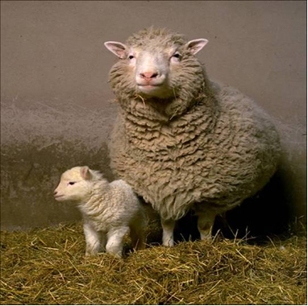
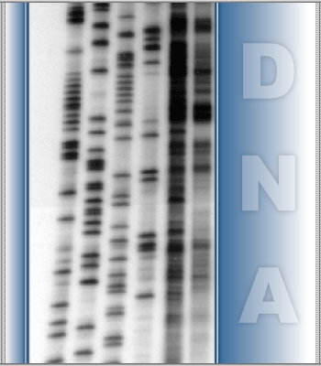
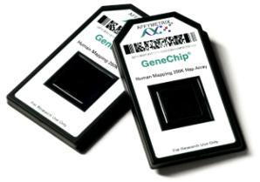
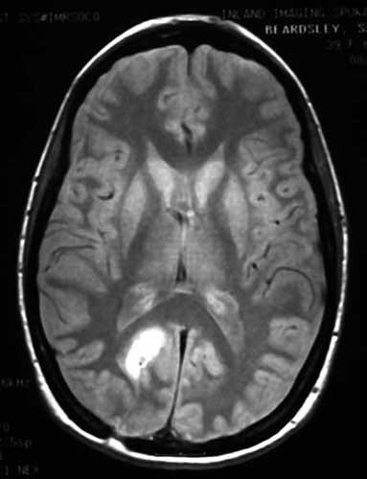
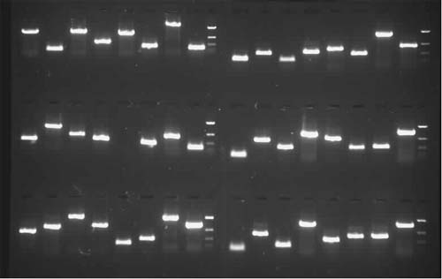
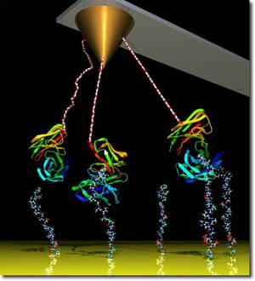
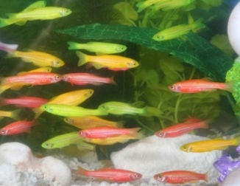
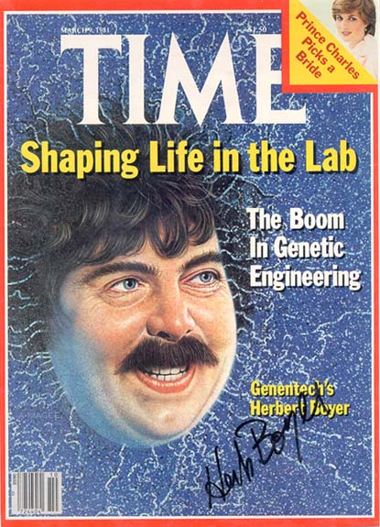
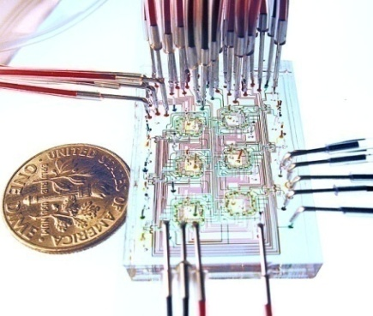
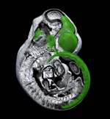
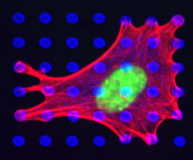
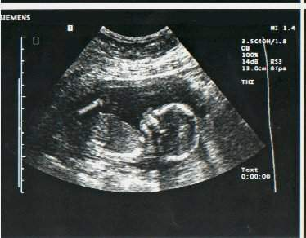
NIH and Non-Hypothesis Driven Research
There are two kinds of scientific revolutions, those driven by new tools and those driven by new concepts… The effect of a concept-driven revolution is to explain old things in new ways. The effect of a tool-driven revolution is to discover new things that have to be explained. -Freeman Dyson, 1997

Slide 44
"Simple can be harder than complex. You have to work hard to get your thinking clean to make it simple. But it's worth it in the end, because once you get there, you can move mountains."

Slide 46
Your Grant Application should reflect
your best thinking.

Slide 47
Rosemarie Hunziker, Ph.D.
Tissue Engineering/Regenerative Medicine, and Biomaterials Program Director
National Institute of Biomedical Imaging and Bioengineering (NIBIB)
National Institutes of Health (NIH)
301-451-1609
Rosemarie.Hunziker@nih.gov
www.nibib.nih.gov

