Slide 1
.
ClinicalTrials.gov and FDAAA for NIH Grantees
David Curren
Special Assistant to the Office Director
Officer of Policy for Extramural Research Administration
NIH Regional Seminar
June 26, 2014

Slide 2
Objectives for This Section
1. Help you understand compliance:
Taking the Responsible Party (RP) role for applicable clinical trials (ACTs) supported by NIH grants
NIH certification of compliance with FDAAA
2. Help you avoid trouble spots:
Resources to help you
Tips
Note: NIH extramural grants only; not NIH research and development contracts.

Slide 3
The NIH encourages registration and results reporting for all NIH-supported clinical trials, regardless of whether or not they are subject to FDAAA.
http://grants.nih.gov/ClinicalTrials_fdaaa/

Slide 4
Responsible Party & NIH Grants
Sponsor [only one per trial] is:
IND/IDE* holder; if none, then:
The Grantee Institution is generally considered to be the Sponsor
Grantee is the “initiator” of the trial, having submitted the funding proposal
http://prsinfo.clinicaltrials.gov/ElaborationsOnDefinitions.pdf
Note:
Includes cooperative agreements (US) & Center grants
* Investigational New Drug/Investigations Device Exemption

Slide 5
Criteria for PI as Responsible Party
Sponsor may designate the PI of the clinical trial as the Responsible Party provided they:
Are responsible for conducting the trial;
Have access to and control over the data from the clinical trial;
Have the right to publish the results of the trial; and
Have the ability to meet all of the requirements for submitting information under the law.
PI must meet all criteria to be designated

Slide 6
Designating the PI as Responsible Party (or Not)
Sponsor is not required to designate the PI as the RP
Carefully consider the implications of designating a PI as the Responsible Party
What is in the best interest of the Sponsor?
After the trial ends?
After the PI leaves?

Slide 7
Understanding the Requirement to Certify Compliance
All Applicable Clinical Trials (ACTs) supported in whole or in part by an NIH grant must be in full compliance with FDAAA
The Responsible Party has made all required submissions to ClinicalTrials.gov
NIH certification of compliance with FDAAA applies to:
All grants supporting ACTs (even if only in part)
Grants where neither grantee nor PI is the RP of the ACT

Slide 8
Certifying of Compliance to NIH
Competing awards (applications):
SF 424: Part II, section 4.1.6
PHS 398: Part II, section 4.1.6
Non-competing continuation progress reports:
PHS 2590: Section 2.2.6.D and section 4.6
For non-Streamlined Non-competing Award Process (SNAP) awards
Research Performance Progress Report (RPPR):
all SNAP awards
all F awards with start dates on or after July 1, 2013
Stay tuned for non-SNAP awards by October 17, 2014 (anticipated)
Unrelated to the FDA certification of compliance

Slide 9
NIH Certification of Compliance: Competing applications and PHS 2590
In the “Human Subjects” section:
Add a heading entitled “ClinicalTrials.gov”
Under the heading, registered trials provide:
NCT number/s
Brief Title/s
ID and contact info for the RP
Under the heading, trials not yet registered (<21 days since enrollment of the first participant):
Include a clear statement that the project includes an ACT which will require registration in ClinicalTrials.gov.

Slide 10
NIH Certification of Compliance: RPPR
Section G. Special Reporting Requirements
G.4.c ClinicalTrials.gov
Does this project include one or more applicable clinical trials that must be registered in ClinicalTrials.gov under FDAAA?
Yes No
If yes, provide the ClinicalTrials.gov identifier, NCT number (e.g., NCT00654321) for those trials.

Slide 11
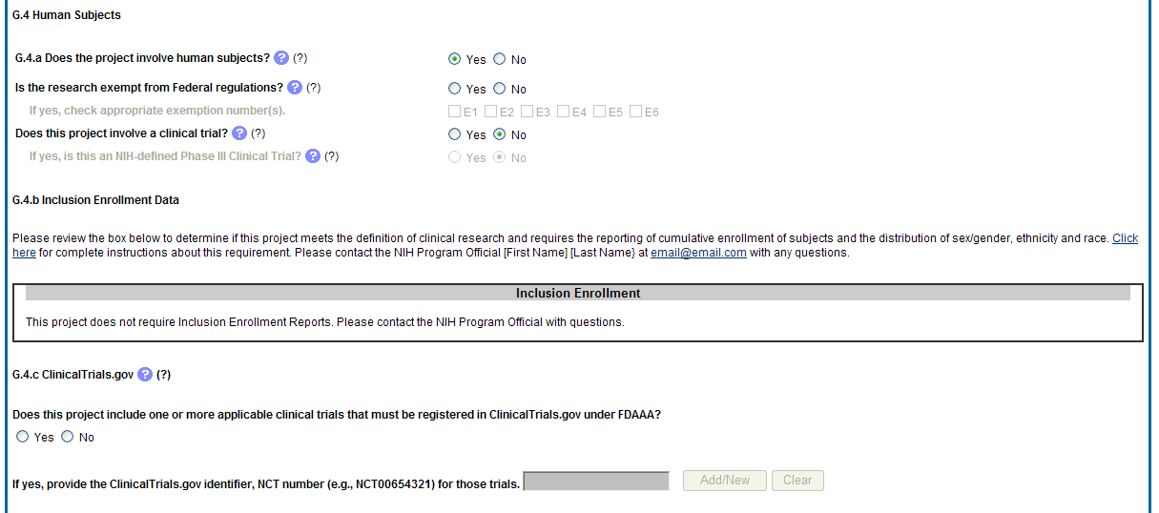
NIH Certification of Compliance: RPPR Screenshot

Slide 12
Record Retention for Clinical Trial Data
Carefully consider requirements
NIH Grantee Institution’s responsibility
Minimum of 3 years after date of submission of final expenditures report to NIH
May be additional durations specified under CFR as well
Requirements apart from those associated with NIH grants

Slide 13
What if NIH has concerns about compliance?
Extramural Program Official may generate a notification email:
PD/PI, Business Official, Responsible Part, NIH Grants Management
FDAAA Issues Report from PRS (Protocol Registration System; NLM)
Missing FDAAA-required fields & results
Work quickly to respond and remedy
Bring trial and grant into compliance

Slide 14
Resources and Tips

Slide 15
NIH OER Resources
“What NIH Grantees Need to Know about FDAAA”
http://grants.nih.gov/ClinicalTrials_fdaaa/
Step-by-step guidance
Flowcharts for ascertaining ACTs and RP
“At-a-glance” requirements
FAQs for NIH Grantees

Slide 16
Tips: Take a Team Approach
Be aware of your Institution’s approach/SOP
Work as a team to identify ACTs and RPs
Sponsored research office, PI, Counsel
Work across institutions
Take actions early to clarify roles and responsibilities
NIH’s role
Resources
Cannot make determinations or register/report results on behalf of Grantee or RP
http://grants.nih.gov/grants/guide/notice-files/NOT-OD-09-147.html

Slide 17
Tip: Manage Risk Wisely
Grantee Institutions as Sponsors
Do you have standard operating procedures?
Monitor compliance
All ACTs belong in Institutional account
Use personnel appropriately to fulfill FDAAA
Not necessary to have a someone designated as RP in order for him/her to enter data
Multi-user access, including user from outside of Institution
Implement appropriate record retention

Slide 18
Tips: Understand FDAAA
Only the Responsible Party can register and report results
If trial is non-compliant, non-RP may not usurp RP’s role
Be attentive to rulemaking

Slide 19
The NIH encourages registration and results reporting for all NIH-supported clinical trials, regardless of whether or not they are subject to FDAAA.
http://grants.nih.gov/ClinicalTrials_fdaaa/

Slide 20
Grants Information: Who to Contact (cont’d)
Division of Grants Policy:
E-Mail: GrantsPolicy@mail.nih.gov
Phone: 301-435-0949
Division of Grants Compliance & Oversight:
E-Mail: GrantsCompliance@mail.nih.gov
Phone: 301-435-0949

Slide 21
Thank You!
Questions?

