Slide 1
ClinicalTrials.gov and FDAAA for NIH Grantees NIH Regional Seminar - June 2014 Rebecca J. Williams, PharmD, MPH Assistant Director, ClinicalTrials.gov National Library of Medicine
http://ClinicalTrials.gov

Slide 2
Overview
Introduction to Section 801 of the Food and Drug Administration Amendments Act of 2007 (FDAAA)
Rationale
Requirements
FDAAA for NIH Extramural Grantees
Implementation for NIH grants
OER resources
ClinicalTrials.gov Practical Considerations
FDAAA Next steps
Protocol Registration System (PRS)
Resources

Slide 3
Rationale for Trial Registration & Summary Results Reporting

Slide 4
Evidence Based Medicine
Clinical and policy decisions should be informed by evidence regarding the benefits, risks, and other burdens associated with all possible alternatives
Clinical trials are a key component of the body of scientific evidence that must be used to make decisions
Our pact with clinical trial volunteers:
Participation will advance medical knowledge
IRBs and others will ensure that you are informed of risks, benefits and alternatives

Slide 5
Three Key Issues
Not all trials are published
Publications do not always include all pre-specified outcome measures
Unacknowledged changes are made to the trial protocol that would affect the interpretation of the findings
e.g., changes to the pre-specified outcome measures

Slide 6
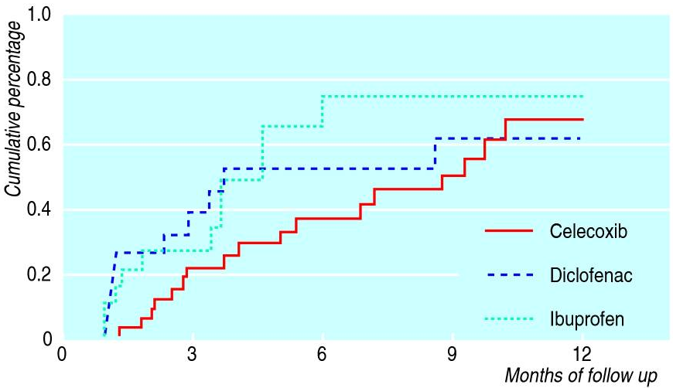
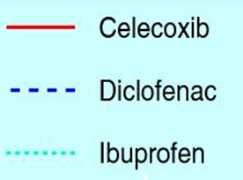
Kaplan-Meier estimates for ulcer complications according to traditional definition. Results are truncated after 12 months, no ulcer complications occurred after this period. Adapted from Lu 2001. Source: Jüni P, Rutjes AW, Dieppe PA. BMJ. 2002 Jun 1;324(7349):1287-8.
Notes:
Zarin CTSA Webinar (10-21-09)
ClinicalTrials.gov / NLM
6

Slide 7
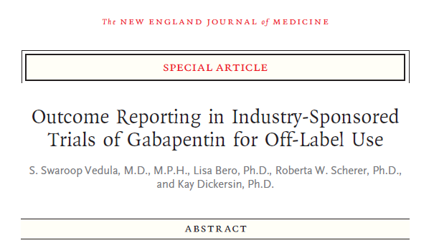
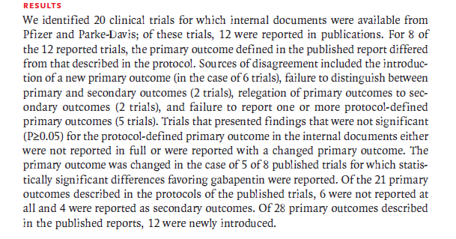
“The primary outcome was changed in the case of 5 of 8 published trials for which statistically significant differences favoring gabapentin were reported.”
N Engl J Med. 2009 Nov 12;361(20):1963-71.
Notes:
Changes in Primary Outcome Measure

Slide 8
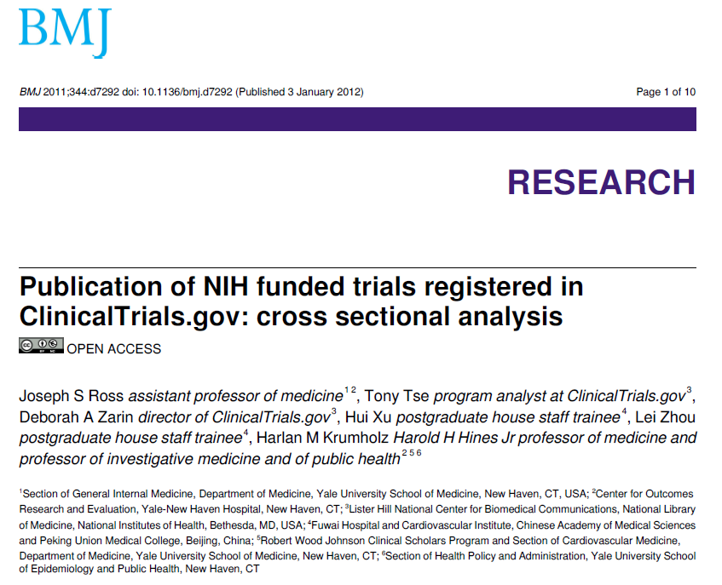

Slide 9
Summary of Findings
Fewer than half of NIH funded trials registered at ClinicalTrials.gov after September 2005 and completed by December 2008 were published in a peer reviewed biomedical journal indexed by Medline within 30 months of trial completion
After a median of 51 months after study completion, a third of NIH-funded trials in the sample remained unpublished
BMJ 2011;344:d7292 doi

Slide 10
Rationale for Registration and Results Reporting
Responsibility to human subjects and the public
Research integrity
Evidence-based medicine
Responsible allocation of resources
Notes:
I don’t understand the “allocation of resources” thing

Slide 11
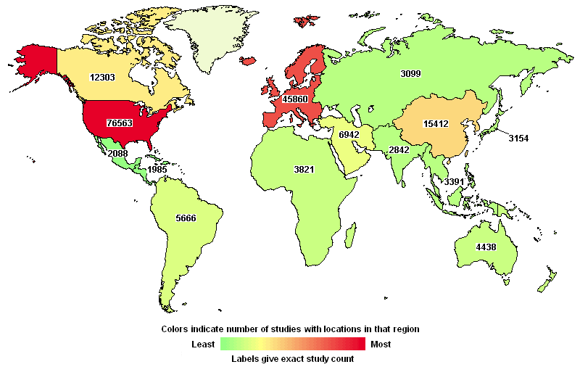
About ClinicalTrials.gov
Clinical studies registry and results database
Over 165,000 studies (trials & observational studies)
Studies with locations in all 50 states and 186 countries
Privately and publicly funded studies involving humans
Study information submitted by sponsors
Web Site & registry launched in February 2000
Results database, in September 2008
Over 12,000 studies with results
Database updated nightly
Usage
98 million page views per month
64,000 visitors per day

Slide 12
FDAAA and Other Trial Disclosure Policies

Slide 13
Why Register a Clinical Trial?
Required by most medical journals (ICMJE**)
Registration for all clinical trials (all interventions)
http://www.icmje.org/publishing_10register.html
It is Federal law! (FDAAA 801*)
Registration & results submission for “applicable” trials
http://www.clinicaltrials.gov/ct2/manage-recs/fdaaa
Encouraged for all NIH-supported trials
Registration & results submission, even if not subject to FDAAA 801
http://grants.nih.gov/ClinicalTrials_fdaaa/
* Section 801 of the Food and Drug Administration Amendments Act of 2007 (U.S. Public Law 110-85)
** International Committee of Medical Journal Editors

Slide 14
What Studies to Register?
All Clinical Trials (ICMJE)
“Applicable Clinical Trials - ACTs”* (FDAAA 801)
Interventional study of drug, biologic, or device
Exception: Phase 1 drug trials and small feasibility device trials
US FDA jurisdiction (e.g., US site or IND/IDE)
ACTs initiated on or after 9/27/07 or ongoing as of 12/26/07
*Complete definitions at: http://prsinfo.clinicaltrials.gov/ElaborationsOnDefinitions.pdf

Slide 15
Where to Register?
ClinicalTrials.gov
Web-based Protocol Registration System (PRS)
Log-in at: https://register.clinicaltrials.gov
Interactive data entry or XML upload
Tool also available for cancer centers submitting protocol information to NCI Clinical Trials Reporting Program (CTRP)
Studies conducted outside the U.S.
Be aware of all local requirements!
May also be required to register in local trial registry

Slide 16
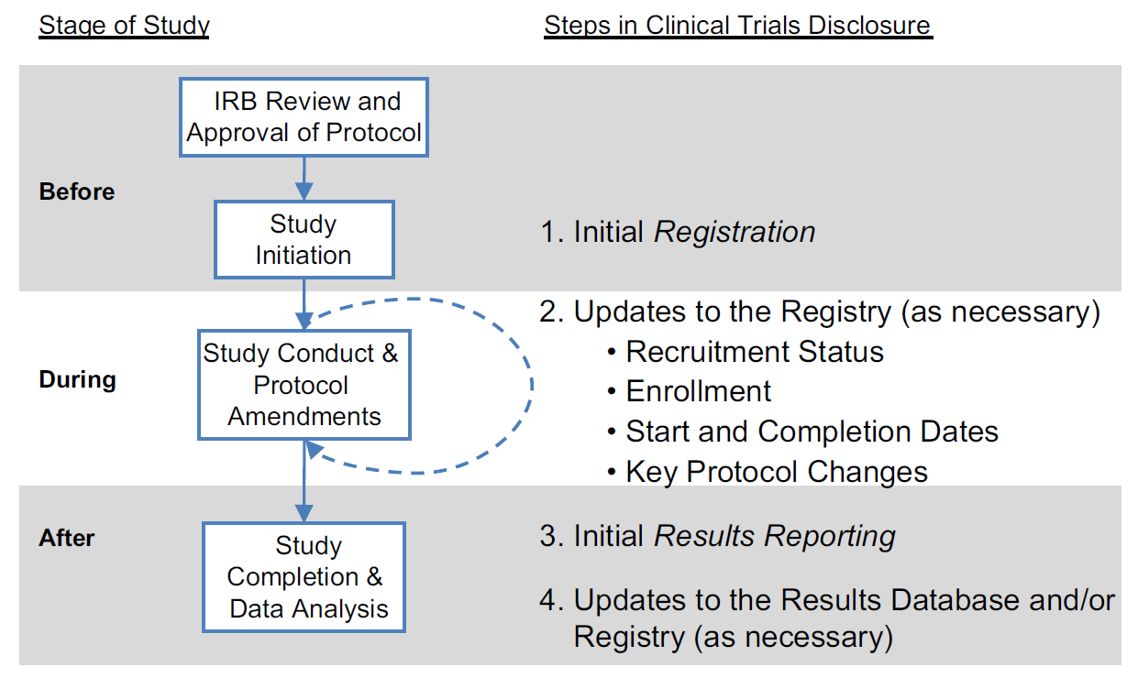
The Clinical Trial Lifecycle & ClinicalTrials.gov

Slide 17
Prior to Trial Initiation (a)
Identify roles and responsibilities
Sponsor and Responsibility Party* (FDAAA 801)
IND/IDE holder; if none, then
Person or entity who “initiated” the trial
Funding recipient if grant or sponsored research agreement
Funder if procurement funding agreement (contract)
Sponsor may designate the Principal Investigator (PI) as Responsible Party if PI meets certain requirements (e.g., has access to and control over data, right to publish)
*Complete definition at http://prsinfo.clinicaltrials.gov/ElaborationsOnDefinitions.pdf IND/IDE= Investigational New Drug Application/Investigational Device Exemption

Slide 18
Prior to Trial Initiation (b)
Register the trial at ClinicalTrials.gov
Before 1st participant is enrolled (ICMJE)
Within 21 days of 1st participant enrolled (FDAAA 801)
Tip: Enter NIH Grant number in record (Secondary ID)
FDA Informed Consent Regulations (21 CFR§50.25(c))
A statement must be included in informed consent documents of applicable clinical trials initiated on or after March 7, 2012 regarding availability of information at ClinicalTrials.gov
21 CFR 50.25(c): http://www.accessdata.fda.gov/scripts/cdrh/cfdocs/cfcfr/CFRSearch.cfm?fr=50.25
FDA Guidance: http://www.fda.gov/downloads/RegulatoryInformation/Guidances/UCM291085.pdf

Slide 19
While the Trial is Ongoing (a)
Updates to ClinicalTrials.gov
Required at least once every 12 months (FDAAA 801)
Update/verify “active” trials once every 6 mo. (ClinicalTrials.gov)
Consider any protocol amendments that impact registration
Recruitment status and (primary) completion date must be updated within 30 days of a change (FDAAA 801)
Certification of Compliance to NIH
Applies to:
All grants supporting ACTs (even if only supporting one aspect)
Grants where neither grantee nor PI is RP of the ACT
See: http://grants.nih.gov/clinicaltrials_fdaaa/
See: http://grants.nih.gov/grants/rppr/index.htm

Slide 20
While the Trial is Ongoing (b)
Certification of Compliance to FDA
Form 3674 must accompany human drug, biological, and device product submissions
FDA Form: http://www.fda.gov/downloads/AboutFDA/Reports ManualsForms/Forms/UCM048364.pdf
Guidance (2009): http://www.fda.gov/RegulatoryInformaton/ Guidances/ucm125335.htm
CMS Medicare National Coverage Determination (NCD) for Routine Costs in Clinical Trials*
Must provide NCT Number if submitting claims for routine costs that occur during a clinical trial
Initially mandatory Jan 1, 2014 but delayed 1 year
*MLN Matters® Number: SE1344 and Related Change Request Number: 8401

Slide 21
After the Trial “Completes” (a)
(NIH/FDA Certifications may still apply)
Definitions
Primary Completion Date - PCD (FDAAA 801)
“The date that the final subject was examined or received an intervention for the purposes of final collection of data for the primary outcome, whether the clinical trial concluded according to the prespecified protocol or was terminated.”
Study Completion Date (last subject, last visit)
Final date on which data were collected
See ClinicalTrials.gov Protocol Data Element Definitions: http://prsinfo.clinicaltrials.gov/definitions.html

Slide 22
After the Trial “Completes” (b)
Submit Summary Results (FDAAA 801)
Which Trials?
ACTs of FDA-approved or -cleared drugs, biologics, & devices;
Initiated on or after 9/27/07 or “ongoing” as of 12/26/07
When to Submit?
< 1 year after PCD (or < 30 days of approval or clearance)
Delays possible
Seeking approval of a new use (if Sponsor = manufacturer)
Extensions for “good cause”
Pending publication is not considered “good cause”
ACT = applicable clinical trial
PCD = primary completion date

Slide 23
After the Trial “Completes” (c)
Submit Summary Results
Scientific Information (“per arm”)*
Participant Flow
Baseline Characteristics
Primary and Secondary Outcome Measures
Statistical analyses, as appropriate
Adverse Events – Serious and “Other”
Administrative Information
Results Point of Contact
Certain Agreements (related to investigator’s right to publish, if not an employee of sponsor)
*ClinicalTrials.gov Results Data Element Definitions at http://prsinfo.clinicaltrials.gov/results_definitions.html
23
23

Slide 24
FDAAA Results Clarifications
Summary results at the end of the trial
No interim or “real-time” reporting
No participant-level reporting
Summary results submission not required for:
Registered non-ACTs (e.g., observational, Phase 1)
Trials completed by 12/26/07
Relationship to publication (ICMJE)
Submitting summary results to ClinicalTrials.gov will not interfere with publication*
(But, failing to register the trial will!)
*http://www.icmje.org/publishing_10register.html

Slide 25
FDAAA Enforcement Provisions
Notices of non-compliance
Civil monetary penalties (up to $10,000/day)
Withholding of NIH grant funds

Slide 26
The ClinicalTrials.gov Results Database

Slide 27
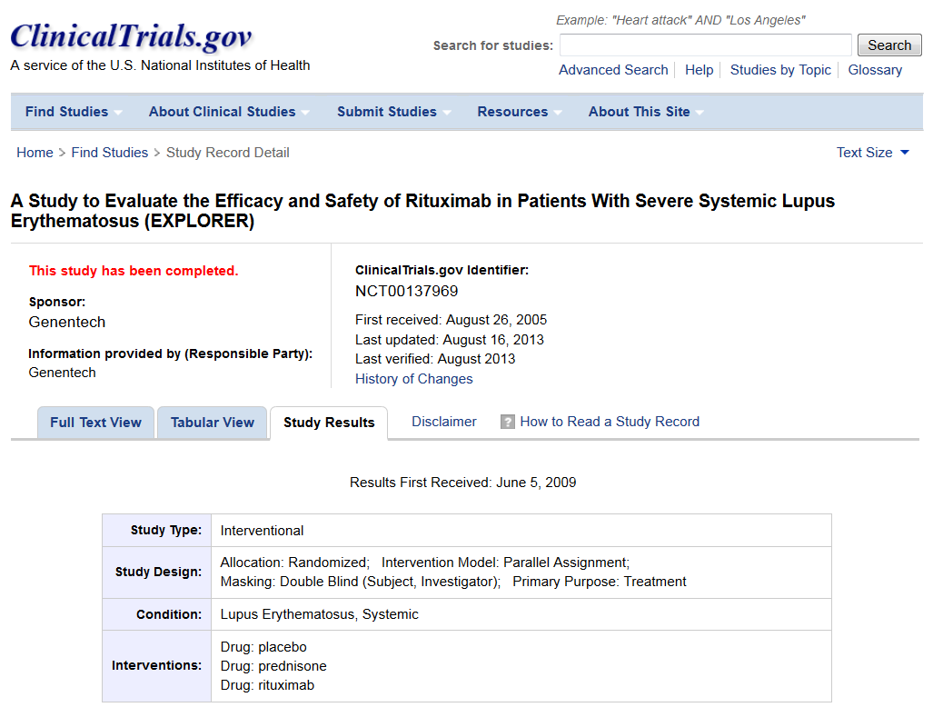
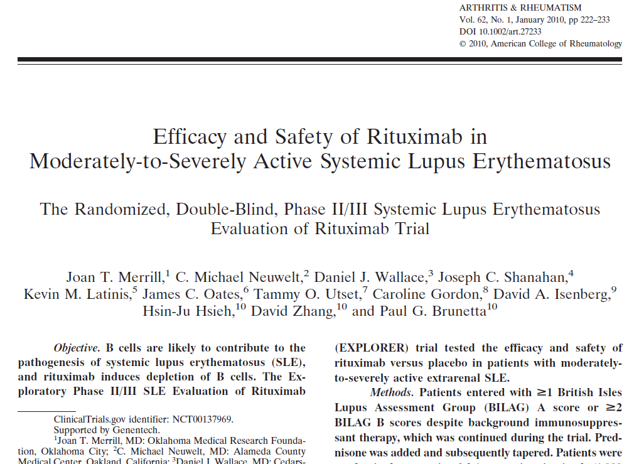
Results: NCT00137969
ClinicalTrials.gov:
Publication:

Slide 28
Results: Participant Flow
Publication (CONSORT Flow Diagram)
ClinicalTrials.gov
Patients
Randomized 2:1
(n=257)
Period 1: 52 Weeks
 | Placebo + Prednisone | Rituximab + Prednisone
STARTED | 88 | 169
COMPLETED | 64 | 120
NOT COMPLETED | 24 | 49
Adverse Event | 13 | 19
Patients’ Decision | 5 | 11
Physicians’ Decision | 4 | 13
Lost to Follow-up | 2 | 3
Death | 0 | 3
Placebo + Prednisone
(n=88)
Rituximab + Prednisone
(n=169)
24 Withdrawals Total
13 Adverse Events
5 Patients’ Decision
4 Physicians’ Decision
2 Lost to Follow-up
0 Death
49 Withdrawals Total
19 Adverse Events
11 Patients’ Decision
13 Physicians’ Decision
2 Lost to Follow-up
0 Death
Completed Week 52
(n=64) 73%
Completed Week 52
(n=120) 71%
Adapted from Merrill JT et al. Arthrit Rheum 2010 and NCT00137969

Slide 29
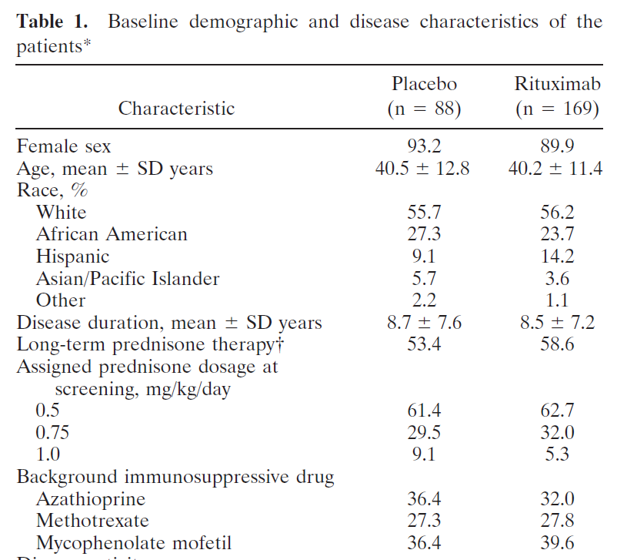
Results: Baseline Characteristics
Publication (“Table 1”)
ClinicalTrials.gov
Baseline Measures
 | Placebo + Prednisone | Rituximab + Prednisone | Total
Number of Participants | 88 | 169 | 257
Age [units: years] Mean ± Standard Deviation | 40.5 ± 12.8 | 40.2 ± 11.4 | 40.3 ± 11.9
Gender [units: participants]
Female | 82 | 152 | 234
Male | 6 | 17 | 23
Race [units: participants]
White | 49 | 95 | 144
African American | 24 | 40 | 64
Hispanic | 8 | 24 | 32
Asian/Pacific Islander | 5 | 6 | 11
Other | 2 | 2 | 4
Disease duration [units: years] Mean ± Standard Deviation | 8.7 ± 7.6 | 8.5 ± 7.2 | 8.6 ± 7.3
Adapted from Merrill JT et al. Arthrit Rheum 2010 and NCT00137969

Slide 30
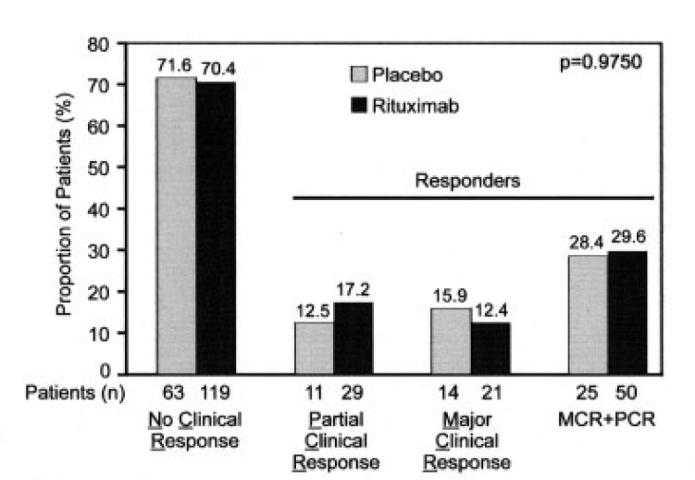
Results: Outcome Measures
Publication
ClinicalTrials.gov
Primary Outcome
“At week 52, no difference was noted in major clinical responses or partial clinical responses between the placebo group (15.9% had a major clinical response …) and the rituximab group (12.4% had a major clinical response …)”
Measure Title | Participants Achieving Either a Major Clinical Response (MCR) or Partial Clinical Response (PCR) Defined by British Isles Lupus Assessment Group (BILAG) Scores Over the 52-week Treatment Period
Measure Description | The BILAG Index is used for measuring clinical disease activity in Systemic Lupus …
Time Frame | Baseline to 52 weeks
Measured Values
 | Placebo + Prednisone | Rituximab + Prednisone
Number of Participants Analyzed | 88 | 169
[units: participants]
MCR (excluding PCR) | 14 | 21
PCR | 11 | 29
Nonclinical Response | 63 | 119
Figure 2A. Proportion of patients experiencing a major clinical response (MCR) … at 52 weeks
Adapted from Merrill JT et al. Arthrit Rheum 2010 and NCT00137969

Slide 31
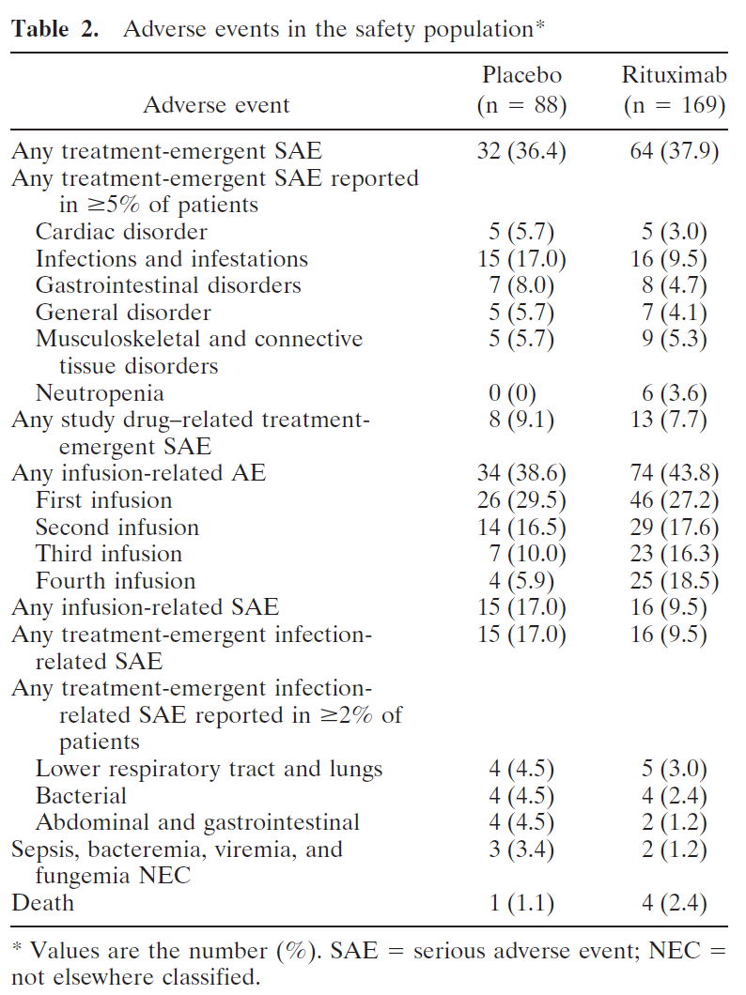
Results: Adverse Events
Publication
ClinicalTrials.gov
Serious Adverse Events
 | Placebo + Prednisone | Rituximab + Prednisone
Total # participants affected/at risk | 32/88 (36.36%) | 68/169 (40.24%)
Blood and lymphatic disorders
Neutropenia | 0/88 (0.00%) | 6/169 (3.55%)
Pancytopenia | 1/88 (1.14%) | 1/169 (0.59%)
Haemolytic Anaemia | 0/88 (0.00%) | 1/169 (0.59%)
Lymphophenia | 0/88 (0.00%) | 1/169 (0.59%)
Thrombocytopenia | 0/88 (0.00%) | 1/169 (0.59%)
Cardiac disorders
Coronary artery disease …. | … | …

Slide 32
Experience with Results Database
Entering results is similar to the process of preparing a journal article
Data provider must be familiar with the study design and data analysis
Typically, the investigator and/or a statistician will need to be involved
32

Slide 33
General Review Criteria
Protocol and results must be clear and informative
Review focuses on:
Logic and internal consistency
Apparent validity
Meaningful entries
Formatting
33

Slide 34
ClinicalTrials.gov Practical Considerations

Slide 35
FDAAA - Next Steps
HHS plans to issue regulations that will prescribe procedures for registering and submitting results of clinical trials to ClinicalTrials.gov in accordance with FDAAA
Notice of Proposed Rulemaking (NPRM)
Received by Office of Management and Budget (OMB) for regulatory review on March 11, 2014
OMB Notice: http://www.reginfo.gov/public/do/eoDetails?rrid=123853

Slide 36
Overview of Rulemaking Process
Food and Drug Administration Amendments Act of 2007
Announcement in Department’s Unified Agenda of Regulatory Action
Agency Develops Draft Notice of Proposed Rulemaking (NPRM)
Department and OMB Review
NPRM Published in Federal Register
Public Comment Period (typically 60 – 90 days)
Agency Responds to Comments/ Develops Final Rule
Department and OMB Review
Final Rule Published in Federal Register
36

Slide 37
Additional Issues in Rulemaking
Expand results reporting to trials of unapproved products?
Include narrative summaries? Can it be done without being promotional and misleading?
Technical; Lay language
Data quality verification
Process
External sources
Full protocol versus extract “necessary to help evaluate the results”

Slide 38
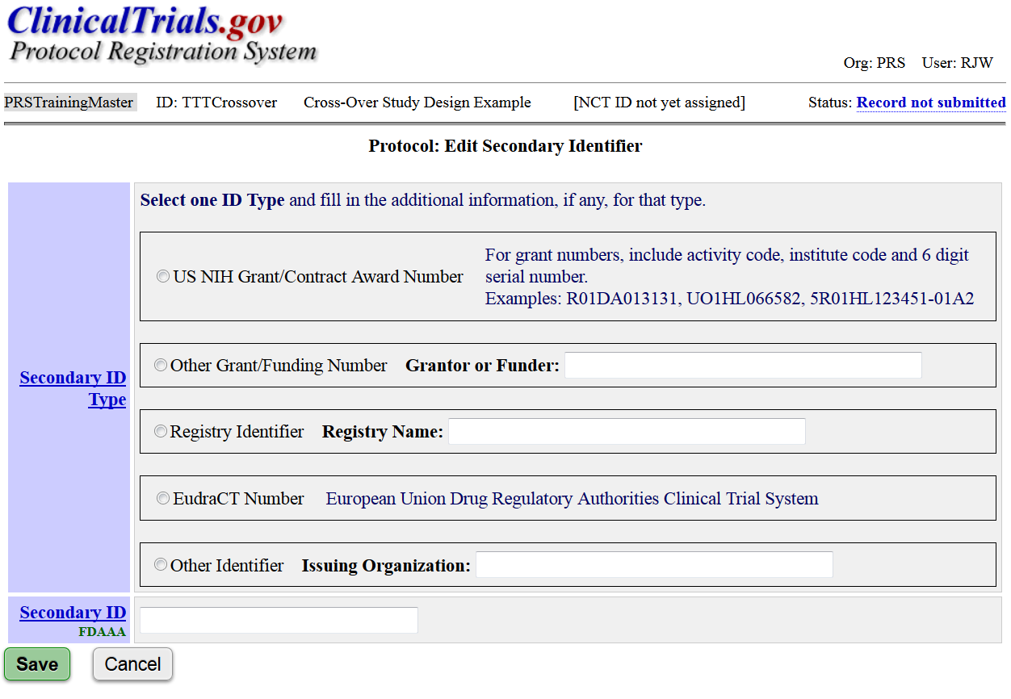
PRS Entry of NIH Grant Number

Slide 39
Additional PRS Resources
Problems Report (downloadable)
Allows investigators and administrators of organizational accounts to identify potential problems with records, including potential FDAAA issues:
Missing FDAAA required data elements
Late results - trials that reached (primary) completion date more than one year ago and results are not posted on ClinicalTrials.gov
Note: Report is for informational purposes only. The Responsible Party must determine if the trial is an “applicable clinical trial” subject to FDAAA requirements.

Slide 40
PRS Information Resources
Protocol Registration
Data Element Definitions
Review Criteria
Results
Data Element Definitions
Review Criteria
Simplified, Printable Results Templates
Helpful Hints and Common Errors
User’s Guide [PRS Main Menu]
http://www.clinicaltrials.gov/ct2/manage-recs/resources
40

Slide 41
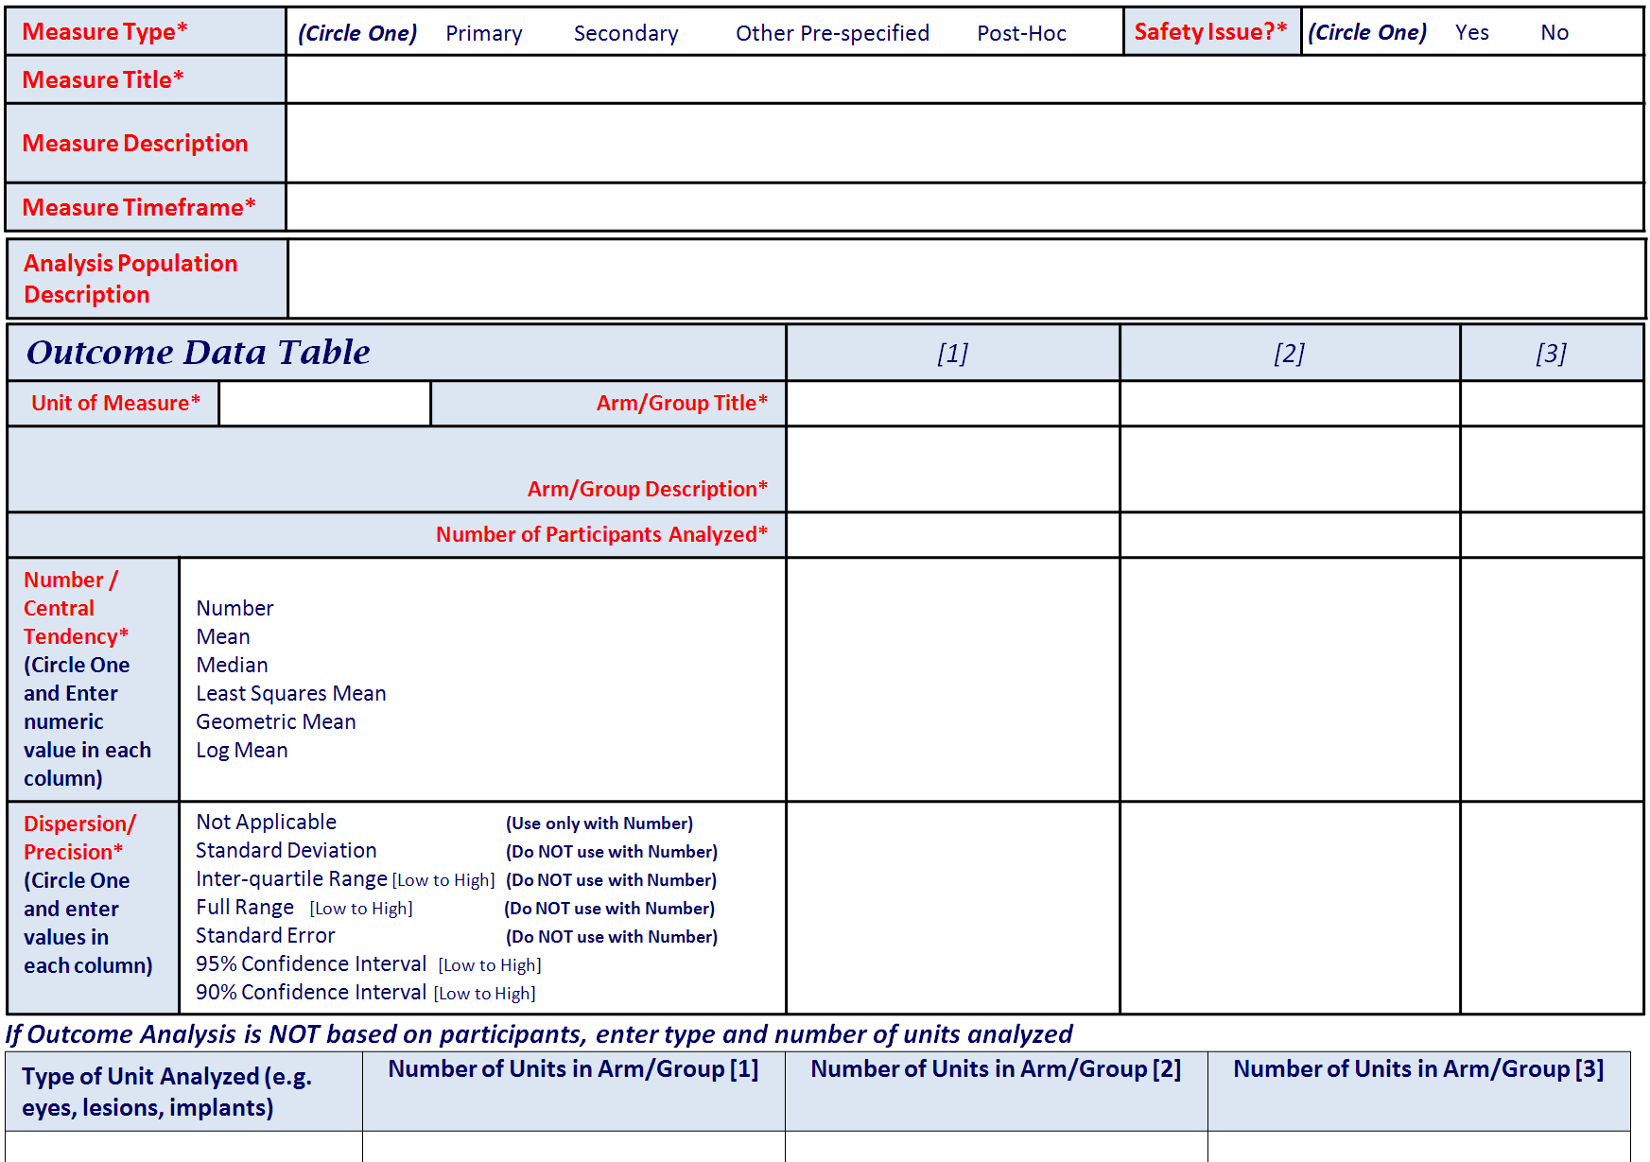
Simple Results Templates
Notes:
Basic Information Needed for Outcome Measures

Slide 42
Recorded Presentations
Available at: http://clinicaltrials.gov/ct2/manage-recs/present
Eight presentations with audio and slides
Overview of ClinicalTrials.gov
Key FDAAA Issues
PRS Information and Data Review Process
PRS Accounts and Registration
Results
5. Participant Flow Module
6. Baseline Characteristics Module
7. Outcome Measures and Statistical Analysis Module
8. Adverse Events Module

Slide 43
Other Practical Considerations
How will you ensure/verify trials are registered?
Some organizations require the NCT Number to be provided as part of the IRB approval process
How will you ensure/verify results are submitted?
Learn and use Administrator tools in the PRS
Which personnel have right skills to register a trial and/or submit results? Who will provide training?
How will you handle staff turnover (e.g., PI leaves)? Who has responsibility for the data?
What if you designated PI as Responsible Party?

Slide 44
Final Thoughts
FDA Compliance Program 7348.810: Sponsors, Contract Research Organizations, and Monitors*
Instructs FDA staff to identify SOPs and determine if studies were registered on ClinicalTrials.gov appropriately
The NIH encourages registration and results reporting for all NIH-supported clinical trials, regardless of whether or not they are subject to FDAAA.
*http://www.fda.gov/ICECI/ComplianceManuals/ComplianceProgramManual/default.htm

Slide 45
Select Publications Available at: http://www.clinicaltrials.gov/ct2/resources/pubs Zarin DA, Tse T, Williams RJ, Califf RM, Ide NC. The ClinicalTrials.gov results database – update and key issues. N Engl J Med 2011;852-860. Tse T, Williams RJ, Zarin DA. Update on registration of clinical trials in ClinicalTrials.gov. Chest 2009;136:304-5. Tse T, Williams RJ, Zarin DA. Reporting basic results in ClinicalTrials.gov. Chest 2009;136:295-303. Wong E, Williams R. ClinicalTrials.gov: Requirements and implementation strategies. Regulatory Focus. 2012 May.

Slide 46
Additional Resources Questions? register@clinicaltrials.gov ClinicalTrials.gov information (Submit Studies page): http://clinicaltrials.gov/ct2/manage-recs Office of Extramural Research (OER) http://grants.nih.gov/Clinicaltrials_fdaaa/ Food and Drug Administration (FDA) http://www.fda.gov/RegulatoryInformation/Legislation/ FederalFoodDrugandCosmeticActFDCAct/ SignificantAmendmentstotheFDCAct/ FoodandDrugAdministrationAmendmentsActof2007/ default.htm

