Slide 1
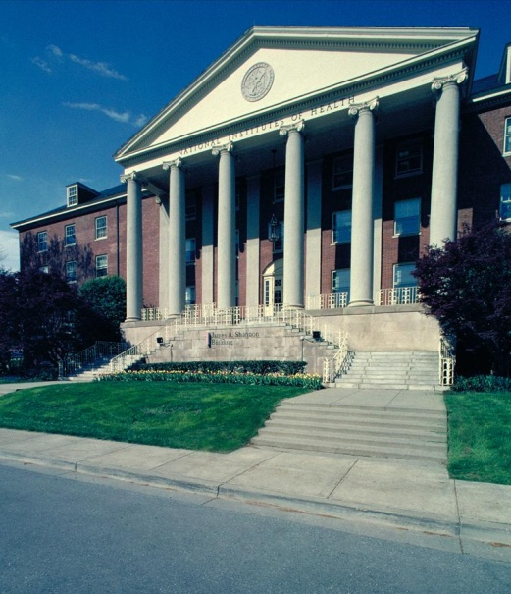
Mapping Your Career with NIH
June 2014
Henry Khachaturian, Ph.D.
Extramural Program Policy Officer
NIH Office of Extramural Research
hk11b@nih.gov

Slide 2
National Institutes of Health
NIH’s mission is to seek fundamental knowledge about the nature and behavior of living systems and the application of that knowledge to enhance health, lengthen life, and reduce the burdens of illness and disability.
World’s largest source of funding for biomedical research
Support more than 300,000 research personnel at over 3,000 universities and research institutions
27 Institutes and Centers (ICs) with specific research agendas

Slide 3
FY 2014 PB: $31.3 billion
~$783 M Training
~$657 M Career
~$1.44 billion
NIH Budget Office: http://officeofbudget.od.nih.gov/index.htm

Slide 4
Advice for Mapping Your Career With NIH
Review Institute/Center (IC) priorities and goals. Each IC has a research training and career development program.
Learn the NIH application and review process
Identify the grant programs offered by each IC
Make early contact with program officers
Find innovative, well-respected mentors and collaborators
Study successful grant applications- talk to your mentor
Propose your best and most creative ideas
Apply (and then Persevere): “It's not that I'm so smart, it's just that I stay with problems longer.” ~Albert Einstein

Slide 5
Notes:
The NIH must train our future research workforce so that you will be able to address not just our nation’s, but the world’s future health needs.
Throughout your research career, most of your funding will probably come from the NIH. To be successful in attaining these awards, keep this advice in mind.

Slide 6
Opportunities
Training Grants & Fellowships
Career Development Awards
Loan Repayment Programs
Research Grants

Slide 7
Advice for Mapping Your Career With NIH
Review Institute/Center (IC) priorities and goals. Each IC has a research training and career development program.
Learn the NIH application and review process
Identify the grant programs offered by each IC
Make early contact with program officers
Find innovative, well-respected mentors and collaborators
Study successful grant applications- talk to your mentor
Propose your best and most creative ideas
Don’t Forget the Review Criteria!
Notes:
The NIH must train our future research workforce so that you will be able to address not just our nation’s, but the world’s future health needs.
Throughout your research career, most of your funding will probably come from the NIH. To be successful in attaining these awards, keep this advice in mind.

Slide 8
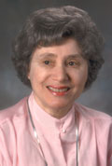
Ruth L. Kirschstein National Research Service Awards
Overview:
The overall goal of the NIH Ruth L. Kirschstein National Research Service Award (NRSA) program is to help ensure that a diverse pool of highly trained scientists is available in appropriate scientific disciplines to address the Nation's biomedical, behavioral, and clinical research needs.
NRSA Opportunities:
Training grants (Ts): Multi-slot awards that are used to support research training activities for several individuals.
Fellowships (Fs): Awards for graduate students working on a doctoral degree and researchers who have just earned their doctorates (postdocs).
Notes:
The NRSA awards, fellowships and training grants, are named after Dr. Ruth L. Kirschstein, a wonderful scientist and friend who helped develop the polio vaccine and was the first woman to direct an NIH institute. She was also a great mentor who championed all things related to training.
There are two types of NRSA awards – training grants and fellowships. Please note that if you receive one of these awards as a postdoc, you have a payback obligation. Briefly stated, you must repay your first year of NRSA support by staying in research for a second year.

Slide 9
Training Grants
Overview:
Training programs to prepare qualified individuals for careers that have a significant impact on the health-related research needs of the Nation.
Awarded to domestic institutions.
Trainees work in mentors’ labs.
Available for Predoctoral and/or Postdoctoral researchers.
Support basic and/or clinical researchers.
T-Kiosk: http://grants.nih.gov/training/T_Table.htm
Core Review Criteria:
Training Program and Environment
Training Program Director(s)/ Principal Investigator(s)
Preceptors/Mentors
Trainees
Training Record
Additional Review Considerations:
Recruitment and Retention Plan to Enhance Diversity
Training in the Responsible Conduct of Research
Notes:
Training grants are a great way to get started in research. Very often individuals start as pre-doc trainees (i.e. grad students) on training grants and then move on to more senior awards, such as fellowships, and career development awards.
The benefits of these grants are outlined on the right.
-- 60 percent tuition reimbursement
-- Stipends ranging from $21,180 to $52,068 depending on whether you have your doctorate and your level of seniority. A postdoc who has just finished a PhD is Level 0; one who is seven years past the PhD is Level 7.
-- In addition, there are some training, travel and facilities and administrative allowances (what we now call F&A) but were known as indirect costs.
In FY 2010, NIH awarded 2,122 NRSA training grants and trained a total of 14,065 individuals of which 8,281 were pre-docs and 5,409 were postdocs. There were also 375 summer trainees.

Slide 10
Fellowships
Overview:
Awarded to Predoctoral or Postdoctoral fellows who are working with mentors.
Training can be at domestic or foreign institutions.
Opportunities in basic and/or clinical research.
Open to any scientific area within the NIH scientific mission.
PhDs and MD/PhDs receive most of the awards.
F-Kiosk: http://grants.nih.gov/training/F_files_nrsa.htm
Core Review Criteria:
Fellowship Applicant – Academic record and training, publications, etc.
Sponsors, Collaborators, and Consultants
Research Training Plan
Training Potential
Institutional Environment & Commitment to Training
Additional Review Consideration:
Training in the Responsible Conduct of Research
Notes:
In FY 2010, NIH supported 3,070 fellowships, of which 1,661 were pre-doc and 1,409 were post-docs fellowships. While there are opportunities in both basic and clinical research, most of the awards are basic. One thing that makes them differ from training grants is that there are no facilities and administrative allowances. The majority of these fellowships are reviewed by the Center for Scientific Review (CSR) in fellowship-only study sections.
All of the above criteria are important if you want to receive a fellowship award.
Stress your research training. Obviously, the more publications you have the better off you will be, especially if they are related to your present area of interest (i.e. the content of your application). But include all your publications, including the ones you may have had as an undergraduate- this will help you because it shows commitment. For your awards and achievements, include everything that may be relevant (this is not the time to be modest with your achievements).
Make sure your sponsor is a senior, respected figure in your field. Stay away from assistant professors with little or no track record in training people. If you work with a young assistant professor, get a more seasoned person to be your official mentor. You can always work with the junior mentor in the lab, but don’t use that person as the main sponsor.
Develop a strong, coherent training plan with your mentor. State specific milestones along the way (make sure they are realistic). Reviewers tend to like timelines.
Get very strong letters of reference. It doesn’t hurt to lobby the people you are asking to write letters for you. Have your letters of references address your strengths, your work ethic, your enthusiasm, and your lab “smarts.” Have them state how committed you are to a research career.
Emphasize the strengths of your institution and the research environment

Slide 11
F30 and F31 Predoctoral Fellowships
Overview:
Support Predoctoral Fellows during graduate (possibly medical) training.
F30 (MD/PhD) may support up to 6 years of training.
F31 is limited to 5 years total.
Promising doctoral candidates who will be performing dissertation research.
Some Institutes and Centers only support Diversity F31s.
Fellows may not change the scope, move fellowship, or change mentor without prior NIH approval!
Program Features:
Stipend:
FY 2014: $22,476
Tuition/Fees:
60% of requested tuition, capped at $16,000 ($21,000 for MD/PhD programs)
Institutional Allowance:
$4,200
Includes health insurance
Travel Allowance:
Part of IA
Notes:
Now we are moving onto specific mechanisms. The F30 and F31 are pre-doctoral fellowships for graduate students.
They offer
-- 60 percent tuition
-- $21,180 stipend
-- also training and travel allowances

Slide 12
F32 Postdoctoral Fellowships
Overview:
Support Postdoctoral research training.
Promising fellows with the potential to become productive, independent investigators in scientific health-related research fields relevant to the missions of NIH Institutes & Centers.
NRSA support for up to 3 years total. Awardees incur two years of payback.
Repay the 1st year by staying in research a 2nd year
Fellows may not change the scope, move fellowship, or switch mentor without prior NIH approval!
Program Features:
Stipends:
FY 2014: $42,000 (Level-0) to $55,272 (Level-7)
Tuition/Fees:
60% of requested tuition, capped at $4,500 ($16,000 for those seeking another doctoral degree)
Institutional Allowance:
$7,850
Includes health insurance
Travel Allowance:
Up to $1,000
Notes:
The F32 is for postdoctoral researchers. These researchers receive a stipend as well as training expenses, health insurance and a travel allowance.

Slide 13
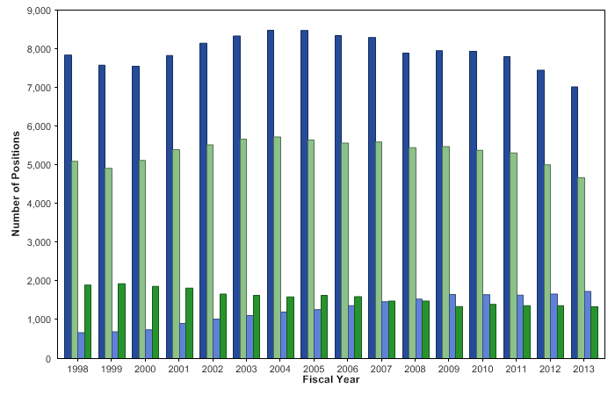
Kirschstein-NRSA training grants and fellowships Pre- and Post-Doctoral full-time training positions awarded
Notes:
13
Data and chart description for this slide can be located at http://report.nih.gov/NIHDatabook/Charts/Default.aspx?showm=Y&chartId=52&catId=17

Slide 14
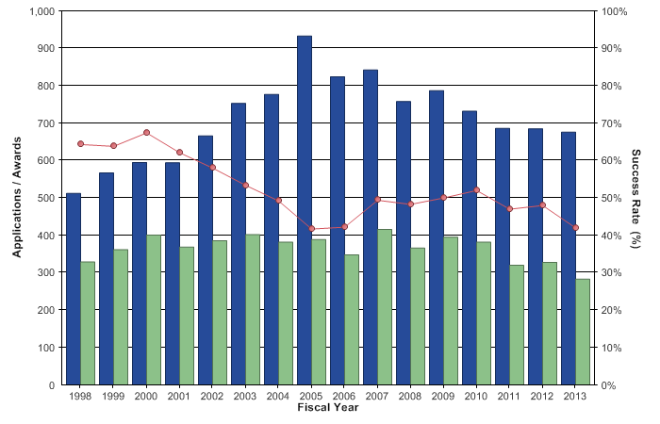
Kirschstein-NRSA institutional research training grants Applications, awards, and success rates
Notes:
14
Data and chart description for this slide can be located at http://report.nih.gov/NIHDatabook/Charts/Default.aspx?showm=Y&chartId=60&catId=17

Slide 15
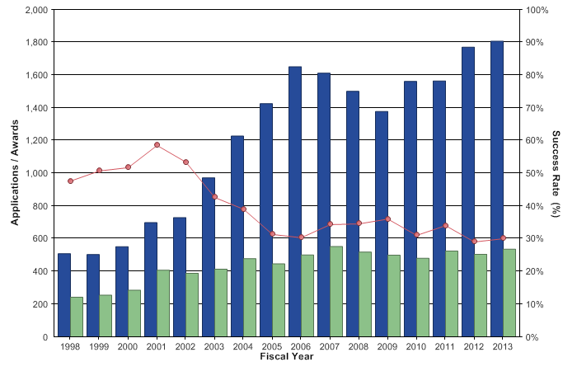
Kirschstein-NRSA pre-doctoral fellowships (F31s) Applications, awards, and success rates
Notes:
15
Data and chart description for this slide can be located at http://report.nih.gov/NIHDatabook/Charts/Default.aspx?showm=Y&chartId=61&catId=17

Slide 16
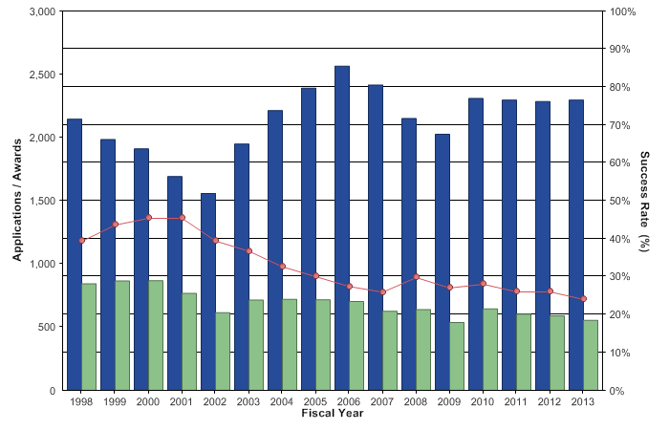
Kirschstein-NRSA post-doctoral fellowships (F32s) Applications, awards, and success rates
Notes:
16
Data and chart description for this slide can be located at http://report.nih.gov/NIHDatabook/Charts/Default.aspx?showm=Y&chartId=62&catId=17

Slide 17
Career Development Awards
Overview:
Individual and Institutional Awards.
Opportunities for basic and clinical investigators.
Mix of mentored and independent mechanisms.
Some designed as awards for faculty investigators.
Newer programs (K22 and K99/R00) are transition awards for MDs and PhDs.
K-Kiosk: http://grants.nih.gov/training/careerdevelopmentawards.htm
Core Review Criteria:
Candidate
Career Development Plan/Career Goals & Objectives (or Plan to Provide Mentoring*)
Research Plan
Mentor(s), Consultants(s) and Collaborator(s)
Environment and Institutional Commitment to the Candidate
Additional Review Consideration:
Training in the Responsible Conduct of Research
* For Independent K awards
Notes:
K awards are more “senior” than fellowships. It is common for a young scientist to start on a training grant, move to a fellowship, and finally to a K award. Potential applicants are encouraged to contact the ICs because K awards are used differently throughout the NIH.
In FY 2010, NIH awarded 4,059 K awards. Applications are reviewed in IC review panels. The review criteria for Ks are very similar to the ones for Fs. However, reviewers expect a little more from a K applicant. As with fellowships, reviewers in general are sympathetic to investigators who are in the early stages of their career.
It is clear that when reviewing a fellowship or even a K award, the reviewers aren’t expecting an R01 application, but for K applications, the closer you approximate the R01 model, the better off you are. For a K application, the reviewers will forgive small flaws, but not too many.

Slide 18
K01 Mentored Research Scientist Development Award
Overview:
Supports an intensive, supervised career development experience in the biomedical, behavioral, or clinical sciences leading to research independence.
Some ICs use the K01 for individuals who propose to train in a new field or those who have had a hiatus in their research career.
Some ICs utilize the K01 award to increase research workforce diversity.
Primarily for PhDs or equivalent research doctoral degrees.
Program Features:
Duration: 3 to 5 years
Salary Support: Up to legislative cap (varies by Institute/Center) – Most common salary cap is $75,000
Research Support: Up to $50,000/year (varies by Institute/Center)
Institute and Center contacts and policies: See Funding Opportunity Announcement
Notes:
The K01 is for researchers moving towards independence, and there are opportunities for MDs and PhDs.

Slide 19
K02 Independent Scientist Award
Overview:
To foster the development of outstanding scientists and enable them to expand their potential to make significant contributions to their field of research.
For newly independent scientists who can demonstrate the need for a period of intensive research focus as a means of enhancing their research careers.
Must have independent grant support as Principal Investigator (e.g. R01).
Mix of PhDs and MDs.
Relatively few applicants.
Program Features:
Duration: 3 to 5 years
Salary Support: Up to legislative cap (varies by Institute/Center) – Most common salary cap is $75,000
Research Support: Most Institutes/Centers do not provide research costs
Institute and Center contacts and policies: See Funding Opportunity Announcement
Notes:
The best candidates for these awards are “senior” assistant professors or “junior” associate professors who are close to or recently promoted and tenured. This may vary by IC.

Slide 20
K08 Mentored Clinical Scientist Development Award K23 Mentored Patient-Oriented Career Development Award
Overview:
K08: Supports individuals with a clinical doctoral degree for a period of intensive, supervised research career development experience in the fields of biomedical and behavioral research, including translational research.
K23: Supports career development of investigators who have made a commitment to patient-oriented research.
Majority of awardees are MDs and MD/PhDs.
Program Features:
Duration: 3 to 5 years
Salary Support: Up to legislative cap (varies by Institute/Center) – Most common salary cap is $75,000
Research Support: up to $50,000/year (varies by Institute/Center)
Institute and Center contacts and policies: See Funding Opportunity Announcement

Slide 21
K24 Mid-Career Investigator Award in Patient-Oriented Research
Overview:
Support for mid-career health-professional doctorates or equivalent who are typically at the Associate Professor level or the equivalent for protected time to devote to patient-oriented research and to act as research mentors primarily for clinical residents, clinical fellows and/or junior clinical faculty.
Typically associate professors, but can continue to support those promoted to full professor.
Typically MDs.
Program Features:
Duration: 3 to 5 years
Salary Support: Most Institutes and Centers provide salary up to the legislative cap
Research Support: Most Institutes and Centers provide up to $50,000/year
Institute and Center contacts and policies: See Funding Opportunity Announcement

Slide 22
K25 Mentored Quantitative Research Development Award
Overview:
For investigators whose quantitative science and engineering research has thus far not been focused primarily on questions of health and disease.
Supports a period of supervised study and research for productive professionals with quantitative (e.g., mathematics, statistics, economics, computer science, imaging science, informatics, physics, chemistry) and engineering backgrounds to integrate their expertise with NIH-relevant research.
Benefits
Duration: 3 to 5 years
Salary Support: Up to legislative cap (varies by Institute/Center)
Research Support: up to $50,000/year (varies by Institute/Center)
Institute and Center contacts and policies: See Funding Opportunity Announcement
Notes:
These individuals typically have a mathematics, statistics, computer science, imaging science, informatics, physics, or engineering background.

Slide 23
K22 Research Scholar Development Award
Overview:
Facilitates the transition of investigators from the mentored stage of career development to the independent stage.
Typically, transition award for Postdocs moving to assistant professor positions.
Two Phases:
Phase 1: May or may not be affiliated with an institution. Some IC’s require NIH Intramural experience
Phase 2: Assistant professor with own lab and little to no teaching and administrative responsibilities.
Program Features:
Duration: 2 years mentored (Intramural), followed by 3 years independent
Salary Support: Up to legislative cap (varies by Institute/Center)
– None during Intramural phase
Research Support: up to $50,000/year (varies by Institute/Center)
– None during Intramural phase
Institute and Center contacts and policies: See Funding Opportunity Announcement
Notes:
Some ICS offer a two-phased application. This is described on the right.

Slide 24
K99/R00 Pathway to Independence Award
Overview:
To facilitate a timely transition from a mentored postdoctoral research position to a stable independent research position with independent NIH or other independent research support at an earlier stage than is currently the norm.
Transition award for postdocs moving to assistant professor positions (tenure track or equivalent)
Supported by almost all ICs with variations
No citizenship/green card requirement
Program Features:
K99 Phase
Mentored Phase: Up to 2 years
Research Support: Up to $90,000/year (most Institutes & Centers provide more funds)
R00 Phase
Independent Phase: Up to 3 years; 75% effort
Research Support: $249,000/year
Institute and Center contacts and policies: See Funding Opportunity Announcement

Slide 25
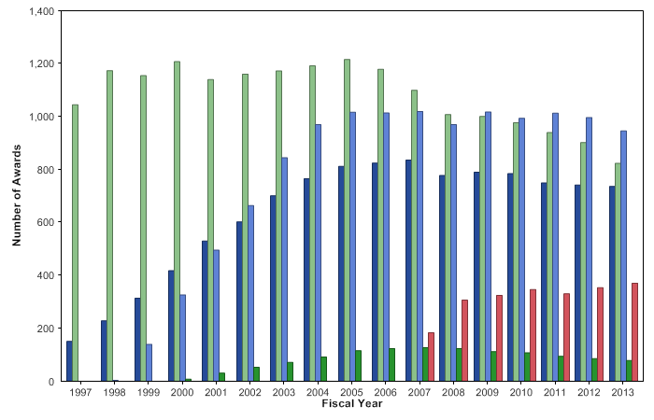
Research Career Development Awards Number of entry-level awards
Notes:
25
Data and chart description for this slide can be located at http://report.nih.gov/NIHDatabook/Charts/Default.aspx?showm=Y&chartId=223&catId=16

Slide 26
Success Rate of K01 Awards

Slide 27
Success Rate of K08 Awards

Slide 28
Success Rate of K23 Awards

Slide 29
Success Rate of K25 Awards

Slide 30
Success Rate of K99 Awards

Slide 31
Small Grant Program (R03)
Overview:
Provides limited funding for a short period of time to support a variety of types of projects, including:
Pilot or feasibility studies
Collection of preliminary data
Secondary analysis of existing data
Small, self-contained research projects
Development of new technology, etc.
Program Features:
Limited to two years of funding
Direct costs generally up to $50,000 per year
Not renewable
Utilized by more than half of the NIH Institutes and Centers
Institute and Center contacts and policies: See Funding Opportunity Announcement

Slide 32
Exploratory/Developmental Research (R21)
Overview:
Encourages new, exploratory and developmental research projects by providing support for the early stages of project development.
Sometimes used for pilot and feasibility studies.
Preliminary data are not required but may be included if available.
Limited to up to two years of funding.
Program Features:
Combined budget for direct costs for the two year project period usually may not exceed $275,000
No preliminary data is generally required
Most Institutes and Centers utilize the R21 program
Institute and Center contacts and policies: See Funding Opportunity Announcement

Slide 33
New and Early-Stage Investigators
Becoming an independent research is taking longer and longer
Bridges to Independence: Fostering the Independence of New Investigators in Biomedical Research (2005)
Concerns have been raised for decades about scientists spending long periods of time as postdoctoral appointees, unable to set their own direction
Age at First R01 Equivalent Award
from NIH: FY 1980-2009

Slide 34
New and Early-Stage Investigators
NIH is finding new methods to encourage funding (and hiring)
of early-stage investigators
Revised New and Early Stage Investigator Policies (NOT-OD-09-013)
Goal of funding new investigators
at same rate as established investigators submitting new projects
Support outstanding early-stage
Investigators as they pursue high risk/high reward research
A new program to allow exceptional young investigators to “skip” the post-doc!

Slide 35
Definition of New Investigator
A PD/PI who has not previously competed successfully for a significant NIH independent research award, other than the following awards:
Research Project Grants: R00, R03, R15, R21, R25, R90, (RL9, RL5), R34, R36, (R41, R43), R55, R56, SC2, SC3
All training Grants: T32, T34, T35, T90, D43
All Fellowships: F awards
Mentored Career Awards: All individual and institutional mentored K awards
Loan repayment contracts: L30, L32, L40, L50, L60
Instrumentation, Construction, Education, Health Disparity Endowment Grants, or Meeting Awards: G07, G08, G11, G13, G20, R13, S10, S15, S21, S22

Slide 36
Definition of Early Stage Investigator
A PD/PI who qualifies as a New Investigator is considered an Early Stage Investigator (ESI) if he/she is within 10 years of completing his/her terminal research degree or is within 10 years of completing medical residency (or the equivalent).
Implementing the Early Stage Investigator Policy: eRA Commons profiles include degree and residency completion dates
Encouraging early transition to research independence: Modifying the NIH New Investigator policy to identify ESIs
Can request an extension of the ESI Period

Slide 37
NIH New Investigator Policies
New investigators are considered essential to the vitality of health-related research, thus several NIH initiatives to nurture promising scientists.
Goal is to encourage funding for scientists new to NIH and those who are at an early stage in their careers.
New policy intended to level the playing field to allow new investigators to achieve success rates comparable to those of established scientists.
The ESI policy is an important part of NIH initiative to enhance the peer review process with a goal to “fund the best science, by the best scientists, with the least amount of administrative burden.”

Slide 38
New Investigator Initiatives
New Investigators (NIs) receive special attention at Council as high program priority or equivalent.
Increased payline for scored R01 applications from NIs.
No imposed reductions in duration and amount of awards (beyond the recommendations of the initial review group) for NIs.
Fund applications to achieve a designated success rate rather than setting a specific payline for NIs applying for R01s.
R01 NIs whose applications score below the payline can submit 5-page letters responding to critiques in the summary statement for Advisory Council review. If these letters respond satisfactorily to the concerns raised by the study sections, the Council can decide to fund these applications, avoiding the need for resubmission.

Slide 39
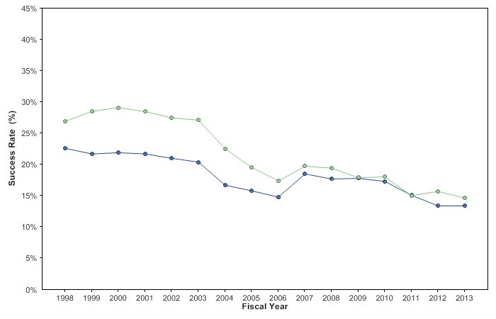
R01-Equivalent grants, New (Type 1) Success rates, by career stage of investigator
Notes:
39
Data and chart description for this slide can be located at http://report.nih.gov/NIHDatabook/Charts/Default.aspx?showm=Y&chartId=165&catId=22

Slide 40
NIH Director’s New Innovator Award
Support creative new investigators with highly innovative research ideas at early career stages.
No preliminary data required.
Evaluate pre-application—Invite full application.
Potential for significant impact on an important biomedical or behavioral research problem.
Applicants must hold independent research position at a domestic institution.
Doctoral degree or completed internship/residency within past 10 years.
Must commit at least 25% of research effort.
There are no citizenship or residency requirements.

Slide 41
NIH Director’s Early Independence Award (EIA)
A new program to allow exceptional young investigators to “skip” the post-doc!
“For the most creative of young scientists, nothing can equal the chance to have a lab of one's own.”
Francis Collins, Nature, 2010
Inspired in some respects by programs at Carnegie, Whitehead, UCSF, and other institutions showing that exceptional individuals do not require a post-doc to undertake pioneering research.
Solicited and incorporated input from research community.
First year will be a pilot (~10 awards) to test ideas and process, but may be scaled up in subsequent years.
Program Features:
An institution may submit up to two applications
Awards will be up to $250K per year (direct costs) for up to 5 years

Slide 42
NIH Director’s Early Independence Award (EIA) What’s Novel?
Institution may actively recruit eligible EIA candidates
Institution ensures independent lab space/supplies/space/equipment
Appointment up to 5 yrs
Protected research time for development as researcher
Proposed research complements and enhances institution’s programs
Institution may choose to retain candidate
New PhD or MD locates an institution willing to host them for an EIA
Must be within 12 mo. before or after graduation
Must demonstrate exceptional creativity, maturity, management skills
Research relevant to NIH mission
Strong letters of recommendation

Slide 43
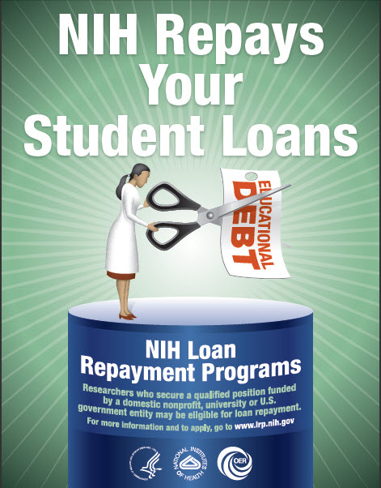
NIH Loan Repayment Programs
Summary
Up to $35,000 per year in educational loan repayment depending on debt level
Coverage of most Federal taxes resulting from the NIH LRP
2 Year initial contracts with 1 or 2 year competitive renewal contracts
NIH Institutes and Centers fund approximately 1,600 researchers each year
Applicant success rate is 50 percent

Slide 44
Programs and Eligibility
Extramural Programs
Clinical Research
Pediatric Research
Health Disparities Research
Contraception and Infertility Research
Clinical Research for Individuals from Disadvantaged Backgrounds
Eligibility
Doctoral degree (M.D., Ph.D. or equivalent)
EXCEPTION = Contraception & Infertility Research LRP
Research funded by a domestic nonprofit, university or government organization
Educational loan debt equal to at least 20 percent of your annual salary
Conduct qualifying research for at least 20 hours/week
U.S. citizen, U.S. national or permanent resident

Slide 45
Additional Resources
To learn more about NIH grants and training opportunities, visit: http://grants.nih.gov
Also, you may follow funding announcements at: http://twitter.com/nihforfunding

