Slide 1
FORMS-E
Good stuff to know when developing support in system-to-system solutions for FORMS-E application forms.
August 2017

Slide 2
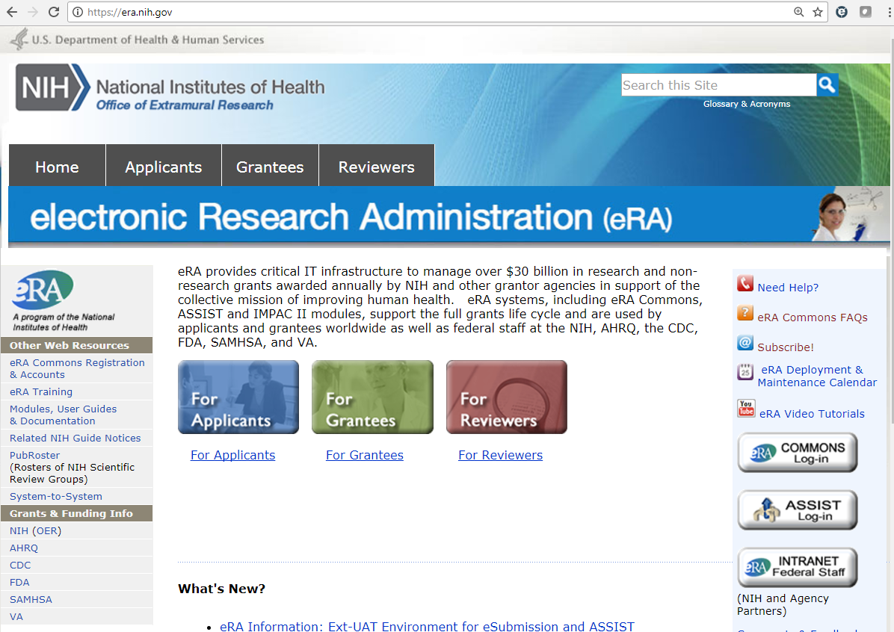
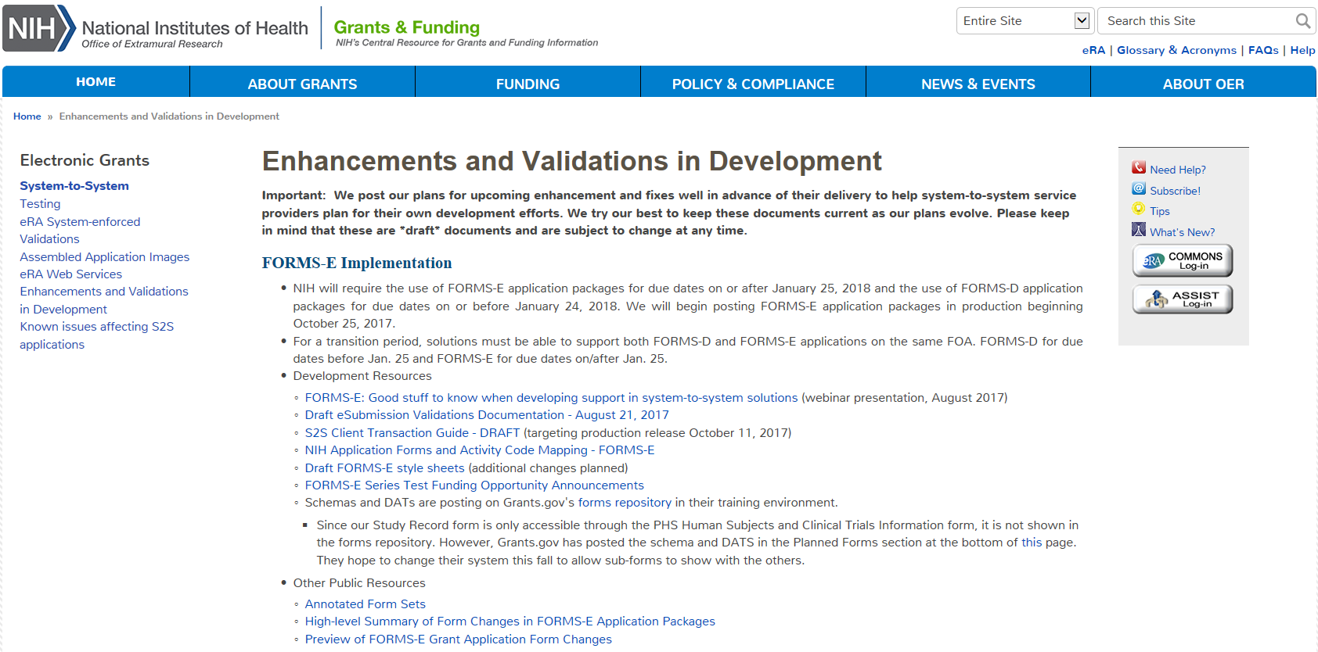
S2S Web pages
Development Resources

Slide 3
Forms updated in FORMS-E
Agency-specific forms
PHS 398 Career Dev. Award Supp.
PHS 398 Cover Page Supplement Form
PHS 398 Modular Budget
PHS 398 Research Plan
PHS 398 Research Training Program Plan
PHS 398 Training Budget & Subaward
PHS Additional Indirect Costs
PHS Assignment Request Form
PHS Fellowship Supp. Form
PHS Inclusion Enrollment Report
No longer used
Rolled into new PHS Human Subjects and Clinical Trials Information form
Federal-wide forms
SF424 (R&R)
Project/Performance Site Location(s)
R&R Other Project Info
R&R Sr/Key Person Profile (Expanded)
R&R Budget & Subaward
5 YR, 10 YR, MP
SF424C – Construction Budget
SBIR/STTR Information
Resources
Annotated Form Sets
High-level Summary of Form Changes in FORMS-E Application Packages
Preview of FORMS-E Grant Application Form Changes

Slide 4
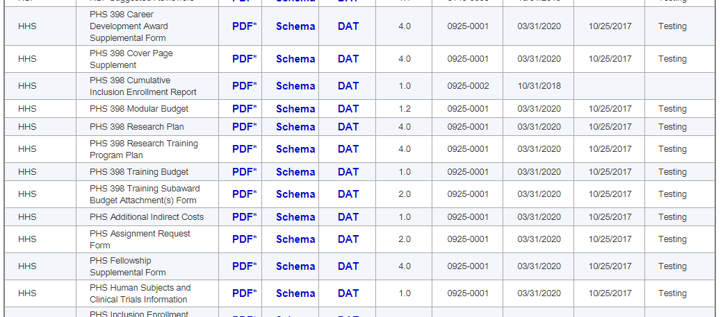
Schemas and DATS
FORMS-E Schemas and DATs can be found on Grants.gov’s forms repository in the training environment
https://training.grants.gov/web/grants/forms/r-r-family.html#sortby=1

Slide 5
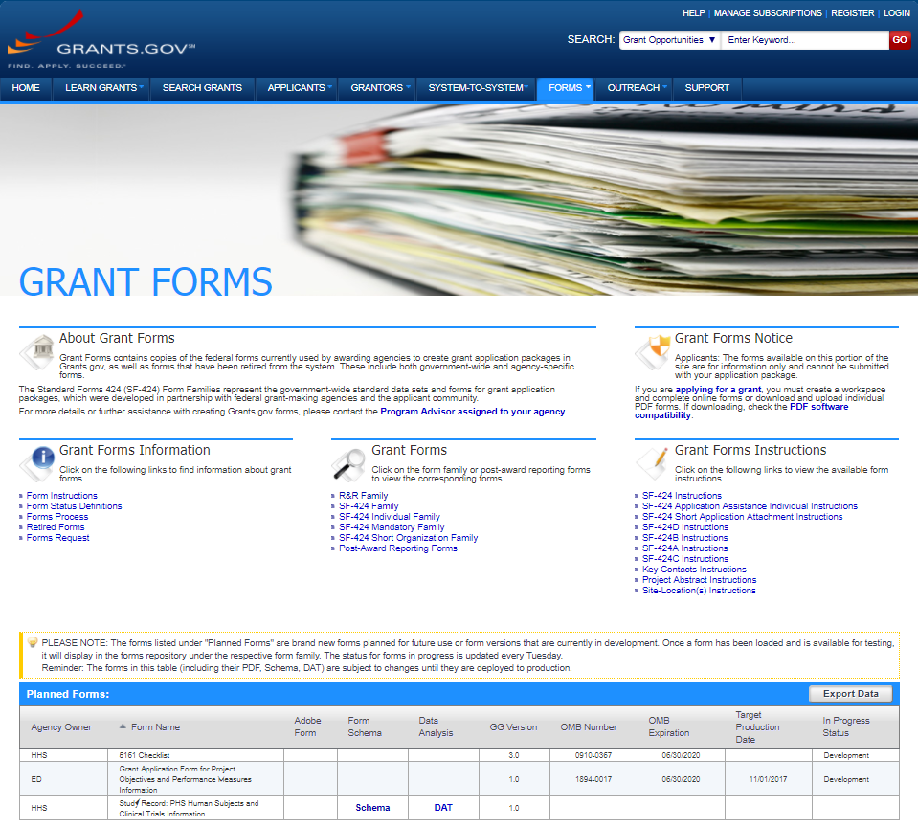
Study record
Grants.gov has posted the Study Record: PHS Human Subjects and Clinical Trials Information form on the main page of the form repository
This fall they will update their system to allow it to be listed with other R&R Forms
Currently unable to list sub-forms that can’t act as a stand-alone form in an application package

Slide 6
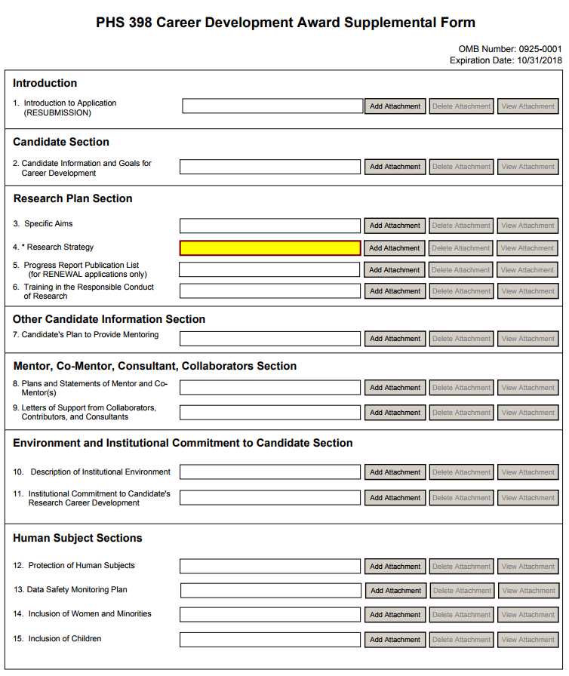
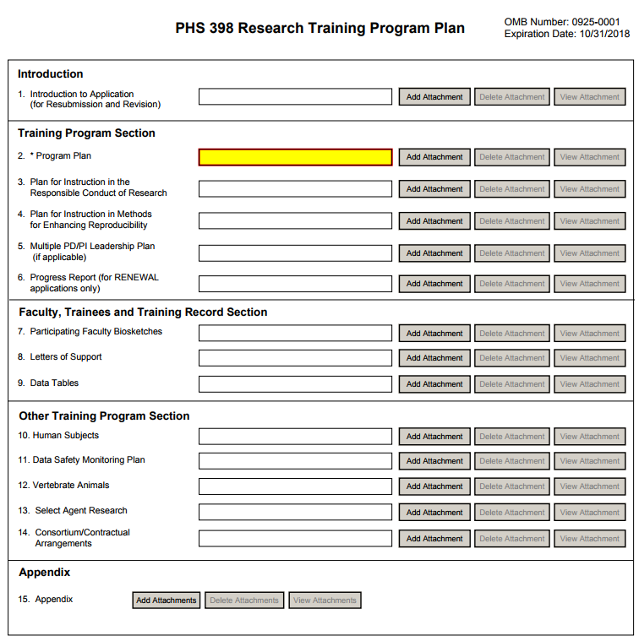
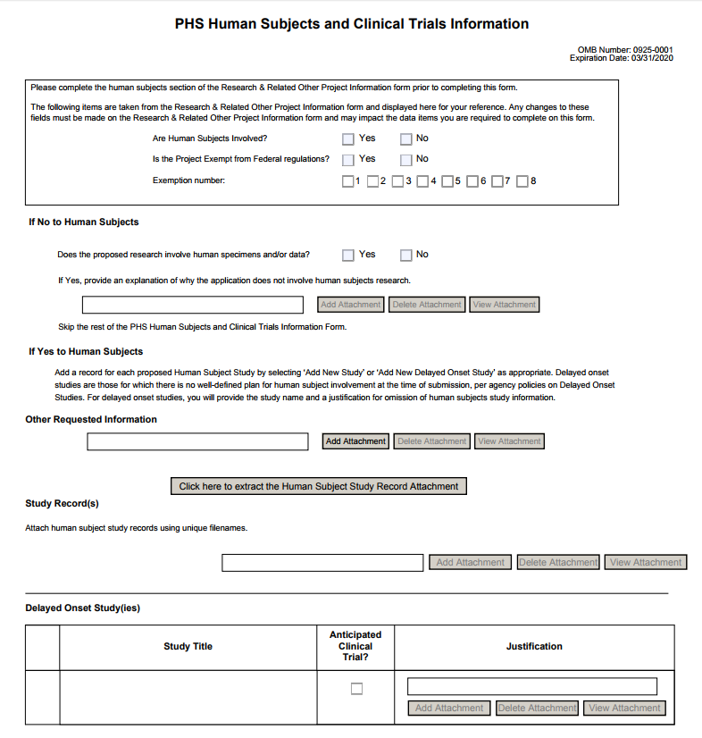
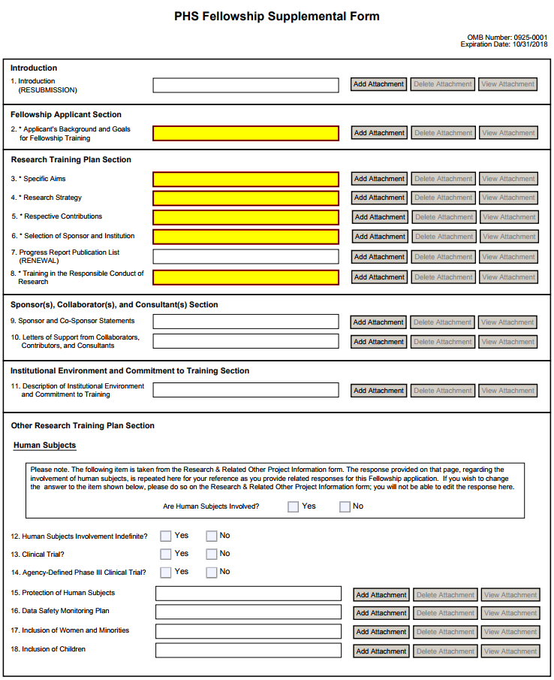
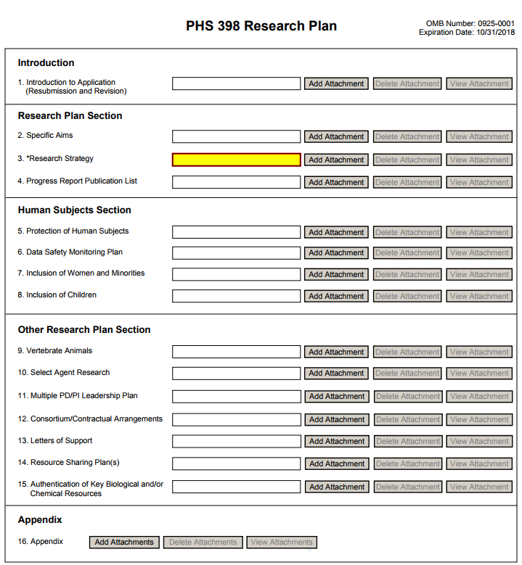
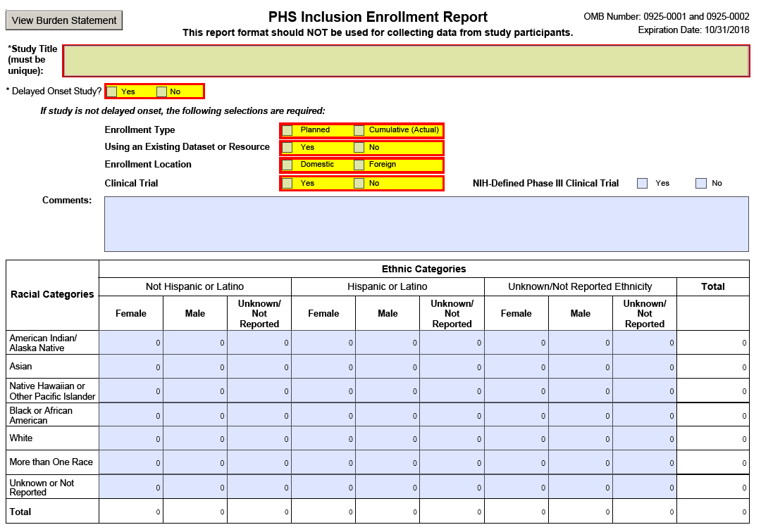
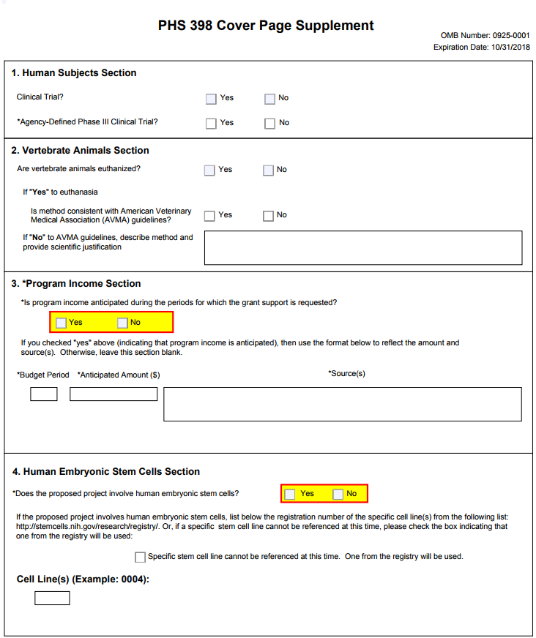
changes
Majority of changes related to human subjects and clinical trials data collection
Consolidation of data fields collected on multiple forms into new PHS Human Subjects and Clinical Trials Information form

Slide 7
Common rule
We are preparing our systems for the expected implementation of the Common Rule this January.
Although HHS has not yet confirmed the targeted January 2018 implementation date, we hope to include the new exemption codes in FORMS-E to avoid multiple form updates
Will use validations to prevent use of new codes if implementation date is delayed
Only change to our application forms is the addition of two human subjects exemption codes (7 and 8)
R&R Other Project Information
Waiting on OMB approval
PHS Human Subjects & Clinical Trials Information
Learn more about the Common Rule
https://www.hhs.gov/ohrp/regulations-and-policy/regulations/finalized-revisions-common-rule/index.html

Slide 8
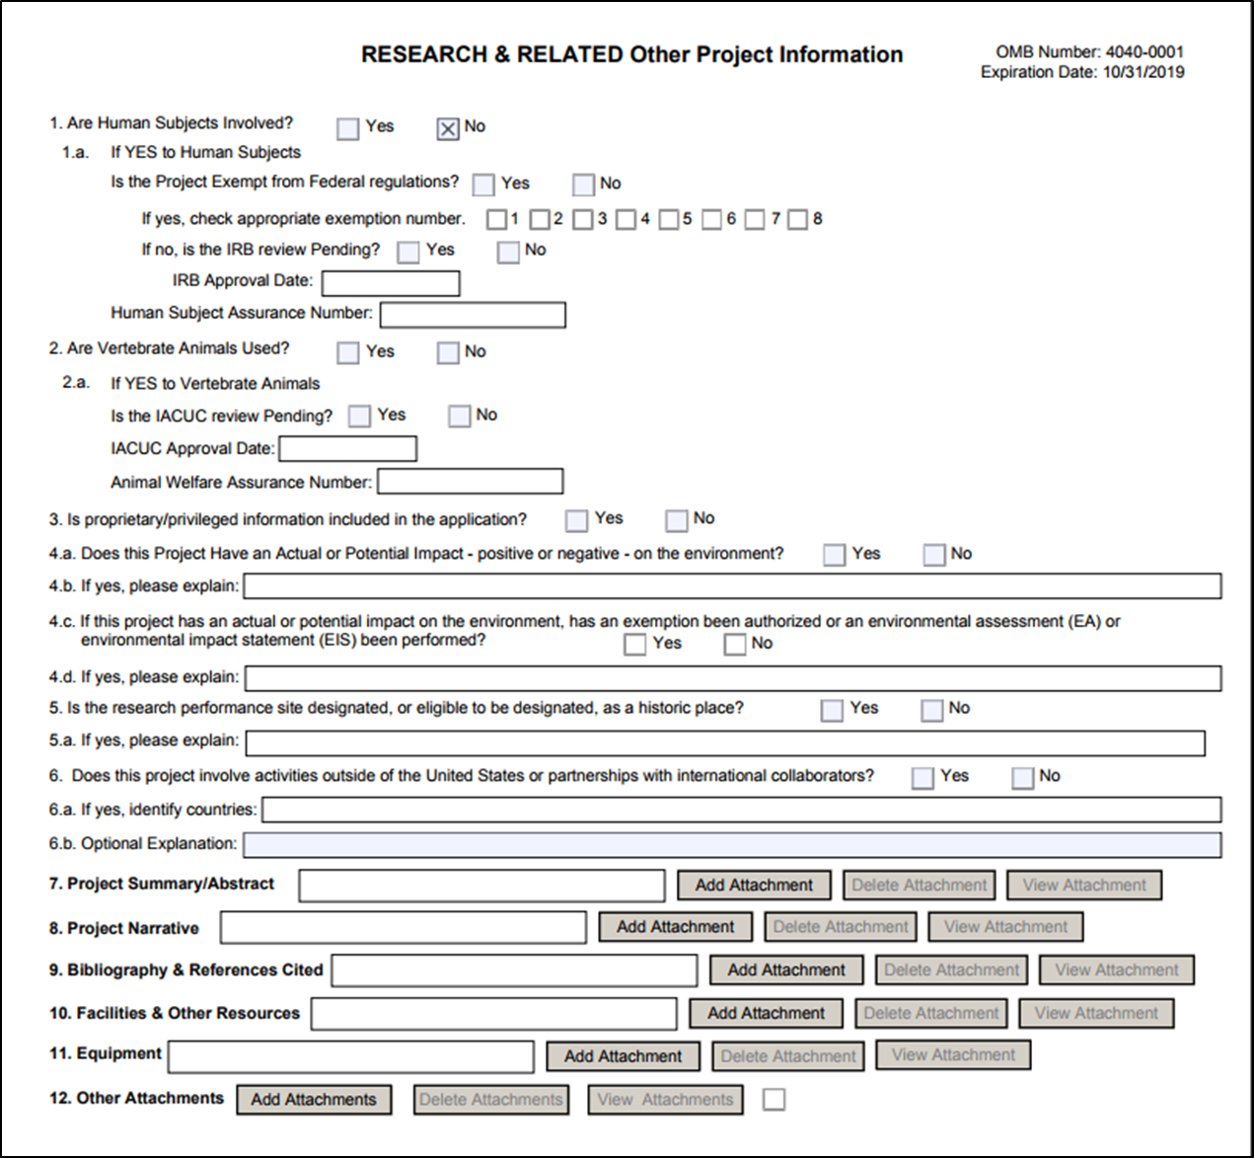
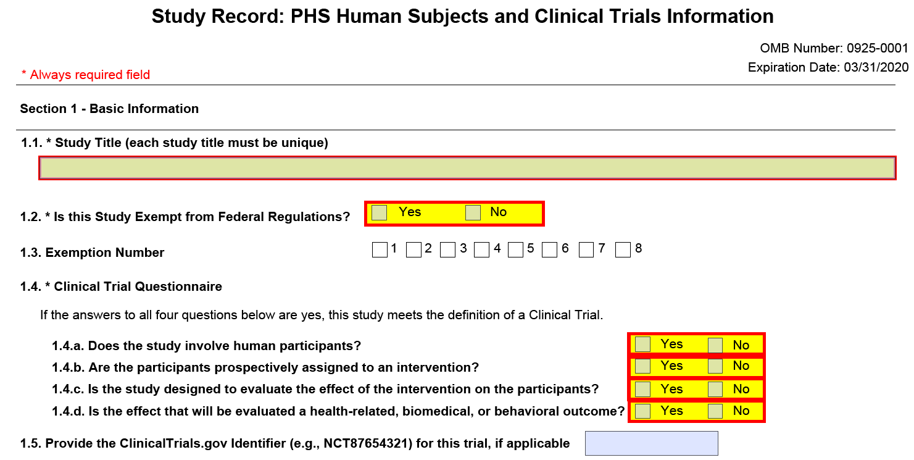
New human subject exemption codes

Slide 9
Timing of fORMS-E Roll-out
FORMS-E application packages MUST be used for applications to due dates on or after January 25, 2018 and CANNOT be used for earlier due dates.
Application guide instructions will be posted ~September 25, 2017
eRA will deploy FORMS-E support to production ~October 11, 2017
We will begin posting FORMS-E packages ~October 25, 2017
Some FOAs will be posted prior to Oct. 25 without packages (e.g., PAR-17-301)
FORMS-E will be added to all active non-clinical trial FOAs with due dates on/after Jan. 25 between Oct. 25 and Nov. 25
FOAs that will allow clinical trials using FORMS-E on/after Jan. 25 will be reissued
NOT-OD-17-062 - New NIH "FORMS-E" Grant Application Forms and Instructions Coming for Due Dates On or After January 25, 2018

Slide 10
General Posting rules
Posting rules for updates to existing FOAs with due dates on/after Jan. 25, 2018
FORMS-D package
Competition Title – change to “Use for due dates on or before January 24, 2018”
Close date – January 24, 2018
Grace period – 21 days (Feb 7 for continuous submitters, plus a week padding)
FORMS-E package
Competition ID – FORMS-E
Competition Title – “Use for due dates on or after January 25, 2018”
Open date – posting date
Close date – original close date of FOA
Grace period – 35 days (standard)

Slide 11
Admin Request posting rules
Posting rules for Type 6, Type 7 and Admin Supp (Type 3)
FORMS-E
Issue new FORMS-E FOAs on January 25, 2018
FORMS-D
Close FORMS-D FOAs on February 24, 2018
Gives applicants 1 month to complete submissions
Grace period – 0 days

Slide 12
Parent announcements
All parent announcements will be reissued
Posting rules for Parent FOAs (except Admin Supp/Type 6/Type 7)
FORMS-D FOAs
Close – January 24, 2018
Grace period – 21 days (Feb 7 for continuous submitters, plus a week padding)
In “Related Notices” section indicate “<Date> - This PA has been reissued as PA-17-xxx for due dates on or after January 25, 2018.”
FORMS-E FOAs
Reissue targeted for at least 60 days prior to first use
In “Announcement Type” section indicate “Reissue of PA-xx-xxx for due dates on or after January 25, 2018”

Slide 13
clinical-trial specific FOAs
For due dates on or after January 25, 2018, NIH requires that all applications involving one or more clinical trials be submitted through a Funding Opportunity Announcement (FOA) specifically designed for clinical trials.
New FOAs will specify allowability of clinical trials in the FOA title
NIH Research Project Grant (Parent R01 – Clinical Trial Not Allowed)
Exploratory Clinical Trial Grants in Arthritis and Musculoskeletal and Skin Diseases (R21 – Clinical Trial Allowed)
Administrative Supplements to Existing NIH Grants and Cooperative Agreements (Admin Supp – Clinical Trial Optional)
Ruth L. Kirschstein National Research Service Award (NRSA) Individual Postdoctoral Fellowship (Parent F32 – No Independent Clinical Trials)
All FOAs will specify the allowability of clinical trials in Section II. Award Information
NOT-OD-17-043 - Update on Clinical Trial Funding Opportunity Announcement Policy

Slide 14
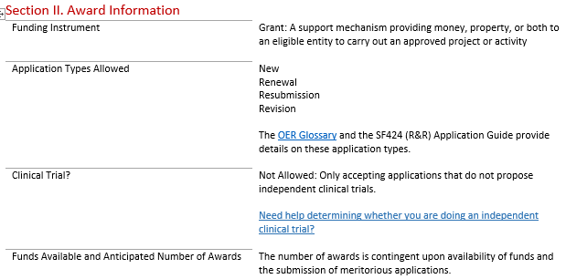
FOA Section II

Slide 15
Clinical Trials FOA Designations
Fellowship FOAs
Not Allowed: Only accepting applications that do not propose independent clinical trials. Note: Applicants may propose to gain experience in a clinical trial led by a sponsor/co-sponsor as part of their research training.
Career Development FOAs
Required: Only accepting applications that propose independent clinical trial(s)
Not Allowed: Only accepting applications that do not propose independent clinical trials Note: Applicants may propose to gain experience in a clinical trial led by a mentor/co-mentor as part of their research career development.
All Other FOAs
Not Allowed: Only accepting applications that do not propose clinical trial(s)
Required: Only accepting applications that propose clinical trials
Optional: Accepting applications that either propose or do not propose clinical trial(s)

Slide 16
Systematic identification of clinical Trial FOA Designation
New clinicalTrialCode data element in FOA Information Request response in Submission Agency Data Service (SADS)
Indicates whether the FOA supports a clinical trial
This is a string with possible values: N, O, R and I
N = Not Allowed
O = Optional
R = Required
I = Required (Infrastructure)
Resource
S2S Client Transaction Guide - DRAFT

Slide 17
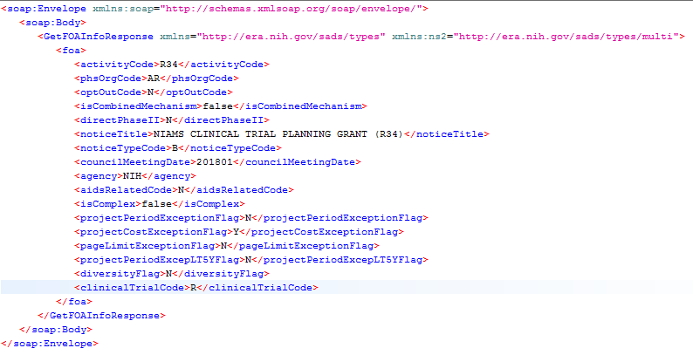
GET FOA Info
Request
Response

Slide 18
Infrastructure
Shows as “Required” in Section II of the FOA
Behind the scenes, relaxes validations so that only the following study record fields are required
1.1 Study Title
1.2 Is this Study Exempt from Federal Regulations?
1.3 Exemption Number
1.4 Clinical Trial Questionnaire
2.1 Conditions or Focus of Study
2.4 Inclusion of Women, Minorities, and Children
3.1 Protection of Human Subjects
3.2 “Is this a multi-site study...” question and associated Single IRB plan
3.3 Data and Safety Monitoring Plan
4.7 Dissemination Plan

Slide 19
Sample validation – relaxing field requirements for Infrastructure FOAs

Slide 20
Phs human subjects and clinical trials information form

Slide 21
New form & application packages
New PHS Human Subjects and Clinical Trials Information form is a mandatory form in most NIH application packages
Exceptions
Form not included in package
Training - T15, T32, T34, T35, T36, T37, D71, U2R, T01, T02, T03, T14, T42, T90, T90/R90, TU2
Shared Instrumentation – S10
Construction – C06/UC6, G20
Resource Awards – X01
Form optional
Admin Supp Type 3 – research, career dev, fellowship, institutional training (K12 and D43)
Type 6 & Type 7 - research, career dev, fellowship
Resource
NIH Application Forms and Activity Code Mapping - FORMS-E

Slide 22
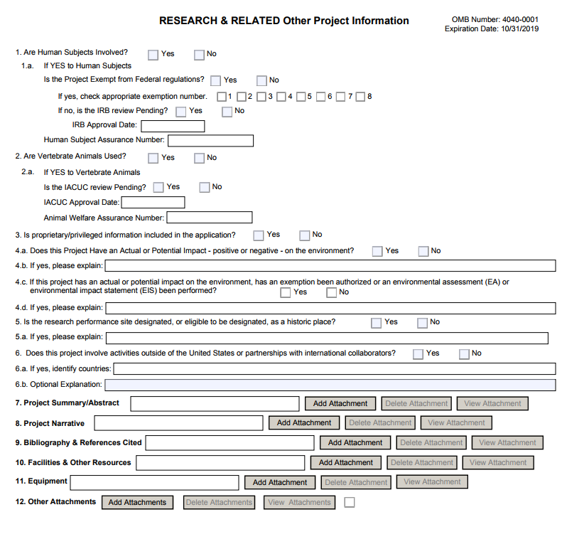
Relationship between forms
Human Subjects data on R&R Other Project Info form drives behavior on new form
Schema does not force consistency of data across forms – so, you must!

Slide 23
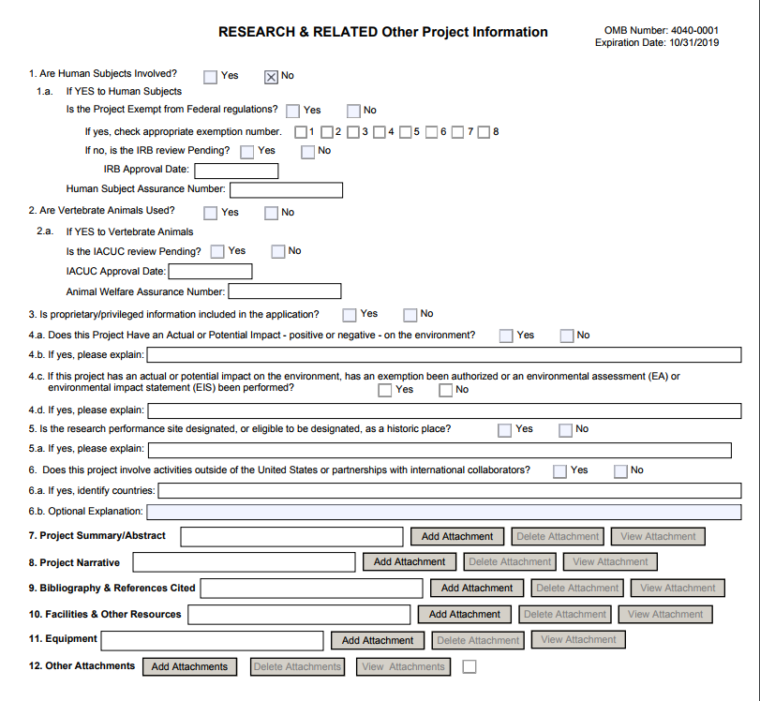
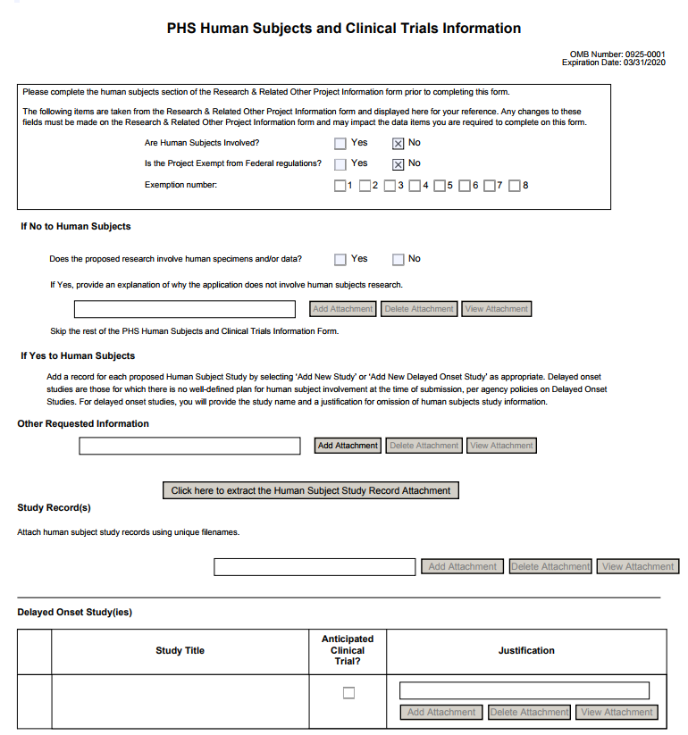
When HS=No…

Slide 24
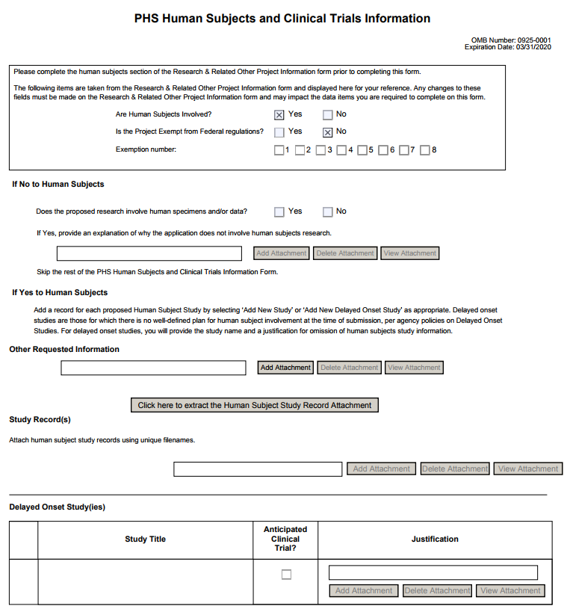
When HS=Yes…
…must include at least one full or delayed onset study record.
Full Study Record
Delayed Onset Study

Slide 25
Sample validations – enforcing at least 1 study record

Slide 26
Other requested information
Only use for information specifically requested in FOA or application guide instructions.
E.g., used for cross-referencing when studies are shared across multiple components in multi-project applications.
Always active (i.e., active when HS = Yes & HS=No).

Slide 27
Delayed Onset Studies
Glossary of NIH Terms
All study titles (both delayed onset and full study records) must be unique within the application (global validation 000.41)
A delayed onset study is considered a clinical trial if Anticipated Clinical Trial box is checked AND FOA allows clinical trials.

Slide 28
D43 & K12
The D43 and K12 programs only allow delayed onset studies
Enforced via validations

Slide 29
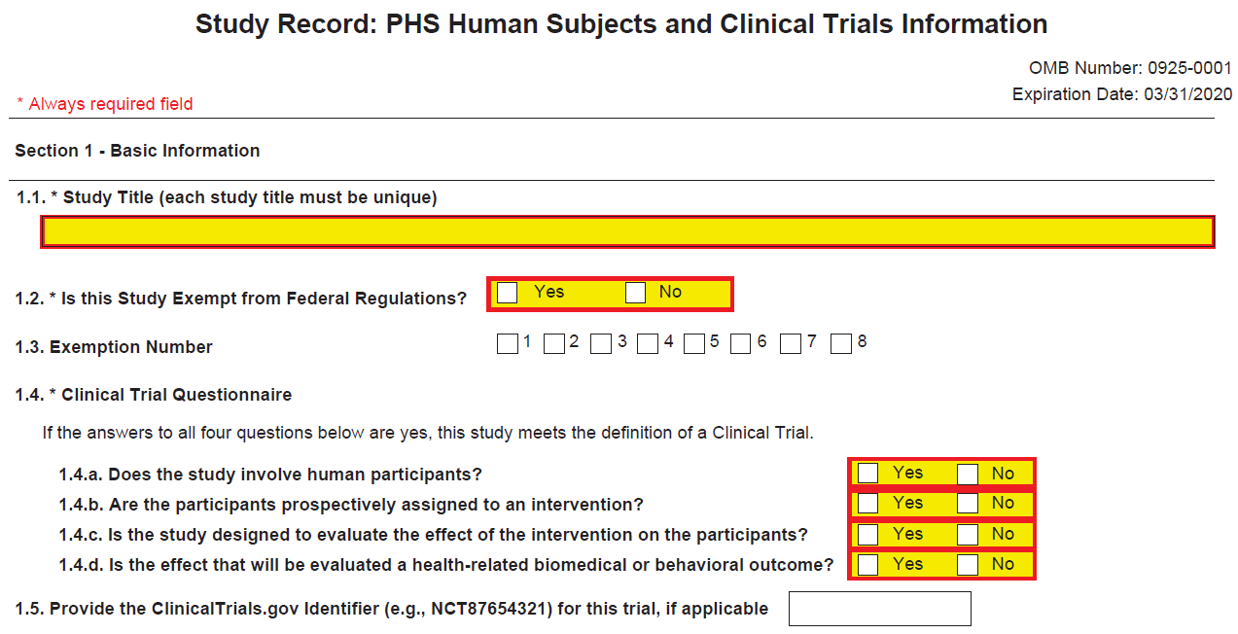
Study Record – Section 1
Required for Human Subjects studies
Required for Clinical Trial studies
Fields 1.1, 1.2, and 1.4 are required and enforced by schema.
A study record is considered a clinical trial if Yes to all Questionnaire questions AND FOA allows clinical trials.
Commas removed Aug. 2017

Slide 30
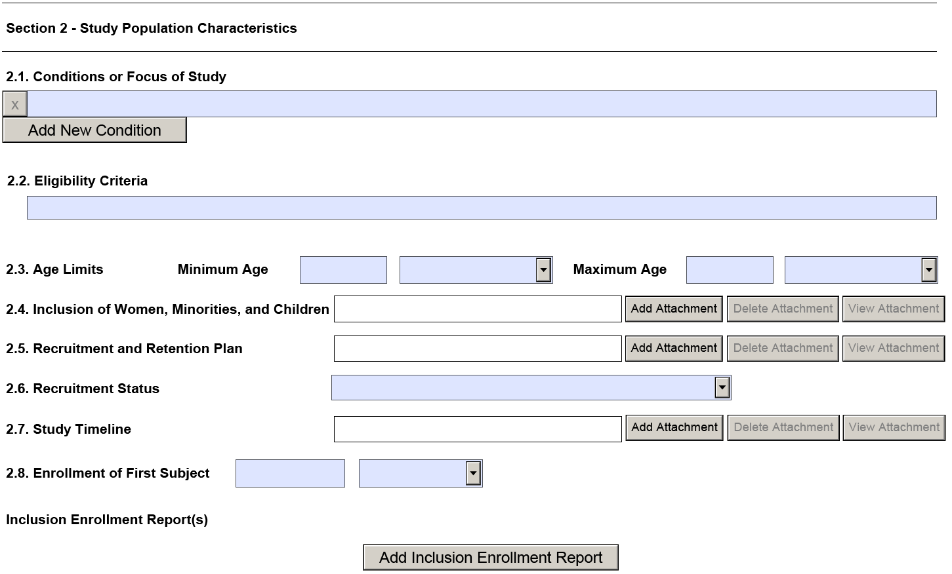
Study Record – Section 2
Section 2 is required for all human subject studies (except exemption 4) and all clinical trial studies.
Required for Human Subjects studies
Required for Clinical Trial studies
Cannot provide a number if unit of time is N/A (Rule 034.6.11).
Cannot provide a number if unit of time is N/A (Rule 034.6.4).

Slide 31
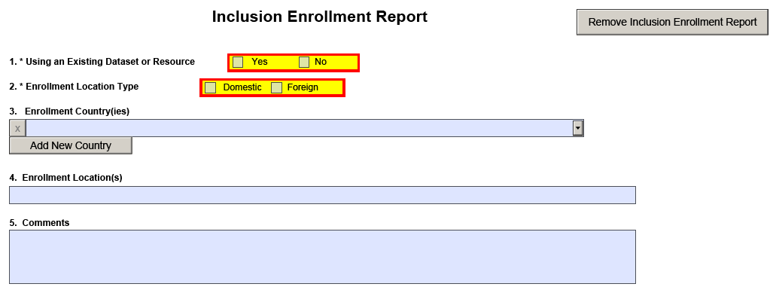
Inclusion Enrollment Report
Multi-select, the eRA team will show you how we are handling it
Existence of a comment relaxes some validations

Slide 32
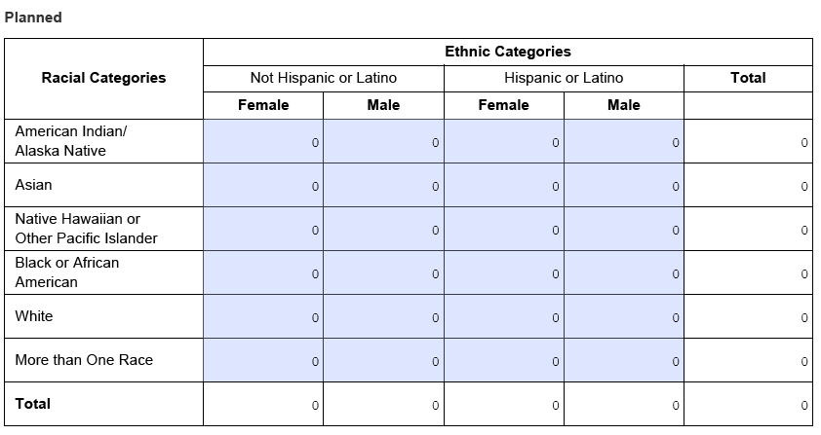
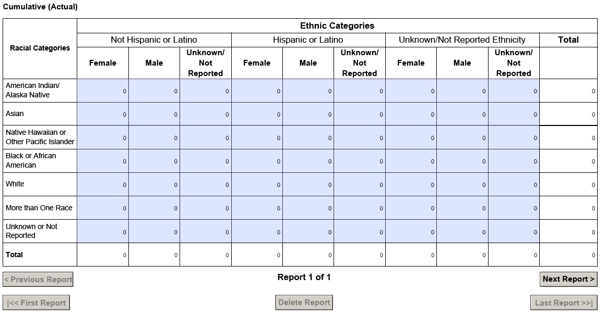
Planned & Cumulative Enrollment Tables
Planned enrollment required when “Using an Existing Dataset or Resource” = No.
Validations do not cover all expected scenarios. It is possible to have both tables in one report.
Cumulative enrollment required when “Using an Existing Dataset or Resource” = Yes.

Slide 33
Study Record – Section 3
3.1 and 3.2 are required for human subject studies (3.3-3.5 are optional). All fields in Section 3 are required for clinical trial studies.
Required for Human Subjects studies
Required for Clinical Trial studies

Slide 34
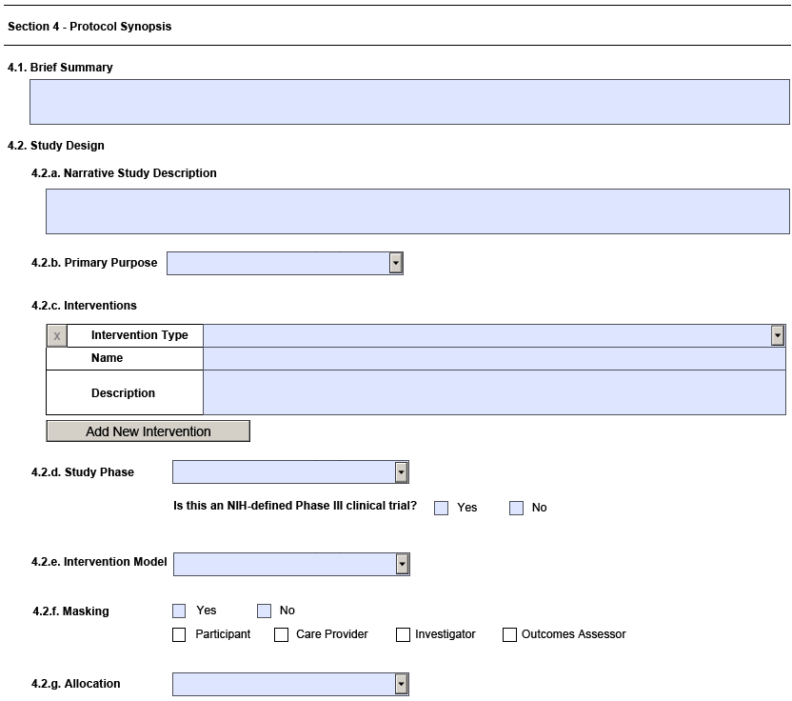
Study Record – Section 4
Required for Clinical Trial studies
Validations prevent section 4 data for
non-CT study records (at least 1 No answer on Clinical Trial Questionnaire)
Fellowship applications
Career Dev applications to Clinical Trials Not Allowed FOAs
For each intervention, all fields are required (schema enforced).

Slide 35
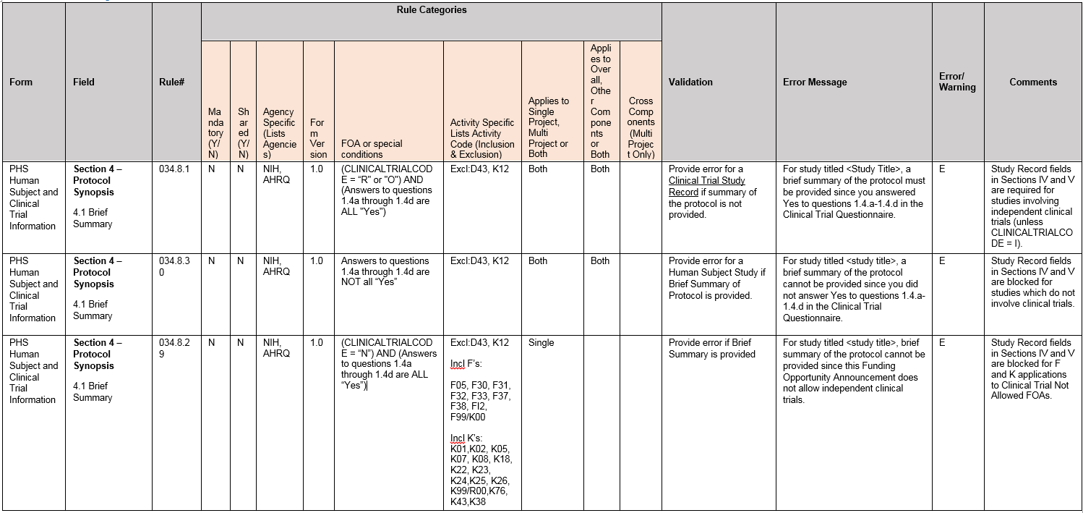
Sample Validations - controlling section 4 & 5

Slide 36
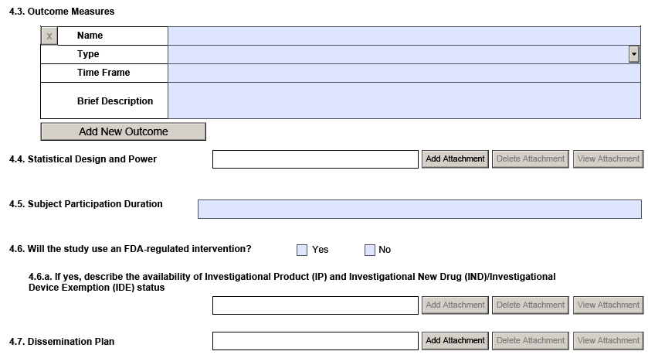
Study Record – Section 4 (cont.)
Required for Clinical Trial studies
For each outcome measure, all fields are required (schema enforced).

Slide 37
Filename uniqueness
Filenames must be unique within a single-project application and within a component of a multi-project application
Given an application can have multiple study records, watch out for folks attaching the same filename in different studies

Slide 38
Study Record – Section 5
Required for Clinical Trial studies
Validations prevent section 5 attachments for
non-CT study records (at least 1 No answer on Clinical Trial Questionnaire)
Fellowship applications
Career Dev applications to Clinical Trials Not Allowed FOAs

Slide 39
Multi-project
FORM included in all components (i.e., Overall and Other Components)
Each study must be specified only once in an application and not repeated
Each study title must be unique
Any HS=Yes component (except Overall) must have at least one proposed study record (can be delayed onset if meets the policy definition)
Exception: for studies that cross projects in a multi-project application, components must refer to study associated with Overall using the Other Requested Information attachment on the HS/CT form. The Other Requested Information attachment in the Overall must reference all involved components.

Slide 40
Studies self-contained in components
We enforce that if any component has HS=Yes, then HS=Yes in Overall component.
Overall Component
PD/PIs: Cher D. Money, Ben A. Round Organization: A
Project Title: Research Center to Cure the Diseases of the World
Other Project Info - HS=Yes
No study record needed in Overall.
Component Type: Admin Core
Component Type: Core
Component Type: Project
Admin Core-001
Core-001
Project-001
Project-002
Project-003
Project Title: Admin Core
Project Lead: Jed I. Knight
Organization: A
HS=No
Project Title: Core 1
Project Lead: Ben A. Round Organization: A
HS=No
Project Title: Fabulous Research Focus 1
Project Lead: Cher D. Money Organization: A
HS=Yes
Project Title: Fabulous Research Focus 2
Project Lead: Quin T. Sential Organization: B
HS=No
Project Title: Fabulous Research Focus 3
Project Lead: Ima Doer Organization: C
H =Yes
Core-002
HS/CT form
Project Title: Core 2
Project Lead: Abel Tu Lead Organization: B
HS/CT form
Project-001, Study 1 -
CT = Yes
Complete Sections 1, 2, 3, 4, 5
Study record can be delayed onset.
Project-003, Study 1 –
Delayed Onset Study
Indicate whether CT is anticipated; attach justification; no other info needed
In each (non-Overall) component where HS = Yes, at least one study record is required
Project-001, Study 2 -
CT = No
Must complete Sections 1, 2, 3; 4 & 5 blocked via validations

Slide 41
Multiple components working on same study
Include details of study in overall. Use Other Requested Information attachment to reference components.
Overall Component
HS/CT form
PD/PIs: Cher D. Money, Ben A. Round Organization: A
Project Title: Research Center to Cure the Diseases of the World
HS=Yes
Overall, Study 1
CT = Yes
Shared study record
Other Requested Information attachment: Reflects shared study in Project-001 and Project-003.
Component Type: Admin Core
Component Type: Core
Component Type: Project
Admin Core-001
Core-001
Project-001
Project-002
Project-003
Project Title: Admin Core
Project Lead: Jed I. Knight
Organization: A
HS=No
Project Title: Core 1
Project Lead: Ben A. Round Organization: A
HS=No
Project Title: Fabulous Research Focus 1
Project Lead: Cher D. Money Organization: A
HS=Yes
Project Title: Fabulous Research Focus 2
Project Lead: Quin T. Sential Organization: B
HS=No
Project Title: Fabulous Research Focus 3
Project Lead: Ima Doer Organization: C
H =Yes
Core-002
HS/CT form
Project Title: Core 2
Project Lead: Abel Tu Lead Organization: B
HS=No
HS/CT form
Shared study record
Use Other Requested Info attachment to refer to study in overall
Shared study record
Use Other Requested Info attachment to refer to study in overall
Both projects working on same study. Each project uses Other Requested Information attachment to refer to study in overall. No other details needed here.
Both projects working on same study. Each project uses Other Requested Information attachment to refer to study in Overall. No other details needed here.

Slide 42
Retirement of Downloadable forms
Downloadable forms will not be a back-up option for FORMS-E
You need to be prepared to use either ASSIST or Workspace for FORMS-E application packages
Reminder: NIH’s system issue policy only applies to federal systems.

Slide 43
Expect some late tweaks
eRA uses Agile development practices
Adjustments to requirements continue – make sure your systems are flexible
Take advantage of eRA web services rather than recoding
Submission Agency Data Service (SADS)
Submission Validation Service (SVS)
Submission Image Service (SIL)
Code “overrides” for the validations you choose to implement
Stay tuned for Go – No Go for Common Rule implementation
Validations for new exemption codes - TBD

Slide 44
Final questions…

