Slide 1





NIH electronic Research Administration
Building a Multi-project Application
Using
A
T
S
S
S
I
December 2012
Sheri Cummins Megan Columbus
CumminsS@od.nih.gov ColumbuM@od.nih.gov

Slide 2

Building a Multi-project Application - ASSIST
Preparing paper-based, multi-project applications can be an overwhelming task…

Slide 3

Building a Multi-project Application - ASSIST
…but the future is looking brighter.
NIH Multi-project applications are going electronic with ASSIST!

Slide 4

Building a Multi-project Application - ASSIST
It’s about time.

Slide 5

Building a Multi-project Application - ASSIST
What is ASSIST?
ASSIST - Application Submission System & Interface for Submission Tracking
  Web-based system for the preparation and submission of multi-project applications
  ASSIST replaces Grants.gov downloadable forms for multi-project applications

Slide 6
Building a Multi-project Application - ASSIST
What are the key features of ASSIST?
Key features:
  Leverages existing eRA Commons credentials
  Pre-populates data from eRA Commons profiles
  Validates Grants.gov and NIH business rules before you submit
  Provides preview of NIH application image
  Generates table of contents, headers & footers
  Tracks Grants.gov and eRA Commons submission status

Slide 7
Building a Multi-project Application - ASSIST
When can I use it?
Now for pilot opportunities only
NIH will post 6-9 pilot Funding Opportunity Announcements (FOAs) with deadlines between January and September 2013
  Electronic submission required
  Paper PHS 398 applications will not be accepted
  Participating FOAs will clearly state that they are part of the pilot and require electronic submission
  http://grants.nih.gov/grants/ElectronicReceipt/files/Timeline_NIH_Complex_Transition.pdf

Slide 8
Building a Multi-project Application - ASSIST
When can I use it?
Electronic submission required for all applications following activity-code transitions:
  September 25, 2013 deadlines and beyond
    P01, P20, P50, R24, U19, U24
  January 25, 2014 deadlines and beyond
    G12, P30, P40, P41, P42, P51, P60, R28, U10, U41, U42, U45, U54, U56, UC7, UM1
  http://grants.nih.gov/grants/guide/notice-files/NOT-OD-12-161.html

Slide 9
Building a Multi-project Application - ASSIST
What registrations are required?
All ASSIST users must have eRA Commons credentials with one of the following roles:
  Signing Official (SO)
  Administrative Official (AO)
  Principal Investigator (PI)
  Assistant (ASST)
  Account Administrator (AA)

Slide 10
Building a Multi-project Application - ASSIST
What registrations are required?
To submit your application you will need BOTH:
  eRA Commons account with the Signing Official (SO) role
  Active Grants.gov Authorized Organization Representative (AOR) credentials
  http://grants.nih.gov/grants/ElectronicReceipt/preparing.htm

Slide 11

Building a Multi-project Application - ASSIST
Account Notes
ASSIST leverages account credentials from eRA Commons and Grants.gov.
Work within eRA Commons and Grants.gov to establish your accounts and be sure you can log in to those systems before using your accounts with ASSIST.
If you run into password or other account
issues, return to eRA Commons or Grants.gov
to work through those issues.

Slide 12

Building a Multi-project Application - ASSIST
Your Title Here
Find
Opportunity

Slide 13


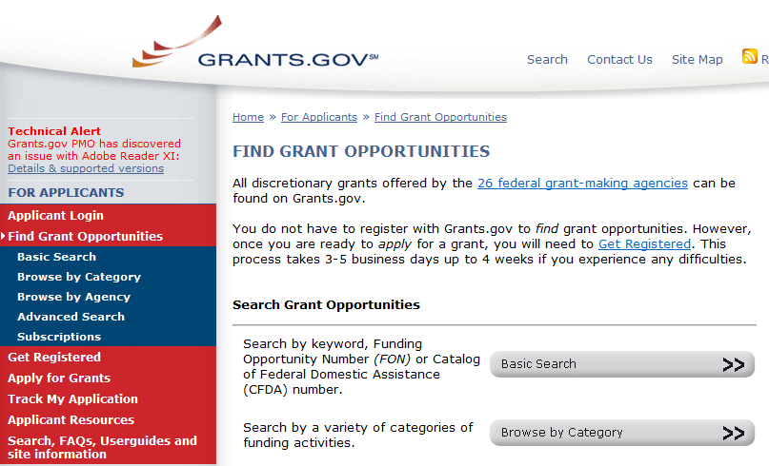
Building a Multi-project Application - ASSIST
Multi-project FOAs
Multi-project FOAs are posted in:
NIH Guide for Grants & Contracts
Grants.gov Find

Slide 14
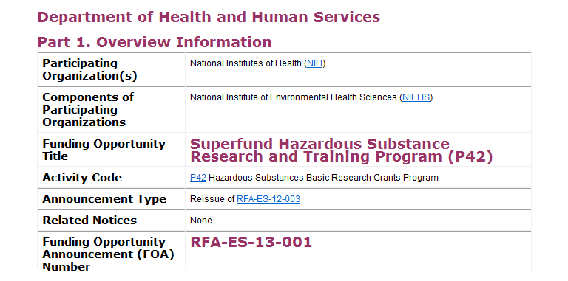
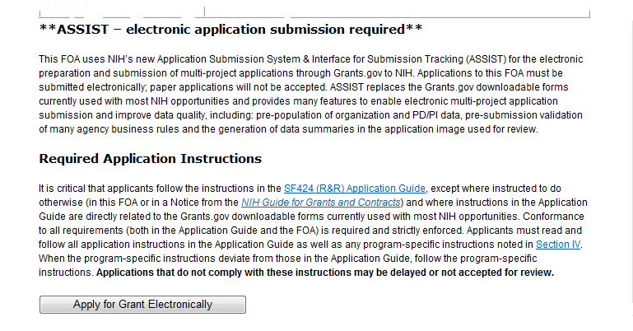
Building a Multi-project Application - ASSIST
NIH Guide for Grants & Contracts
Announcement text clearly indicates electronic submission is required.
Apply for Grant Electronically button brings you to the ASSIST site.

Slide 15
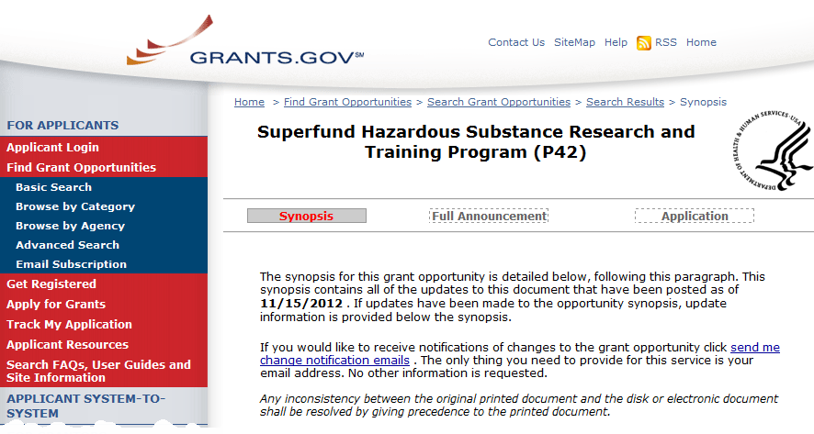
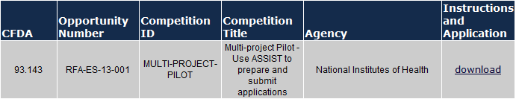
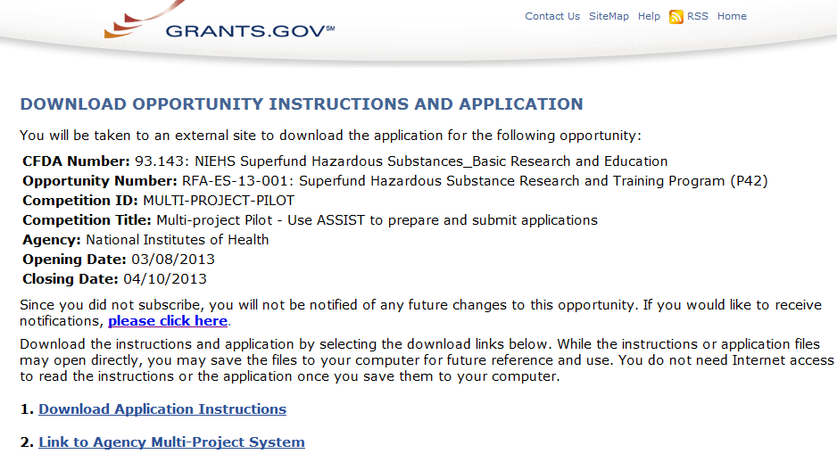
Building a Multi-project Application - ASSIST
Grants.gov
Click Application button.
Click Download.
Clicking the Link to Agency Multi-project System will bring you to ASSIST.

Slide 16

Building a Multi-project Application - ASSIST
Before jumping into ASSIST, take some time to learn about the new process

Slide 17
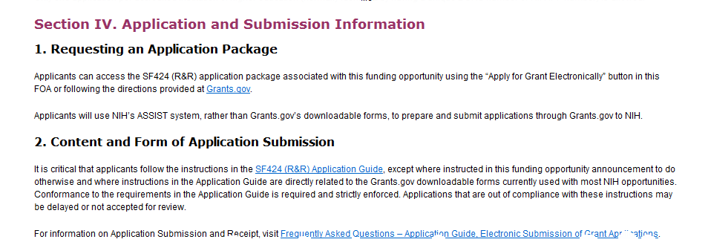
Building a Multi-project Application - ASSIST
Multi-project FOAs
Section IV. Application and Submission Information of NIH FOAs includes important guidance for preparing your application in ASSIST.
The SF424 (R&R) Application Guide provides general instructions for completing application forms.

Slide 18
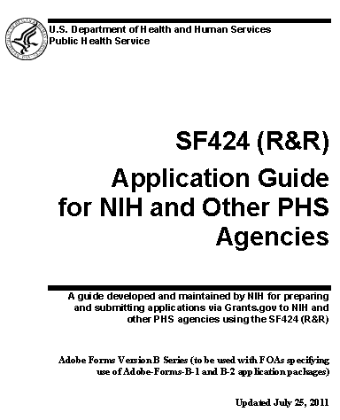

Building a Multi-project Application - ASSIST
Multi-project FOAs
Agency-specific instructions are marked with the HHS logo.
When instructions in the Application Guide conflict with instructions in the FOA, the FOA wins.

Slide 19
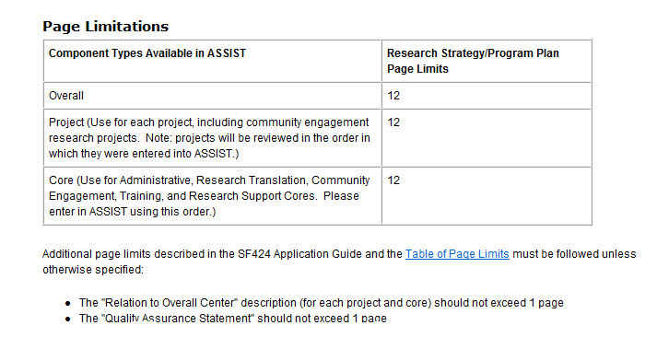
Building a Multi-project Application - ASSIST
Multi-project FOAs
Types of components allowed for the FOA and available in ASSIST for application preparation.
The Research Strategy page limits enforced in ASSIST for each component.

Slide 20
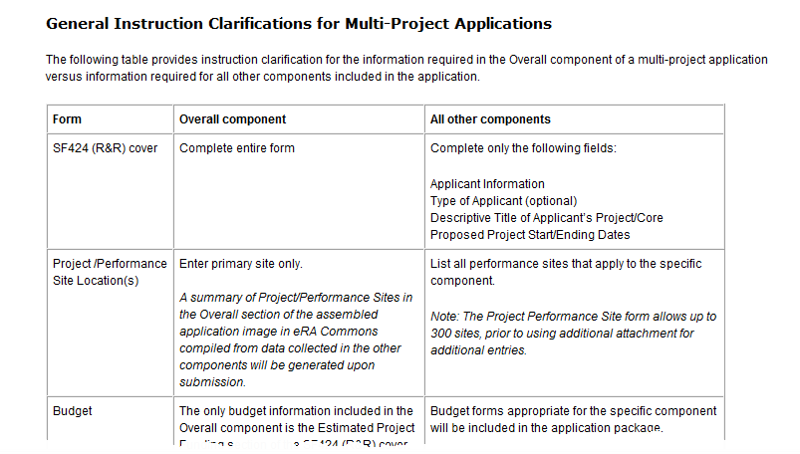
Building a Multi-project Application - ASSIST
Multi-project FOAs
Table provides additional instructions common to all multi-project applications.

Slide 21
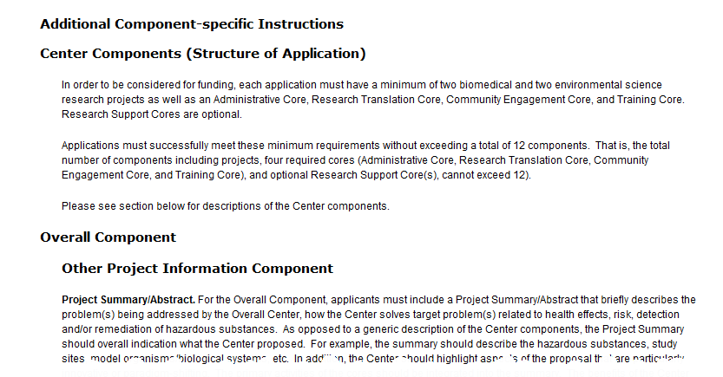
Building a Multi-project Application - ASSIST
Multi-project FOAs
Additional component-specific instructions provide guidance specific to the FOA.

Slide 22
Building a Multi-project Application - ASSIST
Get Familiar with the New Format
All electronic multi-project applications will include:
  A single Overall component
    Provides overview of entire application
  Some number of additional components
    Component types allowed vary by opportunity
    Announcements will clearly indicate the types of components expected in a responsive application
  Automatically prepared data summaries
    Compiled from information included in components
    Helps reviewers and staff work with the applications

Slide 23
Building a Multi-project Application - ASSIST
Understand How Your Application Image will be Assembled
Multi-project application images are assembled as follows:
  The Overall component is presented first
  Data summaries follow the Overall component
  Additional component types are presented in alphabetical order (e.g. Cores before Projects)
  Components of the same type are grouped together and presented in the order created in ASSIST
    Identified by Component Type and sequential number (e.g. Core-001, Core-002)

Slide 24
Building a Multi-project Application - ASSIST
ASSIST Application Format

Slide 25

Building a Multi-project Application - ASSIST
Create an Application Plan

Slide 26
Building a Multi-project Application - ASSIST
Create an Application Plan
  Carefully read the FOA and note the allowable types of required/optional components and any special instructions
  Decide how you want to distribute the work
  Ensure all eRA Commons and Grants.gov registrations are in place
  Gather the Commons IDs for everyone who will be working on your application in ASSIST

Slide 27
Building a Multi-project Application - ASSIST
Define the Layout of Your Application
Think about the components you plan to include
  PD/PIs for entire application
  Project lead for each component
  Organization lead for each component
  Project Title for each component
  Start/End dates
Determine the order you want the components to appear in the final application image
Create the application shell

Slide 28







Sample Application Layout
Overall Component
PD/PIs: Cher D. Money, Ben A. Round
Organization: A
Project Title: Research Center to Cure the Diseases of the World
Component Type: Admin Core
Component Type: Core
Component Type: Project
Admin Core-001
Core-001
Project-001
Project Title: Administrative Core
Project Lead: Jed I. Knight
Organization: A
Project Title: Research Core
Project Lead: Ben A. Round
Organization: A
Project Title: Fabulous Research Focus 1
Project Lead: Cher D. Money
Organization: A
Subaward Budget
Project-002
Organization: D
Project Title: Fabulous Research Focus 2
Project Lead: Quin T. Sential
Organization: B
Core-002
Project Title: Communications Core
Project Lead: Abel Tu Lead
Organization: B
Project-003
Project Title: Fabulous Research Focus 3
Project Lead: Ima Doer
Organization: C

Slide 29

Building a Multi-project Application - ASSIST
Before we talk about application initiation, are there any questions so far?

Slide 30

Building a Multi-project Application - ASSIST
Your Title Here
Initiate your application and create the
application shell

Slide 31
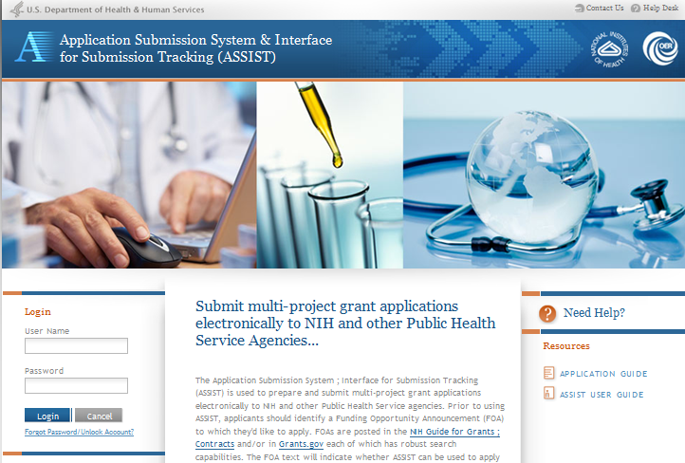
Building a Multi-project Application - ASSIST
Log In To ASSIST
https://public.era.nih.gov/assist
Use your eRA Commons credentials to access ASSIST.

Slide 32
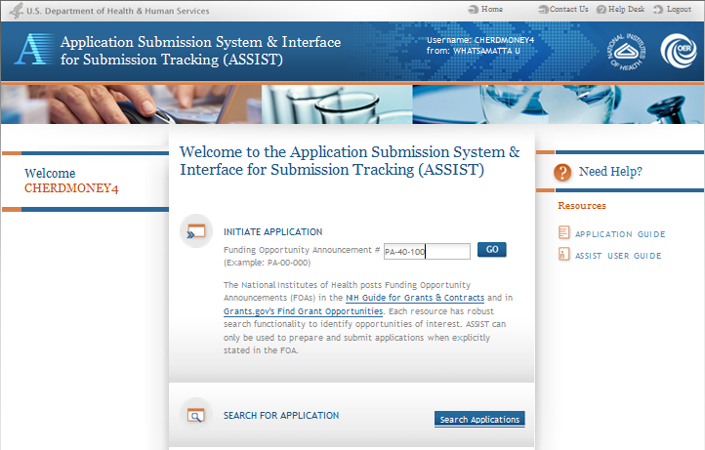
Building a Multi-project Application - ASSIST
Initiate Your Application
Find FOA of interest in NIH Guide or Grants.gov Find.
Enter FOA # and click Go to initiate your application.

Slide 33
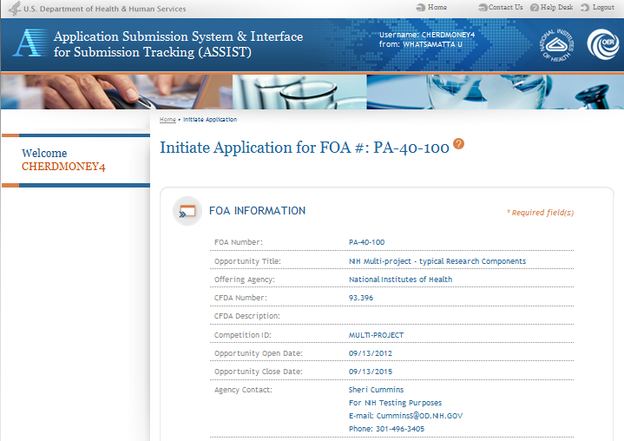
Building a Multi-project Application - ASSIST
Initiate Your Application
Top of Initiate screen includes non-editable FOA information pulled from Grants.gov.

Slide 34
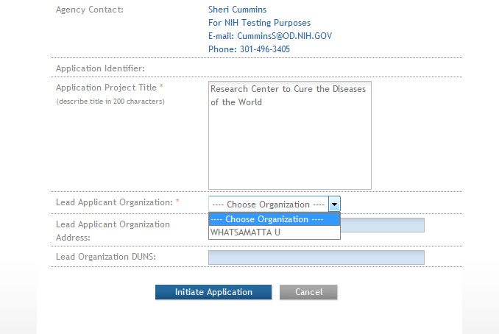
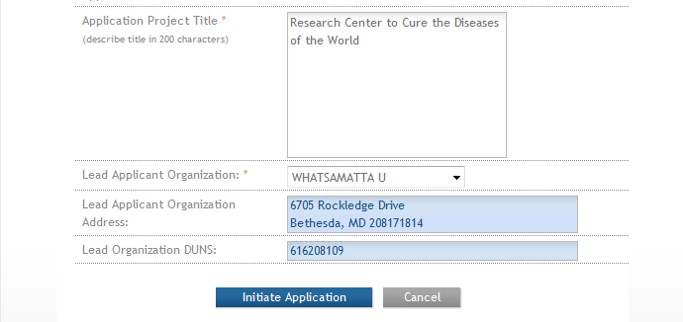
Building a Multi-project Application - ASSIST
Initiate Your Application
Bottom of Initiate screen requests the minimal information needed to save the application.
Enter Project Title.
NIH truncates at 81 characters.
Choose organization from list to populate organization name, address and DUNS.
Click Initiate Application to complete the initiation and save the application.

Slide 35
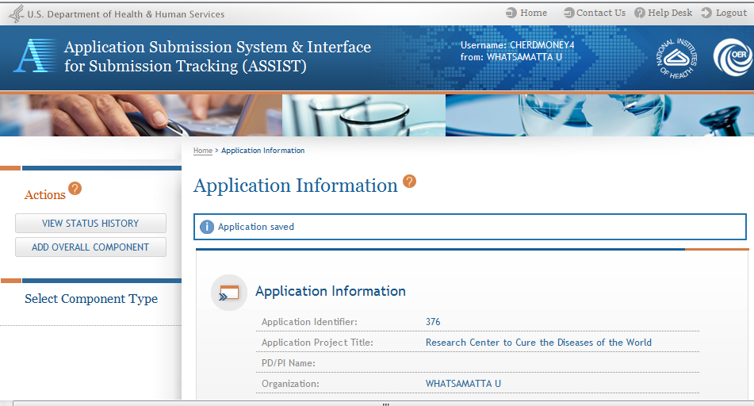
Building a Multi-project Application - ASSIST
Using ASSIST
Handy links including Help Desk and Logout in the upper right corner of every screen.
Click on question mark icon to access ASSIST help.
ASSIST messages appear at top of screen.
Available actions appear in the upper left corner of the screen and vary based on application context and access.

Slide 36
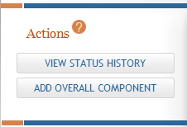
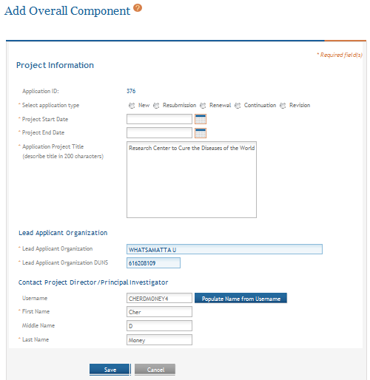
Building a Multi-project Application - ASSIST
Add Overall Component
Click Add Overall Component to start building your application.
The Add Overall Component screen requests the minimal information needed to save the component.
Enter the Commons Username for the contact PD/PI and use the Populate Name from Username button or type PD/PI name.
Click Save.

Slide 37
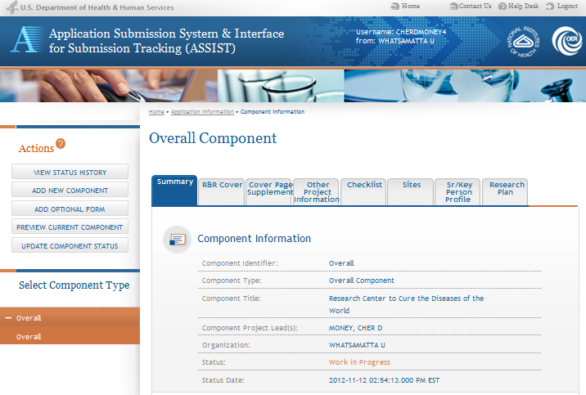
Building a Multi-project Application - ASSIST
Overall Component
The required forms are presented for the component.
The Overall Component is added to the component navigation.

Slide 38
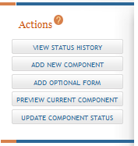
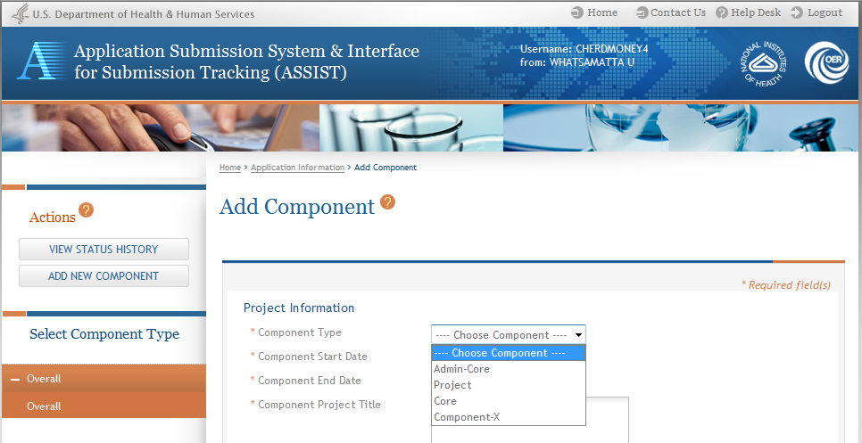
Building a Multi-project Application - ASSIST
Adding Additional Components
Click Add New Component to continue building your application.
Select from the drop-down list of component types available for the FOA.

Slide 39
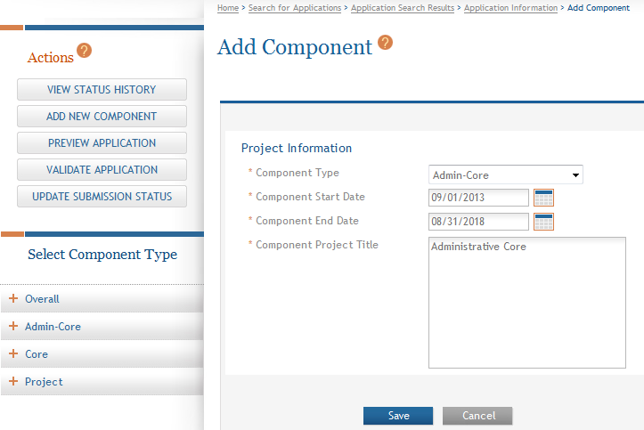
Building a Multi-project Application - ASSIST
Add Component
The Add Component screen requests the minimum information needed to save the component.
Click Save.

Slide 40
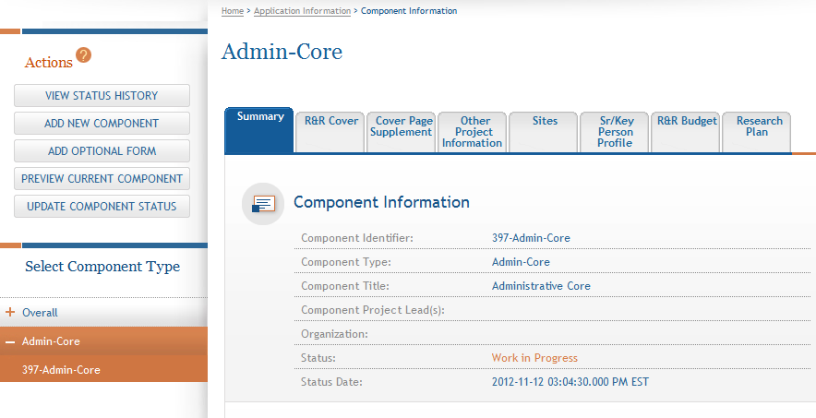
Building a Multi-project Application - ASSIST
Adding Components
The required forms are presented for the component.
The component is added to the component navigation.
Each component is given a random 3-digit, system-generated number for identification during application preparation. Components will be given sequential numbers in the assembled application image.

Slide 41
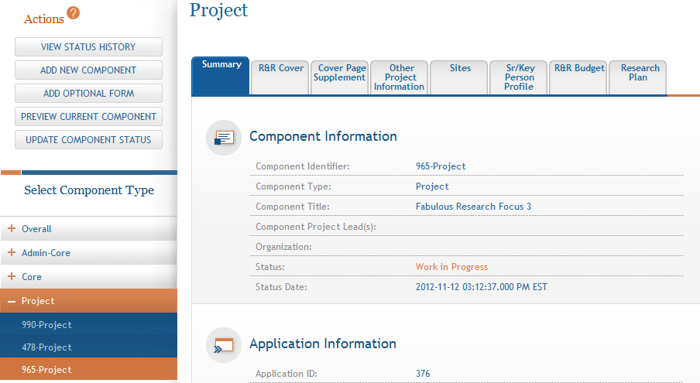
Building a Multi-project Application - ASSIST
Adding Components
Continue adding components to build out the application shell.
Components are grouped by component type.
Click the ‘+’ or ‘–’ next to each component type to expand or collapse list of components under each type.

Slide 42
Building a Multi-project Application - ASSIST
Before we talk about managing application access, are there any questions about initiating your application or creating
an application shell?

Slide 43

Building a Multi-project Application - ASSIST
Your Title Here
Define Your
Team and Provide Application
Access

Slide 44
Building a Multi-project Application - ASSIST
Automatic Application Access
ASSIST automatically provides application access to some individuals based on their Commons roles or role on the application
  All SOs and AOs at the applicant institution have edit access for the entire application
  All PD/PIs listed on the Overall application have edit access for the entire application
  The Project Leads have edit access for their components
  The person that initiates the application has edit access for the entire application

Slide 45
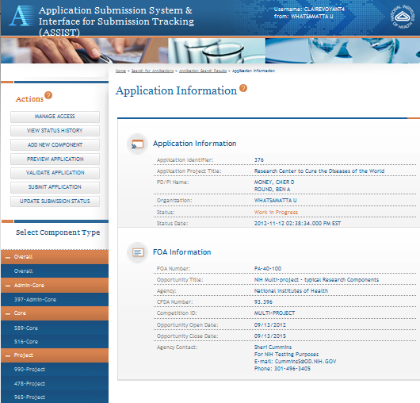
Building a Multi-project Application - ASSIST
Access Based on Commons Role
Example: User CLAIREVOYANT4 is an SO at Whatsamatta U and has automatic access to the entire application.
All components appear in the navigation.

Slide 46
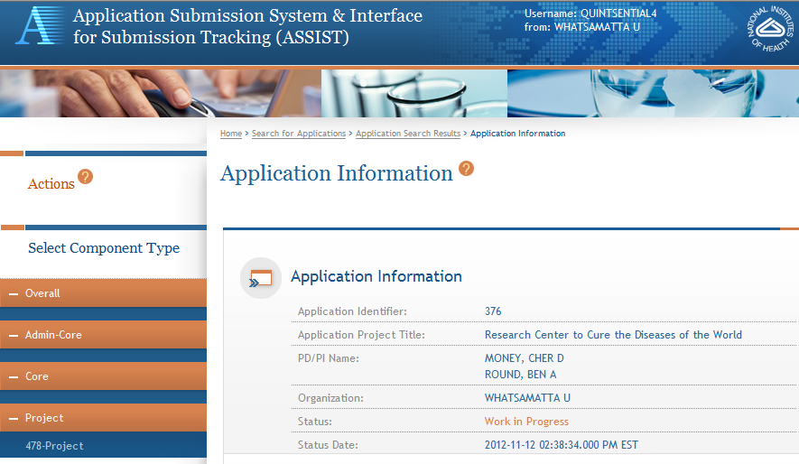
Building a Multi-project Application - ASSIST
Access Based on Application Role
Example: User QUINTSENTIAL4 only has automatic access to 478-Project for which he is the Project Lead.

Slide 47
Building a Multi-project Application - ASSIST
Managing Access
  SOs at the applicant institution can
    Manage application access for other users
    Delegate Access Maintainer authority to other users within their institution
Application access can be controlled across these variables:
  Entire application vs. specific components
  Read vs. Edit
  Budget vs. Non-budget data

Slide 48
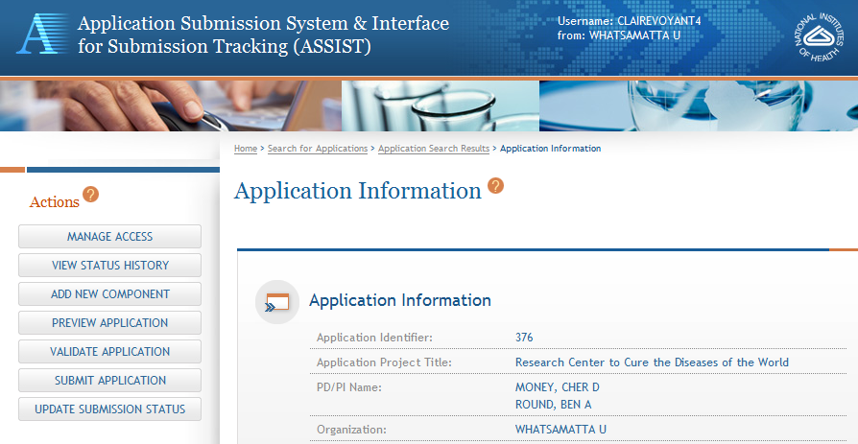
Building a Multi-project Application - ASSIST
Managing Access
CLAIREVOYANT4 is an SO at Whatsamatta U.
Click Manage Access.

Slide 49
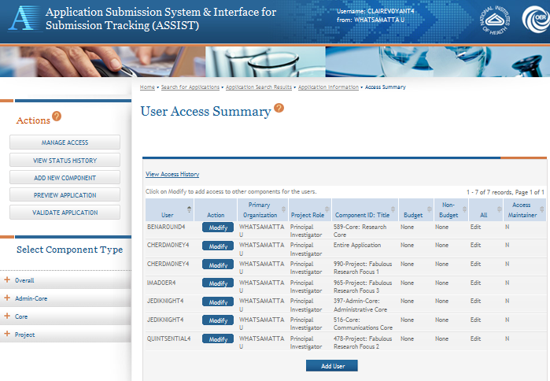
Building a Multi-project Application - ASSIST
Managing Access
Users with automatic access based on application role are listed on the User Access Summary page.
Click Add User to provide access to others.

Slide 50
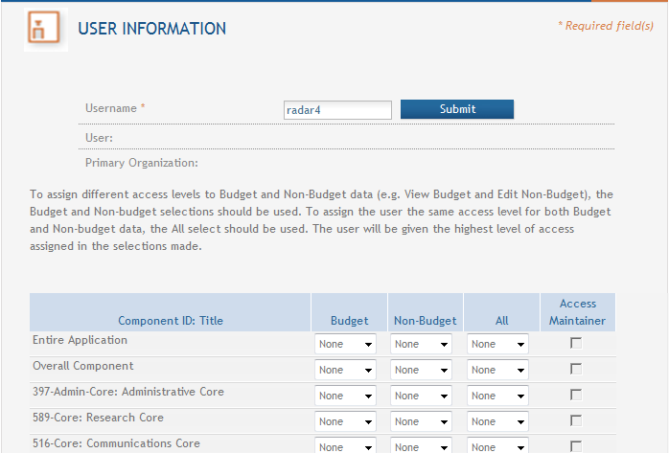
Building a Multi-project Application - ASSIST
Managing Access
Provide the Commons Username of the person to be given access and click Submit.

Slide 51
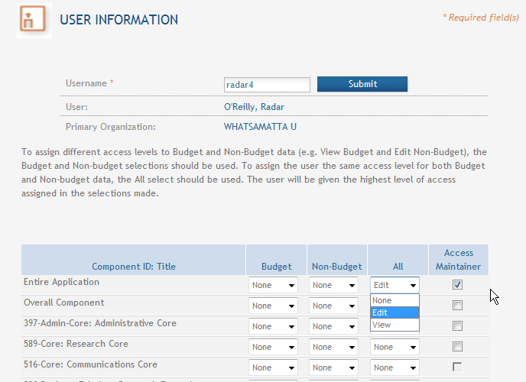
Building a Multi-project Application - ASSIST
Managing Access
The users name and organization is pulled from their Commons profile.
SOs can give Access Maintainer authority to other users in their organization.
Edit access to the Entire Application can be granted be selecting Edit under All.
Edit access for the Entire Application can be granted by selecting Edit under All.

Slide 52
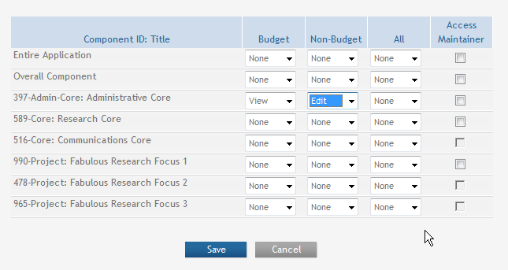
Building a Multi-project Application - ASSIST
Managing Access
Access can also be given for individual components instead of the entire application.
Different access levels can be selected for Budget and Non-budget data on a component.
Click Save after the desired access is selected.

Slide 53
Building a Multi-project Application - ASSIST
Before we talk about application data entry, are there any questions about managing application access?

Slide 54

Building a Multi-project Application - ASSIST
Entering
Application
Data

Slide 55
Building a Multi-project Application - ASSIST
Searching for In-progress Applications
Click Search Applications.

Slide 56
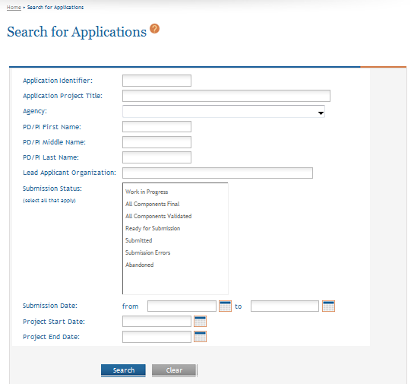
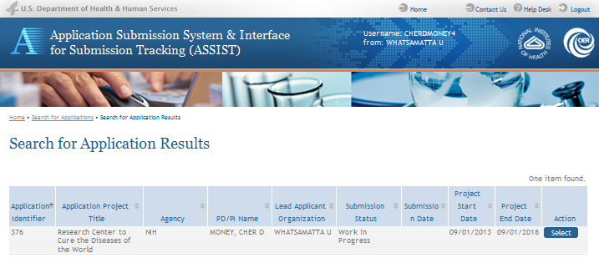
Building a Multi-project Application - ASSIST
Searching for In-progress Applications
Enter search parameters.
Click Search.
Click Select.

Slide 57
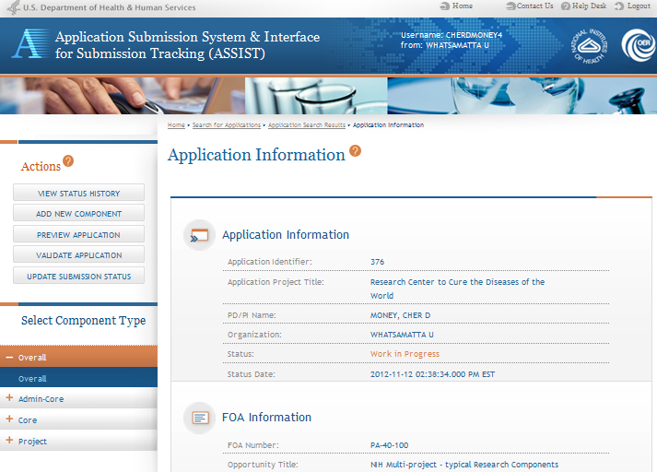
Building a Multi-project Application - ASSIST
Navigating to a Component
Use the component navigation to identify the component you want to work on.

Slide 58
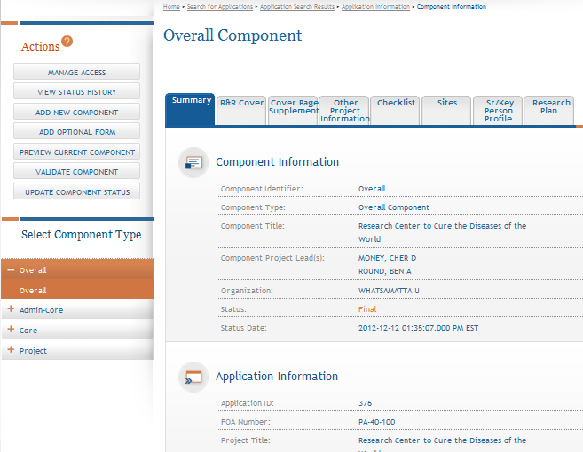
Building a Multi-project Application - ASSIST
Summary Page
Every component has a Summary page.
Some actions are only available from the Summary page.

Slide 59
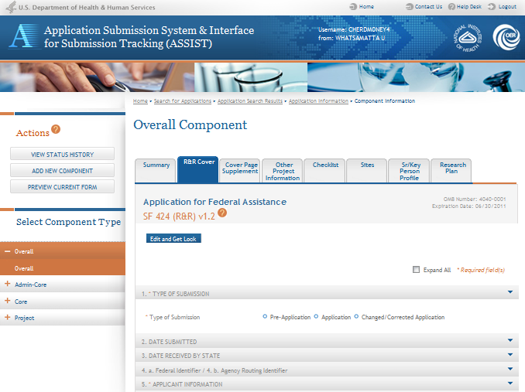
Building a Multi-project Application - ASSIST
Entering Application Data
Breadcrumbs provide quick and easy navigation.
Click each tab to access form data entry screens.
Click Edit and Get Lock to edit data.
Click Expand All to expose all data fields.

Slide 60
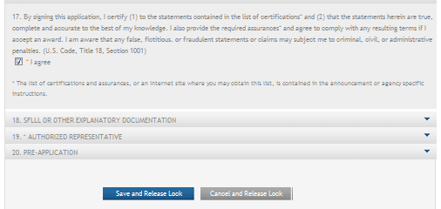
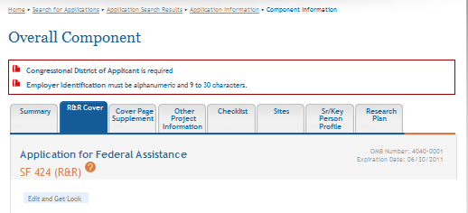
Building a Multi-project Application - ASSIST
Entering Application Data
Once all data is entered. Click Save and Release Lock.
ASSIST will validate entered data and provide any errors at the top of the screen. Errors must be corrected before saving.

Slide 61
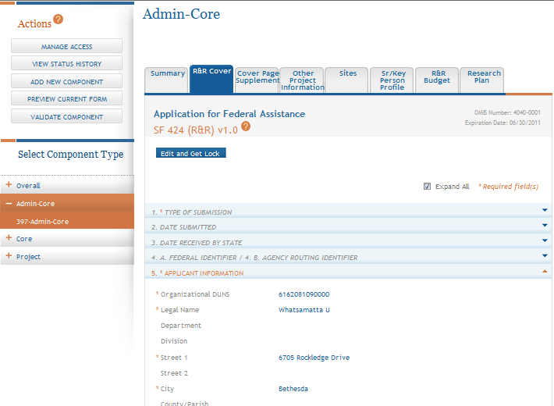
Building a Multi-project Application - ASSIST
Entering Application Data: R&R Cover
Expand All exposes only the subset of fields required for components other than the Overall.

Slide 62
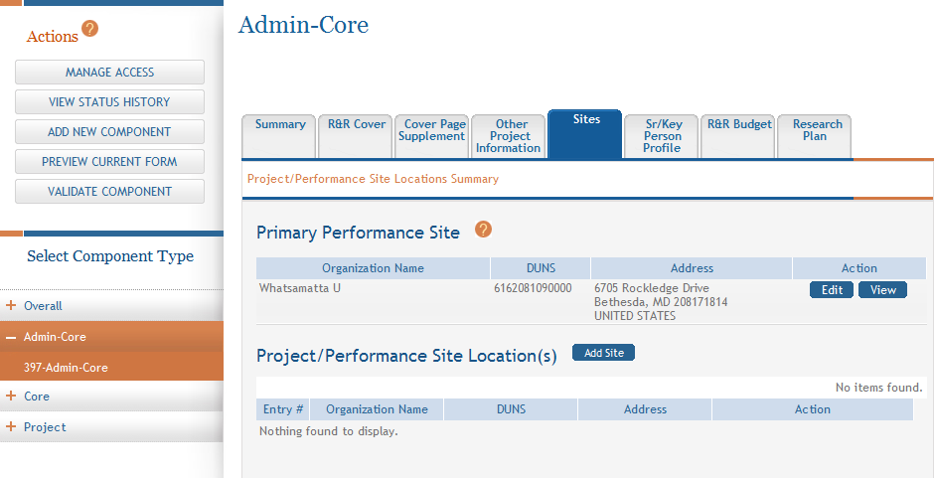
Building a Multi-project Application - ASSIST
Entering Application Data: Sites
Primary Performance Site is required.
Add up to 300 additional sites .
After 300 sites are added the option to add an attachment with additional site information will appear.

Slide 63
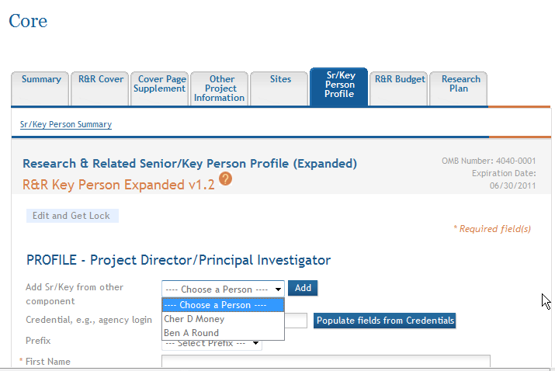
Building a Multi-project Application - ASSIST
Entering Application Data: Sr/Key
Take advantage of options to populate data from list of Sr/Key persons already entered in application or from eRA Commons credentials.
Up to 100 Sr/Key persons can be added per component.

Slide 64
Building a Multi-project Application - ASSIST
Tips for Filling out the Sr/Key Form
Overall component:
  Use the Project Director/Principal Investigator section to designate the Contact PD/PI
  Include any Multi-PD/PIs
  Use Project Role of PD/PI
All other components:
  Use the Project Director/Principal Investigator section to designate the Project Lead
  Must use role other than PD/PI
    ASSIST defaults role to Other, Project Lead
Important: Applications must include a single biographical sketch for each Sr/Key person regardless of the number of components they are listed on.

Slide 65
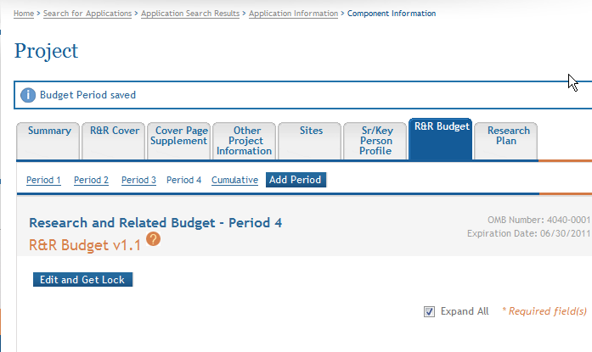
Building a Multi-project Application - ASSIST
Entering Application Data: Budget
The Add Period button creates an additional budget period carrying over entries from the previous period. All fields remain editable.

Slide 66
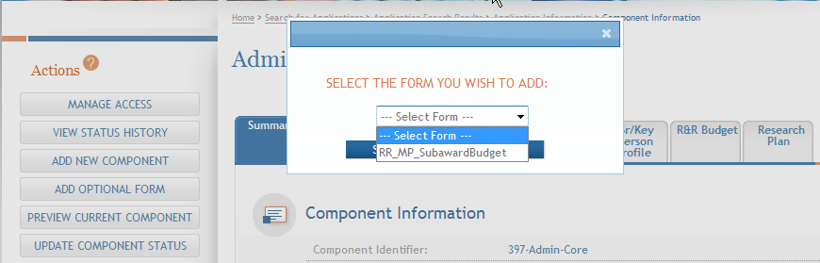
Building a Multi-project Application - ASSIST
Tips for Filling out the Budget Form
Section A: Senior Key Persons
  Can include up to 100 entries
  Remember to include effort in Calendar or Academic/Summer months for all Sr/Key
Use the Add Optional Form action if subaward budgets are included

Slide 67
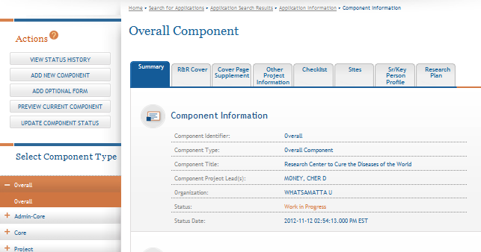
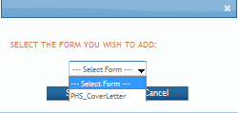
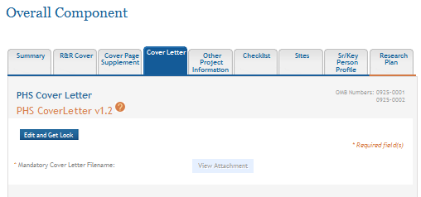
Building a Multi-project Application - ASSIST
Adding Optional Forms
Click Add Optional Form.
Select form and click Submit.
The form tab is added to navigation.

Slide 68
Building a Multi-project Application - ASSIST
Component Actions
As component data is entered several actions are available:
  Validate Component
  Preview Current Component
  Update Component Status
    Work In Progress
    Complete
    Final

Slide 69
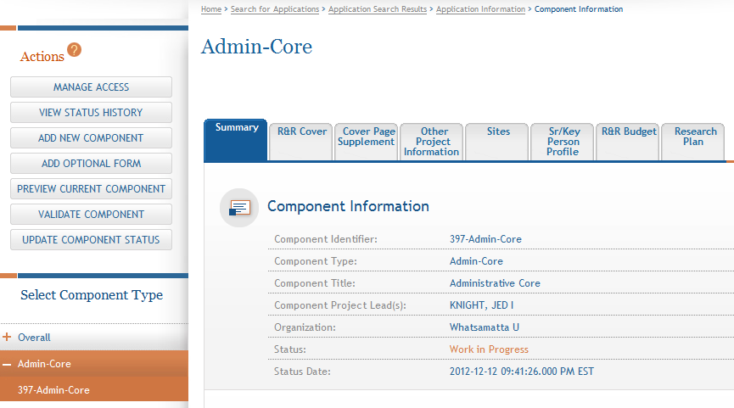
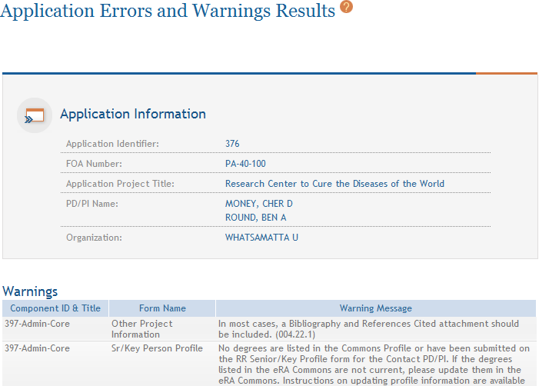
Building a Multi-project Application - ASSIST
Validating a Component
Click Validate Component.
Errors and Warnings are displayed.

Slide 70


Building a Multi-project Application - ASSIST
Errors & Warnings
Errors stop application processing and must be corrected before the deadline
Warnings do not stop application submission and are corrected at the discretion of the applicant before the deadline
Avoiding Common Errors page:
http://grants.nih.gov/grants/ElectronicReceipt/avoiding_errors.htm

Slide 71
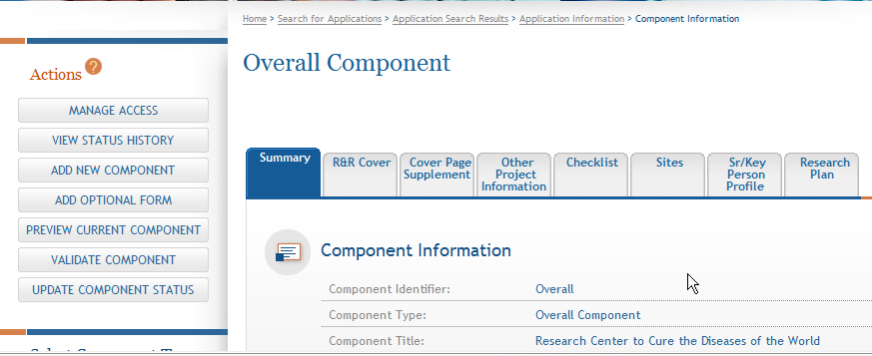

Building a Multi-project Application - ASSIST
Previewing a Component
Click Preview Current Component to view the information included in that component.

Slide 72


Building a Multi-project Application - ASSIST
Marking a Component Complete
Click Update Component Status.
Select status and enter comment for Status History.
Once a component is marked ‘Complete’ no additional edits can be made unless someone with entire application edit authority returns the status to ‘Work in Progress’.
Status on Summary page is updated.

Slide 73
Building a Multi-project Application - ASSIST
Before we talk about preparing your application for submission, are there Any questions about
data entry in ASSIST?

Slide 74

Building a Multi-project Application - ASSIST
Preparing Your
Application
for Submission

Slide 75
Building a Multi-project Application - ASSIST
Finalizing Components
As components are marked ‘Complete’, the applicant organization can preview them and incorporate those that are ready into the final application by updating the component status to ‘Final’.
All components must be marked ‘Final’ before an application can be prepared for submission.
Prior to finalizing components it is good practice to validate the application.

Slide 76

Building a Multi-project Application - ASSIST
Validating the Application
The Validate Application action is only available from the Application Information screen.
Click Validate Application.

Slide 77

Building a Multi-project Application - ASSIST
Validating the Application
If Errors or Warnings are detected for a component in ‘Complete’ status it can be put back in ‘Work In Progress’ status for correction.
Each Error or Warning includes the Component and Form where the problem was identified.

Slide 78

Building a Multi-project Application - ASSIST
Finalizing Components
Update the component status to Final once you are satisfied that the component is ready to be included in the final application.

Slide 79

Building a Multi-project Application - ASSIST
Finalizing Components
ASSIST will check to ensure that only one biosketch is included for every Senior/Key person in the application.
Click Submit Biosketch.
If a biosketch is already included for any Sr/Key, you will have the option to view each biosketch and select the one you wish to keep.

Slide 80

Building a Multi-project Application - ASSIST
Finalizing Components
  After all biosketch issues are reconciled, the component status is set to Final.

Slide 81

Building a Multi-project Application - ASSIST
Updating Application Status
Although the Status shown in the Component Information for each component is set to Final. The Application Information still shows a Status of Work in Progress.

Slide 82
Building a Multi-project Application - ASSIST
Application Status Flow
Work In Progress – Allows editing
All Components Final – Can only be updated once each component status is Final
All Components Validated – Automatically set once Application Validation is error-free
Ready for Submission – Should be set after all internal reviews have taken place
Submitted – Automatically set after submitting to Grants.gov

Slide 83


Building a Multi-project Application - ASSIST
All Components Final
You can prepare your application for submission once the status for all individual components has been set to Final.
Go to Application Information.
Click Update Submission Status.
Set the application status to All Components Final.

Slide 84

Building a Multi-project Application - ASSIST
Final Validation Check
Before an application can be submitted, it must pass validations (Warnings are OK).

Slide 85

Building a Multi-project Application - ASSIST
All Components Validated
When the application passes validations, the application status is automatically updated to All Components Validated.

Slide 86
Building a Multi-project Application - ASSIST
Preview Application
Before you submit you can Preview the Application and verify that everything is just the way you want it to go to review.

Slide 87

Building a Multi-project Application - ASSIST
Ready for Submission
Once all internal reviews are complete, update the application status to Ready for Submission.

Slide 88
Building a Multi-project Application - ASSIST
Before we talk about submitting to Grants.gov, are there any questions about preparing your application for submission?

Slide 89

Building a Multi-project Application - ASSIST
Your Title Here
Submitting Your Application

Slide 90

Building a Multi-project Application - ASSIST
On-time Submission
Error-free submission must be made by 5:00 p.m. local time (of submitting organization) on due date
  Submit early (days, not minutes)
  to have time to address any
  unforeseen issues and to view
  your application image in Commons

Slide 91


Building a Multi-project Application - ASSIST
Submitting Your Application
Only a Signing Official (SO) for the Lead Organization who is an Authorized Organizational Representative (AOR) can submit an application.
Click Submit Application.
Application Status must be set to Ready for Submission before you can submit.
Click Submit.

Slide 92


Building a Multi-project Application - ASSIST
Submitting Your Application
Applications are submitted from ASSIST to Grants.gov.
Enter your Grants.gov AOR credentials and click Enter.
Message will appear indicating the application was sent to Grants.gov.

Slide 93
Building a Multi-project Application - ASSIST
Before we talk about tracking your application, are there any questions about submitting your application to
Grants.gov?

Slide 94

Building a Multi-project Application - ASSIST
Your Title Here
Tracking Your Application

Slide 95

Building a Multi-project Application - ASSIST
Notifications
ASSIST sends out quite a few email notifications throughout the preparation and submission process to help you track your application
  When access to the application is granted or changed
  Updates to component or application
  status
  Updates to submission status
  More…
Let us know if it is too much or too little.
http://grants.nih.gov/grants/electronicreceipt/files/ASSIST_eNotifications.pdf

Slide 96
Building a Multi-project Application - ASSIST
Tracking Submission Status in ASSIST
ASSIST provides the ability to track both Grants.gov and NIH status
In the future, ASSIST will also provide a link to the Commons Detailed Status Information to view your application
  For now, you will need to view your final application image directly in Commons

Slide 97
Building a Multi-project Application - ASSIST
Tracking Submission Status in ASSIST
After submitting to Grants.gov, submission status can be tracked in ASSIST.
Click View Submission Status Details.

Slide 98

Building a Multi-project Application - ASSIST
Tracking Submission Status in ASSIST
You must click Check for Status Updates to force ASSIST to poll Grants.gov and NIH for status.
ASSIST will indicate if a status change was detected.

Slide 99

Building a Multi-project Application - ASSIST
Tracking Submission Status in ASSIST
ASSIST, Grants.gov and Agency submission status are available.
Grants.gov status of Agency Tracking Number Assigned and Agency status of Processed is good news!

Slide 100

Building a Multi-project Application - ASSIST
Viewing Your Application in Commons
Log in to Commons and click the Status tab.
Select the Recent/Pending eSubmissions Status search, enter search parameters, and click Search.

Slide 101

Building a Multi-project Application - ASSIST
Viewing Your Application in Commons
Click on the Application ID to view detailed status information for the selected application.
An eSubmission Status of Pending Verification indicates the application was successfully processed and an image is available for viewing.

Slide 102

Building a Multi-project Application - ASSIST
Viewing Your Application in Commons
eApplication is the application image reviewers will use so check it carefully.
You will also want to check the Cover Letter and Component Appendices which are stored separate from the image.

Slide 103

Building a Multi-project Application - ASSIST
Viewing Your Application Image in Commons
It is your responsibility to carefully review the entire application to ensure it has been processed correctly!

Slide 104




Building a Multi-project Application - ASSIST
Automatic Data Summaries

Slide 105
Building a Multi-project Application - ASSIST
Application Viewing Window
Applicants have two (2) business days to view the assembled application image in Commons before it automatically moves forward to NIH staff for further processing
SO can Reject application within viewing window and submit a Changed/Corrected application prior to the due date

Slide 106
Building a Multi-project Application - ASSIST
Rejecting a Submitted Application
Within the Viewing Window an SO can use the Reject eApplication link to prevent the application from moving forward to NIH for processing and funding consideration.

Slide 107

Building a Multi-project Application - ASSIST
Submission Complete!
If no action is taken to reject the application during the two business day viewing window, the application automatically moves forward to NIH for further processing.

Slide 108
Building a Multi-project Application - ASSIST
Any questions about tracking your submission status?

Slide 109

Building a Multi-project Application - ASSIST
Some Final Notes…
Don’t be a Repeat Clicker!
Some ASSIST actions are quite involved and require some time to complete.
Be patient when Validating or Previewing a Component or Application and resist the urge to click the action button again and again. It will only increase the time to complete the action.

Slide 110

Building a Multi-project Application - ASSIST
Some Final Notes…
ASSIST is a new system and it’s likely we’ll encounter a few (hopefully small) bumps along the way.
If you are having trouble figuring out how to do something and can’t find the guidance you need in our resources, don’t panic.
We’ve got your back.
Contact the eRA Commons
Help Desk and we’ll figure it
out together.

Slide 111

Building a Multi-project Application - ASSIST
Your Title Here
ASSISTance

Slide 112


Building a Multi-project Application - ASSIST
On-line ASSIST Help
Help opens in a separate window at the location requested.
Click on question mark icon to access ASSIST help.
Search feature.
Help on form data entry screens provides easy access to Application Guide for additional guidance on field content information.

Slide 113

Building a Multi-project Application - ASSIST
Links & Self Help Resources
ASSIST: https://public.era.nih.gov/assist
Online help: http://era.nih.gov/erahelp/ASSIST/
Applying Electronically Website for Multi-project Applications: http://grants.nih.gov/grants/ElectronicReceipt/com_index.htm
Annotated form set: http://grants.nih.gov/grants/ElectronicReceipt/files/annotated_multi-project.pdf

Slide 114

Building a Multi-project Application - ASSIST
Help Desk
eRA Commons Help Desk
Web: http://era.nih.gov/help/
Toll-free: 1-866-504-9552
Phone: 301-402-7469
TTY: 301-451-5939
Hours: Mon-Fri, 7a.m. to 8 p.m. Eastern Time
(Except for Federal holidays)
Although we’ve worked closely with Grants.gov, ASSIST is a system developed and managed by NIH.
The eRA Commons Help Desk should be your first stop for support.

Slide 115

Building a Multi-project Application - ASSIST
Dealing with System Issues
Follow our ‘system issue’ procedure if you run into problems beyond your control that threaten your on-time submission:
  http://grants.nih.gov/grants/ElectronicReceipt/support.htm#guidelines

Slide 116

Building a Multi-project Application - ASSIST
Feedback
ASSIST is in pilot.
We need your feedback to improve the service and make our full transition to electronic submission of multi-project applications go as smoothly as possible.
To provide feedback take advantage of the
eRA Help Desk web ticketing system
  https://public.era.nih.gov/commonshelp
  Choose ‘Other’ for the ‘I need help with question’
  Start your Description with ‘ASSIST Feedback’

Slide 117







Building a Multi-project Application - ASSIST
Q
S
S
I
U
E
T
O
N
Thank You for Attending our Webinar!

