Slide 1
Ready, Set, Submit!
GRANT Application Preparation & Submission
Kasima Garst & Laurie Roman
October 2020

Slide 2
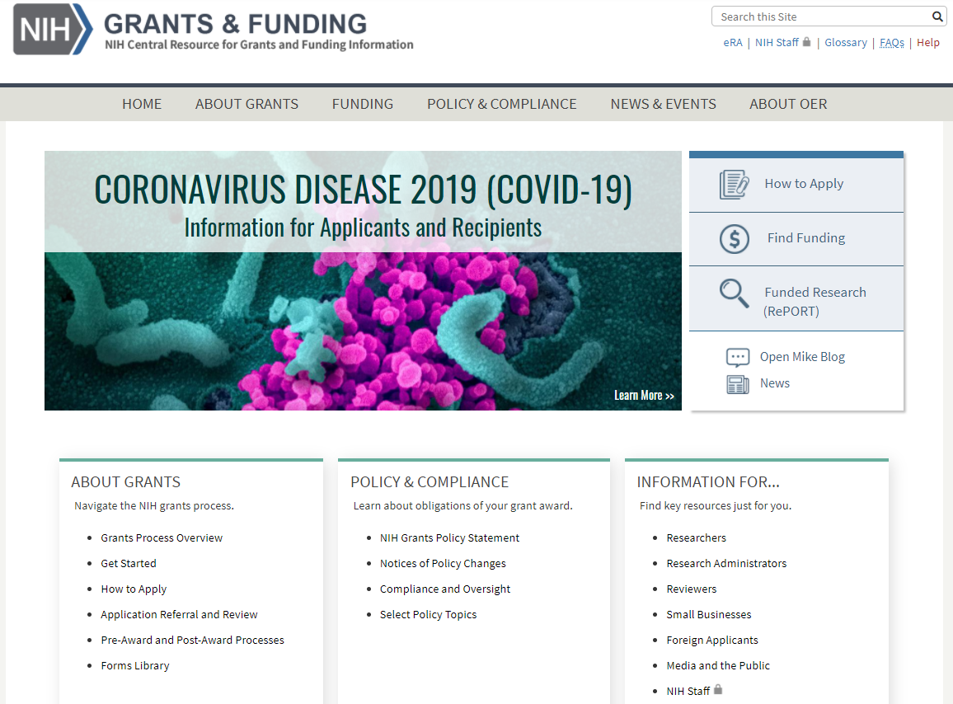
NIH Grants and Funding https://grants.nih.gov/
How to Apply- Application Guide
Notes:
The NIH Application Guide can be found via the “How to Apply” link on the NIH Grants and Funding webpage.

Slide 3
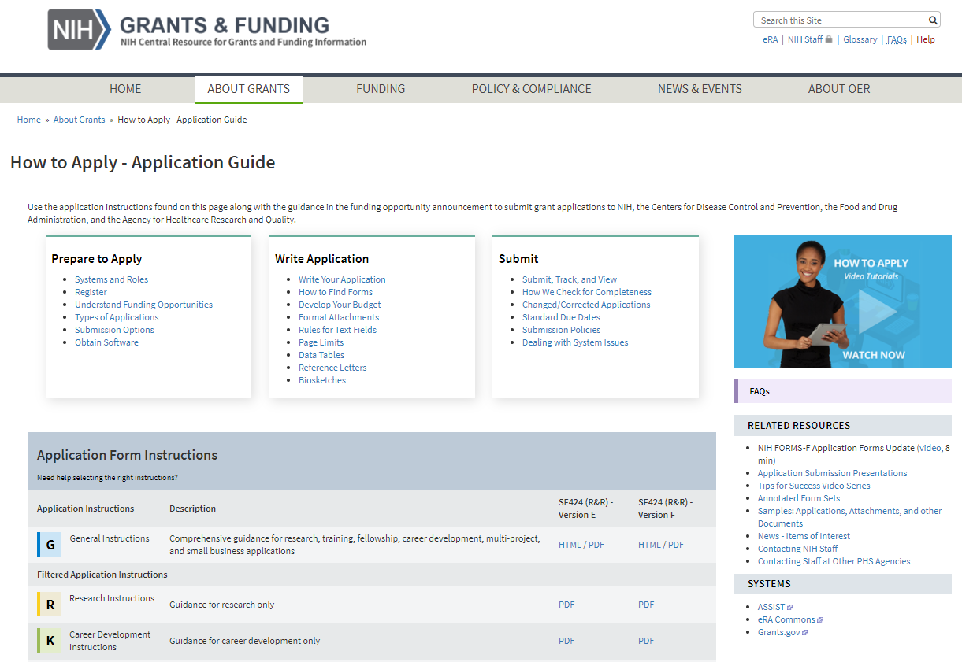
How to Apply – Application Guide https://grants.nih.gov/grants/how-to-apply-application-guide.html
General Application Process Information
Form Instructions
Resources
Notes:
The How to Apply page contains the full Application Guide resources including:
General Application Process Information (i.e. information on how to prepare to apply (e.g. registrations), write your application (e.g. formatting attachments), and submitting your application (e.g. submission policies)
Resources (e.g. Annotated form sets, application submission related presentations, and samples)
Application form instructions, includes filtered instructions for different application types (i.e. Research, Career Development, Fellowship, Training, and Multi-project applications)

Slide 4
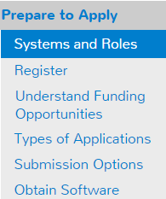
Understand Key Systems & Roles
https://grants.nih.gov/grants/how-to-apply-application-guide/prepare-to-apply-and-register/key-systems-and-roles.htm
Grants.gov
eRA Commons
E-Business Point of Contact (EBiz POC)
Authorized Organization Representative (AOR)
Signing Official (SO)
Principal Investigator (PI)
Notes:
There are two main systems involved in our grant application process - Grants.gov and eRA Commons. Each system has its own registration, terminology and business rule requirements.
Grants.gov - The on-line portal used by all federal grant-making agencies and their applicants to find and apply for federal grant funding.
eRA Commons - A system managed by NIH that allows applicants, grantees and federal staff to securely share, manage and process grant-related information.
Key Grants.gov Applicant Roles
E-Business Point of Contact (EBiz POC)
Designated during registration with System for Award Management (SAM)
Manages grant activities for your organization
Authorizes representatives of your organization to perform specific tasks in Grants.gov (e.g., assigns Authorized Organizational Representative (AOR) role to users authorized to submit applications)
Authorized Organization Representative (AOR)
Grants.gov applicant user who has been given the AOR role by the EBiz POC enabling them to legally bind your institution and assume responsibility for adhering to all federal grant administration requirements referenced in the NIH Grants Policy Statement
Similar authority as a Signing Official (SO) in eRA Commons
Signs and submits grant applications and required certifications and assurances
Key eRA Commons Roles
Signing Official (SO)
Holds authority to legally bind your institution and assume responsibility for adhering to all federal grant administration requirements referenced in the NIH Grants Policy Statement
Registers the institution and maintains institutional profile data
Accesses information for all applications and grants within your institution, including status and award information
Creates and administers user accounts including additional SO and account administrator (AA) accounts
Principal Investigator (PI)
Holds eRA Commons PI role as the designated project director/principal investigator (PD/PI) of an application or grant
Directs the project or activity being supported by the grant and is accountable to the grantee organization for the proper conduct of the project or activity
Performs or delegates tasks such as maintaining person profile information, checking application status, checking assembled application image used for review and performing post-submission administrative functions
Accesses information for their own grants and applications , including summary statements, scores and notices of award

Slide 5
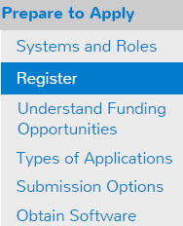
Organization Registration
https://grants.nih.gov/grants/how-to-apply-application-guide/prepare-to-apply-and-register/registration/org-representative-registration.htm
Your organization must be registered in multiple systems to submit. Start early – can take 6 weeks!
DUNS – provides unique organization identifier * plans to switch to Unique Entity Identifier (UEI)
SAM (System for Award Management) – needed to do business with government
Requires annual renewal
Grants.gov – required to submit grants
eRA Commons – required to do business with NIH
SBA (Small Business Administration) – required for SBIR/STTR applications
Notes:
Note: eRA Commons registrations for some individuals will be required for application submission (e.g. all PD/PIs, sponsors on fellowship applications, candidates for diversity supplement support, component leads on a multi-project application, primary mentor identified on individual mentored career development applications.)
Reminder: ORCID iDs (Open Researcher and Contributor Identifiers) are required for the Program Director/Principal Investigators (PD/PIs) for individual fellowship and career development applications; the ORCID iD must be linked to the PD/PI’s eRA Commons Personal Profile prior to submission.

Slide 6
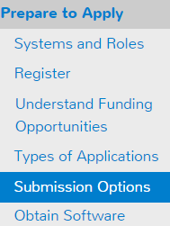
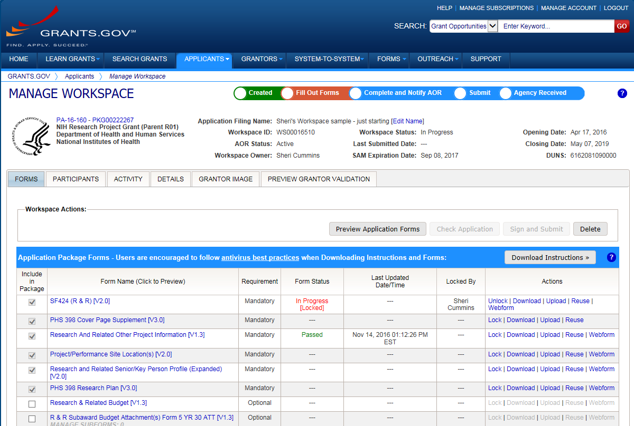
Application Submission Options
https://grants.nih.gov/grants/how-to-apply-application-guide/prepare-to-apply-and-register/choose-a-submission-option.htm
ASSIST
System-to-System
Workspace
Managed by NIH
Leverages eRA Commons accounts
Pre-population from eRA Commons profiles
Track application status in single system
Supports all NIH competing applications
Pull study information from ClinicalTrials.gov
Integrated NIH messaging (tips, system alerts)
Managed by Grants.gov
Requires additional user registrations
No Pre-population from existing profiles
Must track application in multiple systems
Supports all NIH single- project competing applications (no multi-project support)
Notes:
There are 3 primary methods for submitting competing grant applications: Grants.gov Workspace, a System-to-System (S2S) provider solution, and NIH ASSIST
Key considerations: 1) What submission method your institution uses and 2) What kind of application are you preparing
93% of NIH applications are submitted using NIH ASSIST or a System to System provider

Slide 7
Your Application will be…
Subject to the same registration requirements
Completed with the same data items
Routed through Grants.gov
Validated against the same NIH business rules
Assembled in a consistent format for review consideration
Tracked in eRA Commons
…regardless of submission option used.

Slide 8
Application Forms
There is NOT a universal set of application forms that can be downloaded from our form library or websites
You must use the application form package attached to your funding opportunity announcement
Each application form package includes the customized subset of forms supported by NIH which are needed for that opportunity
Application forms are accessed using your chosen submission method

Slide 9
Now Let’s Talk About the Application Process
Step 1: Find
Step 2: Plan
Step 3: Initiate
Step 4: Build team
Step 5: Enter data
Step 6: Finalize
Step 7: Submit
Step 8: Track
Notes:
We are now going to touch on the 8 major steps you must complete in order to successfully submit your application

Slide 10
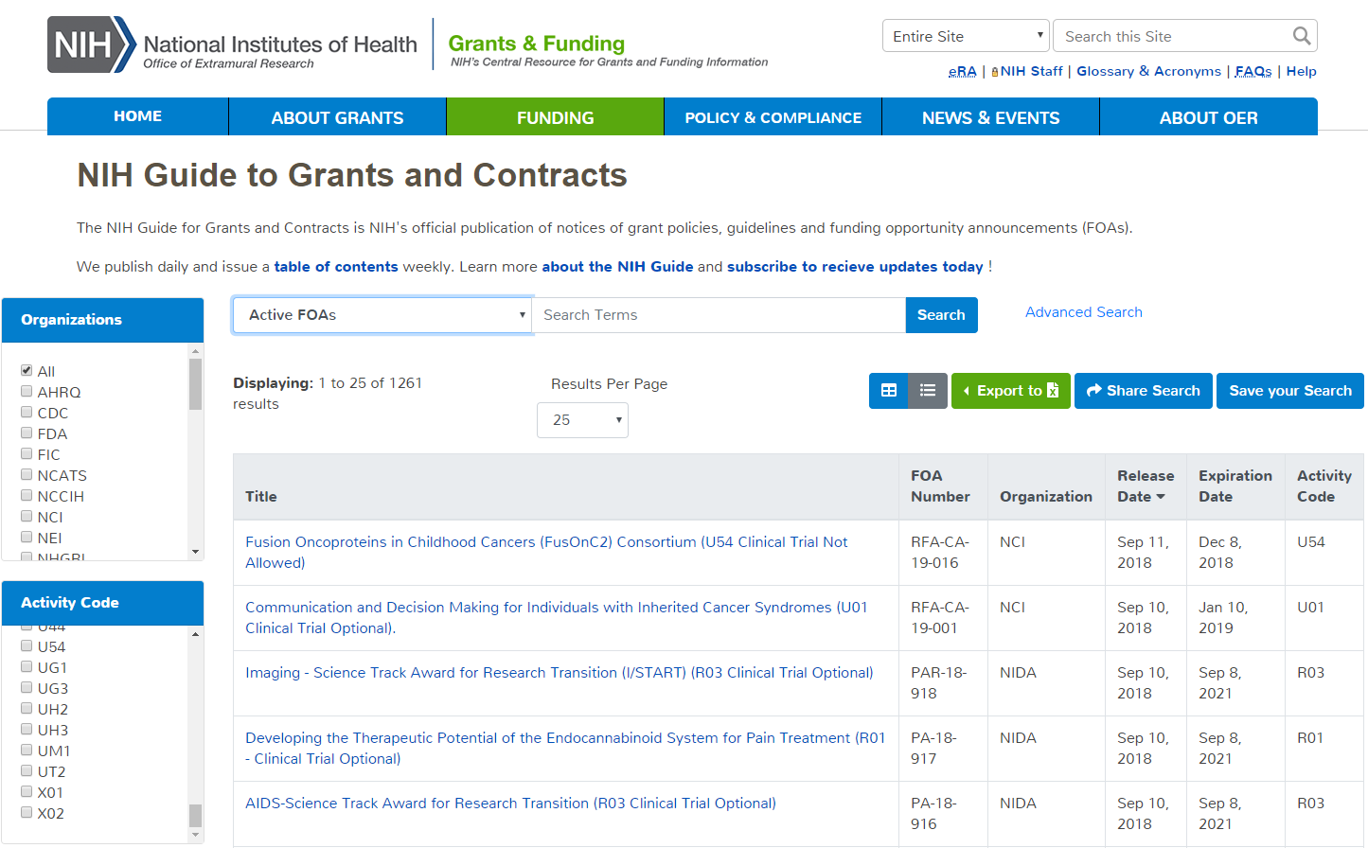
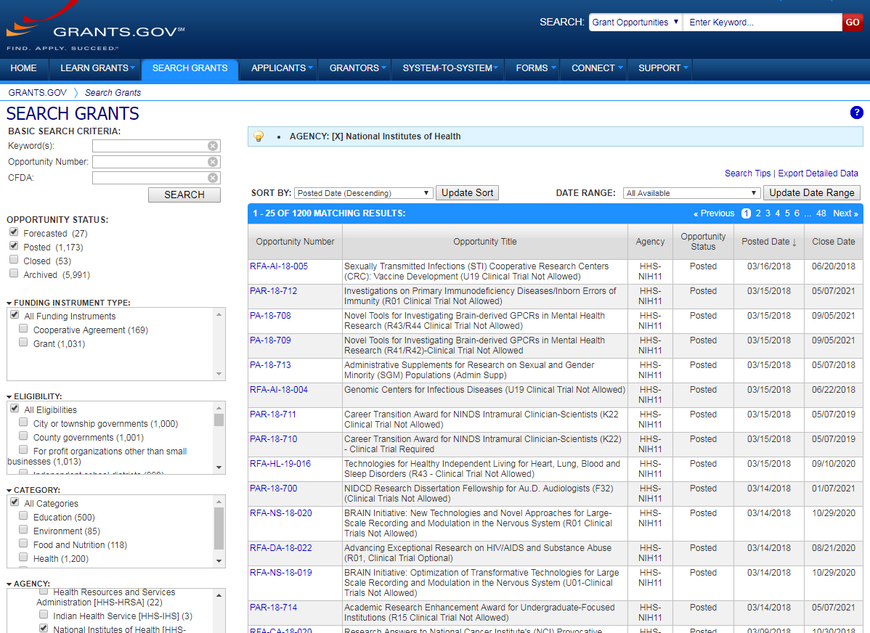
Step 1: Find an Opportunity of Interest
NIH Guide for Grants & Contracts
Grants.gov Search Grants
Notes:
First you must identify a funding opportunity announcement (FOA). We recommend looking at both NIH Guide for Grants&Contracts and Grants.gov Search for Grants. Each system has robust search capabilities. Grants.gov has the added benefit of returning opportunities for other funding agencies. For example, DOD has a number of opportunities that support breast cancer research

Slide 11
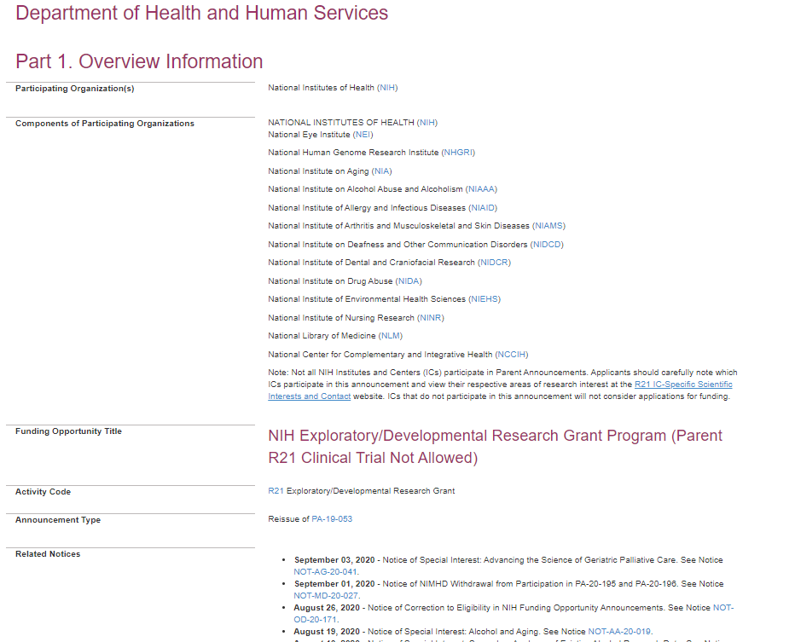
Funding Opportunity Announcement (FOA) Text
Carefully read full announcement
Participating Institutes
Check for updates in Related Notices
Notes:
FOAs all follow the same layout and you should read the ENTIRE announcement carefully focusing on the participating institutes and related Guide Notices or Notices of Special Interests (NOSIs) that are targeting the FOA for submission. This is important because we can assign an application to an institute if it does not support the FOA. Best to be remembered- Check for fit, before you submit.

Slide 12
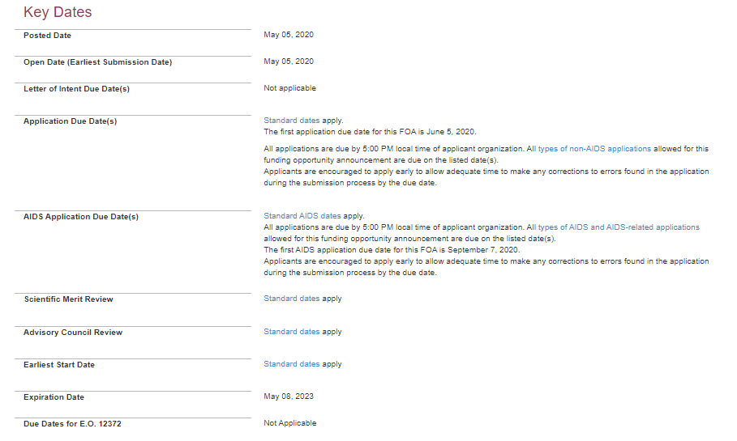
FOA Key Dates
Due Dates section links to standard dates web page or lists specific due dates
Notes:
The Application Due Dates portion of the Key Dates section will display the specific due date(s) or link to the NIH Standard dates web page. Here is a screenshot of a sample table of standard due dates from that web page. Shows the standard due dates for 3 cycles for new R01, U01, and K series applications. Note that the table will indicate if there are different standard due dates depending on your application type (i.e. new, revision, renewal).

Slide 13
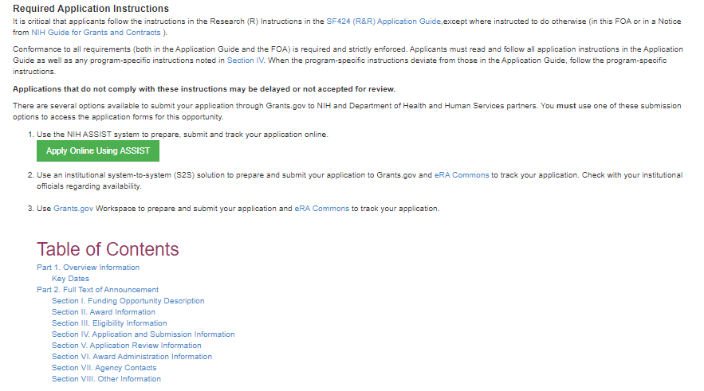
FOA Application and Submission Information
Link to Application Guide
Links to apply in ASSIST and Grants.gov Workspace
(if applicable)
Section I. Funding Opportunity Description
Program description
Check for fit before you submit!
Section II. Award Information
Includes Application Types allowed and Clinical Trial allowability indicator
Section III. Eligibility Information
Includes eligibility related to organizations and Program Director/Principal Investigator (PD/PI)
Section IV. Application and Submission Information
Includes any FOA-specific submission instructions
Section V. Application Review Information
Includes criteria that will be used evaluate scientific and technical merit through the NIH peer review system

Slide 14
Step 2: Plan for Your Submission
Identify team members
Verify registrations are in place and active
Choose submission method
Determine application preparation responsibilities
Who will – prepare budget, gather data, create attachments, do data entry
Make sure everyone is aware of process
Internal review & approval process
Post-submission responsibilities
How to deal with errors/warnings
Who will verify application in eRA Commons?
Notes:
One of my father’s favorite acronyms was PATSA-not pasta with a Boston accent by plan ahead to stay ahead. It is a really good idea to get everything in place like registrations and team members, and knowing who is going to What and when- before you start putting an application together. In terms of submission method- make sure you check with your sponsored research office before starting the application process.

Slide 15
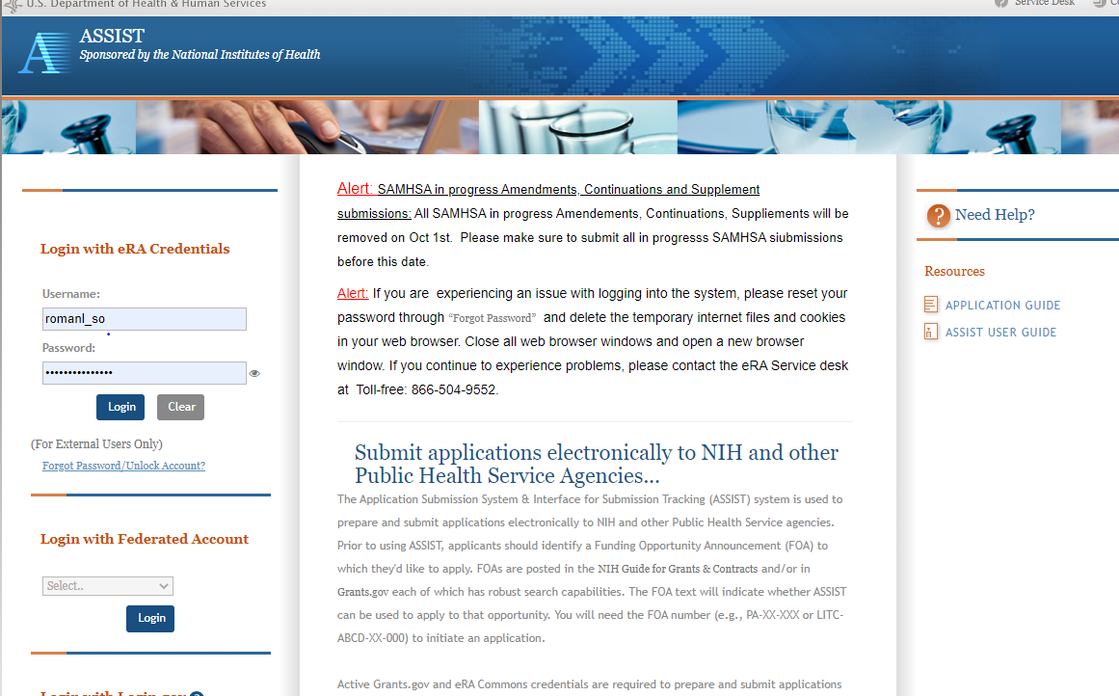
Step 3: Initiate Application
Login to your submission system and initiate your application and access the application forms
ASSIST | Workspace
Initiate Application | Create Workspace
Notes:
Regardless of the system- you have to start somewhere, whether it is initiate in ASSIST or create workspace at Grants.gov or whatever the process is for individual service providers

Slide 16
Step 4: Build Your Team
Provide application access to appropriate team members
Gather eRA Commons usernames to include in your application for the following individuals
Project Director/Principal Investigators (PD/PIs)
Component leads on a multi-project application
Sponsor on a fellowship application
Candidates for diversity and re-entry supplements
Primary mentor on individual mentored career development application
Can control access to specific sections of the application such as budgets
ASSIST | Workspace
Gather eRA Commons usernames and use Manage Access to give folks access | Gather Grants.gov usernames and use Participants tab to give folks access
Notes:
Both ASSIST and Workspace have specific features that allow you to give access for other people to work on the application. You can also use these tools to control the parts of the application they can view and edit. In ASSIST everyone who is added to work on the application must have a Commons ID. In addition to working on the application, other people associated with certain types of applications also have a Commons account

Slide 17
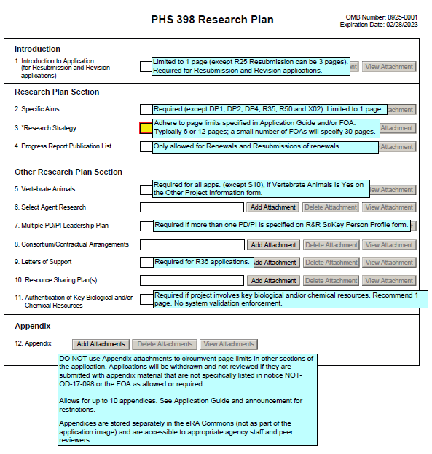
Step 5: Enter Data https://grants.nih.gov/grants/how-to-apply-application-guide.html
Follow All Guidance
Handy Resource
Notices in NIH Guide for Grants & Contracts including Notices of Special Interest (NOSIs)
Funding Opportunity Announcement
Section IV. Application and Submission Information
How to Apply - Application Guide
Annotated form sets
Precedence / Importance

Slide 18
Application Attachments https://grants.nih.gov/grants/how-to-apply-application-guide/format-and-write/format-attachments.htm
Use simple PDF-formatted files for all attachments
Disable security features such as password protection
Keep file names to 50 characters or less
Filenames must be unique within the application
Use meaningful filenames, especially for “Other Attachments”
Do not include headers or footers
Section headings as part of the text (e.g., Significance, Innovation, Approach) are encouraged
Follow specified page limits
Follow guidelines for fonts and margins
Follow guidelines for hyperlinks and URLs
Notes:
Hyperlinks and URLs are only allowed when specifically noted in funding opportunity announcement (FOA) and form field instructions. The use of hyperlinks is typically limited to citing relevant publications in biosketches and publication lists. It is highly unusual for a FOA to allow links in Specific Aims, Research Strategy and other page-limited attachments.
Hyperlinks and URLs may not be used to provide information necessary to application review.
Reviewers are instructed against viewing linked sites and are cautioned that they should not directly access a website (unless the link to the site was specifically requested in application instructions) as it could compromise their anonymity and allow for malware to be downloaded onto their computers.
When allowed, you must hyperlink the actual URL text so it appears on the page rather than hiding the URL behind a specific word or phrase. Example: NIH (http://www.nih.gov/)

Slide 19
Step 6: Finalize Your Application
Action | ASSIST | Workspace
6a. Run a pre-submission validation check | Validate Application | Preview Grantor Validation
6b. Generate a pre-submission image of your assembled application in the NIH format | Preview Application | Grantor Image
6c. Take any additional steps needed to prepare for Submission | Update Submission Status to “Ready to Submit” | Complete and Notify AOR (optional)
Notes:
After filling out all of the information on the forms, you should run the presubmission validations to make sure your application is complete and compliant. You can also see what the assembled grant application will look like by generating a pre-submission image. Always a good idea to check all of the attachments- we have gotten homework AND a margarita recipe!

Slide 20
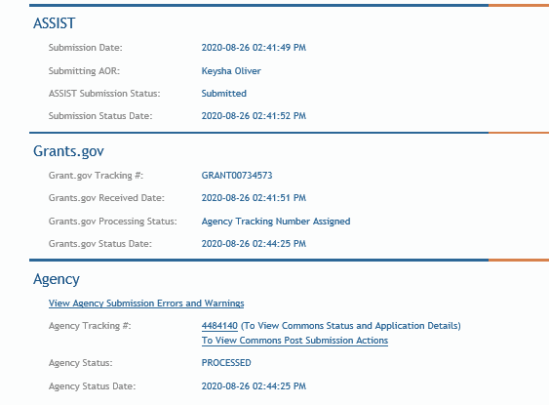
Step 7: Submit Your Application
Follow steps for your submission method
Only folks with Grants.gov AOR (Authorized Organization Representative) credentials can submit
All NIH applications route through Grants.gov
Your Grants.gov timestamp is used to determine “on-time” submission
Grants.gov Tracking #
Date/Time Stamp – always recorded in Eastern Time
Notes:
This is one of the most important steps in the process. Checking the status of your application. You can do that directly in ASSIST but must log into Commons if you submitted using Workspace or S2S systems

Slide 21
On-time Submission
Deadline = 5 p.m. local time of submitting organization on the due date
All registrations and SAM renewal must be completed before the deadline
Application must be free of all federal system-identified errors (Grants.gov & eRA)
NIH’s late policy does not allow corrections after the deadline
NIH recommends submitting early to allow time to correct any unexpected errors or submission issues
Notes:
Early is on a calendar NOT a clock

Slide 22
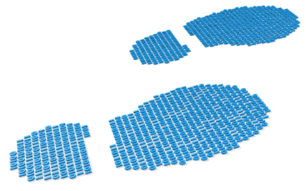
Step 8: Track Your Application
eRA Commons Status is an integral part of your submission
Applications that pass Grants.gov validations are picked up by eRA Commons and checked against many application guide and opportunity instructions
Authorized users can check eRA Commons Status for processing results
Signing Officials (SOs)
Administrative Officials (AOs)
Principal Investigators (PIs)
Delegated Assistants (ASSTs)
E-mail notifications sent
DO NOT depend solely on email notifications
It is YOUR responsibility to proactively check your application status in eRA Commons

Slide 23
Errors & Warnings
Corrective submissions must be made BEFORE the submission deadline and overwrite previous submissions
Errors stop application processing and must be corrected
Warnings do not stop application processing and are corrected at your discretion based on your circumstances

Slide 24
Correcting Errors Found After Submission https://grants.nih.gov/grants/how-to-apply-application-guide/submission-process/changed-corrected-application.htm
To correct system-identified errors found after submission:
Make corrections to local copy of the application
Update SF424 (R&R) form
Check “Changed/Corrected” as “Type of Submission”
Enter “Previous Grants.gov Tracking ID” (e.g., GRANT12345678) in field 4c
Submit the entire Changed/Corrected application back through Grants.gov before the deadline
Track submission through to eRA Commons
NOTE: Reviewers do not see applicant warnings, nor can they tell how many submission attempts were needed to complete the submission process

Slide 25
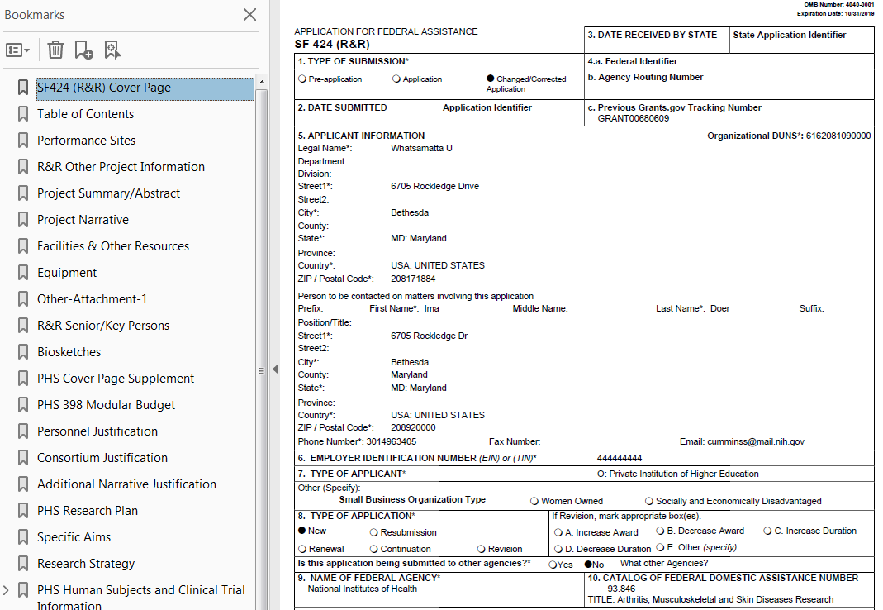
Application Assembled & Posted in eRA Commons
Once an error-free application is received by NIH, the eRA system will:
Assemble the grant application image
Insert headers (PI name) and footers (page numbers) on all pages
Generate Table of Contents and bookmark important sections
Post the assembled application image in the PD/PI’s eRA Commons account
Send notifications

Slide 26
Application Viewing Window https://public.era.nih.gov/commons
Applicants have two (2) business days to view the assembled application image before the application automatically moves forward for further processing
SO can Reject application within viewing window to prevent it from moving forward to NIH staff
Can submit a Changed/Corrected application before the submission deadline
ASSIST | Workspace
View Submission Status Details link | Must login to eRA Commons directly and access the application’s detailed status screen

Slide 27
Submission Complete!
If you don’t reject within the two business day viewing window, the application automatically moves forward for further processing at NIH
Any subsequent application changes are subject to the NIH policy on late submission of grant applications and the NIH policy on post-submission application materials

Slide 28
Application Checks (Validations)
Grants.gov
eRA Systems
Agency Staff
Active System for Award Management (SAM) registration
Submitter has AOR role for DUNS on application
Submission made to active opportunity and application package
Virus check
Filenames include only appropriate characters
Fields required by agency, but not required federal-wide
R&R Senior/Key form
Credential for PD/PIs
Organization name for all sr/key
Biosketch for all sr/key
Performance Site form
DUNS for primary site
Attachments in PDF format
Adherence to page limits in our Table of Page Limits
All appropriate attachments included
Fit with NIH/Institute mission
Eligibility
“Overstuffing”
On-time submission
Adherence to funding opportunity announcement specific instructions
Font, margin, and hyperlink guidelines
Simultaneous review of essentially same application
Notes:
All grant applications will go through multiple levels of checks and validations as part of the submission process. Some are automatic system validations while others are completed as part of a manual review.
Applications will first encounter system validations from Grants.gov. These are primarily fed-wide level requirements and some higher-level validations (e.g. checking if the FOA and application forms package active).
Applications will also encounter system validations from eRA systems based on agency-level requirements.
After the application is submitted in the system, agency staff will also conduct a manual evaluation on requirements that cannot be easily systematically validated prior to assignment and peer review. Even if an application passes all system validations for submission, an application may still be withdrawn if it does not pass these checks.

Slide 29
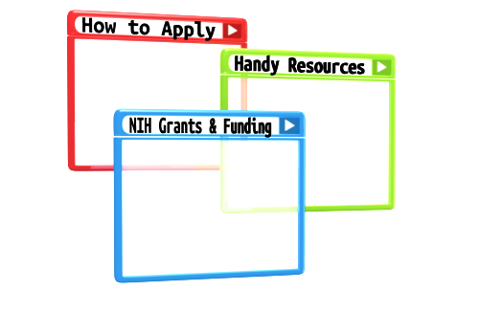
Resources

Slide 30
Help Desks
Grants.gov Contact Center
eRA Service Desk
Toll-free: 1-800-518-4726
Hours : 24x7 (Except Federal Holidays)
Email : support@grants.gov
Resources: https://www.grants.gov/web/grants/support.html
Web: https://grants.nih.gov/support/
Phone: 1-866-504-9552
Hours : Mon-Fri, 7a.m. to 8 p.m. ET

Slide 31
Online Resources & Websites
NIH Grants and Funding https://grants.nih.gov/grants/oer.htm
How to Apply – Application Guide https://grants.nih.gov/grants/how-to-apply-application-guide.html
Annotated form set https://grants.nih.gov/grants/how-to-apply-application-guide/resources/annotated-form-sets.htm
Preparing Your Application Using ASSIST https://grants.nih.gov/grants/how-to-apply-application-guide/prepare-to-apply-and-register/submission-options/assist.htm

Slide 32
Stay Connected – Subscribe to Listservs https://era.nih.gov/about-era/get-connected.htm
eRA-Information-L
For administrators, principal investigators and the people that support them
Used by NIH to notify the community of information related to eRA Commons, ASSIST and eSubmission
NIH_ESUB_SYS2SYS-L
For technical personnel involved in system-to-system solution development and planning
Used to exchange information related to the implementation of system-to-system solutions for grant application preparation and submission to NIH
ASSIST-Development-L
For ASSIST users willing to share their individual perspectives on proposed ASSIST enhancements and options for addressing identified system issues

Slide 33
Questions?

