Slide 1
Finding and Understanding Funding Opportunity Announcements (FOAs)
Fall 2020
Notes:
Finding and Understanding Funding Opportunity Announcements

Slide 2
Funding Opportunity Announcements (FOAs) are used to advertise grant opportunities.
Notes:
We use funding opportunity announcements, or FOAs, to advertise our grant opportunities.
They contain all the information you need to successfully submit a grant application to NIH.

Slide 3
FOA types
FOA types
Requests for applications (RFAs)
Parent Announcements
Program Announcements (PAs)
Notices of Special Interest (NOSIs)
Notes:
We post several types of FOAs, including Requests for Applications or RFAs, Parent Announcements, and Program Announcements or PAs.
We also use notices of special interest to highlight research topics.

Slide 4
Requests for Applications
Requests for Applications (RFAs)
Narrowly defined scope
Set-aside funds
Often a single receipt date
Notes:
Requests for Applications have a narrowly defined scope. The participating ICs set aside funds in their budgets to award applications submitted to each RFA. The award information section of the RFA indicates the number of expected awards and/or the amount of funding that’s been set aside.
RFAs often have a single receipt date and may not be posted again.

Slide 5
Parent Announcements
Parent Announcements
Many NIH institutes and centers (ICs) participate
For “investigator initiated” or “unsolicited” research
No area of research specified
Use standard due dates
Notes:
Many ICs participate in our parent announcements which are used for investigator initiated or unsolicited research.
They don’t specify a particular area of research. They simply provide the infrastructure and information needed to submit a research proposal.
They use a standard due date schedule that defines three submission, review, and award cycles per year. They are posted for up to three years and are then reissued.

Slide 6
Flavors of Parent Announcements
Parent Announcements for …
Research
Fellowship
Career Development
Training
Administrative Supplements
Post-award administrative actions
Notes:
We have parent announcements for research grants, fellowship, career development, administrative supplements and post-award administrative actions like a change of institution request.

Slide 7
Clinical Trial Specific Parent Announcements
Clinical trial-specific
Parent Announcements.
Notes:
And, we have different parent FOAs depending on whether or not applications are allowed to propose clinical trials.

Slide 8
Program Announcements
Program Announcements (PAs)
Highlights areas of focus
Usually ongoing (3 yrs)
Use standard receipt dates
Special types
PAR – PA with special receipt/referral/review
PAS – PA with set-aside funds
Notes:
Unlike the parent announcements, our program announcements or PAs highlight areas of focus.
They are typically on-going programs posted in increments of up to three years.
They use the same standard due date schedule as parent announcements, unless they are identified as a PAR, a program announcement with special receipt, referral or review considerations.
Applications to parent announcements and program announcements all compete for the same funding. They don’t have set-aside funds, unless they are identified as a PAS which is a program announcement with set-aside funds.

Slide 9
Notices of Special Interest
Notices of Special Interest (NOSIs)
Highlight areas of scientific interest
Designate existing FOAs to use for application submission
Increasingly used instead of program announcements
Notes:
Notices of Special Interest or NOSIs highlight a specific topic of interest, area of research, or program in a concise format and direct applicants to one or more active funding opportunity announcements (often parent announcements) for standard information. The NOSI includes the unique aspects of the opportunity, while the designated FOAs for submission include all the standard application, review, and administration details required of an official opportunity announcement.
Most non-parent program announcements will be issued as NOSIs going forward. The use of NOSIs simply streamlines how NIH announces an area of scientific interest. It in no way diminishes our interest in these topics.

Slide 10
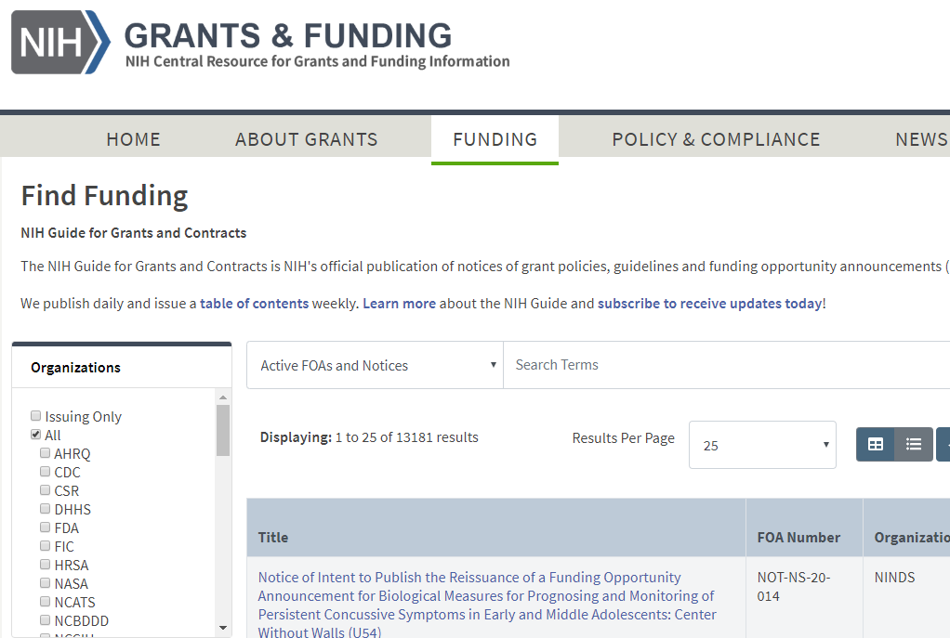
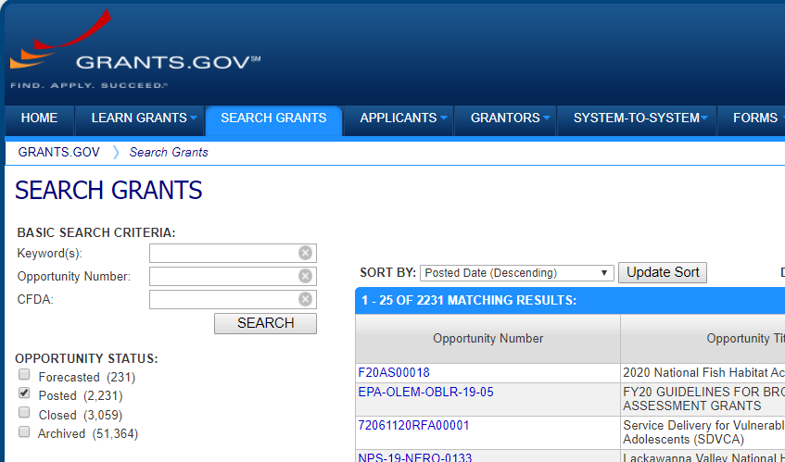
Where we post funding announcements
NIH Guide to Grants & Contracts
Grants.gov
Notes:
You can find all NIH opportunities in the NIH Guide for Grants & Contracts or NIH Guide for short. Our FOAs are also found in Grants.gov which is the federal-wide portal for all grant making agencies.
Both the NIH Guide and Grants.gov have robust search capabilities and I recommend searching both sites.

Slide 11
Grants.gov
FOAs for all federal grant-making agencies
Notes:
Since Grants.gov is federal-wide, you may find opportunities at other agencies you won’t find in the Guide.

Slide 12
NIH Guide
FOAs
Notices
Notices of special interest
Policy updates
Changes to FOAs
Webinars and training events
Notes:
In the NIH Guide, in addition to the FOAs advertised in Grants.gov, you’ll also find notices, including notices of special interest, policy updates, changes to FOAs, webinars and training events and more.

Slide 13
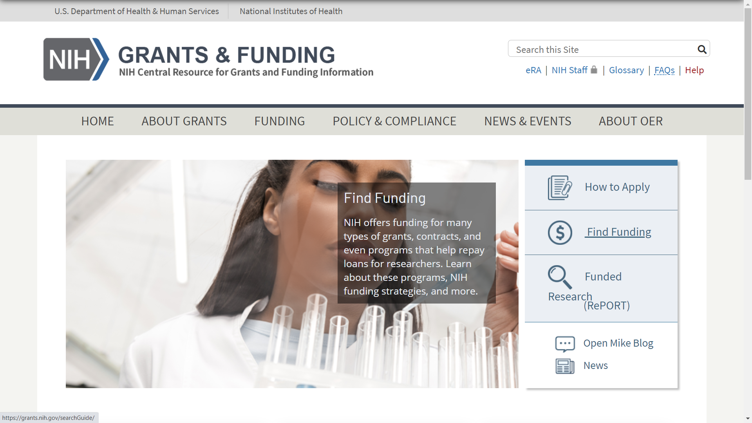
Where to find NIH Guide
Notes:
You can easily get to the NIH Guide from our grants.nih.gov website using the Funding tab in the top navigation or the Find Funding link on the righthand side of the page.

Slide 14
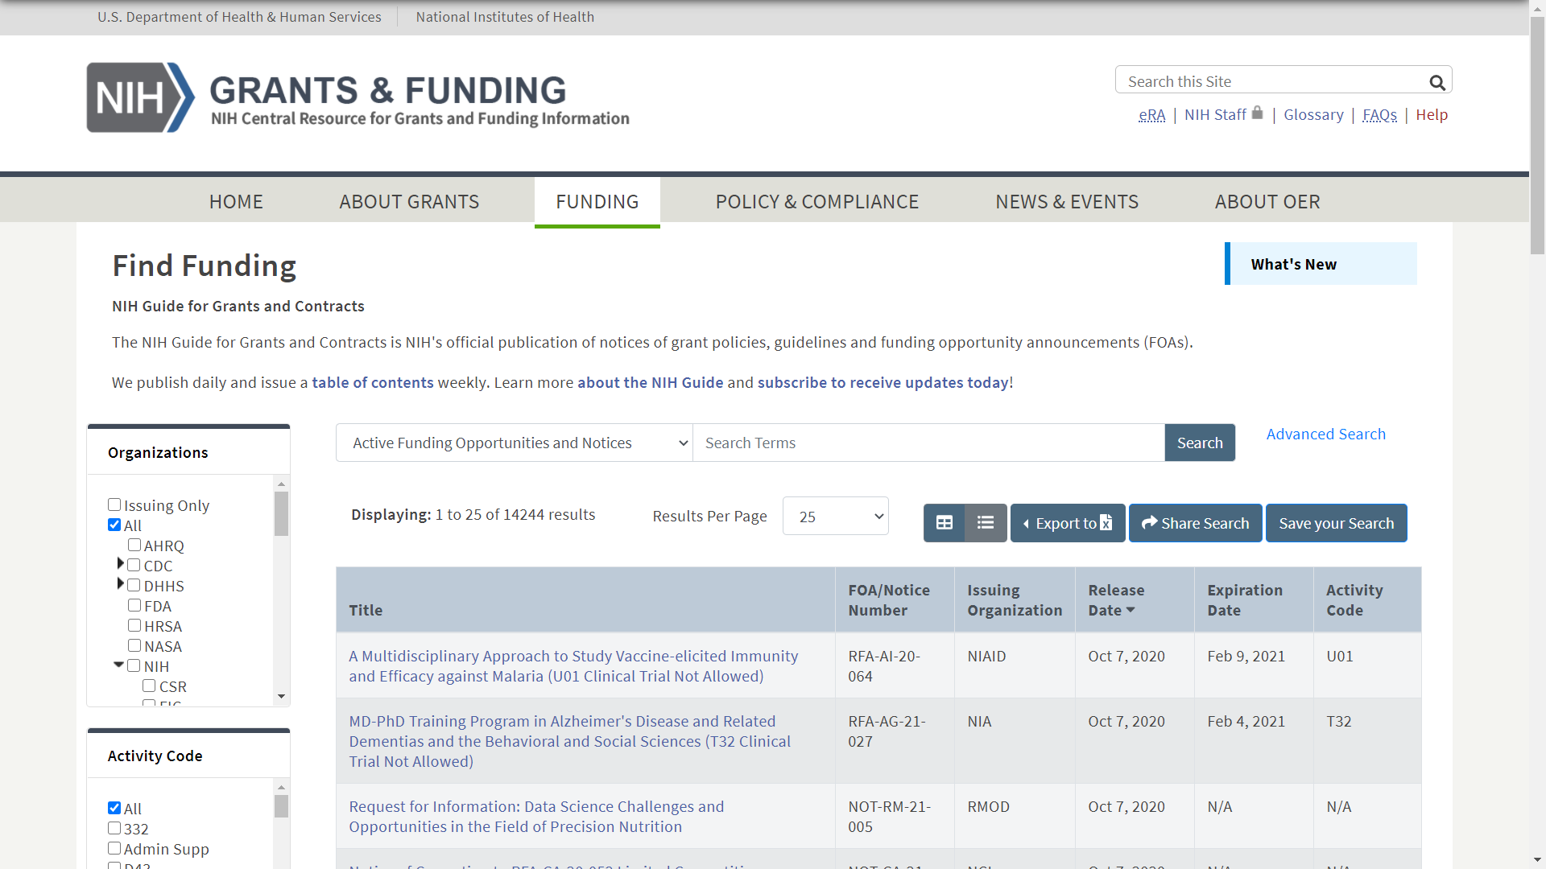
NIH Guide Searching
Notes:
In the NIH Guide search screen you can do a simple keyword search

Slide 15
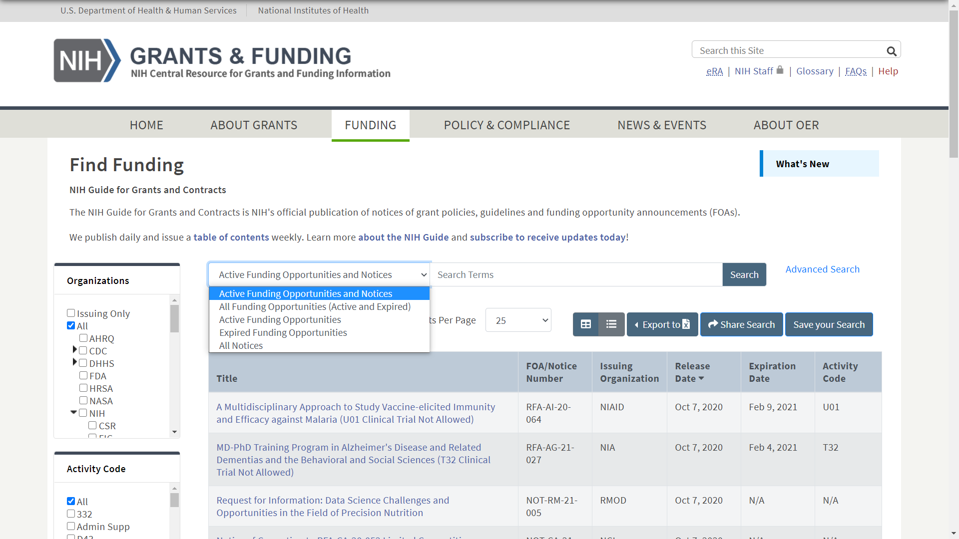
NIH Guide Searching
Notes:
and you can control the items searched to add or remove expired opportunities or limit your search to funding opportunities or notices. Note that since NOSIs are a bit of a hybrid, they are listed under both funding opportunities and notices.

Slide 16
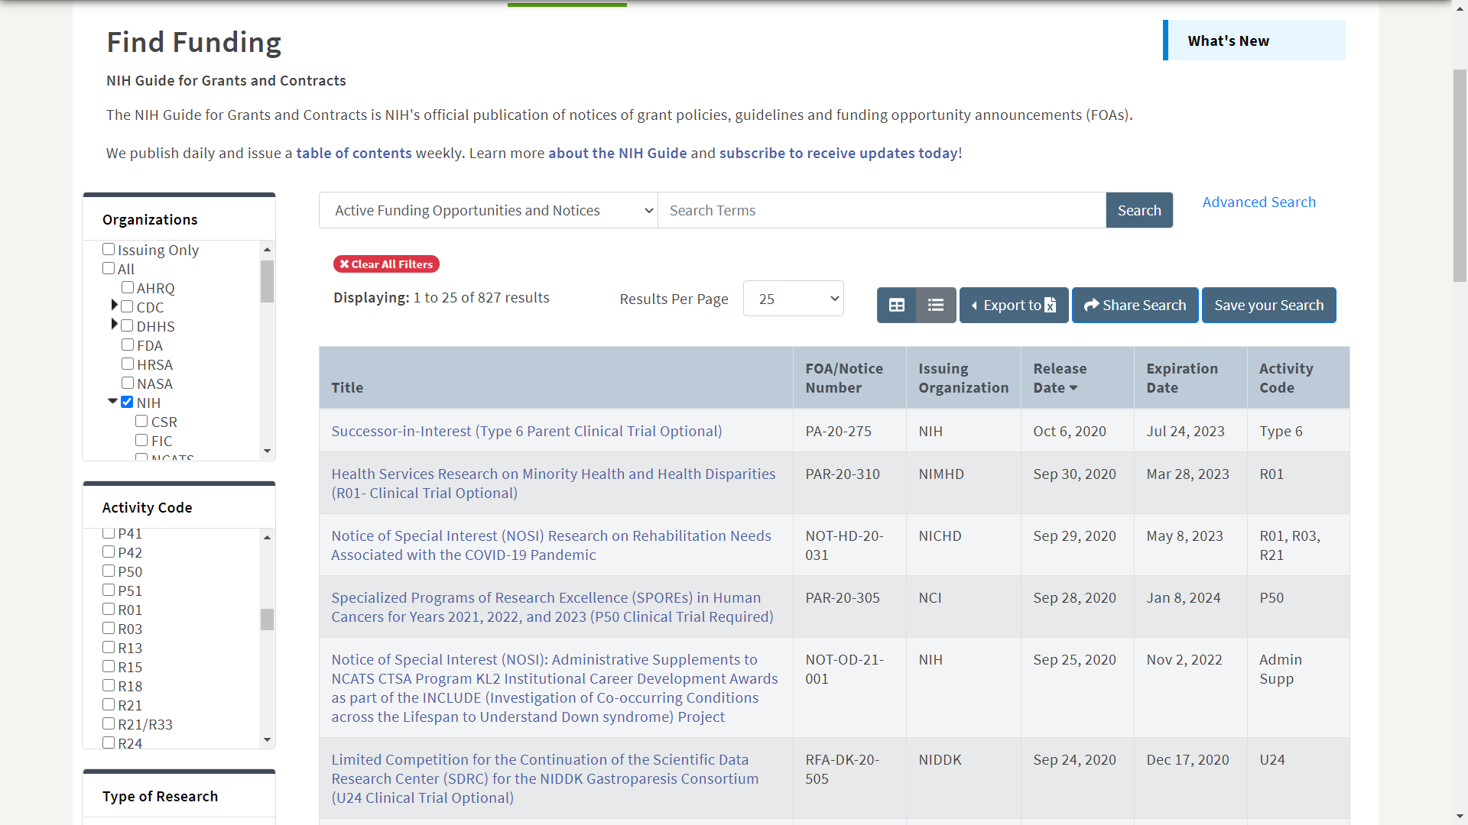
NIH Guide Searching
Notes:
We have additional filters that can be used to narrow your search results including organizations, activity codes, whether clinical trials are allowed, type of funding opportunity, and release date range.
At the top of the search screen there are options to Export your results to Excel, share your search query, or save your search and have updated search results emailed to you on a daily, weekly, or monthly basis.

Slide 17
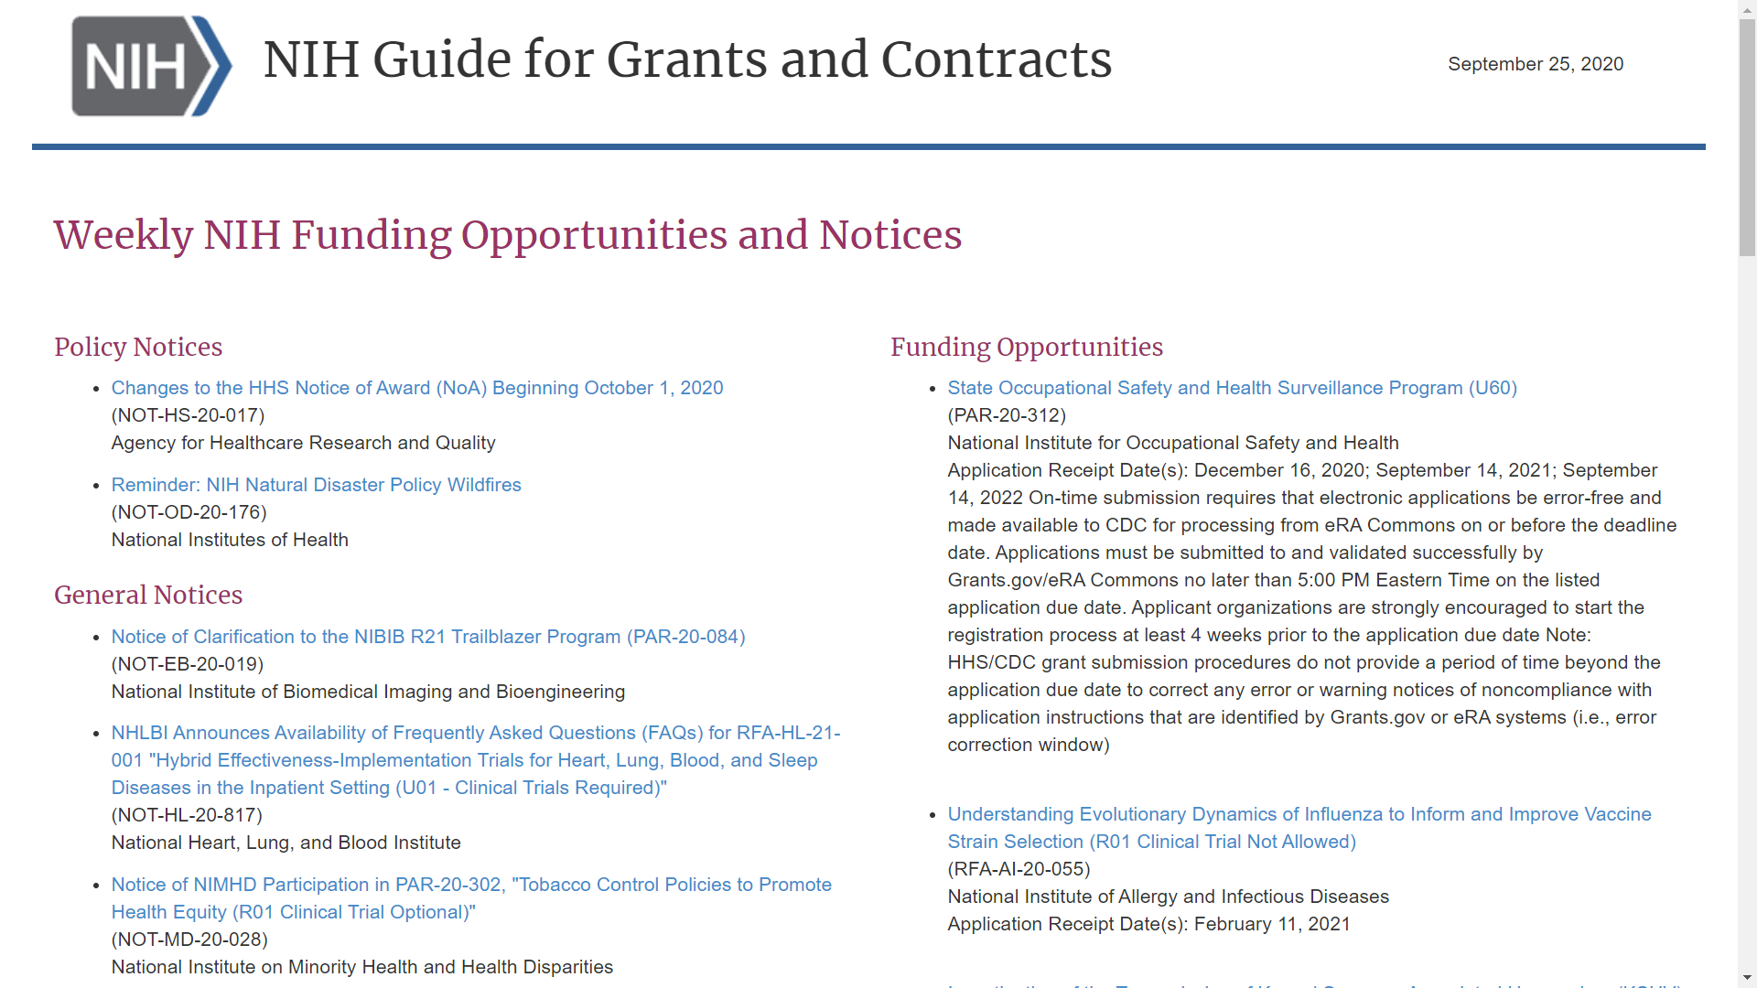
Sample Weekly Guide Email
Notes:
To stay informed of our latest NIH Guide postings, I recommend subscribing to our weekly emails that summarize the postings for the week. You’ll find the links to subscribe under the News and Events tab on the grants.nih.gov site.

Slide 18
Let’s take a closer look at a Funding Opportunity Announcement
Notes:
Let’s take a closer look at a funding opportunity announcement.

Slide 19
FOA Table of Contents
Part 1. Overview Information
Part 2. Full Text of the Announcement
Section I. Funding Opportunity Description
Section II. Award Information
Section III. Eligibility Information
Section IV. Application and Submission Information
Section V. Application Review Information
Section VI. Award Administration Information
Section VII. Agency Contacts
Section VIII. Other Information
Notes:
Each FOA has the same basic structure as shown in the this FOA Table of Contents.
Part 1 contains overview information.
And, Part 2 has detailed information with sections for description, award information, eligibility, application and submission, application review, award administration and agency contacts.

Slide 20
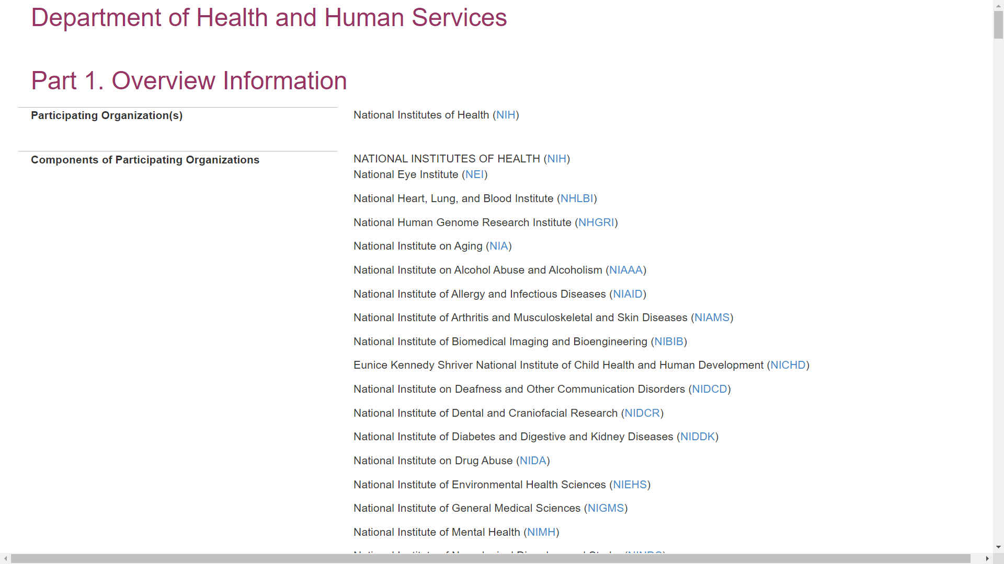
Sample FOA (Parent R01, CT not allowed
Notes:
I’ll use one of our parent R01s as a sample.
At the top in Part 1, you’ll find all the participating organizations with links to their websites. Make sure your proposal fits within the mission of one of the NIH Institutes or Centers listed in the FOA. If applying to a NOSI but using the FOA for submission, you’ll want to check the participating organizations in the NOSI since the initiative would only apply to the organizations listed in that notice.

Slide 21
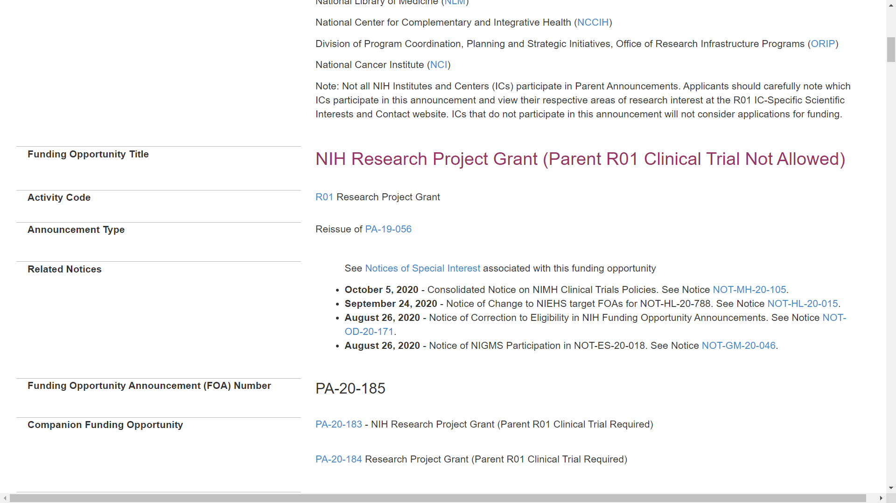
Sample FOA (Parent R01, CT not allowed
Notes:
Scrolling down, you’ll find the funding opportunity title. Most titles include the activity code and an indication of whether clinical trials are allowed.
The 3-character activity code used to identify the program, in this case R01, is repeated in its own field.
The Announcement Type indicates whether it is a new initiative or a reissue of a previous announcement.
The Related Notices section includes policy updates and any corrective notices. If the FOA is used for the submission of applications to NOSIs, there’s also a link to a table of those associated NOSIs.

Slide 22
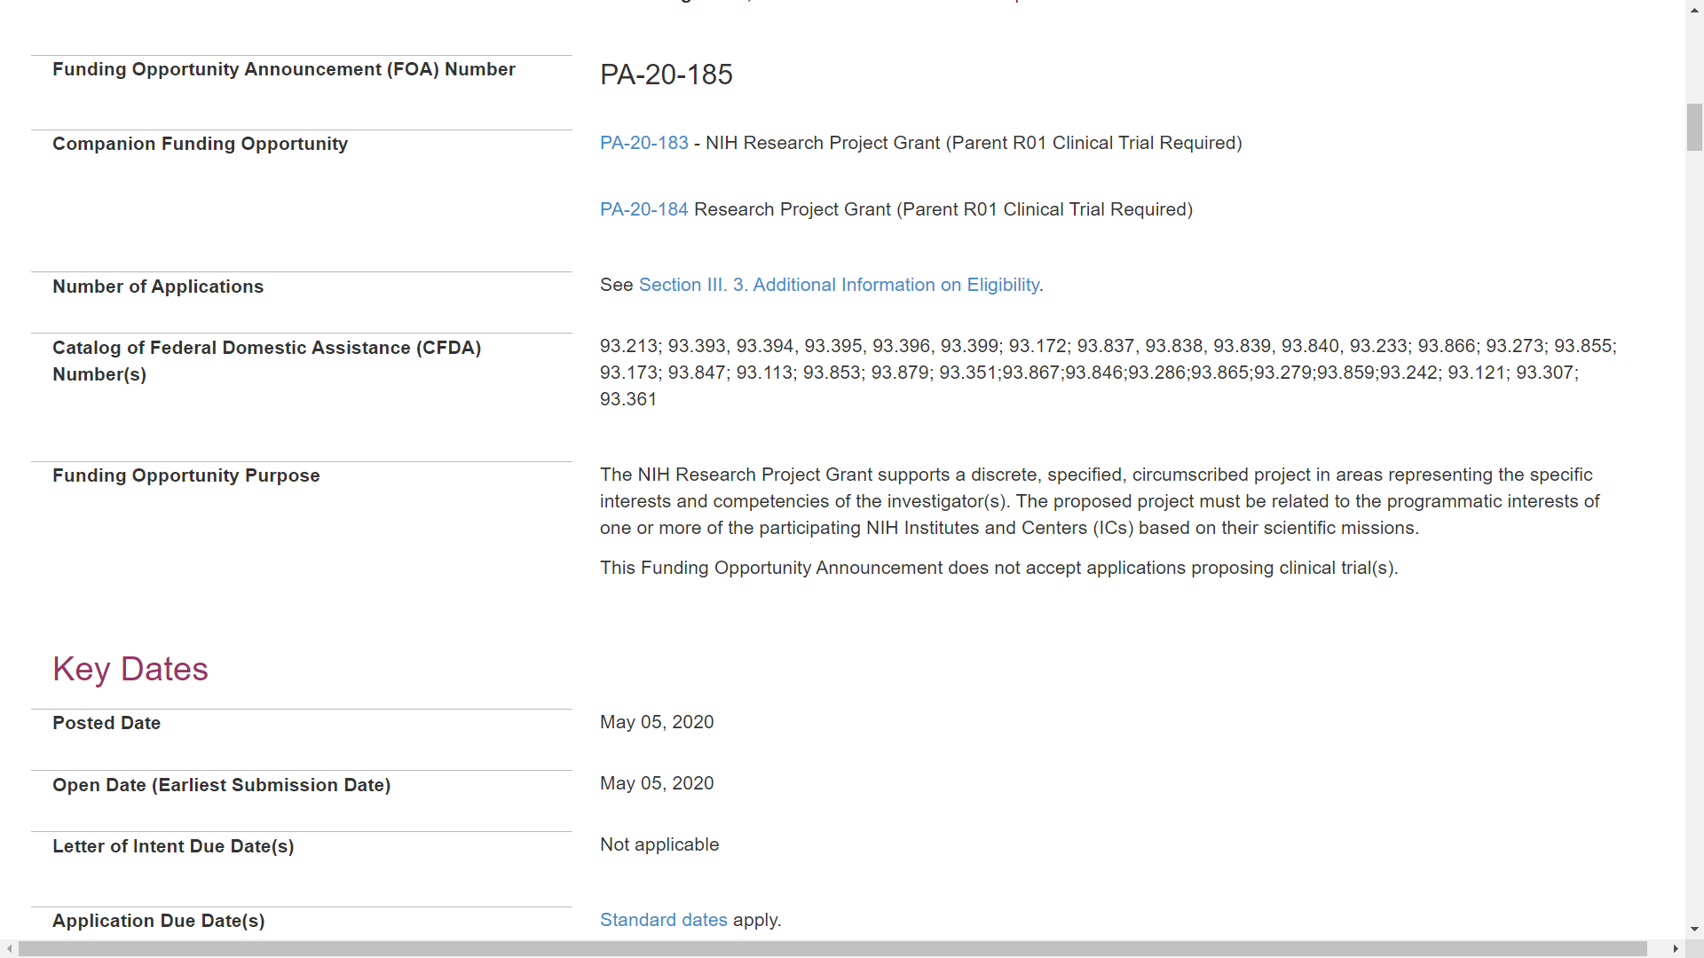
Sample FOA (Parent R01, CT not allowed
Notes:
A unique FOA number is assigned to each announcement. You’ll use this number within your submission system to identify the opportunity and associated application forms.
The Companion Funding Opportunity section includes other FOAs within the same initiative that vary by activity code or clinical trial indicator.
There is a high-level summary of the funding opportunity purpose.

Slide 23
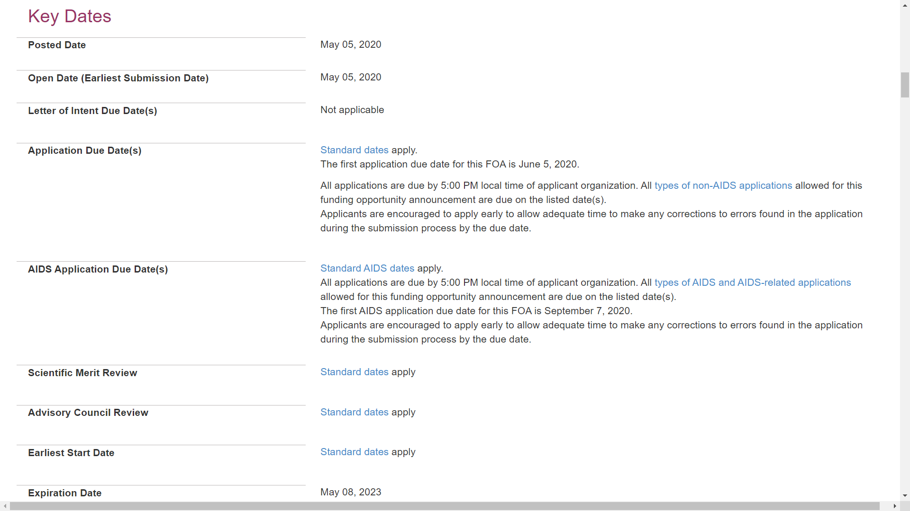
Sample FOA (Parent R01, CT not allowed
Notes:
And then a Key Dates section.
The Open Date is the first date our systems will accept applications. It’s typically 30 days before the first due date.
Letters of Intent are not required, though they are helpful for planning purposes. When requested, we typically ask for them at least 30 days prior to the due date.
The next series of dates – application due dates, AIDS due dates, review dates and earliest start date, will either list specific dates or link to that standard due dates schedule we mentioned for parent announcements and most PAs.
And finally, the expiration date indicates the opportunity is no longer active. Note that our systems are configured to accept applications for a short time beyond the expiration date to receive applications under our continuous submission, late application and system issue policies. These submission policies can be found on our grants.nih.gov website.

Slide 24
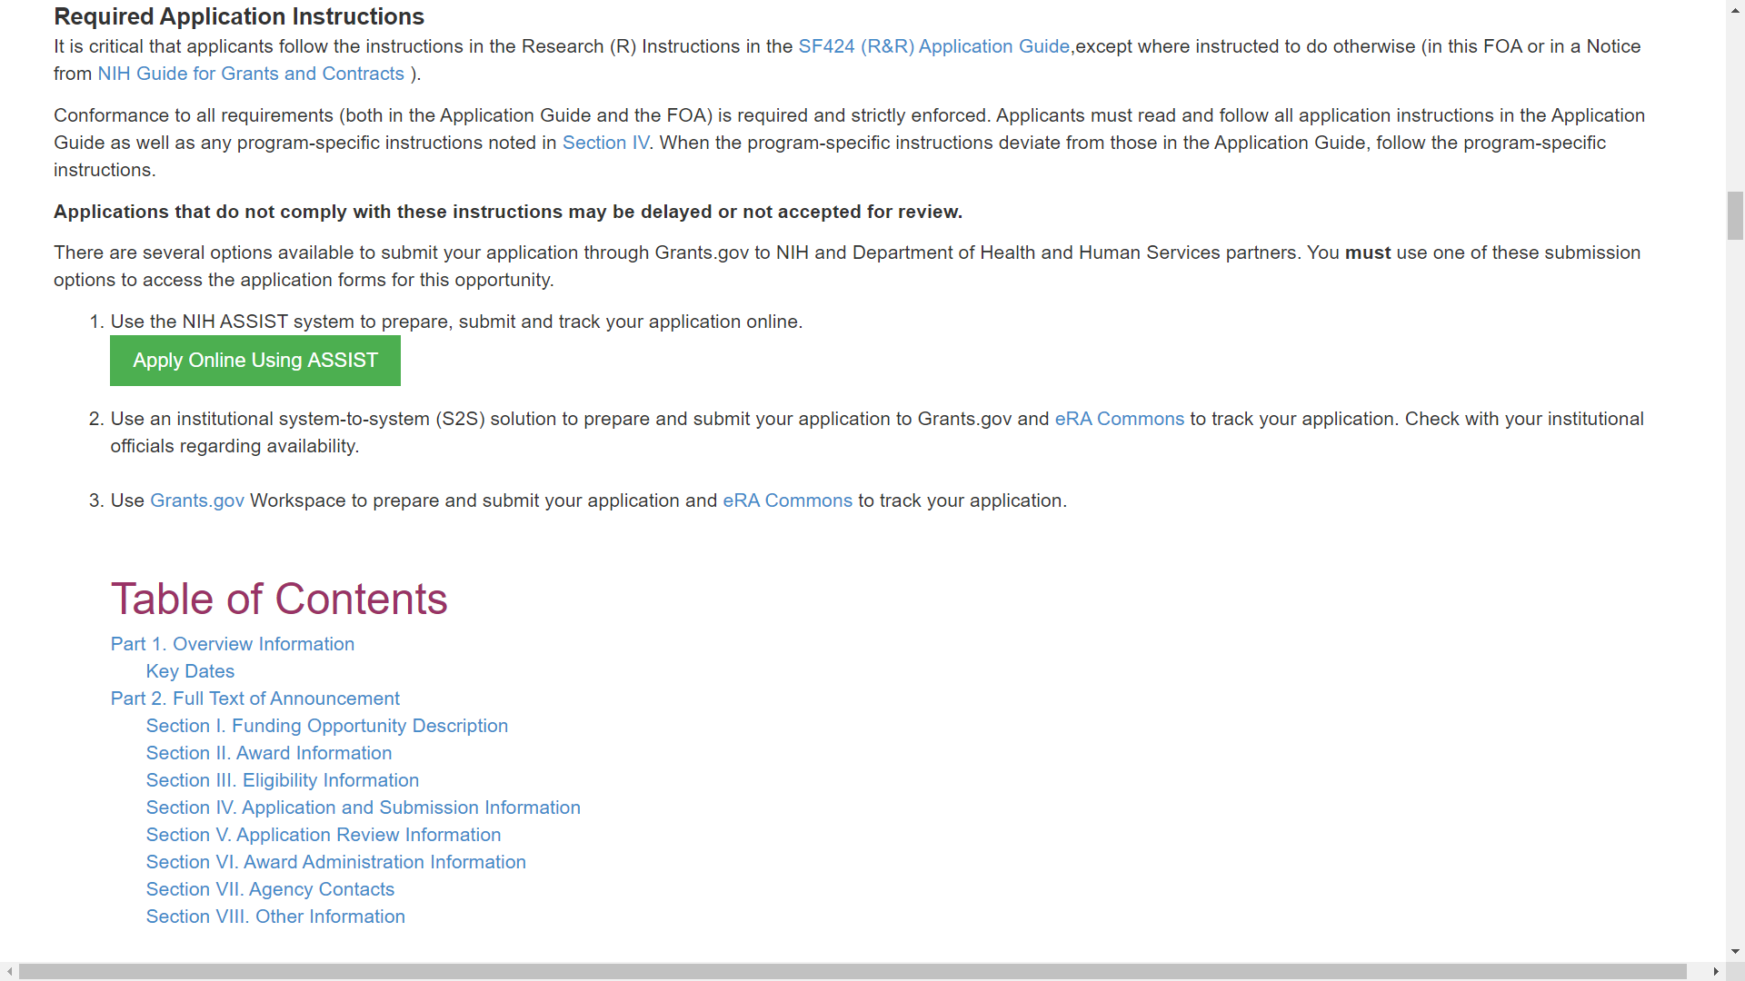
Sample FOA (Parent R01, CT not allowed
Notes:
The FOA includes a link to our general application guide. Applicants must follow the guidance in the application guide, but also the guidance in the FOA, and NIH Guide notices, including those notices of special interest. If the opportunity-specific instructions in the FOA conflict with the general instructions in the application guide, then the FOA wins. If instructions in a Guide notice conflict with either the application guide or the FOA, the notice wins.
Just above the table of contents you will find the available options to access, prepare, and submit your application. For most opportunities, the options include ASSIST, Grants.gov Workspace, or an institutional system-to-system solution. Grants.gov’s Workspace doesn’t support our large multi-project application structure, however so you will only see ASSIST and institutional S2S solutions listed in multi-project FOAs.

Slide 25
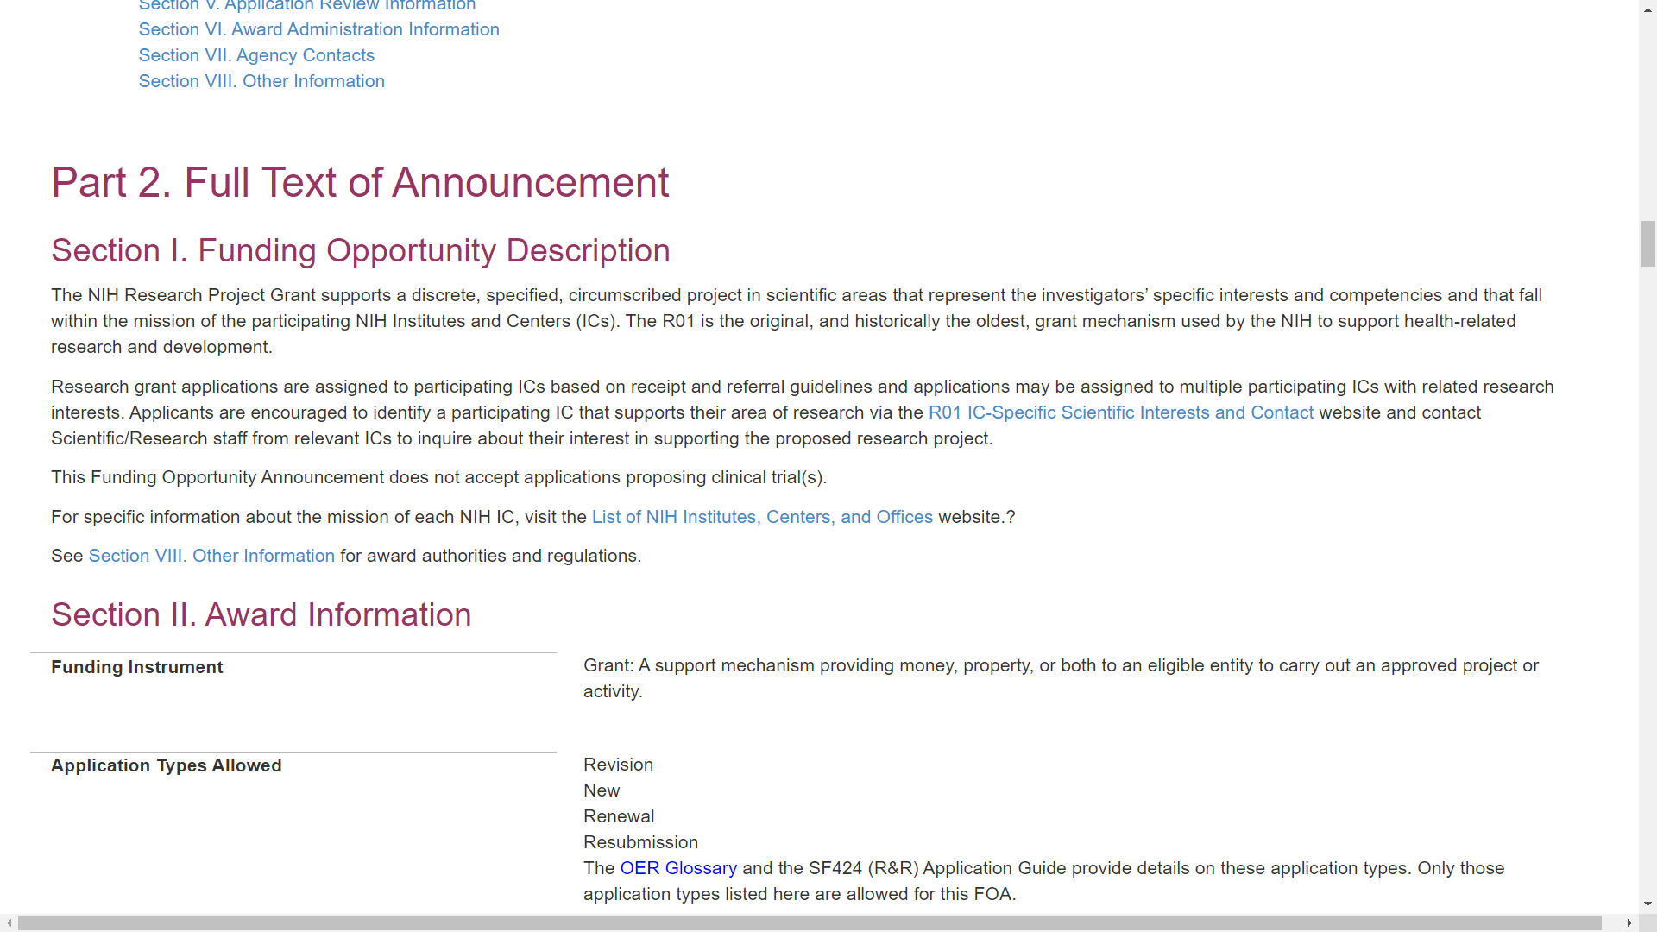
Sample FOA (Parent R01, CT not allowed
Notes:
Part 2 contains the full text of the announcement.
Section 1. Funding Opportunity Description, includes the goals of the FOA, relevant background, why its important, and research objectives. In the case of RFAs, PAs, and PARs, it may also include criteria that would make an application non-responsive to the opportunity. If non-responsive criteria are included, it’s a good idea to reach out to the Scientific/Research contact to discus your proposal and its fit with the opportunity.

Slide 26
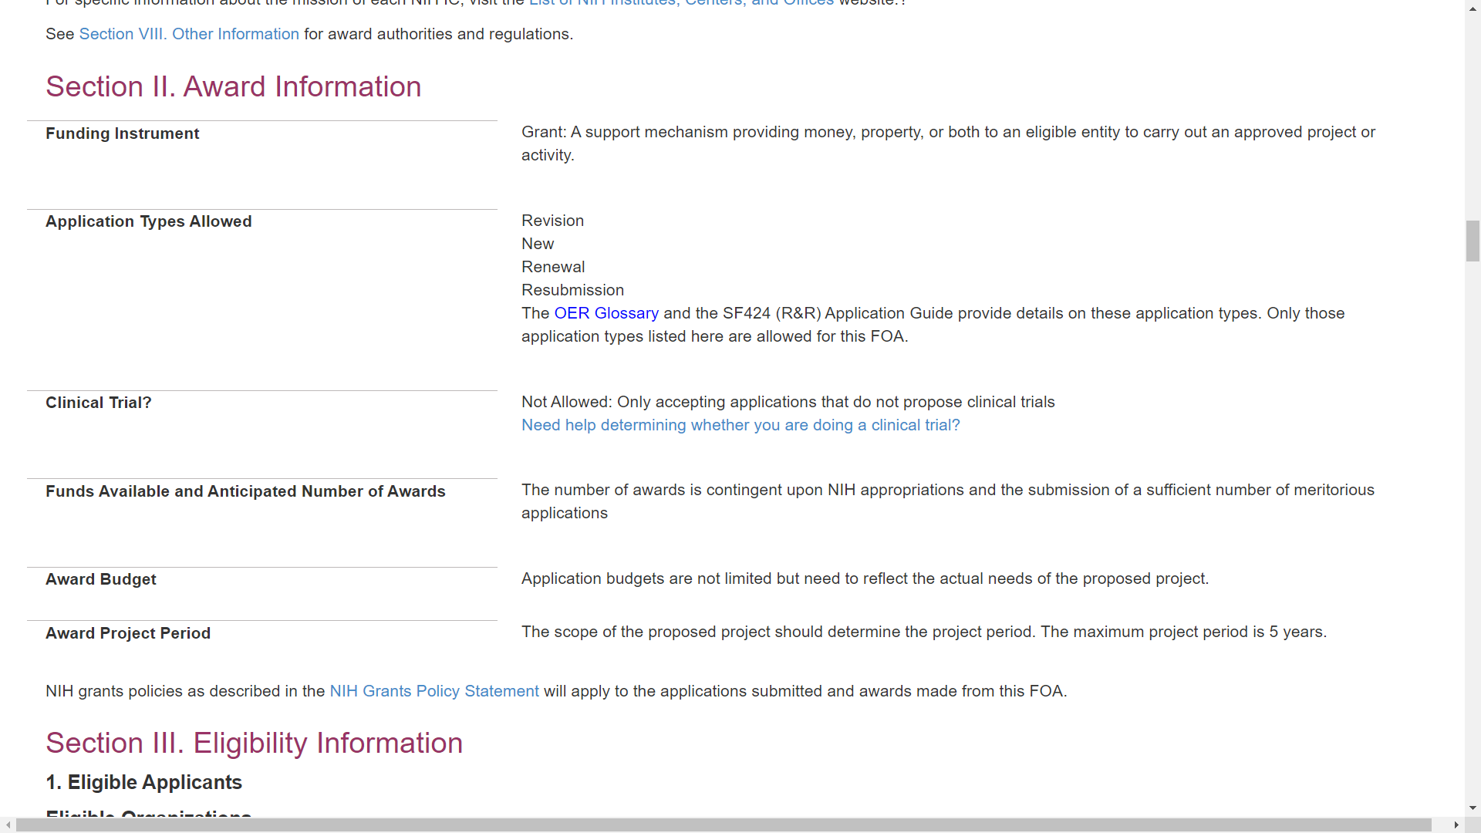
Sample FOA (Parent R01, CT not allowed
Notes:
Section II has award information.
It indicates the funding instrument – typically grant or cooperative agreement.
The application types allowed – New, Renewal, Revision and Resubmission – with a glossary link to explain the various types.
Any application that includes one or more clinical trials must be submitted to an FOA configured to accept them. The Clinical Trial Indicator will display one of four options: Not Allowed, Required, Optional or Required-Basic Experimental Studies with Humans or BESH. If applying to a BESH FOA, your clinical trial must also meet NIHs definition of basic research which you can also find in our glossary.
We talked about RFAs and PASs having set-aside funds. These FOAs will include the number of awards and/or total budget commitment.
You’ll find any direct cost or project period limits for all our FOAs, as well. Allowed project periods vary by program with most being 5 years or less.

Slide 27
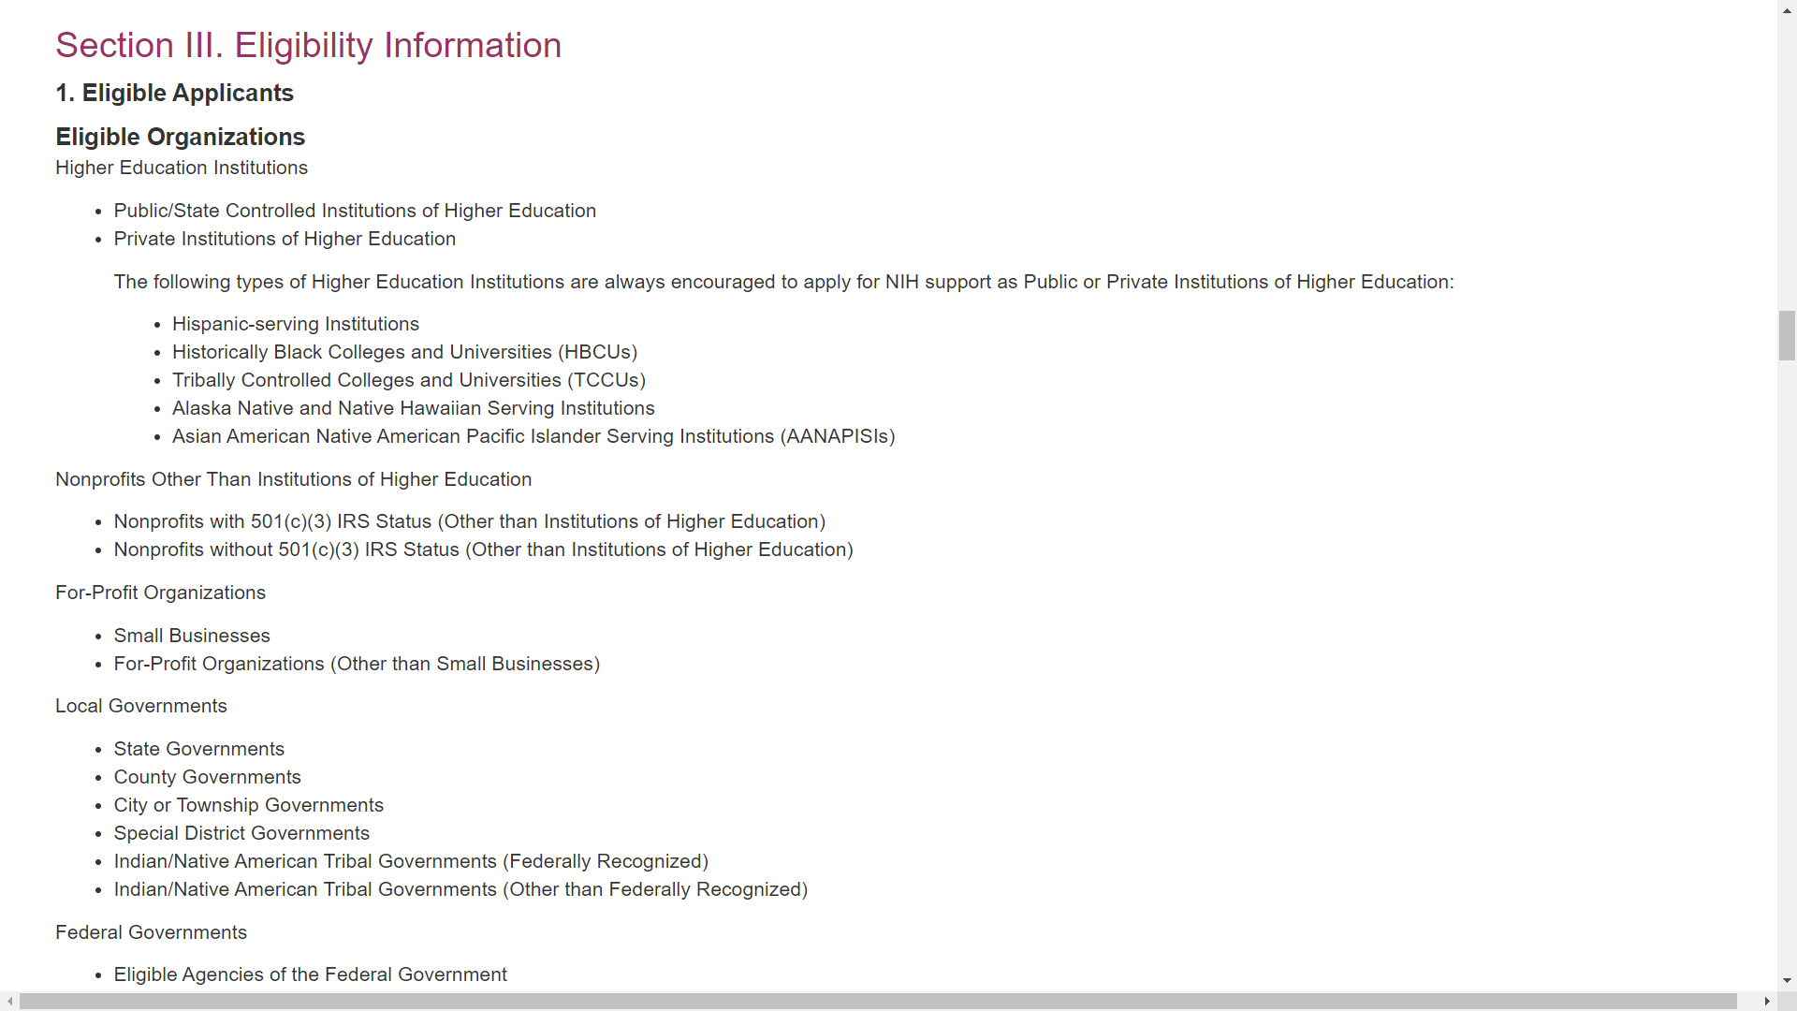
Sample FOA (Parent R01, CT not allowed
Notes:
Moving on to Section III Eligibility, we list the types of eligible organizations,

Slide 28
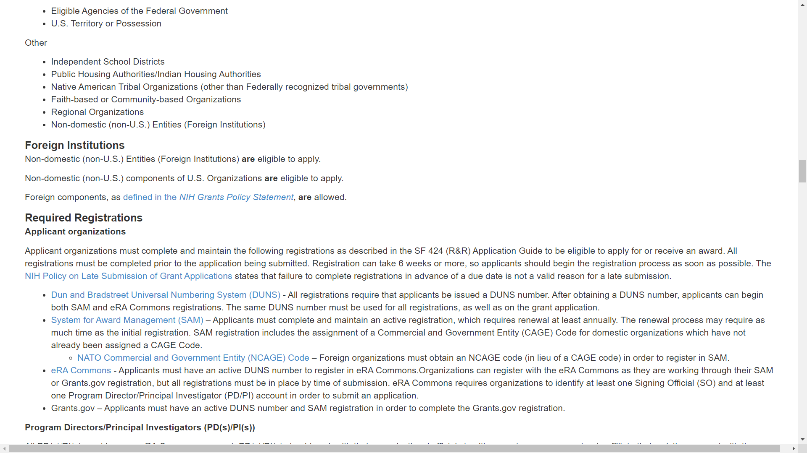
Sample FOA (Parent R01, CT not allowed
Notes:
we clearly indicate whether foreign institutions are eligible, and we summarize required registrations.

Slide 29
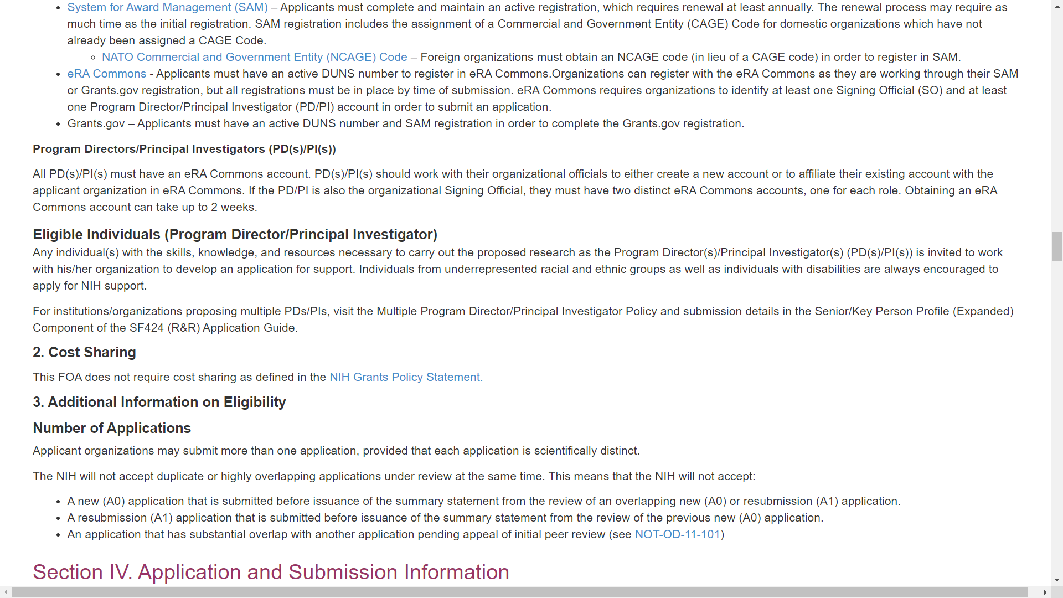
Sample FOA (Parent R01, CT not allowed
Notes:
We then outline any eligibility requirements of the PD/PIs.

Slide 30
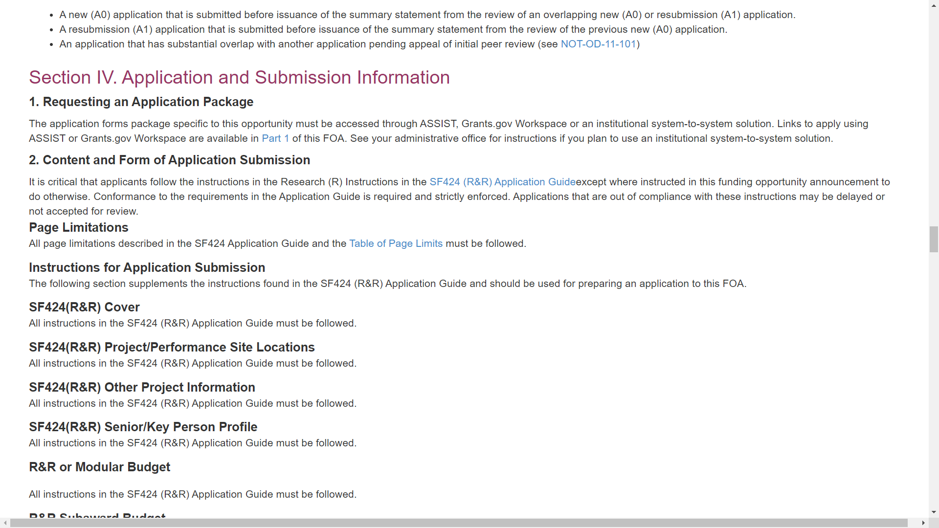
Sample FOA (Parent R01, CT not allowed
Notes:
Section IV. Application and Submission Information is a very important section. All the forms presented through your submission system are listed and with each form we provide any opportunity-specific instructions in addition to or different from our general application guide.
There’s a Page Limitation section that links to a standard table of page limits for application attachments. Any additions or changes to the standard limits are outlined in that section.

Slide 31
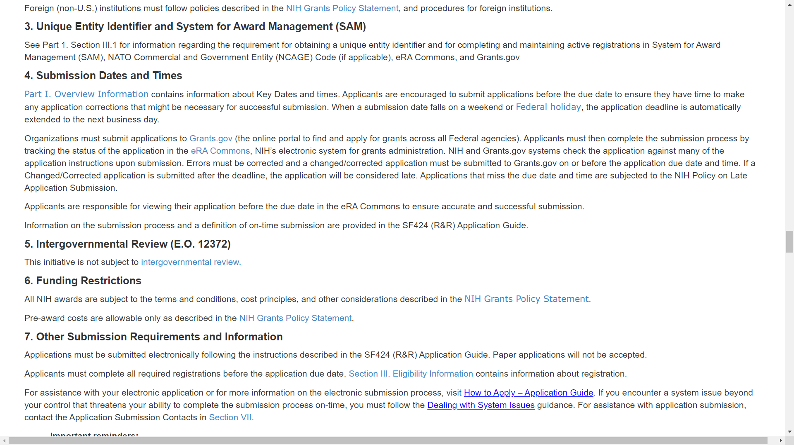
Sample FOA (Parent R01, CT not allowed
Notes:
Section IV.4 includes important deadline reminders to submit early, clear any errors by the deadline and to check the final submitted application image in eRA Commons to ensure it made through all our systems and was formatted without any assembly errors.
Section IV.6 informs applicants that awards are subject to the terms and conditions in the NIH Grants Policy Statement.

Slide 32
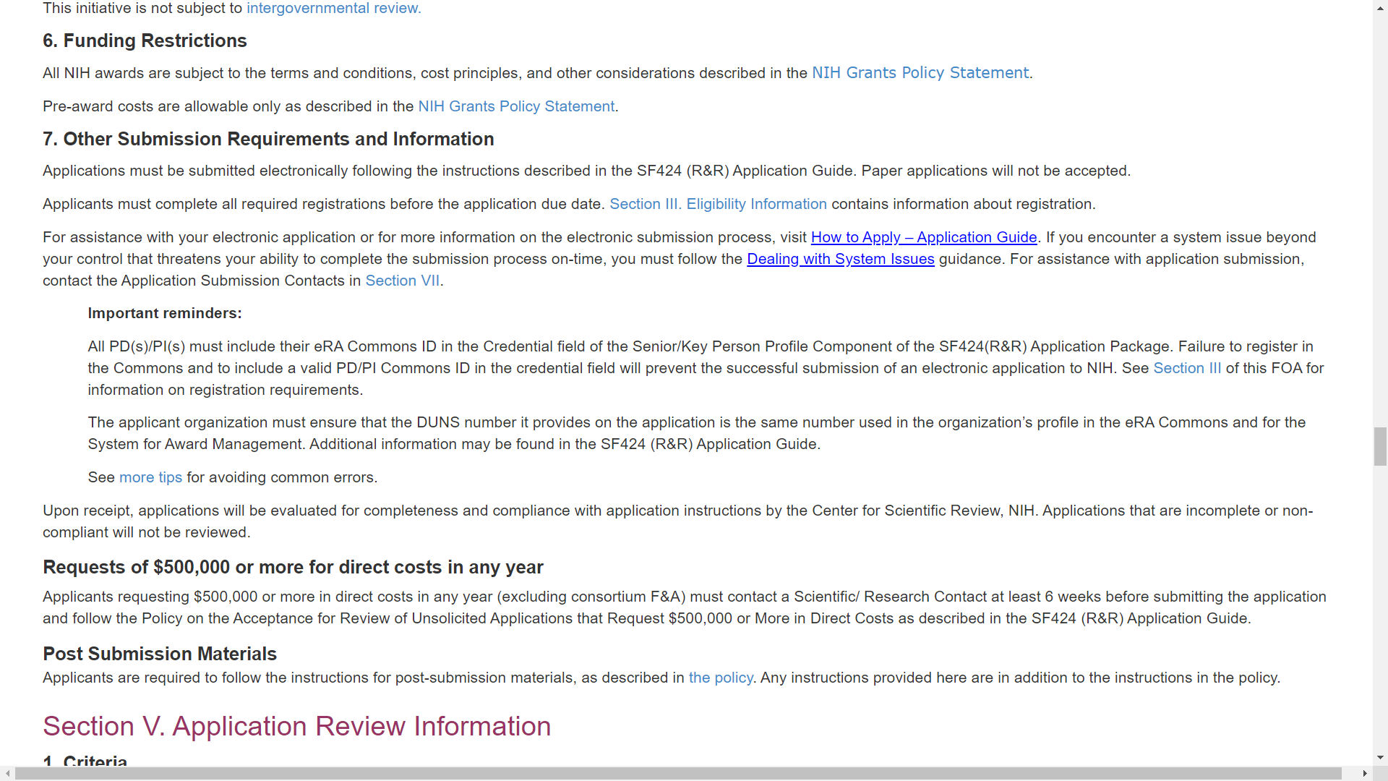
Sample FOA (Parent R01, CT not allowed
Notes:
Section IV.7 links to instructions for dealing with federal system issues that threaten your on-time submission; information on our requirement for obtaining prior approval to submit if any budget period within your application requests $500,000 or more in direct costs; and our policies for submitting post-submission materials.

Slide 33
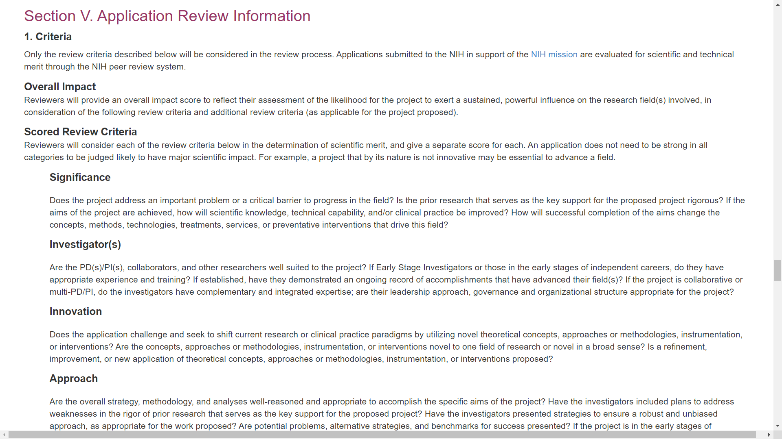
Sample FOA (Parent R01, CT not allowed
Notes:
You’ll want to pay close attention to Section V. Application Review Information. It includes the review criteria used to evaluate the scientific and technical merit of your application. Be sure your proposal clearly addresses each of the listed criteria.

Slide 34
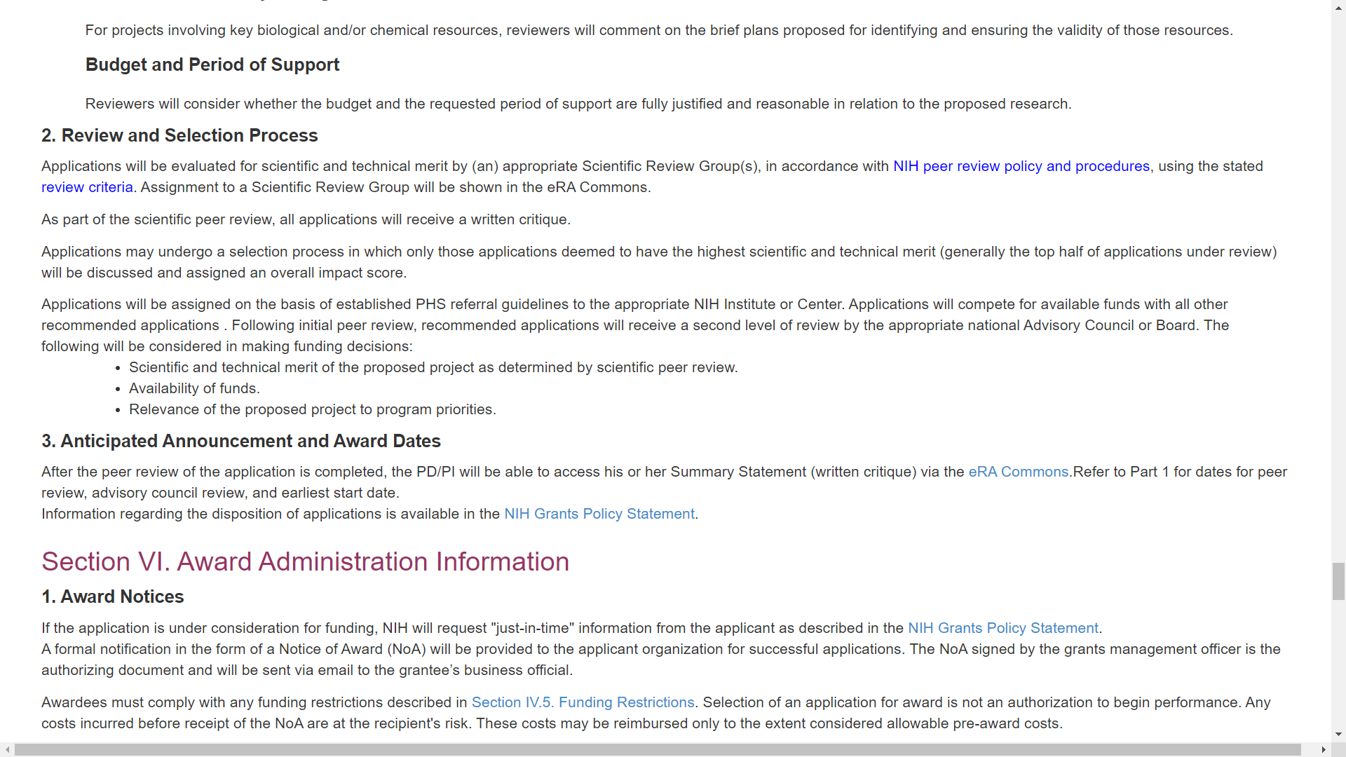
Sample FOA (Parent R01, CT not allowed
Notes:
Section V.2 describes the review and selection process. We take into consideration scientific and technical merit, availability of funds, and relevance to program priorities within the funding organization.
Section VI. Award Administration Information explains the pre-award and award process. This is also where you’d find any FOA-specific provisions to be included in a Notice of Award.

Slide 35
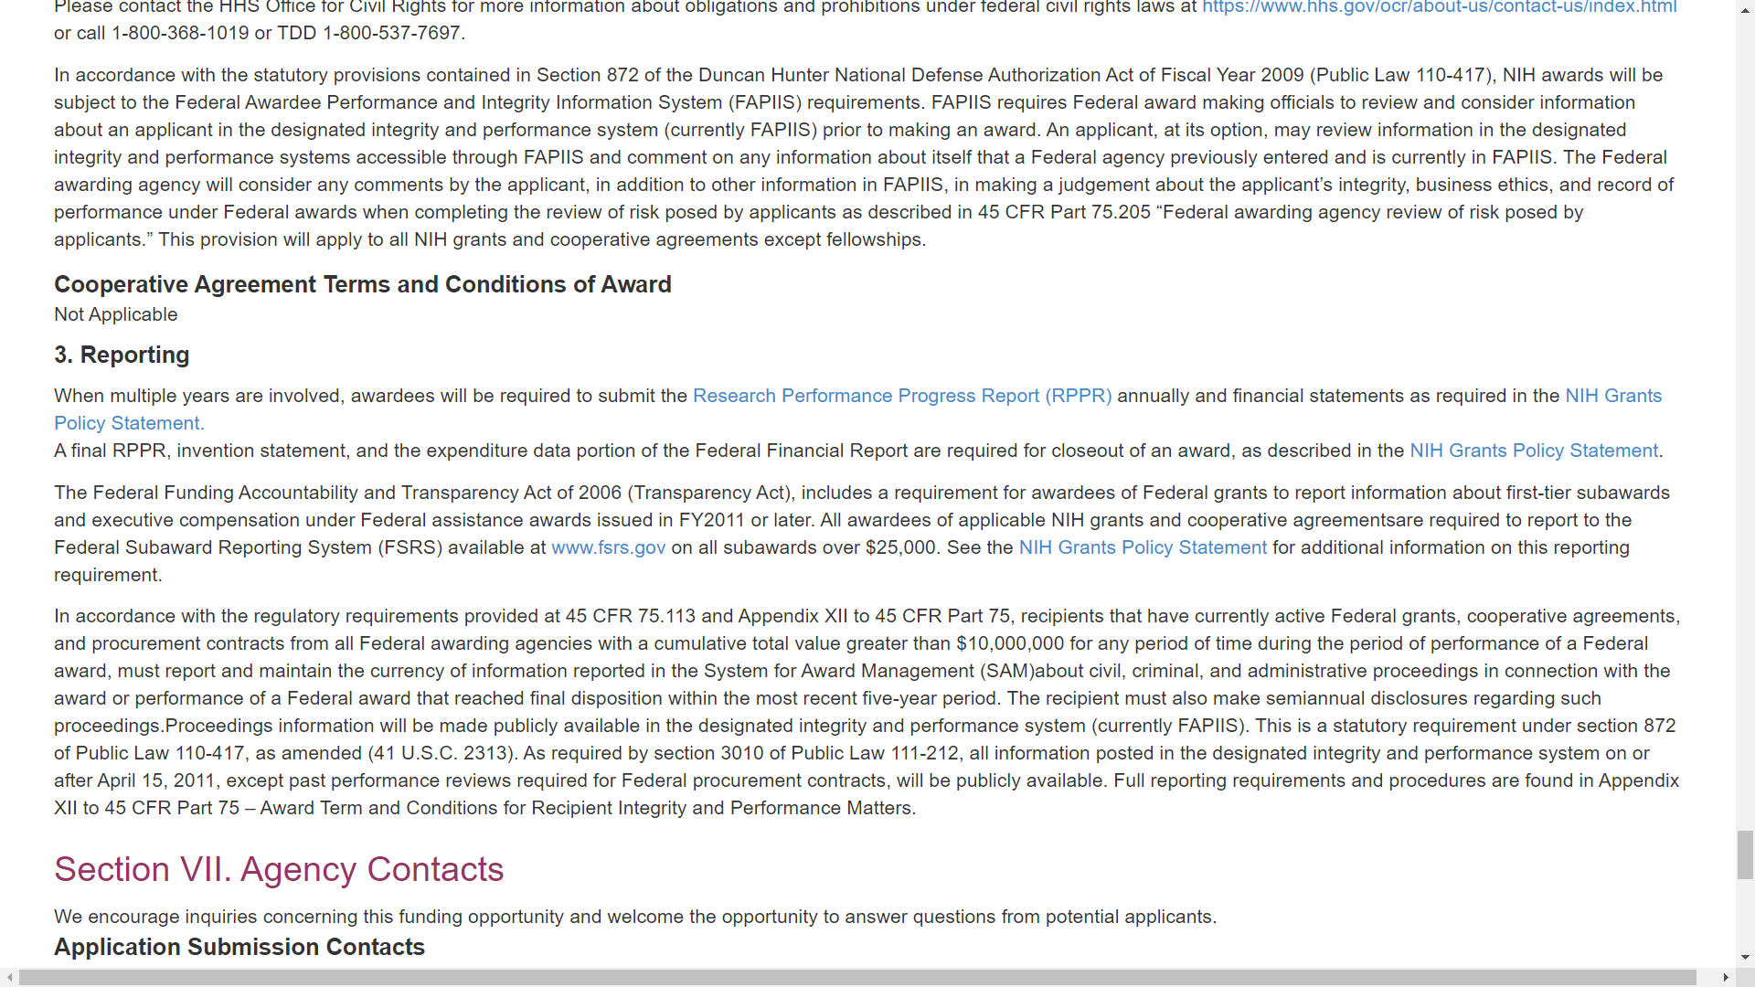
Sample FOA (Parent R01, CT not allowed
Notes:
VI.3 explains post-award reporting requirements and expectations.

Slide 36
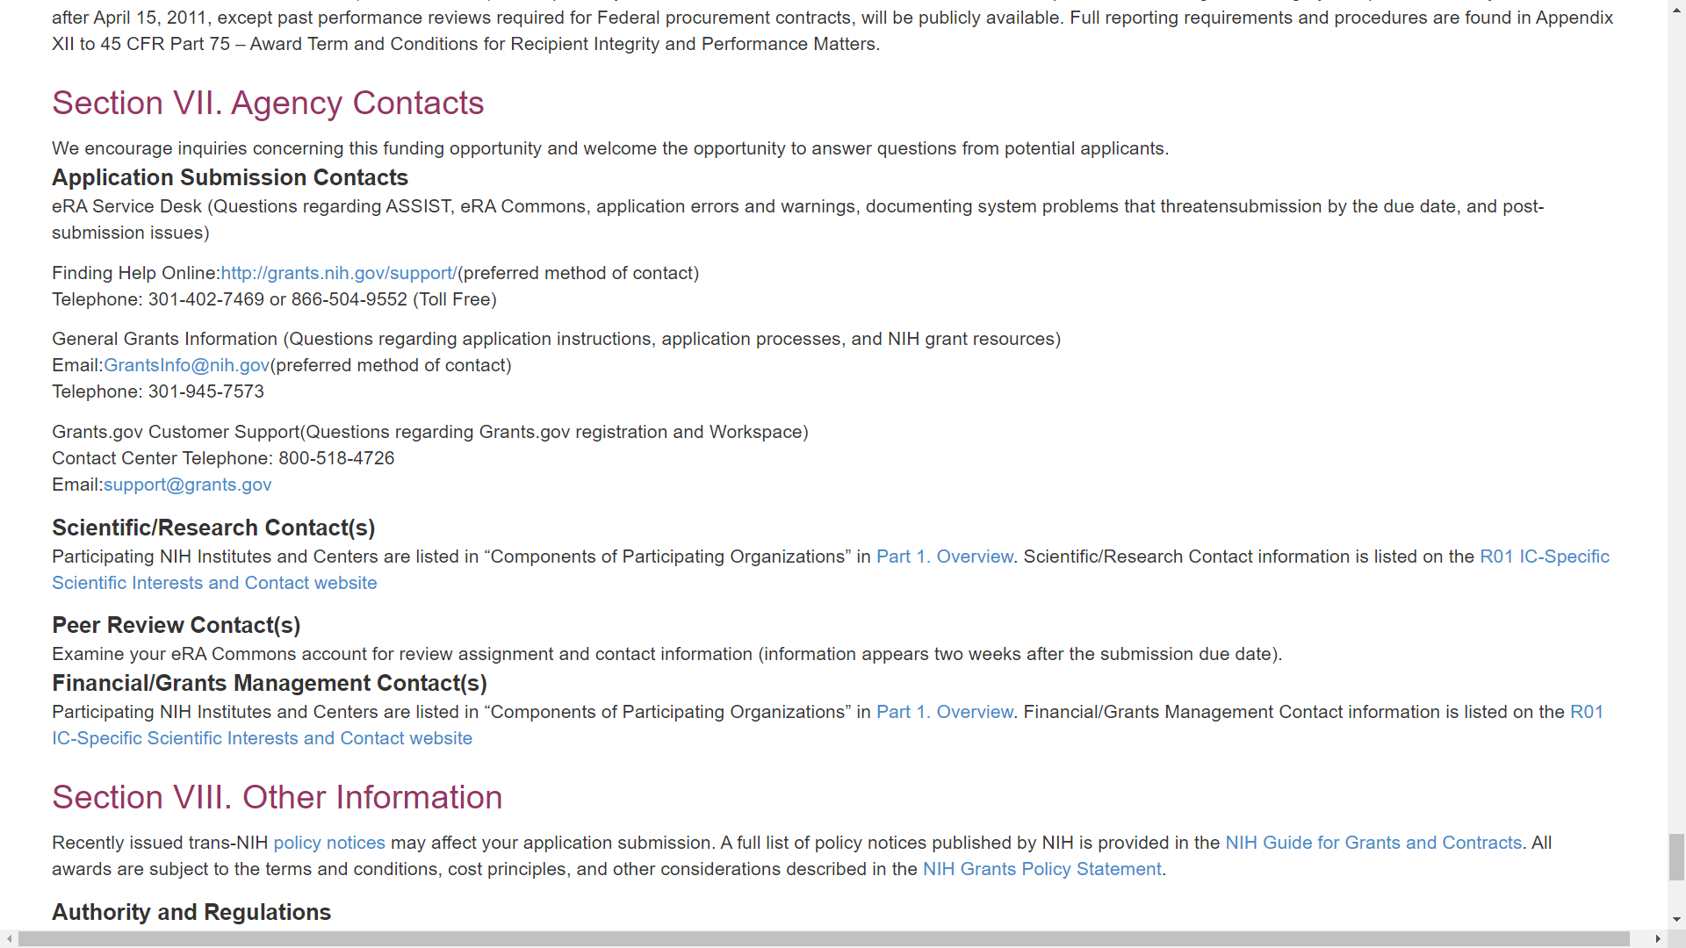
Sample FOA (Parent R01, CT not allowed
Notes:
Section VII. Agency Contacts provides application submission contacts, including the eRA Service Desk who can help system issues; Scientific/Research Contacts who can answer your programmatic questions; Peer Review Contacts who can discuss review concerns; and, Financial/Grants Management contacts who can answer your budget or grants administration questions. Don’t hesitate to reach out if you need help with any step of the application process.

Slide 37
Check out the grants.nih.gov site for additional information.
Notes:
For additional information, please be sure to check out the grants.nih.gov site. Thank you.

