Slide 1
Diversity in the Biomedical Research Workforce
Lisa Evans, JD
Scientific Workforce Diversity Officer
Division of Biomedical Research Workforce, OER

Slide 2
Institutes, Centers and Offices
Office of Extramural Research
Division of Biomed Research Workforce (DBRW)
Office of the Director
Office for Scientific Workforce Diversity
Office Intramural Training and Education
National Institute
on Aging
National Institute
on Alcohol Abuse
and Alcoholism
National Institute
of Allergy and
Infectious Diseases
National Institute
of Arthritis and
Musculoskeletal
and Skin Diseases
National Cancer
Institute
National Institute
of Child Health
and Human
Development
National Institute on
Deafness and Other
Communication
Disorders
National Institute
of Dental and
Craniofacial
Research
National Institute
of Diabetes and
Digestive and
Kidney Diseases
National Institute
on Drug Abuse
National Institute
of Environmental
Health Sciences
National Eye
Institute
National Institute
of General
Medical Sciences
National Heart,
Lung, and Blood
Institute
National Human
Genome Research
Institute
National Institute
of Mental Health
National Institute
of Neurological
Disorders and
Stroke
National Institute
of Nursing Research
National Center
for Complementary
and Integrative
Health
Fogarty
International
Center
National Center
for Advancing
Translational
Sciences
National Library
of Medicine
National Institute of
Biomedical Imaging
and Bioengineering
National Institute on
Minority Health and
Health Disparities
Clinical Center
Center for
Information
Technology
Center for
Scientific Review

Slide 3
Division of Biomedical Research Workforce
Director DBRW
P. Kay Lund, PhD
Develop, maintain, enhance & assess NIH policies & programs that support innovative research training, career development & diversity of the biomedical research workforce
Research and evaluations related to biomedical & clinician scientist research workforce & relevant training, career development, early & established investigators
Scientific Workforce Diversity Officer
Lisa Evans, JD
Senior Advisor & Training Program Policy Officer
Shoshana Kahana, PhD
Extramural Program Policy & Evaluation Officer
Jennifer Sutton, MS
Policy Analyst
Pritty Joshi PhD
Director, Division of Loan Repayment
Ericka Boone PhD
Executive Assistant & Travel Coordinator
Tracy Dowtin
http://acd.od.nih.gov/Biomedical_research_wgreport.pdf ‘NIH should create a permanent unit in the Office of the Director that works with the extramural research community, the NSF and the NIH ICs to coordinate data collection activities and provide ongoing analysis of the workforce and evaluation of NIH policies so that they better align with the workforce needs’.

Slide 4

Discussion Topics
NIH interest in diversity
Underrepresented Groups
Diversity-focused programs
Enhanced Extramural Diversity Website
Workforce Dashboard

Slide 5
NIH Interest in Diversity
NOT-OD-20-031
Enhance the participation of diverse groups including those underrepresented in the biomedical research workforce
Individuals from nationally underrepresented racial & ethnic groups
  Blacks or African Americans, Hispanics or Latinos, American Indians or Alaska Natives, Native Hawaiians and other Pacific Islanders
  In addition, individuals from racial or ethnic groups that can be demonstrated convincingly to be underrepresented by the grantee institution should be encouraged to participate in NIH programs to enhance diversity.
Persons with disabilities
  Individuals with a physical or mental impairment that substantially limits one or more major life activities
Individuals from disadvantaged backgrounds
  Must meet two or more of the criteria listed in this category in NOT-OD-20-031
Women
  NIH encourages institutions to consider women for faculty-level, diversity-targeted programs to address faculty recruitment, appointment, retention or advancement.
  https://grants.nih.gov/grants/guide/notice-files/NOT-OD-20-031.html

Slide 6
NIH Interest in Diversity (cont.)
https://grants.nih.gov/grants/guide/notice-files/NOT-OD-20-031.html
Women are underrepresented in doctorate-granting research institutions at senior faculty levels in most biomedical-relevant disciplines (https://ncses.nsf.gov/pubs/nsf19304/data, See Table 9-23).
Upon review of NSF & AAMC data, & scientific discipline or field related data, NIH encourages institutions to consider women for faculty-level, diversity-targeted programs to address faculty recruitment, appointment, retention or advancement.

Slide 7




Benefits of Diversity
Fosters scientific innovation
Improves quality of the research
Increases likelihood that research outcomes will benefit individuals from underserved or health disparity populations
May increase participation of health disparity populations in clinical studies
Expands public trust
Enhances global competitiveness

Slide 8
Race & Ethnicity of US population vs
Principal Investigators on RPGs
http://acd.od.nih.gov/Biomedical_research_wgreport.pdf
21.6%

Slide 9
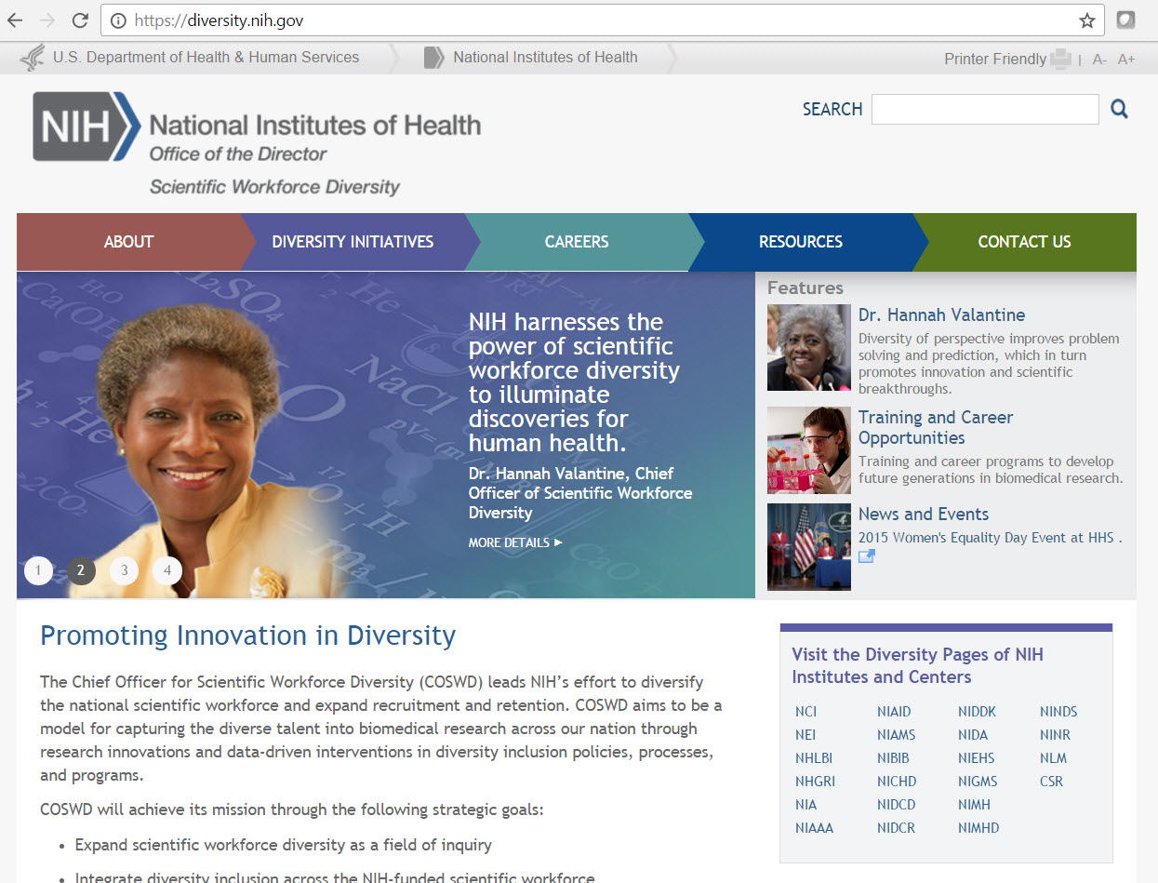
Enhancing Diversity of the NIH Workforce Report
June 2012 http://biomedicalresearchworkforce.nih.gov/docs/Biomedical_research_wgreport.pdf
Appoint Chief Officer and Office for Scientific Workforce Diversity
Enhance data collection, evaluation, and systematic tracking of outcomes
  Coordination and Evaluation Center (CEC)
Mentoring, career preparation, and retention
  Building Infrastructure Leading to Diversity (BUILD)
Mentorship networks and partnerships
  National Research Mentoring Network (NRMN)
https://diversity.nih.gov/

Slide 10
Recommendations on Physician Scientist Workforce, June 2014 http://acd.od.nih.gov/reports/PSW_Report_ACD_06042014.pdf
NIH should intensify its efforts to increase diversity in the physician-scientist workforce (MD, DVM, DDS, Nurse, Dual Degree)
New pilot programs
Networks to promote career advancement
More “On Ramps”
Some Relevant information:
  K99/R00 programs: parent FOAs & some IC specific FOAs encourage applications from physician scientists (clarified that time in clinical training does not count towards the timeframe for eligibility) https://researchtraining.nih.gov/programs/career-development/K99-R00
  K08 & K23 programs: parent FOAs & some IC specific; Some IC permit funds up to the salary cap; many permit NIH salary contribution up to $100,000
  https://researchtraining.nih.gov/programs/career-development/K08 https://researchtraining.nih.gov/programs/career-development/K23

Slide 11

National Academies of Science, Engineering and Medicine 2018
Notes:
NASEM Next Gen Report:
Recommendation 5.4: The NIH, research institutions, and principal investigators should share responsibility for increasing the diversity of and promoting the inclusion of early-career researchers
Recommendation 5.5: The NIH should set aside funds from its Next Generation Researchers Initiative to expand the number of Diversity Supplements

Slide 12
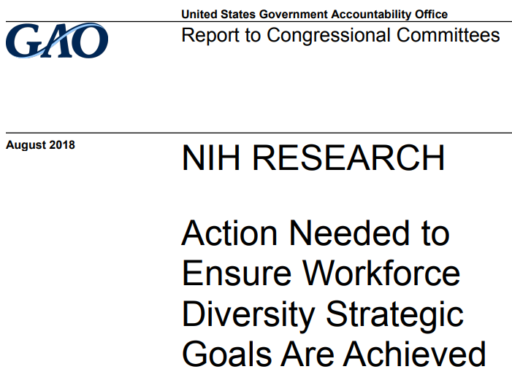
Government Accountability Office
GAO-18-545
Notes:
August 17, 2018 GAO-18-545, NIH Research: Action Needed to Ensure Workforce Diversity Strategic Goals are Achieved, Report Recommendations: The NIH Director should develop quantitative metrics, evaluation details, and specific time frames to assess its current efforts to support investigators from underrepresented groups against its scientific workforce diversity strategic goals, and use the results of its assessment to guide any further actions.

Slide 13
Where Do I Find…
General Information about Diversity?

Slide 14


Extramural Diversity Website https://extramural-diversity.nih.gov/

Slide 15

Extramural Diversity Website https://extramural-diversity.nih.gov/

Slide 16




Icons: Content and Audiences
  Diversity Matters: Why diversity is important; underrepresented groups and data EVERYONE
Reports and Data: NIH and external reports on diversity; abstract database; data sources RESEARCHERS
Career Pathways: Finding NIH opportunities for funding; meet funded researchers STUDENTS, INVESTIGATORS
Building Participation: NIH IC diversity webpages; leveraging stakeholders; recruitment and retention; Congressional interest in diversity SCIENTIFIC LEADERS

Slide 17


Underrepresented Groups https://extramural-diversity.nih.gov/diversity-matters/get-the-facts

Slide 18
Where Do I Find…
Research Training and Career Development Opportunities?

Slide 19
Finding Research Programs https://extramural-diversity.nih.gov/career-pathways/success-strategies
Use NIH RePORTER to find opportunities at your institution
Use the research training and career development website (e.g., fellowships)
Learn about how applications are reviewed by the Center for Scientific Review

Slide 20
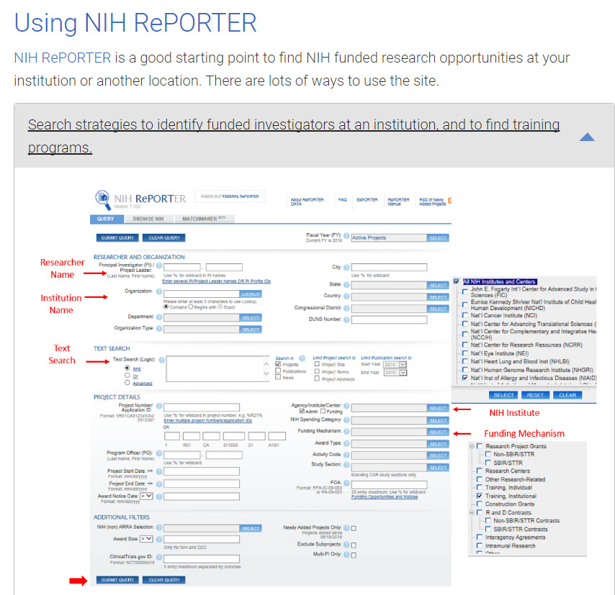
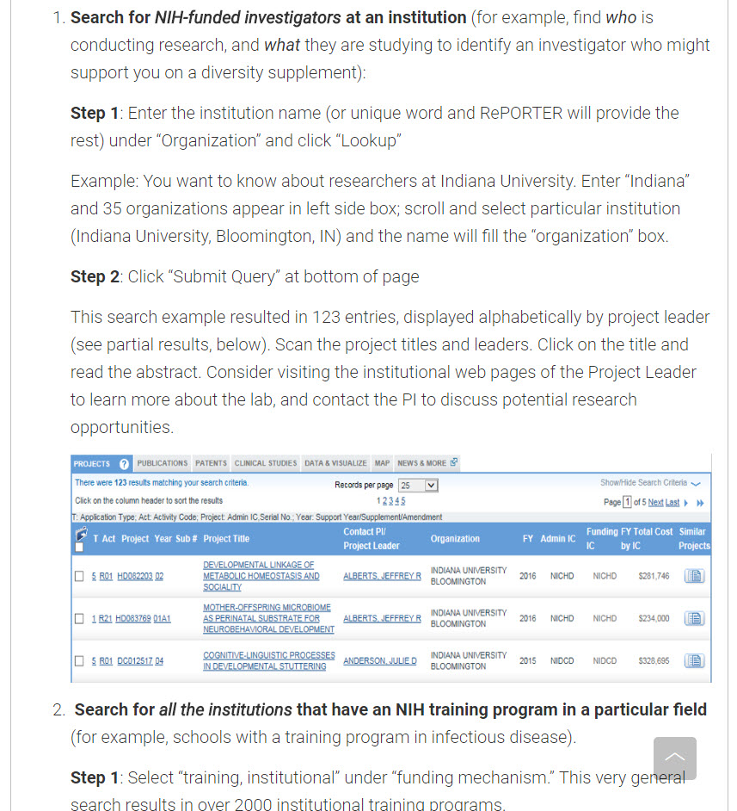
How to Search for NIH Programs
https://projectreporter.nih.gov/reporter.cfm

Slide 21
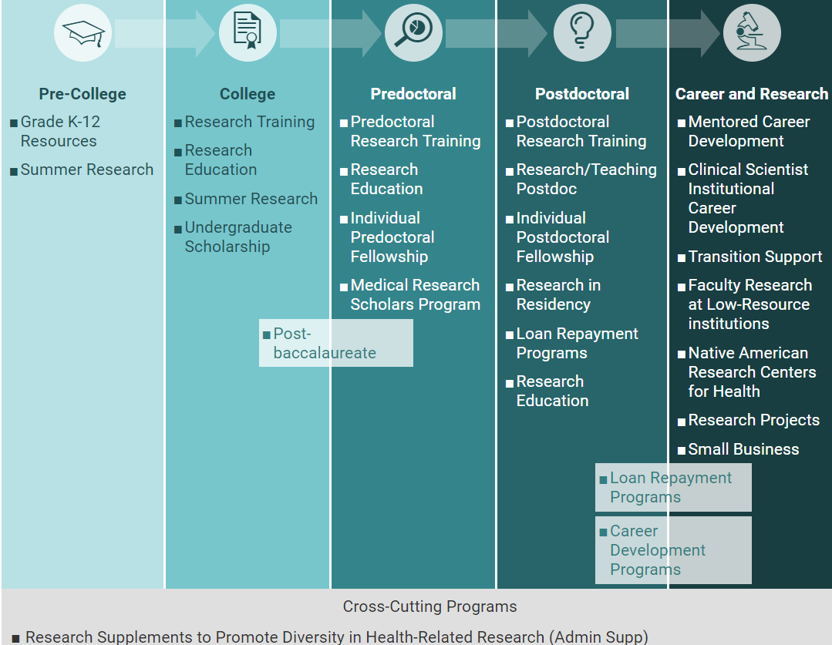
Building Research and Science Careers https://extramural-diversity.nih.gov/career-pathways

Slide 22
Research Training and Career Development Programs
All parent programs include attention to diversity (recruitment plan to enhance diversity)
  Institutional Training Programs (T32, K12)
  K12 Institutional Career Development Awards
  K12 Institutional Research and Academic Career Development Award (IRACDA) (NIGMS)
    Postdoctoral program partnering Research Intensive Institutions with institutions serving underrepresented populations
  Fellowships
  Research Education
  Individual Career Development programs

Slide 23

Selected Programs to Enhance Diversity
By Career Stage:
  F31, Predoctoral Fellowship to Promote Diversity in Health-Related Research
  T32, Training Program for Institutions That Promote Diversity
  T34, Maximizing Access to Undergraduate Research Careers (MARC)
  K01, Mentored Career Award for Faculty at Institutions that Promote Diversity (some ICs)
  K99/R00 Program to Enhance Diversity (Brain Research through Advancing Innovative Neurotechnologies (BRAIN) Initiative: RFA-NS-19-044, RFA-NS-19-043; 10 ICs)
  G12, Research Centers in Minority Institutions Program
  SC1, Support of Competitive Research (SCORE) Research Advancement Award
  R25, Multiple Research Education Programs (RFA-HL-19-024, PAR-20-223, PAR-20-240)
  Other programs
  Small Business Innovation Research & Small Business Technology Transfer (SBIR/STTR) Programs
  Administrative Supplements to Promote Diversity in Research and Development Small Businesses-SBIR/STTR (PA-18-837)
  NIH Loan Repayment Programs, https://www.lrp.nih.gov/

Slide 24

Research Pathways https://extramural-diversity.nih.gov/career-pathways/next-career-steps

Slide 25
What about Diversity Supplements?

Slide 26
Research Supplements to Promote Diversity in Health-Related Research
Administrative supplement to an existing research grant, designed to:
Diversify the biomedical research workforce
Support candidates from diverse & underrepresented groups who “wish to develop research capabilities... participate in… career development experiences”
Support many career stages from high school to junior faculty
Administratively reviewed by the Institute or Center (IC) funding the original grant
  PA-20-222 Most recent FOA
  Note: ICs have different deadlines and policies

Slide 27
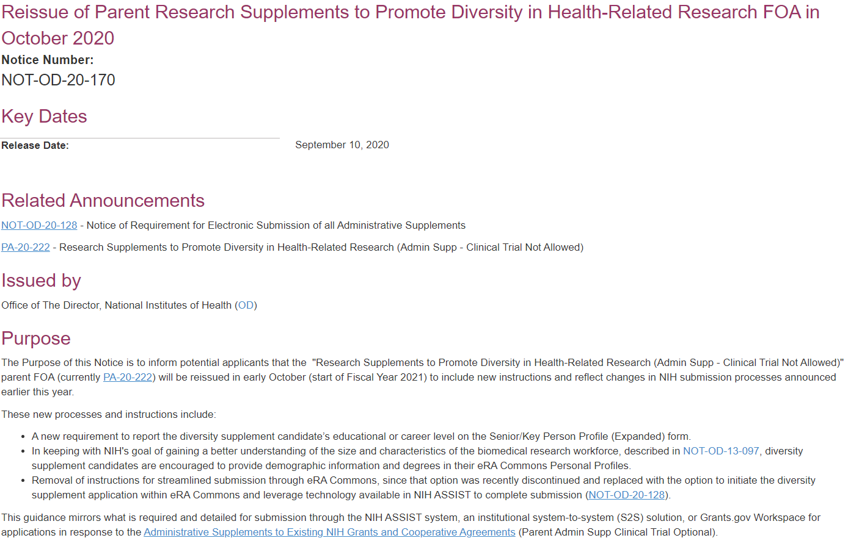
October 1, 2020 Reissue https://grants.nih.gov/grants/guide/notice-files/NOT-OD-20-170.html

Slide 28
Many Award Types are Eligible for
Diversity Supplements
Research Grants | Program Project/ Center Grants
R01 Research Project Grant | P01 Research Program Projects
R15 Academic Research Enhancement Award (AREA), | P30 Center Core Grants
R21 Exploratory/Developmental Research Grant Award | Directors Awards
R21/R33 Phased Innovation Award | DP1 NIH Director’s Pioneer Award (NDPA)
R24 Resource-Related Research Projects | DP2 NIH Director’s New Innovator Awards
R37 Method to Extend Research in Time (MERIT) Award | DP4 NIH Director’s Pathfinder Award
U01 Research Project Cooperative Agreement
*This is a subset of eligible grants.
Check PA-20-222 for additional program types (activity codes)

Slide 29
PA-20-222
https://grants.nih.gov/grants/guide/pa-files/PA-20-222.html

Slide 30
Application Requirements for Diversity Supplements
Proposed research experience plan for the candidate must contribute to the (broad) goals of the funded project
  Research Abstract of funded project, research experience, plans for interaction with others in the grant/research area, mentor commitment
Plans for future career development
Candidate bio-sketch
  Highlight evidence of research interest or achievement, any current funding, personal statement
Candidate eligibility statement (citizenship/permanent resident, identify under-represented group), signed by PI and institutional official

Slide 31
New FY18 Diversity Supplement Applications, Awards, and Success Rate by Career Level
Application and award data withheld

Slide 32
FY18 Diversity Supplement Awards (New and Continuing) by Career Level
Number of All Awards
Funding for All Awards
*High school data withheld

Slide 33
What Resources are Available Regarding Women?

Slide 34

Women in Biomedical Careers
Building Interdisciplinary Research Careers in Women’s Health (BIRCWH) https://orwh.od.nih.gov/career/mentored/bircwh/
  Mentored career development program; connects BIRCWH Scholars (junior faculty) to senior faculty with shared research interests in women’s health and sex-differences research.
Extending Early Stage Investigator Eligibility http://grants.nih.gov/grants/family_friendly.htm
  Early stage investigators (ESI) who have experienced a lapse in their research or research training during the 10-year ESI period can request an extension of their ESI eligibility.
  ESI who have experienced childbirth: https://grants.nih.gov/grants/guide/notice-files/NOT-OD-18-235.html
Re-entry into Biomedical Research Careers https://orwh.od.nih.gov/career/mentored/re-entry/
  Supplements to existing NIH research grants to support full- or part-time research by women or men returning to the scientific workforce
Primary Caregiver Technical Assistance Supplements Primary Caregiver Technical Assistance Supplements
  Supplements to existing NIAID grants to support postdoctoral research scientists taking care of a child or sick family member. Additional funds for NIAID grantees to hire a mid-to-senior level technician to fill in when the caregiver (female or male) needs to be away from the lab.

Slide 35
Where do I find…
Other resources on the Diversity Website?

Slide 36
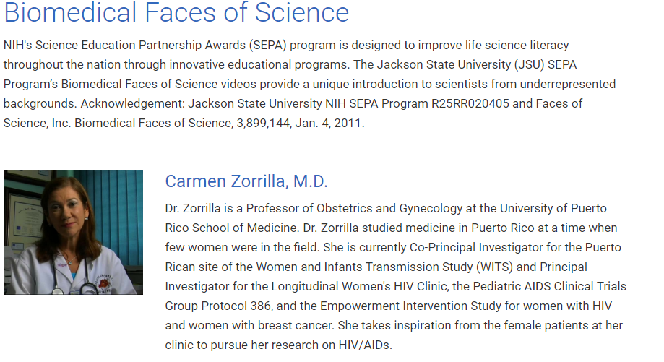
Researchers from Nationally
Underrepresented Backgrounds https://extramural-diversity.nih.gov/biomedical-faces-of-science

Slide 37
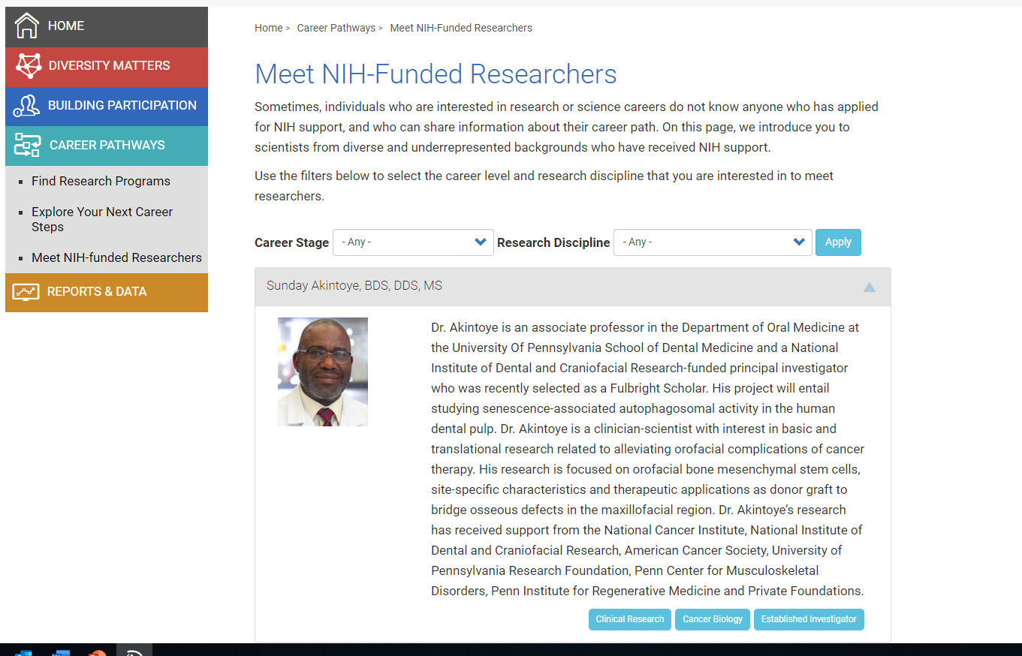
https://extramural-diversity.nih.gov/career-pathways/meet-researchers/all

Slide 38

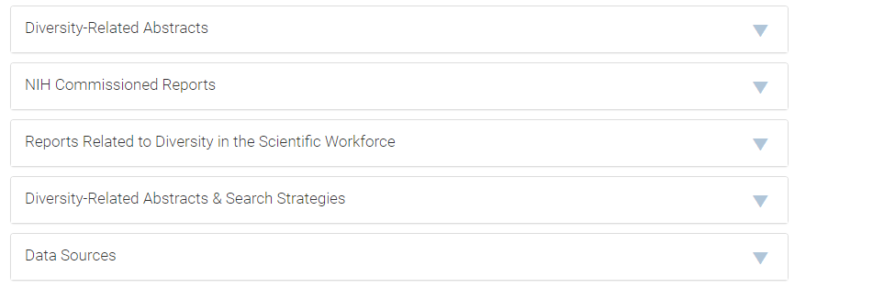
Reports and Data https://extramural-diversity.nih.gov/diversity-reports

Slide 39
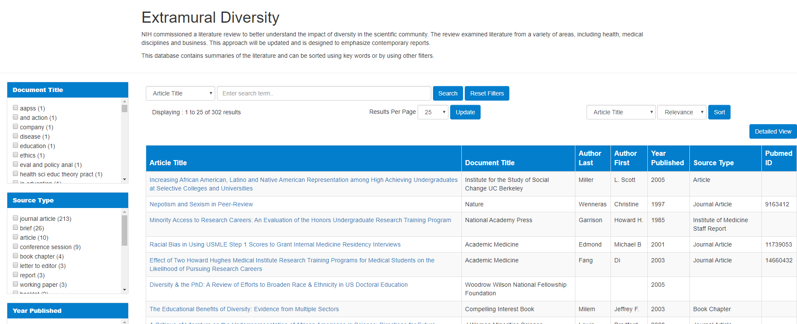
Abstract Database Enhanced Functionality and
New Resources

Slide 40
Research Training and Career Development
Additional NIH Resources

Slide 41

NIH Research Training Website
https://researchtraining.nih.gov
Launched in 2015, one stop for funding opportunities
Useful resource for trainees and early stage faculty
Modifications and updates with information for applicants in progress
Notes:
Separate components – separate slide for matrix

Slide 42
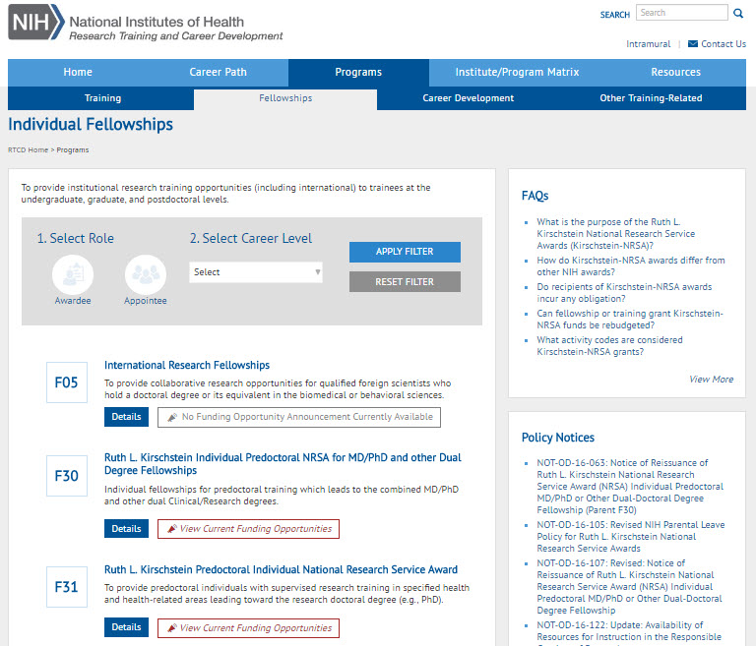
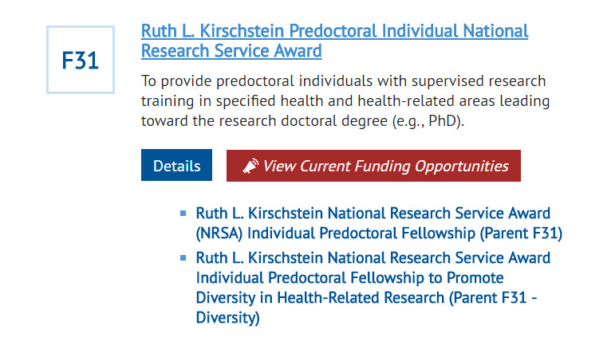
Individual Fellowships

Slide 43

Research Pathways
Research Pathways

Slide 44
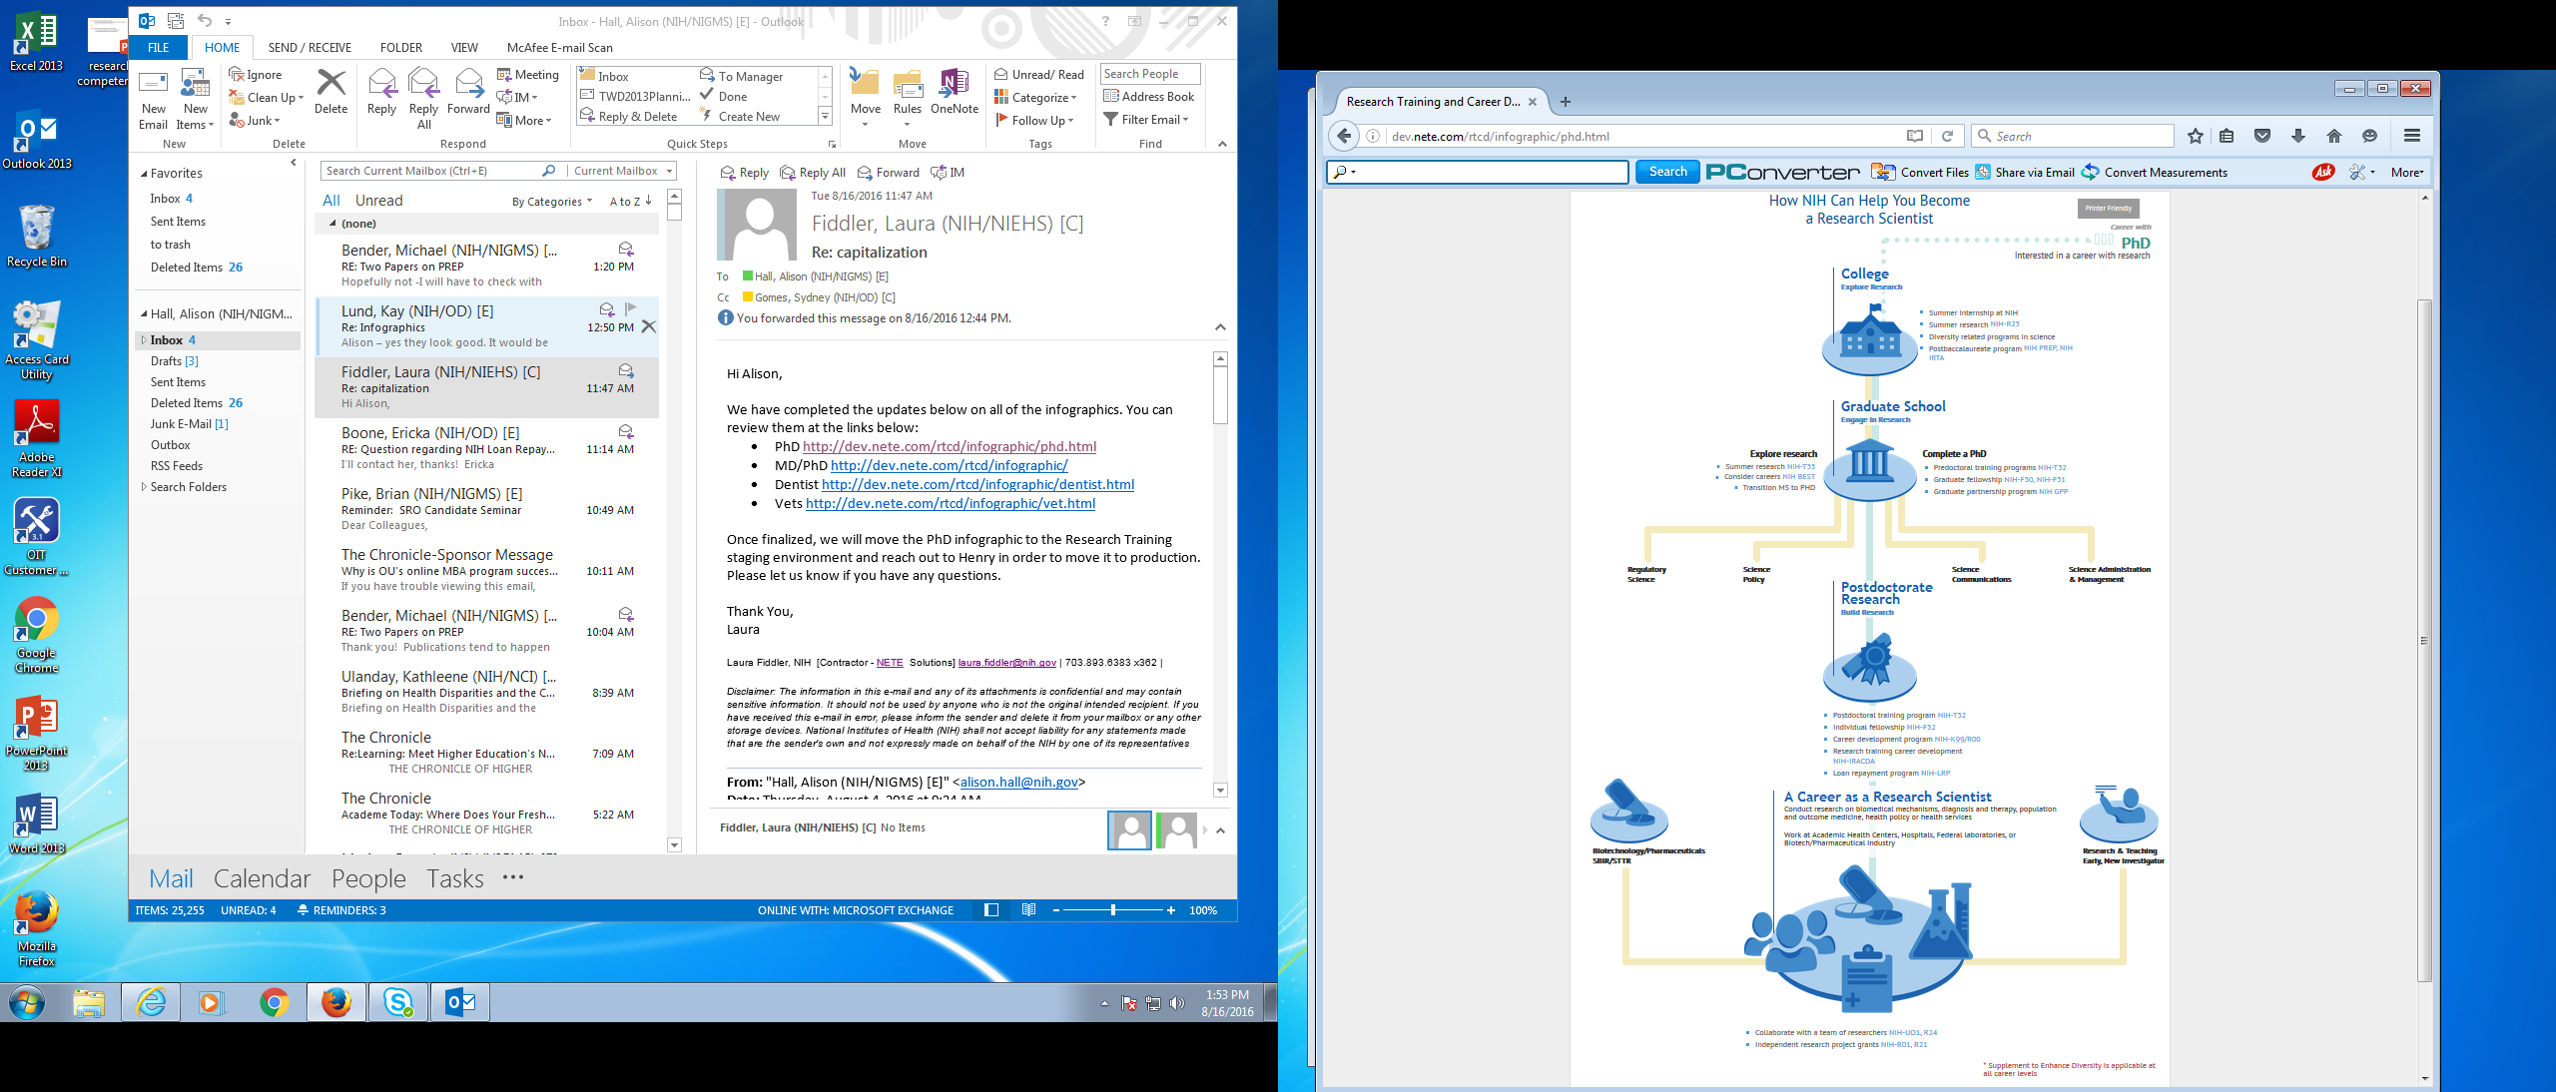
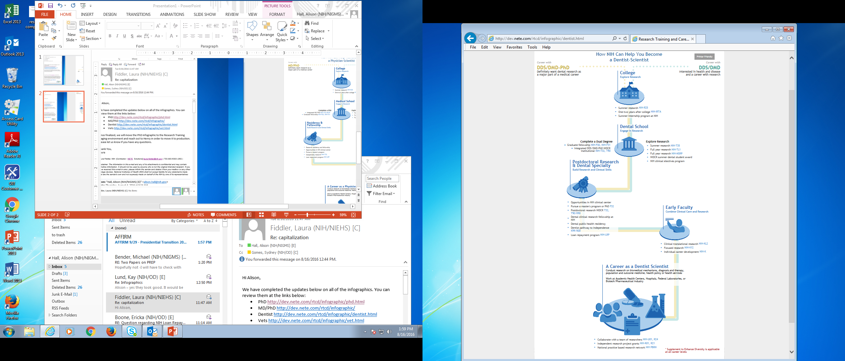
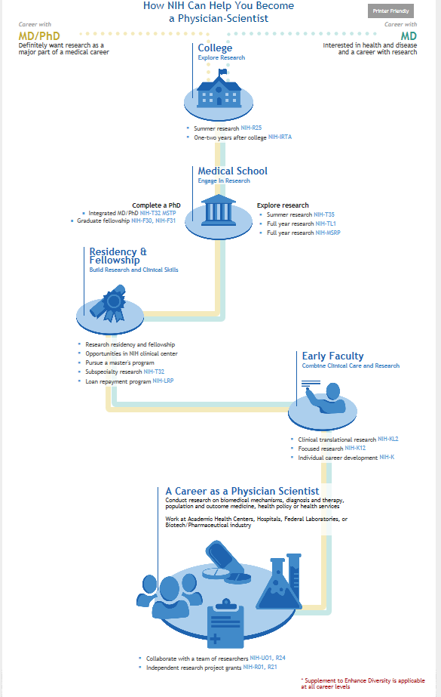
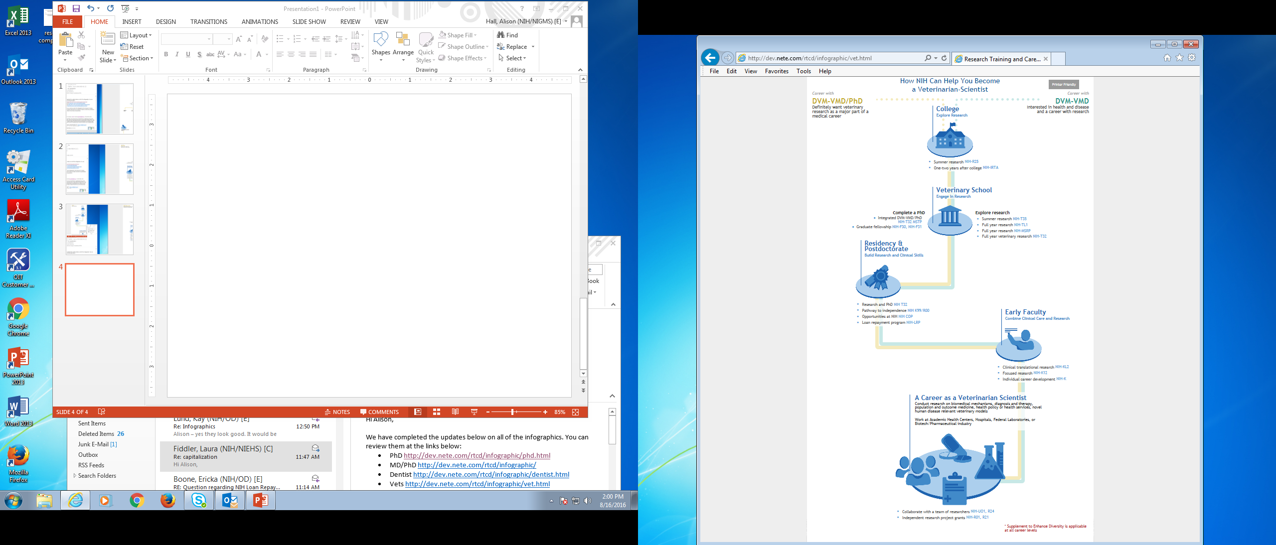
Research Pathway Infographics
https://researchtraining.nih.gov
Research Pathways

Slide 45
BMW Workforce Dashboard

Slide 46
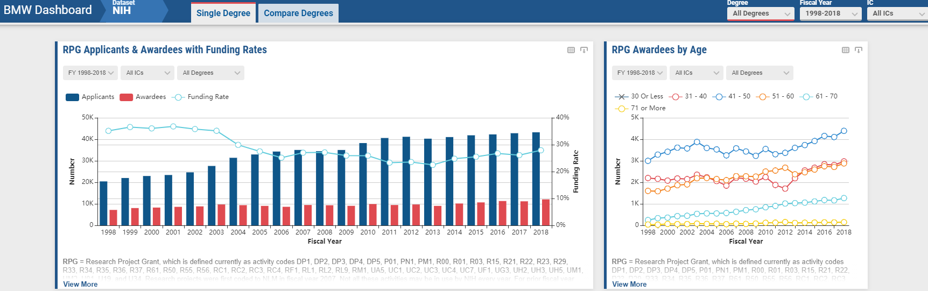
https://report.nih.gov/bmwdashboard/#/nih

Slide 47
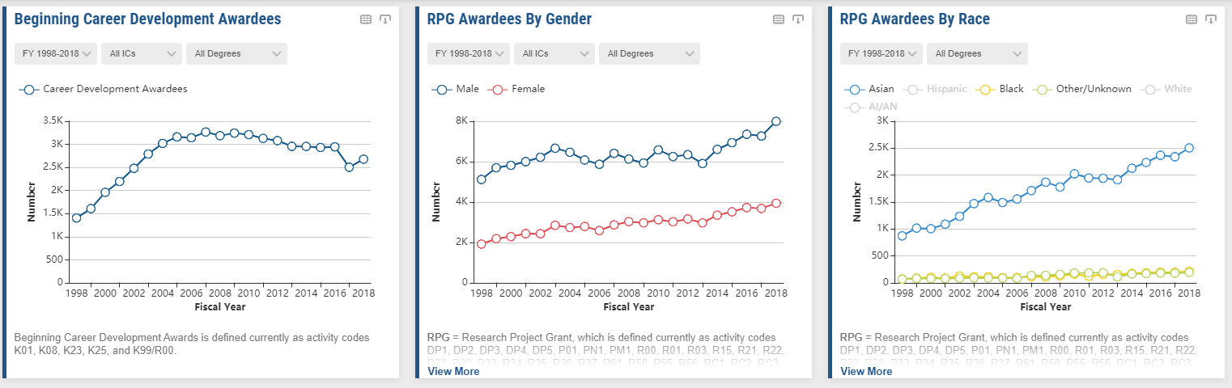
https://report.nih.gov/bmwdashboard/#/nih

Slide 48
Thank You
Questions/Discussion ?

