Slide 1
Using RePORT to Understand Who and What NIH Funds
Cindy Danielson, Ph.D. and Calvin Johnson, Ph.D.
NIH Office Of Extramural Research
NIH Virtual Seminar
November 3, 2021

Slide 2
Learning Objectives
Become familiar with NIH web tools that can help you throughout the grants process
Use the funding information in the RePORT web tools to help target your application
Find key contacts at NIH and in the grantee community
Find other resources to help you navigate through the grants process

Slide 3
Tools to Help Answer Questions Throughout the Grants Process
What is the NIH already funding in my research area?
What results came out of those projects?
Which ICs have priorities that align with my research ideas?
How can I find a relevant point of contact at NIH to discuss my research ideas?
How can I find collaborators?
What are other PIs at my institution working on?
Which types of programs should I apply for, and what are my chances of getting funded?

Slide 4
RePORT: One-Stop Shop for Data on NIH Programs
Uphold NIH’s commitment to public accountability in carrying out its scientific missions.
The Research Portfolio Online Reporting Tools website provides access to reports, data, and analyses of NIH research activities, including expenditures and the results of supported research.
Goals are to
Gather all NIH data and reports
Make these data easily accessible to the public
Highlight the links between NIH funding and research results and products
Access at https://RePORT.nih.gov
Support at RePORT@mail.nih.gov

Slide 5
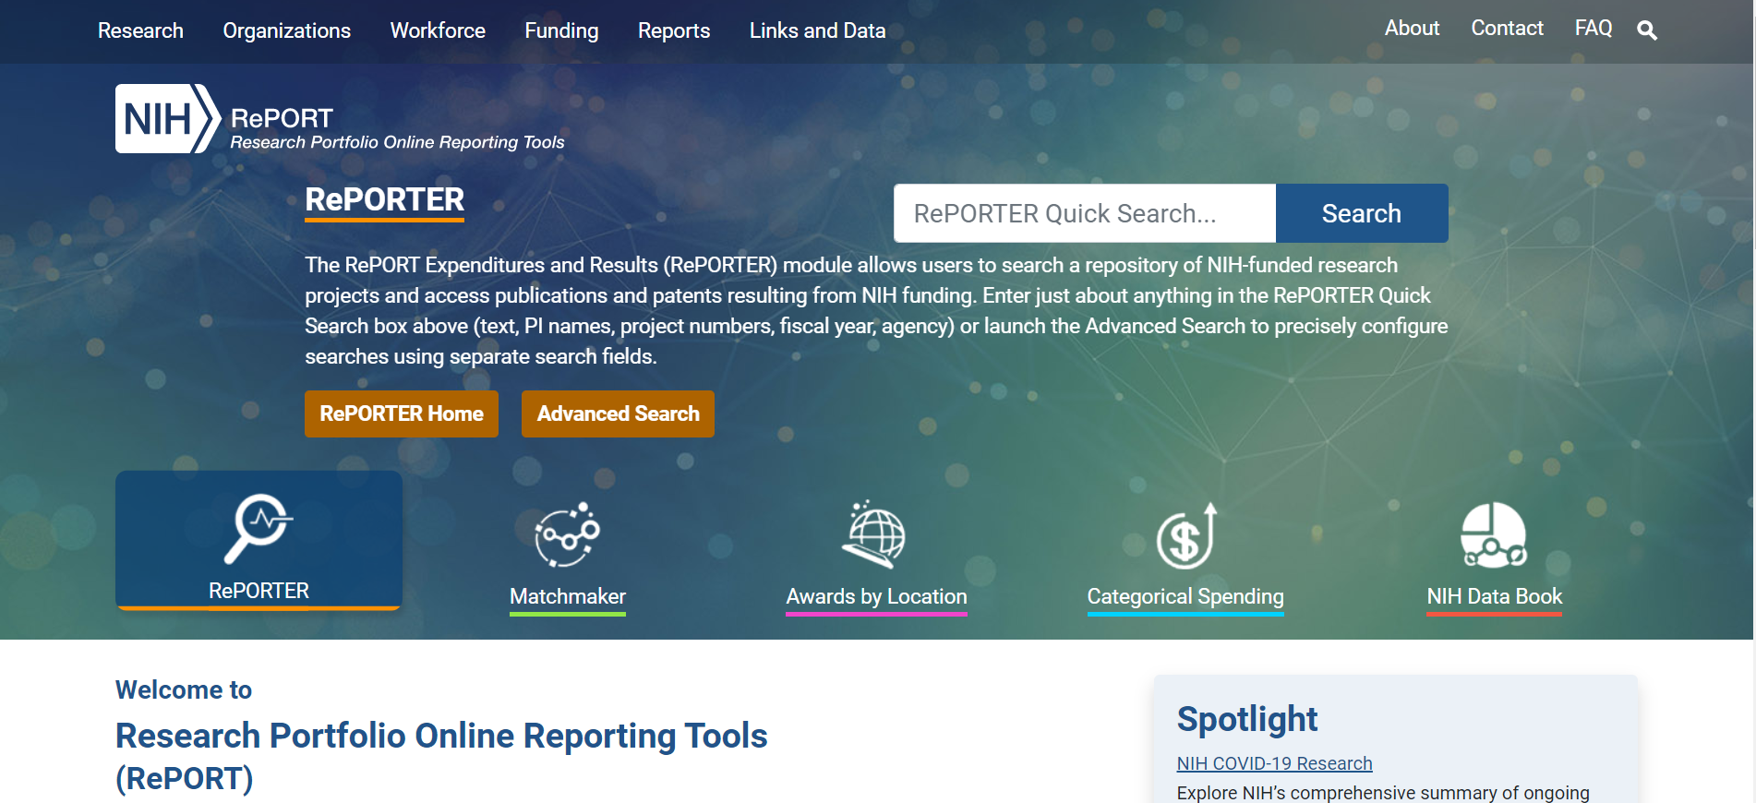
RePORT and RePORTER

Slide 6
Using RePORTER to Help With Your Application
Find funded research projects in areas similar to yours
See what’s been funded already
Get additional background information on prior research
Identify collaborators
Find projects that were awarded earlier under similar Funding Opportunity Announcements (FOAs)

Slide 7
Information in RePORTER
RePORTER = Expenditures and Results
Updated weekly with newly funded grants
Information is included from
NIH, extramural and intramural since FY 1985
Patents, publications, and other research outcomes
Projects supported by other components of HHS
ACF, AHRQ, CDC, FDA
Projects supported by the VA

Slide 8
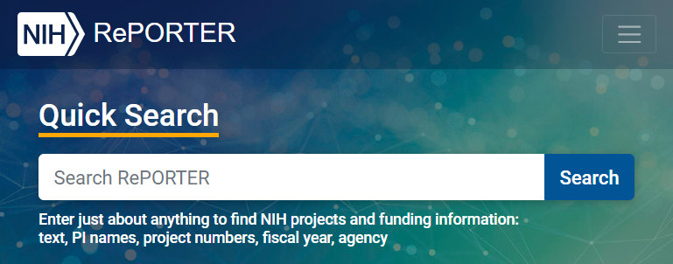
Multiple Ways to Search RePORTER
Quick Search automatically queries across multiple fields, returning relevant results for common queries
Interactive charts let you jump into projects based on location or Institute/Center
Advanced Projects Search allows you to use precisely defined data fields

Slide 9
RePORTER Search Results – Projects, Publications, and More
Easily refine results without having to re-run a search
Explore projects, publications, and more
“Share” button creates a persistent URL for latest results

Slide 10
RePORTER Demonstration: Find Projects Awarded Earlier Under Similar FOAs
After finding a Funding Opportunity Announcement of interest in the NIH Guide, such as PAR-21-080…
Expand the Advanced Projects Search form
Fiscal Year: Select All
FOA: PA-17-041
Click SEARCH
Explore search results
Notes:
https://grants.nih.gov/grants/guide/pa-files/PAR-21-080.html
Addressing the Etiology of Health Disparities and Health Advantages Among Immigrant Populations

Slide 11
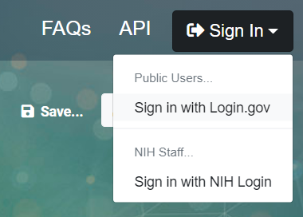
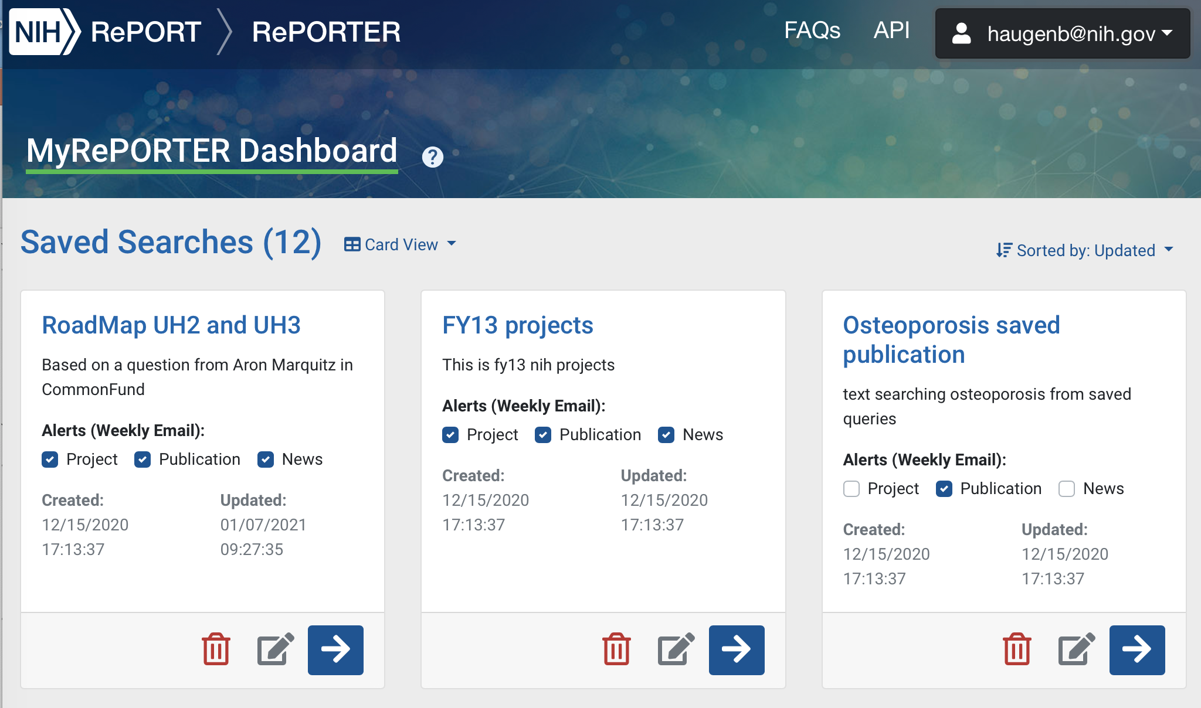
MyRePORTER Saved Searches
Sign in to MyRePORTER using Login.gov credentials
Save searches and set weekly email alerts for new
Projects
Publications
News items

Slide 12
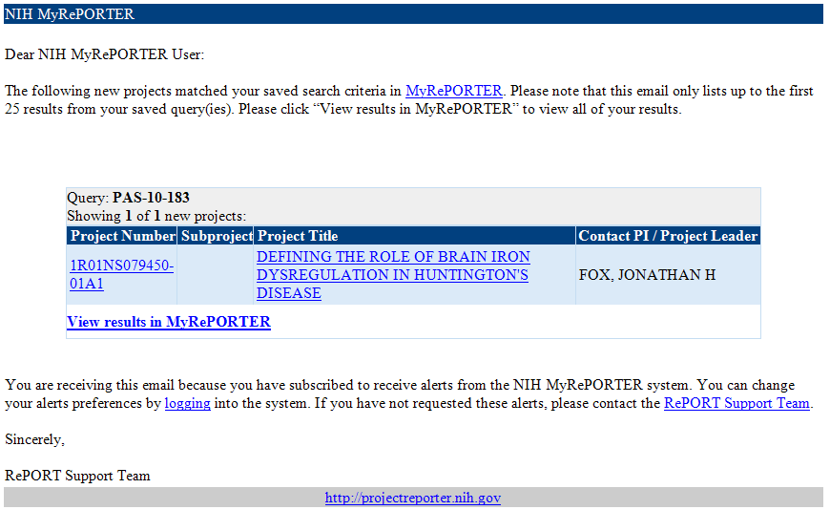
MyRePORTER Automated Email Alerts
Email alerts make it easy to stay up-to-date on current projects while you’re working on your application
Subject: Your NIH MyRePORTER Project Alert
From: do-not-reply-reporter@reporter.nih.gov

Slide 13
Matchmaker: What Projects Like Mine Have Already Been Funded?
The research group investigates the neurobiology underlying drug abuse and related psychiatric disorders. The work is focused on the systematic study of the human brain of drug abusers and subjects with psychiatric disorders in relation to opioid neuropeptide, cannabinoid and dopamine neuronal systems. Drug abuse and, e.g., major depression are associated with alterations of mood, cognition, and motivation, thus, an important goal is to identify and map specific genes in the mesocorticolimbic system, which regulate emotional function. Techniques such as in situ hybridization, RT-PCR, DNA microarray, in vitro autoradiography, and general biochemical assays are used for the detailed analyses of genes, and respective protein products, in discrete mesocorticolimbic brain areas. Molecular, biochemical, and in vivo studies of the human brain are assessed in relation to individual genotype in order to identify neurobiological correlates of functional genetic polymorphisms linked to addiction and affective disorders. Epigeneic mechanisms, e.g., DNA methylation, are also evaluated in relation to the regulation of gene expression.

Slide 14
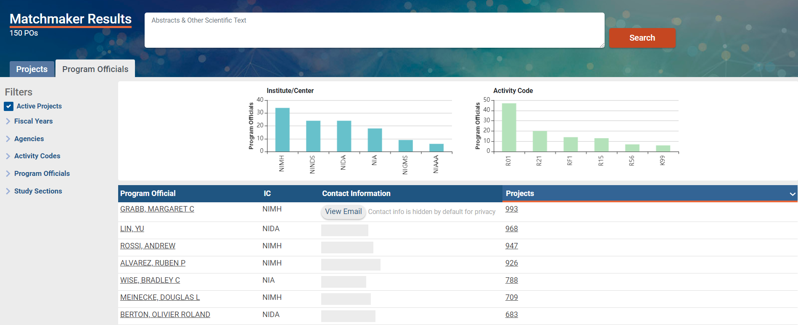
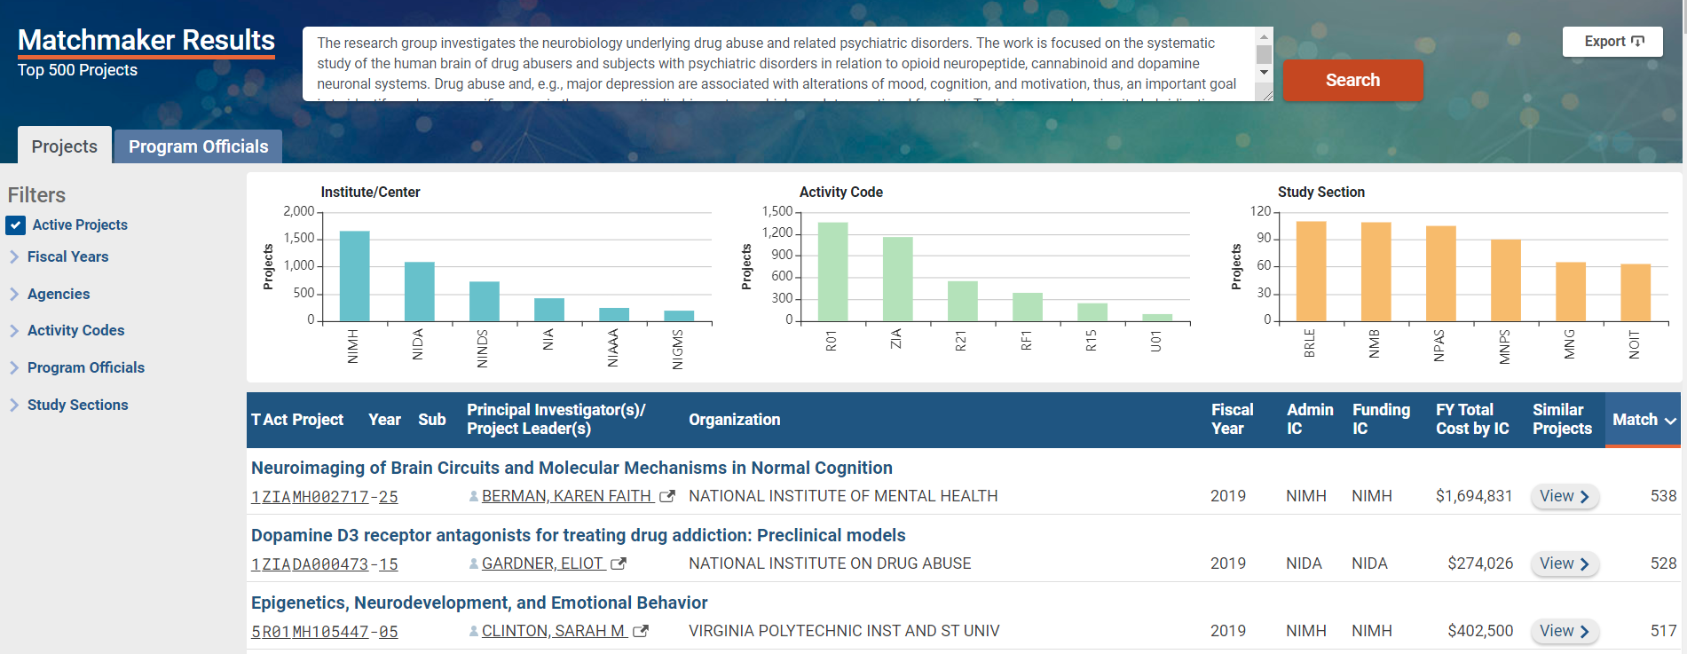
Matchmaker: Who Can I Contact to Discuss My Ideas?
Matchmaker summarizes the projects by the program official, institute or center, review panel, and activity code

Slide 15
NIH Awards by Location: Explore Funding to Your Organization
What types of organizations does NIH fund?
Who has NIH funding in my university system?

Slide 16
Explore Funding at Your Organization or State
Use Awards by Location tool to view year by year funding by:
Organization
School
Department
State/country
Congressional District
Uses frozen data for past fiscal years

Slide 17
Institutional Funding – By School
Use Awards by Location tool to view year by year funding by:
Organization
School
Department

Slide 18
Institutional Funding – By Department
Use Awards by Location tool to view year by year funding by:
Organization
School
Department

Slide 19
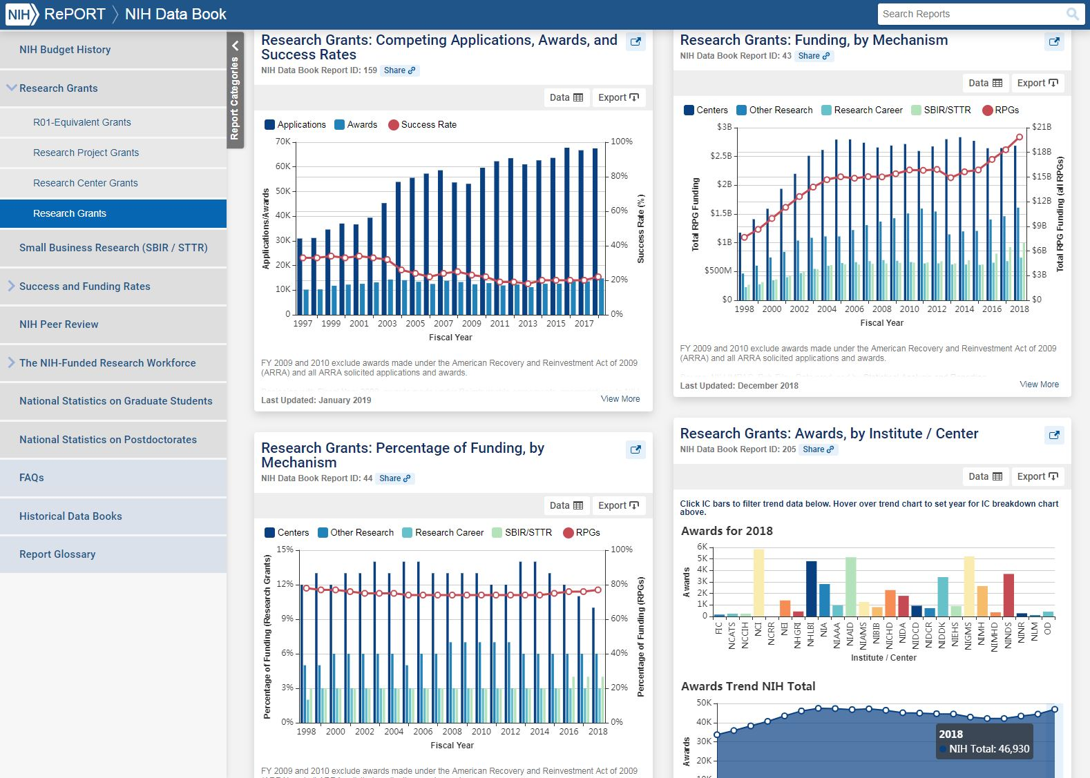
NIH Data Book: Which Programs Should I Apply for? What Are My Chances of Getting Funded?
The NIH Data Book summarizes answers to the most commonly asked questions about the NIH budget and extramural programs.
Data are updated annually.

Slide 20
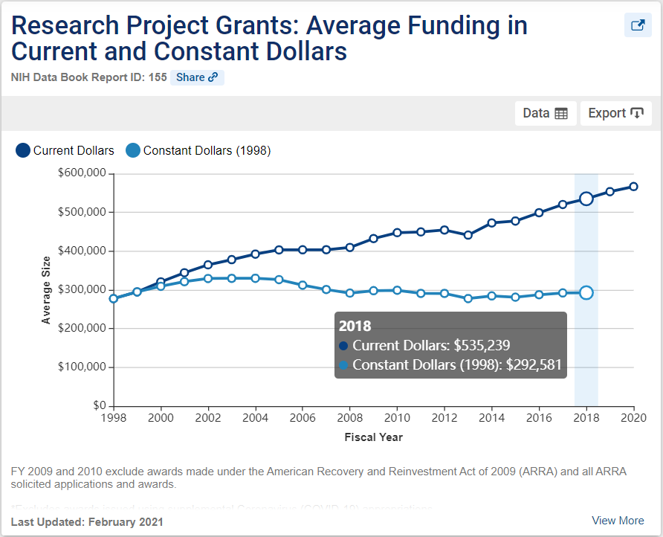
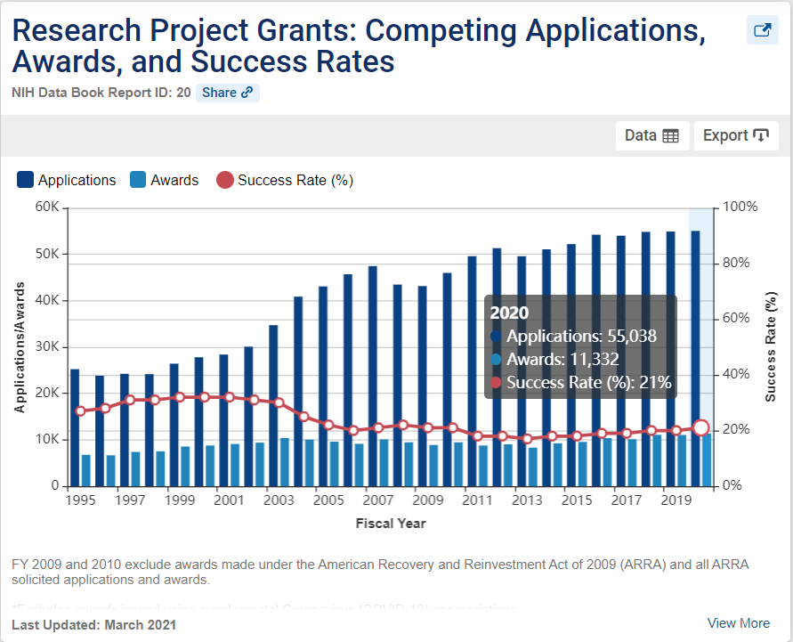
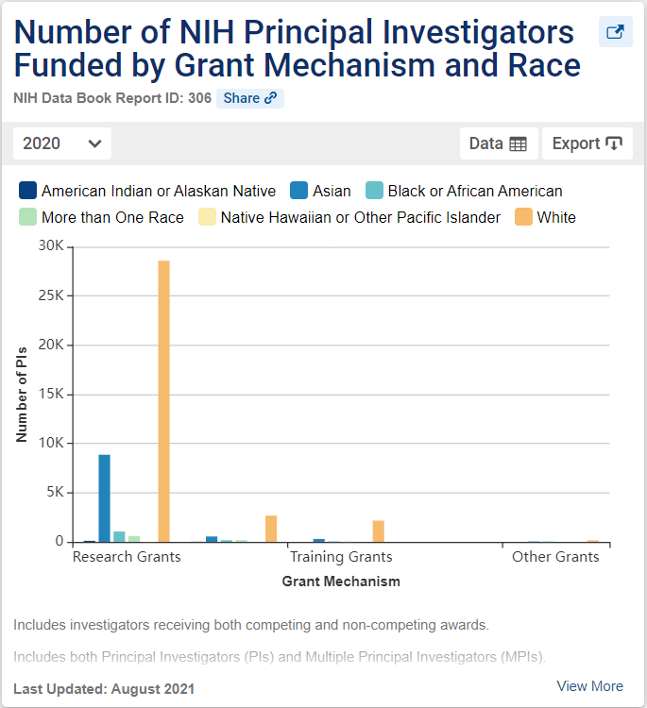
NIH Data Book Examples
Dozens of charts and tables in areas of –
Budget
Research Grants
Small Business
Success and Funding Rates
Peer Review
NIH-Funded Workforce
Charts and data are exportable for re-use.

Slide 21
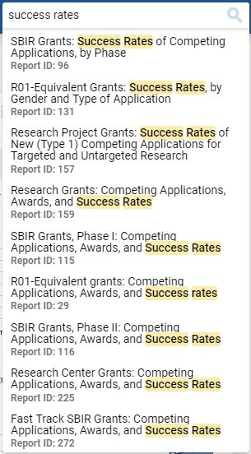
Easily Find the Data You’re Looking For
Intuitive to help you find what you’re looking for:
Built-in search
Interactive visualizations
View different subsets of data

Slide 22
How Much Does NIH Spend On …?
Categorical Spending provides levels of NIH funding over time for:
Research areas
Conditions
Diseases

Slide 23
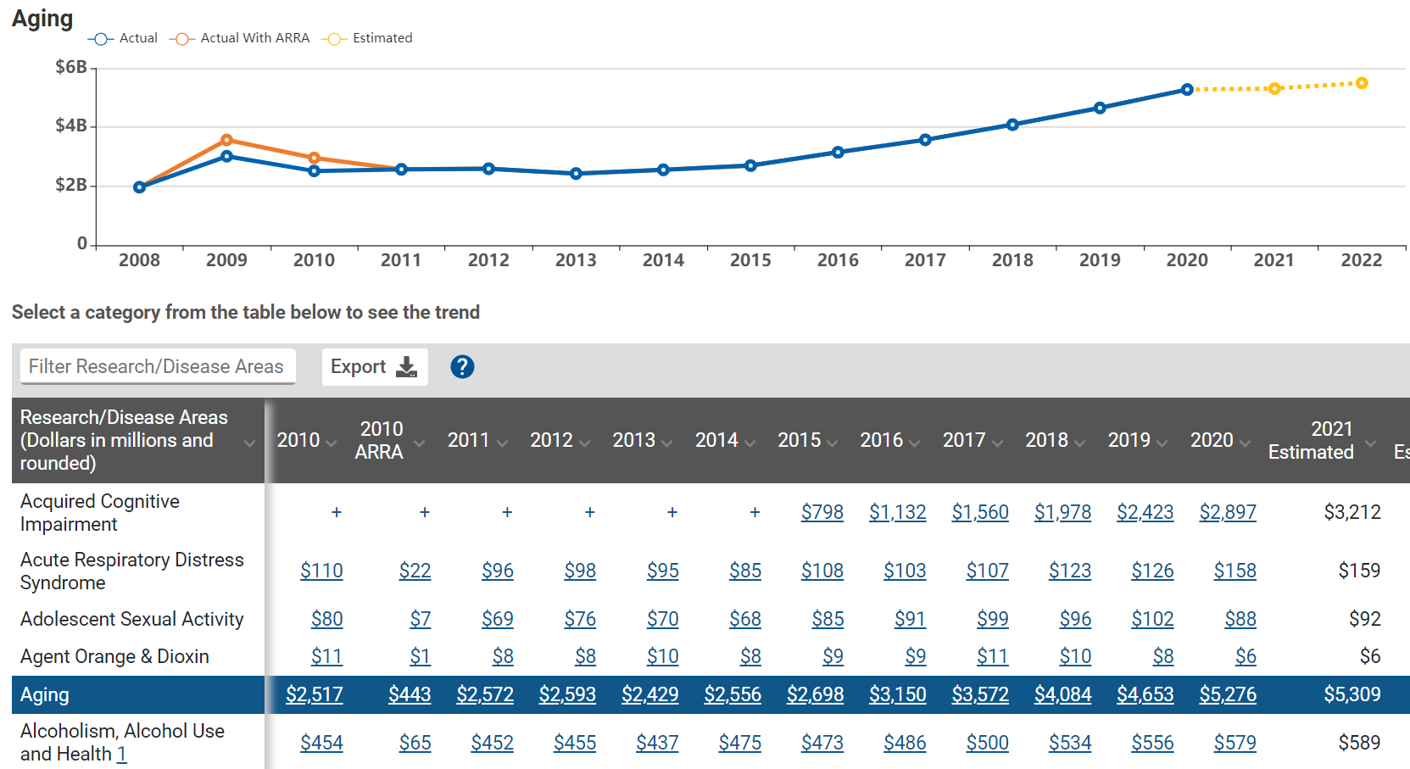
View Trends in Categorical Spending
Annual support level for various research, condition, and disease categories

Slide 24
Summary
What is the NIH already funding in my research area?
What results came out of those projects?
Which ICs have scientific priorities that align with my research ideas?
How can I find a relevant point of contact at NIH to discuss my research ideas?
How can I find collaborators?
What are other PIs at my institution working on?
Which types of programs should I apply for, and what are my chances of getting funded?
What is the NIH already funding in my research area? RePORTER text search
What results came out of those projects? RePORTER search results (tabs for Publications, Patents, Clinical Studies, News & More)
Which ICs have scientific priorities that align with my research ideas? Matchmaker (summary by IC)
How can I find a relevant point of contact at NIH to discuss my research ideas? Matchmaker (Similar POs)
How can I find collaborators? RePORTER or Matchmaker
What are other PIs at my institution working on? NIH Awards by Location
Which types of programs should I apply for, and what are my chances of getting funded? NIH Data Book

Slide 25
Other Resources for Understanding the Grants Process
More information to guide you through the application process can be found at https://grants.nih.gov

Slide 26
Thank You
Need Help? RePORT@mail.nih.gov
Websites
RePORT: https://report.nih.gov
RePORTER: https://reporter.nih.gov

