Slide 1
Keynote: Perspectives on Extramural Research in the Era of COVID-19
Michael Lauer, MD
Deputy Director for Extramural Research; Director, Office of Extramural Research
National Institutes of Health (NIH)
NIH Virtual Seminar
November 1, 2021
Virtual Meeting
Disclosures: None

Slide 2
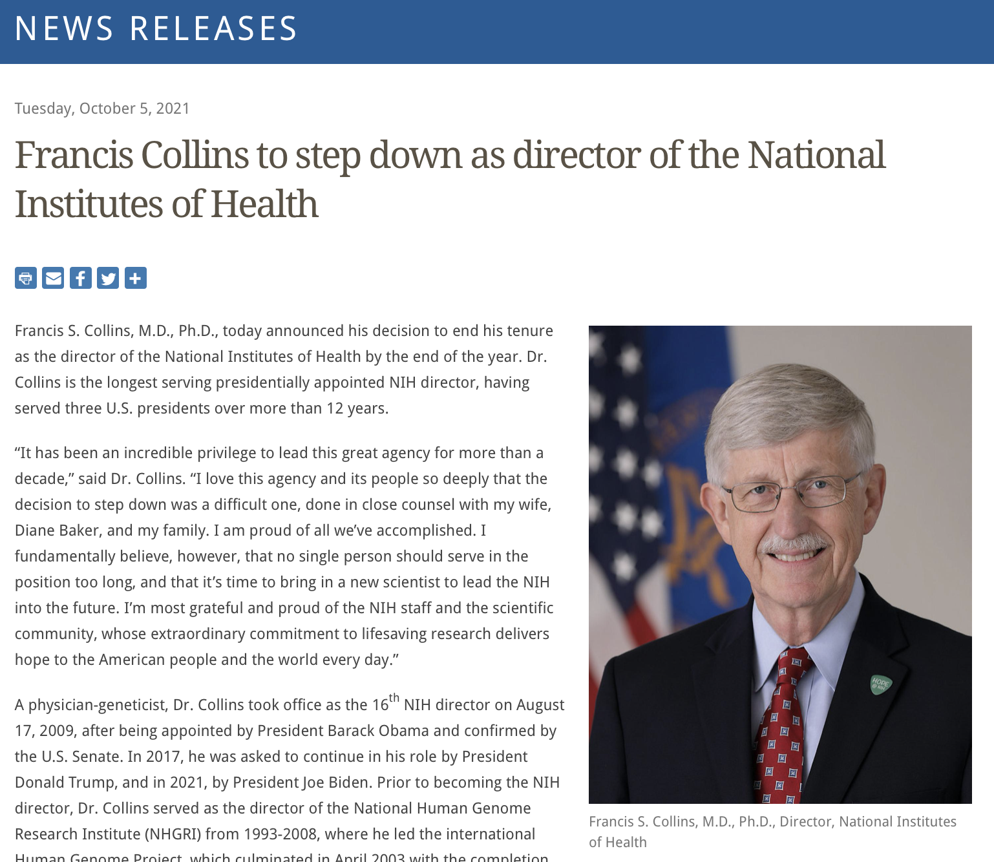
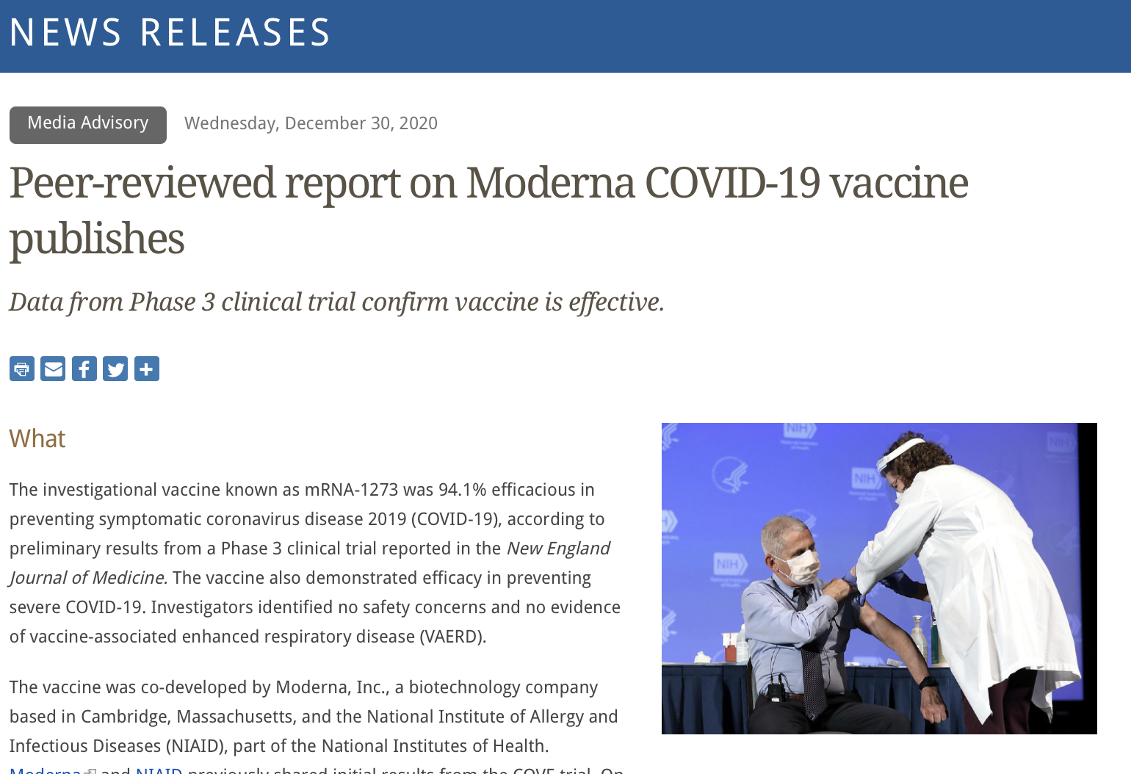
FY2021: Historical Year!
https://www.nih.gov/news-events/news-releases/peer-reviewed-report-moderna-covid-19-vaccine-publishes
https://www.nih.gov/news-events/news-releases/francis-collins-step-down-director-national-institutes-health

Slide 3

Perhaps the Current Question
Consensus
  Community and expertise
  Empirically-informed dissent
Diversity
  Overcome shared biases
  Multiple perspectives
Methodological openness, flexibility
https://press.princeton.edu/books/hardcover/9780691179001/why-trust-science

Slide 4
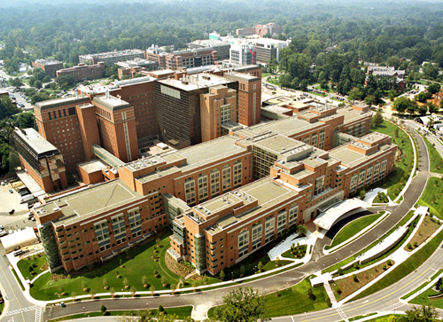
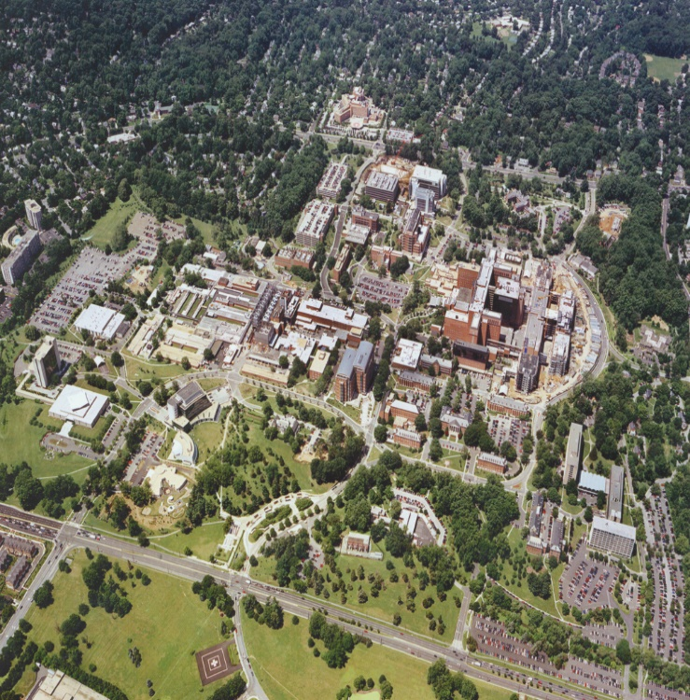
NIH Communities
NIH INTRAMURAL RESEARCH
NIH is an institution
NIH EXTRAMURAL RESEARCH
Supports:
Over 6,000 scientists
11% of NIH budget
Primary location: Bethesda, MD
A few labs throughout U.S.
Supports:
Over 2,600 institutions worldwide
Over 300,000 scientists & research personnel
Awards issued to over 100 countries
Clinical, Basic, & Translational Research
Over 80% of the NIH budget
*All figures are estimates.

Slide 5
Supporting a Growing Community: FY2021 Budget
Mechanism | Amount ($B) | Percent NIH Budget
Research Projects (RPG) | 23.1 | 54.0
SBIR/STTR | 1.17 | 2.7
Research Centers | 2.75 | 6.4
Other Research | 2.95 | 6.9
Training | 0.95 | 2.2
Research Contracts | 3.36 | 7.8
Intramural Research | 4.54 | 10.6
RMS | 2.07 | 4.8

Slide 6
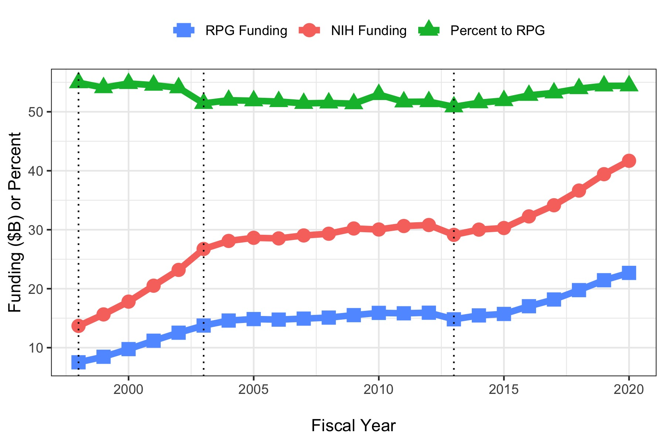
Funding

Slide 7
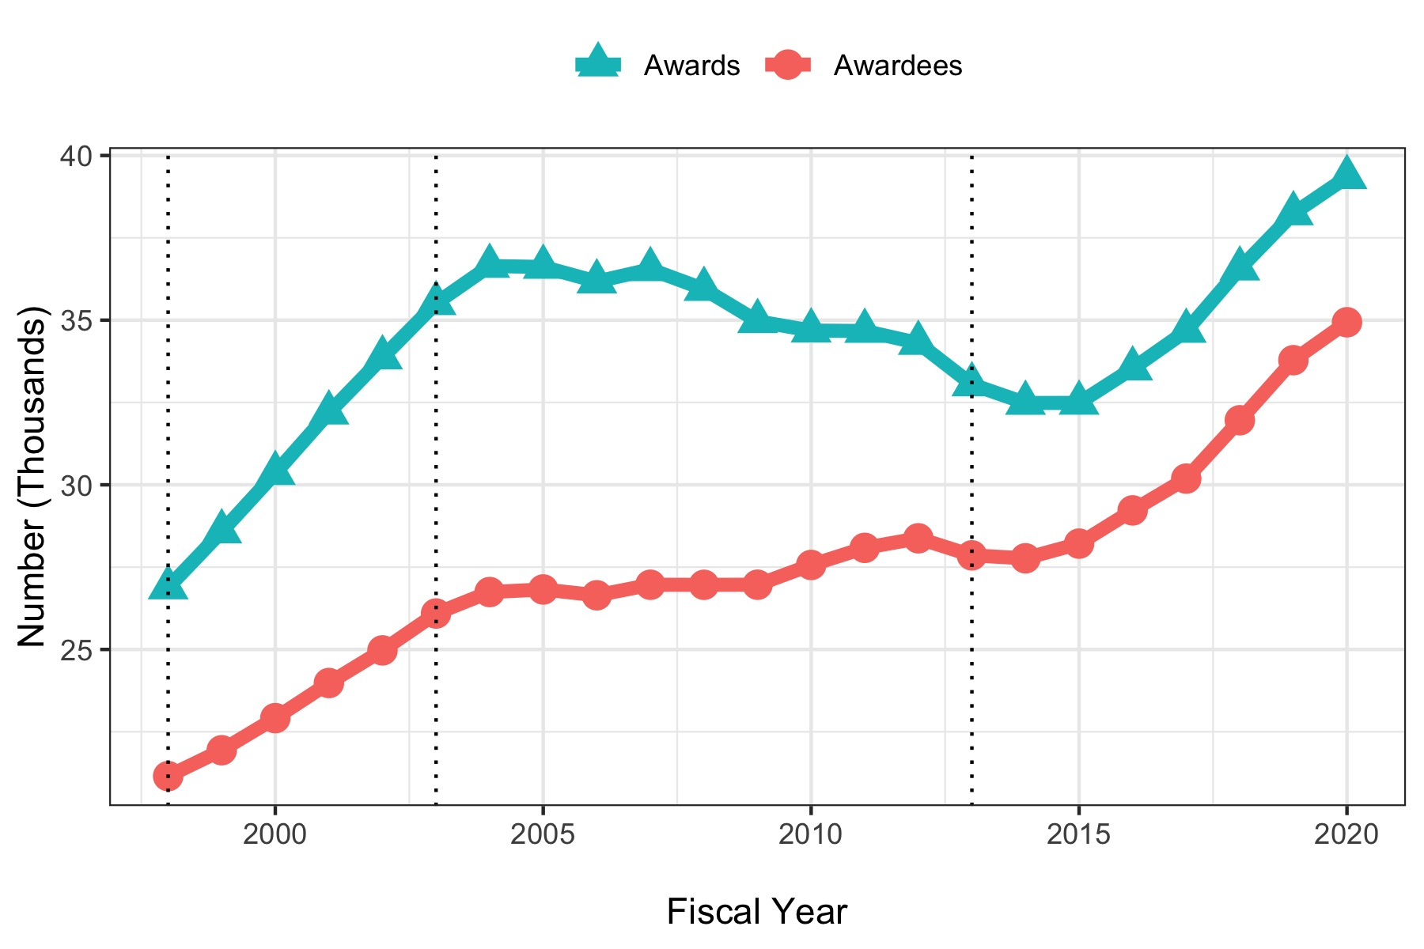
Awards and Awardees

Slide 8
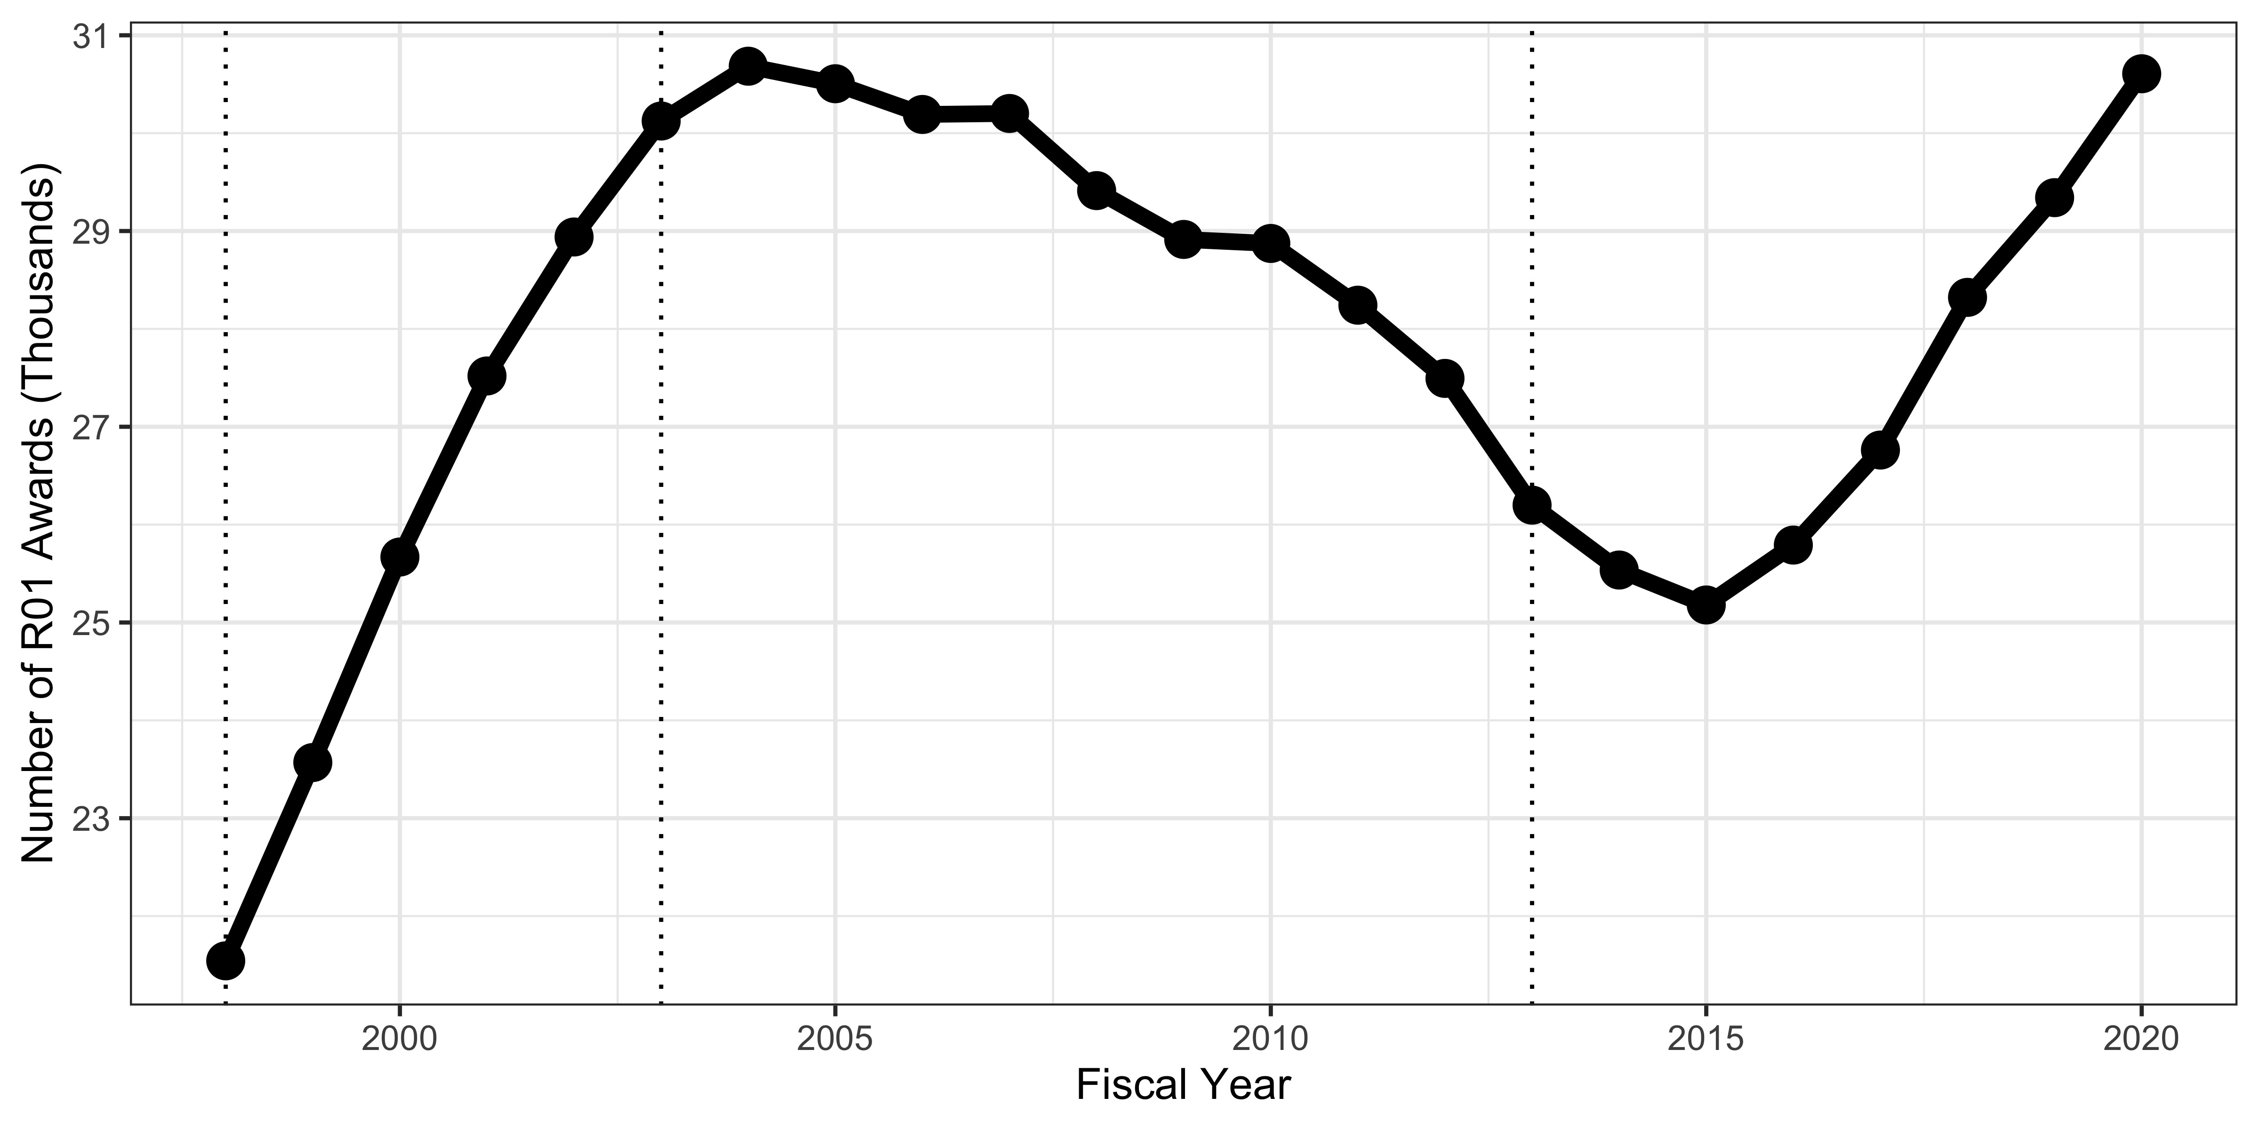
R01-equivalent Numbers

Slide 9
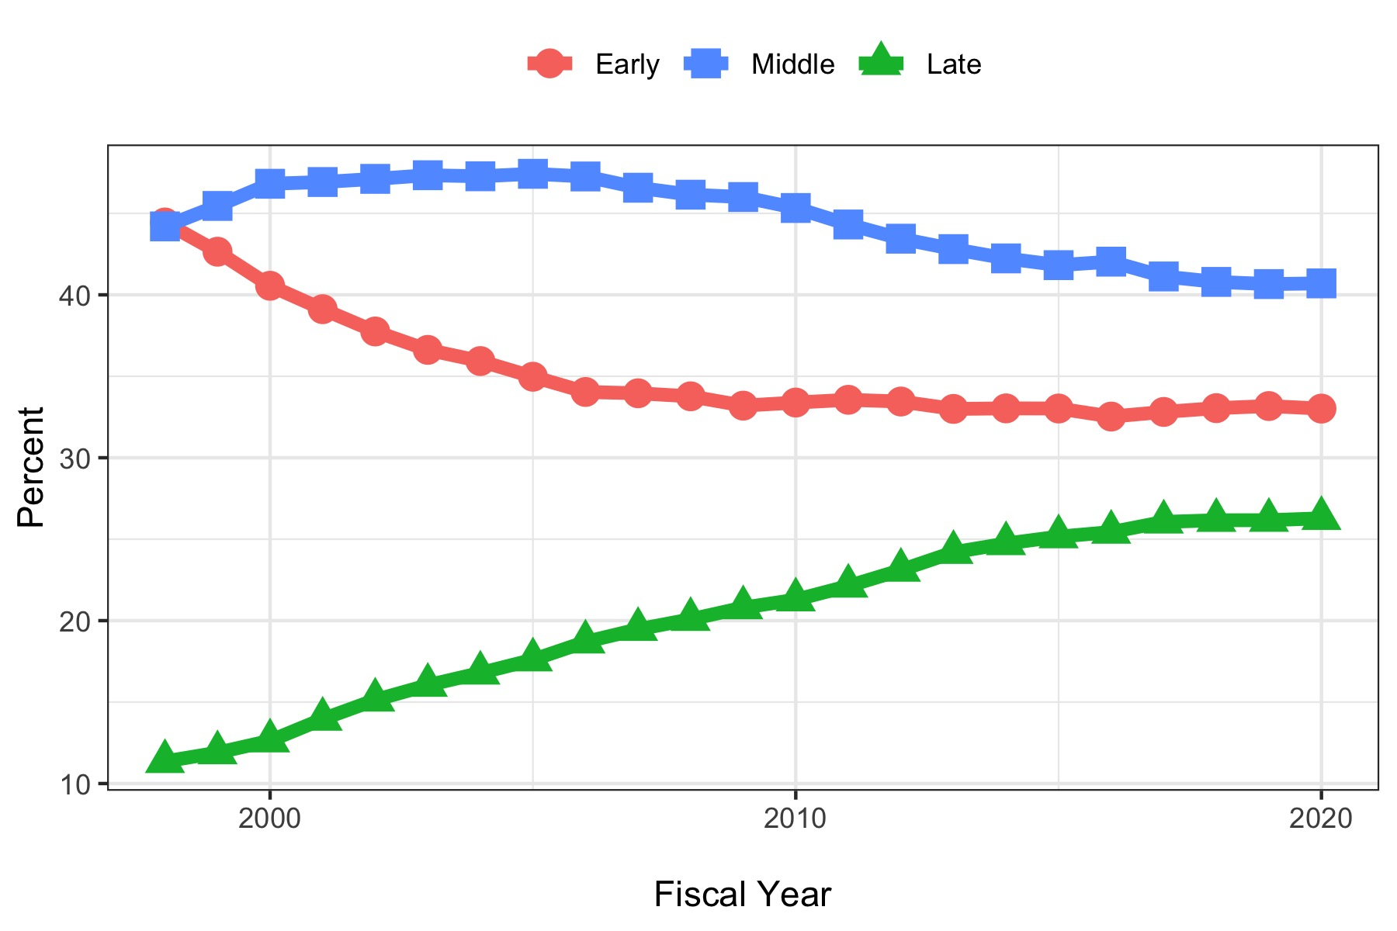
Career Stage

Slide 10
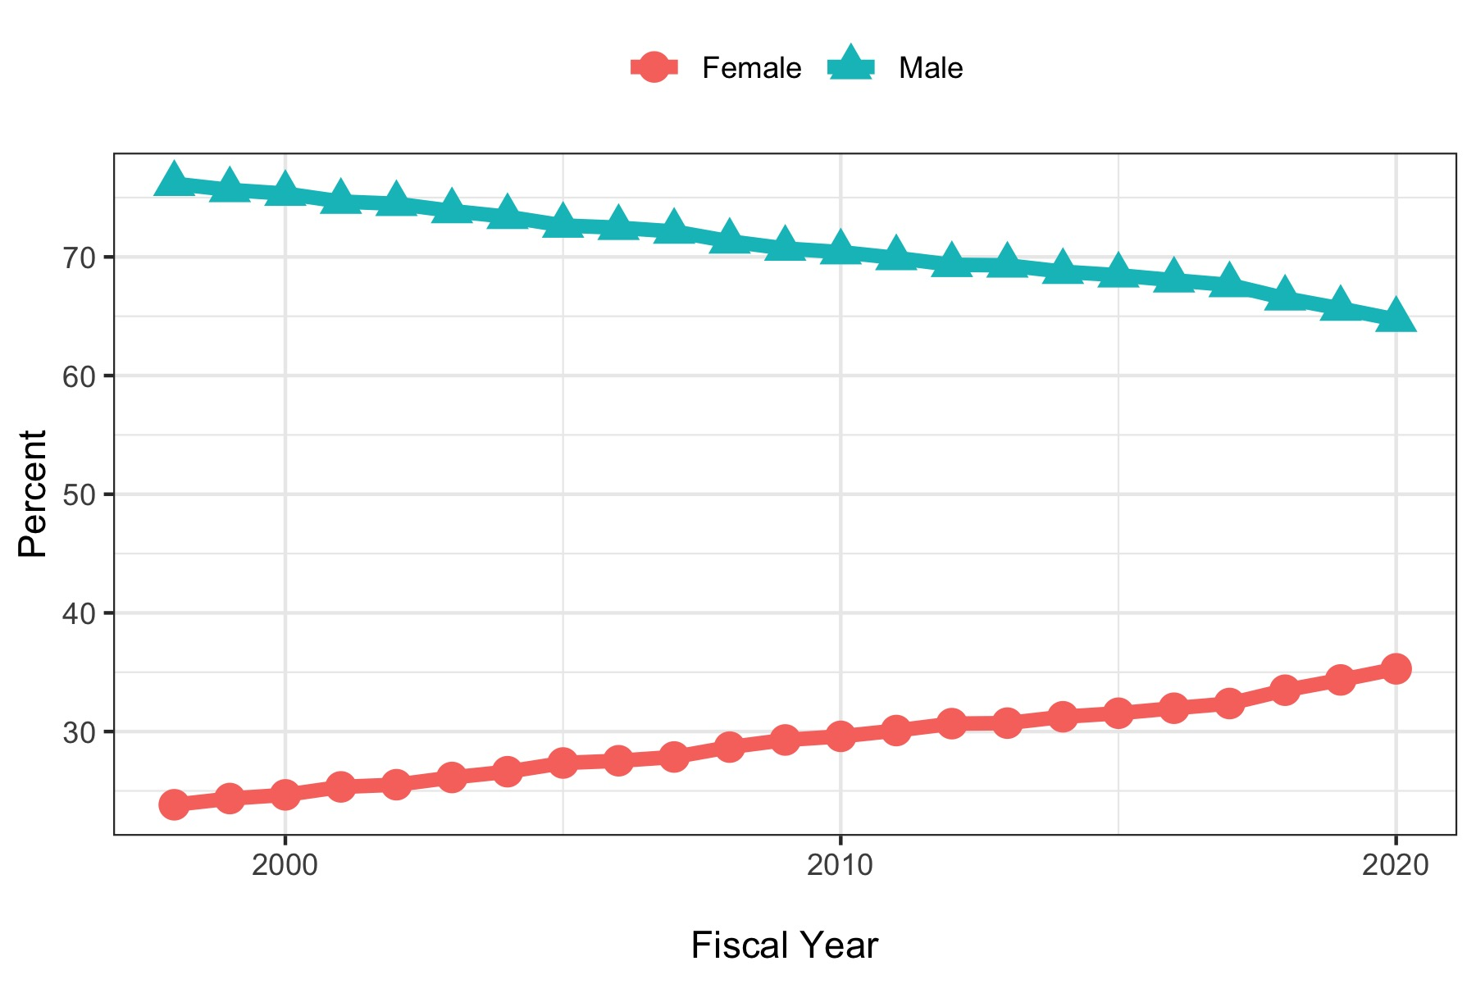
Gender

Slide 11
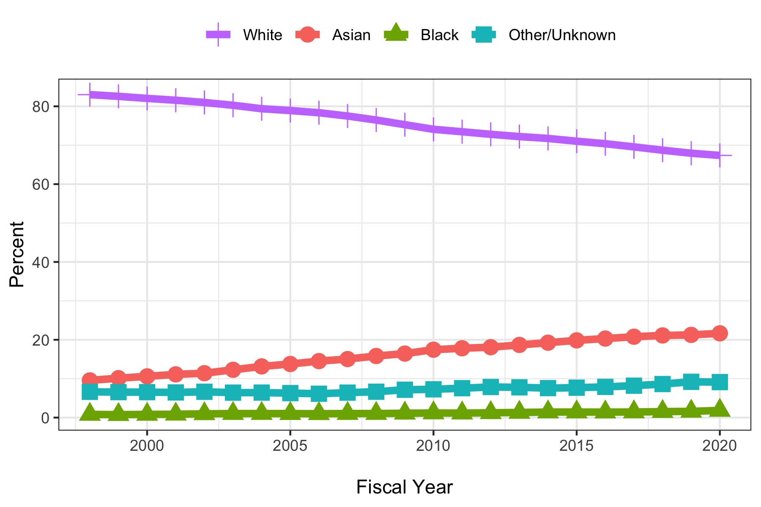
Chart of Percentage of Awardees by Race
Race

Slide 12
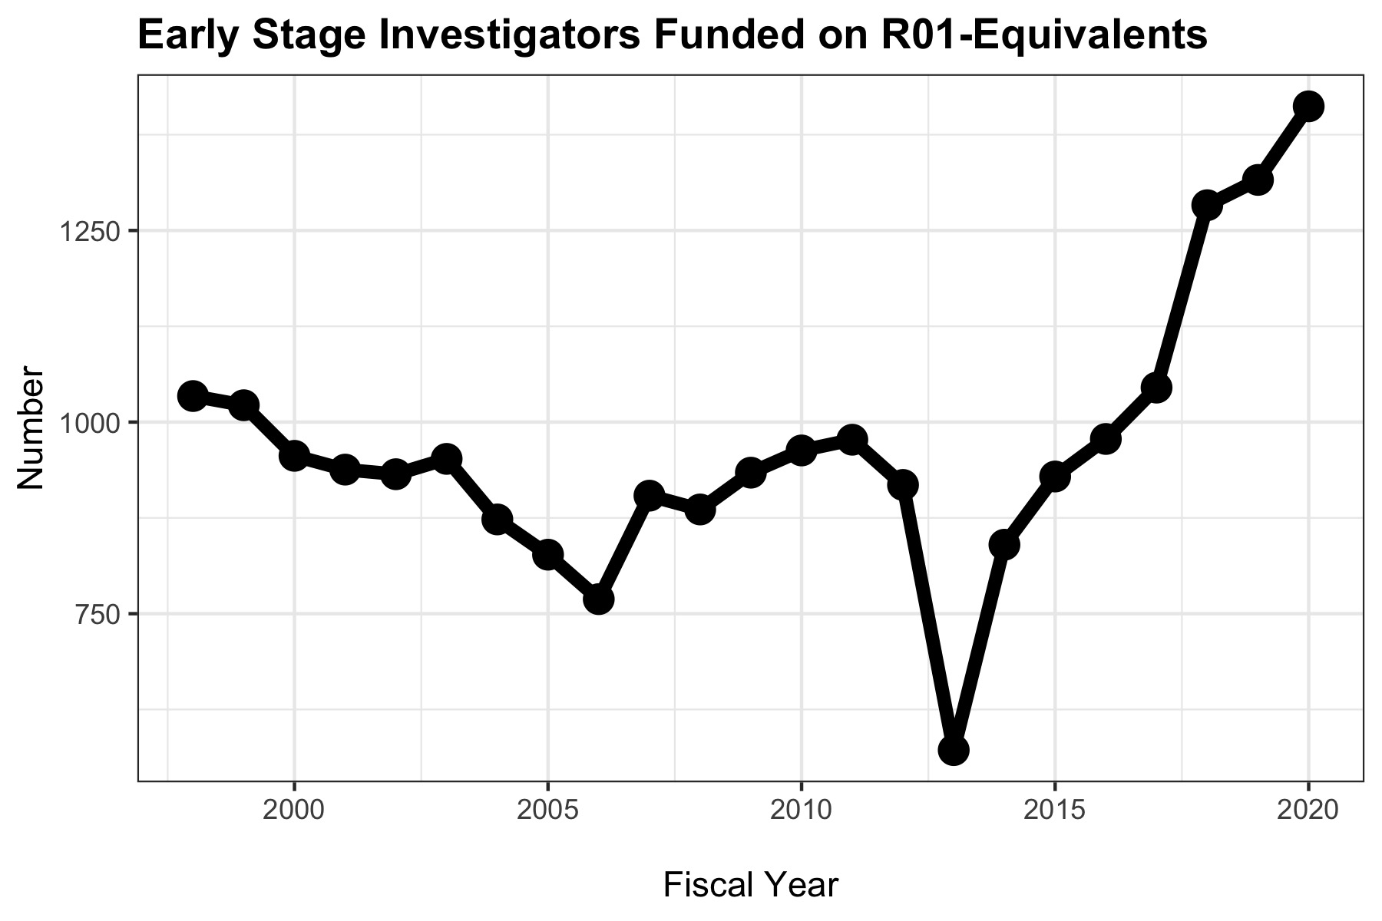
Early Stage Investigators Funded on R01-Equivalents

Slide 13
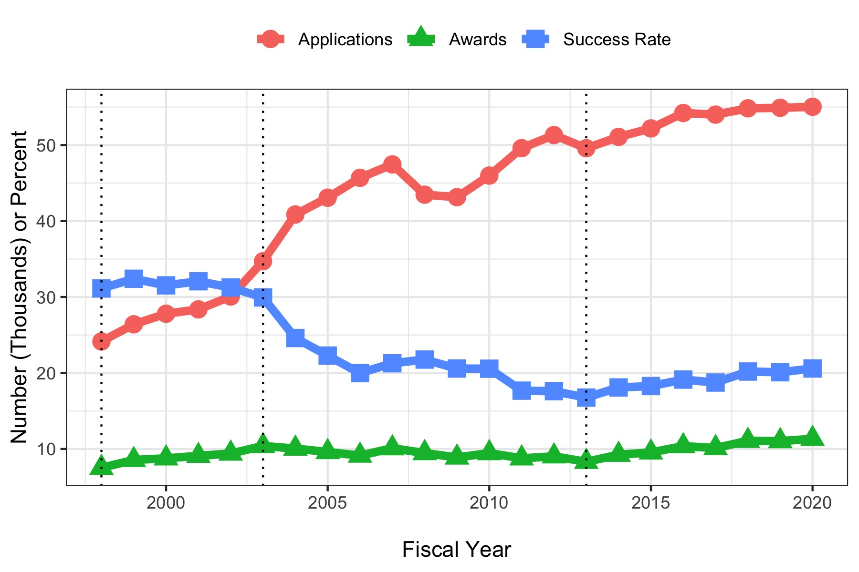
Award Competition

Slide 14
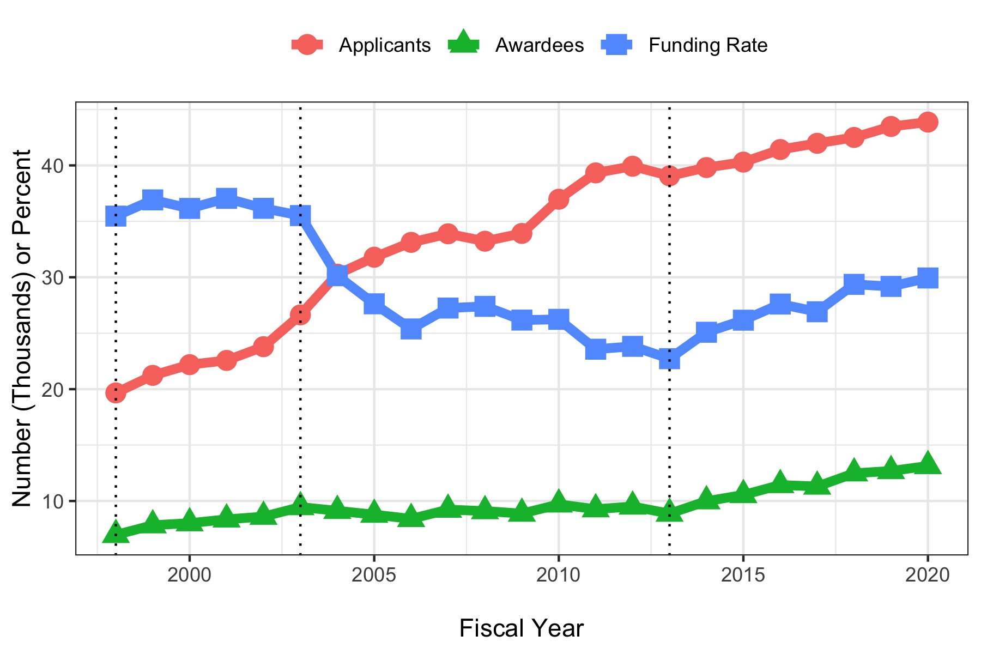
PI Competition

Slide 15
Summary of Trends: Growing Community
Increased number of awards and awardees
Increased number of Early-Stage Investigators
Increased proportion of women (but well below parity)
Persistent low proportion of Black investigators
Increased success, funding rates despite more applications / applicants

Slide 16
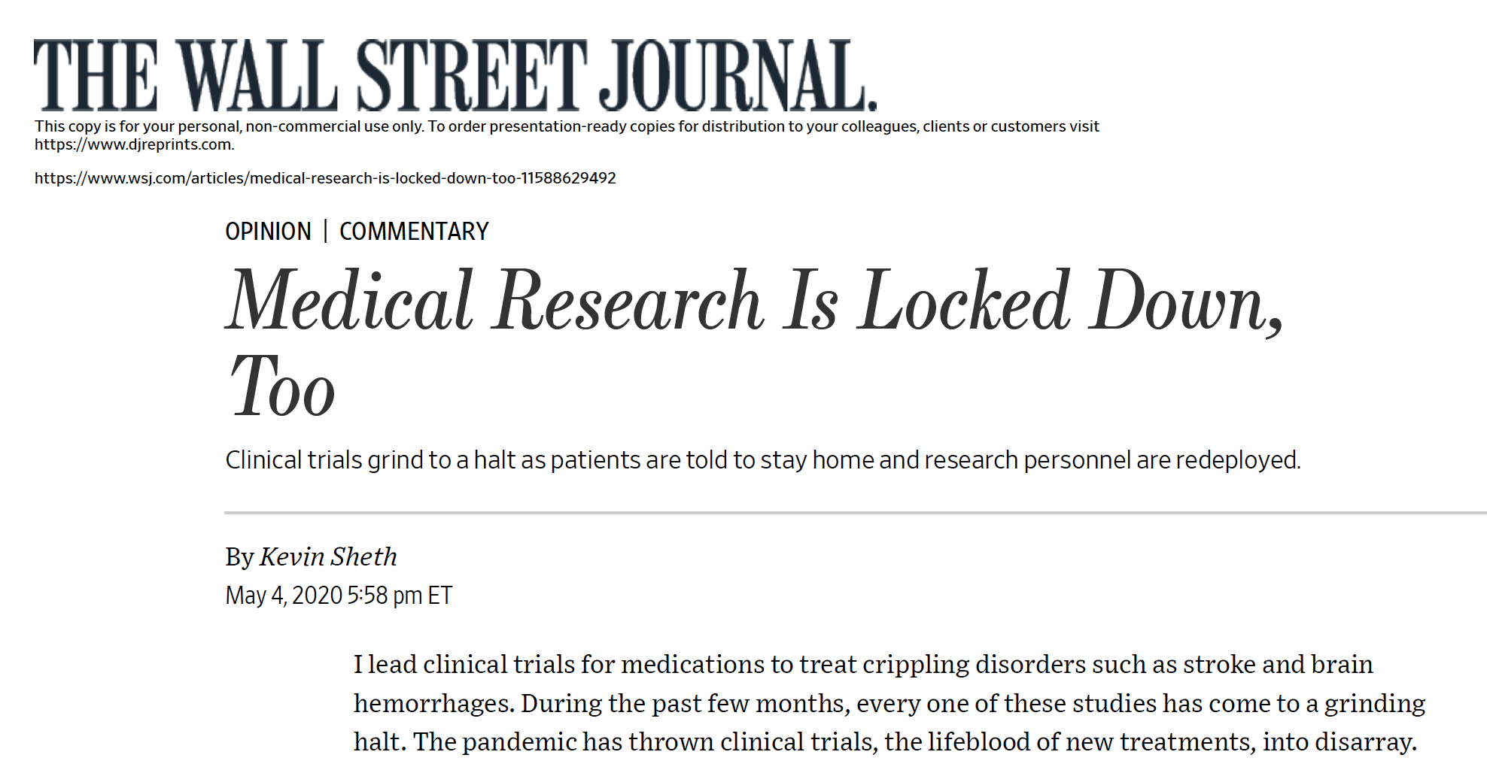
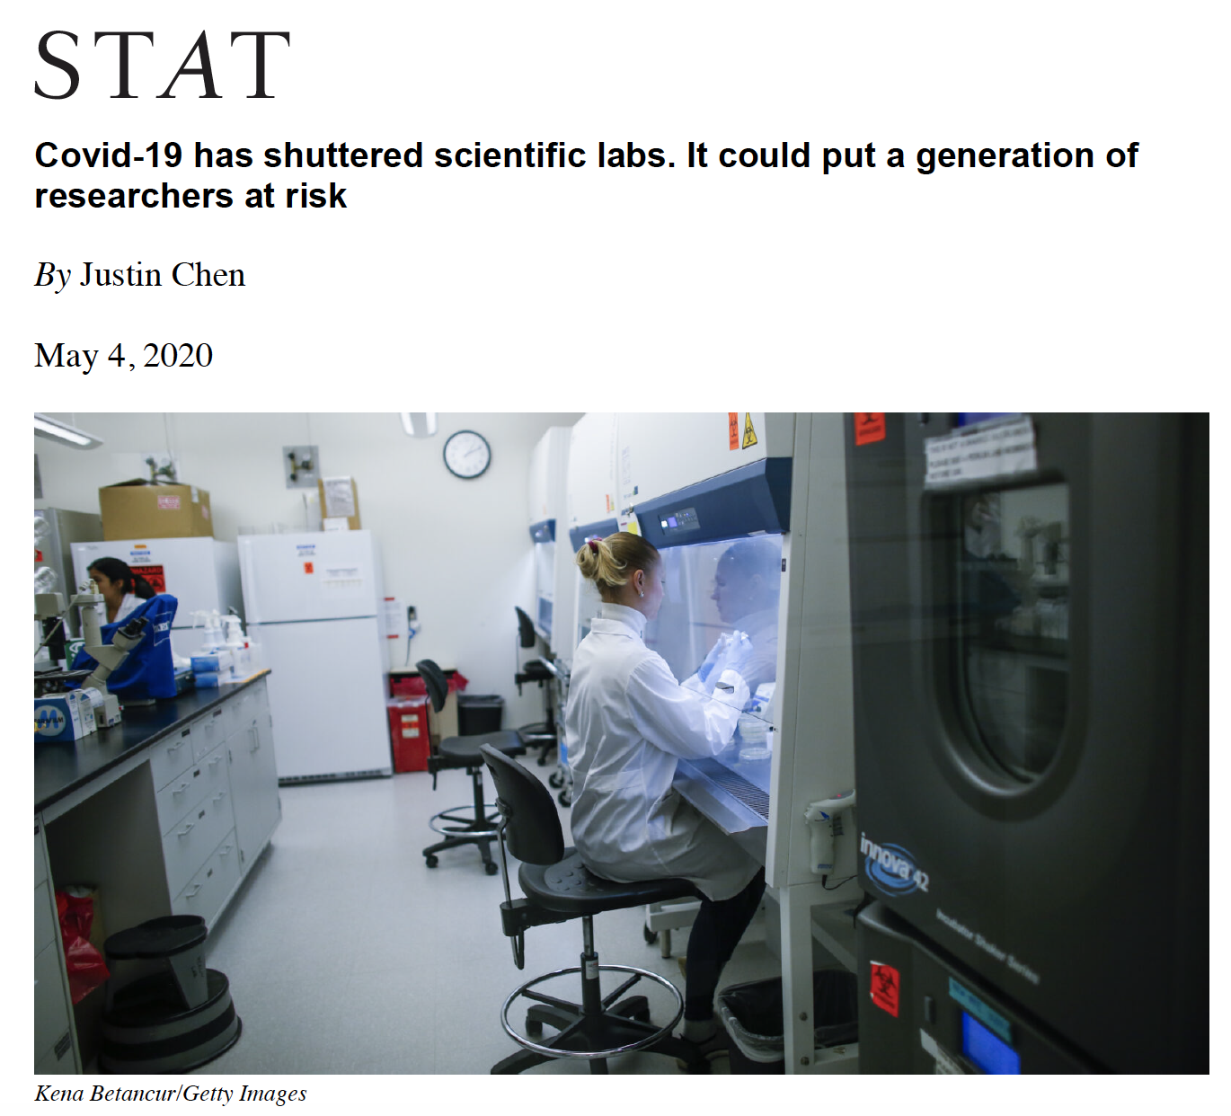
Growing but Stressed Community …

Slide 17

Stresses …
“To those individuals in the biomedical research enterprise who have endured disadvantages due to structural racism, I am truly sorry. NIH is committed to instituting new ways to support diversity, equity, and inclusion, and identifying and dismantling any policies and practices at our own agency that may harm our workforce and our science.” — Francis S. Collins, M.D., Ph.D., NIH Director

Slide 18
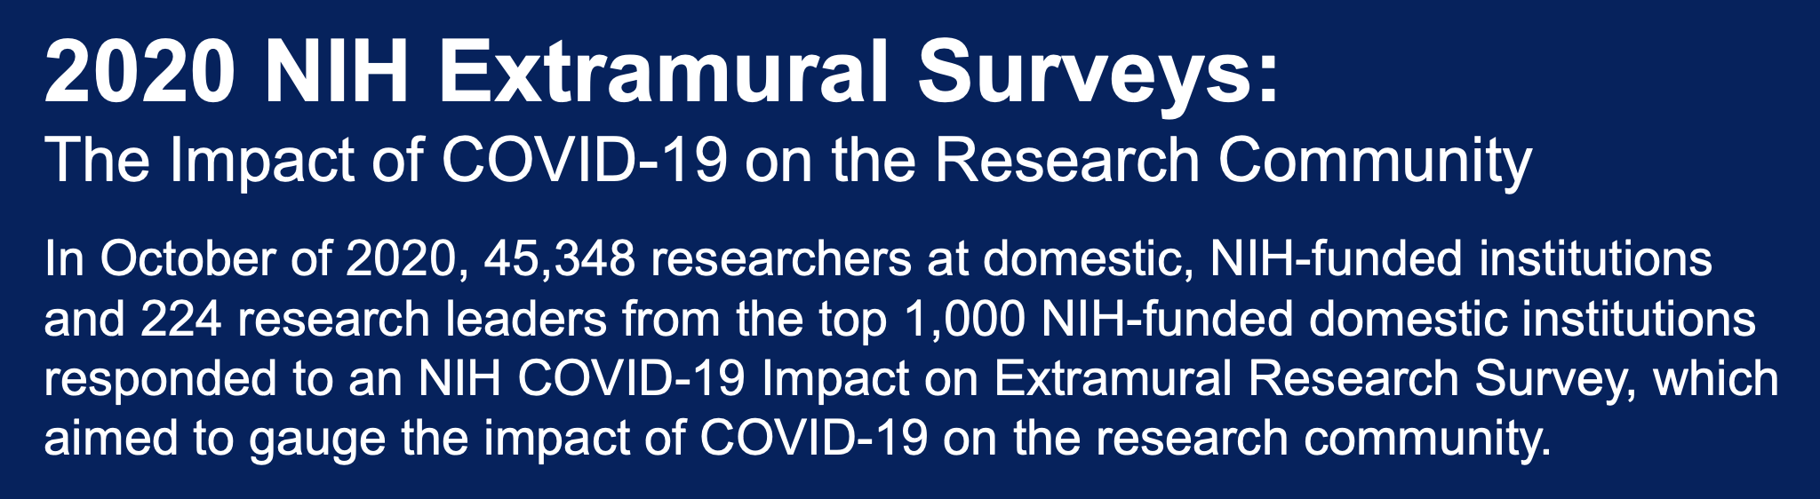
Input from Institutions and Researchers
https://grants.nih.gov/sites/default/files/NIH%20COSWD_COVID19%20Impact_Infographic_vF_Updated_3-19.pdf

Slide 19
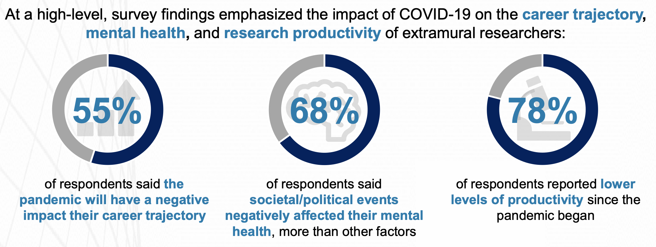
High-Level Findings
https://grants.nih.gov/sites/default/files/NIH%20COSWD_COVID19%20Impact_Infographic_vF_Updated_3-19.pdf

Slide 20
Impact on Career Trajectory by Career Stage
20
diversity.nih.gov

Slide 21
Impact on Career Trajectory by Type of Research
21
diversity.nih.gov

Slide 22
Impact on Career Trajectory by Race & Gender
Race by Gender | % Impacted
Asian, Men | 67%
Asian, Other Gender | 64%
Asian, Women | 62%
White, Other Gender | 61%
Two or More Races, All Genders | 59%
All Respondents | 55%
AIAN, Women | 41%
African American, Men | 40%
African American, Women | 39%
NHPI, Men | 31%
African American, Other Gender | 22%
22
diversity.nih.gov

Slide 23
Most Important Predictors of Career Trajectory Concerns
 | Top 10 Variables (Negative Class Predictors) | Importance
1 | Ability to apply for grants | 0.1634
2 | Progress towards promotion/tenure | 0.0627
3 | Reduced access to on-site laboratories | 0.0604
4 | Reduced access to core facilities | 0.0573
5 | Concern for the health of family and friends | 0.0510
6 | Reduced access to colleagues | 0.0479
7 | Caretaking responsibilities | 0.0402
8 | Lost access to expertise | 0.0321
9 | Timeline uncertainty for returning to work | 0.0277
10 | Personal mental/physical health has impacted productivity | 0.0258
AUC = 79.3
23
diversity.nih.gov

Slide 24

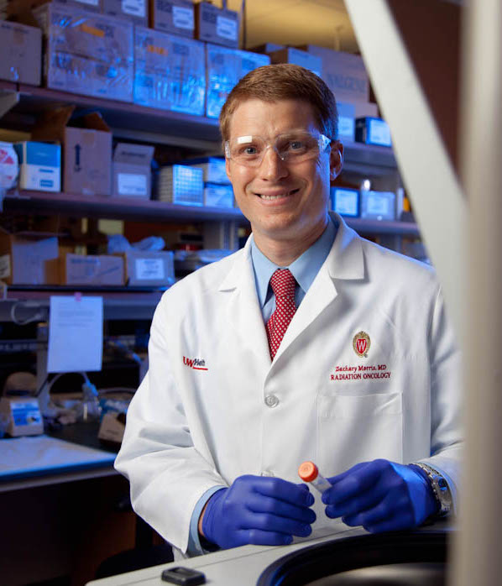
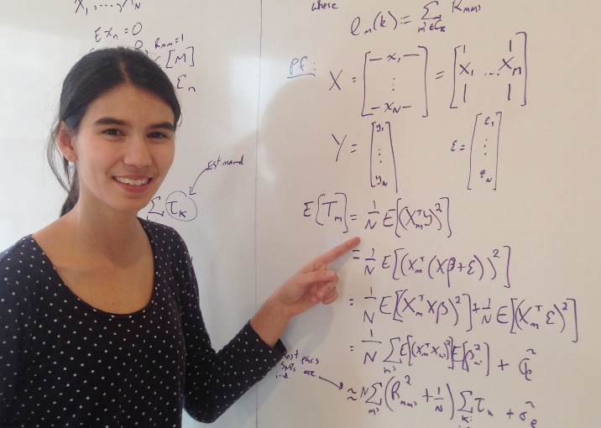
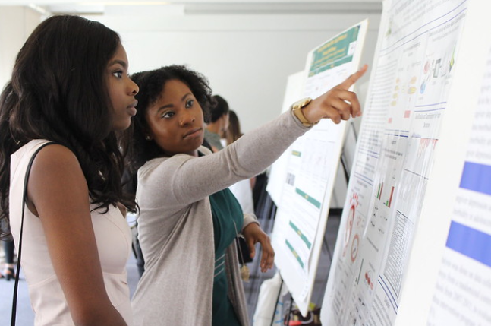
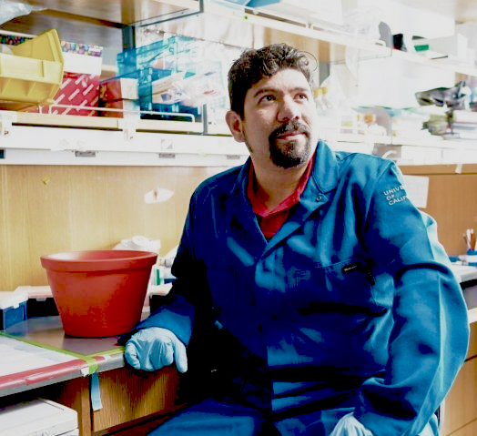
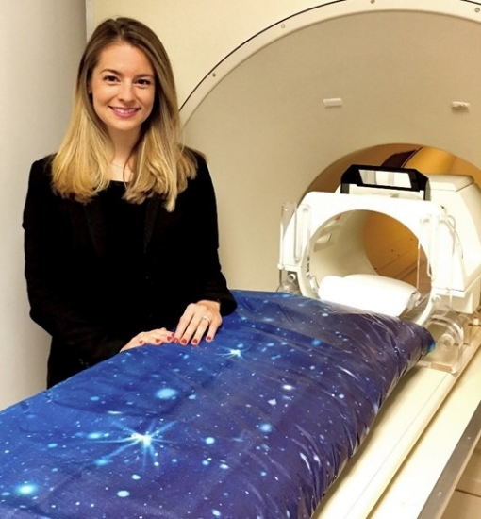
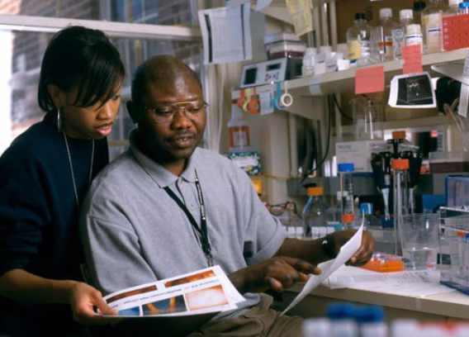
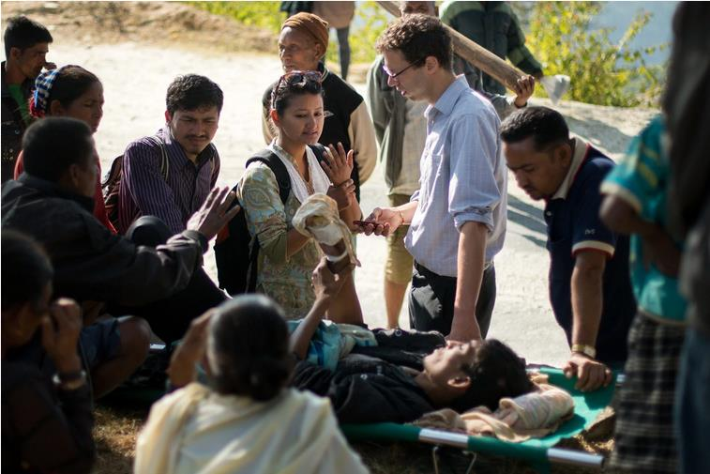
NIH’s Priorities for Early Career Investigators
Thanks to Francis Collins

Slide 25

Flexibilities
No-cost extensions (2nd no-cost extensions)
Funded extensions for select F and K awards
Eligibility extensions:
  Early-Stage Investigator status: ~500 to ~1000
  K99/R00
Leniency on late applications
Preliminary data post-submission

Slide 26
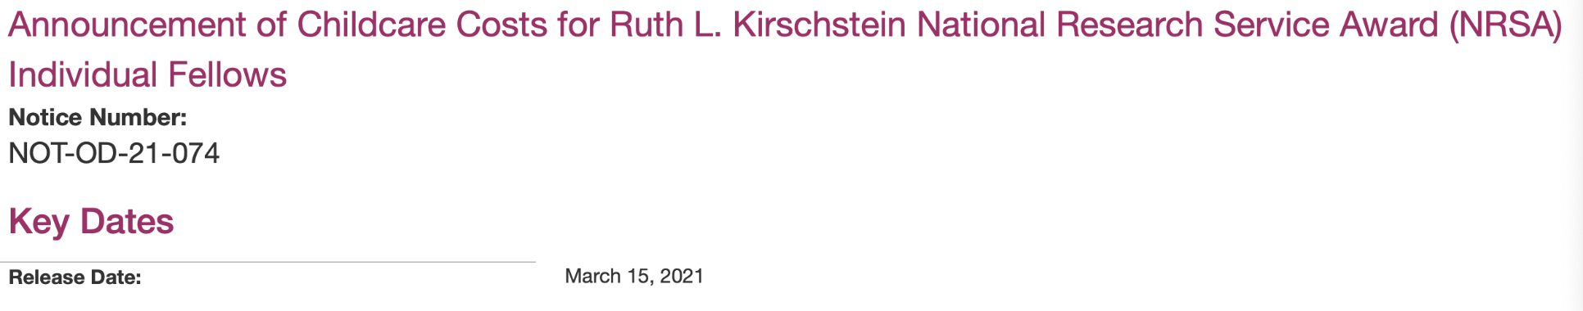

Childcare Allowance
$2500 / year / Fellow
Defray child-care costs
  Children < 13 years, disabled < 18 years
  Licensed childcare provider
  Recipient responsible for documentation
Plan for T awardees in FY2022

Slide 27
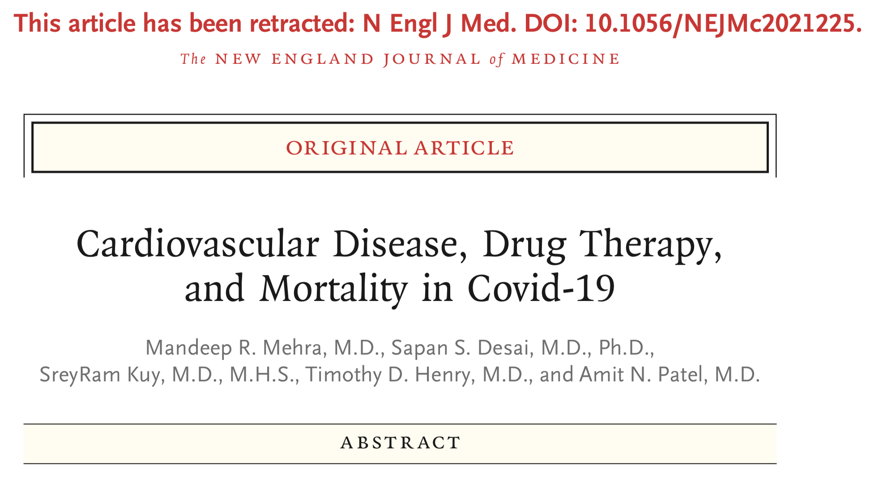
Threats to Community: Concerns About Integrity

Slide 28
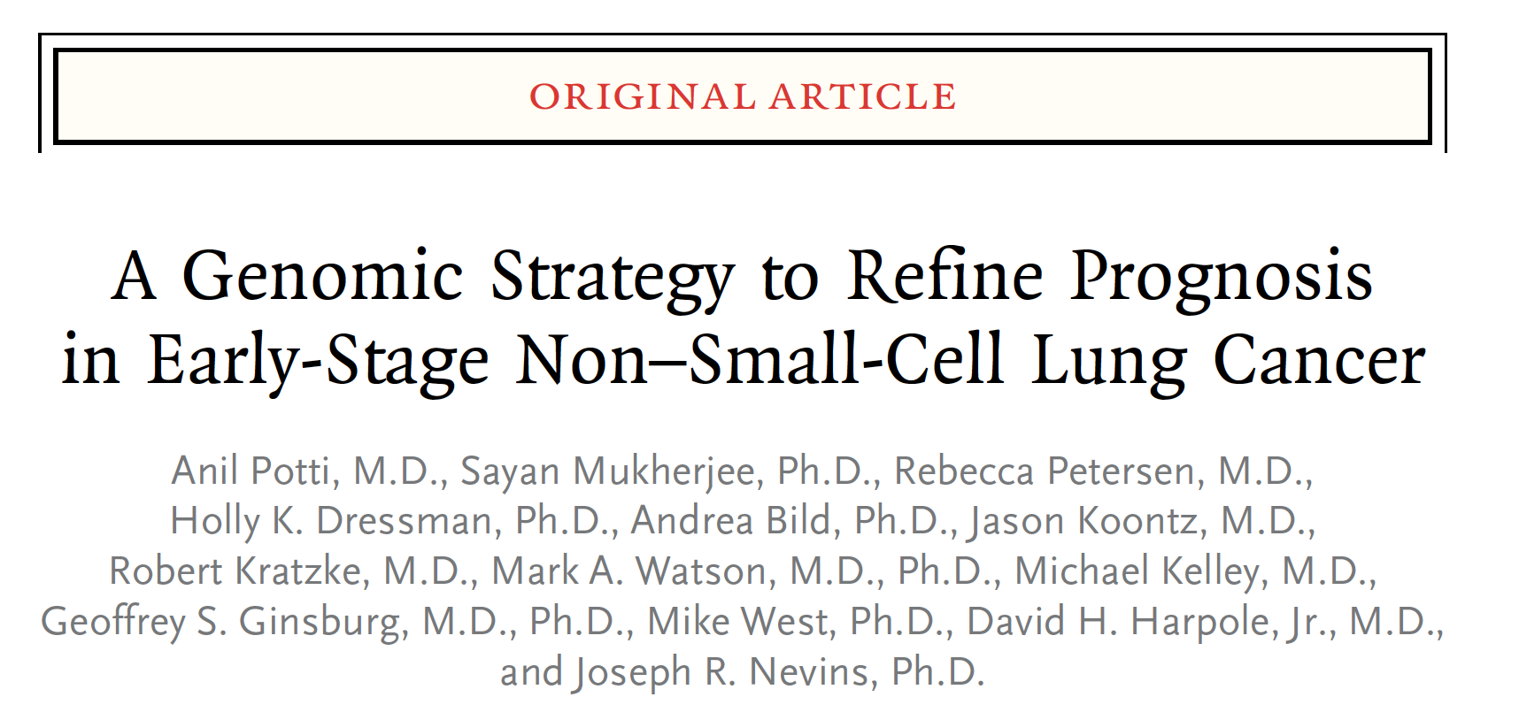
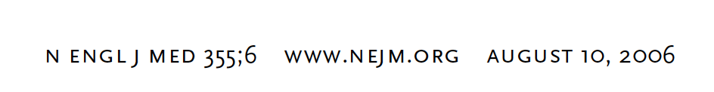
“Classic” Misconduct

Slide 29
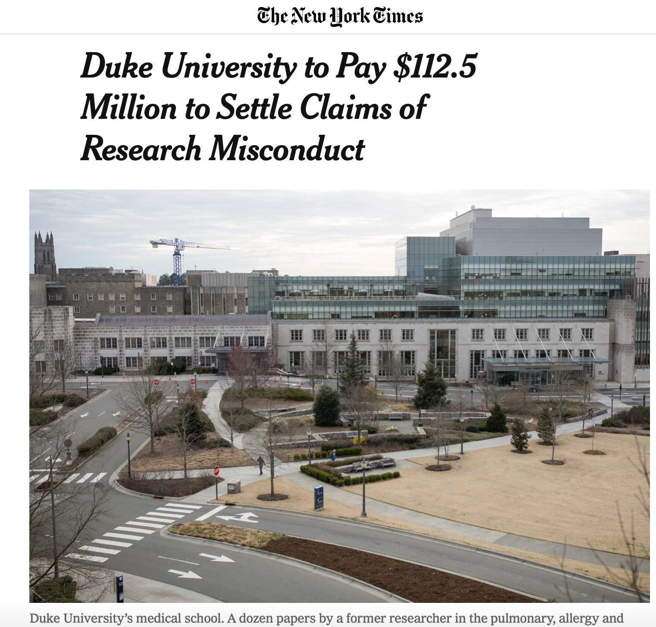
Consequences of Repeated Misconduct …
“ Vincent E. Price, president of Duke University, said … ‘This is a difficult moment for Duke. This case demonstrates the devastating impact of research fraud and reinforces the need for all of us to have a focused commitment on promoting research integrity and accountability.’”
https://www.nytimes.com/2019/03/25/science/duke-settlement-research.html

Slide 30
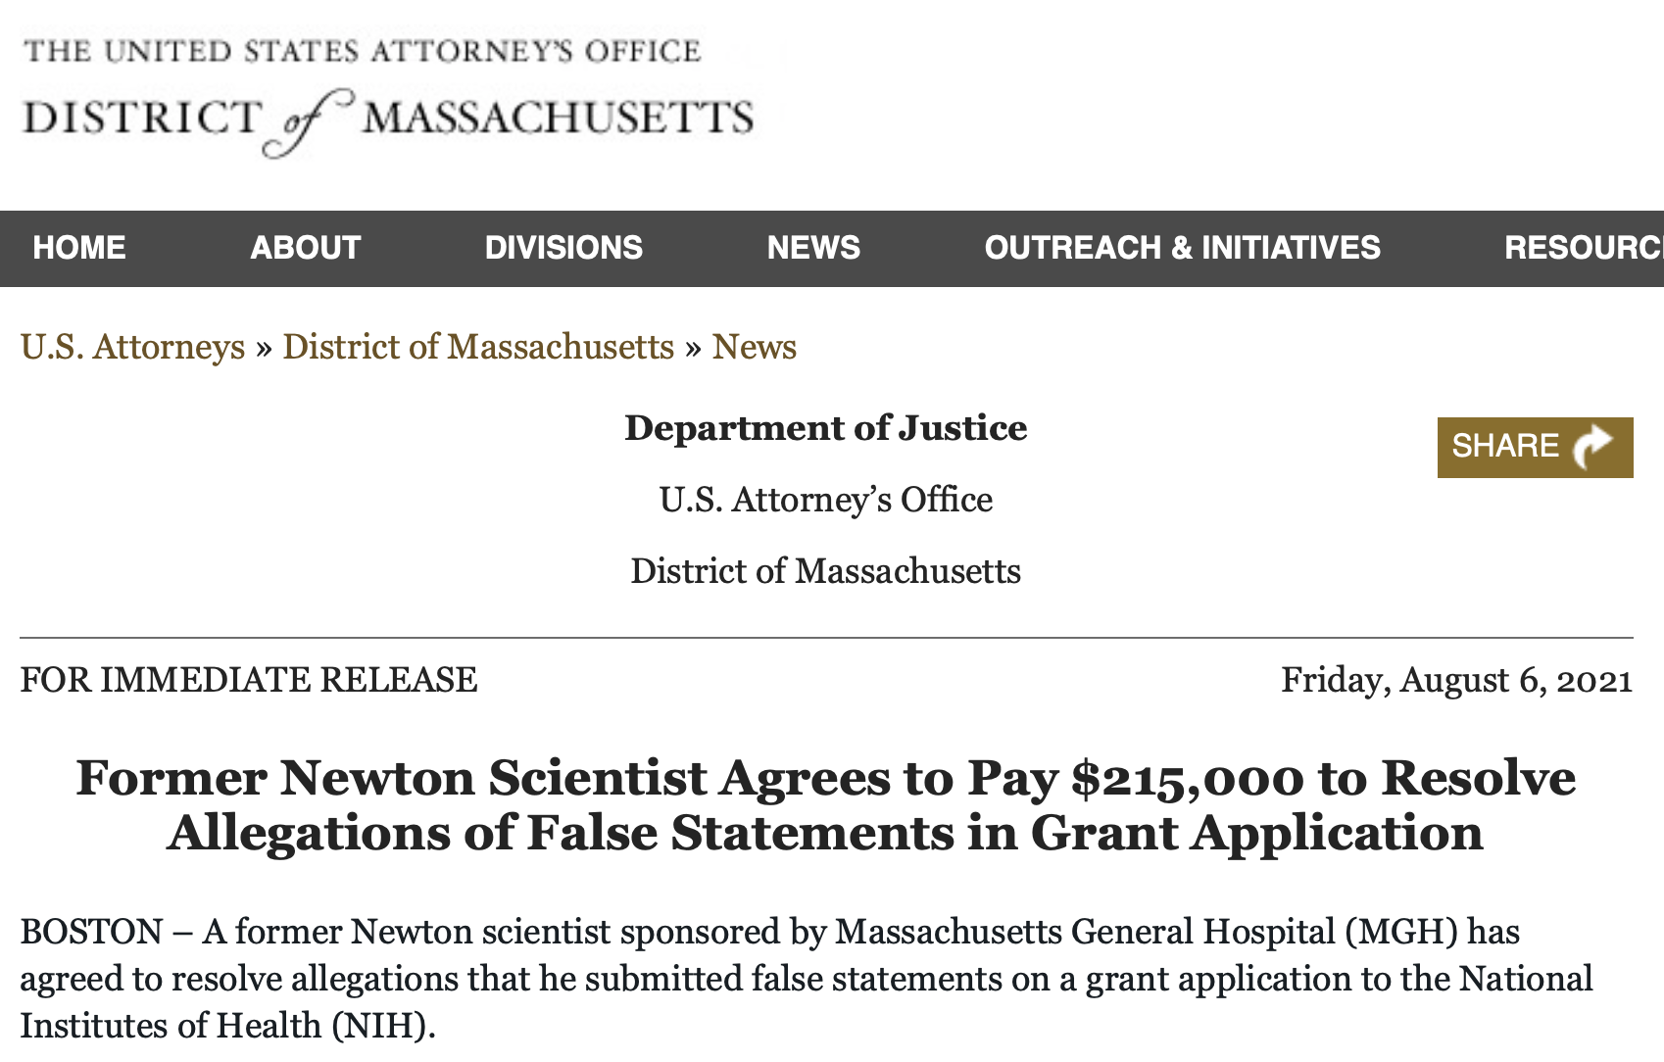
Consequences for Scientists

Slide 31
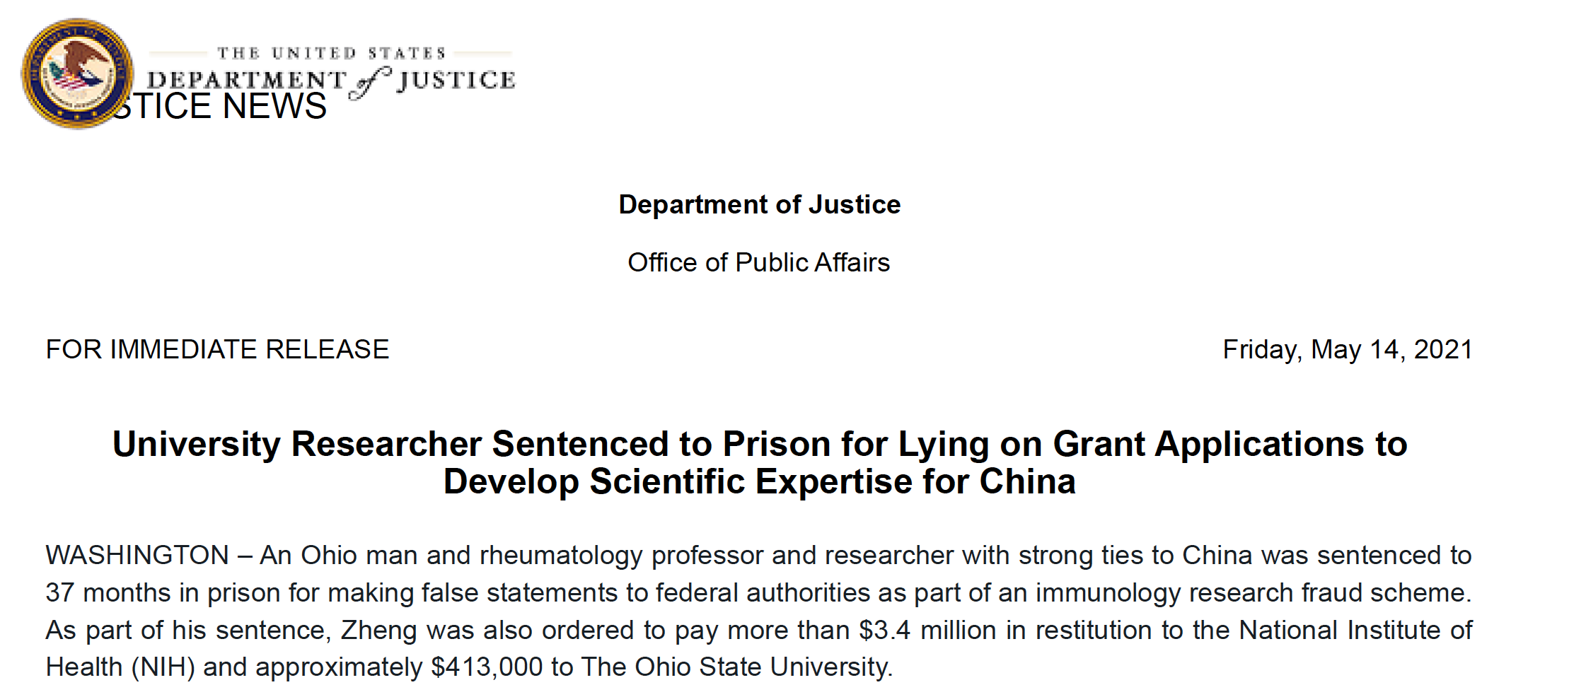
Lying on Grant Applications

Slide 32
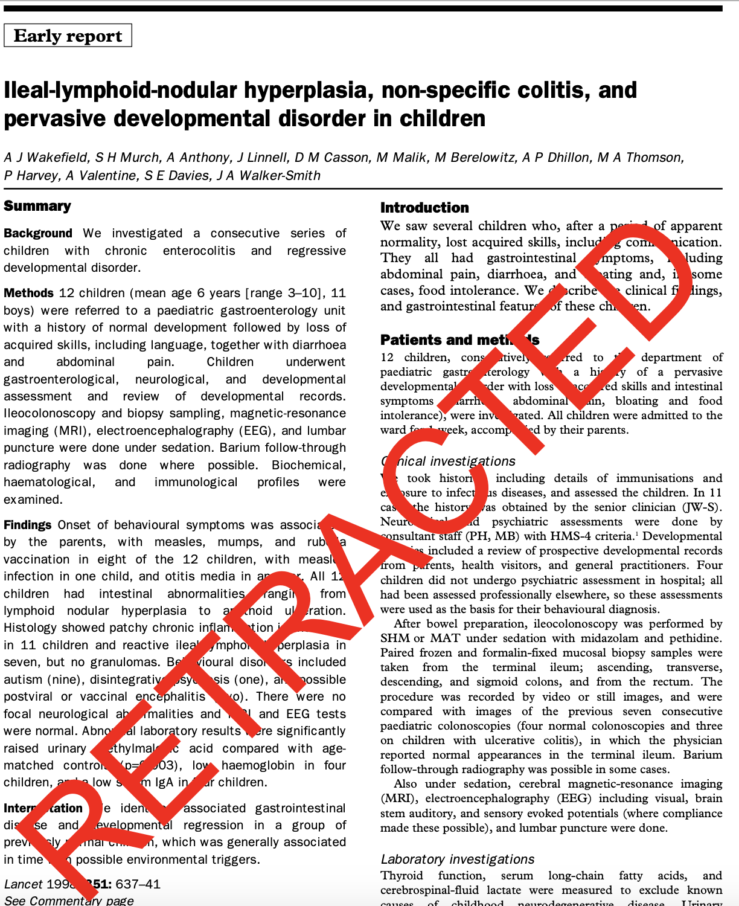
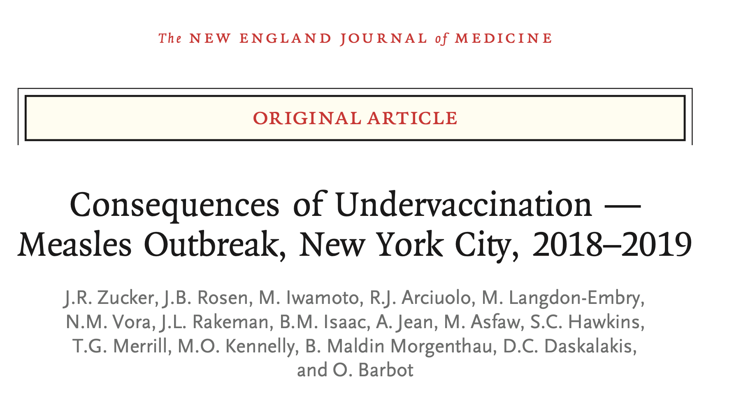
Pandemic – The Harms are Real
https://www.nejm.org/doi/pdf/10.1056/NEJMoa1912514?articleTools=true

Slide 33
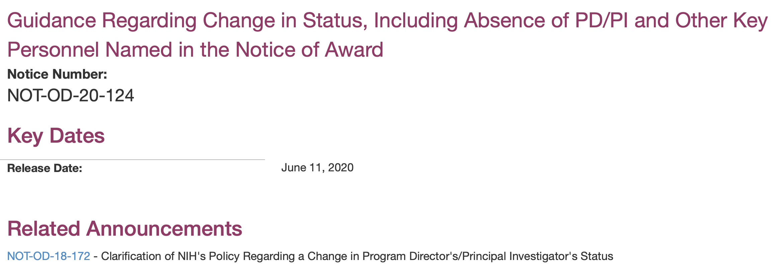
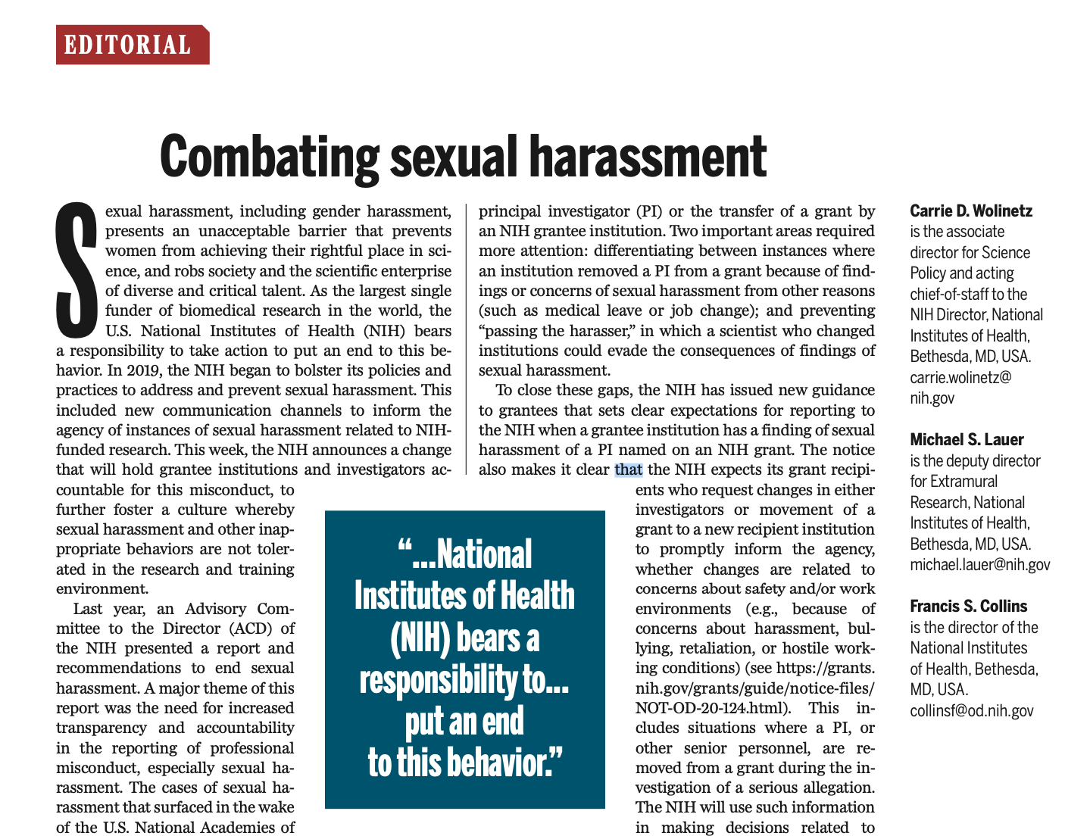
Combating sexual harassment
“In addition, because NIH recipients are expected to provide safe and healthful working conditions for their employees and foster work environments conducive to high-quality research, the request for approval should include mention as to whether change(s) in PD/PI or Senior/Key Personnel is related to concerns about safety and/or work environments (e.g. due to concerns about harassment, bullying, retaliation, or hostile working conditions).”
https://science.sciencemag.org/content/368/6497/1291

Slide 34
Changing the Culture to End Sexual Harassment
Overarching Themes
  Transparency and Accountability in Reporting of Professional Misconduct, especially Sexual Harassment
  Mechanisms for Restorative Justice
  Safe, Diverse, and Inclusive Environments
  System-wide Change
Source: https://acd.od.nih.gov/documents/presentations/12122019ChangingCulture_Report.pdf

Slide 35
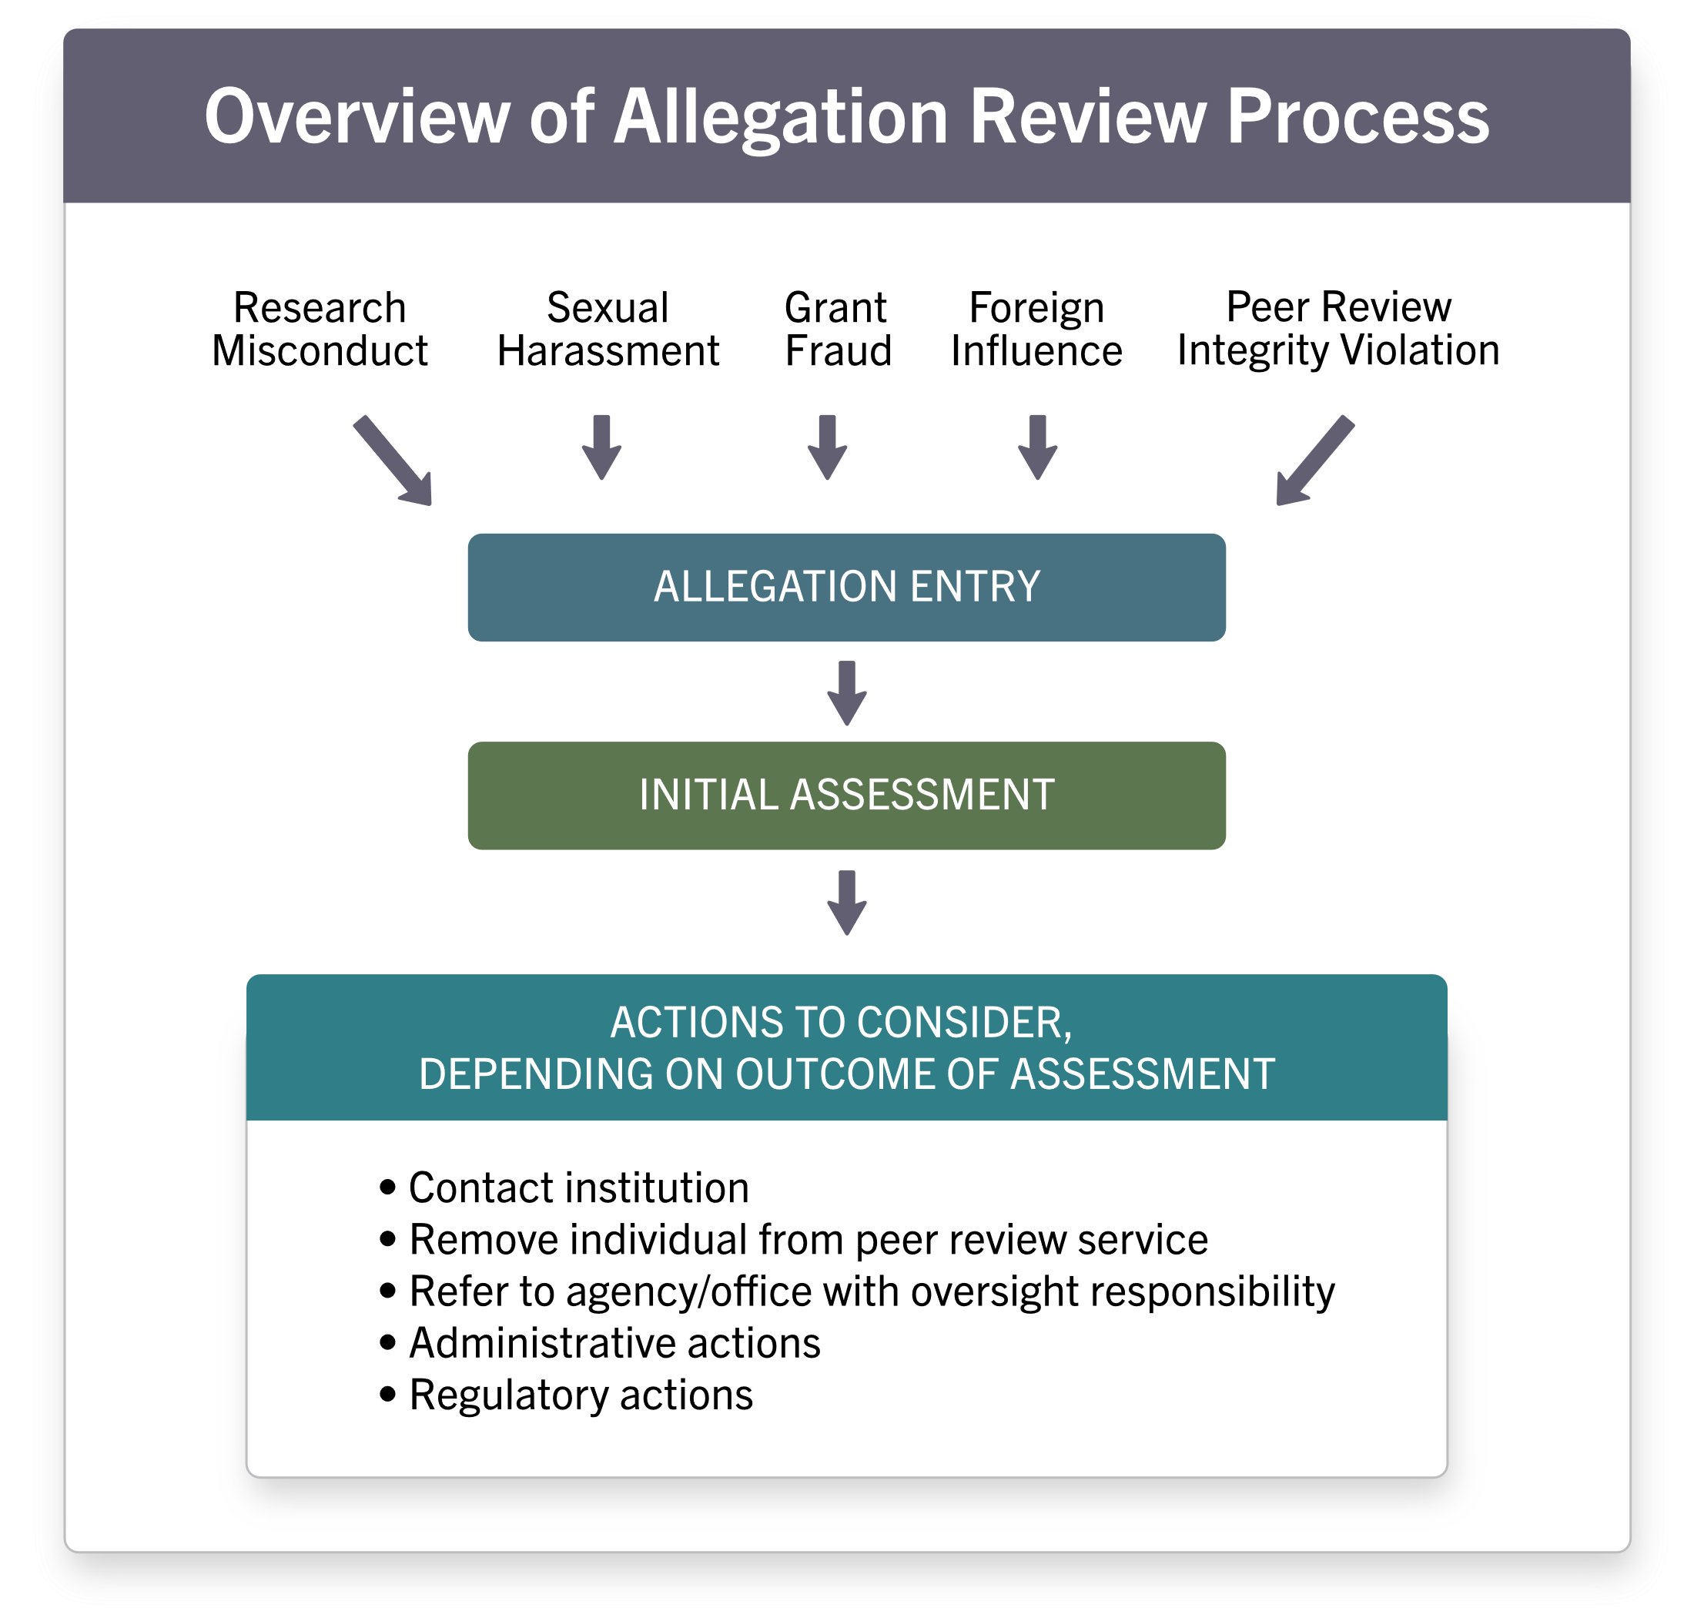
Implementation of Recommendations
Rec 1.1 Create a parallel process to treat professional misconduct, including sexual harassment, as seriously as research misconduct
Actions:
Extramural Integrity Team reviews all professional misconduct allegations
Complaints involving over 390 individuals received, addressed
https://grants.nih.gov/grants/policy/harassment/actions-oversight/allegation-process.htm

Slide 36

Process for Handling Allegations
Rec 1.3 Establish clear and transparent SOPs to respond to reports/findings of professional misconduct, including sexual harassment, or change in PI status in extramural labs.
Action: Posted NIH process for handling allegations of sexual harassment on an NIH-funded project at a recipient institution
https://grants.nih.gov/grants/policy/harassment/actions-oversight/allegation-process.htm

Slide 37
Reprise: Perhaps the Current Question
Consensus
  Community and expertise
  Empirically-informed dissent
Diversity
  Overcome shared biases
  Multiple perspectives
Methodological openness, flexibility
https://press.princeton.edu/books/hardcover/9780691179001/why-trust-science

Slide 38

Enhancing Community and Openness
The extraordinary effort to speed the development of treatments and vaccines in response to the COVID-19 pandemic has put into sharp relief the need for the global science community to share scientific data openly … NIH is addressing this need with a new NIH Policy for Data Management and Sharing. This policy … establishes the baseline expectation that data sharing is a fundamental component of the research process ...
https://www.nih.gov/about-nih/who-we-are/nih-director/statements/statement-final-nih-policy-data-management-sharing

Slide 39
Closing Thoughts
Growing community
  Increasing numbers: awards, awardees (including early career)
Stressed community
  Ongoing effects of COVID-19
  Structural racism, opportunities to enhance diversity
Assuring trust, transparency, credibility
  Integrity above all
  Enhancing openness through data sharing

