Slide 1
NIH Virtual Grants Conference –
PreCon Workshop
Human Subjects Research:
Policies, Clinical Trials, and Inclusion
An Overview of NIH Policies on Human Subjects
Lyndi Lahl, RN, MS
Human Subjects Officer, DHSR/OER/NIH
December 6, 2022

Slide 2
Objectives
Identify NIH policies pertaining to research involving human subjects
Review considerations when applying to NIH for award that will support research involving human subjects
Identify NIH resources for investigators conducting research involving human subjects

Slide 3
Objective 1
Identify NIH policies pertaining to research involving human subjects
Review considerations when applying to NIH for award that will support research involving human subjects
Identify NIH resources for investigators conducting research involving human subjects

Slide 4
Human Subjects Research Policies
Certificates of Confidentiality
Inclusion Policies
Clinical Trials Policies
Human Subjects Research
Delayed Onset Award
Human Fetal Tissue
Human Subjects Education
Single IRB

Slide 5
When do NIH Human Subjects Policies Apply?
Research activities that involve Human Subjects (HS)
  Human subjects defined in the Common Rule
  Some HS policies apply to clinical research (e.g., Inclusion)
  Some HS policies apply only to clinical trials (e.g., Data and Safety Monitoring)
NIH policies complementary or in addition to the Common Rule

Slide 6
Required Education In the Protection of Human Research Participants
All key personnel must have education on the protection of human research participants:
  Individuals responsible for design and conduct of the research
  Also applies to key personnel at performance sites
No mandated course or content
One-time training
Guide Notices
NOT-OD-00-039 & NOT-OD-11-061
Published
June 5, 2000 & September 5, 2001
Notes:
Guide Notice, REQUIRED EDUCATION IN THE PROTECTION OF HUMAN RESEARCH PARTICIPANTS, published June 5, 2000: https://grants.nih.gov/grants/guide/notice-files/not-od-00-039.html
Guide Notice, REQUIRED EDUCATION IN THE PROTECTION OF HUMAN RESEARCH PARTICIPANTS published September 5, 2001: https://grants.nih.gov/grants/guide/notice-files/NOT-OD-01-061.html

Slide 7

Certificates of Confidentiality (CoC) (1 of 2)
Applicable NIH research ongoing or awarded as of December 13, 2016 is deemed to be issued a Certificate
CoCs protect “covered information” (e.g., identifiable, sensitive information)
  Names or any information, documents, or biospecimens
  If there is a small risk that covered information can be combined with other data to determine individual’s identity
CoC applies to all copies of the data
  Secondary researchers must also uphold CoC protections
Covered information protected in perpetuity
Notes:
Alternate text: This graphic illustrates a shield.

Slide 8
Certificates of Confidentiality (CoC) (2 of 2)
Must not disclose identifiable, sensitive information :
  In any Federal, State, or local civil, criminal, administrative, legislative, or other proceeding
  To any other person not connected with the research
Disclosure permitted only when:
  Required by other Federal, State, or local laws* (e.g., reporting child or elder abuse, mandatory disease reporting)
  With participants’ consent
  For other scientific research
  *Disclosure must be done when required by other laws
Guide Notice
NOT-OD-17-109
Published
September 7, 2017
Notes:
Guide Notice, Notice of Changes to NIH Policy for Issuing Certificates of Confidentiality: https://grants.nih.gov/grants/guide/notice-files/NOT-OD-17-109.html

Slide 9
Single IRB Requirement
Guide Notices
NOT-OD-16-094 & NOT-OD-20-058
Published
June 21, 2016 & January 22, 2020
  NIH sIRB Policy
  Nonexempt human subjects research studies with more than one domestic site are expected to use a single IRB
Revised Common Rule Cooperative Research Provision at 45 CFR 46.114(b)
  All cooperative research projects are expected to abide by the cooperative research provision, when applicable
Notes:
Guide Notice, Final NIH Policy on the Use of a Single Institutional Review Board for Multi-Site Research: https://grants.nih.gov/grants/guide/notice-files/not-od-16-094.html
NOT-OD-20-028, Additional Guidance on the NIH Policy on the Use of a Single Institutional Review Board for Multi-Site Research

Slide 10
NIH Requirement for Delayed Onset Research (1 of 2)
Definitive plans for research involving human subjects not included in application or proposal
Recipient for single project award must submit to NIH awarding IC a detailed human subjects section for approval
  In general, submitted at least 30 days before proposed change
  Needs to describe risk, protections, benefits and importance of knowledge to be gained
  Other documentation, if applicable (e.g., Inclusion plans and enrollment report, Data and Safety Monitoring Plan)
Guide Notice
NOT-OD-15-129
July 7, 2015
Notes:
Guide Notice, Prior NIH Approval of Human Subjects Research in Active Awards Initially Submitted without Definitive Plans for Human Subjects Involvement (Delayed Onset Awards): https://grants.nih.gov/grants/guide/notice-files/NOT-OD-15-129.html

Slide 11
NIH Requirement for Delayed Onset Research (2 of 2)
Recipient for cooperative agreement or multi-project award must follow funding IC’s instructions and procedures for approval of new protocol
  Ensure appropriate inclusion enrollment information is provided
Recipient of award mechanism that allows portion of their budget to support small human subjects research projects (e.g., pilot projects) are responsible for ensuring selected projects follow all relevant regulations/policies.
  Follow funding IC’s guidance re: prior approval of projects
  submit appropriate inclusion enrollment information

Slide 12
Human Fetal Tissue (HFT)
NIH implemented the HHS Policy, effective June 5, 2019
Applicants must provide:
  a justification of the use of HFT,
  details regarding procurement and costs,
  information about how the applicant/contract offeror will use HFT
NIH will not accept modular budgets for applications for research involving HFT
Applications that do not address all required information will be administratively withdrawn and not reviewed
Guide Notices
NOT-OD-19-128 & NOT-OD-19-137
Published
July 26, 2019 & August 23, 2019
Notes:
Guide Notice, Changes to NIH Requirements Regarding Proposed Human Fetal Tissue Research: https://grants.nih.gov/grants/guide/notice-files/NOT-OD-19-128.html
Guide Notice, Clarifying Competing Application Instructions and Notice of Publication of Frequently Asked Questions (FAQs) Regarding Proposed Human Fetal Tissue Research: https://grants.nih.gov/grants/guide/notice-files/NOT-OD-19-137.html

Slide 13
Polling question 1: True or False?
Investigators and all key personnel involved in human subjects research that is determined to be exempt from the regulatory requirements in 45 CFR 46 must meet the protection of human subjects education requirement.

Slide 14
Polling question 1: The correct response is True
Similar to the educational requirement for nonexempt human subjects research, investigators and all key personnel involved in human subjects research that is determined to be exempt from the regulatory requirements in 45 CFR 46 must meet the protection of human subjects education requirement.

Slide 15
Polling question 2: True or False?
NIH will provide a physical certificate for my NIH-funded research project to document CoC protections.

Slide 16
Polling question 2: The correct response is False
NIH does not issue a physical certificate for NIH-funded research projects. The NIH CoC Policy, Notice of Award, the NIH Grants Policy Statement for grant awards, and the NIH DGS Contract Handbook- Special Contracts Requirements for R&D Contracts, provide documentation of the CoC protection.

Slide 17
Polling question 3: Under the CoC Policy, an investigator may release a participant’s identifiable, sensitive information:
  If required by institutional policy
  If the participant consents
  If the investigator decides it is appropriate to disclose identifiable, sensitive information
  All of the above
  None of the above

Slide 18
Polling question 3: The correct response is B
Under the CoC Policy, an investigator may release a participant’s identifiable, sensitive information when the participant consents to such disclosure.
An institutional policy does not give the investigator the authority to release the participant’s identifiable, sensitive information.
An investigator cannot decide on her/his own that the participant's identifiable, sensitive information can be released.
See the NIH CoC website, Investigators and Institutional CoC Responsibilities, for the limited circumstances under which an investigator or institution may release participant’s identifiable, sensitive information, and other responsibilities.

Slide 19
Objective 2
Identify NIH policies pertaining to research involving human subjects
Review considerations when applying to NIH for award that will support research involving human subjects
Identify NIH resources for investigators conducting research involving human subjects

Slide 20
Evaluation of Applications and Proposals
45 CFR 46.120
Evaluate all applications and proposals involving nonexempt human subjects research
Evaluation will take into consideration:
  the risks to the subjects,
  the adequacy of protection against these risks,
  the potential benefits of the research to the subjects and others, and
  the importance of the knowledge gained or to be gained
May approve or disapprove the application or proposal, or enter into negotiations to develop an approvable one

Slide 21

Plan Protection of Human Subjects (1 of 2)
1. Risks
  Study population, procedures
  Sources of materials –access to identifiers
  Potential Risks for ALL research interventions: physical, psychological, social, legal
2. Adequacy of Protection Against Risks
  Description of recruitment and consent
  Procedures to minimize identified risks, including protecting participant privacy
  Additional protections for vulnerable subjects

Slide 22

Plan Protection of Human Subjects
(2 of 2)
3. Potential Benefits of Research to Human Subjects and Others
  Discuss risks in relation to anticipated benefits
  In some cases, there is no direct benefit to subjects
  Financial compensation is not a benefit
4. Importance of Knowledge to be Gained
  Discuss in relation to risks

Slide 23
Considerations and Issues with Planned Protections
  Don’t assume reviewers will understand what you mean
    Provide details and adequate descriptions of planned activities involving human subjects
  Common human subject issues identified in peer review:
    Missing or inadequate Data & Safety Monitoring Plans
    Incidental findings not addressed
    Physical or psychological risks not adequately addressed
    Inadequate protections for vulnerable populations
    Source of specimen and/or data not identified

Slide 24
Just-in-Time Information for Grants Involving Human Subjects
Submit required information
    Federalwide Assurance Number (FWA)
    Certification of IRB approval (latest IRB approval date)
    Certification that all key personnel have completed human subjects education
Request policy exception (rare)
    Exemption 5
    sIRB exception request
      See NIH website, Single IRB for Multi-site or Cooperative Research
    Public Health Surveillance Exclusion
      See NIH website, Public Health Surveillance Exclusions
  See NIH website, Just In Time (JIT) Information for Grants Involving Human Subjects, for additional information.

Slide 25
Exemption 5 Research
45 CFR 46.104(d)(5)
Research and demonstration projects that are conducted or supported by a Federal department or agency and are designed to study, evaluate, improve, or otherwise examine public benefit or service programs.
  NIH must post study information on NIH website prior to initiating study
  Typically in error

Slide 26
Multi-Site Study Considerations
In general, the Prime recipient is considered engaged in human subjects (HS) research, even when all HS research activities are done by employees of another institution
All engaged sites must have:
  Federalwide Assurance (FWA)
  IRB Approval
    U.S. sites to rely on one IRB under 45 CFR 46.114
      OHRP Institutional Review Board (IRB) Authorization Agreement

Slide 27
Subaward/Pilot Project Requirements
Obtain IRB approval before involving participants in nonexempt human subjects research activities
  Note: Single IRB requirements may apply
Recipient institution will submit progress reports that include relevant information on pilot projects, subawardee activities
Note: All applicable NIH policies and regulations apply to subawards and pilot projects (e.g., for nonexempt research involving human subjects, regulations at 45 CFR 46 and NIH Certificate of Confidentiality Policy apply)

Slide 28
Objective 3
Identify NIH policies pertaining to research involving human subjects
Review considerations when applying to NIH for award that will support research involving human subjects
Identify NIH resources for investigators conducting research involving human subjects

Slide 29
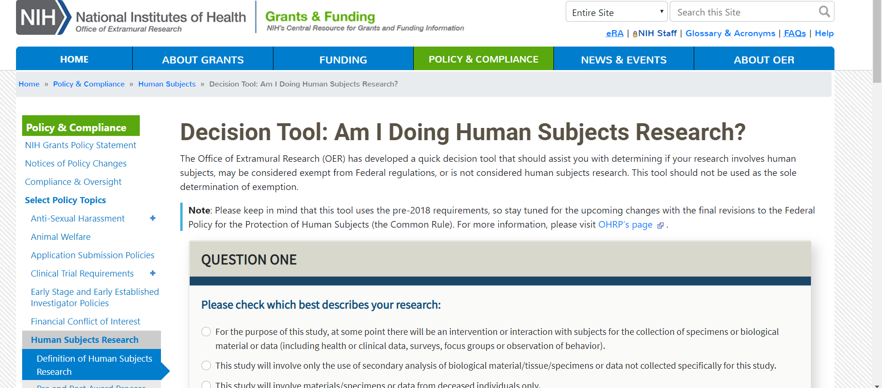
Decision Tool: Am I Doing Human Subjects Research
Decision Tool: Am I Doing Human Subjects Research?
Notes:
Decision Tool: am I doing human subjects research?: https://grants.nih.gov/policy/humansubjects/hs-decision.htm

Slide 30

Resources: Human Subjects Protections
NIH Human Subjects Research Home Page
Office for Human Research Protections (OHRP) Home Page
Resources: Human Subjects Protections, Inclusion, and Clinical Trials
SLIDE | 30
Notes:
NIH human subjects research home page: https://grants.nih.gov/policy/humansubjects.htm
Office for Human Research Protections home page: https://www.hhs.gov/ohrp/index.html
Compiled list of resources: human subject protections, inclusion and clinical trials

Slide 31

Questions

